Slide 1
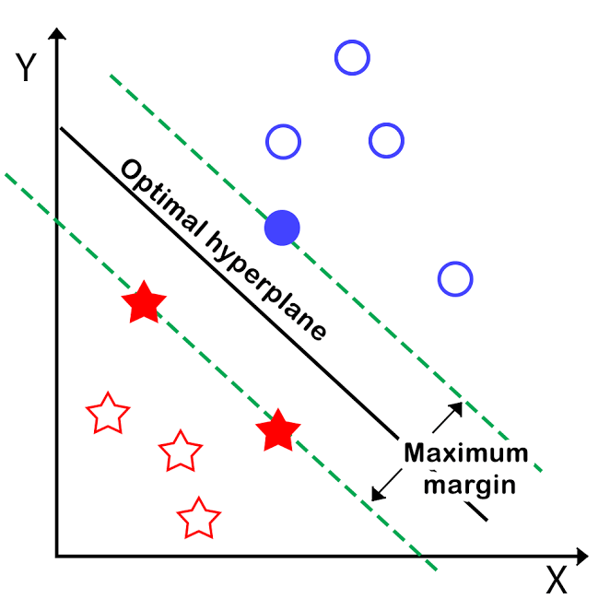
Taha elhariri
Makine öğrenmesi dersi
Support vector machine

Slide 2
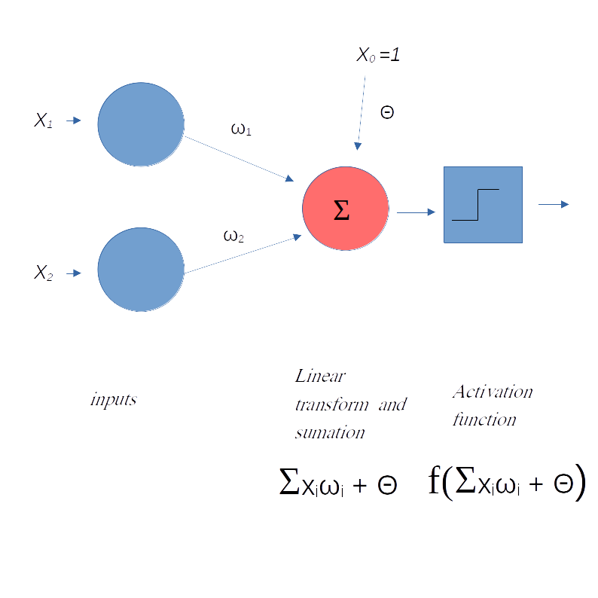
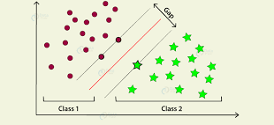
support vector machine (SVM), can be considered an extension of the perceptron
perceptron algorithm
SVM
minimized misclassification errors
maximize the margin

Slide 3
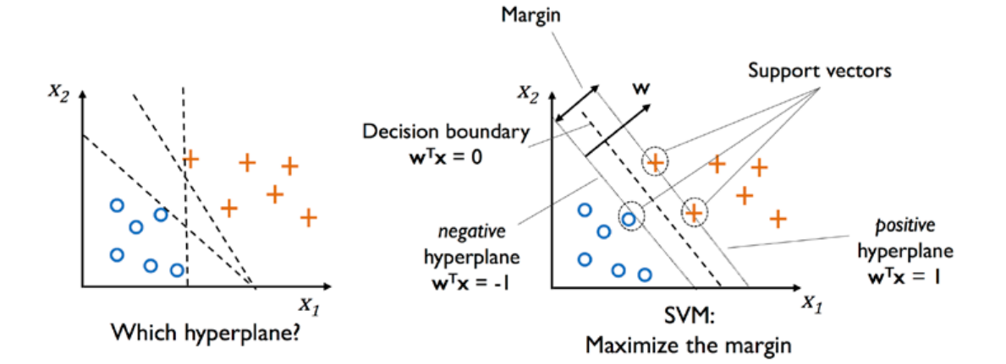
The margin is defined as the distance between the separating hyperplane (decision boundary) and the training examples that are closest to this hyperplane, which are the so-called support vectors. This is illustrated in the following figure:

Slide 4
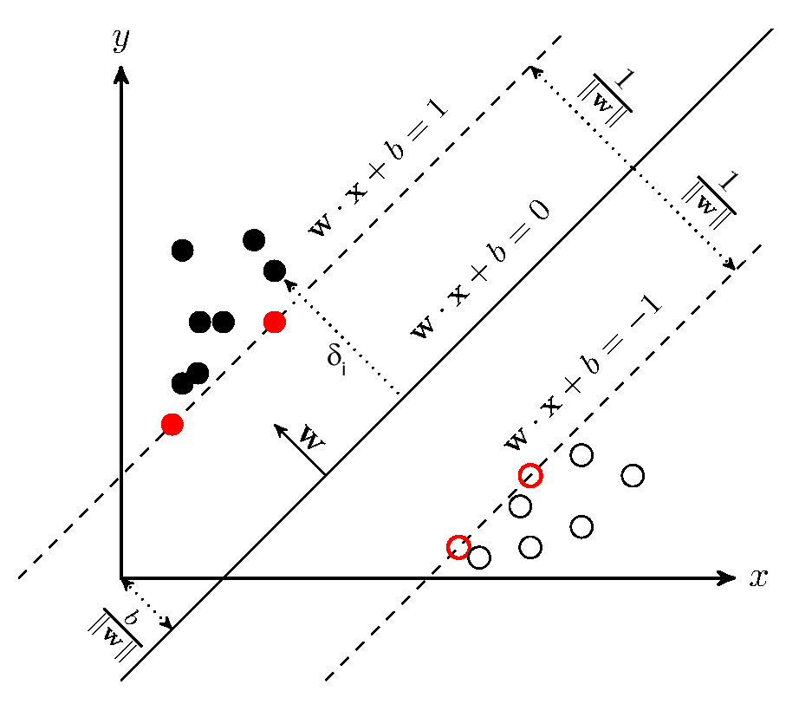

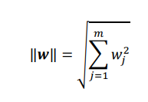
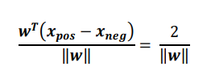
Maximum margin intuition:
have a lower generalization error.
models with small margins are more prone to overfitting
positive and negative hyperplanes that are parallel to the decision boundary
subtract two linear equations from each other to get
normalize this equation by the length of the vector w
arrive at the following equation

Slide 5
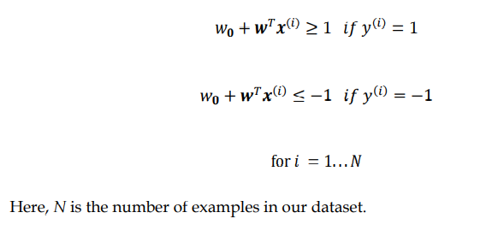
the maximization of this margin by maximizing 2 ‖𝒘‖ under the constraint that the examples are classified correctly

Slide 6
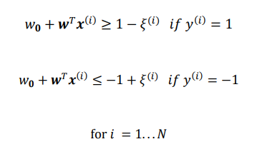
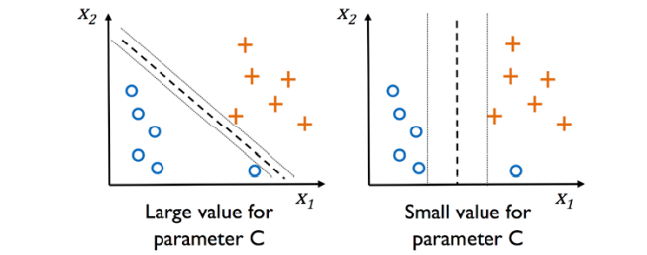
Dealing with a nonlinearly separable case using slack variables
the slack variable, 𝜉, was introduced by Vladimir Vapnik in 1995 and led to the socalled soft-margin classification. The motivation for introducing the slack variable was that the linear constraints need to be relaxed for nonlinearly separable data to allow the convergence of the optimization in the presence of misclassifications, under appropriate cost penalization.
Via the variable, C, we can then control the penalty for misclassification. Large values of C correspond to large error penalties, whereas we are less strict about misclassification errors if we choose smaller values for C. We can then use the C parameter to control the width of the margin and therefore tune the bias-variance tradeoff

Slide 7
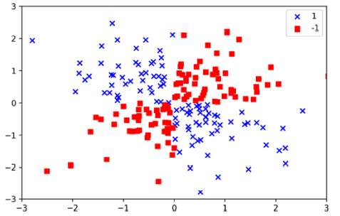
Solving nonlinear problems using a kernel SVM
we will create a simple dataset that has the form of an XOR gate using the logical_or function from NumPy, where 100 examples will be assigned the class label 1, and 100 examples will be assigned the class label -1

Slide 8
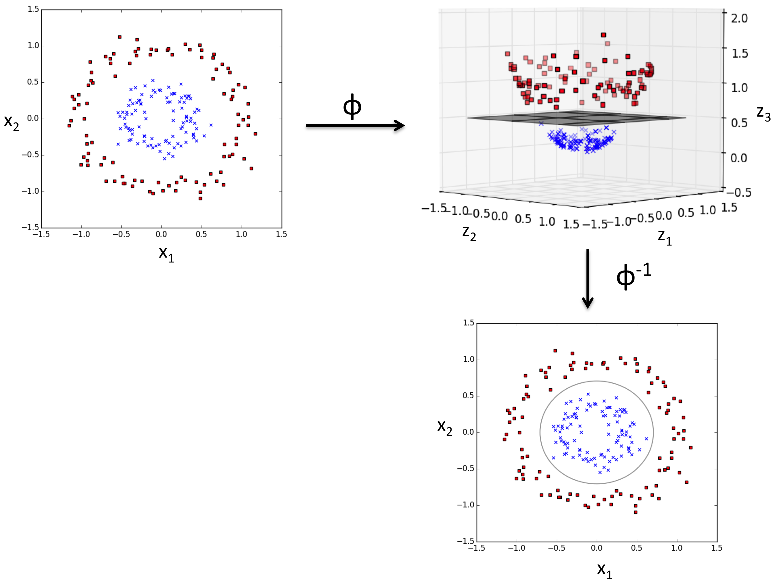

The basic idea behind kernel methods to deal with such linearly inseparable data is to create nonlinear combinations of the original features to project them onto a higher-dimensional space via a mapping function, 𝜙, where the data becomes linearly separable.

Slide 9
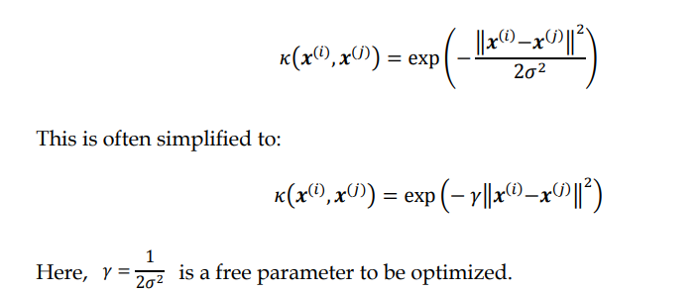
Using the kernel trick to find separating hyperplanes in a high-dimensional space
To solve a nonlinear problem using an SVM, we would transform the training data into a higher-dimensional feature space via a mapping function, 𝜙, and train a linear SVM model to classify the data in this new feature space. Then, we could use the same mapping function, 𝜙, to transform new, unseen data to classify it using the linear SVM model
One of the most widely used kernels is the radial basis function (RBF) kernel, which can simply be called the Gaussian kernel
due to the exponential term, the resulting similarity score will fall into a range between 1 (for exactly similar examples) and 0 (for very dissimilar examples)

Slide 10
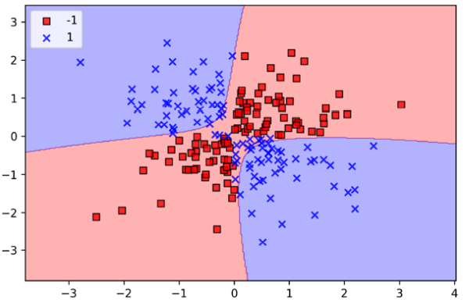
use the SVC class from scikit-learn and replace the kernel='linear' parameter with kernel='rbf'
The 𝛾𝛾 parameter, which we set to gamma=0.1, can be understood as a cut-off parameter for the Gaussian sphere. If we increase the value for 𝛾, we increase the influence or reach of the training examples, which leads to a tighter and bumpier decision boundary.

Slide 11
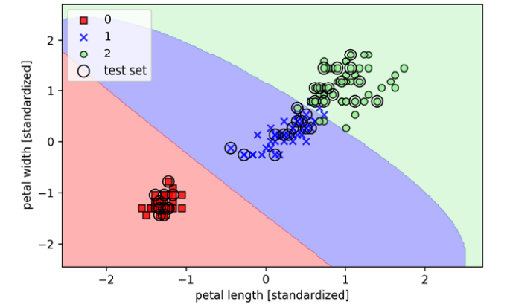
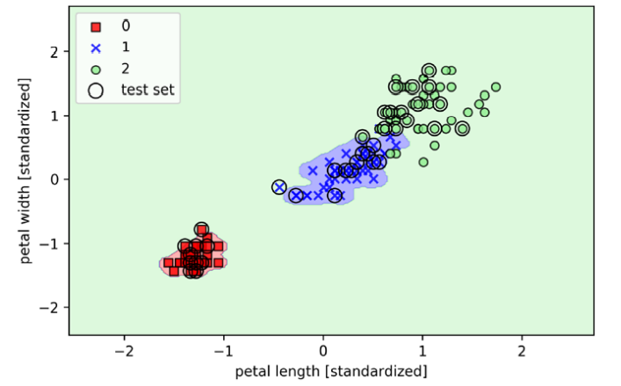
To get a better understanding of 𝛾, let's apply an RBF kernel SVM to our Iris flower dataset
gamma=0.2
gamma=100

Slide 12
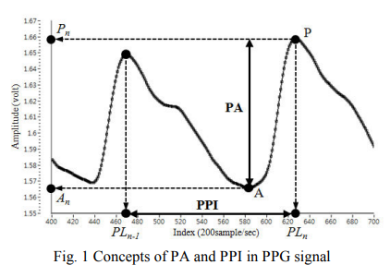
Identification of Arousal and Relaxation by using SVM-Based Fusion of PPG Features
In this paper, a new method to distinguish between arousal and relaxation states by using multiple features acquired from a photoplethysmogram (PPG) and support vector machine (SVM) is proposed. To induce arousal and relaxation states in subjects, 2 kinds of sound stimuli are used, and their corresponding biosignals are obtained using the PPG sensor. Two features pulse to pulse interval (PPI) and pulse amplitude (PA) are extracted from acquired PPG data, and a nonlinear classification between arousal and relaxation is performed using SVM.
in order to improve the classification accuracy, SVM-based nonlinear classification was performed.
the average classification accuracy was 74.67%.
each classifier is determined for each subject by individual SVM training to improve the accuracy of classification

Slide 13
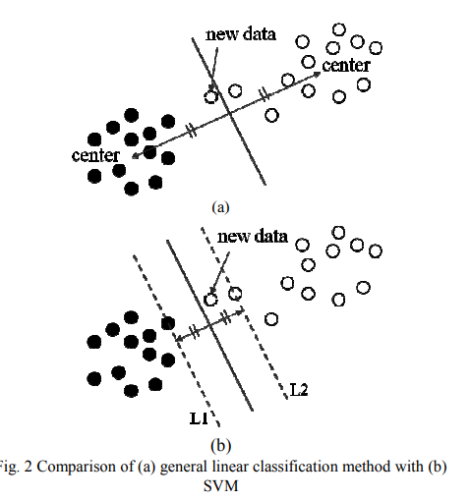
Identification of Arousal and Relaxation by using SVM-Based Fusion of PPG Features
SVM Classification:
the WinSVM software was used for the classification of arousal and relaxation on the basis of SVM
The WinSVM is operated in 3 steps: optimization, learning, and prediction.
The optimization step acts to calculate the minimum mean square error (MSE) through training data. This step is for determining a kernel type and its optimal parameters.
In the learning step, the data set is learned by using the previously determined kernel and parameters. That is, a maximum-margin classifier is defined by combining several support vectors in this step.
the test data were verified using the previously defined classifier in the prediction step.

Slide 14
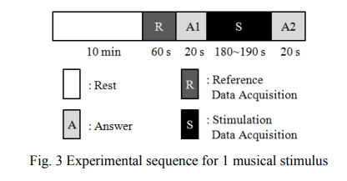
Identification of Arousal and Relaxation by using SVM-Based Fusion of PPG Features
5 adult subjects 3 men and 2 women.
2 pieces of arousing music and 2 pieces of relaxing music.
the subjects sat on a chair and rested for 10 min.
the PPG sensor was attached to the left earlobe of the subjects.
After the rest period, the PPG signal was measured for 60 s, and this was used as reference data.
All subjects were requested to answer a questionnaire regarding their degree of arousal (or relaxation) for 20 s before and after the measurement.
During the actual music stimulation time, the PPG signal was measured.

Slide 15
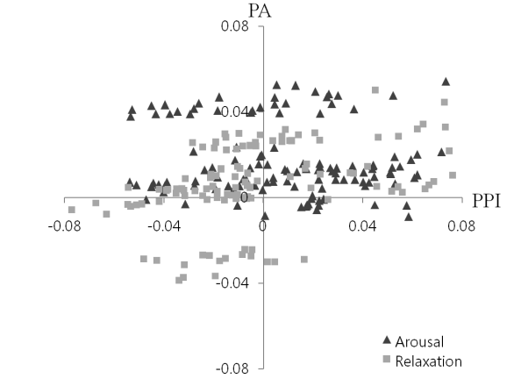
Identification of Arousal and Relaxation by using SVM-Based Fusion of PPG Features
In training for SVM, 60 feature sets were divided into 2 classes consisting of 30 training data sets and 30 test data sets.
since the amount of data was low, bootstrap aggregating was used.
30 training data points were randomly selected, and the remainder was used for testing.
Using the same random selection scheme, 3 selections were performed. Consequently, 90 training data points and 90 test data points were acquired.
For 1 subject's training, 180 data points for 2 arousal music stimuli and 180 data points for 2 relaxation music stimuli were used. The other 180 data points for 2 arousal music stimuli and 180 data points for 2 relaxation music stimuli were used in order to perform tests for measuring SVM classification accuracy.

Slide 16
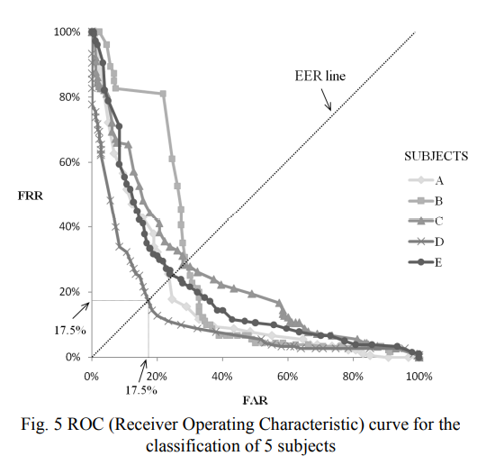
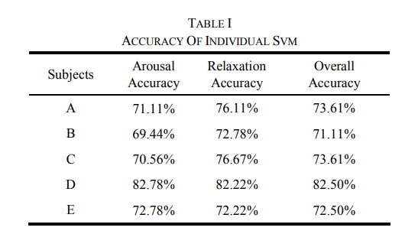
Identification of Arousal and Relaxation by using SVM-Based Fusion of PPG Features

Slide 17
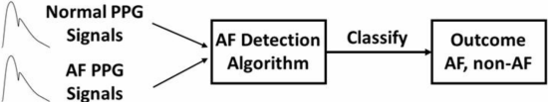
Reliable PPG-based algorithm in atrial fibrillation detection
Atrial Fibrillation (AF) is the most common type of arrhythmia.
Automatic detection of AF is an important public health issue.
Currently, the most useful and accurate tool for diagnosing AF is electrocardiography ECG.
The aim of this study is to investigate the potential of analyzing PPG waveforms to identify patients with AF.
With the extracted features from multiple parameters, including interval and amplitude of PPG signals, patients were classified into AF and non-AF by support vector machine (SVM).
Among 468 patients' signals recorded in clinic environments.
achieve ROC area under curve, sensitivity and accuracy of 0.971, 0.942, and 0.957, respectively.

Slide 18
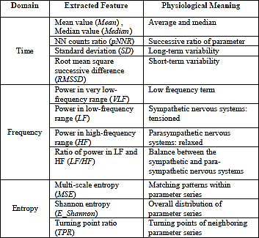
Reliable PPG-based algorithm in atrial fibrillation detection
Pre-Processing:
peak detection
amplitude (AMP), and pulse-pulse interval (PPI) were extracted from PPG signals.
R-R intervals (RRI) were extracted from EKG signals for comparison.
Each patient's EKG signals were visually checked and labeled as AF or non-AF.
Feature Extraction:
Linear Features: Time-domain and Frequency-domain
Multiscale Entropy (MSE): In the case of AF detection, AF subjects have more unstable heartbeat, and thus prone to present higher entropy value.
Other Entropy Domain Features: to quantify the similarities in the signals.

Slide 19
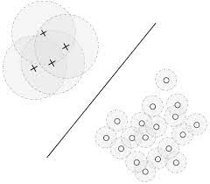
Reliable PPG-based algorithm in atrial fibrillation detection :
Classification
Feature Selection: feature selection has advantages of potential higher accuracy, less computing and finding the dominant features for AF detection. The famous sequential forward selection algorithm (SFS) is chosen to find the best features heuristically.
Cost Sensitive SVM: 468 subjects, 104 of them are AF and 304 of them are non-AF, and the AF class is more important. a cost-sensitive method is adopted to deal with the class imbalance problem.
performed the grid search on cost (C) and penalty weight (W) to find the best combination for highest accuracy. And we applied five-fold cross validation to avoid over-fitting in learning. The whole SVM procedure is supported by the famous machine learning toolbox LIBSVM .

Slide 20
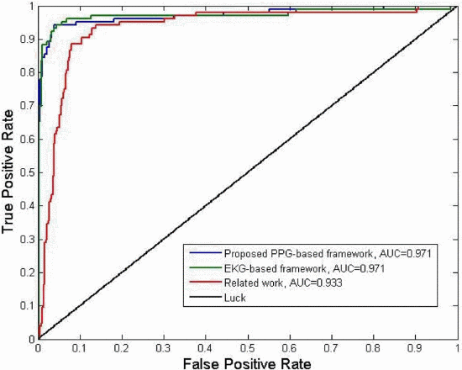

Reliable PPG-based algorithm in atrial fibrillation detection :
Results

Slide 21
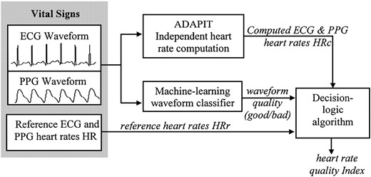
A Method for Automatic Identification of Reliable Heart Rates Calculated from ECG and PPG Waveforms
The authors describe a method that automatically estimates the reliability of reference heart rates (HRr) derived from electrocardiogram (ECG) waveforms and photoplethysmogram (PPG) waveforms recorded by vital-signs monitors. The reliability is quantitatively expressed through a quality index (QI) for each HRr.

Slide 22
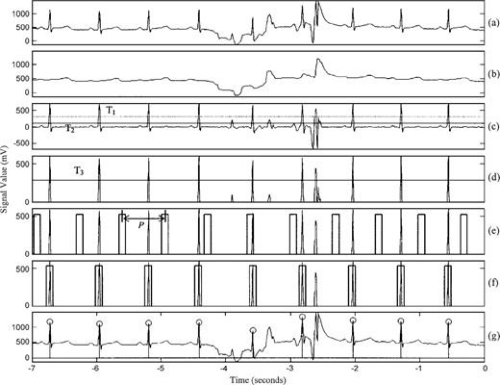
A Method for Automatic Identification of Reliable Heart Rates Calculated from ECG and PPG Waveforms :
Methods
physiologic time-series data collected during transport of trauma patients.
The data of 726 patients include ECG and PPG waveform signals and their corresponding monitor-calculated HRr.
ADAPIT algorithm is applied on ecg and ppg signals to calculate heart rate [HRr].

Slide 23
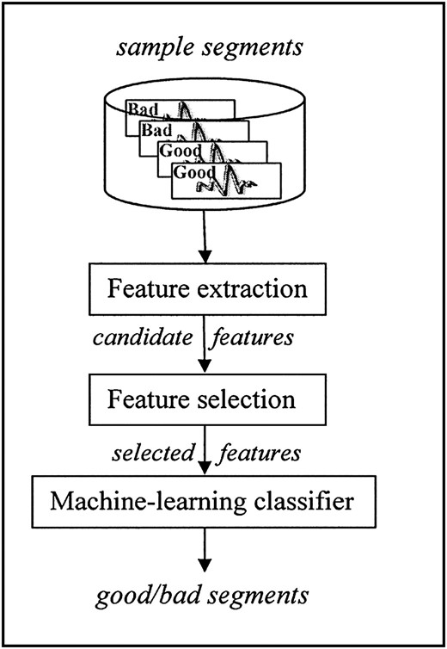
A Method for Automatic Identification of Reliable Heart Rates Calculated from ECG and PPG Waveforms :
Methods: Waveform Qualification
the reliability of HRr is highly dependent on the quality of the underlying waveforms from which they are derived.
SVM classifier “learns” rules by finding coefficients that optimize the “correlations” between a set of waveform-extracted features and waveform quality obtained from manually categorized waveform samples.

Slide 24
A Method for Automatic Identification of Reliable Heart Rates Calculated from ECG and PPG Waveforms :
Methods: Waveform Qualification
Candidate Waveform Features:
three features in the frequency domain from ECG waveforms and three features in the time domain from ECG and PPG waveforms.
extract features from 7-second waveform segments that immediately precede each HRr we wish to qualify.
Feature Selection: find that HFE, FW, and SN are the most discriminatory features for ECG waveform classification and that FW and PV are the most informative features for PPG waveform classification.
Support Vector Machine Classifier:
trained and tested an SVM classifier through a cross-validation procedure employing the manually categorized waveform samples (362 ECG and 388 PPG), where at each of 200 cross-validation repetitions 70%–30% of the samples were used for training-testing the classifier.
Averaged over the 200 cross-validation repetitions, the SVM yielded 93% sensitivity and 96% specificity for the ECG waveforms, and 91% sensitivity and 88% specificity for the PPG waveforms. The slightly worse performance for the PPG waveforms reflects the increased difficulty in classifying this waveform due to a lack of more distinct characteristics of its profile.

Slide 25
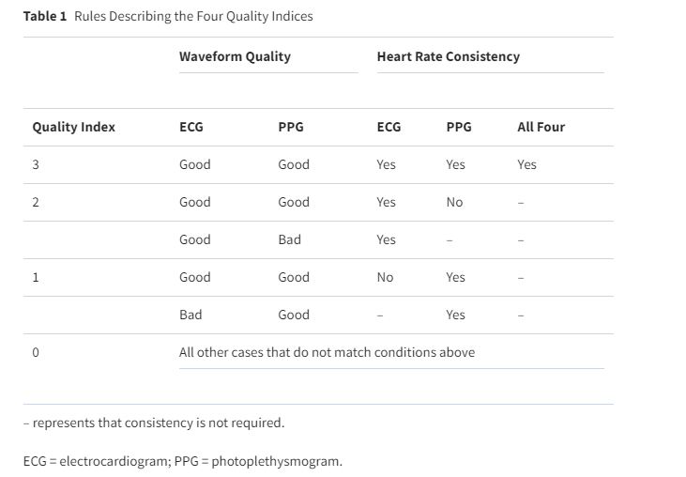
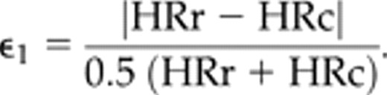
A Method for Automatic Identification of Reliable Heart Rates Calculated from ECG and PPG Waveforms :
Methods: Quality Index Determination
The final component of the algorithm is the numerical qualification of the ECG HRr and PPG HRr provided by the vital-signs monitor.

