Slide 1
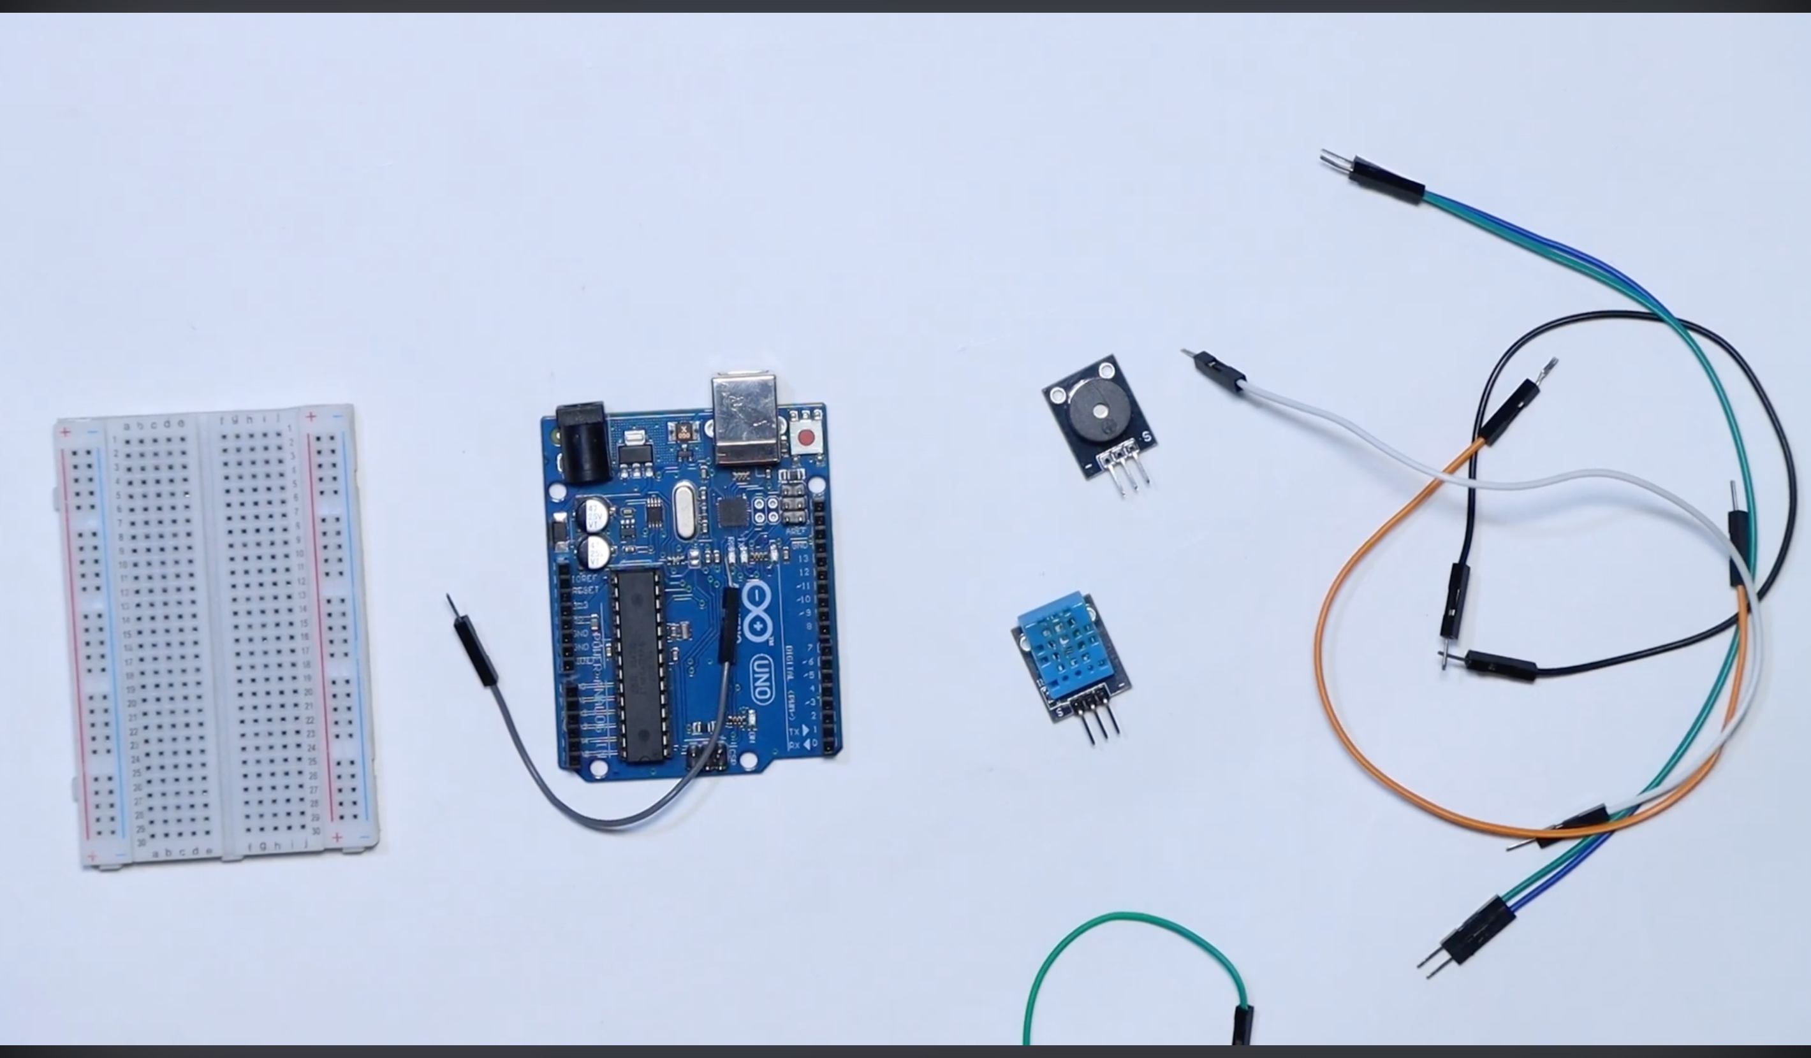


IoT · EMBEDDED SYSTEMS
Prepared by :
Manal HOUMAIDY
OUMAIMA GASSI
SALMA BENMOUMA
Mohamed Taha El Qassid
Smart Connected
Thermometer
Temperature & humidity monitoring
with real-time alerts using Arduino Uno + DHT11
DHT11
Buzzer + LED
Serial Monitor
Sensor
Alert
Output
Arduino → Serial USB → Python server → Web browser dashboard
Department of Electronics · Arduino Embedded Systems Project · Academic Year 2026

Slide 2
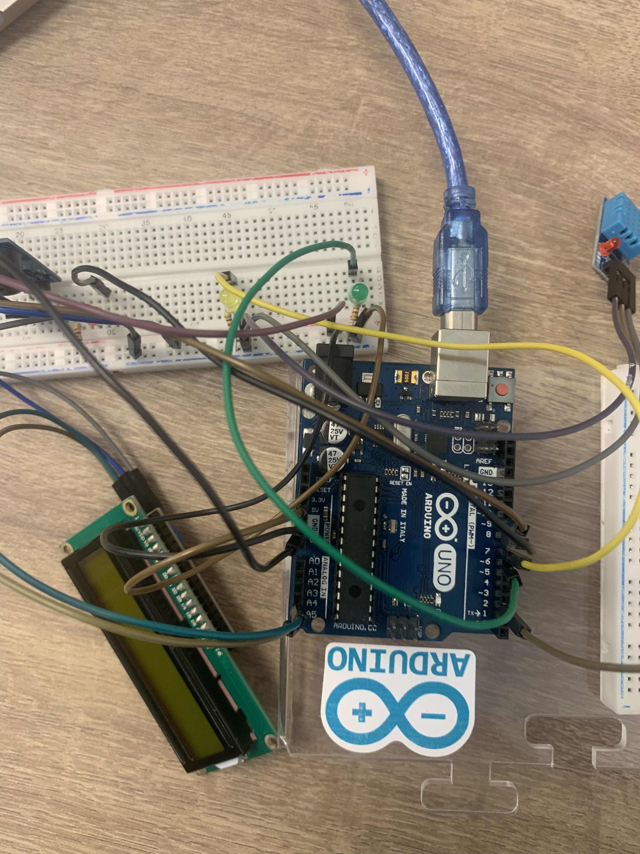
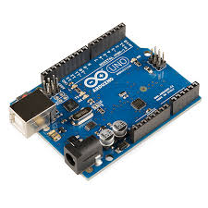
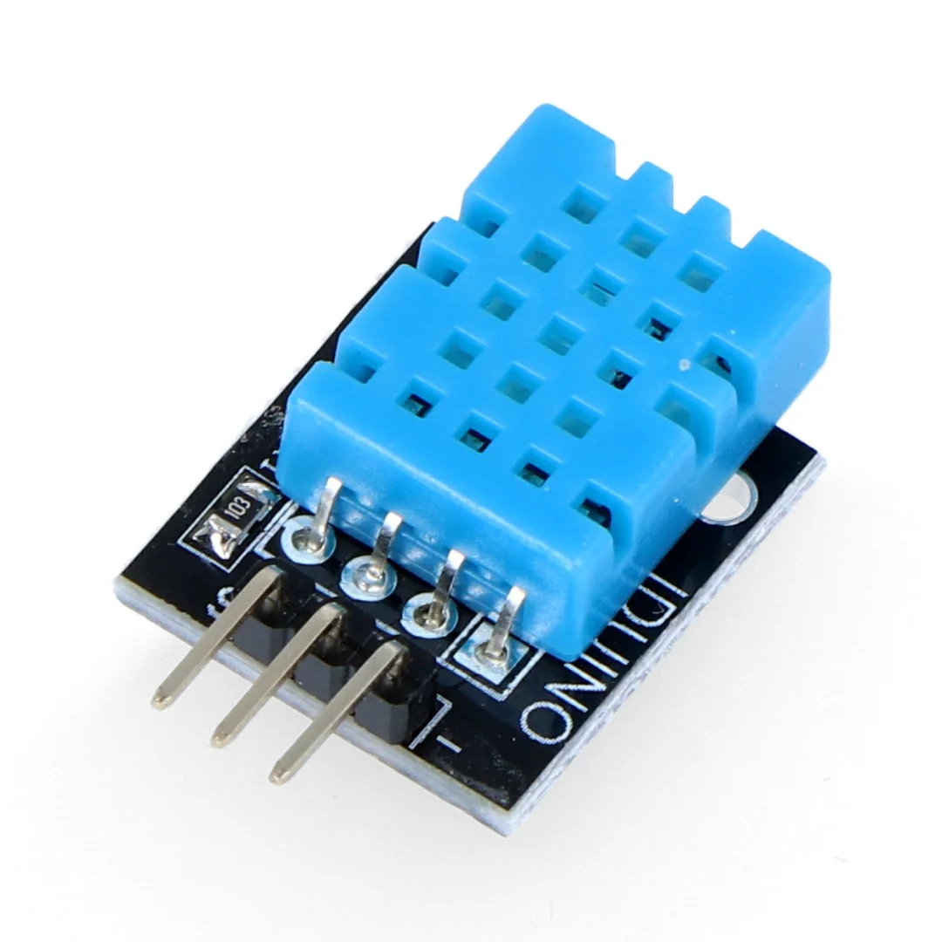
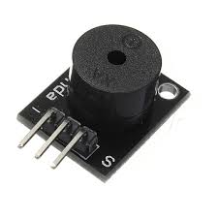
01 · HARDWARE
Our Components
Arduino Uno
DHT11 Module
Microcontroller
Temp + Humidity
Buzzer Module
Jumper Wires
Connections
Alert Actuator
Your actual components
© 2024
Smart Thermometer · Arduino + DHT11 · IoT Embedded Systems

Slide 3
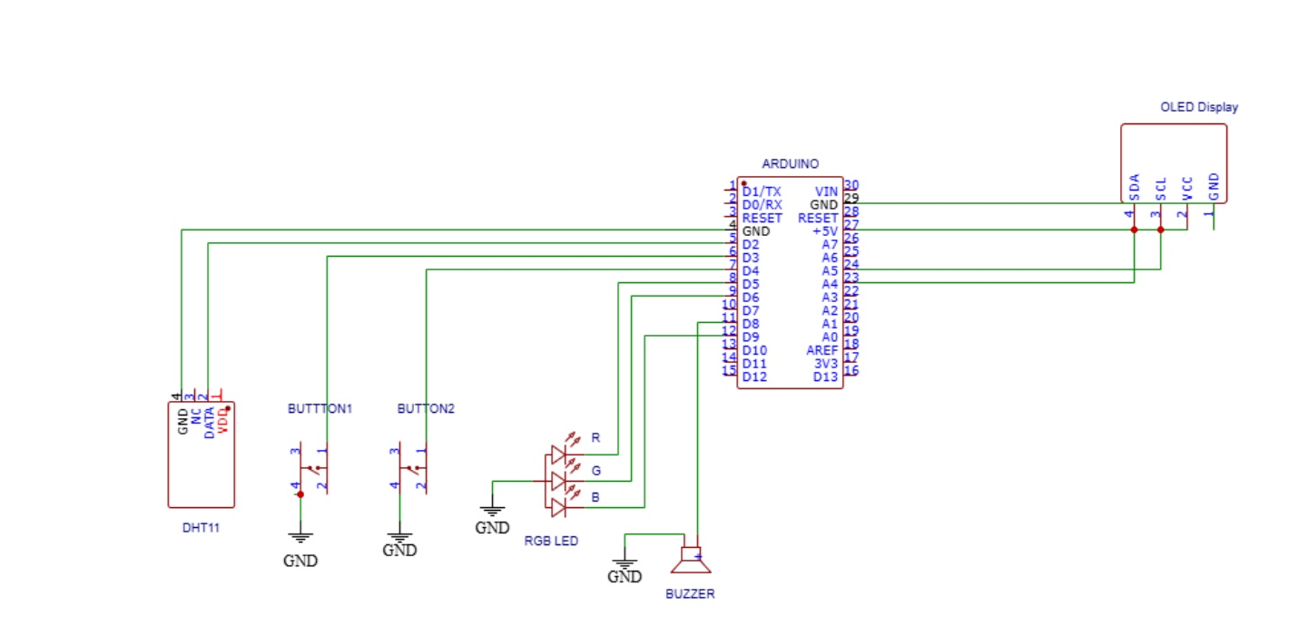
02 · CIRCUIT
Wiring Schematic
Pin Connections
DHT11 → DATA
Pin 2
Green LED → (+)
Pin 7
Red LED → (+)
Pin 8
Buzzer → (+)
Pin 9
DHT11 → VCC
5V
All GND
GND
Project schematic — Arduino Project Hub
⚠ LEDs need 220Ω resistors in series
© 2024
Smart Thermometer · Arduino + DHT11 · IoT Embedded Systems

Slide 4
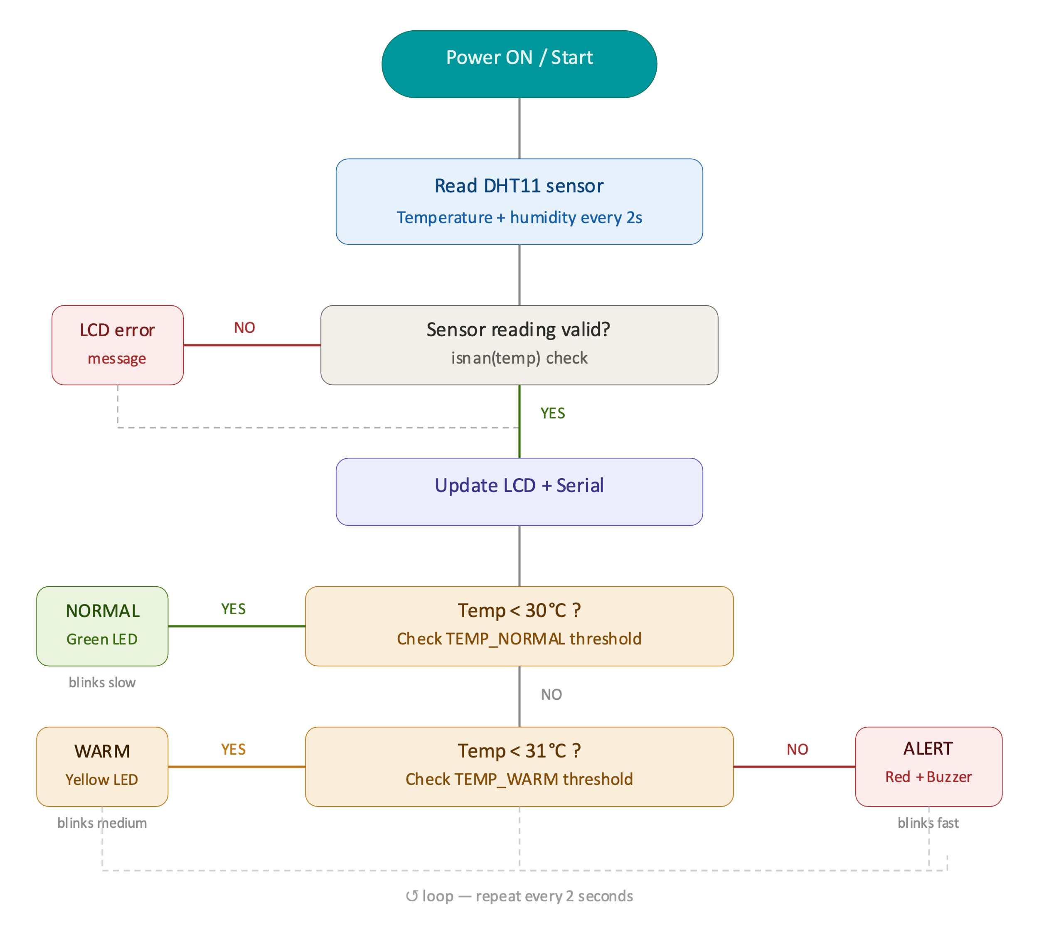
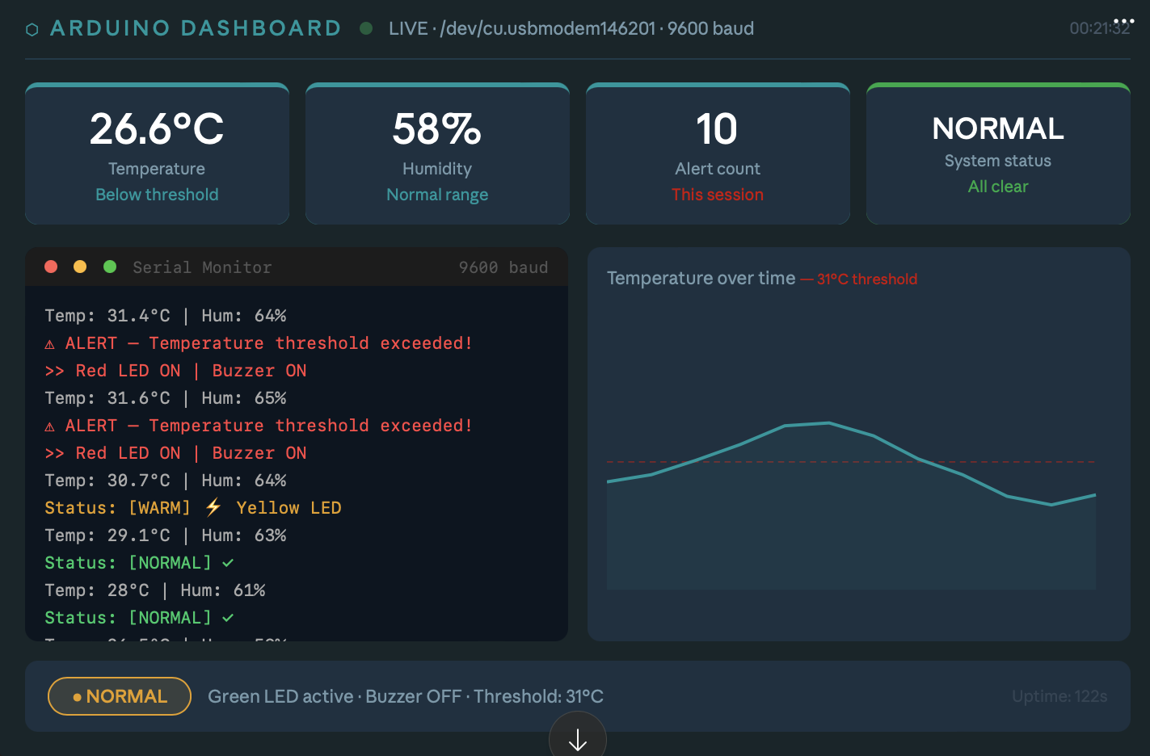
Server.py
System Logic Flow diagram

Slide 5
📄 thermometer.ino
04 · CODE
Arduino Sketch
1
#include <DHT.h>
# pip install flask pyserial
#include <LiquidCrystal.h>
1. Install Library
2
3
// ── Pin definitions ──
Sketch → Include Library (Flask pyserial)
→ Manage Libraries
Search: DHT sensor library
by Adafruit → Install
4
#define DHT_PIN 2
5
#define LED_GREEN 7
6
#define LED_RED 8
7
#define BUZZER_PIN 9
8
9
// ── Threshold (change this!) ──
2. Upload
10
const float THRESHOLD = 30.0; // °C
11
DHT dht(DHT_PIN, DHT11);
Select Board: Arduino Uno
Select correct COM port
Click Upload (→)
12
13
void loop() {
14
float temp = dht.readTemperature();
15
if (temp > THRESHOLD) {
16
digitalWrite(LED_RED, HIGH);
3. Monitor
17
tone(BUZZER_PIN, 1000, 500);
18
} else {
Tools → Serial Monitor
Baud: 9600
See live readings!
19
digitalWrite(LED_GREEN, HIGH);
20
noTone(BUZZER_PIN);
21
}
22
}

Slide 6
05 · RESULTS
Live Output — Serial Monitor
● ● ● Serial Monitor 9600 baud
28.9°C
61%
> System initialized!
> DHT11 sensor OK
Current Temp
Humidity
Below threshold
Normal range
Temp: 24.5°C | Humidity: 58%
Status: [NORMAL] ✓
2
NORMAL
Temp: 26.1°C | Humidity: 60%
Status: [NORMAL] ✓
Alert Count
Status
Temp: 30.8°C | Humidity: 63%
This session
All clear
⚠ ALERT — Temperature threshold exceeded!
>> Buzzer ON | Red LED ON
Temp: 31.5°C | Humidity: 65%
30°C threshold
⚠ ALERT — Temperature threshold exceeded!
Temp: 28.9°C | Humidity: 61%
Status: [NORMAL] ✓ Buzzer OFF
▌
© 2024
Smart Thermometer · Arduino + DHT11 · IoT Embedded Systems

Slide 7
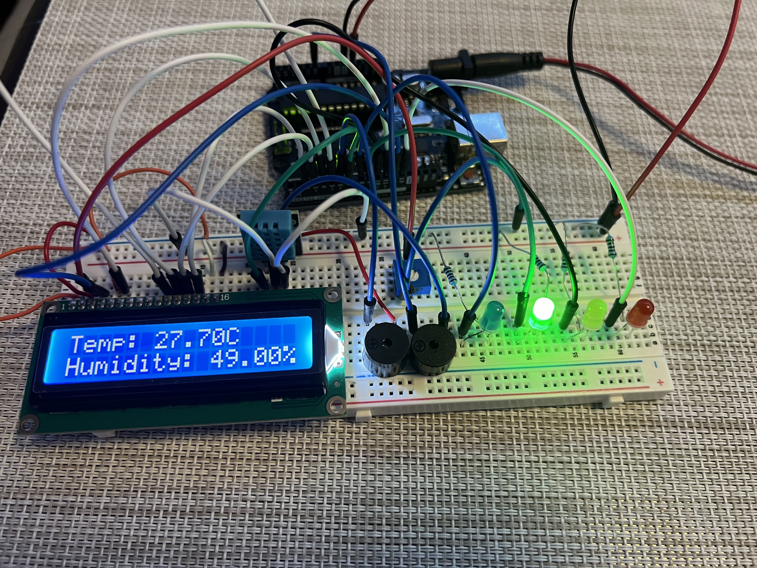
06 · CONCLUSION
What We Built
Server.py : Live Dashboard Code
Arduino.ino : TempHum Code
Project Outcomes
✓ DHT11 sensor reads temp & humidity every 2s
✓ Threshold-based alert: buzzer + LED activate
✓ Green/Red LED indicates system state clearly
✓ Serial Monitor shows live readings dashboard
✓ Threshold configurable directly in code
Thank you · Questions?

