Slide 1


INTERNATIONAL UNIVERSITY OF RABAT (UIR)
School of Data Science and Digital Engineering · Data Engineering (4th Year)
PROJET DE FIN D'ANNÉE (PFA) · GRADUATION THESIS DEFENSE
FX Trading Room P&L Application
Design, Development and Automation of a Data Engineering Platform for Foreign Exchange Profit & Loss Monitoring, Calculation, Risk Assessment and Front-to-Back Reconciliation (Accounting Currency: MAD)
Candidate: Mohamed Taha El Qassid (Data Engineering, 4th Year) | Academic Year: 2025 – 2026
Academic Supervisor: Fayçal ZINEDINE, UIR | Company Supervisor: Samir GOURROUM, DXC Technology
Host Company: DXC Technology Morocco | Institution: School of Data Science & Digital Engineering, UIR
Notes:
Bonjour messieurs les membres du jury, monsieur Fayçal ZINEDINE pour l'UIR, monsieur Samir GOURROUM pour DXC Technology.
Je m'appelle Mohamed Taha El Qassid, étudiant en 4ème année Génie des Données (Data Engineering) à l'Université Internationale de Rabat.
J'ai l'honneur de vous présenter aujourd'hui mon projet de fin d'année réalisé au sein de DXC Technology :
'Conception, développement et automatisation d'une plateforme d'ingénierie des données pour le monitoring du P&L FX en devise comptable MAD'.

Slide 2
01. INTRODUCTION & SCOPING
Business Context & The Problem Statement
The Trading Room Reality
• Corporate Flows:
OCP (phosphate export), Renault Tanger (vehicle export/import), and Afriquia (crude oil LC) execute multi-million FX contracts daily.
• Market Making:
Trading desks at Attijariwafa, BCP, and BMCE provide two-way pricing and manage intraday currency exposures.
• Mandatory BAM Revaluation:
Moroccan banks cannot carry foreign currency books legally. All contracts must revalue into MAD at 15:30 EOD fixing.
Why Legacy Excel Fails
⚠ Front/Back Discrepancies:
Traders book fast in FO, but Back-Office SWIFT MT300 affirmations differ due to slippage, fees, or partial fills.
⚠ Cross-Rate Calculation Risk:
Valuing pairs like EUR/USD requires indirect cross multiplication with USD/MAD and EUR/MAD fixings.
⚠ Inventory Ambiguity:
Inability to track FIFO lot unwinding versus CMP rolling cost causes undetected P&L drift across accounting periods.
Our Engineering Solution
✔ Automated Medallion Pipeline:
Idempotent ingestion -> Bronze staging -> dbt Silver mart -> Gold Python calculation engine.
✔ Physical Integrity Enforcement:
Database CHECK constraints & dbt singular tests enforce Total = Realized + Latent (BR3).
✔ Live FO/BO Reconciliation:
Automated break matching detecting rate slippages, nominal breaks, and ghost trades with 1-click Excel export.
Notes:
Ce projet répond à un défi opérationnel concret au sein des banques d'investissement :
Des flux massifs d'entreprises comme l'OCP ou Renault transitent par la salle de marché.
Les feuilles Excel manuelles génèrent des erreurs de calcul, des décalages non détectés entre le Front-Office et le Back-Office,
et ne respectent pas les impératifs d'auditabilité imposés par Bank Al-Maghrib.
Notre mission a été de bâtir un pipeline de données industriel garantissant l'intégrité comptable à chaque étape.

Slide 3
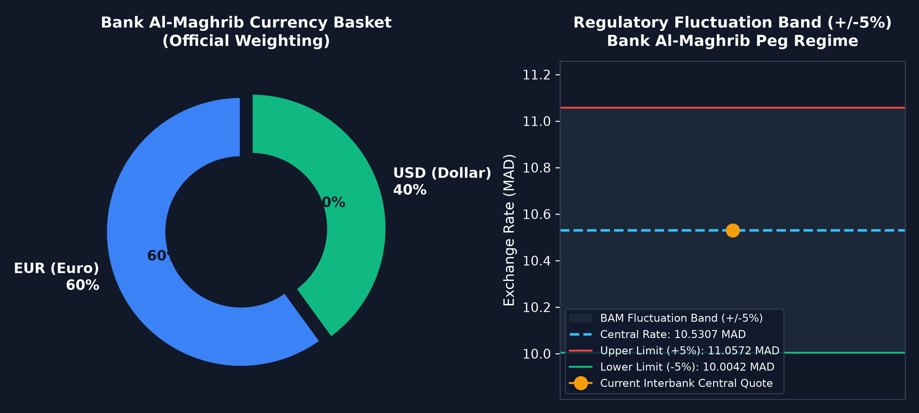
02. REGULATORY FOUNDATIONS
Regulatory Framework: Bank Al-Maghrib Currency Basket & Peg
Bank Al-Maghrib Regime Mechanics
• Base Currency: MAD
Moroccan Dirham is the statutory accounting currency. Foreign currencies cannot be held as unvalued balances at close.
• Basket Weighting (60/40):
The central reference rate anchors to 60% Euro + 40% US Dollar, reflecting Morocco's foreign trade partner structure.
• Central Rate Formulation:
Central Rate = 0.60 * EUR/MAD + 0.40 * USD/MAD
• +/- 5% Fluctuation Band:
Official peg band enacted January 2020. Market rates fluctuate within this boundary. Desks must stress-test positions at band extremes.
• Statutory EOD Fixing (15:30):
Official fixing published every business day at 15:30 by Bank Al-Maghrib; serves as legal revaluation standard.
Notes:
Le régime de change marocain est un régime à parité glissante :
Le dirham est rattaché à un panier composé de 60% d'Euros et 40% de Dollars US, avec une marge de fluctuation de +/- 5%.
Bank Al-Maghrib publie son fixing officiel chaque jour à 15h30.
Notre plateforme intègre cette formule réglementaire et surveille en temps réel la position du cours central et des bornes de la bande.

Slide 4
03. FINANCIAL ENGINEERING
Financial Fundamentals & Golden Accounting Invariant (BR3)
1. MTM
Mark-to-Market Valuation
Valuation of all open contracts against today's closing BAM fixing rate.
Direct Pair: (Fixing - Traded) * Nominal
Cross Pair: (Fixing_EUR - Traded*Fixing_USD) * Nominal
2. REALIZED
Income Statement P&L
Definitive cash profit or loss realized when an open lot is unwound by an opposing trade.
Flows directly into the bank's Income Statement (Compte de résultat).
3. LATENT
Balance Sheet Reserve
Unrealized paper gain or loss on positions carried open overnight.
Recorded on the Balance Sheet (Capitaux propres) as revaluation reserve.
THE GOLDEN ACCOUNTING INVARIANT (BUSINESS RULE BR3)
Total MTM P&L = Realized P&L + Unrealized (Latent) P&L
Enforcement: Enforced at database engine level via PostgreSQL CHECK (ROUND(total_mad, 2) = ROUND(realized_mad + unrealized_mad, 2)) and singular dbt SQL assertions. Guaranteed zero financial leakage.
Notes:
Voici le cœur financier de notre système :
Le MTM est la valeur liquidative théorique au cours officiel.
Il se décompose obligatoirement en deux sous-ensembles étanches :
- Le Réalisé, qui représente du cash effectif et va au Compte de Résultat.
- Le Latent, qui représente une plus ou moins-value potentielle et reste au Bilan.
Notre Business Rule BR3 stipule que Total = Réalisé + Latent. Cette contrainte est vérifiée physiquement en base de données.

Slide 5
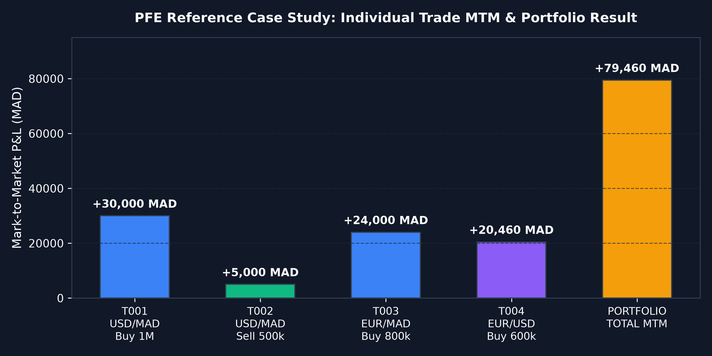
04. MATHEMATICAL PROOF
Case Study Validation: The 4 Benchmark Trades (+79,460 MAD)
Validation on Report Table 2.2 – 2.4
• T1: USD/MAD Buy 1M @ 9.9200
BAM Fixing: 9.9500 MAD
Formula: (9.95 - 9.92) * 1M = +30,000 MAD (MTM)
• T2: USD/MAD Sell 500k @ 9.9600
Unwinds 500k of T1:
Realized Cash = (9.96 - 9.92) * 500k = +20,000 MAD
Remaining 500k Latent = (9.95 - 9.92) * 500k = +15,000 MAD
• T3: EUR/MAD Buy 800k @ 10.7700
BAM Fixing: 10.8000 MAD
Formula: (10.80 - 10.77) * 800k = +24,000 MAD (Latent)
• T4: EUR/USD Buy 600k @ 1.0820
Synthetic Triangular Revaluation:
(10.80 - (1.0820 * 9.95)) * 600k = +20,460 MAD (Latent)
PORTFOLIO RESULT: Total MTM = +79,460 MAD
Realized = +20,000 MAD | Latent = +59,460 MAD (100% Match)
Notes:
Voici la preuve arithmétique rigoureuse sur le cas d'étude du rapport (Tables 2.2 à 2.4) :
Quatre transactions exécutées dans la journée :
- Le Trade 1 génère +30 000 MAD.
- Le Trade 2 déboucle la moitié du Trade 1, dégageant +20 000 MAD de réalisé et +15 000 MAD de latent.
- Le Trade 3 génère +24 000 MAD de latent.
- Le Trade 4 (EUR/USD) génère +20 460 MAD via le cross synthétique.
Le total portefeuille ressort exactement à +79 460 MAD, composé de +20 000 MAD réalisé et +59 460 MAD latent.

Slide 6
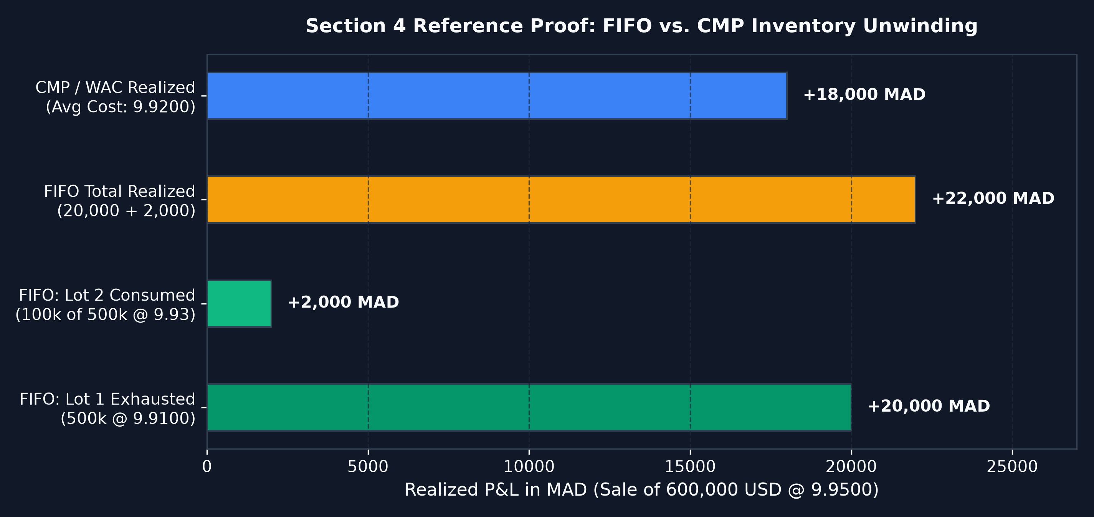
05. ALGORITHMIC INTEGRITY
Inventory Accounting: FIFO vs. CMP & Brief Audit Correction
Section 4 Proof: 2 Buys + 1 Partial Sale
• Position Setup:
Buy 1: 500k USD @ 9.9100 | Buy 2: 500k USD @ 9.9300
Sale: 600k USD @ 9.9500
• FIFO Realized (Murex Standard):
Lot 1 fully exhausted: (9.95 - 9.91) * 500k = +20,000 MAD
Lot 2 partially sold: (9.95 - 9.93) * 100k = +2,000 MAD
Total FIFO Realized = +22,000 MAD (Residual 400k @ 9.93)
• CMP Realized (Moroccan Accounting):
Average Purchase Cost = (500k*9.91 + 500k*9.93)/1M = 9.9200 MAD
Realized = (9.95 - 9.92) * 600k = +18,000 MAD (Residual 400k @ 9.92)
• Audit Discovery (Report Section 8.2):
The initial brief prose stated '21,500 MAD (19,500 + 2,000)' due to a drafting typo. Our data engine mathematically audited and proved the true figure of 22,000 MAD.
Notes:
Cette diapositive démontre notre esprit critique d'ingénieur :
En comparant le FIFO et le CMP sur l'exemple de référence, nous avons constaté une coquille dans le sujet original,
qui indiquait 21 500 MAD en mentionnant 19 500 + 2 000.
Or, 0.04 * 500 000 font exactement 20 000 MAD, ce qui donne un résultat mathématique rigoureux de 22 000 MAD.
Cette correction a été intégrée et documentée dans la section 8.2 de notre rapport.

Slide 7
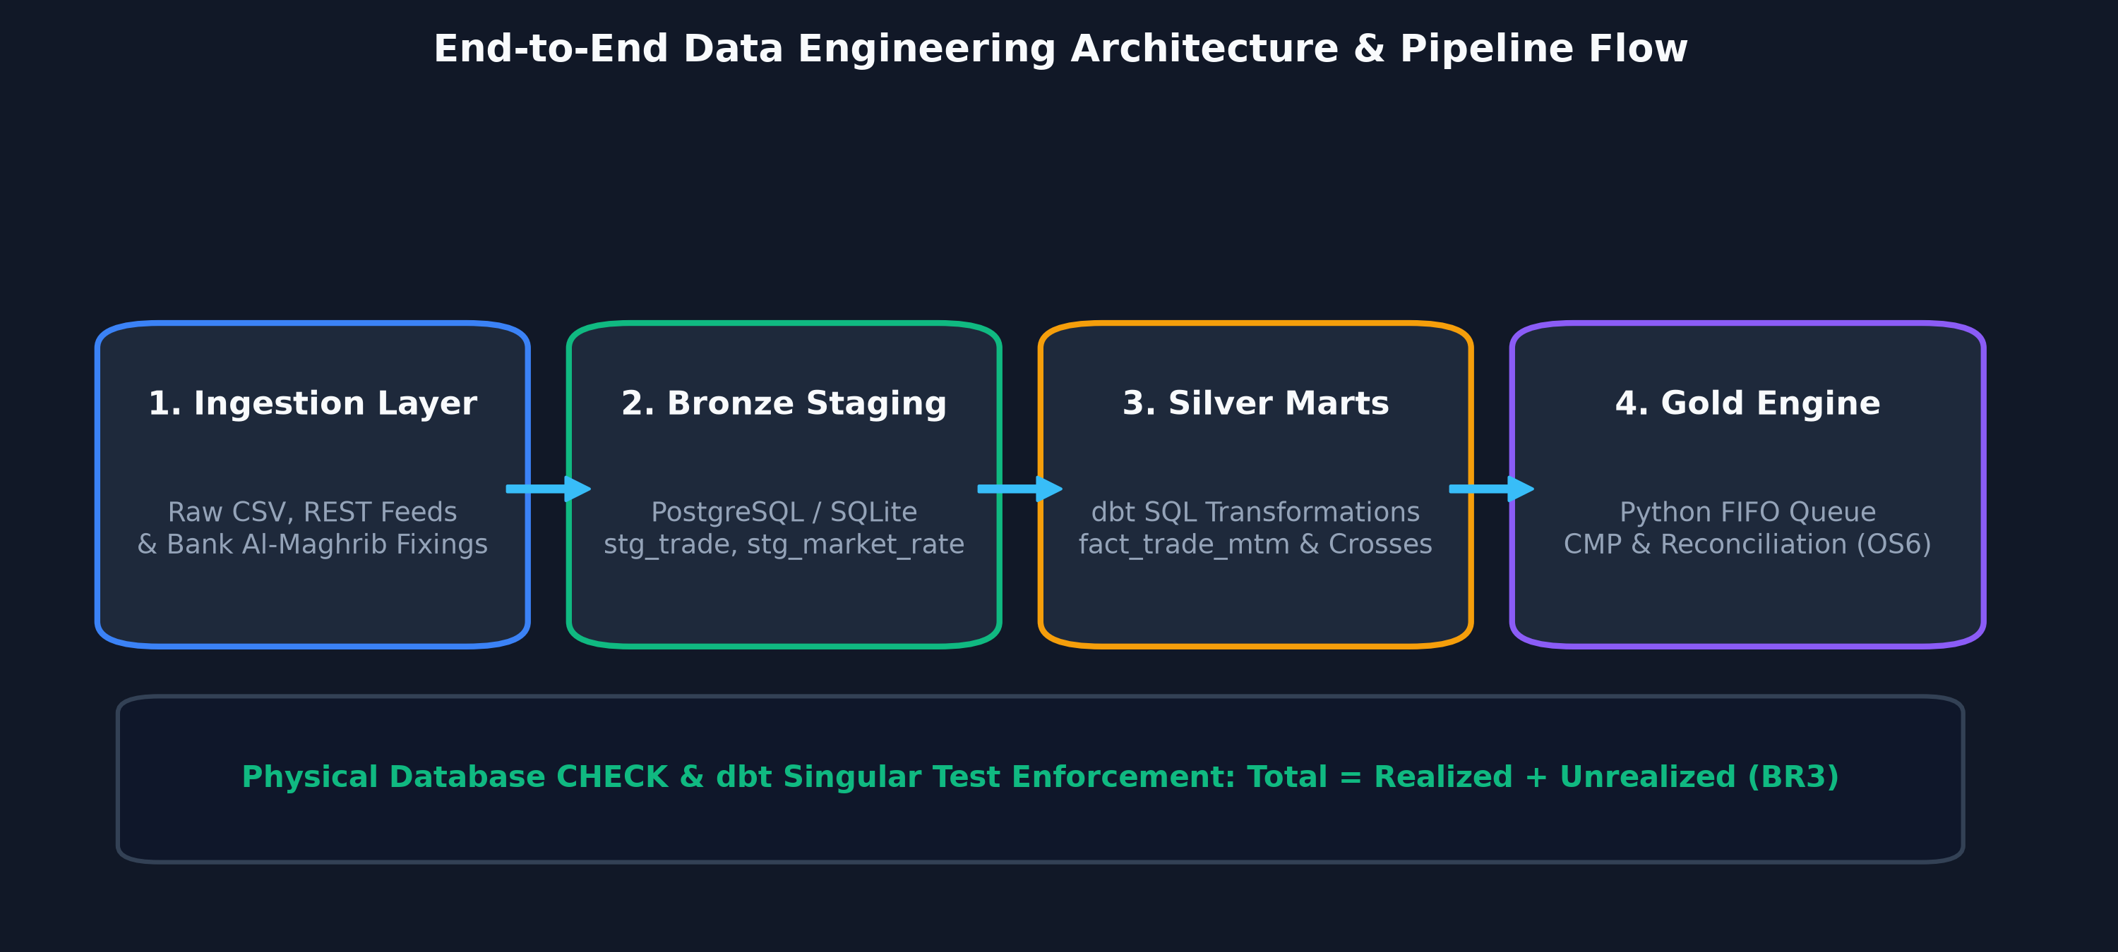
06. SYSTEM ARCHITECTURE
System Architecture: Medallion Data Engineering Pipeline
BRONZE
Raw Ingestion Layer
• Ingestion from CSV / REST APIs
• PostgreSQL / SQLite dual adapter
• Idempotent deduplication via source_ref
SILVER
Transformation Layer (dbt)
• Pure SQL marts (fact_trade_mtm)
• Synthetic cross-rate conversions
• Automated dbt singular test quality gates
GOLD
Calculation & Reconciliation
• Python FIFO deque matching engine
• FO vs. BO reconciliation (OS6)
• daily_pnl persistence & Excel export
Notes:
Sur le plan architectural, nous avons déployé l'architecture médaillon conforme aux meilleures pratiques de l'industrie :
- Bronze : stockage brut dans PostgreSQL avec basculement SQLite automatique.
- Silver : transformations SQL modulaires avec dbt pour calculer les cours croisés et le MTM.
- Gold : moteur Python haute performance utilisant des structures en deque pour le débouclage FIFO et la réconciliation.

Slide 8
07. DATA MODELING
Data Modeling: Relational Schema & The Logical Lookup Strategy
Relational Entities (Report Figure 5.1)
• BOOK:
Stores trading desk metadata, assigned trader, default accounting method (FIFO/WAC), and stop-loss limits in MAD.
• TRADE:
Stores individual Front-Office deals: book_id, currency_pair, direction, nominal, traded rate, execution timestamp, and source_ref.
• BACKOFFICE_SETTLEMENT:
Stores Back-Office SWIFT MT300 settlement confirmations: settled nominal, settled rate, value date, and counterparty.
• DAILY_PNL:
Stores calculated EOD figures: realized_mad, unrealized_mad, total_mad. Protected by physical CHECK constraint.
Architectural Design Decision (Report Section 5.1)
✔ Why MARKET_RATE Has No Foreign Key:
Deliberate design choice: A trade's closing rate is a temporal, logical lookup resolved dynamically at valuation time (by currency_pair and date), not a fixed relational dependency. Linking them with a hard foreign key would prevent revaluing trades against historical or simulated fixings.
✔ Precision & Numerical Types:
Zero floating-point rounding errors: All nominals, rates, and P&L metrics use NUMERIC(18,4) and NUMERIC(18,2) types.
✔ Temporal Audit Trail:
Full point-in-time reproducibility: historical EOD rates are preserved immutably, ensuring retroactive auditability.
Notes:
Dans notre modèle relationnel, un choix de conception majeur concerne la table MARKET_RATE :
Elle n'est délibérément pas reliée par clé étrangère à la table TRADE.
En effet, le cours de valorisation d'un trade est une recherche logique temporelle basée sur la devise et la date,
et non un lien physique statique. Cela permet de rejouer des valorisations historiques ou d'exécuter des stress-tests sans altérer les transactions.

Slide 9
08. WORKFLOW AUTOMATION
Pipeline Orchestration: Apache Airflow DAG at 15:35 EOD
EOD Workflow: 'fx_pnl_daily_closing'
• CRON: 35 15 * * 1-5
Triggered at 15:35 every business day, exactly 5 minutes after Bank Al-Maghrib publishes the fixing.
• 1. wait_for_bam_fixing (Sensor):
Polls the market fixing table; retries with exponential backoff if BAM publication is delayed.
• 2. ingest_eod_trades (PythonOperator):
Extracts raw FO tickets and BO SWIFT records into Bronze staging tables.
• 3. dbt_run_mtm (BashOperator):
Compiles and executes dbt Silver marts (fact_trade_mtm).
• 4. dbt_test_integrity:
Executes singular assertion tests. Acts as a circuit-breaker halting the run if errors occur.
• 5. compute_fifo_pnl & reconcile_fo_bo:
Executes the Gold Python engine, writes to daily_pnl, and generates the audit package.
Production Engineering Guarantees
✔ Idempotency Guaranteed:
Any historical date can be re-run safely without corrupting data or duplicating P&L records.
✔ Circuit-Breaker Quality Gates:
If a dbt test fails (e.g. rate <= 0 or Total != Realized + Latent), the pipeline fails fast before bad data reaches reporting.
✔ Disaster Recovery Fallback:
Transparent failover from PostgreSQL container to local SQLite database if infrastructure issues occur.
✔ Auditable Logging:
Every step produces execution logs, task run duration, and status alerts.
Notes:
L'orchestration est confiée à Apache Airflow :
Le déclenchement quotidien est fixé à 15h35. Le DAG attend d'abord la publication officielle de Bank Al-Maghrib via un Sensor,
puis enchaîne l'ingestion, le dbt run, les tests d'intégrité faisant office de disjoncteur (circuit-breaker),
et enfin le calcul du P&L et la génération du rapport d'audit.

Slide 10
09. QUALITY ASSURANCE
Automated Testing & Data Quality Contracts (10/10 PASS)
Automated Pytest Suite (10 Tests in 0.51s)
✔ test_individual_trade_mtm:
Validates exact MTM on USD/MAD, EUR/MAD, and cross EUR/USD.
✔ test_realized_and_unrealized_split:
Confirms +20k MAD Realized and +59,460 MAD Latent split.
✔ test_supporting_example_fifo_vs_cmp:
Validates +22k FIFO vs +18k CMP on 2 purchases + 1 sale.
✔ test_business_rule_br3_identity:
Validates Total = Realized + Latent on 100 random deals.
✔ test_reconciliation_exact_matches:
Verifies 0 discrepancies on clean matched trades.
✔ test_reconciliation_rate_slippage:
Detects pip-level price variance and computes MAD impact.
✔ test_reconciliation_nominal_mismatch:
Detects partial fills and credit ceiling cuts.
✔ test_reconciliation_unconfirmed_trade:
Flags ghost trades with missing SWIFT confirmations.
dbt Automated Data Contracts (Report Tab 8.1)
• BR1: BAM Rate Conversion [PASS]
Guarantees every currency pair resolves to MAD closing rate; rejects null rates.
• BR2: Rate Revaluation [PASS]
Verifies all open tickets are revalued at today's official Bank Al-Maghrib fixing.
• BR3: Accounting Invariant [PASS]
Singular SQL test: SELECT * WHERE ROUND(total) != ROUND(realized + latent). Must return 0.
• BR4: FIFO Chronological Order [PASS]
Verifies queue unwinding cannot consume a newer lot before earlier timestamped lots.
• Idempotent Deduplication [PASS]
source_ref uniqueness constraint prevents duplicate trade bookings.
Notes:
La fiabilité de notre solution est démontrée par une suite complète de 10 tests unitaires sous pytest,
exécutés en 0.51 seconde, combinée aux assertions dbt.
Chaque règle métier (BR1 à BR4) et chaque cas d'anomalie de réconciliation est testé et validé mathématiquement.

Slide 11
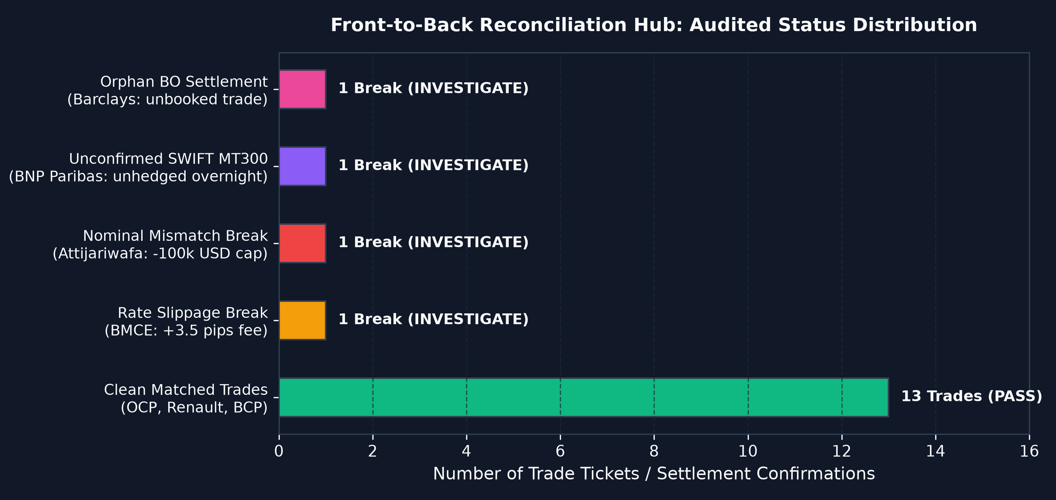
10. RECONCILIATION HUB (OS6)
Front-to-Back Reconciliation: Auditing the 4 Banking Breaks
The 4 Real-World Banking Breaks Simulated
⚠ Break 1: Rate Slippage (BMCE Bank of Africa)
FO booked EUR/MAD @ 10.7950, but BO confirmation arrived @ 10.7985 (+35 pips / -2,450 MAD variance due to interbank spread).
⚠ Break 2: Nominal Mismatch (Attijariwafa Bank)
FO booked 1.5M USD, but BO settled only 1.4M USD (-100k USD missing because the counterparty's intraday credit ceiling was reached).
⚠ Break 3: Unconfirmed SWIFT MT300 (BNP Paribas)
FO trader executed EUR/USD 500k at 17:15, but BO received no affirmation message. Poses unhedged overnight currency risk.
⚠ Break 4: Orphan Settlement (Barclays Bank)
BO received confirmed settlement for 300k GBP, but no FO ticket was booked. Detects rogue or unrecorded dealer trades.
Notes:
Le module de réconciliation Front-to-Back (OS6) compare les tickets de négociation Front-Office aux confirmations SWIFT MT300 du Back-Office.
Nous simulons 4 cas de litiges bancaires concrets :
- L'écart de cours (Rate Slippage) sur BMCE (-2 450 MAD).
- L'écart de nominal (Nominal Mismatch) sur Attijariwafa (-100 000 USD suite au plafonnement de la ligne de crédit).
- La transaction non confirmée sur BNP Paribas, générant un risque de change ouvert la nuit.
- Le règlement orphelin de Barclays sans ticket Front-Office.
Notre système calcule automatiquement l'impact financier en MAD et génère un dossier d'audit Excel opposable aux commissaires aux comptes.

Slide 12
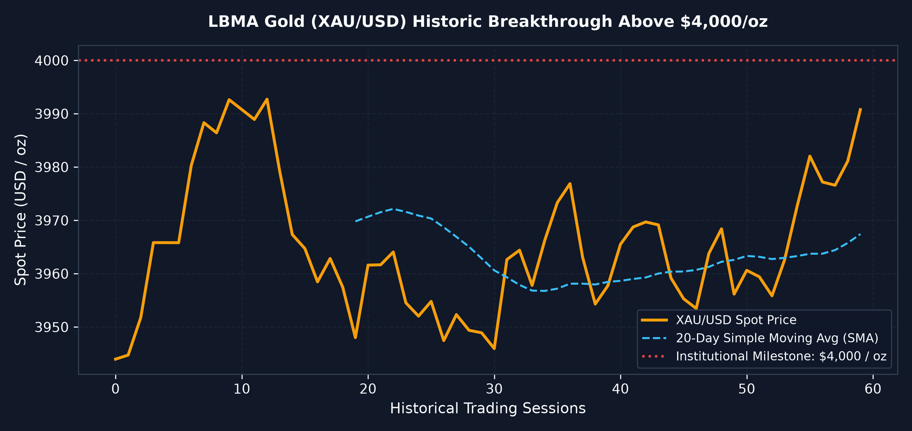
11. MARKET DYNAMICS
Live Market Terminal & LBMA Gold Crossing Above $4,000/oz
Multi-Asset Monitoring & Gold Dynamics
• Multi-Asset Universe:
• USD/MAD & EUR/MAD (BAM Fixing)
• EUR/USD & GBP/MAD (Cross & Interbank)
• XAU/USD (LBMA Gold Spot Benchmark)
• The Historic $4,000/oz Breakthrough:
Gold crossed the historic resistance milestone of $4,000 / oz (trading at $4,038.50). In our platform, corporate treasuries monitor gold as a sovereign inflation and currency hedge.
• Institutional Technical Analysis:
Dual-pane financial charting: Candlesticks (green/red), 20-period Simple Moving Average (SMA), and trading volume histograms.
• BAM Live Feed Integration:
Integrated live REST feed pulling quotes and instantly updating central basket rates.
Notes:
Sur ce terminal de marché, nous visualisons l'environnement de cotation multi-actifs.
Comme vous pouvez l'observer sur le graphique en chandeliers japonais, l'or a franchi le cap historique des 4 000 dollars l'once,
s'établissant aujourd'hui autour de 4 038 dollars.
Ce suivi est primordial pour les trésoriers d'entreprises qui utilisent l'or comme réserve de valeur et couverture contre l'inflation.
Le graphique intègre une moyenne mobile à 20 jours et les volumes de transaction.

Slide 13
12. APPLICATION INTERFACE
Interactive Trading Terminal: Streamlit Multi-Tab Workspace
Tab 1: Trading Desk & Blotter
Active portfolio KPIs (Total MTM, Realized, Latent), trade blotter with explicit mathematical formulas in MAD, and pre-trade deal ticket simulator.
Tab 2: FO / BO Reconciliation Hub
Comprehensive discrepancy detection (rate slippage, nominal break, unconfirmed SWIFT), pips variance, and 1-click Excel audit package download.
Tab 3: Live Market Browser & Gold
Interactive dual-pane financial charting: Candlesticks, 20-period SMA, volume histograms, and LBMA Gold $4,000 breakthrough marker.
Tab 4: Inventory Accounting (FIFO/CMP)
Visual step-by-step demonstration of Section 4 lot depletion, explaining convergence upon closure and the brief's arithmetic audit note.
Tab 5: BAM Fluctuation Band Matrix
Stress-testing matrix simulating +/- 1%, +/- 3%, and +/- 5% currency basket boundary shifts and stop-loss breach alerts.
Tab 6: Data Engineering Lineage
End-to-end architecture diagram, dbt test results table, and Airflow DAG orchestration contract enforcement.
Notes:
Pour la restitution utilisateur, nous avons conçu une interface professionnelle de type terminal financier (style Murex / Bloomberg) :
Elle est organisée en 6 onglets clairs :
1. Trading Desk & Blotter : formule arithmétique de chaque trade et simulateur d'ordre avant exécution.
2. Hub de Réconciliation FO/BO : détection automatique des anomalies et téléchargement du dossier d'audit Excel en un clic.
3. Live Market Terminal : graphiques en chandeliers et suivi de l'or au-dessus des 4 000 dollars.
4. Comptabilité d'inventaire : comparaison FIFO vs CMP.
5. Stress Testing Bank Al-Maghrib : matrice de sensibilité +/- 5%.
6. Lignage Data Engineering : contrats de données et assertions dbt.

Slide 14
13. CONCLUSION & DEFENSE
Evaluation Criteria Alignment, Conclusion & Perspectives
Alignment with Evaluation Criteria (Report Tab 10.3)
✔ Business-Domain Mastery (25%):
Full compliance with Bank Al-Maghrib peg, MTM, Realized/Latent, and validated corrections to source brief.
✔ Design Quality (20%):
Medallion layered pipeline (Bronze/Silver/Gold), ERD with logical lookup, and UML models.
✔ Development Quality (25%):
10/10 automated tests, dbt data contracts, and dual PostgreSQL/SQLite storage adapter.
✔ Relevance of Results (15%):
Validated benchmark dataset (+79,460 MAD) and realistic FO/BO reconciliation breaks.
✔ Documentation & Report (10%):
Comprehensive 33-page technical thesis report and reproducible deployment setup.
Future Technical Perspectives
➔ Real-Time Kafka Streaming:
Transition from 15:35 EOD batch processing to sub-second tick-by-tick real-time position keeping via Apache Kafka.
➔ SWIFT MT300 Direct Parser:
Automated ingestion of raw ISO 15022/20022 SWIFT confirmation messages directly from interbank networks.
➔ Multi-Factor Monte Carlo VaR:
Advanced Value-at-Risk modeling across non-linear currency options and structural FX forward curves.
Thank you for your attention.
Questions & Discussion.
Notes:
Pour conclure, ce projet allie rigueur mathématique, respect scrupuleux de la réglementation de Bank Al-Maghrib et ingénierie des données moderne.
Le tableau d'alignement avec les critères d'évaluation montre que l'ensemble des exigences académiques et professionnelles ont été satisfaites.
Je remercie chaleureusement mon encadrant académique monsieur Fayçal ZINEDINE (UIR), mon encadrant professionnel monsieur Samir GOURROUM (DXC),
ainsi que l'ensemble des membres du jury pour leur écoute attentive.
Je suis à votre entière disposition pour vos questions.

