Slide 1
SMART PRODUCT
Intelligence
AI-powered product analytics for Amazon beauty reviews
TensorFlow / Keras
DistilBERT
RAG
Stable Diffusion
Gradio
Dataset
Final Output
Portfolio Focus
Amazon Reviews 2023 Category: All_Beauty
Integrated multimodal Gradio application
AI engineering workflow from data to demo
University Capstone Final Presentation
Notes:
Introduce Smart Product Intelligence as a complete AI engineering capstone. Emphasize that the project combines data preparation, modeling, generative AI, and a final application.

Slide 2
02
OVERVIEW
A multimodal AI system for product intelligence
Goal: build an end-to-end AI workflow for beauty product analytics
Inputs: metadata, review text, product images, user questions
Outputs: rating bands, category signals, similar products, review summaries, generated hero images
Final interface: five-tab Gradio application with safe fallbacks
Understand
EDA, cleaning, product-level splits
Predict
Tabular, vision, text, transformers
Generate
RAG answers and hero image concepts
The project demonstrates breadth across ML, deep learning, NLP, retrieval, and generative AI while keeping the implementation practical for local execution.
Smart Product Intelligence | All_Beauty | Final Presentation
Notes:
Explain the project goal: turn product reviews, images, and metadata into useful product intelligence outputs through a final app.

Slide 3
03
DATASET
Amazon Reviews 2023 provides the product intelligence foundation
Dataset Details
Product-level split
Source: McAuley-Lab/Amazon-Reviews-2023 Category: All_Beauty Reviews: raw_review_All_Beauty Metadata: raw_meta_All_Beauty
Train
70
Validation
15
Test
15
Processed outputs
data/processed/train.csv
Leakage Control
data/processed/validation.csv
Train, validation, and test sets are split by product ID rather than individual review rows.
data/processed/test.csv
Smart Product Intelligence | All_Beauty | Final Presentation
Notes:
Describe the dataset, selected category, and why product-level splitting matters for realistic evaluation.

Slide 4
04
ARCHITECTURE
A clean pipeline connects data, models, and the final app
Raw Data
Processed Splits
Model Workflows
Generative AI
Gradio App
Reviews + metadata
Train / validation / test
Tabular, vision, text, transformer
RAG + diffusion
Five-tab interface
src/data.py
src/models.py
src/utils.py
app/app.py
Data access and preprocessing layer
Model construction and inference layer
Configuration, paths, logging, seeds
Presentation layer and demo fallbacks
MVC-like organization keeps notebooks, model logic, app integration, and reporting clearly separated.
Smart Product Intelligence | All_Beauty | Final Presentation
Notes:
Walk through the system architecture from raw dataset to processed splits, model notebooks, final Gradio app, and report artifacts.

Slide 5
05
MILESTONE 0
Data preparation created reliable modeling inputs
Load
Clean
Join
Engineer
Split
Hugging Face configs
Missing values + text
Reviews + metadata
Length, price, images
By product ID
Maximum local subset: 30,000 reviews and 10,000 products
EDA plots: rating distribution, price distribution, review length, missing values, image availability
Final outputs: train.csv, validation.csv, test.csv
Why it matters
Reliable data preparation makes every later milestone easier to evaluate and debug.
Smart Product Intelligence | All_Beauty | Final Presentation
Notes:
Explain the data engineering steps: loading, cleaning, joining, feature creation, EDA, and product-level split.

Slide 6
06
MILESTONE 1
Tabular baselines established a structured-data benchmark
Features
Baseline
Neural Model
Price Rating count Review length Image availability Helpful votes
Logistic Regression Imputation + scaling Fast and interpretable
TensorFlow/Keras MLP ReLU hidden layers Dropout + softmax
Evaluation workflow
Classification report
4
Milestone 1 answers: how far can metadata alone go before we add text and image signals?
Confusion matrix
4
Learning curves
3
Error analysis
3
Smart Product Intelligence | All_Beauty | Final Presentation
Notes:
Describe the tabular models and why baselines are necessary before moving to multimodal modeling.

Slide 7
07
MILESTONE 2
Transfer learning made image analysis practical on small samples
Small CNN
Image preview
from scratch
Image URLs
Cache
Compare
safe detection
data/images
metrics
MobileNetV2
transfer learning
Screenshot placeholder
Limits: up to 1,000 train images, 300 validation, 300 test
Broken image URLs are skipped safely
Outputs include accuracy, macro-F1, confusion matrix, and sample predictions
Smart Product Intelligence | All_Beauty | Final Presentation
Notes:
Explain the image pipeline and why MobileNetV2 transfer learning is included alongside a small CNN.

Slide 8
08
MILESTONE 3
Text modeling enabled both classification and product discovery
Part A: Text Classification
Part B: Similar Product Search
TF-IDF + Logistic Regression baseline Keras TextVectorization + Embedding model Accuracy, macro-F1, report, confusion matrix
Product-level search text TF-IDF vectors Cosine similarity top-k retrieval
Example query
Query
TF-IDF
Top 5
gentle moisturizer for sensitive skin
Smart Product Intelligence | All_Beauty | Final Presentation
Notes:
Describe the two-part text milestone: classification and similar product search.

Slide 9
09
MILESTONE 4
DistilBERT added contextual language understanding
Baseline
Transformer
Fallback
TF-IDF + Logistic Regression Fast, interpretable comparison point
DistilBERT distilbert-base-uncased Rating-band classification
Frozen transformer embeddings + Logistic Regression if fine-tuning fails
Evaluation package
Accuracy and macro-F1
Classification report
Confusion matrix
Latency comparison
Short error analysis
Why DistilBERT?
It provides contextual review representations while staying lighter than full BERT for local capstone execution.
Smart Product Intelligence | All_Beauty | Final Presentation
Notes:
Explain the transformer milestone and its fallback strategy for local execution.

Slide 10
10
MILESTONE 5
RAG grounded review answers in retrieved evidence
Aggregate
Retrieve
Generate
Validate
product-level reviews
top 5 chunks
LLM answer
evidence + risk
Summaries
LLM Options
Grounding
Answer Confidence score Retrieved evidence snippets
Pros Cons Short product summary
google/flan-t5-small facebook/bart-base fallback prompt-template fallback
RAG reduces hallucination risk by forcing the answer to use retrieved review context.
Smart Product Intelligence | All_Beauty | Final Presentation
Notes:
Explain how product-level summaries and RAG question answering work.

Slide 11
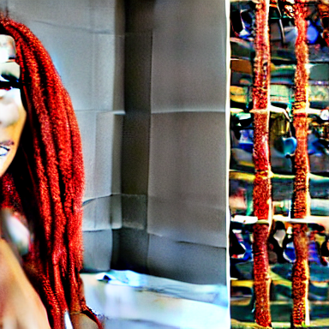
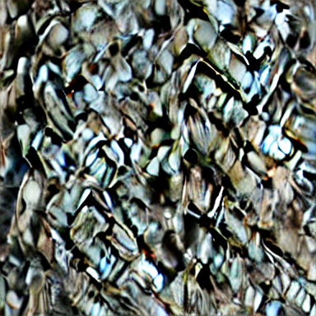
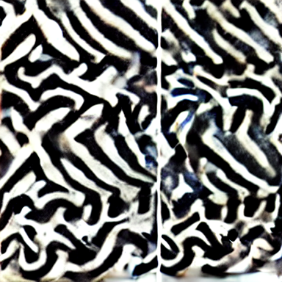
11
MILESTONE 6
Stable Diffusion explored product image ideation
Prompt Inputs
Model Path
Outputs
Product title Description Category
Stable Diffusion v1.5 Fallback: tiny SD pipeline FAST_MODE for local runs
Original product photo Lifestyle variation Marketing hero image
Original
Lifestyle
Hero
Failure modes: invented packaging, incorrect labels, unrealistic claims, and CPU runtime limits.
Smart Product Intelligence | All_Beauty | Final Presentation
Notes:
Describe prompt creation, Stable Diffusion model choice, fallback model, and quality limitations.

Slide 12
12
MILESTONE 7
The Gradio demo connects every milestone into one experience
Predicted Rating
Image Analysis
Similar Products
Review Intelligence
AI Image Gen
Screenshot placeholder
Screenshot placeholder
Screenshot placeholder
Screenshot placeholder
Screenshot placeholder
Demo flow
1. Enter product metadata and predict a rating band
2. Upload a product image for category-style analysis
3. Search for similar products using natural language
4. Ask a review question and inspect grounded evidence
5. Generate a hero image concept from product metadata
Fallback-first design
The app stays usable even when trained artifacts are not present.
Smart Product Intelligence | All_Beauty | Final Presentation
Notes:
Explain the live demo sequence and what each tab represents.

Slide 13
13
RESULTS
The project delivers a complete AI engineering workflow
Delivered artifacts
Data
Train, validation, and test splits saved under data/processed/.
Processed data
3
Model notebooks
7
Models
Tabular, vision, text, transformer, RAG, and diffusion workflows.
App tabs
5
Report assets
3
Application
Five-tab Gradio interface with safe fallbacks.
Documentation
README, final report, and presentation materials.
Final numeric metrics are produced by running each milestone notebook in the target environment.
Smart Product Intelligence | All_Beauty | Final Presentation
Notes:
Summarize the tangible outputs across data, notebooks, app, report, and generated artifacts.

Slide 14
14
CHALLENGES
Robustness mattered as much as model complexity
Schema variability
Leakage risk
Runtime limits
Columns can differ across processed files, requiring safe detection.
Product-level splitting avoids duplicate product signals across splits.
Transformers, vision, and diffusion can be slow on CPU.
Missing artifacts
Generative reliability
The final app needs fallbacks when trained models are not saved.
LLM and diffusion outputs require grounding and validation.
Limitation: the repository is designed for capstone execution, so FAST_MODE and local fallbacks prioritize reproducibility over full-scale production performance.
Smart Product Intelligence | All_Beauty | Final Presentation
Notes:
Explain the engineering and modeling limitations encountered across the project.

Slide 15
15
FUTURE IMPROVEMENTS
The next step is production readiness
1
Persist model artifacts
Save and version trained models for direct app loading.
2
Improve retrieval
Portfolio upgrade
Add FAISS or Chroma for stronger vector search.
Add screenshots, demo video, deployment URL, and model cards.
3
Add experiment tracking
Use MLflow, W&B, or TensorBoard summaries.
4
Deploy demo
Host the Gradio app and add real screenshots/video.
5
Safety evaluation
Evaluate hallucination and product-claim risk.
Smart Product Intelligence | All_Beauty | Final Presentation
Notes:
Present a practical roadmap for improving the project after the capstone.

Slide 16
16
CONCLUSION
Smart Product Intelligence demonstrates full-stack AI engineering
Key Takeaways
Final message
Built a complete multimodal product intelligence pipeline
Combined TensorFlow, DistilBERT, RAG, Stable Diffusion, Transfer Learning, and Gradio
Connected experiments into a final interactive application
Documented results, limitations, lessons learned, and future improvements
This capstone shows practical AI engineering discipline: robust data prep, meaningful baselines, modern models, generative AI, and a clear application layer.
Thank you
Questions?
Smart Product Intelligence | All_Beauty | Final Presentation
Notes:
Close by emphasizing breadth, integration, and portfolio readiness.

