Slide 1
Finite Automata
Motivation
Examples
‹#›
Notes:
‹#›

Slide 2
Informal Explanation
Finite automata are finite collections of states with transition rules that take you from one state to another.
Original application was sequential switching circuits, where the “state” was the settings of internal bits.
Today, several kinds of software can be modeled by Finite Automata.
‹#›
Notes:
‹#›

Slide 3
Representing Finite Automata
Simplest representation is often a graph.
Nodes = states.
Arcs indicate state transitions.
Labels on arcs tell what causes the transition.
‹#›
Notes:
‹#›

Slide 4
Example: Recognizing Strings Ending in “ing”
Not i or g
Not i
Not i or n
i
nothing
Saw i
Saw in
Saw ing
i
n
g
Start
i
i
Not i
‹#›
Notes:
‹#›

Slide 5
Automata to Code (by hand)
In C/C++/Java:
Initialize state q to start state.
Loop through the string one character at a time.
Make a switch statement with a case for each state for q, where each case sets q according to the transitions for that state.
Accept if you end in a final state.
‹#›
Notes:
‹#›

Slide 6
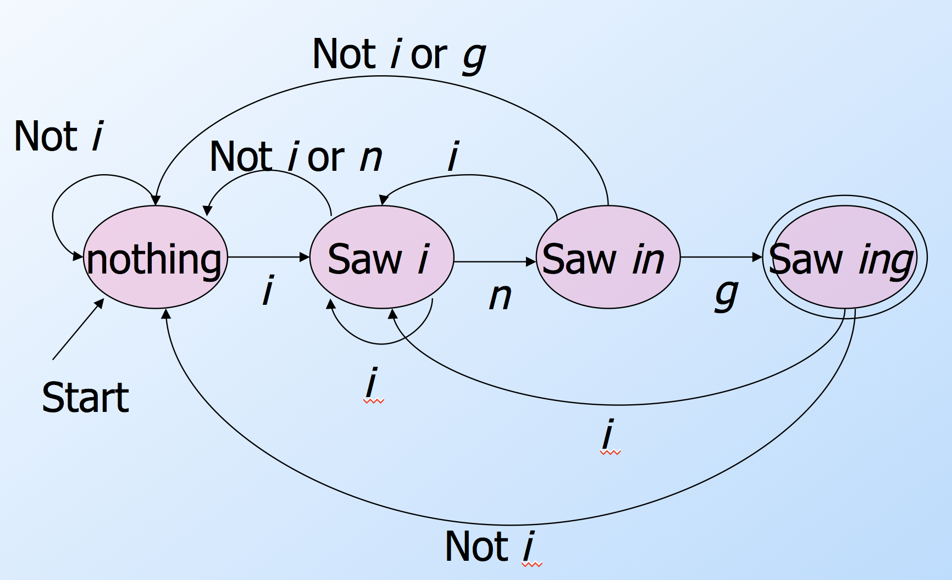
Example in Java
Scanner scan = new Scanner(System.in);
String s = scan.next();
int q = 0;
for (char c : s.toCharArray()) {
switch (q) {
case 0: q = (c=='i')? 1 : 0; break;
case 1: q = (c=='n')? 2 : ((c=='i')? 1 : 0); break;
case 2: q = (c=='g')? 3 : ((c=='i')? 1 : 0); break;
case 3: q = (c=='i')? 1 : 0;
}
}
if (q==3)
System.out.println("accept.");
else
System.out.println("reject.");
Start state
Loop through string s
Transitions
Final state
0
1
2
3
‹#›
Notes:
‹#›

Slide 7
Automata to Code – General
It would be nice to have an automatic way to generate such code…
Rather than do it by hand, a code generator takes a “regular expression” describing the pattern(s) you are looking for and produces the code for it.
Example: .*ing works in grep.
‹#›
Notes:
‹#›

Slide 8
Example: An Even Number of 1’s
0
0
1
even
odd
Start
1
How would it look to accept a number of 1’s that is a multiple of 3?
‹#›
Notes:
‹#›

Slide 9
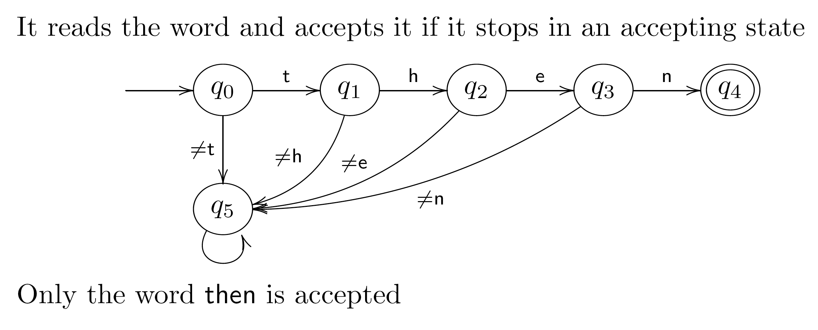
Password/Keyword Example
any character
any character
This is sometimes called a dead state.
BTW, there is a potential security risk on the password application if this finite automaton reports failure too quickly.
‹#›

Slide 10
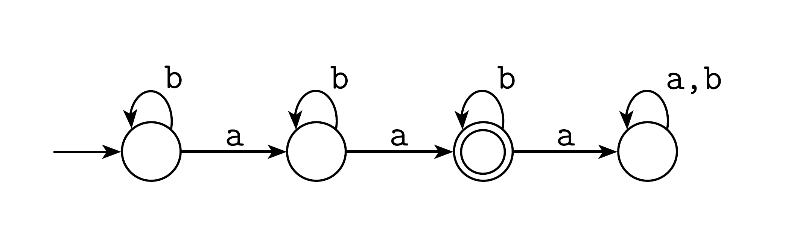
Exactly Two a’s
‹#›
Notes:
‹#›

Slide 11
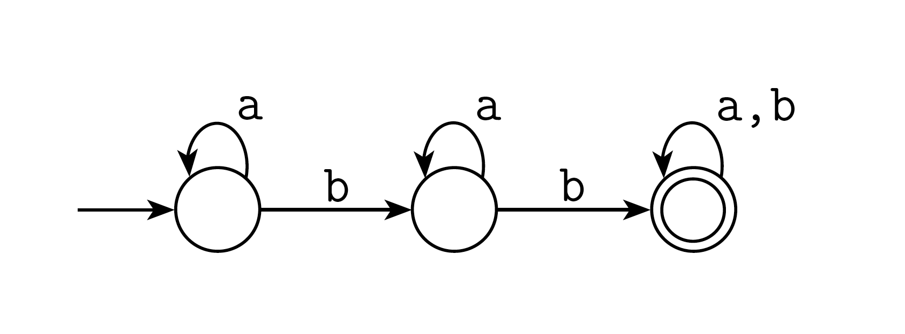
At Least Two b’s
‹#›
Notes:
‹#›

Slide 12
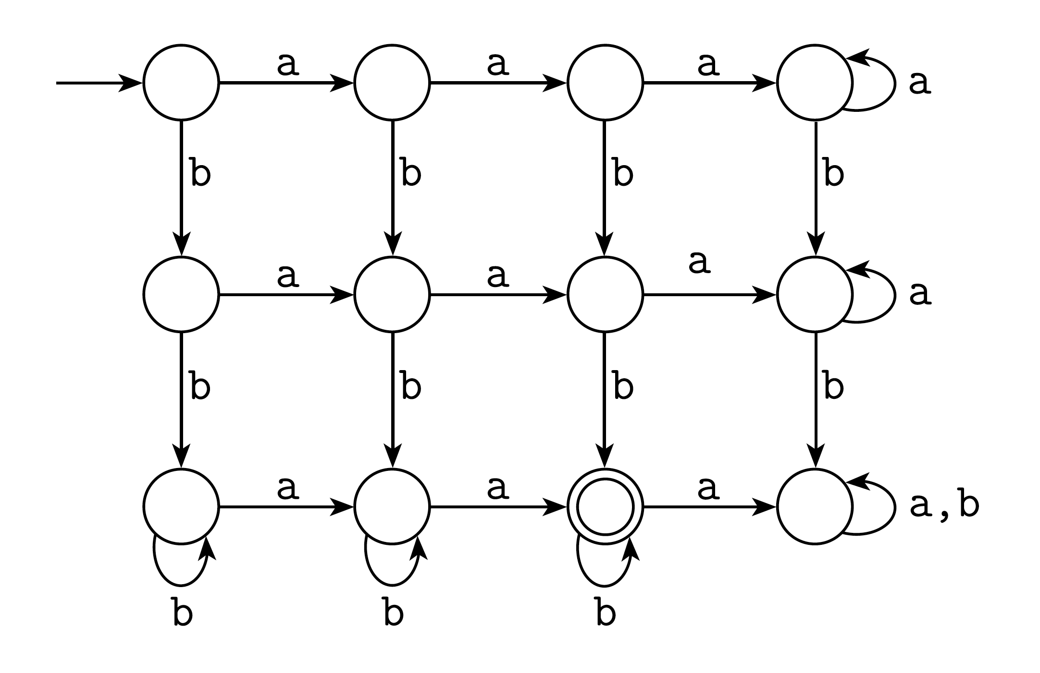
Exactly two a’s and at least two b’s
‹#›
Notes:
‹#›

Slide 13
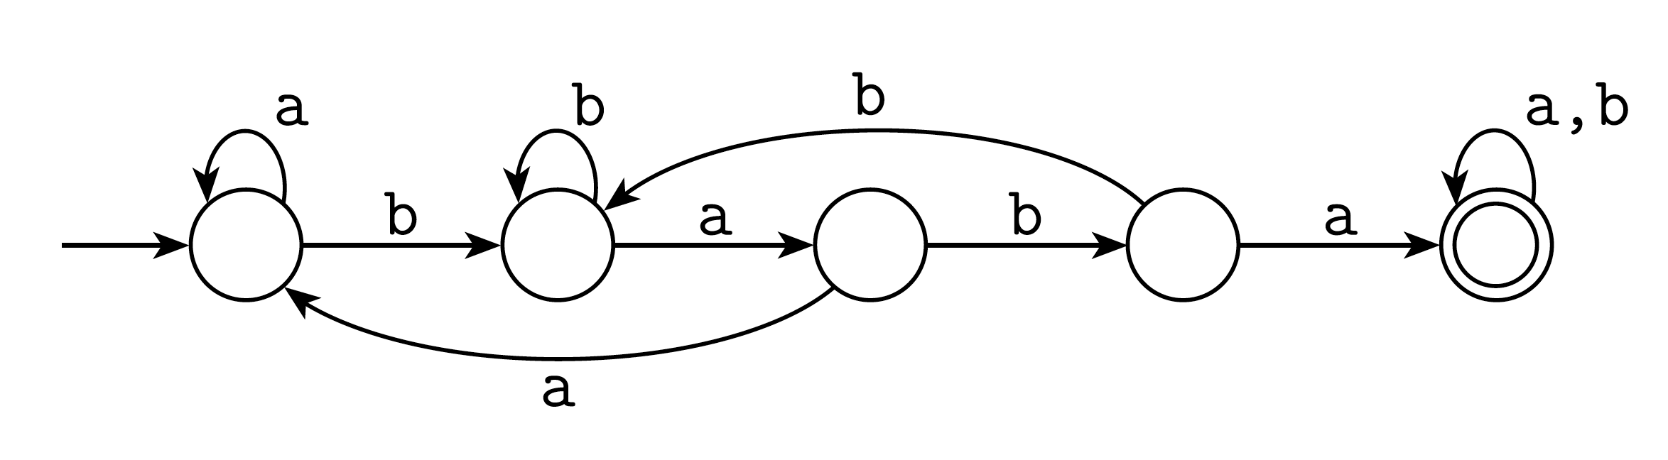
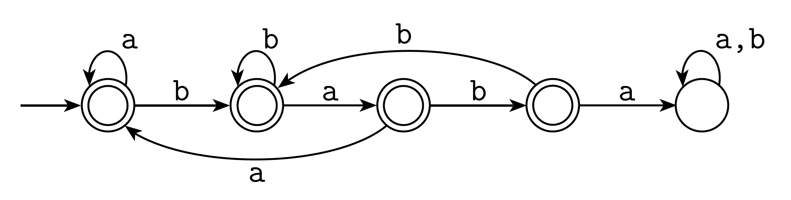
Containing Substrings or Not
Contains baba:
Does not contain baba:
‹#›

Slide 14
General Comments
Some things are easy with finite automata:
Substrings (…abcabc…)
Subsequences (…a…b…c…b…a…)
Modular counting (odd number of 1’s)
Some things are impossible with finite automata (we will prove this later):
An equal number of a’s and b’s
More 0’s than 1’s
But when they can be used, they are fast.
‹#›

