Slide 1
Nondeterministic Finite Automata
Nondeterminism
Subset Construction

Slide 2
Nondeterminism
A nondeterministic finite automaton has the ability to be in several states at once.
Transitions from a state on an input symbol can be to any set of states.

Slide 3
Nondeterminism – (2)
Start in one start state.
Accept if any sequence of choices leads to a final state.
Intuitively: the NFA always “guesses right.”

Slide 4
Example: Moves on a Chessboard
States = squares.
Inputs = r (move to an adjacent red square) and b (move to an adjacent black square).
Start state, final state are in opposite corners.

Slide 5
Example: Chessboard – (2)
1
2
3
r b
2,4 5
4,6 1,3,5
2,6 5
2,8 1,5,7
2,4,6,8 1,3,7,9
2,8 3,5,9
4,8 5
4,6 5,7,9
6,8 5
4
5
6
7
8
9
r
b
b
1
2
1
5
4
3
1
*
5
3
7
7
9
Accept, since final state reached

Slide 6
Formal NFA
A finite set of states, typically Q.
An input alphabet, typically Σ.
A transition function, typically δ.
A start state in Q, typically q₀.
A set of final states F ⊆ Q.

Slide 7
Transition Function of an NFA
δ(q, a) is a set of states.
Extend to strings as follows:
Basis: δ(q, ε) = {q}
Induction: δ(q, wa) = the union over all states p in δ(q, w) of δ(p, a)

Slide 8
Language of an NFA
A string w is accepted by an NFA if δ(q₀, w) contains at least one final state.
That is, there exists a sequence of valid transitions from q₀ to a final state given the input w.
The language of the NFA is the set of strings it accepts.

Slide 9
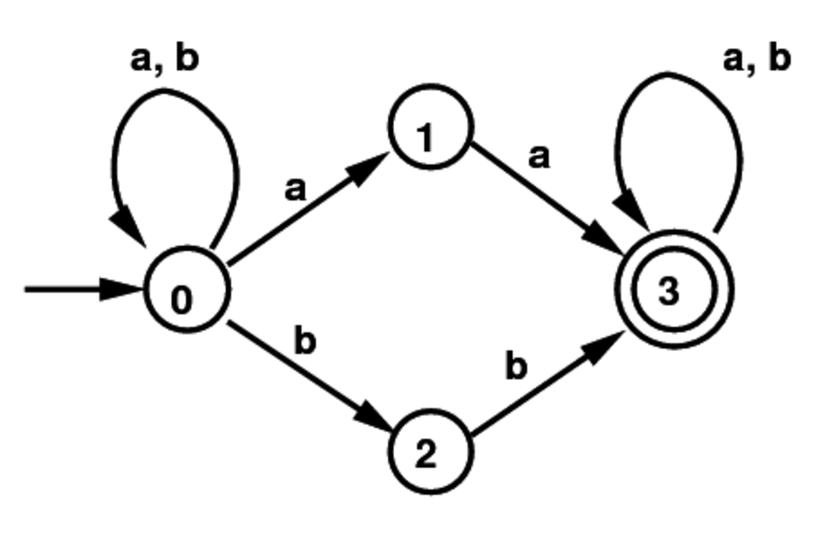
Example NFA
Set of all strings with two consecutive a’s or two consecutive b’s:
Note that some states have an empty transition on an a or b, and some have multiple transitions on a or b.

Slide 10
Example 2: Language of an NFA
1
2
3
4
5
6
7
8
9
For our chessboard NFA we saw that rbb is accepted.
If the input consists of only b’s, the set of accessible states alternates between {5} and {1,3,7,9}, so only even-length, nonempty strings of b’s are accepted.
What about strings with at least one r?

Slide 11
Equivalence of DFA’s, NFA’s
A DFA can be turned into an NFA that accepts the same language.
If δ_{D}(q, a) = p, let the NFA have δ_{N}(q, a) = {p}.
Then the NFA is always in a set containing exactly one state – the state the DFA is in after reading the same input.

Slide 12
Equivalence – (2)
Surprisingly, for any NFA there is a DFA that accepts the same language.
Proof is the subset construction.
The number of states of the DFA can be exponential in the number of states of the NFA.
Thus, NFA’s accept exactly the regular languages.

Slide 13
Subset Construction
Given an NFA with states Q, inputs Σ, transition function δ_{N}, state state q₀, and final states F, construct equivalent DFA with:
  States 2^{Q} (Set of subsets of Q).
  Inputs Σ.
  Start state {q₀}.
  Final states = all those with a member of F.

Slide 14
Critical Point
The DFA states have names that are sets of NFA states.
But as a DFA state, an expression like {p,q} must be read as a single symbol, not as a set.
Analogy: a class of objects whose values are sets of objects of another class.

Slide 15
Subset Construction – (2)
The transition function δ_{D} is defined by:
δ_{D}({q₁,…,q_{k}}, a) is the union over all i = 1,…,k of δ_{N}(q_{i}, a).
Example: We’ll construct the DFA equivalent of our “chessboard” NFA.

Slide 16
Example: Subset Construction
r b
2,4 5
4,6 1,3,5
2,6 5
2,8 1,5,7
2,4,6,8 1,3,7,9
2,8 3,5,9
4,8 5
4,6 5,7,9
6,8 5
r b
{1}
{2,4} {5}
{2,4}
{5}
*
Alert: What we’re doing here is
the lazy form of DFA construction,
where we only construct a state
if we are forced to.

Slide 17
Example: Subset Construction
r b
2,4 5
4,6 1,3,5
2,6 5
2,8 1,5,7
2,4,6,8 1,3,7,9
2,8 3,5,9
4,8 5
4,6 5,7,9
6,8 5
r b
{1}
{2,4} {5}
{2,4}
{2,4,6,8} {1,3,5,7}
{5}
{2,4,6,8}
{1,3,5,7}
*

Slide 18
Example: Subset Construction
r b
2,4 5
4,6 1,3,5
2,6 5
2,8 1,5,7
2,4,6,8 1,3,7,9
2,8 3,5,9
4,8 5
4,6 5,7,9
6,8 5
r b
{1}
{2,4} {5}
{2,4}
{2,4,6,8} {1,3,5,7}
{5}
{2,4,6,8} {1,3,7,9}
{2,4,6,8}
{1,3,5,7}
* {1,3,7,9}
*

Slide 19
Example: Subset Construction
r b
2,4 5
4,6 1,3,5
2,6 5
2,8 1,5,7
2,4,6,8 1,3,7,9
2,8 3,5,9
4,8 5
4,6 5,7,9
6,8 5
r b
{1}
{2,4} {5}
{2,4}
{2,4,6,8} {1,3,5,7}
{5}
{2,4,6,8} {1,3,7,9}
{2,4,6,8}
{2,4,6,8} {1,3,5,7,9}
{1,3,5,7}
* {1,3,7,9}
* {1,3,5,7,9}
*

Slide 20
Example: Subset Construction
r b
2,4 5
4,6 1,3,5
2,6 5
2,8 1,5,7
2,4,6,8 1,3,7,9
2,8 3,5,9
4,8 5
4,6 5,7,9
6,8 5
r b
{1}
{2,4} {5}
{2,4}
{2,4,6,8} {1,3,5,7}
{5}
{2,4,6,8} {1,3,7,9}
{2,4,6,8}
{2,4,6,8} {1,3,5,7,9}
{1,3,5,7}
{2,4,6,8} {1,3,5,7,9}
* {1,3,7,9}
* {1,3,5,7,9}
*

Slide 21
Example: Subset Construction
r b
2,4 5
4,6 1,3,5
2,6 5
2,8 1,5,7
2,4,6,8 1,3,7,9
2,8 3,5,9
4,8 5
4,6 5,7,9
6,8 5
r b
{1}
{2,4} {5}
{2,4}
{2,4,6,8} {1,3,5,7}
{5}
{2,4,6,8} {1,3,7,9}
{2,4,6,8}
{2,4,6,8} {1,3,5,7,9}
{1,3,5,7}
{2,4,6,8} {1,3,5,7,9}
* {1,3,7,9}
{2,4,6,8} {5}
* {1,3,5,7,9}
*

Slide 22
Example: Subset Construction
r b
2,4 5
4,6 1,3,5
2,6 5
2,8 1,5,7
2,4,6,8 1,3,7,9
2,8 3,5,9
4,8 5
4,6 5,7,9
6,8 5
r b
{1}
{2,4} {5}
{2,4}
{2,4,6,8} {1,3,5,7}
{5}
{2,4,6,8} {1,3,7,9}
{2,4,6,8}
{2,4,6,8} {1,3,5,7,9}
{1,3,5,7}
{2,4,6,8} {1,3,5,7,9}
* {1,3,7,9}
{2,4,6,8} {5}
* {1,3,5,7,9}
{2,4,6,8} {1,3,5,7,9}
*

Slide 23
Proof of Equivalence: Subset Construction
The proof is almost a pun.
Show by induction on |w| that
δ_{N}(q₀, w) = δ_{D}({q₀}, w)
Basis: w = ε: δ_{N}(q₀, ε) = δ_{D}({q₀}, ε) = {q₀}.

Slide 24
Induction
Assume IH for strings shorter than w.
Let w = xa; IH holds for x.
Let δ_{N}(q₀, x) = δ_{D}({q₀}, x) = S.
Let T = the union over all states p in S of δ_{N}(p, a).
Then δ_{N}(q₀, w) = δ_{D}({q₀}, w) = T.
  For NFA: the extension of δ_{N}.
  For DFA: definition of δ_{D} plus extension of δ_{D}.
    That is, δ_{D}(S, a) = T; then extend δ_{D} to w = xa.

Slide 25
NFA’s With ε-Transitions
We can allow state-to-state transitions on ε input.
These transitions are done spontaneously, without looking at the input string.
A convenience at times, but still only regular languages are accepted.

Slide 26
Example: ε-NFA
0 1 ε
A {E} {B} ∅
B ∅ {C} {D}
C ∅ {D} ∅
D ∅ ∅ ∅
E {F} ∅ {B, C}
F {D} ∅ ∅
ε
1
1
1
B
C
D
A
ε
*
ε
0
0
E
F
0

Slide 27
Closure of States
CL(q) = set of states you can reach from state q following only arcs labeled ε.
Example: CL(A) = {A};
CL(E) = {B, C, D, E}.
Closure of a set of states = union of the closure of each state.
ε
1
1
1
B
C
D
A
ε
ε
0
0
E
F
0

Slide 28
Extended Delta
˄
Basis: (q, ε) = CL(q).
Induction: (q, xa) is computed as follows:
  Start with (q, x) = S.
  Take the union of CL(δ(p, a)) for all p in S.
Intuition: (q, w) is the set of states you can reach from q following a path labeled w.
δ
˄
δ
˄
δ
˄
δ
And notice that δ(q, a) is not
that set of states, for symbol a.

Slide 29
Example: Extended Delta
ε
1
1
1
B
C
D
A
ε
ε
0
0
E
F
˄
0
δ
(A, ε) = CL(A) = {A}.
(A, 0) = CL({E}) = {B, C, D, E}.
(A, 01) = CL({C, D}) = {C, D}.
Language of an ε-NFA is the set of strings w such that (q₀, w) contains a final state.
˄
δ
˄
δ
˄
δ

Slide 30
Equivalence of NFA, ε-NFA
Every NFA is an ε-NFA.
  It just has no transitions on ε.
Converse requires us to take an ε-NFA and construct an NFA that accepts the same language.
We do so by combining ε–transitions with the next transition on a real input.
Warning: This treatment is a
bit different from that in the text.

Slide 31
Picture of ε-Transition Removal
a
a
a
Transitions
on ε
Transitions
on ε

Slide 32
Picture of ε-Transition Removal
To here, and performs
the subset construction
Text goes
from here
a
a
a
Transitions
on ε
Transitions
on ε

Slide 33
Picture of ε-Transition Removal
To here, with no
subset construction
a
We’ll go
from here
a
a
Transitions
on ε
Transitions
on ε

Slide 34
Equivalence – (2)
Start with an ε-NFA with states Q, inputs Σ, start state q₀, final states F, and transition function δ_{E}.
Construct an “ordinary” NFA with states Q, inputs Σ, start state q₀, final states F’, and transition function δ_{N}.

Slide 35
Equivalence – (3)
Compute δ_{N}(q, a) as follows:
  Let S = CL(q).
  δ_{N}(q, a) is the union over all p in S of δ_{E}(p, a).
F’ = the set of states q such that CL(q) contains a state of F.
Intuition: δ_{N} incorporates ε–transitions before using a but not after.

Slide 36
Equivalence – (4)
Prove by induction on |w| that
CL(δ_{N}(q₀, w)) = _{E}(q₀, w).
Thus, the ε-NFA accepts w if and only if the “ordinary” NFA does.
˄
δ

Slide 37
Example: ε-NFA-to-NFA
Interesting
closures: CL(B)
= {B,D}; CL(E)
= {B,C,D,E}
0 1 ε
A {E} {B} ∅
B ∅ {C} {D}
C ∅ {D} ∅
D ∅ ∅ ∅
E {F} ∅ {B, C}
F {D} ∅ ∅
0 1
A {E} {B}
B ∅ {C}
C ∅ {D}
D ∅ ∅
E {F} {C, D}
F {D} ∅
*
*
*
*
Since closure of
E includes B and
C; which have
transitions on 1
to C and D.
ε-NFA
Since closures of
B and E include
final state D.

Slide 38
Summary
DFA’s, NFA’s, and ε–NFA’s all accept exactly the same set of languages: the regular languages.
The NFA types are easier to design and may have exponentially fewer states than a DFA.
But only a DFA can be implemented in linear time!

