Slide 1
Project 05: Hydrogen Sloshing on Ansys FLUENT
Dated: 16th February 2026
Team Members
Narmeen Asif
Daniel Pineda Estrada
Taha Javed
Decency Chukwuemeka Ukonu
Muhammad Ehab Bin Nauman
Aly Morsy
Pegah Aghasikhani

Slide 2

Executive Summary – Multiphase Sloshing Simulation
🔷 Objective:
Transient CFD analysis of liquid–gas sloshing in a partially filled storage tank under harmonic excitation, focusing on interface dynamics, pressure loads and thermal effects.
🔷 Modeling Approach:
• 2D tank (~75% water)
• Harmonic motion (f = 0.89 Hz)
• Transient pressure-based solver (ANSYS Fluent)
• VOF + k–ω SST + Energy equation
🔷 Numerical Verification:
• 4 structured meshes (1k–24k cells)
• Monitored: average upper wall pressure
• 1.8% error (Medium vs Fine)
• Medium mesh selected for post-processing
🔷 Key Results
• Stable sloshing for more than one cycle (2 s)
• Pressure amplification near walls
• Similar wave behaviour for both gases
• Suitable for structural safety assessment

Slide 3

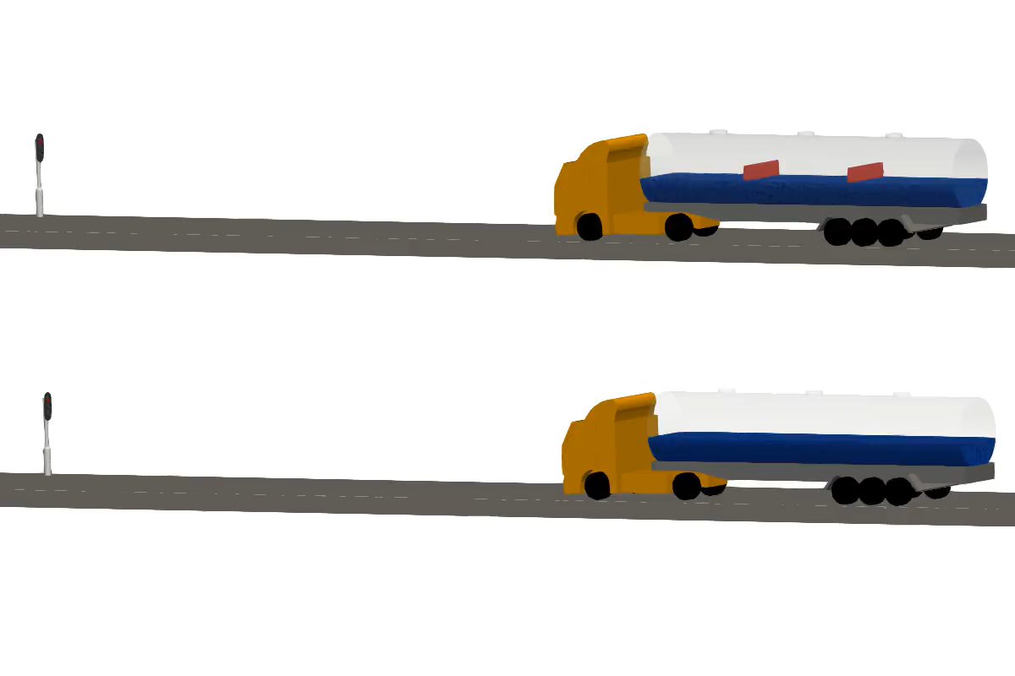
Motivation for the Study
Sloshing - Motion of a Liquid’s Free Surface, due to tank movement
Fundamental fluid phenomenon in many real-world systems
Talking about Hydrogen…
Applications:
Transport Vehicles
Aerospace Rockets
Cryogenic Storage Tanks

Slide 4

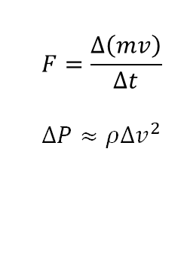
What are the problems in such applications?
Liquid impacts wall → sudden deceleration
Momentum change → impact force
Local pressure rise (possible temperature increase)
Structural stress on tank
Gas compression → enhanced boil-off
Rocket/Vehicle functions failure risk
$$F=\frac{Δ\left(mv\right)}{Δt}$$
$$ΔP≈ρΔv^{2}$$
​

Slide 5

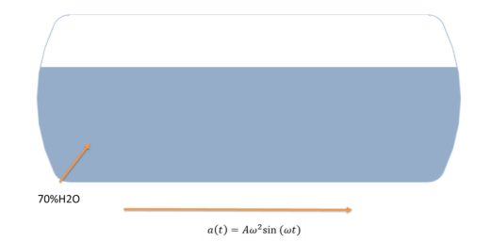
Case Description (Hydrogen Sloshing in a Tank)
Transient CFD Simulation to study Fluid Interface, Liquid-Gas Regions, Heat transfer from Tank to Atmosphere, Wave Behavior, Fluid-Wall Interactions
0.75 m
For simplicity, hydrogen is not used in the study; instead, water and two surrogate gases are considered, one denser than the other
0.35 m
Approx ~75 % H20
Harmonic Motion

Slide 6

Work Distribution
Pre-Processing & Numerical Solution
Post-Processing
Daniel Pineda Estrada
Numerical Grid Independence Study
Muhammad Ehab Nauman
Ali Morsy
Pegah Aghasikhani
Narmeen Asif
Decency Chukwuemeka UKONU
Taha Javed

Slide 7

Timeline of the Project
Week 01 (12/01 – 16/01)
Project onboarding & planning: Understanding project description, defining tasks, assigning roles
Week 02 (19/01 – 23/01)
Geometry Cleanup and Meshing: Edge and face sizing, quality checks defining fluid/solid zones, motion setup
Week 03 (26/01 – 30/01)
Week 04 (02/02 – 06/02)
Week 05 (09/02 – 13/02)
Mesh Independence Study, Presentation preparation, cross-checking results, team integration
Post-Processing: Extracting contours, vectors, pressure plots, heat flux, interface evolution
Solver Setup: Physics models, boundary conditions, time‑step selection

Slide 8

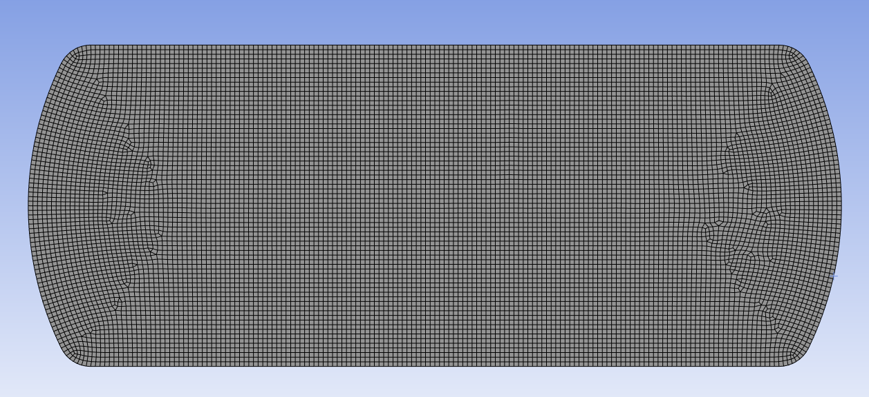
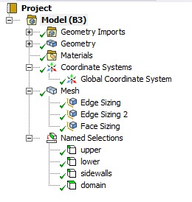
Geometry and Meshing
Edge Sizing
Horizontal walls – 50 Divisions
Vertical walls – 10 Divisions
Face Sizing with element size = 0.005m
Skewness ~ 0.5, Orthogonality ~ 0.95
Simple 2D Geometry Featuring Specific Edges, Meshed Using Hexahedral Elements

Slide 9


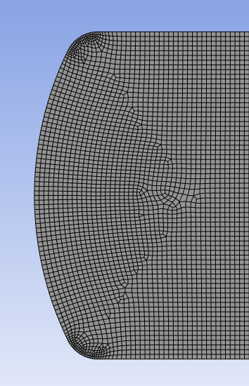
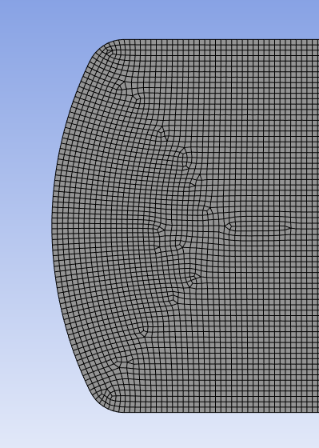
Edge Sizing
Refined mesh on specific edges using edge sizing
10 divisions used
If we merge the edges in geometry setup, it could lead to some non-structured meshes in center

Slide 10

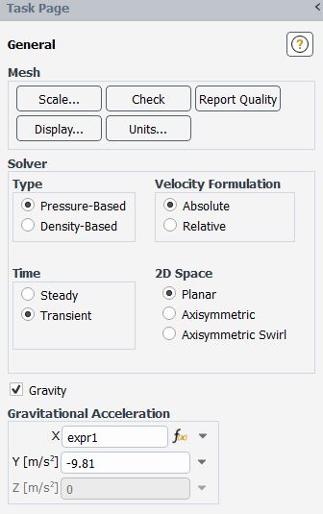
Solver Setting
Solver Configuration & Global Settings (General)
Solver type: Pressure-based
suitable for incompressible, appropriate for water–gas sloshing simulations
Why transient simulation?
To capture:
time-dependent sloshing motion
interface deformation under dynamic excitation
Equations solved for:
• Flow
• Volume Fraction
• Turbulence
• Energy
Notes:
The simulation was performed using the pressure-based solver with absolute velocity formulation.
A transient 2D planar configuration was selected to capture the sloshing dynamics.
Gravity was enabled in the negative y-direction to represent realistic liquid–gas stratification.
The horizontal acceleration was introduced using a time-dependent expression to model the tank excitation.

Slide 11
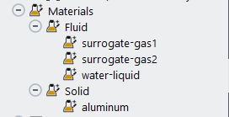
Solver Setting
Tthermophysical properties (Materials)
 | Gas 1 | Gas 2
Density | 3.99 kg/m3 | 6 kg/m3
Cp | 710 J/(kg.K) | 670 J/(kg.K)
Thermal Conductivity | 0.015 W/(m.K) | 0.013 W/(m.K)
Dynamic Viscosity | 1.55e-5 (Pa.s) | 1.5e-5 (Pa.s)
Water was also selected from FLUENT database
Notes:
Next step we defined the thermophysical properties of the materials.
Water was selected directly from the Fluent database.
Two surrogate gases were implemented to study the effect of gas density on sloshing behaviour.
Gas 2 has a higher density than Gas 1, allowing comparison of interface response under different gas environments.

Slide 12
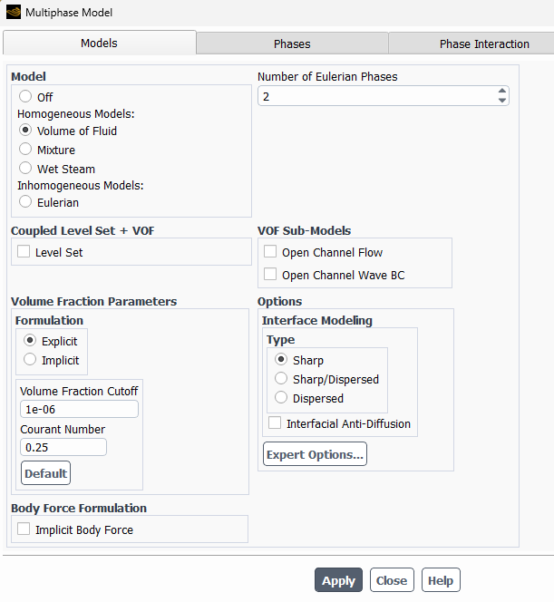
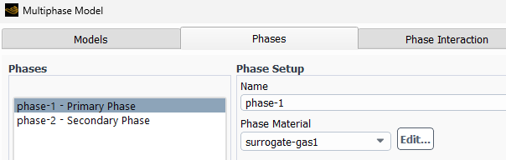
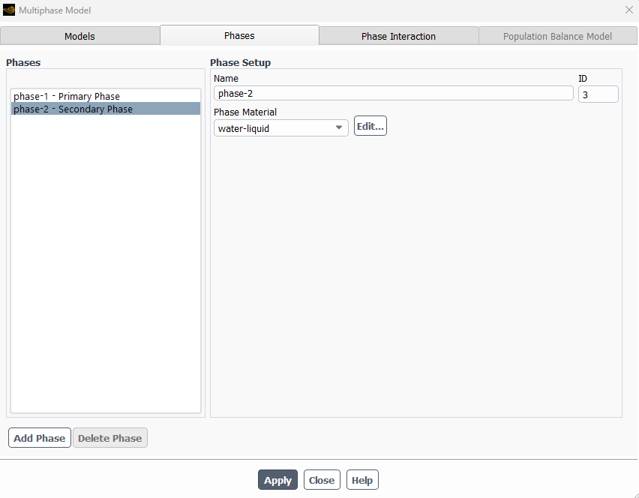
Solver Setting
K-omega SST Model is used for Turbulent Regime
Physics Models: Turbulence & Multiphase Model
Notes:
For the physics models, we used the Volume of Fluid model to capture the liquid–gas interface.
Two Eulerian phases were defined: water as the 2ndary phase and the surrogate gas as the primary phase.
For turbulence modelling, the SST k–omega model was selected to accurately resolve near-wall effects and transient flow behaviour during sloshing.
The implicit scheme is more stable for larger time steps, but the explicit formulation offers better interface resolution when the time step is sufficiently small, which was the case in our simulation. The explicit scheme improves numerical stability for interface capturing and allows better control of the Courant number, which is important in transient multiphase simulations.

Slide 13
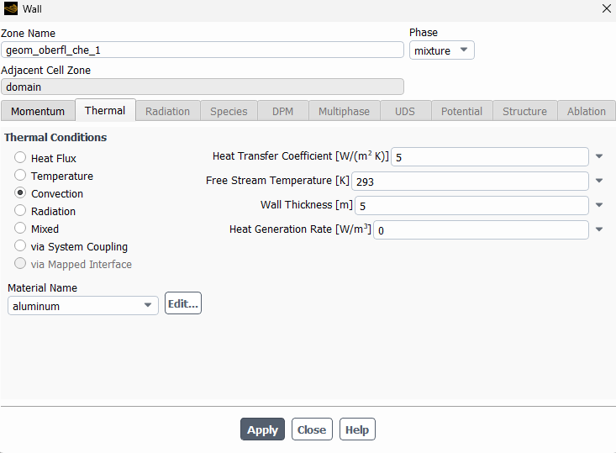
Solver Setting
Boundary Conditions
For all the tank walls, convection boundary condition was applied to model external heat exchange with the environment.
Notes:
For the tank walls, a convection boundary condition was applied to model heat exchange with the surrounding environment.
A heat transfer coefficient of 5 W per square meter Kelvin and an ambient temperature of 293 Kelvin were specified. Convection better represents realistic heat exchange with the external environment compared to a fixed temperature or heat flux condition.

Slide 14
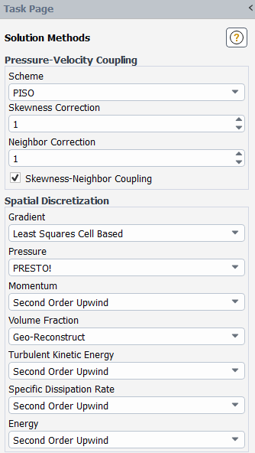
Solver Setting
Solution Methods
Numerical Strategy
PISO for transient pressure-velocity coupling
PRESTO for gravity-driven pressure field
Second-order schemes for improved accuracy
Geo-Reconstruct for sharp interface tracking
Under-Relaxation Factors
Pressure = 0.3
Momentum = 0.7
k, ω = 0.8
Energy = 1
Notes:
For the solution methods, the PISO scheme was selected for pressure–velocity coupling, as it improves accuracy in transient simulations with rapidly changing flow fields.
For spatial discretization, PRESTO was used for pressure to better handle gravity effects.
Momentum, turbulence, and energy equations were discretized using second-order upwind schemes to increase spatial accuracy.
The Geo-Reconstruct scheme was applied for volume fraction to ensure sharp interface capturing in the VOF model.
PISO performs multiple correction steps per time step, which improves transient solution stability and accuracy.
PRESTO improves pressure interpolation in flows influenced by gravity and free-surface motion.
Second-order schemes reduce numerical diffusion and improve solution accuracy compared to first-order schemes.
Conservative relaxation was used to ensure stable convergence under transient multiphase conditions. Because our simulation is transient, under-relaxation factors are less dominant than in steady simulations. In transient simulations:
Stability is mainly controlled by time step size
Under-relaxation still helps numerical stability, but is secondary

Slide 15
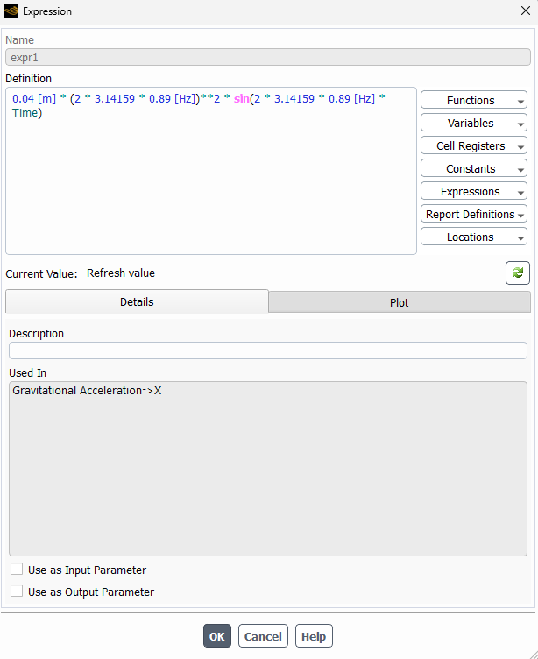

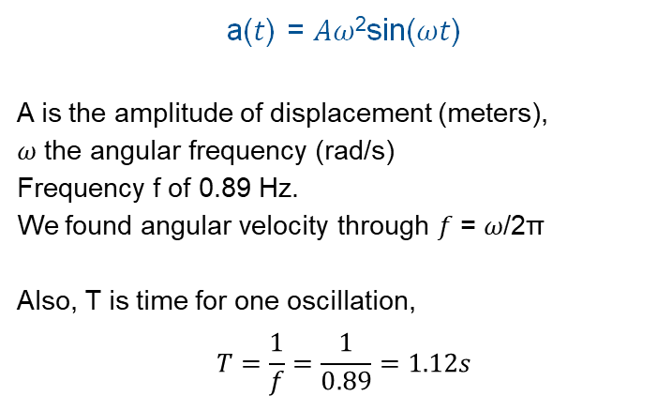
Solver Setting
Harmonic Motion (Sinusoidal Acceleration)
a(𝑡) = 𝐴𝜔²sin(𝜔𝑡)
A is the amplitude of displacement (meters),
𝜔 the angular frequency (rad/s)
Frequency f of 0.89 Hz.
We found angular velocity through 𝑓 = 𝜔/2π
Also, T is time for one oscillation,
$$T=\frac{1}{f}=\frac{1}{0.89}=1.12s$$
No reference frame or mesh motion was activated

Slide 16

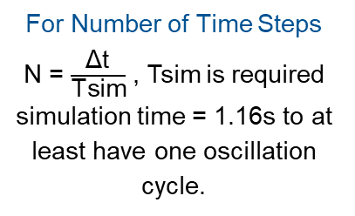
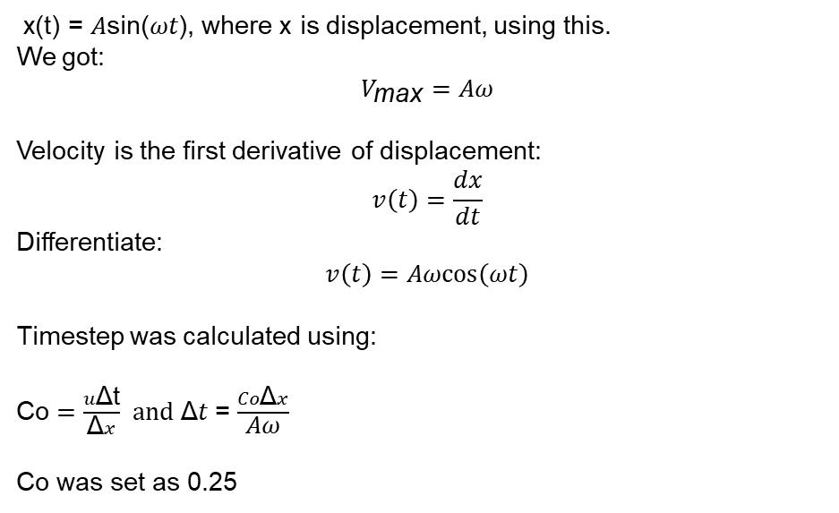
Solver Setting
Timesteps calculation to get desired simulation time
x(t) = 𝐴sin(𝜔𝑡), where x is displacement, using this.
We got:
$$V_{\text{max}}=Aω$$
Velocity is the first derivative of displacement:
$$v\left(t\right)=\frac{dx}{dt}$$
Differentiate:
$$v\left(t\right)=Aωcos⁡\left(ωt\right)$$
Timestep was calculated using:
Co $=\frac{u\text{Δ}\text{t}}{\text{Δ}x}$ $and \text{Δ}t$= $\frac{Co\text{Δ}x}{\text{A}\text{ω}}$
Co was set as 0.25
For Number of Time Steps
N = $\frac{\text{Δ}\text{t}}{\text{Tsim}}$​​​ , Tsim is required simulation time = 1.16s to at least have one oscillation cycle.
Element Size (m) | Timestep Size | Number of Timesteps | Number of Iterations
0.005 m | 0.005 | ~230 | ~400

Slide 17
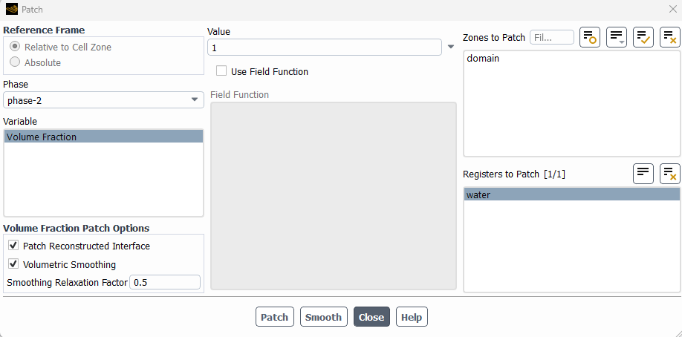
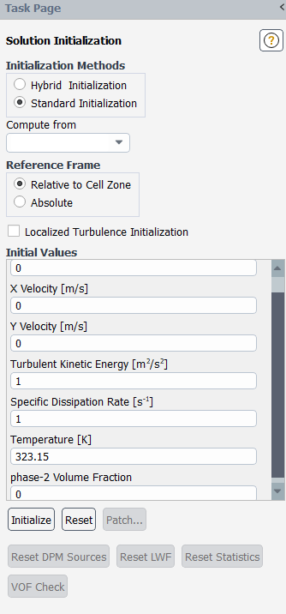
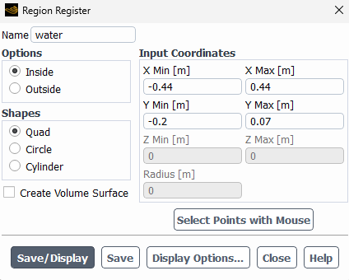
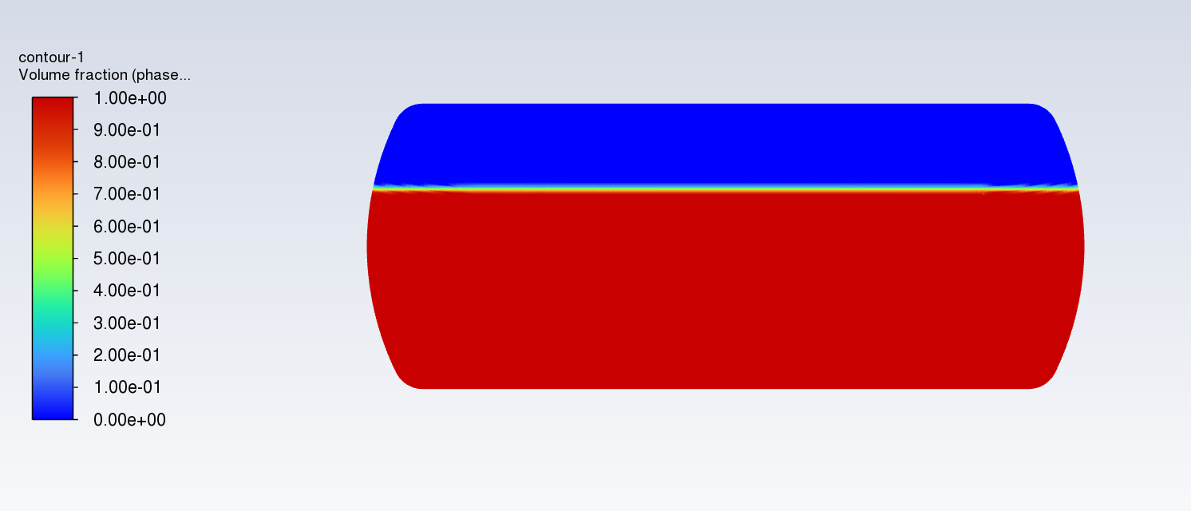
Solver Setting
Standard initialization - Water patched to 70% fill level - Sharp initial interface defined
Initialization and Patching

Slide 18
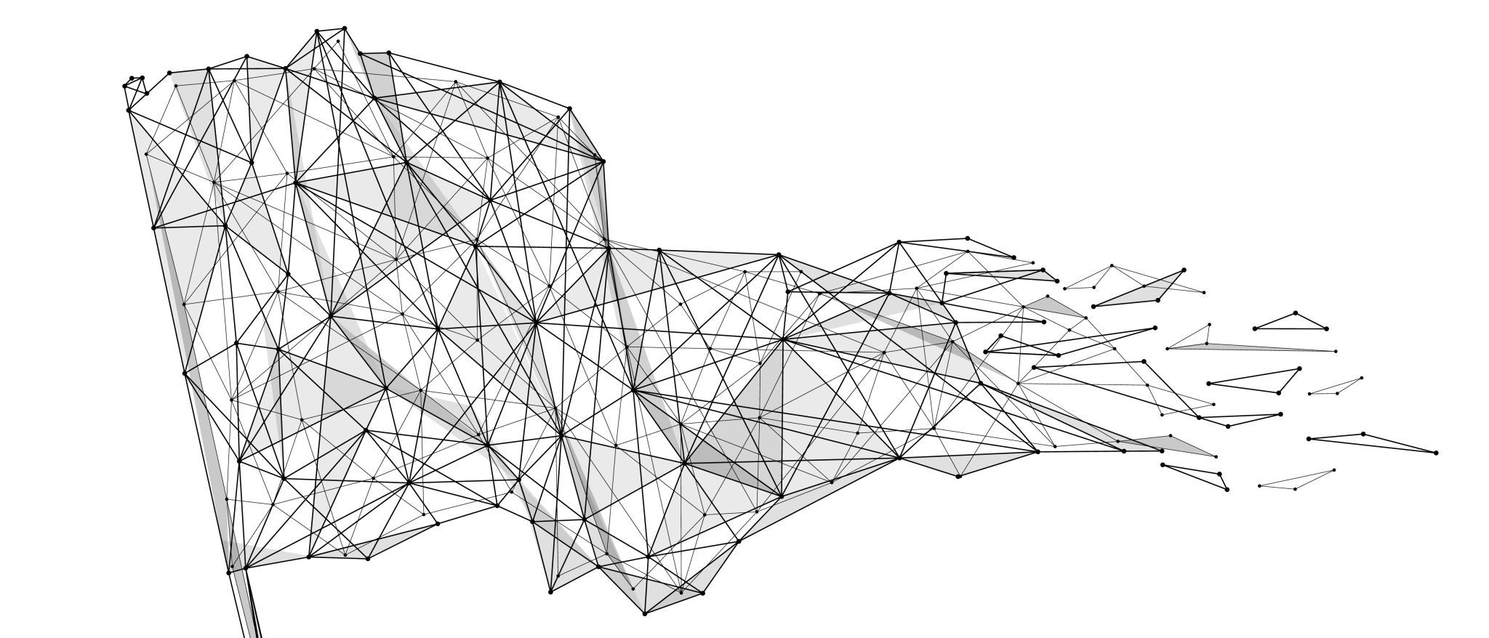
Post Processing

Slide 19
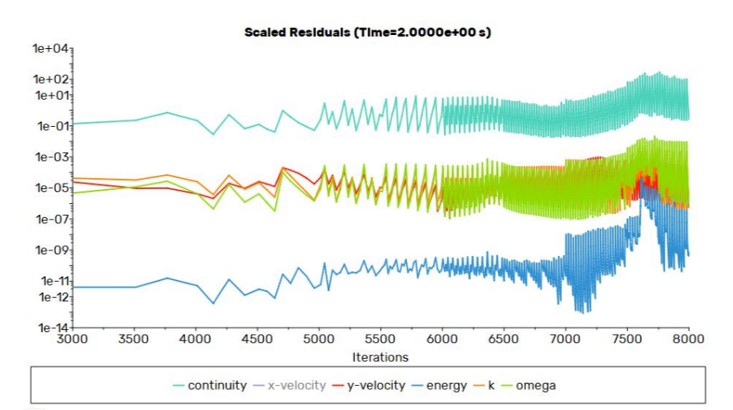
Numerical Convergence Analysis A
Tight Iterations
20 step workout
Solver refines the math before moving on.
Sawtooth Drop
Residual Nose-Dive
Error levels drop up to 3+ orders of magnitude every 0.005s.
Energy < 10⁻⁶
Deep convergence in the Energy equation. Heat transfer results aren't just guesses. They’re reliable.
Thermal Confidence
Residuals of Surrogate Gas 1

Slide 20
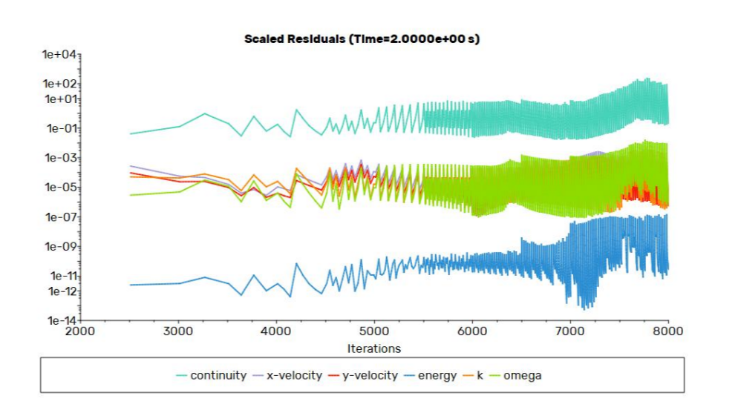
Numerical Convergence Analysis B
Tighter Iterations
20 step workout
Higher gas density. Solver refines the math before moving on.
Sawtooth Drop
Residual Nose-Dive
Error levels drop up to 3+ orders of magnitude every 0.005s.
Energy < 10⁻⁶
Deep convergence in the Energy equation. Heat transfer results aren't just guesses. They’re reliable.
Thermal Confidence
Residuals of Surrogate Gas 2

Slide 21
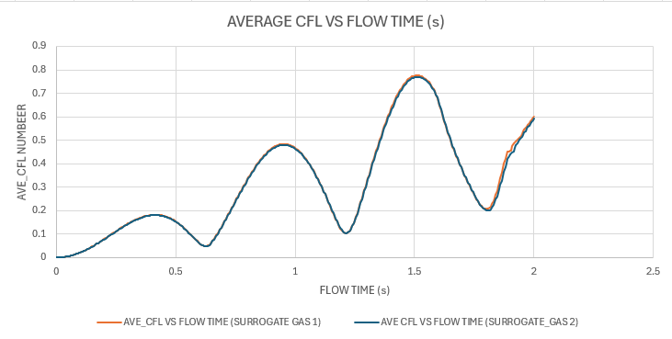
Temporal Stability & CFL Analysis
Stability Threshold
The 2s Milestone
Margin of Safety
At the 2s cycle mark, AVE_CFL is only 0.6. Comfortable buffer against numerical instability.
Temporal Precision
0.005s Step Size
Resolving high-velocity sloshing without excessive cost.
CFL < 1.0 Limit
This acts as a speed limit to prevent the liquid interface from diverging.

Slide 22
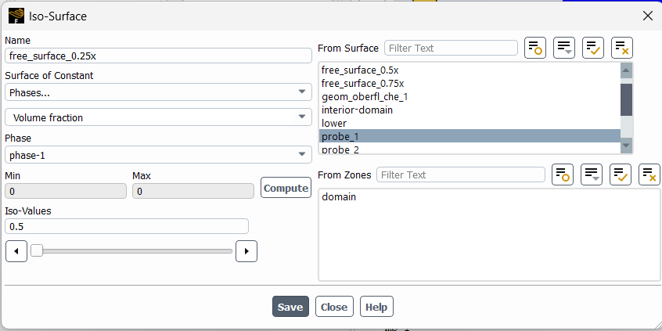
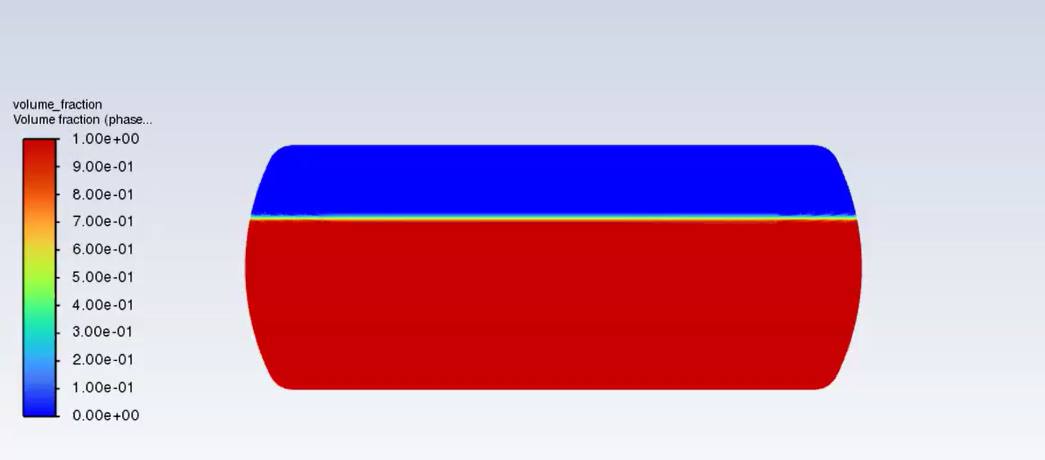
Quantitative Time Evolution Analysis (Surface Tracking)
Iso-surface for vol_fraction = 0.5 (to track interface)
Line1 at
0.75x
Line1 at
0.5x
Line1 at
0.25x

Slide 23
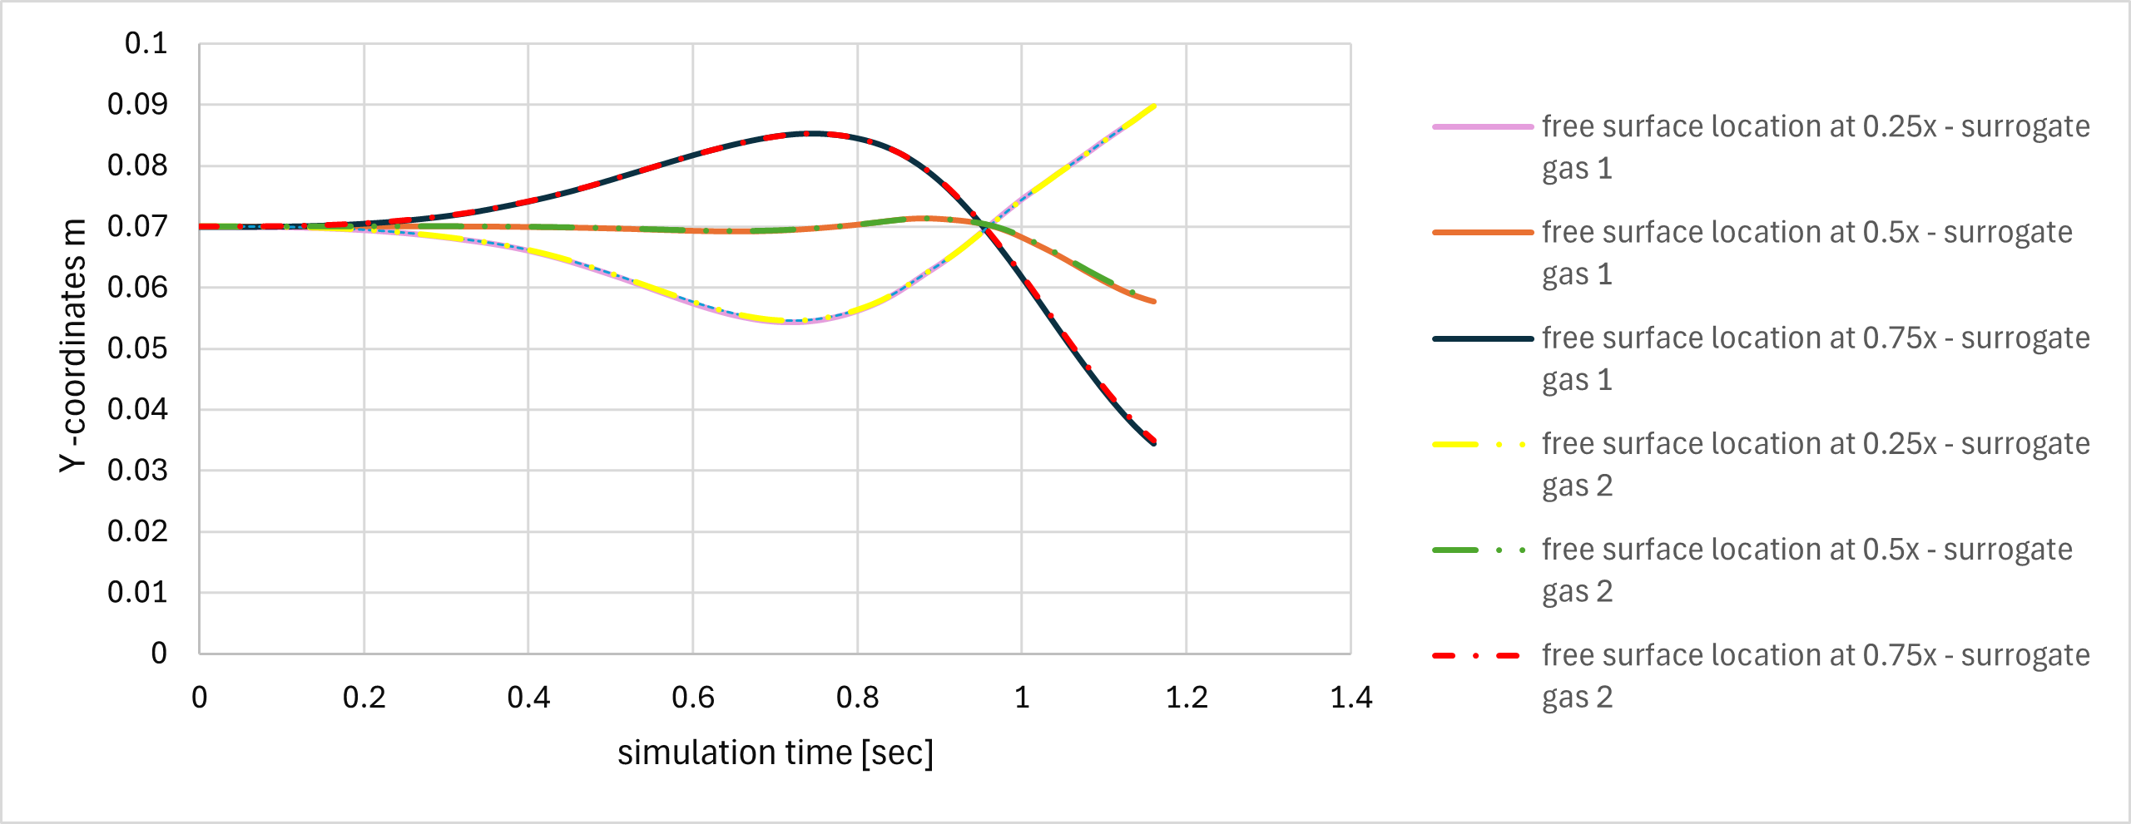
Quantitative Time Evolution Analysis (Surface Tracking)
In one cycle (1.16s), the two surrogate gases 1 and 2 showed almost similar wave behavior in sloshing, the free surface at the three locations is almost identical over simulation time

Slide 24
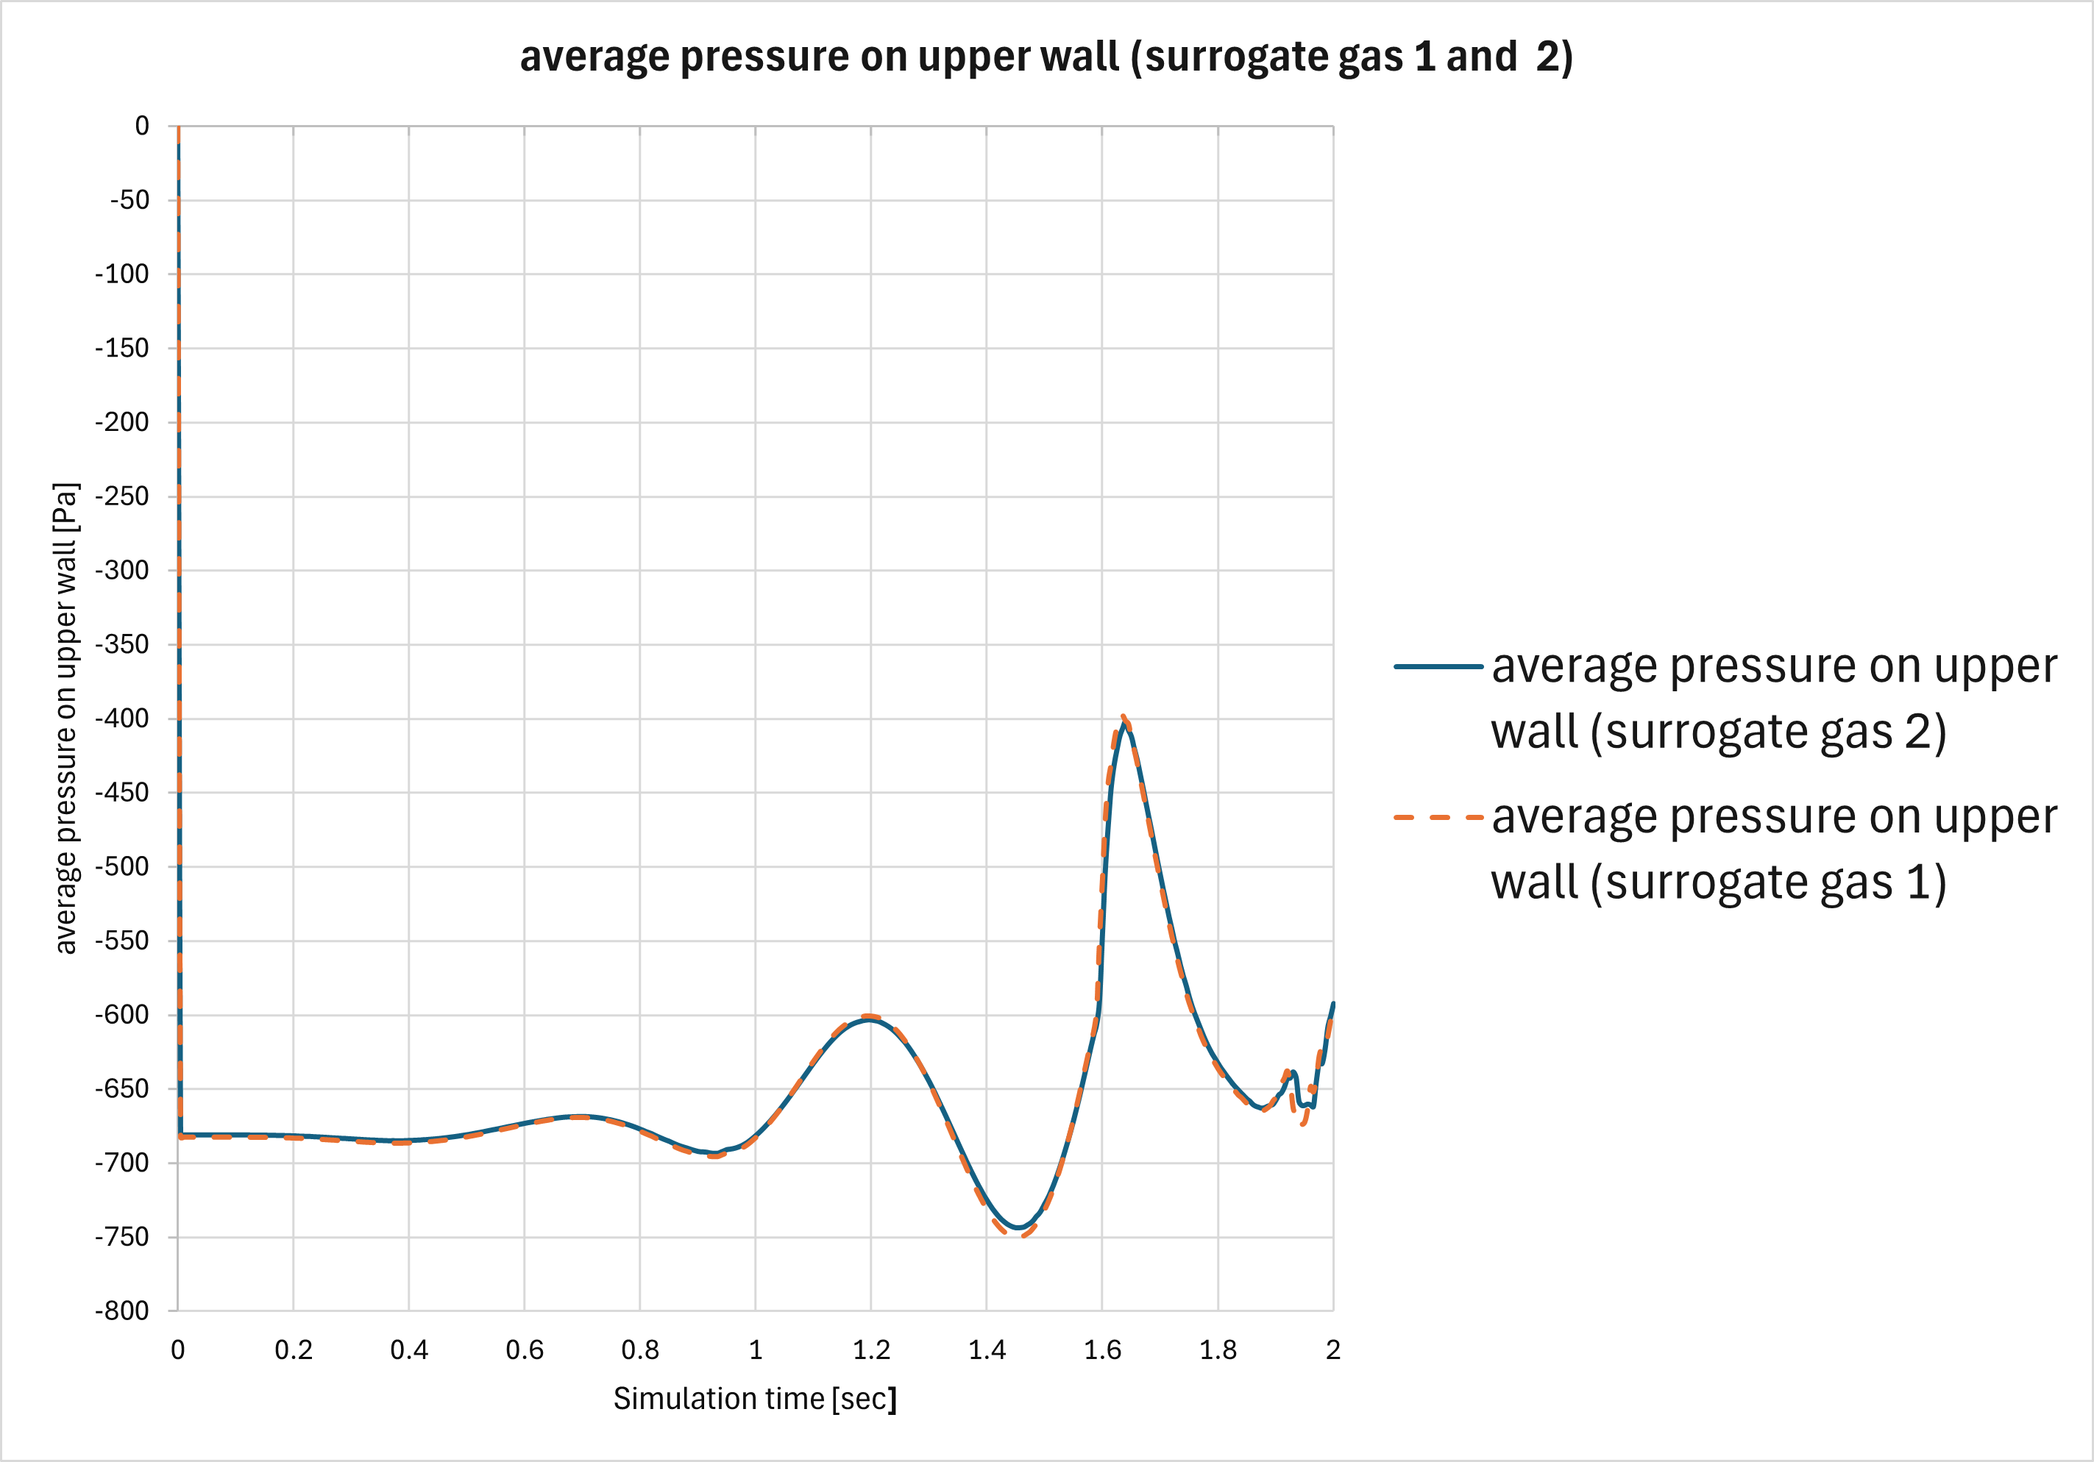
Quantitative Time Evolution Analysis (Pressure)
Average pressure on the upper wall showed almost identical behaviour for the two gases
The high spike is due to impact of the liquid on the upper wall in late simulation time

Slide 25
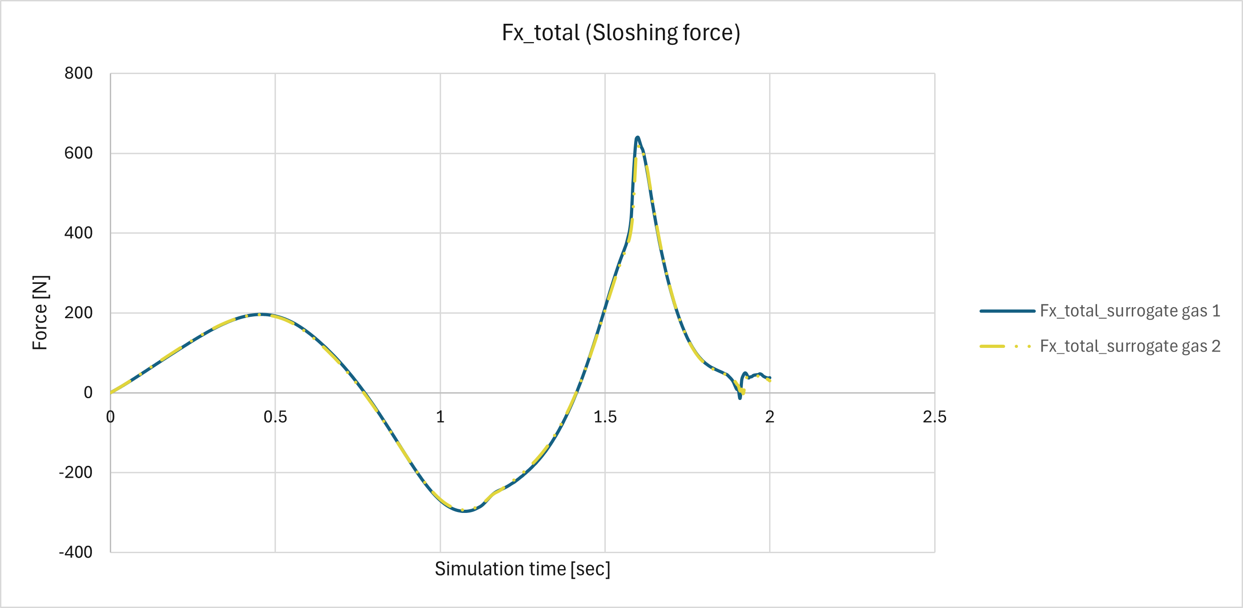
Quantitative Time Evolution Analysis (Force)

Slide 26
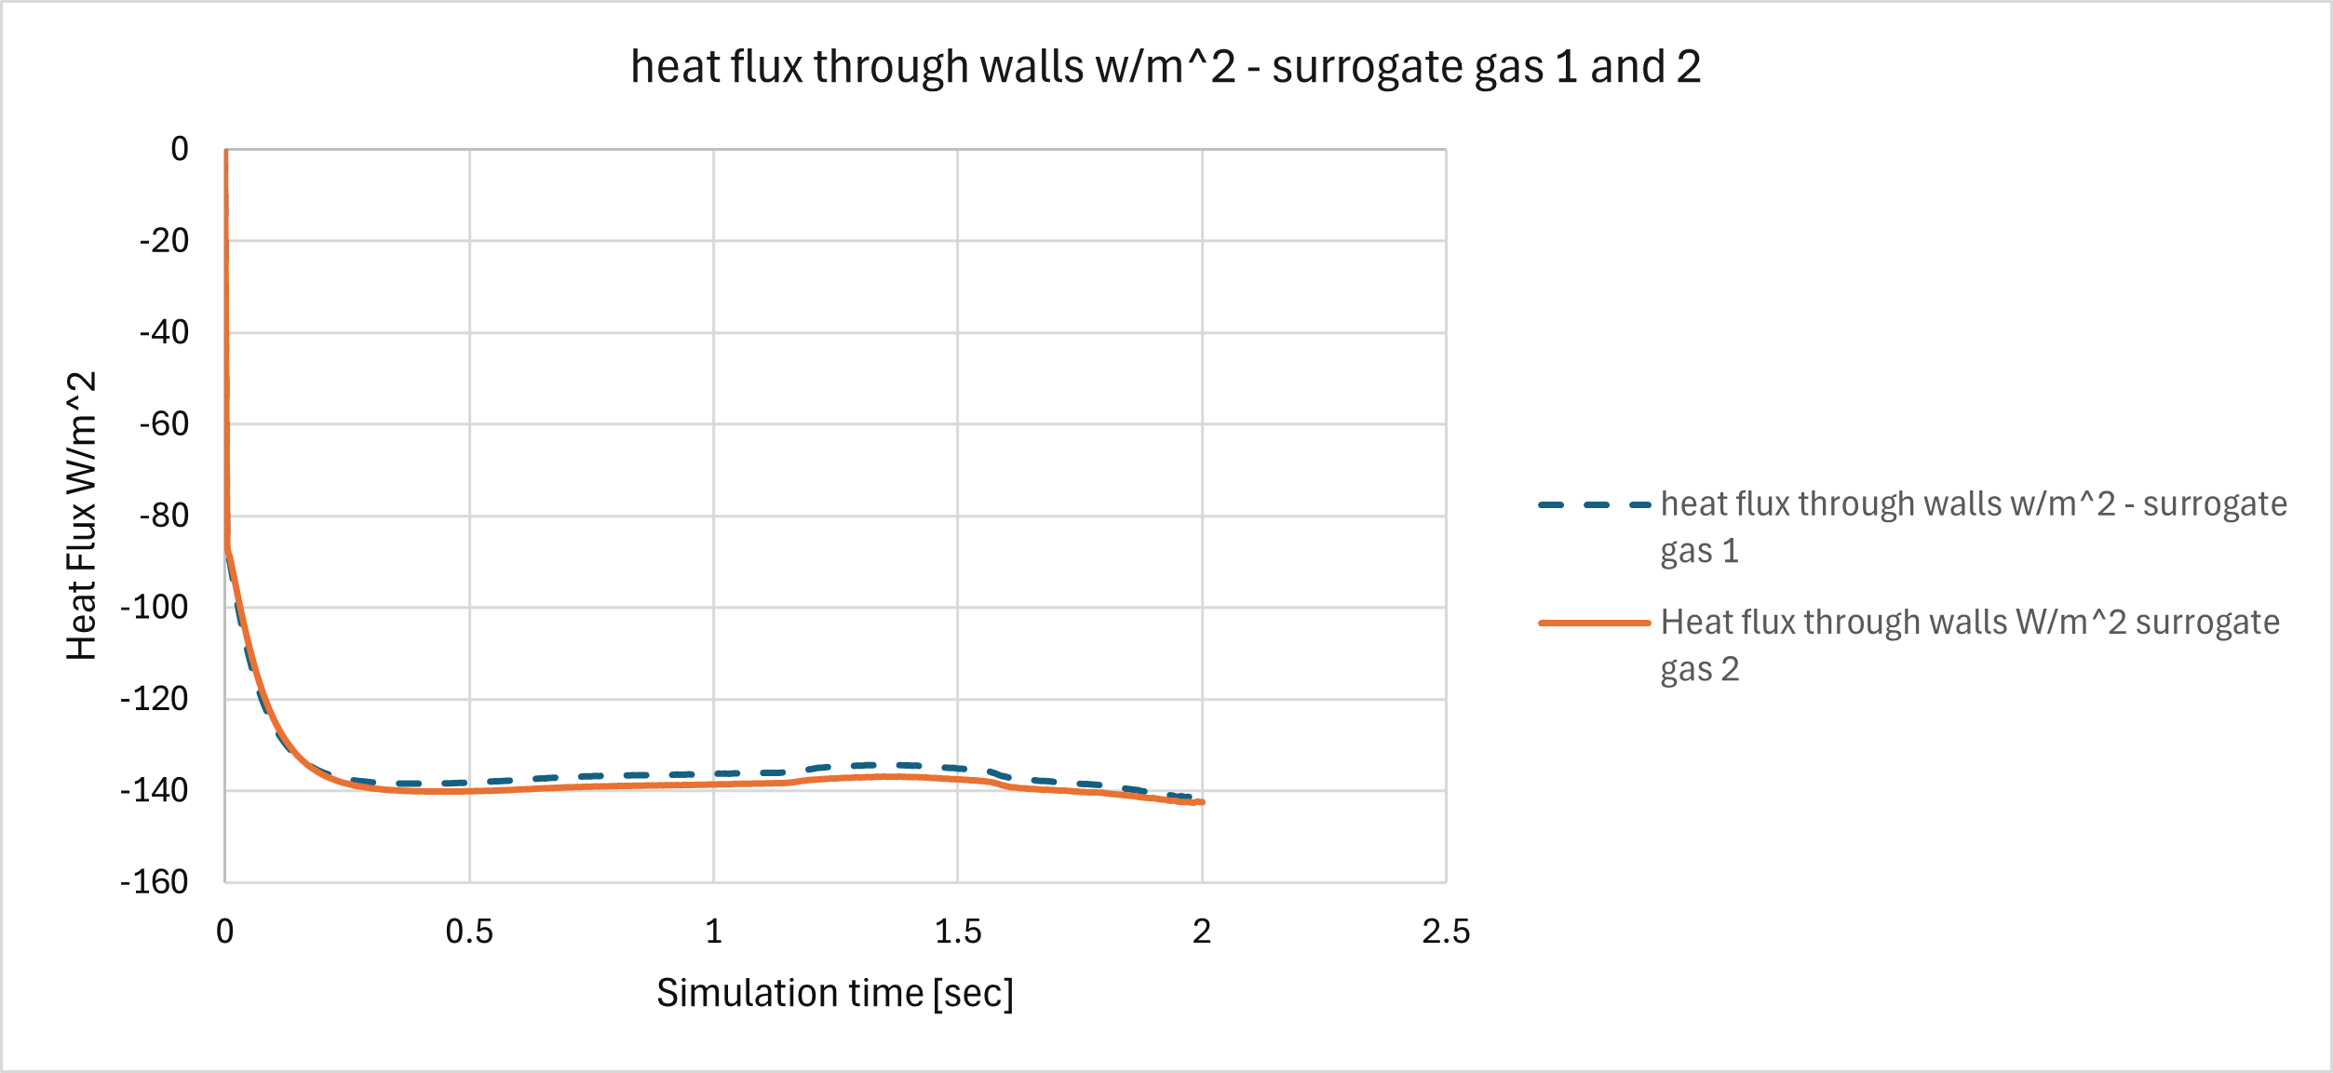
Quantitative Time Evolution Analysis (Heat Flux)
Heat flux through all tank walls (with natural convection BC's and thin wall model for 2D tank)

Slide 27
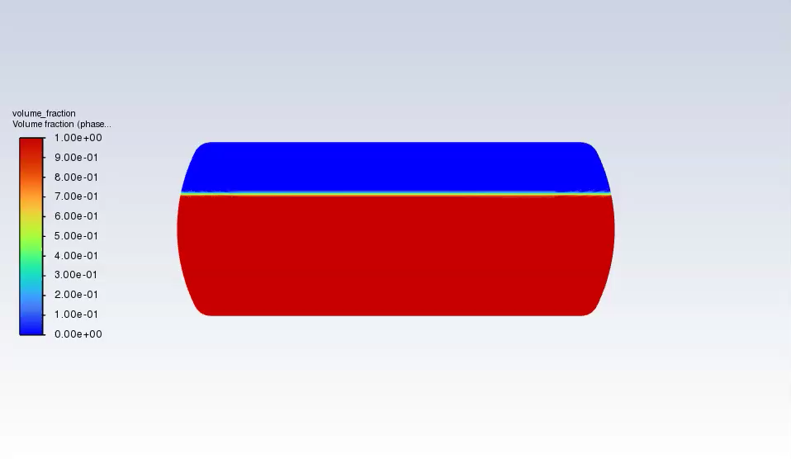
Volume Fraction Contours Show Wave Formation
Notes:
Initial idea was to do the simulation for 1.16 seconds but an extension to 2 seconds permits to see the breakage of the wave by the impact on the walls
What we want to see:
Free surface deformation, liquid impact on walls and ceiling. (helps calculate maximum wave height, sloshing severity or on more complicated cases the risk of hitting structural components.
Also help us evaluate compressibility effects (gas compressibility dampens sloshing)
Interface movement affects pressure oscillations
Do we have jet formation? Wave overturning? Assymetric filling patterns?
PLAY

Slide 28
With little to no change in the qualitative behavior w.r.t surrogate gas 2
Notes:
Surrogate gas 2 doubles surrogate gas 1 in density, but have the same viscosity and comparable CP and thermal conductivity

Slide 29
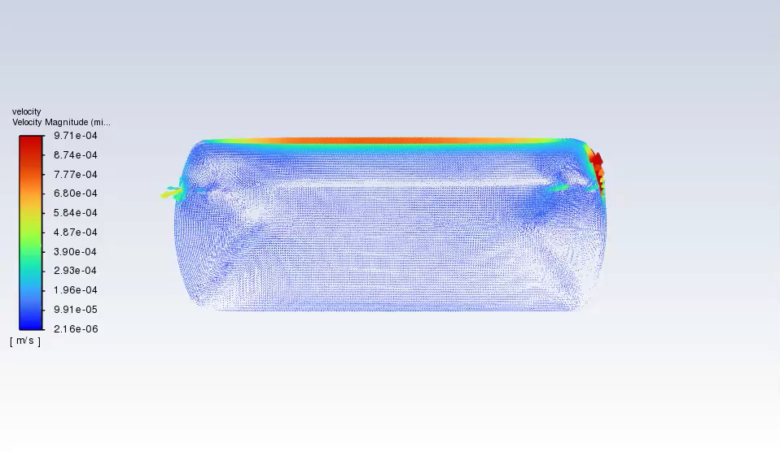
What can we tell from the dynamic behavior?
Velocity vectors show a transient increase in magnitude upon contact with the wall.
Heavier and thicker phases resist more to changing velocities than lighter ones.
Notes:
What we want to see
1. Circulation patterns inside the liquid
2. Wave propagation and direction
3. Vortices and recirculation zones
Do we have gentle slosh?, wave amplification?
PLAY
We can see strong momentum transfer (high velocities near walls), and high shear stress zones
Time of study doesn’t allow to see damping or energy dissipation due to viscosity or turbulence (important for cryogenic storage)

Slide 30
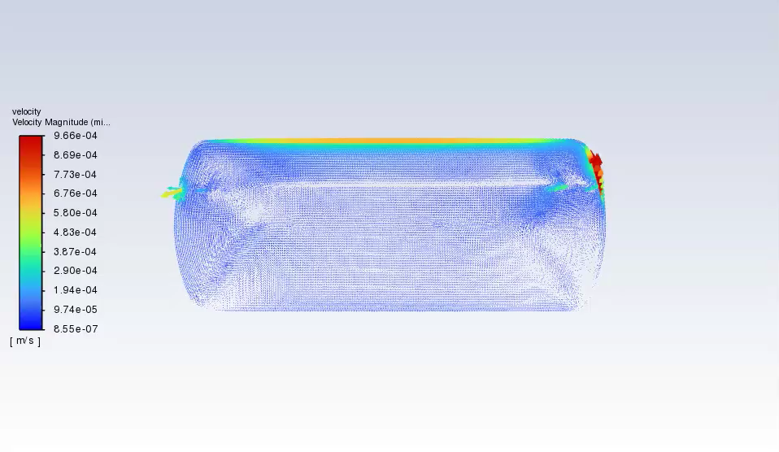
Notes:
Surrogate gas 1 movess lightly faster upon oscillation

Slide 31
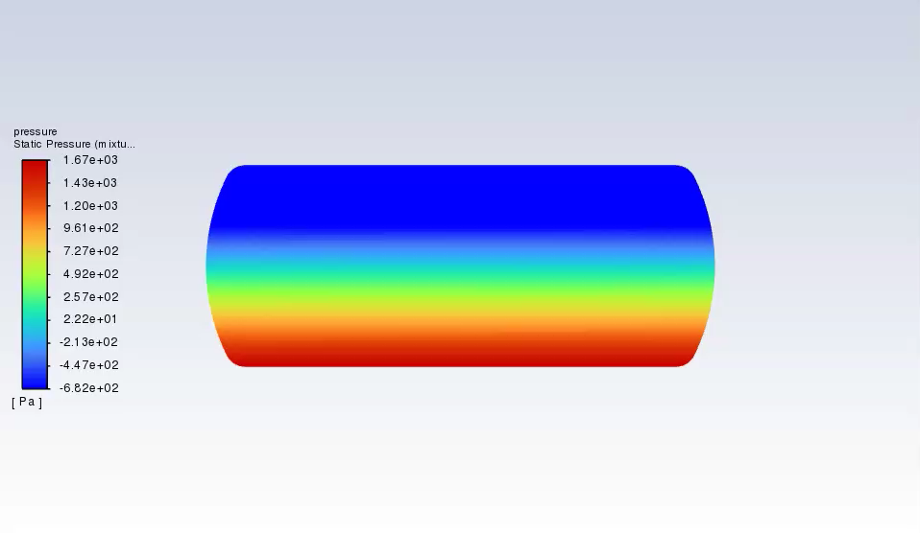
Pressure Amplifies Near Tank Walls
Useful to assess structural stresses, resonance behavior, and damping effect of the gas phase!
Notes:
Static pressure represents the exact thermodynamic pressure on the substance.
Pressure within the system can be less than the atmospheric one leading to negative static pressure values
Goals:
Identify pressure peaks (local stress hotspots) -> structural safety and fatigue
Understand liquid-gas interaction (Dynamic variations due to motion) -> how hydrogen cushion influences pressure oscillations
Reveal wave motion!
For the future: Evaliate structural and design implications
PLAY
The contours reveal pressure amplification near the tank walls during oscillatory motion, reflecting the interaction between the liquid phase inertia and the compressible gas cushion. Essential for evaluating structural stresses, identifying resonance behavior, and understanding the damping effect of the gas phase

Slide 32
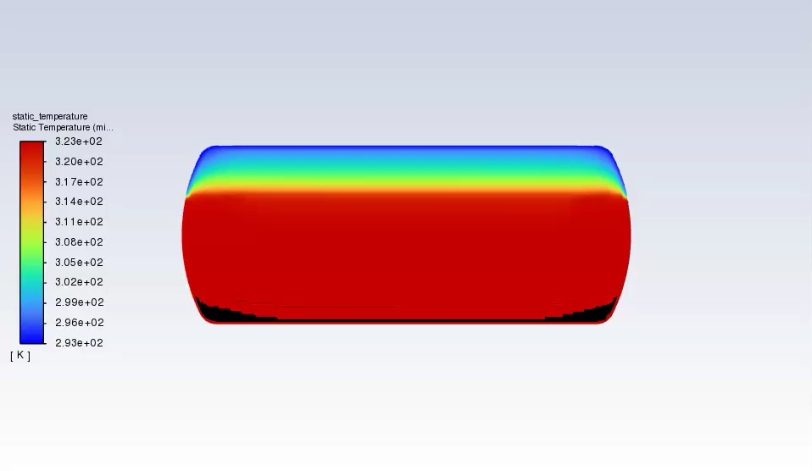
Temperature contours shows achievement of thermodynamic equilibrium inside the tank in the very first moments of total runtime
Notes:
Usually temperature could help us capture:
Thermal stratification(if any)
Heat transfer between phases.

Slide 33
Principal remarks
Together, post-processing analysis provides the multiphase thermo-fluid physics
Velocity describes fluid motion and momentum transfer
Volume fraction describes interface dynamics and sloshing severity
Temperature gives insight into thermal mixing and outside heat transfer
Pressure shows the fluid load distribution and transmission
Applications of the study and possible complementary studies:
Structural safety: Velocity and volume fraction could predict impact intensity on walls; pressure correlation: fatigue of the tank
Sloshing stability and wave resonance
Thermal mixing and stratification

Slide 34
Mesh Independence Study

Slide 35
What is Mesh Independence?
CFD solutions depend on mesh resolution
Coarse mesh : faster but less accurate
Fine mesh : more accurate but expensive
Need to find a compromise
Mesh independence ensures accuracy, numerical stability, and reliable results

Slide 36
Why Mesh Independence Study?
⚙️
Grid Resolution Impact
Objective:
CFD solutions depend on mesh fineness
Verify grid-converged solution
Convergence achieved when:
• Error < 2% between meshes
• Results stable with refinement
• Quality metrics satisfied
📊
Discretization Error
Spatial discretization introduces numerical errors
✓
Solution Verification
Ensures results are mesh-independent
🎯
Optimal Balance
Find accuracy vs. computational cost trade-off

Slide 37
Methodology
Convergence Parameter
Convergence Criterion
Monitored Variable:
Average Upper Wall Pressure
Reason for Selection:
• Direct indicator of sloshing impact
• Critical for structural analysis
• Sensitive to mesh resolution
Error < 2%
Relative error between consecutive
mesh refinements
Analysis Process
1. Create Meshes
→
2. Run Simulations
→
3. Extract Pressure
→
4. Calculate Error

Slide 38
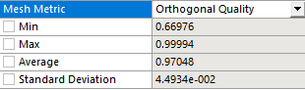
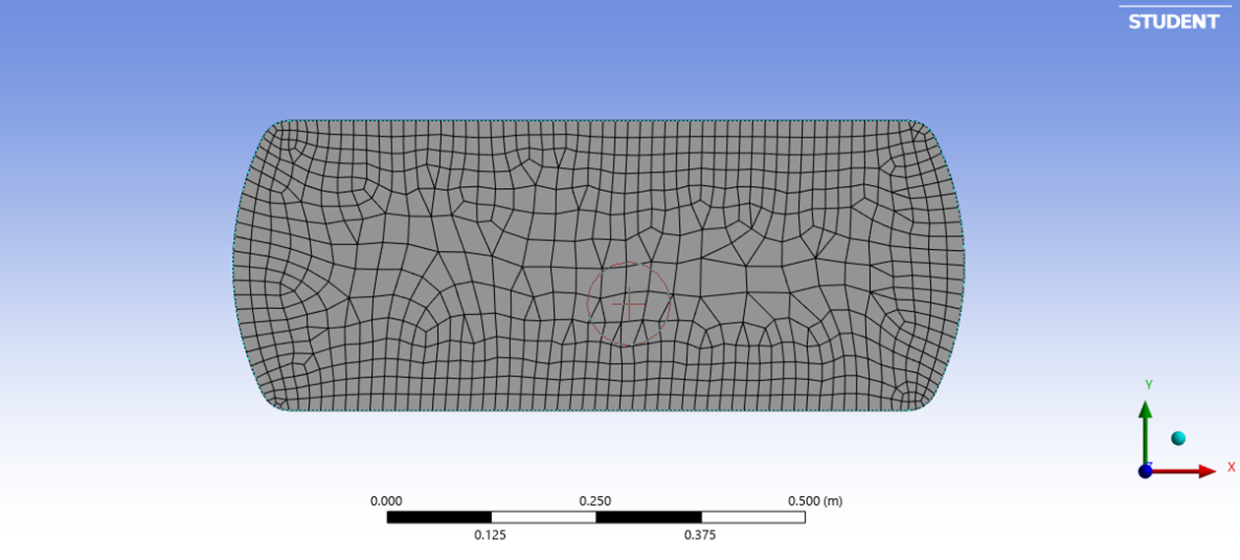
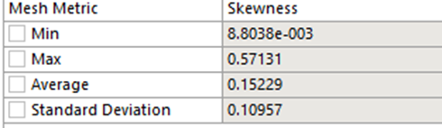
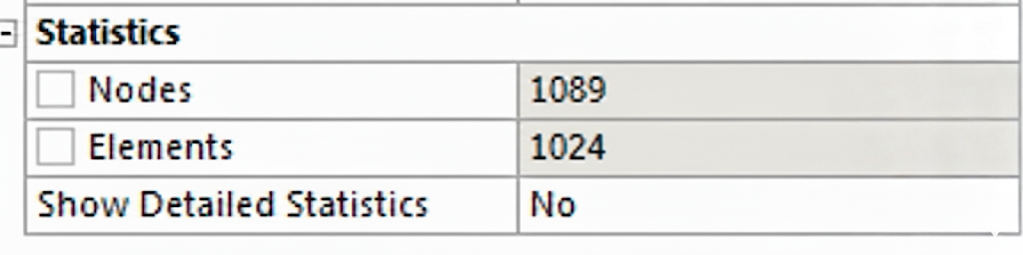
Highly Coarse Mesh

Slide 39
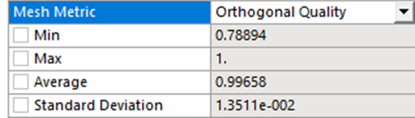
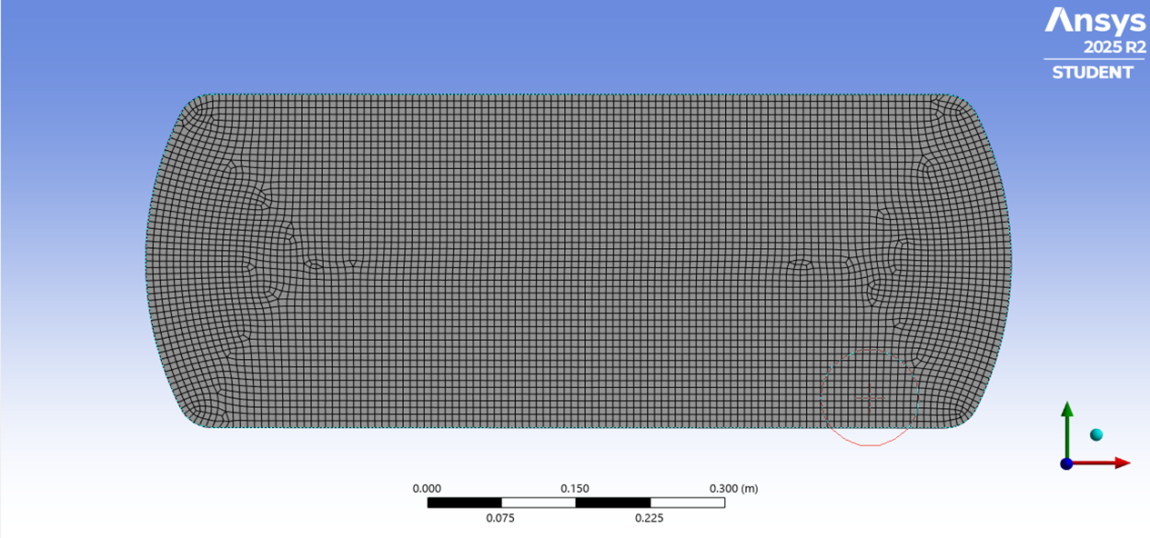
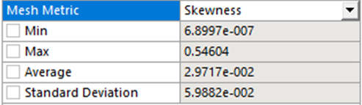
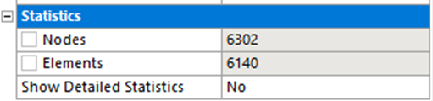
Coarse Mesh

Slide 40
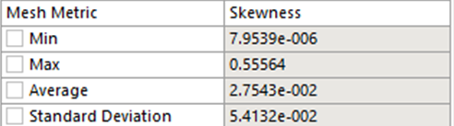
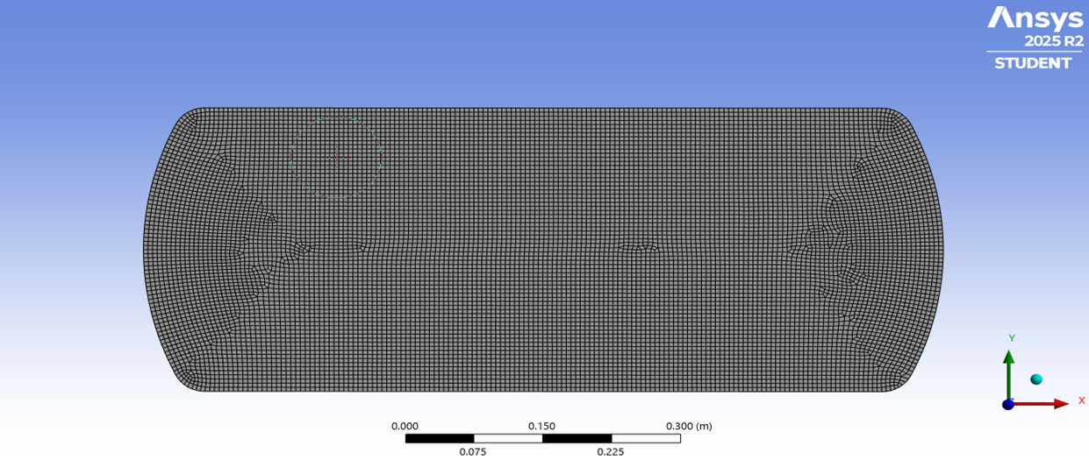
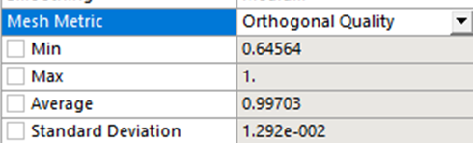
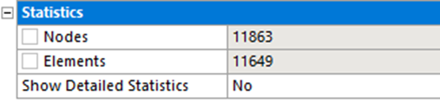
Medium Mesh

Slide 41
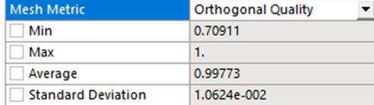



Fine Mesh

Slide 42
Grid Convergence
Timestep | Element size | No. of cells | Pressure (Pa) | Error
0.05 | 0.05 | 1000 | -520 | %
0.007 | 0.007 | 6000 | -566 | 0.088462 | 8.846154
0.005 | 0.005 | 11000 | -595 | 0.051237 | 5.123675
0.0035 | 0.0035 | 24000 | -606 | 0.018487 | 1.848739

Slide 43




Pressure Plots
Highly Coarse
Coarse
Medium
Fine

Slide 44
Mesh Quality
Mesh Type
Number of Cells
Element Size (m)
Min Orthogonality
Max Skewness
Highly Coarse
1,024
0.0098
0.66976
0.57131
Coarse
6,140
0.0070
0.78894
0.54604
Medium
11,649
0.0050
0.64564
0.55564
Fine
24,042
0.0035
0.70911
0.55251
✓ Quality Criteria Met: Orthogonality > 0.15, Skewness < 0.95.

Slide 45
Grid Convergence
Average Upper Wall Pressure vs. Mesh Density
-520 Pa
Pressure (Pa)
-566 Pa
Convergence
Zone
-595 Pa
-606 Pa
1024
6140
11649
24042
Number of Cells

Slide 46
Mesh Quality Comparison
All meshes meet quality criteria for accurate CFD analysis. Quality improves with refinement, ensuring reliable results.
Metric
Target
Coarse
Medium
Fine
Orthogonal Quality
> 0.15
0.970
0.997
0.998
Skewness
< 0.95
0.153
0.028
0.021
Aspect Ratio
< 100
< 25
< 20
< 18
Mesh Representations
Coarse
6,140 cells
Medium
11,649 cells
Fine
24,042 cells

Slide 47
Mesh Independence Summary
Relative error of 1.8% between Medium and Fine meshes (< 2% criterion)
All quality metrics satisfied: Orthogonality > 0.15, Skewness < 0.95
Medium mesh provides accuracy with reasonable computational cost
Medium mesh (11,649 cells) selected as optimal configuration
Further refinement showed < 2% change, confirming mesh independence
Thank you for your attention!

