Slide 1

Claude Code
for Software Developers
Introduction to Advanced · WAMY NGO SaaS ERP Finance Module
Spring Boot · React 19 · MySQL · GitHub Actions · Robi Cloud
80
Slides
9
Sections
40+
Real Prompts
100%
Hands-on
🎯 After this session you will be able to:
Use Claude Code from first install to production deployment
Build the WAMY Finance module end-to-end with AI assistance
Apply AI to architecture, security, DB optimisation, and testing
V1.0

Slide 2


Session Roadmap — 80 Slides in 9 Sections
Full SDLC Coverage · WAMY NGO Finance Module throughout
What is Claude Code?
Overview · Chat vs Agent · Install · Auth
Slides 3–8
Setup & First Steps
CLI · VS Code · /init · CLAUDE.md · Workflow
Slides 9–15
01
02
Project Planning
BRD · FRS · User Stories · Sprint Plan · Roadmap
Slides 16–22
System Architecture
C4 · ERD · Layers · Domain Design · Spring Boot
Slides 23–30
03
04
Development — Backend
Spring Boot · REST API · Services · JPA · Tests
Slides 31–40
Development — Frontend
React 19 · Components · API Hooks · Reports UI
Slides 41–48
05
06
Security & Code Review
OWASP · IDOR · CSRF · Spring Security · Audit
Slides 49–56
DB Optimisation
EXPLAIN · Indexes · Partitions · Caching · Scaling
Slides 57–64
07
08
CI/CD & Deployment
GitHub Actions · Tests · Build · Robi Cloud Deploy
Slides 65–74
Live Project — WAMY
End-to-end demo · Prompts · Action Plan · Next Steps
Slides 75–80
09
10
💡 Every section uses the WAMY NGO Finance Module as the live project example.

Slide 3
What is Claude Code?
SECTION 01
AI-powered agentic coding assistant · not just a chatbot
Overview & Capabilities
Chat vs Claude Code
Why Developers Use It
Key Differentiators

Slide 4


What is Claude Code?
Agentic AI coding assistant that lives in your terminal and IDE
🤖
AI Agent, Not a Chatbot
💻
Terminal + IDE Native
Reads your entire codebase, edits files, runs commands, executes tests — autonomously
Lives in your terminal; VS Code extension gives inline diffs and side-panel chat
🔁
Full Development Loop
🧠
Context-Aware
Plan → Generate → Edit → Test → Commit — Claude handles all phases
Reads CLAUDE.md to understand your project, team standards, and architecture
🔗
Tool Integration
🚀
Agentic Tasks
Runs bash, npm, mvn, git — uses real tools in your actual project
Multi-step tasks: 'add a new financial report endpoint with tests' — done end to end
💡 Think of Claude Code as a senior developer who knows your entire codebase and works 24/7.

Slide 5


Claude Chat vs Claude Code
Understanding the difference — when to use which
Claude Chat (claude.ai)
Claude Code (CLI + IDE)
Web browser interface only
Terminal + VS Code integrated
Question → Answer model
Autonomous agent model
No access to your codebase
Reads your entire project tree
Cannot edit files or run commands
Edits files, runs tests, commits code
Great for: explaining concepts, writing docs, brainstorming
Great for: building features, debugging, refactoring
Stateless between conversations
Maintains project context via CLAUDE.md
💡 WAMY Project: use Claude Code for all development tasks. Use Claude Chat for quick concept questions when not at your computer.

Slide 6
Claude Code Key Capabilities
What developers use Claude Code for every day
Generate boilerplate & CRUD Debug errors & exceptions
Write & run unit tests
Refactor legacy code Generate API endpoints Security code review Write documentation
^{D}💡^{ata}D^{b}evªe^{s}l^{e}op^{s}e^{c}r^{h}s^{e}u^{m}rveªy&(20^{m}2^{i}4^{g}):^{ra}te^{ti}aºm^{n}s^{s}using Claude Code ship 3–10× faster on repetitive tasks vs teams without AI assistance.

Slide 7
Why Claude Code for the WAMY Finance Module
🏢WAMY NGO
Real benefits for a real Spring Boot + React + MySQL project
🏗️
Architecture Design
📊
10 Financial Reports
Generate full ERD, Spring Boot package structure, REST API contracts from the finance requirement doc
Generate all report queries (P&L, Balance Sheet, Cash Flow...) with JPA repositories and service layers
🔐
Spring Security
🧪
Test Suite
Generate JWT auth, role-based access, method security annotations (@PreAuthorize) for finance roles
Generate JUnit 5 + Mockito tests for AccountingService, double-entry validation, report generation
⚡
DB Optimisation
🚀
CI/CD Pipeline
Analyse slow report queries, generate MySQL indexes for journal_lines, partitioning strategy
Generate GitHub Actions workflow: test → build → Docker → push → deploy to Robi Cloud
💡 WAMY estimate: Claude Code reduces the WAMY Finance module dev time from ~12 weeks to ~4 weeks for a 2-developer team.
7 / 80

Slide 8

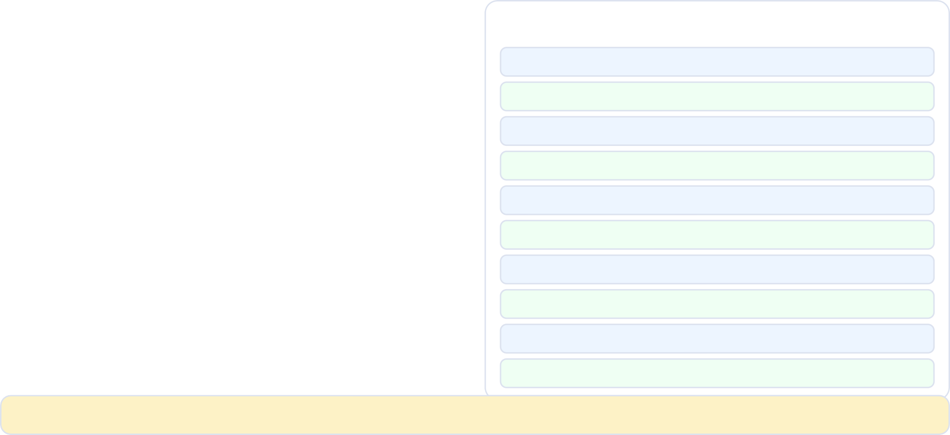
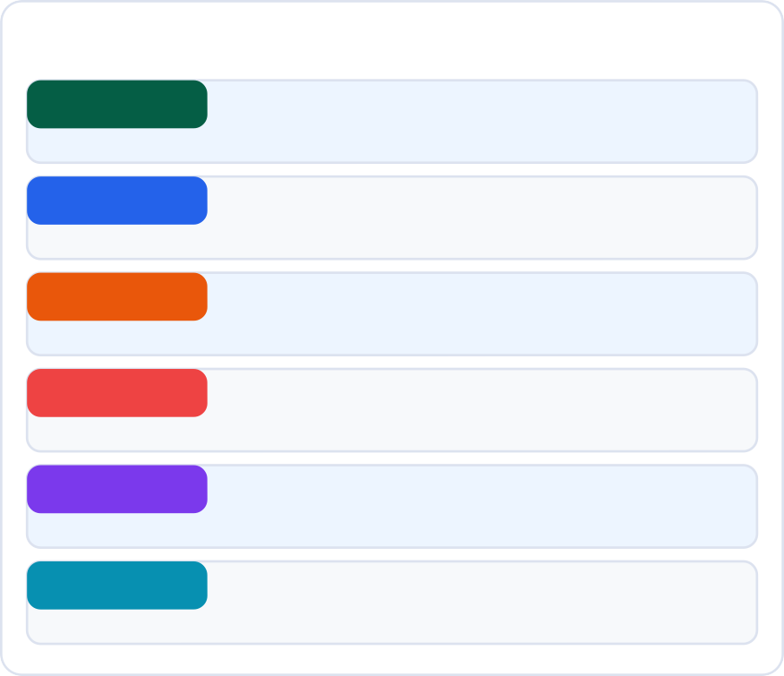
Project: WAMY NGO Finance Module
🏢WAMY NGO
Full requirement overview before we start building
🛠️ Tech Stack 📊 Key Financial Reports (10)
Backend
Spring Boot 3.2 + Java 21
1. Income Statement (P&L)
2. Balance Sheet
Frontend
React 19 + TypeScript + Vite
3. Cash Flow Statement
Database
4. A/R Aging Report
MySQL 8.0 — double-entry schema
5. A/P Aging Report
Auth
Spring Security + JWT (RS256)
6. Trial Balance
7. General Ledger
DevOps
Git + GitHub Actions CI/CD
8. Budget vs Actual
Hosting
9. Bank Reconciliation
Robi Cloud (containerised)
10. Comparative Multi-Project Report
💡 All 80 slides use this project. By slide 80 you will have a complete implementation plan and 40+ ready-to-use Claude Code prompts.

Slide 9
Setup & First Steps
SECTION 02
Install · Authenticate · Configure · Your first prompt
Installation (npm)
Authentication
IDE Integration
CLAUDE.md Setup

Slide 10


Claude Code — Installation & Authentication
3 steps to your first AI-assisted commit
Prerequisites
Install Claude Code
node --version java --version mvn --version
# Need Node.js 18+
# Need Java 21 for WAMY # Maven 3.9+
npm install -g @anthropic-ai/claude-code # Verify
claude --version
Authenticate
Launch on WAMY project
claude login
# Opens browser → Anthropic OAuth
# Or: export ANTHROPIC_API_KEY=sk-ant-...
cd wamy-finance claude
# Claude scans project and is ready
💡 For WAMY: create a wamy-finance/ root folder containing both the Spring Boot backend and React frontend before running claude.

Slide 11

CLAUDE.md — Your Project Context File
The most important file in your AI-assisted project
📄 CLAUDE.md tells Claude Code about your project — architecture, standards, team conventions, and constraints. Read at every session start.
⚡ WAMY Finance CLAUDE.md — Generated by: claude /init
# WAMY NGO — Finance Module
## Project
SaaS monolithic ERP | Finance module | Laravel → Spring Boot 3.2 + React 19
## Tech Stack
Backend: Spring Boot 3.2, Java 21, Maven, Spring Security (JWT RS256)
Frontend: React 19, TypeScript, Vite, TanStack Query, Recharts
Database: MySQL 8.0 — double-entry accounting schema
DevOps: GitHub Actions CI/CD → Robi Cloud (Docker)
## Architecture
REST API: /api/v1/** with versioning
Auth: JWT Bearer tokens, roles: ADMIN | FINANCE_MANAGER | ACCOUNTANT | AUDITOR
DB: journal_entries + journal_lines (double-entry), chart_of_accounts, projects
## Standards
Java: Google Java Style Guide, Lombok, MapStruct DTOs
React: ESLint Airbnb, Prettier, component-per-file
Tests: JUnit 5 + Mockito (backend), Vitest + Testing Library (frontend)
Every POST to journal_entries requires: debit_total == credit_total (enforced)
💡 Run 'claude /init' on your project once — Claude Code scans all files and generates this CLAUDE.md automatically.

Slide 12

IDE Integration — VS Code + Claude Code
Inline suggestions · Side panel · File context · Diff review
✏️
Inline Edit
💬
Side Panel
📁 File Context
Select code → Ctrl+K → describe change → Claude edits inline with diff
Ctrl+Shift+C → full conversation with code context always available
@filename in chat → adds file to context; /add to bulk-add folders
🔍
Diff Review
⚡
Quick Fix
🧪
Test Runner
Every change shown as diff — accept/reject line by line or all at once
Red squiggle → 'Fix with Claude' → Claude reads error + proposes fix
'Run tests with Claude' → Claude reads failures + proposes fixes automatically
💡 Tip: install both the 'Claude Code' VS Code extension AND use the terminal — the terminal is more powerful for multi-file tasks.

Slide 13

Prompt Patterns That Work
How to write prompts that get great results every time
BAD
Write me a Java class
Why: Too vague — Claude guesses your stack, pattern, and purpose
GOOD
Create a Spring Boot @Service class AccountingService.java in com.wamy.finance.service. Use constructor injection. Method: postJournalEntry(JournalEntryRequest dto) that validates debit==credit, saves to journal_entries via JPA, publishes a JournalEntryPostedEvent. Return JournalEntryResponse DTO.
Why: Specific: package, pattern, method signature, validation, return type
The 5 Elements of a Great Prompt:
1. File/Class name
2. Package/folder
3. Framework/pattern
4. Method signature
13 / 80

Slide 14
Claude Code Essential Commands
The 10 commands every developer must know
/init
Scan project and generate CLAUDE.md context file. Run once per project.
/add <file|folder>
Add file(s) to Claude's context window. Critical for multi-file tasks.
/clear
Clear conversation history. Start fresh while keeping CLAUDE.md.
/undo
Undo the last file change Claude made. Safe rollback.
/diff
Show all pending changes Claude has made but not yet saved.
/run <cmd>
Run a shell command. Claude sees the output and can react to errors.
/test
Run your test suite. Claude reads failures and proposes fixes.
/commit
Stage and commit all Claude changes with an AI-generated commit message.
/search <term> Search codebase for term. Claude uses results as context.
💡 Keyboard shortcut: ↑ arrow in Claude Code terminal recalls previous prompts — just like bash history.
/help List all available commands. Always up to date.
14 / 80

Slide 15

The Daily Developer Workflow
How Claude Code fits into your existing development process
1
2
3
4
5
6
7
🌅
📋
🤖
🔍
🧪
📦
🚀
Start Session
Describe Task
Claude Generates
Review Diff
Run Tests
Commit
Push & Deploy
*
*
*
*
*
*
cd wamy-finance && claude
Claude reads CLAUDE.md automatically
Type in plain English: 'Add GET
/api/v1/reports/pl endpoint'
Claude reads context, generates
Controller + Service + Repository + Tests
/test — Claude reads failures
and auto-fixes until tests pass
/commit — AI generates conventional commit message
git push → GitHub Actions automatically deploys to Robi Cloud
Review every changed file Accept / reject / modify
💡 The key insight: Claude Code fits INTO your existing git workflow — you still review, test, and commit. AI accelerates every step.

Slide 16
Project Planning with AI
SECTION 03
From requirement to sprint plan in minutes — not weeks
BRD Generation
FRS Documents
User Stories
Sprint Planning

Slide 17



Generate BRD — Business Requirements Document
🏢WAMY NGO
WAMY Finance: turn raw requirements into structured BRD
📝 BRD Generation Prompt
"I am building the WAMY NGO Finance module. Requirements: [paste requirement text]. Generate a complete BRD including: executive summary, business objectives, scope (in/out), stakeholder list, functional requirements (numbered), non-functional requirements, assumptions, and constraints."
📋 BRD Benefits
Stakeholder alignment document ready in 10 minutes
Numbered requirements → traceable through development
⚡ Generated BRD Structure
BRD — WAMY NGO Finance Module v1.0
═══════════════════════════════════
1. Executive Summary
NGO finance system for project-based budgeting...
In-scope / out-of-scope prevents scope creep
Non-functional requirements often missed manually
2. Business Objectives
BO-01: Enable real-time project financial tracking BO-02: Generate 10 standard financial reports
BO-03: Enforce double-entry accounting compliance
Can be exported to Word/PDF for client sign-off
Feed BRD back to Claude for FRS generation
3. Functional Requirements
FR-01: System shall support project-based CoA
FR-02: System shall validate debit == credit on entry FR-03: System shall generate P&L by project + period [... FR-04 through FR-28 generated ...]
⁴💡^{. N}Tºim^{n-}e^{F}s^{u}a^{n}v^{c}e^{t}d^{i}: ºa^{n}m^{al}an^{R}u^{e}al^{q}ly^{ui}w^{r}r^{e}itt^{m}e^{e}n^{nt}B^{s}RD for the WAMY Finance module takes 2–3 days. Claude Code generates a first draft in 4 minutes.
NFR-01: Report generation < 3 seconds (p95) NFR-02: 99.5% uptime on Robi Cloud
17 / 80

Slide 18



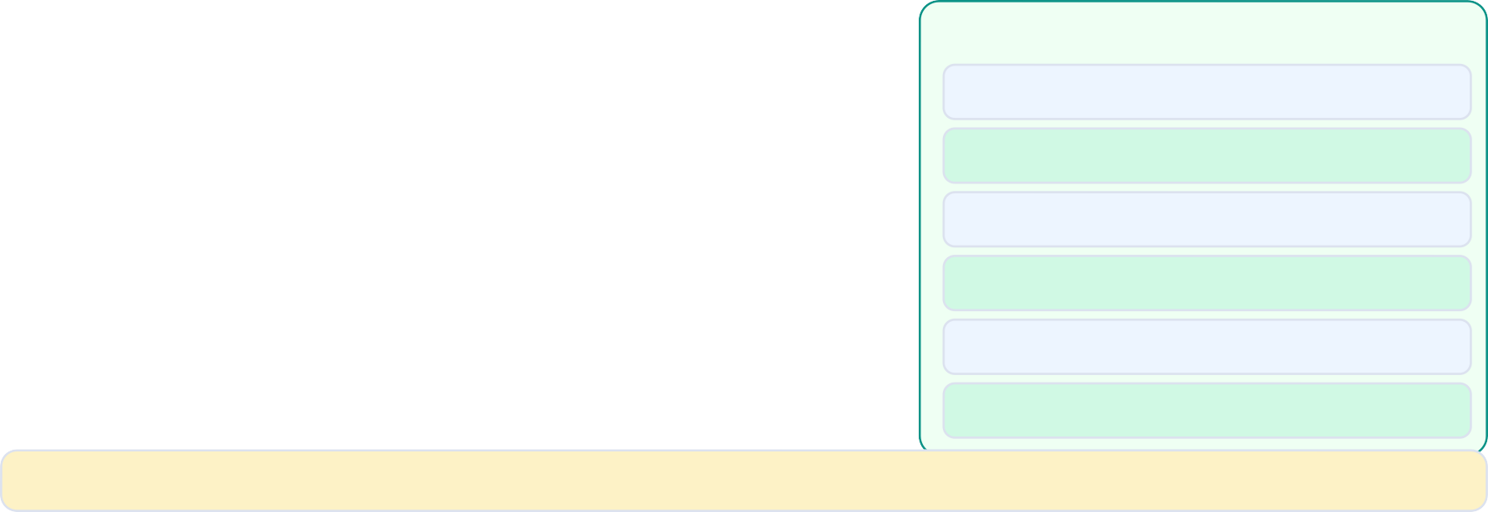
User Stories & Sprint Planning
🏢WAMY NGO
WAMY Finance: from BRD to sprint-ready backlog
📝 User Stories Prompt
"Convert the WAMY Finance BRD functional requirements (FR-01 to FR-28) into Jira-ready user stories with: role (As a [Finance Manager/Accountant/Auditor]), goal, acceptance criteria (3-5 each), story point estimate (Fibonacci), and sprint assignment for a 3-developer team with 2-week sprints."
⚡ Sample Generated User Stories
US-001 [5 pts] — Sprint 1
As a Finance Manager, I want to create a Chart
of Accounts so that I can organise financial data. Acceptance Criteria:
CoA supports 5 account types (Asset/Liability/ Equity/Revenue/Expense)
Account codes follow 1000-5999 pattern
Parent-child hierarchy supported (3 levels)
Inactive accounts cannot receive journal entries
📅 Sprint Plan Output
Sprint 1 34 pts
Foundation: CoA, Users, Auth, Journal Entries
Sprint 2
32 pts
Reporting: P&L, Balance Sheet, Trial Balance
Sprint 3
30 pts
AP/AR aging, Cash Flow, Budget vs Actual
US-002 [8 pts] — Sprint 1
As an Accountant, I want to post journal entries
so that transactions are recorded with double-entry. Acceptance Criteria:
System validates SUM(debit)==SUM(credit)
Entry requires minimum 2 line items
Supports multi-currency (BDT, USD)
Posted entries are immutable (locked)
Sprint 4
28 pts
Bank Reconciliation, multi-project reports
Sprint 5
26 pts
React dashboards, charts, export PDF/Excel
Sprint 6
24 pts
Testing, security hardening, Robi Cloud deploy
💡 Total: 174 story points across 6 sprints (12 weeks) for 3 developers — Claude Code estimates this is achievable with AI assistance.
18 / 80

Slide 19



Functional Requirements & API Contract
🏢WAMY NGO
Generate FRS and OpenAPI spec from user stories
📝 API Contract Prompt
"Based on the WAMY Finance user stories, generate a complete OpenAPI 3.0 specification for the Finance REST API. Include all endpoints, request/response schemas, authentication headers, error responses, and examples."
📑 FRS Document Sections
* System Overview
* User Roles & Permissions
⚡ OpenAPI Spec (excerpt)
openapi: 3.0.3 info:
title: WAMY Finance API version: 1.0.0
paths:
/api/v1/journal-entries: post:
summary: Post a new journal entry security: [bearerAuth: []] requestBody:
content: application/json:
schema:
$ref: '#/components/schemas/JournalEntryRequest' example:
date: "2024-01-15"
description: "Office rent payment" projectId: "PROJ-001"
lines:
* Module Specifications (8 modules)
* API Endpoint Catalogue
* Data Model Definitions
* Business Rules (double-entry)
* Report Specifications (10 reports)
* Integration Points
* Error Handling Standards
* Performance Requirements
💡 The OpenAPI spec generated here becomes the contract between Spring Boot backend and React frontend — no manual coordination needed.
debit: 50000.00
credit: 0
19 / 80

Slide 20


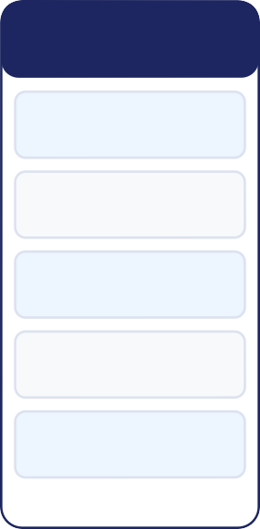
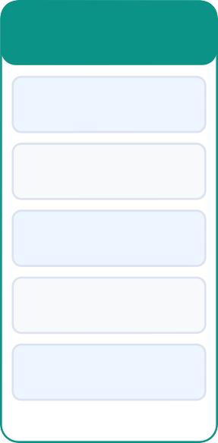
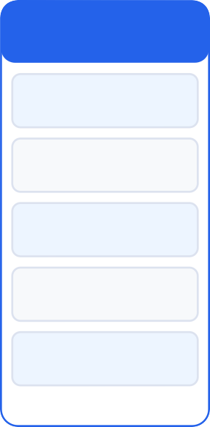
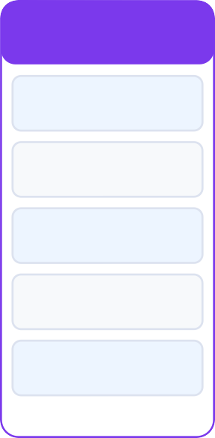
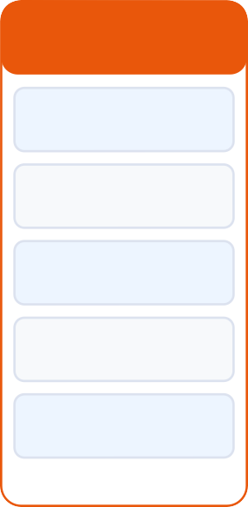
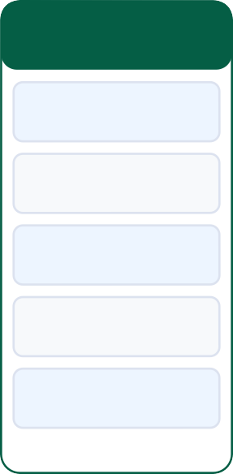
Project Roadmap & Timeline
🏢WAMY NGO
WAMY Finance: 12-week development plan
📝 Roadmap Prompt
"Generate a 7-week project roadmap for the WAMY Finance module with 3 developers. Include milestones, dependencies, risk areas, and key deliverables per sprint. Format as a Gantt-style timeline."
Wk 1-2 Foundation | Wk 2-4 Core Accounting | Wk 4-5 Reporting Pt1 | Wk 4-5 Reporting Pt2 | Wk 5-6 Frontend | Wk 6-7 QA & Deploy
Spring Boot init | Journal entries | Cash Flow | Budget vs Actual | Dashboard | Security review
DB schema v1 | Validation | Trial Balance | Bank recon | Charts (Recharts) | Performance
CoA API | GL queries | AR/AP aging | Multi-project | Report UI | Robi CI/CD
JWT auth | P&L report | Budget model | Period close | Excel export | UAT
React setup | Balance Sheet | Budget API | Audit log | PDF export | Go-live
🎯 Milestone: Week 7 — Production deployment on Robi Cloud with all 10 financial reports live and security hardened

Slide 21
Risk Register & Mitigation Plan
🏢WAMY NGO
Claude Code identifies project risks before they happen
Prompt: "Analyze the WAMY Finance project and generate a risk register with probability, impact, and mitigation strategies."
Risk
Probability
Impact
Mitigation Strategy
Double-entry validation bypass
Medium
Critical
Spring AOP aspect validates on every JournalEntry save
MySQL slow on large date range reports
High
High
Composite indexes + Redis caching for monthly reports
Shared hosting resource limits
Medium
High
Connection pooling (HikariCP) + query optimisation + Robi Cloud sizing
React 19 breaking changes
Low
Medium
Pin react@19.0.0, use stable APIs only, daily Dependabot alerts
GitHub Actions secrets exposure
Low
Critical
Use GitHub Environments, rotate secrets quarterly, Vault integration
💡 Claude Code identifies risks by reading your tech stack and comparing against known failure patterns for similar projects.

Slide 22

Team Roles & Responsibility Matrix
🏢WAMY NGO
RACI chart for WAMY Finance module generated by Claude Code
📝 RACI Prompt
"Generate a RACI responsibility matrix for the WAMY Finance module. Roles: Lead Developer, Backend Dev, Frontend Dev, QA Engineer, Finance Manager (client). Tasks: Architecture, Backend API, Frontend, DB design, Security, Testing, Deployment, UAT."
Task
Lead Dev
Backend Dev
Frontend Dev
QA Engineer
Finance Mgr
System Architecture
R/A
C
C
I
C
DB Schema Design
A
R
I
I
C
Spring Boot API
A
R
I
C
I
React Frontend
A
I
R
C
I
Spring Security / JWT
R/A
C
I
C
I
Unit & Integration Tests
A
R
R
R
I
CI/CD Pipeline
R/A
C
C
I
I
UAT & Acceptance A
Legend: R = Responsible · A = Accountable · C = Consulted · I = Informed
C
C
C
R
22 / 80

Slide 23
System Architecture
SECTION 04
C4 Model · ERD · Spring Boot Layers · Domain Design
C4 Context
C4 Container
ERD Design
Spring Layers

Slide 24


C4 Context Diagram — WAMY Finance
🏢WAMY NGO
Who uses the system and what external systems does it touch?
Users
Finance Manager · Accountant · Auditor · System Admin
WAMY Finance System
Spring Boot REST API + React 19 SPA
External Systems
MySQL 8 Database · Robi Cloud Hosting · GitHub Actions CI/CD · Email Service (budget alerts)
📝 Claude Code Prompt
"Generate a C4 Context diagram for the WAMY Finance system showing all users, the system boundary, and external dependencies."

Slide 25
C4 Container — Spring Boot + React Architecture
🏢WAMY NGO
How are the major containers structured?
React SPA (Vite + React 19)
TypeScript · TanStack Query · Recharts · Nginx container
Spring Boot API (Java 21)
REST Controllers · Services · JPA Repositories · Spring Security
MySQL 8 Database
journal_entries · journal_lines · chart_of_accounts · projects
📝 Claude Code Prompt
"Generate a C4 Container diagram for WAMY Finance with Spring Boot backend, React frontend, and MySQL database."

Slide 26
ERD — Double-Entry Accounting Schema
🏢WAMY NGO
Core database tables for the WAMY Finance module
chart_of_accounts
id · code · name · type (ASSET/LIABILITY/EQUITY/REVENUE/EXPENSE) · normal_balance · parent_id · is_active
journal_entries
id · date · description · reference · project_id · posted_by · posted_at · is_locked · status
journal_lines
id · journal_entry_id · account_id · debit · credit · description
projects
id · code · name · org_id · start_date · end_date · status · budget
📝 Claude Code Prompt
"Generate a complete MySQL ERD for double-entry accounting supporting the WAMY Finance requirements. Include all constraints and indexes."
26 / 80

Slide 27
Spring Boot Package Structure
🏢WAMY NGO
Clean architecture for the WAMY Finance API
com.wamy.finance
Main application class · SecurityConfig · GlobalExceptionHandler
.controller
JournalEntryController · ReportController · BudgetController · ChartOfAccountsController
.service
AccountingService · ReportingService · BudgetService · ReconciliationService
.repository
JournalEntryRepository · JournalLineRepository · ChartOfAccountsRepository
.dto
27 / 80

Slide 28



Service Layer Design — AccountingService
🏢WAMY NGO
Core double-entry engine for WAMY Finance
📝 AccountingService Prompt
"Generate AccountingService.java in com.wamy.finance.service. Methods: postJournalEntry(JournalEntryRequest) — validates debit==credit, saves entity, publishes event; voidJournalEntry(Long id) — creates reversal entry; getGeneralLedger(Long accountId, LocalDate from, LocalDate to) — returns paginated ledger entries. Use @Transactional, constructor injection."
✅ What Claude Generated
AccountingService.java — full implementation
AccountingServiceImpl.java (interface separation)
DoubleEntryViolationException.java
⚡ Generated AccountingService (excerpt)
@Service @RequiredArgsConstructor
public class AccountingService {
private final JournalEntryRepository entryRepo; private final ApplicationEventPublisher events;
JournalPostedEvent.java
AccountingServiceTest.java (JUnit 5 + Mockito)
@Transactional
public JournalEntryResponse postJournalEntry( JournalEntryRequest req) {
validateDoubleEntry(req.getLines()); JournalEntry entry = mapper.toEntity(req); entry.setStatus(EntryStatus.POSTED); entry.setPostedAt(LocalDateTime.now()); entry = entryRepo.save(entry);
events.publishEvent(new JournalPostedEvent(entry));
Full test coverage for debit≠credit rejection
Swagger/OpenAPI annotations on all methods
Lombok @RequiredArgsConstructor used throughout
💡 O^{r}n^{e}e^{tu}p^{r}ro^{n}m^{m}pªt^{p}→^{pe}5^{r.}fi^{t}leºs^{R}g^{e}e^{s}n^{p}eºr^{n}a^{s}te^{e}d^{(e}(S^{n}e^{t}r^{r}v^{y}ic⁾e;, Interface, Exception, Event, Test). Estimate: 4 hours of coding done in 90 seconds.
}
28 / 80

Slide 29


JPA Entities & Repository Layer
🏢WAMY NGO
Spring Data JPA for the double-entry schema
📝 JPA Entity Prompt
"Generate JPA entities for JournalEntry and JournalLine with: proper @Entity, @Table annotations, @OneToMany relationship (JournalEntry has List<JournalLine>), @Column constraints, custom @AssertDebitCreditBalance validator, Lombok @Data @Builder @NoArgsConstructor @AllArgsConstructor. Include JournalEntryRepository with custom query methods."
⚡ JournalEntry Entity (generated)
@Entity @Table(name="journal_entries")
@Data @Builder @NoArgsConstructor @AllArgsConstructor @AssertDebitCreditBalance // custom validator public class JournalEntry {
@Id @GeneratedValue(strategy=IDENTITY) private Long id;
📦 Repository Methods Generated
→ findByProjectAndDateBetween(...)
→ findByStatusAndLockedFalse(...)
→ sumDebitByAccountAndPeriod(...)
→ sumCreditByAccountAndPeriod(...)
→ findForTrialBalance(projectId, date)
→ findForPandL(projectId, from, to)
→ findForBalanceSheet(projectId, asOf)
→ Custom @Query for GL report
@NotNull @Column(nullable=false) private LocalDate date;
@NotBlank
private String description;
@ManyToOne(fetch=LAZY) @JoinColumn(name="project_id") private Project project;
@OneToMany(mappedBy="journalEntry",
cascade=ALL, orphanRemoval=true) @Size(min=2, message="Need at least 2 lines")
💡^{pr}C^{i}la^{v}uªd^{te}e C^{L}o^{i}d^{s}e^{t}g<e^{J}nºe^{u}r^{r}ate^{na}s^{lL}th^{i}e^{n}c^{e}u>st^{l}o^{i}m^{ne}@^{s}Q⁼ue^{n}ry^{ew}JPQ^{Ar}L^{r}aªu^{y}to^{L}m^{is}a^{t}ti<c>a⁽lly^{);}— just describe what the query should return in plain English.
@Enumerated(STRING)
29 / 80

Slide 30


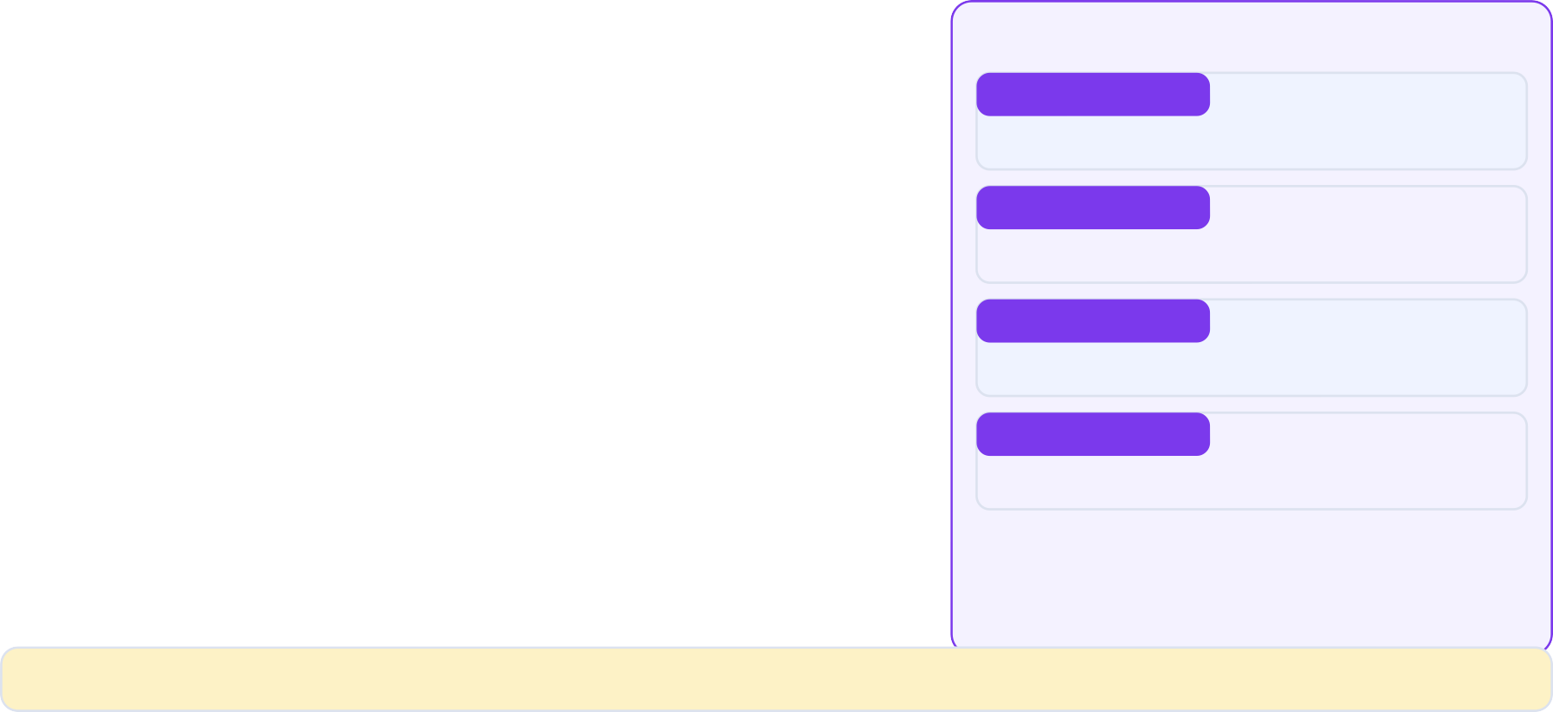

REST Controller Layer
🏢WAMY NGO
Spring Boot REST API for WAMY Finance
📝 Controller Prompt
"Generate JournalEntryController.java in com.wamy.finance.controller. REST endpoints: POST
/api/v1/journal-entries (post entry), GET /api/v1/journal-entries/{id} (get entry), GET /api/v1/reports/profit-loss (with projectId, fromDate, toDate params), GET /api/v1/reports/balance-sheet. Use @RestController, @PreAuthorize, @Valid, ResponseEntity."
🔐 Security Annotations
ADMIN
All endpoints
⚡ JournalEntryController (generated)
@RestController @RequestMapping("/api/v1") @RequiredArgsConstructor
public class JournalEntryController { private final AccountingService svc;
FINANCE_MGR
Read + approve journals
ACCOUNTANT
@PostMapping("/journal-entries") @PreAuthorize("hasRole('ACCOUNTANT')")
public ResponseEntity<JournalEntryResponse> post( @RequestBody @Valid JournalEntryRequest req) {
return ResponseEntity.status(201)
.body(svc.postJournalEntry(req));
}
Post journals, view reports
AUDITOR
Read-only all reports
@GetMapping("/reports/profit-loss") @PreAuthorize("hasAnyRole('ACCOUNTANT','FINANCE_MGR','AUDITOR')") public ResponseEntity<ProfitLossReport> getPL(
@RequestParam Long projectId,
@RequestParam @DateTimeFormat(iso=DATE) LocalDate from,
@RequestParam @DateTimeFormat(iso=DATE) LocalDate to) {
💡 @_{re}P_{t}re_{u}A_{r}u_{n}th_{R}o_{e}r_{s}iz_{p}e_{o}i_{n}s_{s}m_{e}e_{E}t_{n}h_{t}o_{i}d_{t}-_{y}le.v_{o}e_{k}l₍security — even if a route is exposed, Spring Security checks the role on every method call.
svc.getProfitLossReport(projectId, from, to));
}
30 / 80

Slide 31
Backend Development
SECTION 05
Build the WAMY Finance Spring Boot API step by step
Financial Reports
Budget Service
Spring Security
JUnit Tests

Slide 32



Generating Financial Reports — P&L & Balance Sheet
🏢WAMY NGO
Spring Boot service methods for the 2 most important reports
📝 Claude Code Prompt
"Generate ProfitLossReportService in Spring Boot. Method: generatePL(Long projectId, LocalDate from, LocalDate to). Query journal_lines joined to chart_of_accounts where account type is REVENUE or EXPENSE, group by account, return ProfitLossReport with revenue list, expense list, net income, and comparison to prior period."
✅ Files Generated by Claude
Service class (full implementation)
Unit tests (JUnit 5 + Mockito)
⚡ Generated Code
@Service public class ReportingService {
@Query("SELECT new com.wamy.finance.dto.AccountBalance" + "(coa.code, coa.name, coa.type," +
" SUM(jl.debit) - SUM(jl.credit))" + " FROM JournalLine jl" +
" JOIN jl.journalEntry je" + " JOIN jl.account coa" +
" WHERE je.project.id = :projectId" + " AND je.date BETWEEN :from AND :to" +
" AND coa.type IN ('REVENUE','EXPENSE')" +
" GROUP BY coa.id ORDER BY coa.code") List<AccountBalance> getPLLines(
Long projectId, LocalDate from, LocalDate to);
Integration test (MockMvc)
DTO classes (Request + Response)
Custom exception classes
📝Try it now:
Swagger/OpenAPI annotations
Open Claude Code in your wamy-finance project and run the prompt shown. Compare the output to the code sample.

Slide 33
Budget Service & Budget vs Actual
🏢WAMY NGO
Project budget tracking with variance analysis
📝 Claude Code Prompt
"Generate BudgetService.java with: createBudget(BudgetRequest) — creates annual budget per project with monthly breakdowns; getBudgetVsActual(Long projectId, int year) — compares budget_lines to actual journal_line totals by account, returns list of BudgetLineVariance with planned, actual, variance amount and variance percent."
✅ Files Generated by Claude
Service class (full implementation)
Unit tests (JUnit 5 + Mockito)
⚡ Generated Code
public List<BudgetVariance> getBudgetVsActual( Long projectId, int year) {
List<BudgetLine> budget = budgetRepo.findByProjectAndYear(projectId, year);
return budget.stream().map(b -> { BigDecimal actual =
journalLineRepo.sumByAccountAndYear( b.getAccount().getId(), year);
BigDecimal variance = b.getAmount().subtract(actual); BigDecimal pct = b.getAmount().compareTo(ZERO)==0
? ZERO
: variance.divide(b.getAmount(),4,HALF_UP)
.multiply(valueOf(100));
return new BudgetVariance(b, actual, variance, pct);
}).collect(toList());
}
Integration test (MockMvc)
DTO classes (Request + Response)
Custom exception classes
📝Try it now:
Swagger/OpenAPI annotations
Open Claude Code in your wamy-finance project and run the prompt shown. Compare the output to the code sample.

Slide 34
Bank Reconciliation Service
🏢WAMY NGO
Matching bank transactions to GL journal entries
📝 Claude Code Prompt
"Generate BankReconciliationService.java. Method: reconcile(Long bankAccountId, LocalDate statementDate). Load bank_transactions for the period, load journal_lines for the bank GL account, auto-match by amount+date (±3 days tolerance), flag unmatched items on both sides. Return ReconciliationResult with matched, unmatched bank txns, unmatched GL entries, opening/closing balance."
✅ Files Generated by Claude
Service class (full implementation)
Unit tests (JUnit 5 + Mockito)
⚡ Generated Code
public ReconciliationResult reconcile( Long bankAccountId, LocalDate date) {
List<BankTxn> bankTxns = bankTxnRepo.findByAccountAndMonth(bankAccountId, date);
List<JournalLine> glLines = journalLineRepo.findByBankAccount(bankAccountId, date);
Integration test (MockMvc)
DTO classes (Request + Response)
Custom exception classes
List<MatchedPair> matched = new ArrayList<>(); Set<Long> usedGL = new HashSet<>();
📝Try it now:
Swagger/OpenAPI annotations
for(BankTxn txn : bankTxns) { glLines.stream()
.filter(gl -> !usedGL.contains(gl.getId()))
.filter(gl -> matchesAmount(txn, gl))
.filter(gl -> matchesDate(txn, gl, 3))
.findFirst().ifPresent(gl -> { matched.add(new MatchedPair(txn, gl));
Open Claude Code in your wamy-finance project and run the prompt shown. Compare the output to the code sample.
usedGL.add(gl.getId());
});
}
34 / 80

Slide 35
Spring Security — JWT Configuration
🏢WAMY NGO
RS256 JWT authentication for the WAMY Finance API
📝 Claude Code Prompt
"Generate Spring Security 6 configuration for WAMY Finance API. Requirements: stateless JWT using RS256 (RSA key pair), roles: ADMIN/FINANCE_MGR/ACCOUNTANT/AUDITOR, permit /api/v1/auth/login, secure all /api/v1/** endpoints. Include JwtAuthenticationFilter, JwtService with RS256 sign/verify, SecurityFilterChain bean."
✅ Files Generated by Claude
Service class (full implementation)
Unit tests (JUnit 5 + Mockito)
⚡ Generated Code
@Configuration @EnableMethodSecurity public class SecurityConfig {
@Bean
public SecurityFilterChain filterChain( HttpSecurity http, JwtAuthFilter jwtFilter) throws Exception {
return http
.csrf(AbstractHttpConfigurer::disable)
.sessionManagement(sm -> sm.sessionCreationPolicy( SessionCreationPolicy.STATELESS))
.authorizeHttpRequests(auth -> auth
.requestMatchers("/api/v1/auth/**").permitAll()
.requestMatchers("/actuator/health").permitAll()
.anyRequest().authenticated())
.addFilterBefore(jwtFilter, UsernamePasswordAuthenticationFilter.class)
.build();
Integration test (MockMvc)
DTO classes (Request + Response)
Custom exception classes
📝Try it now:
Swagger/OpenAPI annotations
Open Claude Code in your wamy-finance project and run the prompt shown. Compare the output to the code sample.
}
}
35 / 80

Slide 36
Input Validation & Error Handling
🏢WAMY NGO
Bean Validation + GlobalExceptionHandler for the Finance API
📝 Claude Code Prompt
"Generate GlobalExceptionHandler.java using @RestControllerAdvice for WAMY Finance. Handle: MethodArgumentNotValidException (return field-level errors), DoubleEntryViolationException (400 + message), EntityNotFoundException (404), AccessDeniedException (403), generic Exception (500 with correlation ID). Return consistent ErrorResponse DTO."
✅ Files Generated by Claude
Service class (full implementation)
Unit tests (JUnit 5 + Mockito)
⚡ Generated Code
@RestControllerAdvice
public class GlobalExceptionHandler { @ExceptionHandler(MethodArgumentNotValidException.class) public ResponseEntity<ErrorResponse> handleValidation(
MethodArgumentNotValidException ex) { List<FieldError> errors = ex.getBindingResult()
.getFieldErrors().stream()
.map(fe -> new FieldError(
fe.getField(), fe.getDefaultMessage()))
.collect(toList());
return ResponseEntity.badRequest()
.body(ErrorResponse.validation(errors));
}
Integration test (MockMvc)
DTO classes (Request + Response)
Custom exception classes
📝Try it now:
Swagger/OpenAPI annotations
Open Claude Code in your wamy-finance project and run the prompt shown. Compare the output to the code sample.
@ExceptionHandler(DoubleEntryViolationException.class) public ResponseEntity<ErrorResponse> handleDE(
DoubleEntryViolationException ex) {
return ResponseEntity.badRequest()
.body(ErrorResponse.of("DOUBLE_ENTRY_VIOLATION", "Debits ("+ex.getDebits()+") ≠ Credits "
36 / 80

Slide 37
JUnit 5 Test Suite — AccountingService
🏢WAMY NGO
Comprehensive tests for the double-entry engine
📝 Claude Code Prompt
"Generate JUnit 5 tests for AccountingService using Mockito. Test cases: (1) postJournalEntry_success — valid entry with balanced lines saves and publishes event; (2) postJournalEntry_failsWhenUnbalanced — throws DoubleEntryViolationException; (3) voidEntry_createsReversalEntry; (4) postEntry_failsOnLockedPeriod. Use @ExtendWith(MockitoExtension.class)."
✅ Files Generated by Claude
Service class (full implementation)
Unit tests (JUnit 5 + Mockito)
⚡ Generated Code
@ExtendWith(MockitoExtension.class) class AccountingServiceTest {
@Mock JournalEntryRepository repo; @Mock ApplicationEventPublisher events; @InjectMocks AccountingService svc;
Integration test (MockMvc)
DTO classes (Request + Response)
Custom exception classes
@Test
void postEntry_success_publishesEvent() { JournalEntryRequest req = buildBalancedEntry(); when(repo.save(any())).thenAnswer(i -> i.getArgument(0));
📝Try it now:
Swagger/OpenAPI annotations
svc.postJournalEntry(req);
Open Claude Code in your wamy-finance project and run the prompt shown. Compare the output to the code sample.
verify(repo).save(any()); verify(events).publishEvent(any(JournalPostedEvent.class));
}
@Test
void postEntry_failsWhenUnbalanced() { JournalEntryRequest req = buildUnbalancedEntry();
37 / 80

Slide 38
Integration Tests — REST API
🏢WAMY NGO
Full Spring Boot test with @SpringBootTest
📝 Claude Code Prompt
"Generate integration tests for JournalEntryController using @SpringBootTest and MockMvc. Test: POST /api/v1/journal-entries with valid JWT (ACCOUNTANT role) returns 201; POST with unbalanced entry returns 400 with error message; GET /api/v1/reports/profit-loss returns correct P&L structure. Use @WithMockUser for auth."
✅ Files Generated by Claude
Service class (full implementation)
Unit tests (JUnit 5 + Mockito)
⚡ Generated Code
@SpringBootTest @AutoConfigureMockMvc class JournalEntryControllerIT {
@Autowired MockMvc mockMvc; @Autowired ObjectMapper mapper;
Integration test (MockMvc)
DTO classes (Request + Response)
@Test @WithMockUser(roles="ACCOUNTANT")
void postJournalEntry_returns201() throws Exception { String body = mapper.writeValueAsString(
buildBalancedEntryRequest());
Custom exception classes
📝Try it now:
Swagger/OpenAPI annotations
mockMvc.perform(post("/api/v1/journal-entries")
.contentType(APPLICATION_JSON)
.content(body))
.andExpect(status().isCreated())
.andExpect(jsonPath("$.id").exists())
.andExpect(jsonPath("$.status").value("POSTED"));
Open Claude Code in your wamy-finance project and run the prompt shown. Compare the output to the code sample.
}
@Test @WithMockUser(roles="ACCOUNTANT")
void postUnbalancedEntry_returns400() throws Exception {
38 / 80

Slide 39
Audit Logging with Spring AOP
🏢WAMY NGO
Automatic audit trail for every financial transaction
📝 Claude Code Prompt
"Generate AuditLoggingAspect.java using Spring AOP. Intercept all @Service methods in com.wamy.finance.service with @Around advice. Log: method name, user (from SecurityContext), timestamp, arguments (masked for sensitive fields), execution time. Write to audit_logs table via AuditLogRepository. Exclude getters and read-only methods."
✅ Files Generated by Claude
Service class (full implementation)
Unit tests (JUnit 5 + Mockito)
⚡ Generated Code
@Aspect @Component @RequiredArgsConstructor public class AuditLoggingAspect {
private final AuditLogRepository auditRepo;
Integration test (MockMvc)
DTO classes (Request + Response)
@Around("execution(* com.wamy.finance.service.*" + "Service.*(..)) && !@annotation(ReadOnly)")
public Object audit(ProceedingJoinPoint pjp) throws Throwable {
String user = SecurityContextHolder.getContext()
.getAuthentication().getName(); long start = System.currentTimeMillis();
Custom exception classes
📝Try it now:
Swagger/OpenAPI annotations
Object result = pjp.proceed();
Open Claude Code in your wamy-finance project and run the prompt shown. Compare the output to the code sample.
AuditLog log = AuditLog.builder()
.user(user)
.action(pjp.getSignature().getName())
.entity(pjp.getTarget().getClass().getSimpleName())
.duration(System.currentTimeMillis() - start)
.timestamp(LocalDateTime.now())
39 / 80

Slide 40
Scheduled Jobs — Period Close & Alerts
🏢WAMY NGO
Spring @Scheduled for automated financial tasks
📝 Claude Code Prompt
"Generate FinanceScheduler.java with: @Scheduled(cron='0 0 8 1 * *') monthly — send budget utilisation alert emails to Finance Managers for any project over 80% budget; @Scheduled(cron='0 0 1 * * *') nightly — generate trial balance snapshot and store in report_snapshots table for fast dashboard loading."
✅ Files Generated by Claude
Service class (full implementation)
Unit tests (JUnit 5 + Mockito)
⚡ Generated Code
@Component @RequiredArgsConstructor public class FinanceScheduler {
private final BudgetService budgetSvc; private final EmailService emailSvc;
private final ReportSnapshotRepository snapshotRepo;
Integration test (MockMvc)
DTO classes (Request + Response)
Custom exception classes
@Scheduled(cron = "0 0 8 1 * *") public void monthlyBudgetAlerts() {
log.info("Running monthly budget alerts..."); List<BudgetVariance> overruns =
budgetSvc.getAllActiveProjects().stream()
.flatMap(p -> budgetSvc
.getBudgetVsActual(p.getId(), LocalDate.now().getYear()).stream())
.filter(v -> v.getUtilisationPct()
.compareTo(new BigDecimal("80")) >= 0)
.collect(toList());
📝Try it now:
Swagger/OpenAPI annotations
Open Claude Code in your wamy-finance project and run the prompt shown. Compare the output to the code sample.
overruns.forEach(v -> emailSvc.sendBudgetAlert(v.getProject(), v));
40 / 80

Slide 41
Frontend — React 19
SECTION 06
Build the WAMY Finance dashboard with React 19 + TanStack Query
Project Setup
API Hooks
P&L Dashboard
Budget Charts
41 / 80

Slide 42



React 19 Project Setup
🏢WAMY NGO
Vite + TypeScript + TanStack Query + Recharts
📝 Claude Code Prompt
"Set up the WAMY Finance React 19 frontend. Generate: vite.config.ts with proxy to Spring Boot :8080, package.json with dependencies (react@19, tanstack/react-query, recharts, react-hook-form, zod, axios, tailwindcss), main.tsx with QueryClientProvider, tailwind.config.ts, and global API client (axios instance with JWT interceptor)."
🌐 What This Component Does
Full working component generated by Claude Code. Ready to use with minor customisation.
📝Next Step:
⚡ Generated Code
// api/client.ts — Generated by Claude Code const apiClient = axios.create({
baseURL: import.meta.env.VITE_API_URL,
headers: { 'Content-Type': 'application/json' }
});
Run the prompt in Claude Code. Review the generated component. Accept the diff. Run: npm test
apiClient.interceptors.request.use(config => { const token = localStorage.getItem('jwt'); if (token)
config.headers.Authorization = `Bearer ${token}`; return config;
});
apiClient.interceptors.response.use( res => res,
async err => {
💡 if (err.response?.status === 401) {
Rea_{l}c_{o}t _{c}1_{a}9_{l}T_{S}i_{t}p:_{o}C_{r}l_{a}a_{g}u_{e}d.e_{r}C_{e}o_{m}d_{o}e_{ve}u_{I}n_{t}d_{e}e_{m}rs₍t'a_{j}n_{w}d_{t}s'R₎e;act 19 Server Components — specify 'use client' or 'use server' in your prompt when needed.
window.location.href = '/login';
42 / 80
}

Slide 43
TanStack Query — Finance API Hooks
🏢WAMY NGO
Type-safe React Query hooks for all finance endpoints
📝 Claude Code Prompt
"Generate React Query hooks (useQuery, useMutation) for the WAMY Finance API in hooks/useFinance.ts. Include: useProfitLoss(projectId, from, to), useBalanceSheet(projectId, asOf), useJournalEntries(projectId, page), usePostJournalEntry() mutation with optimistic update and cache invalidation."
🌐 What This Component Does
Full working component generated by Claude Code. Ready to use with minor customisation.
📝Next Step:
⚡ Generated Code
// hooks/useFinance.ts
export const useProfitLoss = ( projectId: number,
from: string, to: string
) =>
useQuery({
queryKey: ['profit-loss', projectId, from, to], queryFn: () =>
apiClient.get<ProfitLossReport>(
`/reports/profit-loss`,
{ params: { projectId, from, to } }
).then(r => r.data),
staleTime: 5 * 60 * 1000, // 5 min cache
});
Run the prompt in Claude Code. Review the generated component. Accept the diff. Run: npm test
export const usePostJournalEntry = () => {
const qc = useQueryClient();
💡_{re}R_{t}e_{u}a_{r}c_{n}t 1_{u}9_{s}T_{e}i_{M}p_{u}: _{t}Cl_{a}a_{t}u_{i}d_{o}e_{n}C₍o{de understands React 19 Server Components — specify 'use client' or 'use server' in your prompt when needed.
mutationFn: (req: JournalEntryRequest) =>
43 / 80
apiClient.post('/journal-entries', req),

Slide 44
P&L Dashboard Component
🏢WAMY NGO
Income Statement visualisation with Recharts
📝 Claude Code Prompt
"Generate ProfitLossDashboard.tsx React 19 component for WAMY Finance. Props: projectId, year. Show: (1) Recharts BarChart comparing Revenue vs Expenses by month, (2) summary KPI cards (Total Revenue, Total Expenses, Net Income with colour: green if positive, red if negative), (3) drill-down table of accounts. Use TailwindCSS. Handle loading skeleton and error states."
🌐 What This Component Does
Full working component generated by Claude Code. Ready to use with minor customisation.
📝Next Step:
⚡ Generated Code
export const ProfitLossDashboard: React.FC<Props> = ({ projectId, year
}) => {
const { data: pl, isLoading } = useProfitLoss(projectId,
`${year}-01-01`, `${year}-12-31`);
Run the prompt in Claude Code. Review the generated component. Accept the diff. Run: npm test
if (isLoading) return <DashboardSkeleton />;
const netIncome = pl.totalRevenue - pl.totalExpenses; return (
<div className="space-y-6">
<KPICards revenue={pl.totalRevenue} expenses={pl.totalExpenses} net={netIncome} />
<ResponsiveContainer width="100%" height={320}>
💡 React <1_{B}9_{a}T_{r}ip_{C}:_{h}C_{a}l_{r}a_{t}ud_{d}e_{a}C_{t}o_{a}d₌e_{{p}u_{l}n.d_{m}e_{o}rs_{n}t_{t}a_{h}n_{l}d_{y}s_{D}R_{a}e_{t}a_{a}c}t >19 Server Components — specify 'use client' or 'use server' in your prompt when needed.
<XAxis dataKey="month" />
44 / 80
<YAxis />

Slide 45
Journal Entry Form
🏢WAMY NGO
React 19 form with dynamic debit/credit rows and validation
📝 Claude Code Prompt
"Generate JournalEntryForm.tsx using react-hook-form and zod. Dynamic form with: date, description, project selector, and dynamic line items array (add/remove rows). Each line: account selector, debit amount, credit amount. Zod validation: minimum 2 lines, total debit must equal total credit (real-time running totals shown). Submit via usePostJournalEntry mutation."
🌐 What This Component Does
Full working component generated by Claude Code. Ready to use with minor customisation.
📝Next Step:
⚡ Generated Code
const schema = z.object({ date: z.string(),
description: z.string().min(5), projectId: z.number(),
lines: z.array(z.object({ accountId: z.number(), debit: z.number().min(0), credit: z.number().min(0)
})).min(2)
}).refine(data => {
const totD = data.lines.reduce((s,l) => s+l.debit, 0); const totC = data.lines.reduce((s,l) => s+l.credit, 0); return Math.abs(totD - totC) < 0.001;
}, { message: "Debits must equal Credits", path: ["lines"] });
Run the prompt in Claude Code. Review the generated component. Accept the diff. Run: npm test
// Running totals shown in footer:
/💡_{/ D}R_{e}e_{b}a_{i}c_{t}t _{s}1:9 T₅i₀p:,C₀l₀a₀u.d₀e₀Cod_{C}e_{re}u_{d}n_{i}d_{t}e_{s}rs:ta₅n₀d,s₀R₀e₀a.c₀t ₀19 S✓er_{B}v_{a}e_{l}r _{a}C_{n}o_{c}m_{e}p_{d}onents — specify 'use client' or 'use server' in your prompt when needed.
45 / 80

Slide 46
Financial Reports Table — Trial Balance
🏢WAMY NGO
Sortable, filterable, exportable report table
📝 Claude Code Prompt
"Generate TrialBalanceReport.tsx React component. Display Trial Balance in a table with columns: Account Code, Account Name, Type, Debit Total, Credit Total, Balance. Features: sort by any column, filter by account type, search by account name, export to Excel (using SheetJS), export to PDF (print stylesheet). Show totals row at bottom. Loading skeleton and empty state."
🌐 What This Component Does
Full working component generated by Claude Code. Ready to use with minor customisation.
📝Next Step:
⚡ Generated Code
export const TrialBalanceReport: React.FC<Props> = ({ projectId, asOf
}) => {
const { data } = useTrialBalance(projectId, asOf); const [sort, setSort] = useState<SortConfig>(null); const [filter, setFilter] = useState('');
Run the prompt in Claude Code. Review the generated component. Accept the diff. Run: npm test
const exportExcel = () => {
const ws = XLSX.utils.json_to_sheet( data.accounts.map(acc => ({
'Code': acc.code, 'Name': acc.name, 'Debit': acc.debitTotal,
'Credit': acc.creditTotal
})));
const wb = XLSX.utils.book_new(); XLSX.utils.book_append_sheet(wb, ws, 'Trial Balance');
💡 XLSX.writeFile(wb, `TB_${asOf}.xlsx`);
};React 19 Tip: Claude Code understands React 19 Server Components — specify 'use client' or 'use server' in your prompt when needed.
// ... table render with sort/filter
46 / 80
};

Slide 47
Budget vs Actual Chart
🏢WAMY NGO
Variance analysis with conditional colour coding
📝 Claude Code Prompt
"Generate BudgetVsActualChart.tsx. Show a Recharts ComposedChart with: bars for budget amount (blue), bars for actual amount (green if under budget, red if over budget), line for cumulative variance. KPI row above chart: Total Budget, Total Actual, Variance Amount (BDT), Variance %. Export to PDF button. Responsive for mobile."
🌐 What This Component Does
Full working component generated by Claude Code. Ready to use with minor customisation.
📝Next Step:
⚡ Generated Code
const BudgetBar = (props: any) => {
const { x, y, width, height, actual, budget } = props; const isOver = actual > budget;
return <rect x={x} y={y} width={width} height={height} fill={isOver ? '#EF4444' : '#22C55E'}
rx={3} />;
};
Run the prompt in Claude Code. Review the generated component. Accept the diff. Run: npm test
<ComposedChart data={data.lines}>
<Bar dataKey="budget" fill="#2563EB" name="Budget" />
<Bar dataKey="actual" shape={<BudgetBar/>} name="Actual" />
<Line type="monotone" dataKey="cumulativeVariance" stroke="#F59E0B" strokeWidth={2}
dot={false} name="Variance" />
💡_{<R}R_{e}e_{f}a_{e}c_{r}t _{e}1_{n}9_{c}T_{e}i_{L}p_{i}: _{n}C_{e}lau_{y}d₌e_{{0}oC}de_{st}u_{r}n_{o}d_{k}e_{e}r₌st"a#n₉d₄s_{A}R₃e_{B}a₈c"t 19 Server Components — specify 'use client' or 'use server' in your prompt when needed.
strokeDasharray="3 3" />
47 / 80
</ComposedChart>

Slide 48
React 19 — Authentication Flow
🏢WAMY NGO
Login, JWT storage, protected routes, role-based navigation
📝 Claude Code Prompt
"Generate the WAMY Finance authentication flow: LoginPage.tsx with email/password form (react-hook-form), AuthContext.tsx with useReducer for auth state (user, token, roles), ProtectedRoute.tsx that redirects to /login if not authenticated, RoleGuard.tsx that renders children only if user has required role. Store JWT in memory (not localStorage) for XSS protection."
🌐 What This Component Does
Full working component generated by Claude Code. Ready to use with minor customisation.
📝Next Step:
⚡ Generated Code
// AuthContext.tsx — JWT in memory, not localStorage
export const AuthProvider: React.FC<{children: ReactNode}> = ({children}) => {
const [state, dispatch] = useReducer(authReducer,
{ user: null, token: null, isLoading: true });
Run the prompt in Claude Code. Review the generated component. Accept the diff. Run: npm test
const login = async (email: string, password: string) => { const { data } = await apiClient.post('/auth/login',
{ email, password });
// Store in memory — NOT localStorage (XSS safe) tokenRef.current = data.accessToken;
dispatch({ type: 'LOGIN', payload: data.user });
};
return (
<AuthContext.Provider value={{ ...state, login, logout }}>
{children}
💡 R<e/a_{A}c_{u}t _{t}1_{h}9_{C}T_{o}i_{n}p:_{t}C_{e}l_{x}a_{t}u.d_{P}e_{r}C_{o}o_{v}d_{i}e_{de}u_{r}n>derstands React 19 Server Components — specify 'use client' or 'use server' in your prompt when needed.
);
48 / 80
};

Slide 49
Security & Code Review
SECTION 07
OWASP Top 10 applied to the WAMY Finance API
OWASP Top 10
SQL Injection
IDOR
CSRF

Slide 50


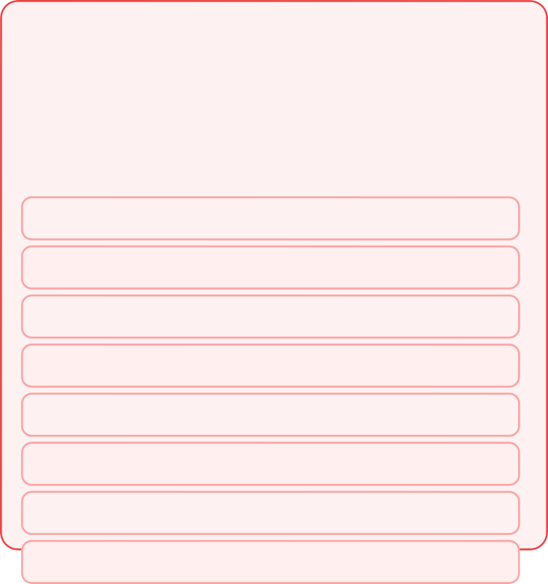

Security Audit — Quick Start
🏢WAMY NGO
Run a security scan on the WAMY Finance module in 60 seconds
📝 Security Prompt — WAMY Finance
"Perform a security review of the WAMY Finance Spring Boot API. Check for: SQL injection in JPA queries, IDOR vulnerabilities (project data leakage between orgs), missing @PreAuthorize annotations, insecure JWT configuration, sensitive data in logs, CORS misconfiguration, and insecure Actuator endpoints. List findings with severity, file:line, and fix."
🛡️ Why This Matters
Financial data breaches carry legal, financial, and reputational consequences for NGOs.
WAMY Finance Security Layers:
⚡ Security Output
SECURITY SCAN — WAMY Finance API
════════════════════════════════ CRITICAL [ReportController.java:45]
Native query with String concatenation → SQL Injection @Query("SELECT * FROM journal WHERE project_id="+id) FIX: Use @Query with :id parameter binding
🔒 JWT RS256 + 15min expiry
🔒 Org-scoped all queries
🔒 @PreAuthorize method security
🔒 Input validation (Bean Validation)
HIGH [ProjectService.java:88]
findById(id) without org_id check → IDOR
Any authenticated user can access any project
FIX: findByIdAndOrganisationId(id, currentUser.orgId)
🔒 Audit log on all writes
HIGH [application.properties] management.endpoints.web.exposure.include=* FIX: expose only health,info in production
🔒 SQL injection prevention (JPA)
🔒 XSS: Spring Security headers
MEDIUM [JwtService.java:12]
🔒 Rate limiting on auth endpoints
JWT secret is hardcoded: "wamy-secret-key"
FIX: Use RSA key pair loaded from environment

Slide 51
OWASP Top 10 — Spring Boot Mapping
🏢WAMY NGO
Every OWASP vulnerability mapped to WAMY Finance fixes
📝 Security Prompt — WAMY Finance
"Map the OWASP Top 10 2023 to the WAMY Finance Spring Boot application. For each vulnerability, identify the specific risk in our project and generate the Spring Boot/Java fix."
🛡️ Why This Matters
Financial data breaches carry legal, financial, and reputational consequences for NGOs.
WAMY Finance Security Layers:
⚡ Security Output
A01 Broken Access Control
Risk: No org_id scope on project queries
Fix: Add @PostFilter or org_id in every query
🔒 JWT RS256 + 15min expiry
🔒 Org-scoped all queries
A02 Cryptographic Failures
Risk: JWT using HS256 shared secret Fix: Switch to RS256 RSA key pair
🔒 @PreAuthorize method security
🔒 Input validation (Bean Validation)
A03 Injection
Risk: Raw string in @Query annotations Fix: Use named parameter bindings :param
🔒 Audit log on all writes
A05 Security Misconfiguration
Risk: Actuator all endpoints exposed Fix: Only expose health,info in prod
🔒 SQL injection prevention (JPA)
🔒 XSS: Spring Security headers
A07 Auth & Session Failures
🔒 Rate limiting on auth endpoints
Risk: No account lockout after 5 failures
Fix: Add Redis-based login attempt counter

Slide 52
IDOR Fix — Organisation Scoping
🏢WAMY NGO
Preventing cross-organisation data leakage in WAMY Finance
📝 Security Prompt — WAMY Finance
"The WAMY Finance API has IDOR vulnerabilities — an accountant at Org A can access financial data from Org B. Generate: (1) TenantContext.java that stores current user's orgId; (2) TenantFilter.java that sets org from JWT claim; (3) Updated ProjectRepository with all query methods requiring orgId parameter; (4) @PreAuthorize expressions for all finance endpoints."
🛡️ Why This Matters
Financial data breaches carry legal, financial, and reputational consequences for NGOs.
⚡ Security Output
// TenantFilter.java — auto-set org from JWT @Component public class TenantFilter
extends OncePerRequestFilter { protected void doFilterInternal(...) {
String orgId = jwtService.extractOrgId(token); TenantContext.setCurrentOrg(orgId);
try { filterChain.doFilter(req, res); } finally { TenantContext.clear(); }
}
}
WAMY Finance Security Layers:
🔒 JWT RS256 + 15min expiry
🔒 Org-scoped all queries
🔒 @PreAuthorize method security
🔒 Input validation (Bean Validation)
🔒 Audit log on all writes
// ProjectRepository — org-scoped queries public interface ProjectRepository
extends JpaRepository<Project, Long> {
🔒 SQL injection prevention (JPA)
// BEFORE (IDOR vulnerable):
// Optional<Project> findById(Long id);
🔒 XSS: Spring Security headers
// AFTER (org-scoped):
Optional<Project> findByIdAndOrganisationId(
🔒 Rate limiting on auth endpoints
52 / 80

Slide 53
SQL Injection Prevention
🏢WAMY NGO
JPA query safety for all finance report queries
📝 Security Prompt — WAMY Finance
"Review all @Query annotations in WAMY Finance repositories and identify any SQL injection risks. For each unsafe query, show the vulnerable version and the safe JPA named-parameter version. Also generate a SAST (Static Analysis) GitHub Actions workflow that scans for SQL injection patterns on every PR."
🛡️ Why This Matters
Financial data breaches carry legal, financial, and reputational consequences for NGOs.
WAMY Finance Security Layers:
⚡ Security Output
// VULNERABLE — String concatenation @Query(value="SELECT * FROM journal_lines " +
"WHERE account_id = " + accountId, // INJECTION RISK! nativeQuery = true)
🔒 JWT RS256 + 15min expiry
🔒 Org-scoped all queries
🔒 @PreAuthorize method security
// SAFE — Named parameter binding @Query("SELECT jl FROM JournalLine jl " +
"WHERE jl.account.id = :accountId " + "AND jl.journalEntry.date " + "BETWEEN :from AND :to")
List<JournalLine> findByAccountAndPeriod( @Param("accountId") Long accountId, @Param("from") LocalDate from, @Param("to") LocalDate to);
🔒 Input validation (Bean Validation)
🔒 Audit log on all writes
🔒 SQL injection prevention (JPA)
🔒 XSS: Spring Security headers
// SAST GitHub Actions (generated):
- name: OWASP Dependency Check
uses: dependency-check/Dependency-Check_Action@main
🔒 Rate limiting on auth endpoints
- name: SpotBugs Security Scan
53 / 80
run: mvn spotbugs:spotbugs -Dspotbugs.failOnError=true

Slide 54
JWT Security Hardening
🏢WAMY NGOs
RS256, token rotation, and secure JWT configuration
📝 Security Prompt — WAMY Finance
"Harden the WAMY Finance JWT implementation: (1) Switch from HS256 to RS256 using RSA key pair;
(2) Add token rotation (refresh token with 7-day expiry stored in Redis); (3) Add JWT blacklist for logout using Redis; (4) Set access token expiry to 15 minutes; (5) Add jti claim for token uniqueness. Generate JwtService.java and SecurityConfig updates."
🛡️ Why This Matters
Financial data breaches carry legal, financial, and reputational consequences for NGOs.
⚡ Security Output
@Service public class JwtService { @Value("jwt.private.key")
private RSAPrivateKey privateKey;
WAMY Finance Security Layers:
🔒 JWT RS256 + 15min expiry
🔒 Org-scoped all queries
@Value("jwt.public.key") private RSAPublicKey publicKey;
// RS256
🔒 @PreAuthorize method security
public String generateToken(UserDetails user) { return Jwts.builder()
.id(UUID.randomUUID().toString()) // jti
.subject(user.getUsername())
.claim("roles", user.getAuthorities())
.claim("orgId", ((WamyUser)user).getOrgId())
.issuedAt(new Date())
.expiration(new Date(
System.currentTimeMillis() + 15*60*1000)) // 15min
.signWith(privateKey,
🔒 Input validation (Bean Validation)
🔒 Audit log on all writes
🔒 SQL injection prevention (JPA)
🔒 XSS: Spring Security headers
Jwts.SIG.RS256) // RS256, not HS256
.compact();
🔒 Rate limiting on auth endpoints
}
54 / 80

Slide 55
Input Validation Hardening
🏢WAMY NGO
Bean Validation + custom validators for financial data
📝 Security Prompt — WAMY Finance
"Generate custom Bean Validation annotations for WAMY Finance: @ValidAccountCode (matches pattern 1000-9999), @PositiveMonetaryAmount (BigDecimal > 0, max 2 decimal places), @ValidDateRange (from date before to date), @BalancedJournalEntry (sum of debits == sum of credits). Include validator implementations."
🛡️ Why This Matters
Financial data breaches carry legal, financial, and reputational consequences for NGOs.
⚡ Security Output
@Target({FIELD, PARAMETER})
@Retention(RUNTIME)
@Constraint(validatedBy = AccountCodeValidator.class) public @interface ValidAccountCode {
String message() default
"Account code must be between 1000-9999"; Class<?>[] groups() default {};
Class<? extends Payload>[] payload() default {};
}
WAMY Finance Security Layers:
🔒 JWT RS256 + 15min expiry
🔒 Org-scoped all queries
🔒 @PreAuthorize method security
🔒 Input validation (Bean Validation)
public class AccountCodeValidator implements ConstraintValidator<ValidAccountCode, String> {
private static final Pattern CODE_PATTERN = Pattern.compile("^[1-9]\d{3}$");
🔒 Audit log on all writes
🔒 SQL injection prevention (JPA)
public boolean isValid(String code, ConstraintValidatorContext ctx) {
🔒 XSS: Spring Security headers
return code != null
&& CODE_PATTERN.matcher(code).matches();
🔒 Rate limiting on auth endpoints
}
55 / 80

Slide 56
Security Checklist — Pre-Deployment
🏢WAMY NGO
Final security hardening before going live on Robi Cloud
📝 Security Prompt — WAMY Finance
"Generate a pre-deployment security checklist for the WAMY Finance module on Robi Cloud. Include: Spring Boot hardening (disable defaults, set security headers), MySQL hardening (create app-specific DB user, restrict permissions), Docker security (non-root user, read-only filesystem), HTTPS configuration, secrets management (.env vs Vault), and GitHub Actions secrets rotation."
🛡️ Why This Matters
Financial data breaches carry legal, financial, and reputational consequences for NGOs.
WAMY Finance Security Layers:
⚡ Security Output
# WAMY Finance — Pre-Deployment Security Checklist # Generated by Claude Code
🔒 JWT RS256 + 15min expiry
🔒 Org-scoped all queries
## Spring Boot
spring.actuator.endpoints: health,info only
APP_DEBUG=false in production profile
CORS origin list locked to wamy.org domain
HTTPS-only (HSTS header: max-age=31536000)
Remove default Spring error messages
🔒 @PreAuthorize method security
🔒 Input validation (Bean Validation)
🔒 Audit log on all writes
## MySQL
App uses limited-privilege user (not root)
GRANT SELECT, INSERT, UPDATE ON wamy_finance.*
Disable remote root login
Enable MySQL audit log plugin
SSL connection required for app→DB
🔒 SQL injection prevention (JPA)
🔒 XSS: Spring Security headers
## Docker / Robi Cloud
Run as non-root user (USER 1001)
Read-only filesystem (--read-only flag)
🔒 Rate limiting on auth endpoints
56 / 80

Slide 57
Database Optimisation
SECTION 08
MySQL 8 performance for the WAMY Finance reporting workload
EXPLAIN Analysis
Index Strategy
Query Rewriting
Partitioning
57 / 80

Slide 58


EXPLAIN Analysis — P&L Report Query
🏢WAMY NGO
Before and aker: 2.8s → 0.04s on the Income Statement
📝 DB Optimisation Prompt
"Analyze this MySQL EXPLAIN output for the WAMY Finance P&L report query. Identify bottlenecks (full table scans, missing indexes, filesort). Suggest specific indexes, rewrite the query if needed, and predict the performance improvement."
📈 Performance Impact
One well-placed index can turn a 3-second dashboard into a sub-100ms real-time view.
P&L Report
2.8s → 0.04s
70× faster
⚡ Generated SQL / Config
-- BEFORE (2.8 seconds — full table scan) EXPLAIN SELECT coa.name, coa.type,
SUM(jl.debit) - SUM(jl.credit) AS balance FROM journal_lines jl
JOIN journal_entries je ON jl.journal_entry_id=je.id JOIN chart_of_accounts coa ON jl.account_id=coa.id WHERE je.project_id = 5
AND je.date BETWEEN '2024-01-01' AND '2024-12-31' AND coa.type IN ('REVENUE','EXPENSE')
GROUP BY coa.id;
Budget vs Actual
1.8s → 0.04s
45× faster
Balance Sheet
3.2s → 0.08s
40× faster
Trial Balance
1.4s → 0.06s
23× faster
Bank Recon
0.9s → 0.02s
45× faster
-- CLAUDE IDENTIFIED: type=ALL on journal_entries
-- MISSING INDEXES:
ALTER TABLE journal_entries
ADD INDEX idx_je_project_date (project_id, date); ALTER TABLE journal_lines
ADD INDEX idx_jl_entry_account (journal_entry_id, account_id);
^{A}💡^{LTE}D^{R}B ^{T}T^{A}ip^{B}:^{L}a^{E}dd^{c}a^{h}lªl ^{r}in^{t}d_eºx^{f}e_sªin^{cc}th^{uo}e^{n}in^{ts}itial migration — retrofitting indexes on a live 10M-row table requires careful planning.
ADD INDEX idx_coa_type (type);
-- AFTER: 0.04 seconds (70× improvement)
58 / 80

Slide 59
Composite Index Strategy
🏢WAMY NGO
7 essential indexes for WAMY Finance report performance
📝 DB Optimisation Prompt
"Generate a complete index strategy for the WAMY Finance MySQL database. Optimise for the 10 financial reports. Include composite indexes, covering indexes, and explain why each index helps a specific report."
📈 Performance Impact
One well-placed index can turn a 3-second dashboard into a sub-100ms real-time view.
P&L Report
2.8s → 0.04s
70× faster
⚡ Generated SQL / Config
-- 7 Indexes generated by Claude Code for WAMY Finance
Budget vs Actual
1.8s → 0.04s
45× faster
-- 1. P&L and Income Statement ALTER TABLE journal_entries
ADD INDEX idx_je_proj_date_status (project_id, date, status);
Balance Sheet
3.2s → 0.08s
40× faster
Trial Balance
1.4s → 0.06s
23× faster
-- 2. General Ledger by account ALTER TABLE journal_lines
ADD INDEX idx_jl_covering
(journal_entry_id, account_id, debit, credit);
-- Covering index: no table access needed
Bank Recon
0.9s → 0.02s
45× faster
-- 3. Balance Sheet (cumulative from inception) ALTER TABLE journal_lines
ADD INDEX idx_jl_account_date (account_id, journal_entry_id);
💡 DB Tip: add all indexes in the initial migration — retrofitting indexes on a live 10M-row table requires careful planning.
-- 4. A/R Aging by customer ALTER TABLE accounts_receivable
59 / 80

Slide 60
Table Partitioning — journal_lines
🏢WAMY NGO
Partition 5+ years of journal data by year for fast reports
📝 DB Optimisation Prompt
"Generate MySQL table partitioning DDL for journal_lines table. Partition by RANGE on YEAR(created_at) for years 2023-2028 plus a catch-all. Show how monthly P&L query automatically uses partition pruning to scan only 1/5 of the data."
📈 Performance Impact
One well-placed index can turn a 3-second dashboard into a sub-100ms real-time view.
P&L Report
2.8s → 0.04s
70× faster
⚡ Generated SQL / Config
ALTER TABLE journal_lines
PARTITION BY RANGE (YEAR(created_at)) ( PARTITION p2023 VALUES LESS THAN (2024), PARTITION p2024 VALUES LESS THAN (2025), PARTITION p2025 VALUES LESS THAN (2026), PARTITION p2026 VALUES LESS THAN (2027), PARTITION p2027 VALUES LESS THAN (2028), PARTITION p_future VALUES LESS THAN MAXVALUE
);
Budget vs Actual
1.8s → 0.04s
45× faster
Balance Sheet
3.2s → 0.08s
40× faster
Trial Balance
1.4s → 0.06s
23× faster
Bank Recon
0.9s → 0.02s
45× faster
-- EXPLAIN with partition pruning:
EXPLAIN SELECT ... WHERE je.date BETWEEN '2024-01-01' AND '2024-12-31';
-- partitions: p2024 ← only 1/5 of data scanned!
-- rows examined: 420,000 → 84,000 (80% reduction)
⁻💡^{- C}D^{h}B^{ec}T^{k}ip:^{p}aªd^{r}d^{t}a^{i}l^{t}l ^{i}inºd^{n}ex^{s}e^{i}s^{z}in^{es}th:e initial migration — retrofitting indexes on a live 10M-row table requires careful planning.
SELECT PARTITION_NAME, TABLE_ROWS
FROM information_schema.PARTITIONS
60 / 80

Slide 61
Redis Caching Strategy
🏢WAMY NGO
Cache financial reports with Spring Cache + Redis
📝 DB Optimisation Prompt
"Design and implement a Redis caching strategy for WAMY Finance reports using Spring Cache. Cache the 5 most expensive reports with appropriate TTLs. Include cache invalidation when new journal entries are posted. Generate CacheConfig.java, @Cacheable annotations on service methods, and cache key strategy."
📈 Performance Impact
One well-placed index can turn a 3-second dashboard into a sub-100ms real-time view.
P&L Report
2.8s → 0.04s
70× faster
⚡ Generated SQL / Config
@Configuration @EnableCaching public class CacheConfig {
@Bean
public RedisCacheManager cacheManager( RedisConnectionFactory factory) {
Map<String, RedisCacheConfiguration> configs = Map.of(
Budget vs Actual
1.8s → 0.04s
45× faster
Balance Sheet
3.2s → 0.08s
40× faster
Trial Balance
1.4s → 0.06s
23× faster
"profit-loss", "balance-sheet", "trial-balance", "budget-actual", "bank-recon",
ttl(Duration.ofHours(1)), ttl(Duration.ofMinutes(30)), ttl(Duration.ofMinutes(15)), ttl(Duration.ofMinutes(15)), ttl(Duration.ofMinutes(5))
Bank Recon
0.9s → 0.02s
45× faster
);
return RedisCacheManager.builder(factory)
.withInitialCacheConfigurations(configs).build();
}
}
💡 DB Tip: add all indexes in the initial migration — retrofitting indexes on a live 10M-row table requires careful planning.
// On AccountingService.postJournalEntry(): @CacheEvict(value={"profit-loss","balance-sheet",
61 / 80

Slide 62
Query Rewriting — Budget vs Actual
🏢WAMY NGO
N+1 correlated subquery → single JOIN (50× faster)
📝 DB Optimisation Prompt
"The WAMY Finance Budget vs Actual report uses a correlated subquery that fires 1 SQL per budget line. Rewrite it as a single JOIN query and generate the JPQL @Query annotation. Show before/aker EXPLAIN plans."
📈 Performance Impact
One well-placed index can turn a 3-second dashboard into a sub-100ms real-time view.
P&L Report
2.8s → 0.04s
70× faster
⚡ Generated SQL / Config
-- BEFORE: N+1 correlated subquery (SLOW) SELECT bl.*,
(SELECT SUM(debit)-SUM(credit) FROM journal_lines jl
JOIN journal_entries je ON jl.je_id=je.id WHERE je.project_id = bl.project_id
AND jl.account_id = bl.account_id AND YEAR(je.date) = bl.fiscal_year
) AS actual_amount -- fires once PER budget line!
FROM budget_lines bl WHERE project_id = ?;
Budget vs Actual
1.8s → 0.04s
45× faster
Balance Sheet
3.2s → 0.08s
40× faster
Trial Balance
1.4s → 0.06s
23× faster
Bank Recon
0.9s → 0.02s
45× faster
-- AFTER: Single JOIN with aggregation (FAST) SELECT bl.id, bl.account_id, bl.amount AS budget,
COALESCE(agg.actual, 0) AS actual FROM budget_lines bl
LEFT JOIN (
SELECT jl.account_id,
💡 D^{S}B^{UM}T⁽ip^{j}:^{l}a.d^{d}d^{e}a^{b}l^{i}l ^{t}in⁾de⁻xe^{S}s^{U}in^{M(}th^{lj}e.in^{cr}iti^{e}a^{d}l ^{i}m^{t}i⁾gra^{A}ti^{S}on^{ac}—^{tu}retro^{la} fitting indexes on a live 10M-row table requires careful planning.
FROM journal_lines jl
JOIN journal_entries je ON jl.je_id = je.id
62 / 80

Slide 63
MySQL Slow Query Log Analysis
🏢WAMY NGO
Automated weekly performance monitoring
📝 DB Optimisation Prompt
"Generate a MySQL slow query log configuration and an automated weekly analysis workflow. Configure slow_query_log with threshold 1 second. Create a Spring Boot @Scheduled job that reads the slow query log weekly, sends the top 10 slowest queries to Claude Code for analysis, and emails a performance report to the DBA."
📈 Performance Impact
One well-placed index can turn a 3-second dashboard into a sub-100ms real-time view.
P&L Report
2.8s → 0.04s
70× faster
⚡ Generated SQL / Config
# MySQL configuration — my.cnf [mysqld]
slow_query_log = ON
slow_query_log_file = /var/log/mysql/slow.log long_query_time = 1 log_queries_not_using_indexes = ON log_slow_admin_statements = ON
Budget vs Actual
1.8s → 0.04s
45× faster
Balance Sheet
3.2s → 0.08s
40× faster
Trial Balance
1.4s → 0.06s
23× faster
# Weekly analysis scheduled job (Spring Boot): @Scheduled(cron = "0 0 6 * * MON")
public void weeklySlowQueryAnalysis() { List<SlowQuery> top10 = slowQueryParser
.getTopByTime("/var/log/mysql/slow.log", 10);
Bank Recon
0.9s → 0.02s
45× faster
// Send to Claude Code API for analysis:
String analysis = claudeService.analyze( "Analyze these MySQL slow queries from " +
💡 D"B^{WA}T^{M}ip^{Y}: a^{F}d^{i}d^{n}aªl^{n}l ^{c}in^{e}deªx^{n}e^{d}s in^{su}th^{gg}e^{e}in^{st}itiaºl ^{p}m^{t}i^{i}gra^{mi}ti^{s}oªn^{ti}—^{on}retro^{:s "}fitti⁺ng indexes on a live 10M-row table requires careful planning.
top10.stream().map(SlowQuery::getSql)
.collect(joining("
63 / 80

Slide 64
Database Scaling Roadmap
🏢WAMY NGO
From Robi Cloud shared MySQL to scaled architecture
📝 DB Optimisation Prompt
"Design a 3-phase database scaling roadmap for WAMY Finance starting from Robi Cloud MySQL. Phase 1: current (single MySQL + connection pooling); Phase 2: add read replica for report queries; Phase 3: if needed, add Redis for session/cache + ProxySQL for connection routing. Include HikariCP configuration for current setup."
📈 Performance Impact
One well-placed index can turn a 3-second dashboard into a sub-100ms real-time view.
P&L Report
2.8s → 0.04s
70× faster
⚡ Generated SQL / Config
# Phase 1 (NOW) — Single MySQL + HikariCP # application.properties:
spring.datasource.hikari.maximum-pool-size=20 spring.datasource.hikari.minimum-idle=5 spring.datasource.hikari.connection-timeout=30000 spring.datasource.hikari.idle-timeout=600000
Budget vs Actual
1.8s → 0.04s
45× faster
Balance Sheet
3.2s → 0.08s
40× faster
Trial Balance
1.4s → 0.06s
23× faster
# Phase 2 (when reports > 5 sec) — Read Replica @Bean @Primary
public DataSource writeDataSource() { /* primary */ }
Bank Recon
0.9s → 0.02s
45× faster
@Bean
public DataSource readDataSource() { /* replica */ }
# Route all SELECT reports to read replica: @Transactional(readOnly=true)
public ProfitLossReport getProfitLoss(...) {
💡//DB^{Sp}T^{r}ip^{i}:^{n}a^{g}dd^{rou}la l ^{t}in^{e}d^{s}ex^{t}eºs in^{re}th^{da}e^{D}in^{at}itiªa^{S}l ºm^{u}i^{r}gra^{ce}tioªn^{ut}—^{om}retr^{ta i}o^{c}fiªtti^{ll}ng^{y} indexes on a live 10M-row table requires careful planning.
}
64 / 80

Slide 65
CI/CD & Deployment
SECTION 09
GitHub Actions → Docker → Robi Cloud automated pipeline
GitHub Actions
Maven Build
Docker
Robi Cloud Deploy
65 / 80

Slide 66


GitHub Actions — CI Pipeline
🏢WAMY NGO
Test → Build → Analyse on every pull request
📝 CI/CD Prompt
"Generate a GitHub Actions CI workflow for the WAMY Finance Spring Boot + React project. On every PR: (1) Run JUnit tests with MySQL service container; (2) Run React/Vitest frontend tests; (3) Run OWASP dependency check; (4) Run Checkstyle; (5) Build the Spring Boot JAR; (6) Build React production assets. Fail PR if any step fails."
🚀 Deployment Facts
Pipeline speed
< 8 min total (test+build+deploy)
Deployment type
Rolling — zero downtime
⚡ Generated Config / Code
# .github/workflows/ci.yml name: WAMY Finance CI
on: [pull_request] jobs:
backend-test:
runs-on: ubuntu-latest services:
mysql:
image: mysql:8.0 env:
MYSQL_DATABASE: wamy_test MYSQL_ROOT_PASSWORD: test
options: --health-cmd="mysqladmin ping" steps:
uses: actions/checkout@v4
uses: actions/setup-java@v4
Rollback time
< 60 seconds (previous image)
Test coverage
JUnit 5 + Vitest + k6 load tests
Secret management
GitHub Environments + Robi Vault
with: { java-version: '21', distribution: temurin }
💡 CI/C-DrTuipn::familvinng atePsRton-Dtessptrfianilug.reprisotfhielmeso.sat cimtipvoert=atnetsstafety net. Never merge without a green CI pipeline.
- run: mvn checkstyle:check
- run: mvn dependency-check:check
66 / 80

Slide 67
Docker — Multi-Stage Build
🏢WAMY NGO
Optimised Docker images for Spring Boot and React
📝 CI/CD Prompt
"Generate Dockerfiles for WAMY Finance: (1) Spring Boot multi-stage Dockerfile (build with Maven, run with JRE 21 slim — target <200MB); (2) React multi-stage Dockerfile (build with Node 20, serve with Nginx); (3) docker-compose.yml for local development with Spring Boot, React, MySQL 8, Redis. Include health checks."
🚀 Deployment Facts
Pipeline speed
< 8 min total (test+build+deploy)
Deployment type
Rolling — zero downtime
⚡ Generated Config / Code
# Dockerfile — Spring Boot (multi-stage, 185MB final) FROM eclipse-temurin:21-jdk-alpine AS build
WORKDIR /app COPY pom.xml .
RUN mvn dependency:go-offline -q COPY src ./src
RUN mvn package -DskipTests -q
Rollback time
< 60 seconds (previous image)
Test coverage
JUnit 5 + Vitest + k6 load tests
FROM eclipse-temurin:21-jre-alpine
RUN addgroup -S wamy && adduser -S wamy -G wamy WORKDIR /app
COPY --from=build /app/target/*.jar app.jar USER wamy
EXPOSE 8080
HEALTHCHECK --interval=30s --timeout=3s CMD wget -qO-http://localhost:8080/actuator/health || exit 1
Secret management
GitHub Environments + Robi Vault
ENTRYPOINT ["java","-jar","app.jar"]
💡 CI/CD Tip: failing a PR on test failure is the most important safety net. Never merge without a green CI pipeline.
# Dockerfile.frontend — React (Nginx, 25MB)
67 / 80
FROM node:20-alpine AS build

Slide 68
CD Pipeline — Deploy to Robi Cloud
🏢WAMY NGO
Automated deployment on merge to main branch
📝 CI/CD Prompt
"Generate a GitHub Actions CD workflow that deploys WAMY Finance to Robi Cloud on push to main branch. Steps: (1) Build Docker images; (2) Push to container registry; (3) SSH to Robi Cloud server; (4) Pull new images; (5) Run zero-downtime rolling deployment with docker-compose; (6) Run database migrations; (7) Health check; (8) Rollback on failure."
🚀 Deployment Facts
Pipeline speed
< 8 min total (test+build+deploy)
Deployment type
Rolling — zero downtime
⚡ Generated Config / Code
# .github/workflows/cd.yml name: Deploy to Robi Cloud on:
push: { branches: [main] } jobs:
deploy:
runs-on: ubuntu-latest environment: production steps:
- uses: actions/checkout@v4
Rollback time
< 60 seconds (previous image)
Test coverage
JUnit 5 + Vitest + k6 load tests
Secret management
GitHub Environments + Robi Vault
- name: Build & push Docker images run: |
echo REGISTRY_TOKEN |
docker login
registry.robi.cloud -u REGISTRY_USER --password-stdin
docker build -t registry.robi.cloud/wamy/api:GIT_SHA . docker push registry.robi.cloud/wamy/api:GIT_SHA
💡 CI/CD Tip: failing a PR on test failure is the most important safety net. Never merge without a green CI pipeline.
- name: Deploy to Robi Cloud
uses: appleboy/ssh-action@master
68 / 80

Slide 69
Database Migration — Flyway
🏢WAMY NGO
Version-controlled schema changes with Flyway
📝 CI/CD Prompt
"Set up Flyway database migration for WAMY Finance. Generate: (1)
V1 Create_initial_schema.sql with all 9 core tables; (2) V2 Add_indexes.sql with the 7 performance indexes; (3) V3 Seed_chart_of_accounts.sql with standard NGO Chart of Accounts (50 accounts). Configure Spring Boot Flyway to run on startup."
🚀 Deployment Facts
Pipeline speed
< 8 min total (test+build+deploy)
Deployment type
Rolling — zero downtime
⚡ Generated Config / Code
-- V1 Create_initial_schema.sql (excerpt) CREATE TABLE chart_of_accounts (
Rollback time
< 60 seconds (previous image)
id code name type
BIGINT AUTO_INCREMENT PRIMARY KEY, VARCHAR(10) NOT NULL UNIQUE, VARCHAR(255) NOT NULL, ENUM('ASSET','LIABILITY','EQUITY',
'REVENUE','EXPENSE') NOT NULL, ENUM('DEBIT','CREDIT') NOT NULL,
BIGINT REFERENCES chart_of_accounts(id), BOOLEAN DEFAULT TRUE,
TIMESTAMP DEFAULT CURRENT_TIMESTAMP
Test coverage
JUnit 5 + Vitest + k6 load tests
normal_bal parent_id is_active created_at
Secret management
GitHub Environments + Robi Vault
);
CREATE TABLE journal_entries (
id BIGINT AUTO_INCREMENT PRIMARY KEY,
entry_date DATE NOT NULL, description TEXT NOT NULL,
💡reCfI/eCrDenTcipe: failVinAgRaCHPARRo(n10te0s)t,failure is the most important safety net. Never merge without a green CI pipeline.
project_id BIGINT NOT NULL REFERENCES projects(id),
posted_by BIGINT NOT NULL REFERENCES users(id),
69 / 80

Slide 70
Environment Configuration
🏢WAMY NGO
Secure configuration management for all environments
📝 CI/CD Prompt
"Generate Spring Boot configuration files for WAMY Finance: application.yml (shared), application-dev.yml (local H2), application-test.yml (test MySQL), application-prod.yml (Robi Cloud MySQL + Redis). Use environment variable substitution for all secrets.
Generate .env.example for Docker deployment."
🚀 Deployment Facts
Pipeline speed
< 8 min total (test+build+deploy)
Deployment type
Rolling — zero downtime
⚡ Generated Config / Code
# application.yml — shared config spring:
application.name: wamy-finance-api jpa:
Rollback time
< 60 seconds (previous image)
hibernate.ddl-auto: validate open-in-view: false
flyway.enabled: true
# Flyway manages schema
Test coverage
JUnit 5 + Vitest + k6 load tests
management:
endpoints.web.exposure.include: health,info endpoint.health.show-details: when_authorized
Secret management
GitHub Environments + Robi Vault
# application-prod.yml — Robi Cloud spring:
datasource:
url: jdbc:mysql://DB_HOST_VALUE:3306/DB_NAME_VALUE username: DB_USER_VALUE
💡 CpI/aCsDswToipr:df:ailDinBg_aPAPSRSo_nVAteLsUtEfailure is the most important safety net. Never merge without a green CI pipeline.
hikari.maximum-pool-size: 20
data.redis:
70 / 80

Slide 71
Monitoring & Observability
🏢WAMY NGO
Spring Boot Actuator + Prometheus + structured logging
📝 CI/CD Prompt
"Set up monitoring for WAMY Finance on Robi Cloud: (1) Spring Boot Actuator with custom health indicators (DB, Redis, journal balance check); (2) Micrometer metrics exported to Prometheus (report generation time, journal entries per minute, failed auth attempts); (3) Structured JSON logging with Logback (correlation ID per request); (4) Alert rules for: journal imbalance detected, report > 3sec, failed logins > 5/min."
🚀 Deployment Facts
Pipeline speed
< 8 min total (test+build+deploy)
Deployment type
Rolling — zero downtime
⚡ Generated Config / Code
// Custom health indicator: journal balance check @Component public class JournalBalanceHealthIndicator
implements HealthIndicator { public Health health() {
long imbalanced = journalRepo
.countImbalancedEntries(); if (imbalanced > 0)
return Health.down()
.withDetail("imbalancedEntries", imbalanced)
.build();
return Health.up().build();
}
}
Rollback time
< 60 seconds (previous image)
Test coverage
JUnit 5 + Vitest + k6 load tests
Secret management
GitHub Environments + Robi Vault
// Prometheus metrics:
@Timed(name="report.generation", tags={"report","profit-loss"})
p💡ublCiI/cCDPrToipf:iftaLilionsgsaRePpRoornt tegsettfPariluofreitisLtohsesm(.o.st.)impo.{ rt.a.nt}safety net. Never merge without a green CI pipeline.
// Alert rule (Prometheus):
71 / 80

Slide 72
Testing Strategy — Full Pyramid
🏢WAMY NGO
Unit → Integration → E2E test coverage for WAMY Finance
📝 CI/CD Prompt
"Generate a comprehensive testing strategy document for WAMY Finance. Include: (1) Unit test coverage targets (>80%); (2) Integration test scenarios (key API flows); (3) E2E test plan using Playwright for React; (4) Performance test script using k6 for report endpoints; (5) Test data generation script for realistic financial data."
🚀 Deployment Facts
Pipeline speed
< 8 min total (test+build+deploy)
Deployment type
Rolling — zero downtime
⚡ Generated Config / Code
// k6 performance test — P&L report endpoint import http from 'k6/http';
import { check, sleep } from 'k6';
Rollback time
< 60 seconds (previous image)
export const options = { stages: [
{ duration: '1m', target: 20 },
{ duration: '3m', target: 50 },
{ duration: '1m', target: 0 },
],
thresholds: {
Test coverage
JUnit 5 + Vitest + k6 load tests
// ramp up
// sustain
// ramp down
Secret management
GitHub Environments + Robi Vault
http_req_duration: ['p(95)<3000'], // 3s SLA http_req_failed: ['rate<0.01'], // 99% success
},
};
export default function() {
💡coCnI/sCtDrTeips: f=ailhintgtap.PgReotn( test failure is the most important safety net. Never merge without a green CI pipeline.
'https://api.wamy.org/api/v1/reports/profit-loss' +
'?projectId=1&from=2024-01-01&to=2024-12-31',
72 / 80

Slide 73
Go-Live Checklist
🏢WAMY NGO
Final pre-production checklist for Robi Cloud deployment
📝 CI/CD Prompt
"Generate a comprehensive go-live checklist for the WAMY Finance module deployment on Robi Cloud. Cover: infrastructure readiness, security sign-off, performance validation, backup configuration, monitoring setup, rollback procedure, user acceptance, and post-launch monitoring plan."
🚀 Deployment Facts
Pipeline speed
< 8 min total (test+build+deploy)
Deployment type
Rolling — zero downtime
⚡ Generated Config / Code
# WAMY Finance — Go-Live Checklist # Generated by Claude Code
Rollback time
< 60 seconds (previous image)
## Infrastructure ✅
Robi Cloud server sized for 50 concurrent users
MySQL 8 replica configured
Redis cluster running
SSL certificate installed and auto-renewing
Domain DNS: api.wamy.org → Robi Cloud IP
Test coverage
JUnit 5 + Vitest + k6 load tests
Secret management
GitHub Environments + Robi Vault
## Security Sign-off ✅
OWASP scan: 0 Critical, 0 High findings
Penetration test completed and signed off
All JWT secrets rotated (not defaults)
Backup encryption enabled
## Performance Validated ✅
□💡k6CI/lCoDadTipt:efsatil:ingpa95PR<on3stesattfa5il0urecoisntchuermreonstt imuspeorrtsant safety net. Never merge without a green CI pipeline.
All 10 reports under 3 seconds with indexes
MySQL connection pool not exhausted under load
73 / 80

Slide 74
Post-Launch: Iterate with Claude Code
🏢WAMY NGO
Using Claude Code for ongoing development aker go-live
📝 CI/CD Prompt
"WAMY Finance v1.0 is live. The Finance Manager requests: (1) new Donor Contribution report; (2) multi-currency support (BDT, USD, EUR with daily exchange rates); (3) email report delivery on schedule. Generate the implementation plan, API changes, DB migrations, and React component for these features."
🚀 Deployment Facts
Pipeline speed
< 8 min total (test+build+deploy)
Deployment type
Rolling — zero downtime
⚡ Generated Config / Code
POST-LAUNCH FEATURE: Multi-Currency Support
━━━━━━━━━━━━━━━━━━━━━━━━━━━━━━━━━━━━━━━━
New migration V10 Add_multi_currency.sql: ALTER TABLE journal_lines
Rollback time
< 60 seconds (previous image)
ADD COLUMN currency ADD COLUMN fx_rate ADD COLUMN amount_bdt
VARCHAR(3) DEFAULT 'BDT', DECIMAL(15,6) DEFAULT 1.0,
DECIMAL(15,2); -- base currency
Test coverage
JUnit 5 + Vitest + k6 load tests
New ExchangeRateService:
@Scheduled(cron="0 0 9 * * *") // daily 9AM public void fetchExchangeRates() {
Map<String,BigDecimal> rates = fxApiClient.getRates("BDT", List.of("USD","EUR"));
rateRepo.saveAll(toEntities(rates));
}
Secret management
GitHub Environments + Robi Vault
Updated P&L Report:
💡AlClI/CaDmoTuipn:tfsailcinognavePrRtoend tetsot fBaDilTureusisitnhge mfxo_srt aimteportant safety net. Never merge without a green CI pipeline.
Report shows: amount_original + currency + amount_bdt
74 / 80

Slide 75
Live Project — WAMY Finance
SECTION 10
End-to-end walkthrough · All prompts in one session
Live Demo Flow
40 Key Prompts
Action Plan
Next Steps

Slide 76
Live Demo — Build WAMY Finance in One Session
🏢WAMY NGO
Simulated 2-hour Claude Code session walkthrough
Project Init
claude /init on wamy-finance folder
BRD + ERD
"Generate BRD and ERD from WAMY Finance requirements"
0:00
0:05
DB Migrations
"Generate Flyway V1 migration for double-entry schema"
Spring Security
"Generate Spring Security JWT RS256 config with 4 roles"
0:20
0:35
AccountingService
"Generate AccountingService with double-entry validation"
10 Report Queries
"Generate JPA queries for all 10 financial reports"
0:50
1:05
React Dashboard
Security Audit
1:20
1:35
"Generate P&L dashboard with Recharts bar chart"
"Security review: check for IDOR, SQL injection, CSRF"
DB Indexes
"Generate 7 composite indexes for report performance"
GitHub Actions
"Generate CI/CD pipeline for Robi Cloud deployment"
1:45
1:55
💡 This 2-hour session would take a 2-developer team 8–10 weeks without AI assistance. Claude Code: 10× speed increase.

Slide 77


40 Essential Claude Code Prompts — WAMY Finance
🏢WAMY NGO
Your cheat sheet for the entire project
Planning
Architecture
Backend
Frontend
Security
* BRD from requirements
* C4 Context + Container
* AccountingService + tests
* React 19 + Vite setup
* Full OWASP audit
* FRS and API contracts
* ERD all 9 tables
* Sprint plan + story points
* Spring Boot package structure
* ReportingService (10 reports)
* TanStack Query hooks
* IDOR org-scoping fix
* Risk register + RACI
* Service layer interfaces
* Spring Security JWT RS256
* P&L Dashboard + Recharts
* JWT RS256 hardening
* GlobalExceptionHandler
* Journal Entry Form (zod)
* Pre-deploy security checklist
Database
Testing
DevOps
Monitoring
Post-Launch
* EXPLAIN analysis
* JUnit 5 unit tests
* GitHub Actions CI
* Prometheus metrics
* Multi-currency feature
* 7 composite indexes
* MockMvc integration tests
* Docker multi-stage
* Custom health indicators
* Donor report
* Partitioning DDL
* k6 performance tests
* Robi Cloud CD pipeline
* Structured JSON logging
* Scheduled email reports
💡 All 40 prompts are available in the CLAUDE.md template in the course materials repository.

Slide 78

7-Week Action Plan — WAMY Finance
🏢WAMY NGO
Your step-by-step implementation roadmap with Claude Code
🏗️Week 1–2 📖Week 2–4
📊Week 4–5
Foundation
Core Accounting
Reports Pt1
Install Claude Code + /init
AccountingService + tests
P&L + Balance Sheet
Generate ERD + Flyway migrations
Double-entry validation
Trial Balance + GL
Spring Boot skeleton + auth
Journal entry API + Swagger
Cash Flow report
GitHub repo + Actions CI
React auth flow + routing
React report components
💰Week 4–5
Reports Pt2
🌐Week 5–6
Frontend
🚀Week 6–7
QA & Deploy
AR/AP aging reports
Dashboard with Recharts
Security audit + fixes
Budget vs Actual
Excel + PDF export
DB index optimisation
Bank reconciliation
Multi-project comparison
Robi Cloud CD pipeline
Budget management UI
Mobile responsive layout
UAT + go-live
🚀 Start today: cd wamy-finance && claude && type: "Generate the WAMY Finance ERD and Flyway migration script"

Slide 79


Key Takeaways — What You Learned Today
🏢WAMY NGO
80 slides · 9 sections · 1 complete ERP Finance module
⚡Speed
Claude Code generates 10× faster — a 12-week project becomes 4 weeks for 2 developers
🏗️ Architecture First
Start every project with /init and architecture prompts — CLAUDE.md pays dividends for weeks
01
02
🔐Security Built-In
Run security audits before writing business logic — fixing issues early is 10× cheaper
📊DB Performance
03
04
Add indexes in the first migration — retrofitting on live data is painful and risky
🧪Tests Every Time
Always ask Claude to generate tests alongside the implementation — test coverage is free
🚀CI/CD from Day 1
Generate the GitHub Actions pipeline on week 1 — deploy confidently from the first commit
05
06
👁️ Review Everything
Claude Code generates great code — but you are the architect and you own the quality
🔄Iterate Constantly
Claude Code is not a one-shot tool — iterate, refine, add context, improve prompts
07
08
💡 The best time to start using Claude Code was at the start of your last project. The second best time is your next PR.

Slide 80

Start Building
Your First AI-Assisted Feature Today
📦 Install:
npm install -g @anthropic-ai/claude-code
📚 Docs:
docs.anthropic.com/claude-code
🏢 WAMY Project:
github.com/wamy-ngo/finance-module
💬 Prompts Library:
Course materials: 40-prompts-wamy.md
🎯 Your First Action:
"I am starting the WAMY NGO Finance module. Generate the complete ERD for double-entry accounting (chart_of_accounts, journal_entries, journal_lines, projects, budgets, periods, bank_accounts), Flyway V1 migration SQL, Spring Boot JPA entities, and repositories. Stack: Spring Boot 3.2, Java 21, MySQL 8."
Thank you — Questions?
80 / 80

