Slide 1

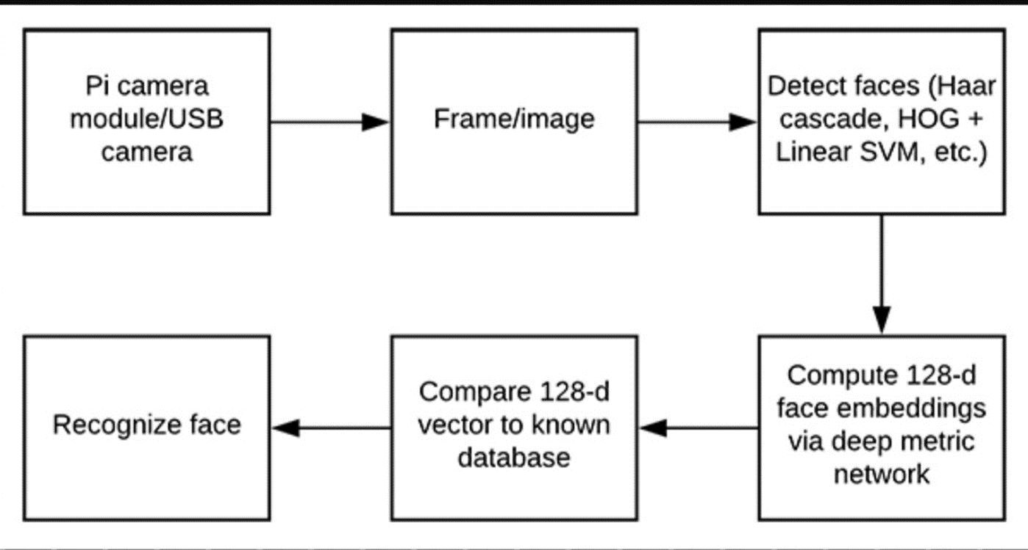
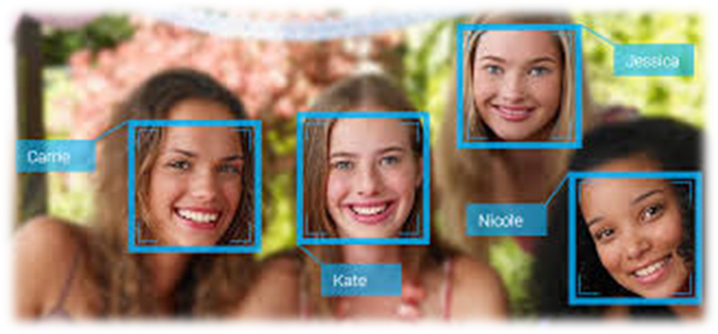
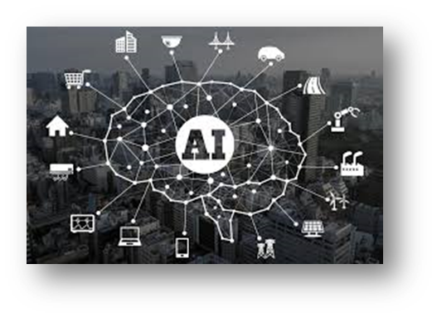
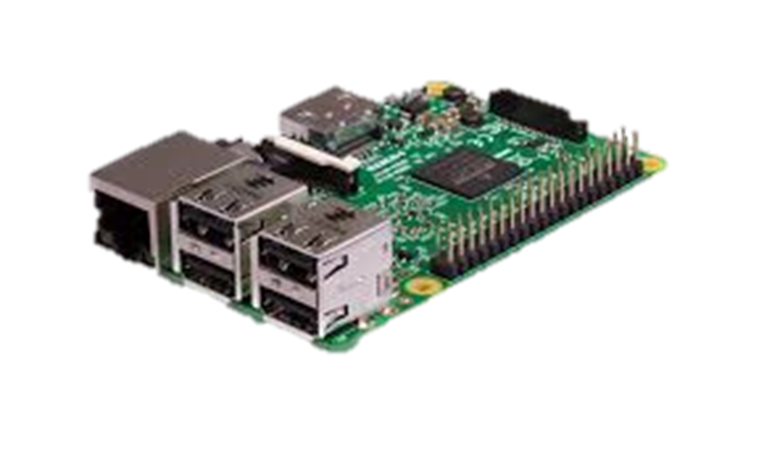
THIRD EYE FOR THE BLIND
Taha Junaid [18BCD7072] ,Mohd Taquiddin [18BCN7050] ,Darrain Saa-eyd [18BCN7009] ,Shoaeb Nawab Shaik [18BCE7067] , P.Sai Teja [18MIS7109] ,Chaitanya [18MIS7259] | Prof.Asish Kumar Dalai| VIT-AP
Introduction
Results
The whole device has multiple modules which are essential for reading text ,setting alarms/remainders and face recognition which works on raspberry pi.
Text reading is controlling the peripherals like Camera, speaker and LCD which act as an interface between the system and the user.
Optical Character Recognition or OCR is implemented in this project to recognize characters which are then read out by the system through a speaker.
Camera is mounted on a stand in such a position that if a paper is placed in between the area marked by angular braces, it captures a full view of the paper into the system.
Also, when the camera takes the snapshot of the paper, it is ensured that there is good lighting conditions.
Face recognition:In order to perform face recognition on the Raspberry Pi you first need to consider a few optimizations — otherwise, the face recognition pipeline would fall flat on its face.
Namely, on which machine you are computing your face recognition embeddings for your training set (i.e., onboard the Raspberry Pi, on a laptop/desktop, on a machine with a GPU), the method you are using for face detection (Haar cascades, HOG + Linear SVM, or CNNs), polling for frames from your camera sensor (threaded vs. non-threaded).
We will be using a deep neural network to compute a 128-d vector (i.e., a list of 128 floating point values) that will quantify each face in the dataset.
SCOPE OF PROJECT
The major objective of the project is to make a blind person access to all benefits of his surroundings. This module that is prepared can replace braille. This can read out either through a speaker or headphones.
METHODOLOGY
CONCLUSION/SUMMARY
The final conclusion of the project would be helping the blind in the way of helping them to read , recognize someone and access all the benefits surrounding him. As a future scope we are going to include Lithium Polymer battery to get a module which would be independent of the need for a wall socket for power supply.We also include reader for the blind which would conver written text into speech output , we will use specially designed boards instead to Aurdino , Raspberry-pi.
CONTACT DETAILS
*taha.18bcd7072@vitap.ac.in
*saaeyd.18bcn7009@vitap.ac.in
*taqiuddin.18bcn7050@vitap.ac.in
*shoaeb.18bec7067@vitap.ac.in
*saiteja.18mis7109@vitap.ac.in
*chaitanya.18mis7259@vitap.ac.in
REFERENCES
1. https://www.raspberrypi.org/blog/learning-python-with-raspberry-pi/
2. https://www.hackster.io/Rjuarez7/raspberry-pi-3-face-detection-in-python-2-and-opencv-2-2b06bf
3. https://www.instructables.com/id/Google-Assistant-on-a-Raspberry-Pi/
4. https://www.irjet.net/archives/V5/i6/IRJET-V5I6306.pdf
5. https://www.hackster.io/mjrobot/real-time-face-recognition-an-end-to-end-project-a10826
There are several steps involved in the Project. • Initially it can take a picture of the image that is kept in between the square braces. • Later using a AI(Google Assistant) tracks quota usage and gives you valuable.
Using PI camera module/USB camera it detects the given image using method Haar cascades ,HOG + Linear SVM , or CNNs.
It computes 128-2d face embeddings via deep metric network.
It compares 128-d vector to known database and recognizes the face.
The AI installed in the module would give them walking directions to the nearest saloon or so. • There are many other extra added components like, it can read date, time and day.
The final result of the project would be reading out the text in the image , recognising face. As some extra added components are involved, it can read out date, time and, date also and get alarms, give directions also

