Slide 1
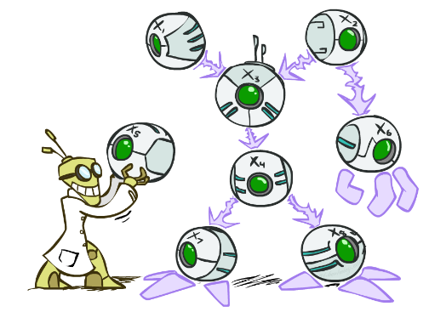
Bayes’ Nets
These slides are adopted from AI courses at UC Berkeley and UIUC

Slide 2
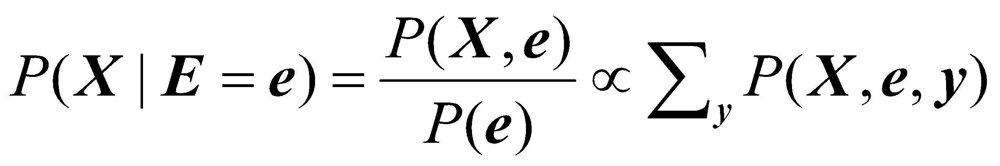
Another look at Bayesian inference
A general scenario:
Query variables: X
Evidence (observed) variables and their values: E = e
Unobserved variables: Y
Inference problem: answer questions about the query variables given the evidence variables
This can be done using the posterior distribution P(X | E = e)
In turn, the posterior needs to be derived from the full joint P(X, E, Y)
Bayesian networks are a tool for representing joint probability distributions efficiently
Notes:
‹#›
‹#›

Slide 3


Bayesian networks
More commonly called graphical models
A way to depict conditional independence relationships between random variables
A compact specification of full joint distributions
Notes:
‹#›

Slide 4
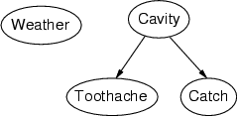
Bayesian networks: Structure
Nodes: random variables
Arcs: interactions
An arrow from one variable to another indicates direct influence
Must form a directed, acyclic
Notes:
‹#›

Slide 5

Example: N independent coin flips
Complete independence: no interactions
…
X₁
X₂
X_{n}
Notes:
‹#›

Slide 6
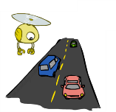
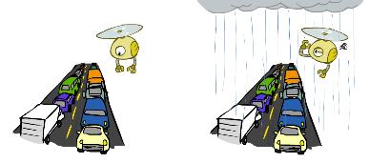
Example: Traffic
Variables:
R: It rains
T: There is traffic
Model 1: independence Mode1 2: rain causes traffic
Why is an agent using model 2 better?
R
R
T
T

Slide 7
Example: Naïve Bayes document model
Random variables:
X: document class
W₁, …, W_{n}: words in the document
X
…
W₁
W₂
W_{n}
Notes:
‹#›

Slide 8
Example: Burglar Alarm
I have a burglar alarm that is sometimes set off by minor earthquakes. My two neighbors, John and Mary, promised to call me at work if they hear the alarm
Example inference tasks
Suppose Mary calls and John doesn’t call. What is the probability of a burglary?
Suppose there is a burglary and no earthquake. What is the probability of John calling?
Suppose the alarm went off. What is the probability of burglary?
Notes:
‹#›

Slide 9
Example: Burglar Alarm
I have a burglar alarm that is sometimes set off by minor earthquakes. My two neighbors, John and Mary, promised to call me at work if they hear the alarm
What are the random variables?
Burglary, Earthquake, Alarm, John, Mary
What are the direct influence relationships?
A burglar can set the alarm off
An earthquake can set the alarm off
The alarm can cause Mary to call
Notes:
‹#›

Slide 10
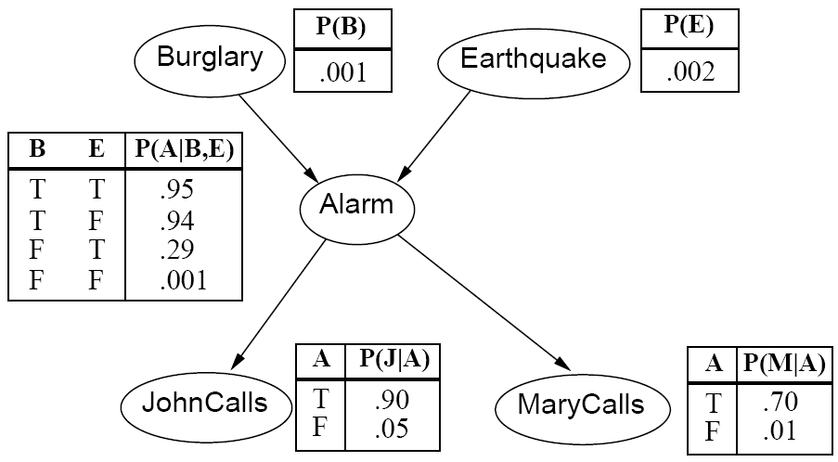
Example: Burglar Alarm
Notes:
‹#›

Slide 11
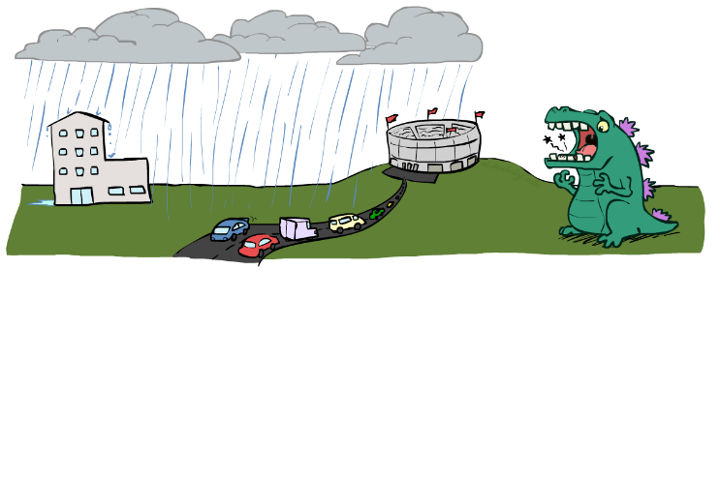
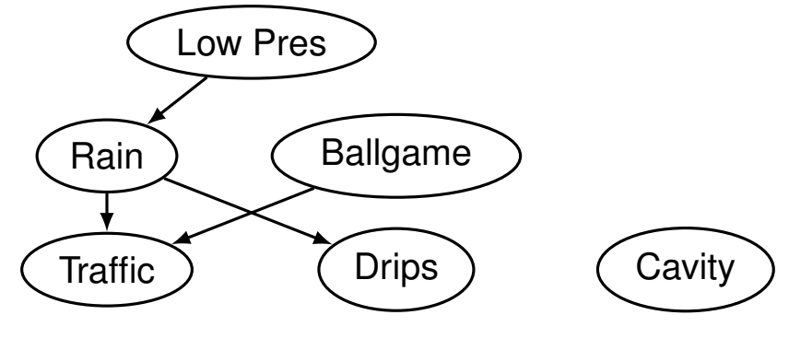
Example: Traffic II
Variables
T: Traffic
R: It rains
L: Low pressure
D: Roof drips
B: Football match
C: Cavity

Slide 12
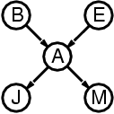
Conditional independence relationships
Suppose the alarm went off. Does knowing whether there was a burglary change the probability of John calling?
P(John | Alarm, Burglary) = P(John | Alarm)
Notes:
‹#›

Slide 13
Conditional independence relationships
Suppose the alarm went off. Does knowing whether there was a burglary change the probability of John calling?
P(John | Alarm, Burglary) = P(John | Alarm)
Suppose the alarm went off. Does knowing whether John called change the probability of Mary calling?
P(Mary | Alarm, John) = P(Mary | Alarm)
Notes:
‹#›

Slide 14
Conditional independence relationships
Suppose the alarm went off. Does knowing whether there was a burglary change the probability of John calling?
P(John | Alarm, Burglary) = P(John | Alarm)
Suppose the alarm went off. Does knowing whether John called change the probability of Mary calling?
P(Mary | Alarm, John) = P(Mary | Alarm)
Suppose the alarm went off. Does knowing whether there was an earthquake change the probability of burglary?
P(Burglary | Alarm, Earthquake) != P(Burglary | Alarm)
Notes:
‹#›

Slide 15
Conditional independence relationships
Suppose the alarm went off. Does knowing whether there was a burglary change the probability of John calling?
P(John | Alarm, Burglary) = P(John | Alarm)
Suppose the alarm went off. Does knowing whether John called change the probability of Mary calling?
P(Mary | Alarm, John) = P(Mary | Alarm)
Suppose the alarm went off. Does knowing whether there was an earthquake change the probability of burglary?
P(Burglary | Alarm, Earthquake) != P(Burglary | Alarm)
Suppose there was a burglary. Does knowing whether John called change the probability that the alarm went off?
P(Alarm | Burglary, John) != P(Alarm | Burglary)
Notes:
‹#›

Slide 16
Conditional independence relationships
John and Mary are conditionally independent of Burglary and Earthquake given Alarm
Children are conditionally independent of ancestors given parents
Notes:
‹#›

Slide 17
Conditional independence relationships
John and Mary are conditionally independent of Burglary and Earthquake given Alarm
Children are conditionally independent of ancestors given parents
John and Mary are conditionally independent of each other given Alarm
Siblings are conditionally independent of each other given parents
Notes:
‹#›

Slide 18
Conditional independence relationships
John and Mary are conditionally independent of Burglary and Earthquake given Alarm
Children are conditionally independent of ancestors given parents
John and Mary are conditionally independent of each other given Alarm
Siblings are conditionally independent of each other given parents
Burglary and Earthquake are not conditionally independent of each other given Alarm
Parents are not conditionally independent given children
Notes:
‹#›

Slide 19
Conditional independence relationships
John and Mary are conditionally independent of Burglary and Earthquake given Alarm
Children are conditionally independent of ancestors given parents
John and Mary are conditionally independent of each other given Alarm
Siblings are conditionally independent of each other given parents
Burglary and Earthquake are not conditionally independent of each other given Alarm
Parents are not conditionally independent given children
Alarm is not conditionally independent of John and Mary given Burglary and Earthquake
Nodes are not conditionally independent of children given parents
General rule:
Each node is conditionally independent of its non-descendants given its parents
Notes:
‹#›

Slide 20
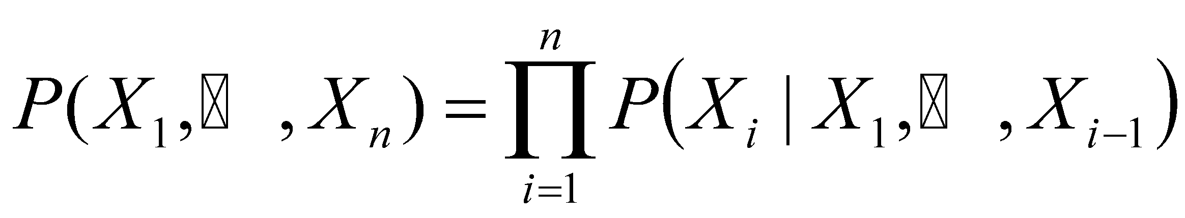
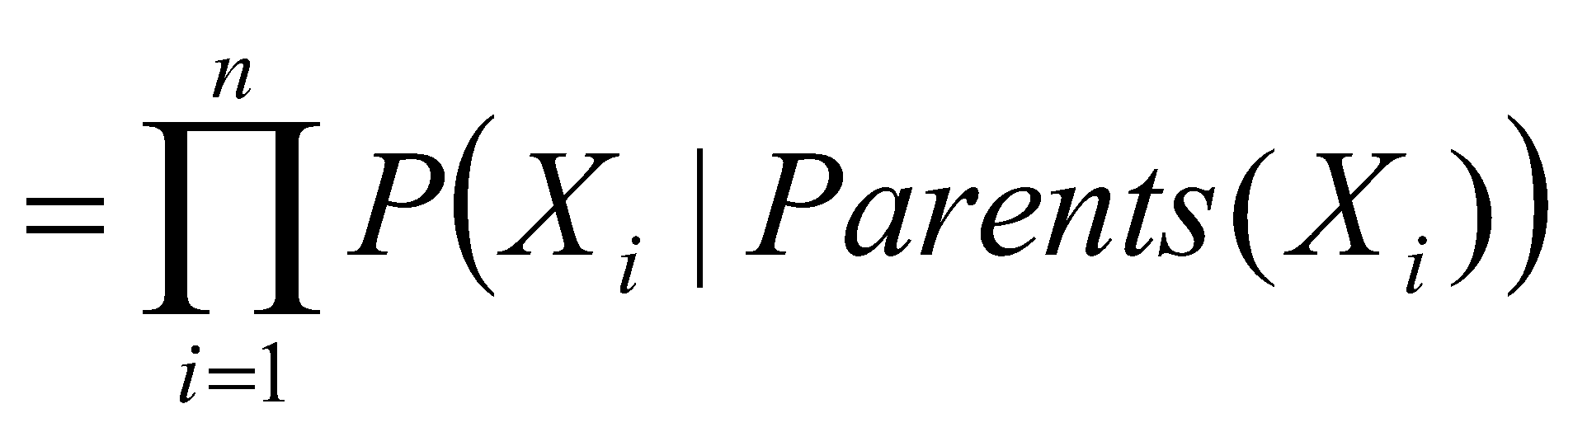
Conditional independence and the joint distribution
General rule: each node is conditionally independent of its non-descendants given its parents
Suppose the nodes X₁, …, X_{n} are sorted in topological order (parents before children)
To get the joint distribution P(X₁, …, X_{n}), use chain rule:
Notes:
‹#›

Slide 21
Conditional probability distributions
To specify the full joint distribution, we need to specify a conditional distribution for each node given its parents: P (X | Parents(X))
…
Z₁
Z₂
Z_{n}
X
P (X | Z₁, …, Z_{n})
Notes:
‹#›

Slide 22
Example: Burglar Alarm
The conditional probability tables are the model parameters
Notes:
‹#›

Slide 23
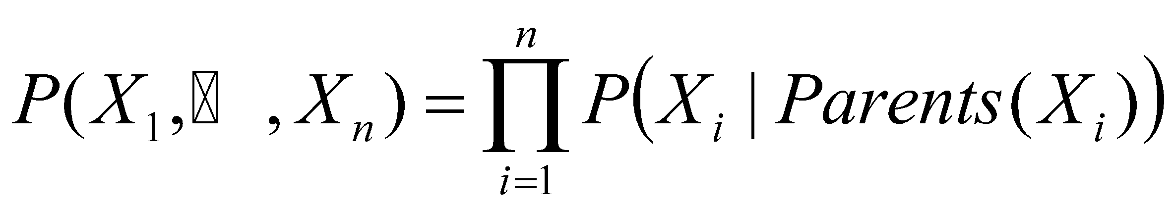
The joint probability distribution
For example, P(j, m, a, ¬b, ¬e)
= P(¬b) P(¬e) P(a | ¬b, ¬e) P(j | a) P(m | a)
Notes:
‹#›

Slide 24
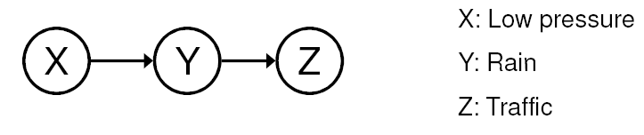
Conditional independence
General rule: X is conditionally independent of every non-descendant node given its parents
Example: causal chain
Are X and Z independent?
Notes:
‹#›

Slide 25
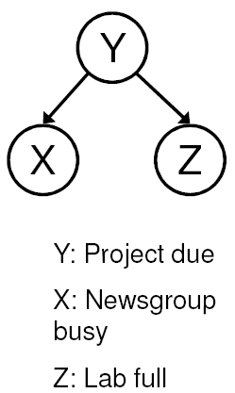
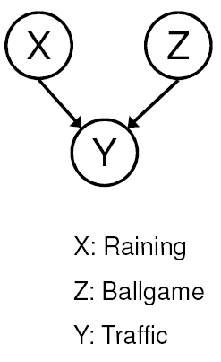
Conditional independence
Common cause
Are X and Z independent?
No
Are they conditionally independent given Y?
Yes
Common effect
Are X and Z independent?
Yes
Are they conditionally independent given Y?
No
Notes:
Is P(Raining | Traffic) the same as P(Raining | Traffic, Ballgame)?
‹#›

Slide 26
Compactness
Suppose we have a Boolean variable X_{i} with k Boolean parents. How many rows does its conditional probability table have?
2^{k} rows for all the combinations of parent values
Each row requires one number for P(X_{i} = true | parent values)
If each variable has no more than k parents, how many numbers does the complete network require?
O(n · 2^{k}) numbers – vs. O(2^{n}) for the full joint distribution
How many rows for the burglary network?
1 + 1 + 4 + 2 + 2 = 10 numbers (vs. 2⁵
Notes:
‹#›

Slide 27
Constructing Bayesian networks
Choose an ordering of variables X₁, … , X_{n}
For i = 1 to n
add X_{i} to the network
select parents from X₁, … ,X_{i-1} such that P(X_{i} | X₁, ... X_{i-1}) = P(X_{i} | Parents(X_{i}))
Notes:
‹#›

Slide 28
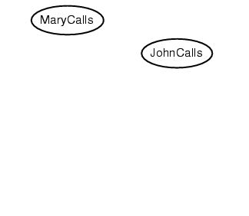
Example
Suppose we choose the ordering M, J, A, B,
Notes:
‹#›

Slide 29
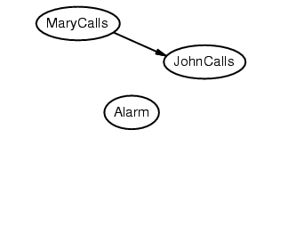
Example
Suppose we choose the ordering M, J, A, B, E
Notes:
‹#›

Slide 30
Example
Suppose we choose the ordering M, J, A, B, E
Notes:
‹#›

Slide 31
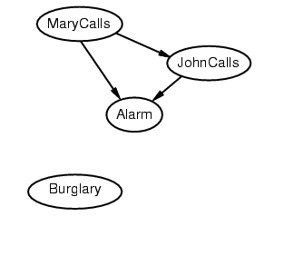
Example
Suppose we choose the ordering M, J, A, B, E
Notes:
‹#›

Slide 32
Example
Suppose we choose the ordering M, J, A, B, E
Notes:
‹#›

Slide 33
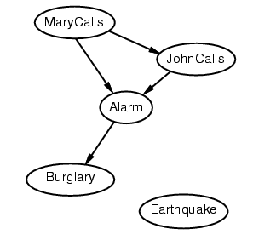
Example
Suppose we choose the ordering M, J, A, B, E
Notes:
‹#›

Slide 34
Example
Suppose we choose the ordering M, J, A, B, E
Notes:
‹#›

Slide 35
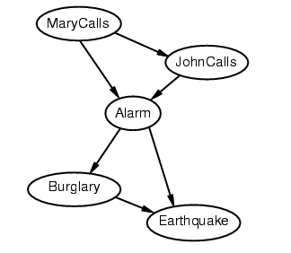
Example
Suppose we choose the ordering M, J, A, B, E
Notes:
‹#›

Slide 36
Example contd.
Deciding conditional independence is hard in noncausal directions
The causal direction seems much more natural
Network is less compact: 1 + 2 + 4 + 2 + 4 = 13 numbers needed (vs. 10 for the causal ordering)
Notes:
‹#›

Slide 37
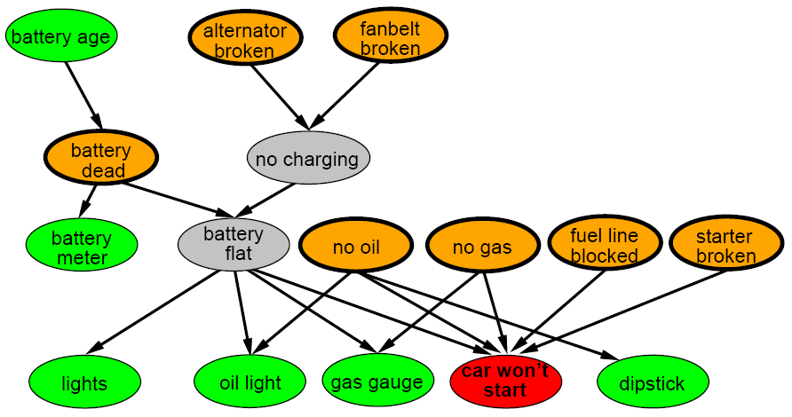
A more realistic Bayes Network: Car diagnosis
Notes:
‹#›

Slide 38
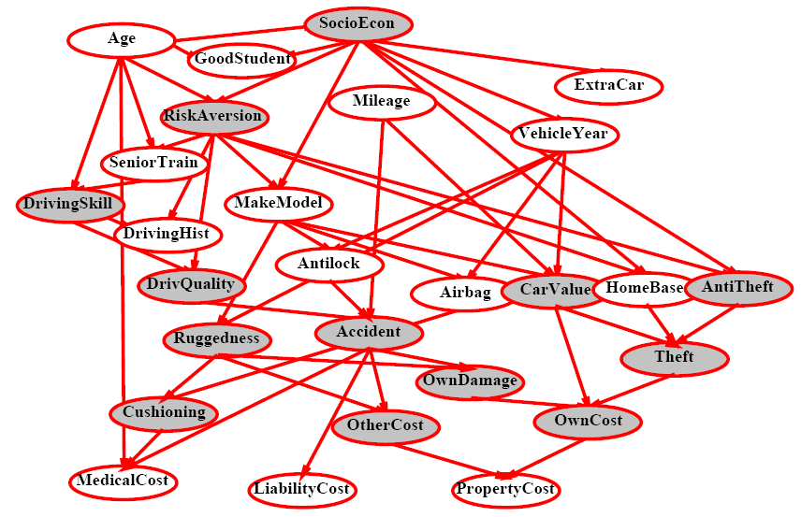
Car insurance
Notes:
‹#›

Slide 39
Summary
Bayesian networks provide a natural representation for (causally induced) conditional independence
Topology + conditional probability tables
Generally easy for domain experts to construct
Notes:
‹#›

