Slide 1
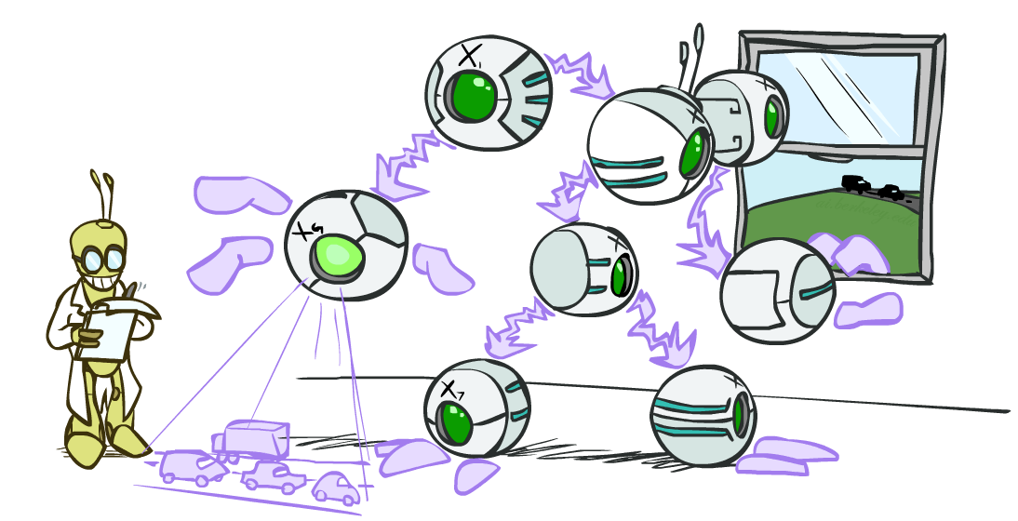
Artificial Intelligence
Bayes’ Nets: Inference
[Slides by Dan Klein, Pieter Abbeel, Anca Dragan. http://ai.berkeley.edu.]
Notes:
Please retain proper attribution, including the reference to ai.berkeley.edu. Thanks!

Slide 2
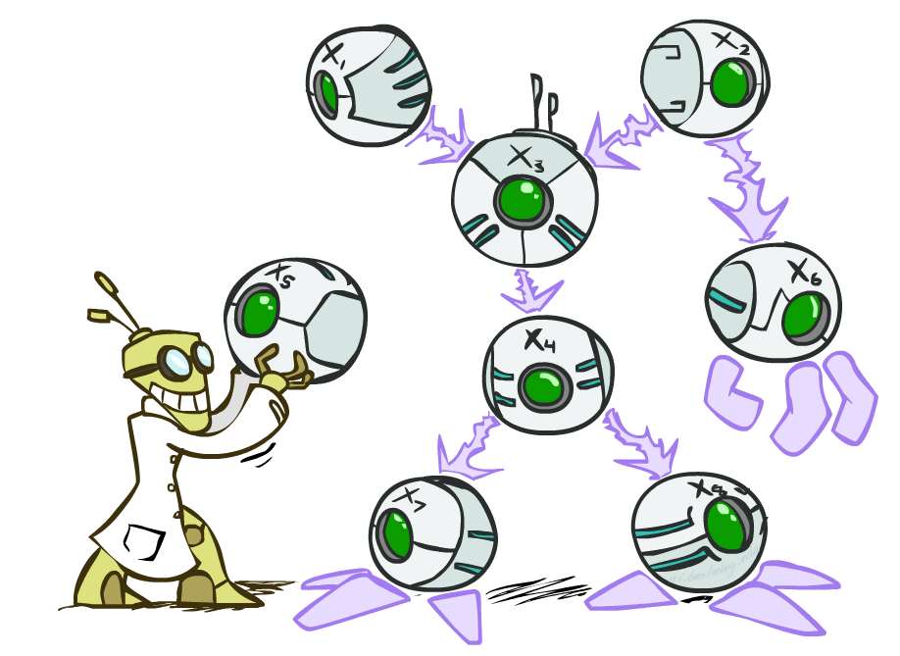

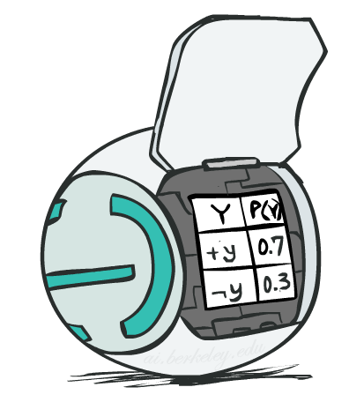
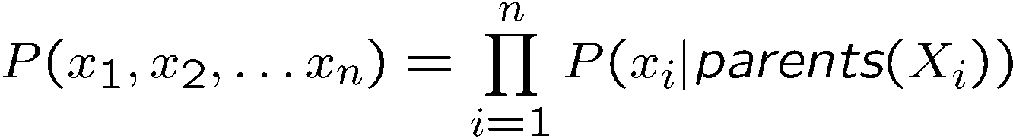
Bayes’ Net Representation
A directed, acyclic graph, one node per random variable
A conditional probability table (CPT) for each node
A collection of distributions over X, one for each combination of parents’ values
Bayes’ nets implicitly encode joint distributions
As a product of local conditional distributions
To see what probability a BN gives to a full assignment, multiply all the relevant conditionals together:

Slide 3
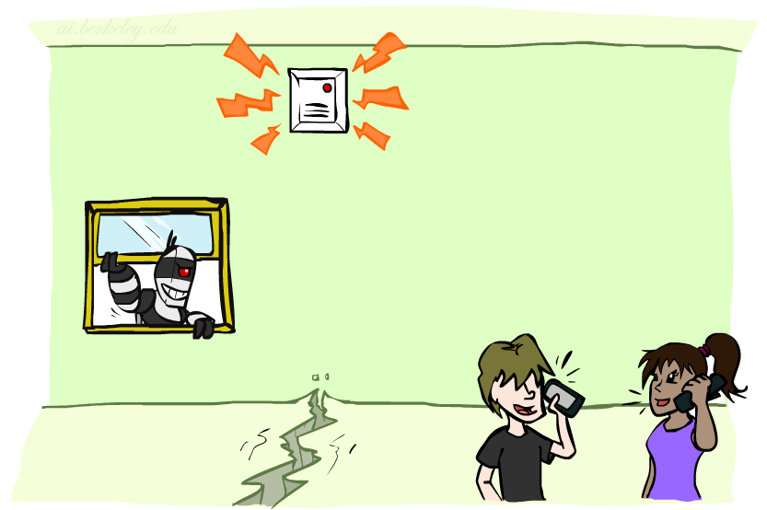
Example: Alarm Network
B | P(B)
+b | 0.001
-b | 0.999
E | P(E)
+e | 0.002
-e | 0.998
Burglary
Earthqk
Alarm
B | E | A | P(A|B,E)
+b | +e | +a | 0.95
+b | +e | -a | 0.05
+b | -e | +a | 0.94
+b | -e | -a | 0.06
-b | +e | +a | 0.29
-b | +e | -a | 0.71
-b | -e | +a | 0.001
-b | -e | -a | 0.999
John calls
Mary calls
A | J | P(J|A)
+a | +j | 0.9
+a | -j | 0.1
-a | +j | 0.05
-a | -j | 0.95
A | M | P(M|A)
+a | +m | 0.7
+a | -m | 0.3
-a | +m | 0.01
-a | -m | 0.99
Notes:
Demo:
Draw network
Specify the CPTs
Then query, e.g., Mary Calls --- not something we specified, inference computed this for us
P(B) = ?
P(B | +e) = ?
Independence
P(B) = ?
P(B | +m) = ?
Show explaining away

Slide 4
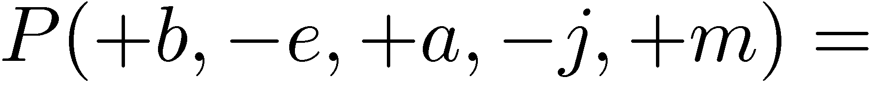
Example: Alarm Network
B | P(B)
+b | 0.001
-b | 0.999
E | P(E)
+e | 0.002
-e | 0.998
B
E
A
A | J | P(J|A)
+a | +j | 0.9
+a | -j | 0.1
-a | +j | 0.05
-a | -j | 0.95
A | M | P(M|A)
+a | +m | 0.7
+a | -m | 0.3
-a | +m | 0.01
-a | -m | 0.99
B | E | A | P(A|B,E)
+b | +e | +a | 0.95
+b | +e | -a | 0.05
+b | -e | +a | 0.94
+b | -e | -a | 0.06
-b | +e | +a | 0.29
-b | +e | -a | 0.71
-b | -e | +a | 0.001
-b | -e | -a | 0.999
J
M
Notes:
demo

Slide 5

Example: Alarm Network
B | P(B)
+b | 0.001
-b | 0.999
E | P(E)
+e | 0.002
-e | 0.998
B
E
A
A | J | P(J|A)
+a | +j | 0.9
+a | -j | 0.1
-a | +j | 0.05
-a | -j | 0.95
A | M | P(M|A)
+a | +m | 0.7
+a | -m | 0.3
-a | +m | 0.01
-a | -m | 0.99
B | E | A | P(A|B,E)
+b | +e | +a | 0.95
+b | +e | -a | 0.05
+b | -e | +a | 0.94
+b | -e | -a | 0.06
-b | +e | +a | 0.29
-b | +e | -a | 0.71
-b | -e | +a | 0.001
-b | -e | -a | 0.999
J
M
Notes:
demo

Slide 6

Inference
Inference: calculating some useful quantity from a joint probability distribution
Examples:
Posterior probability
Most likely explanation:

Slide 7





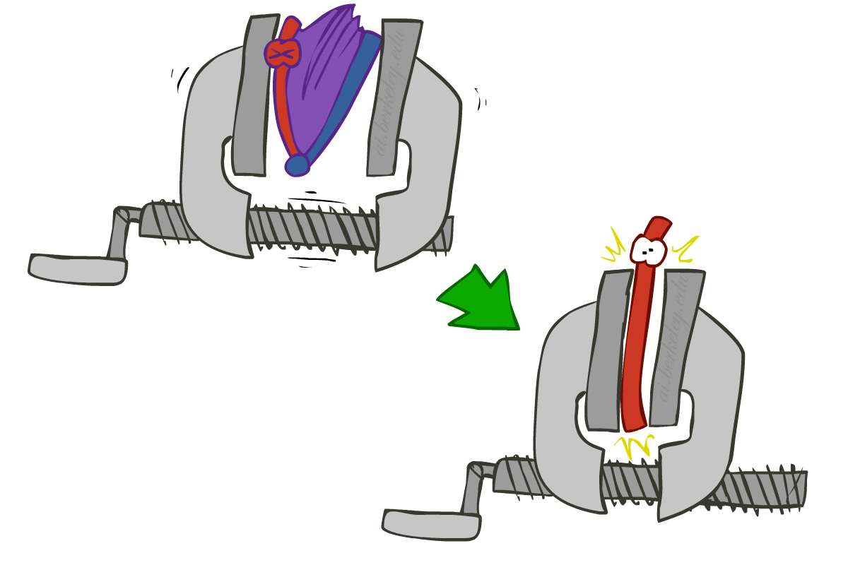
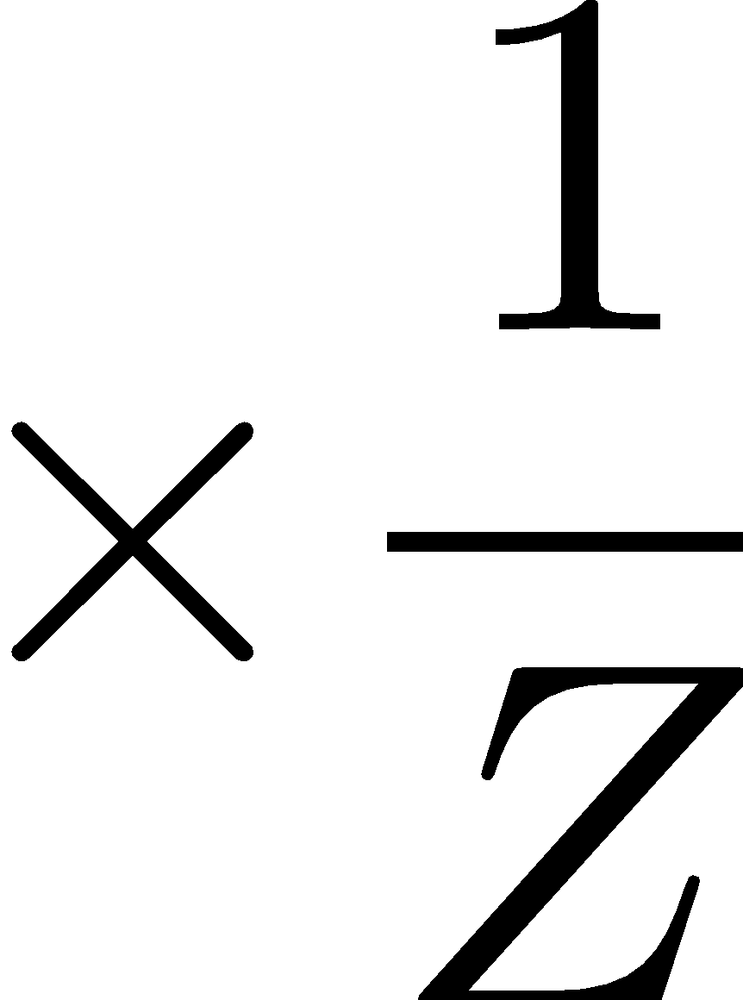
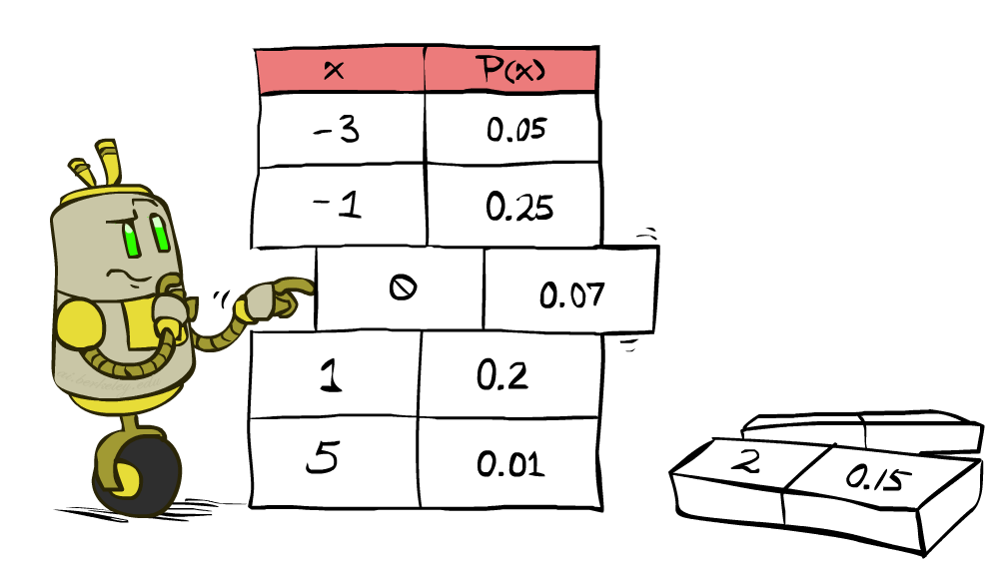


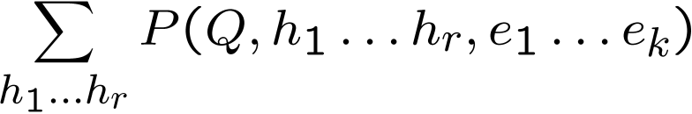
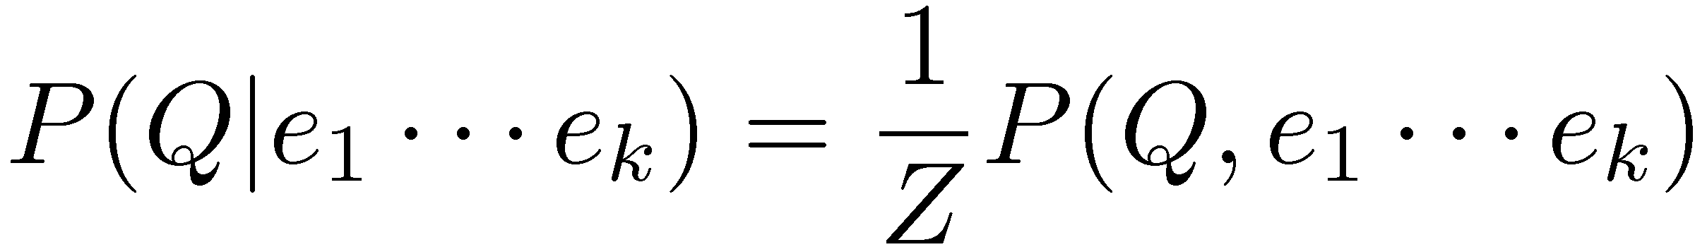
Inference by Enumeration
* Works fine with multiple query variables, too
General case:
Evidence variables:
Query* variable:
Hidden variables:
We want:
All variables
Step 1: Select the entries consistent with the evidence
Step 2: Sum out H to get joint of Query and evidence
Step 3: Normalize

Slide 8
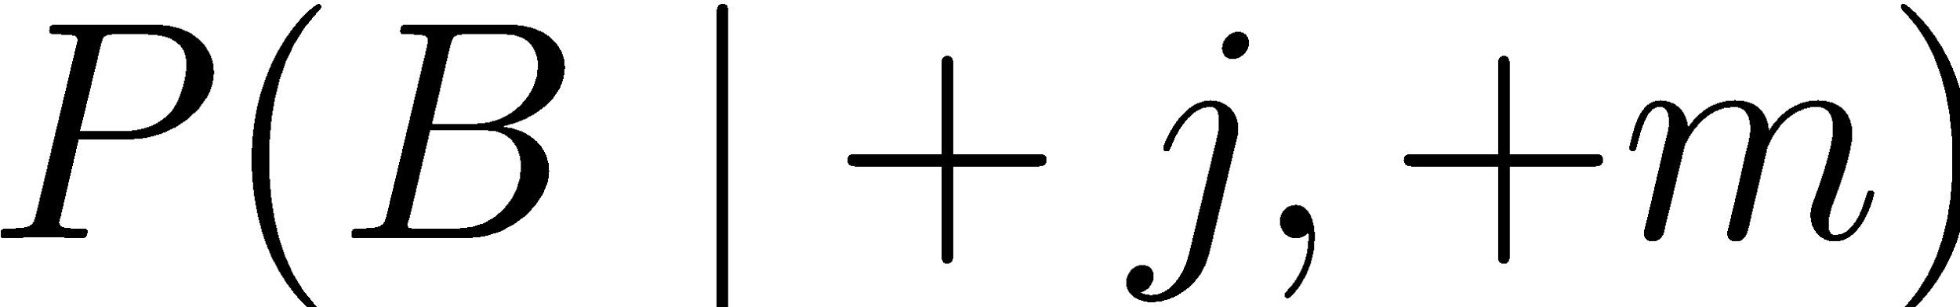
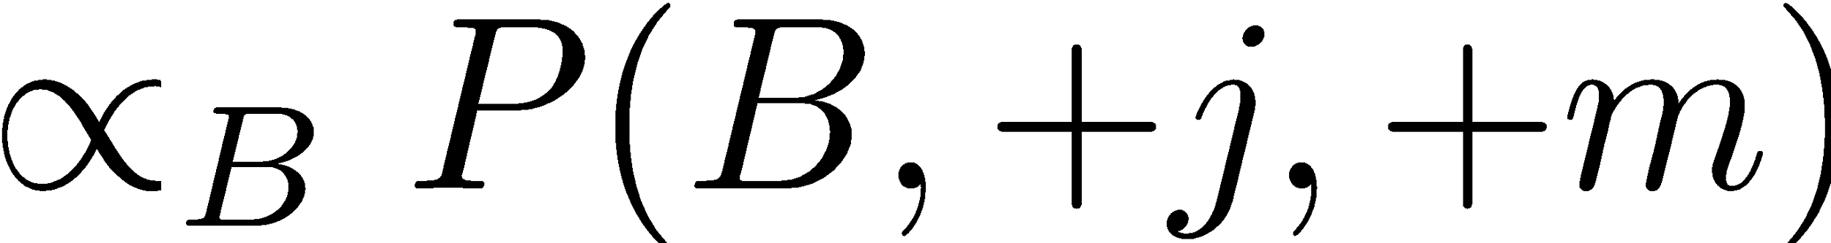
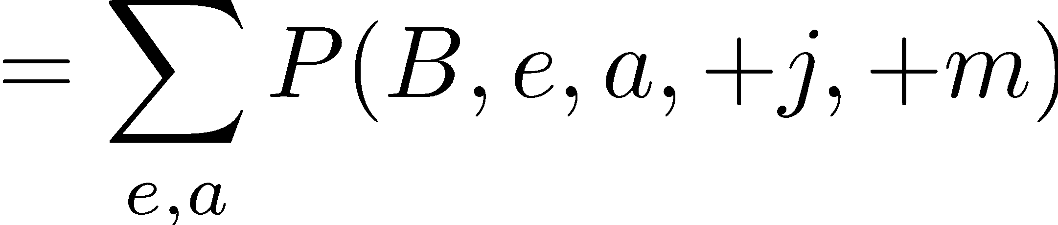
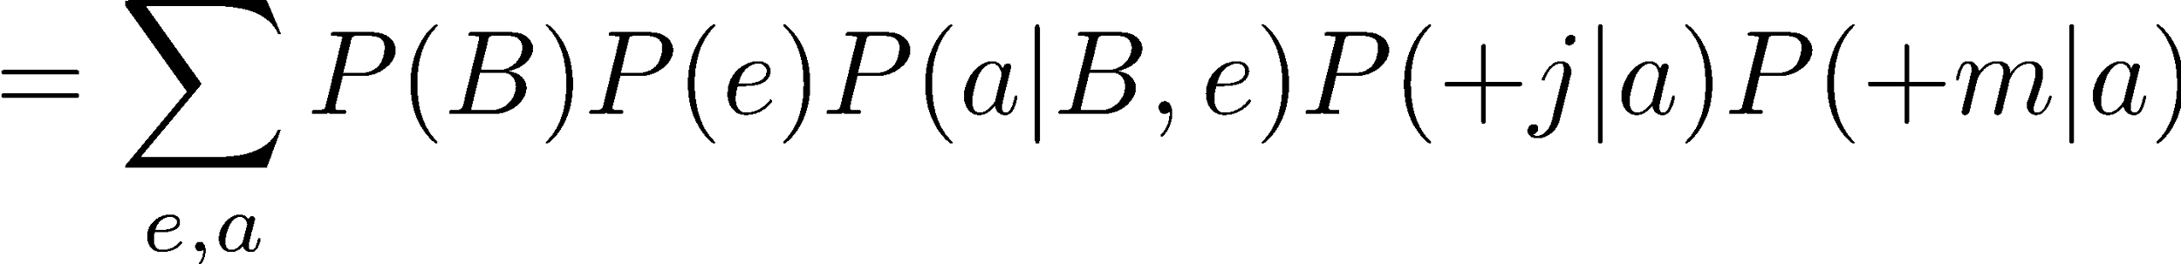
Inference by Enumeration in Bayes’ Net
Given unlimited time, inference in BNs is easy
B
E
A
J
M

Slide 9
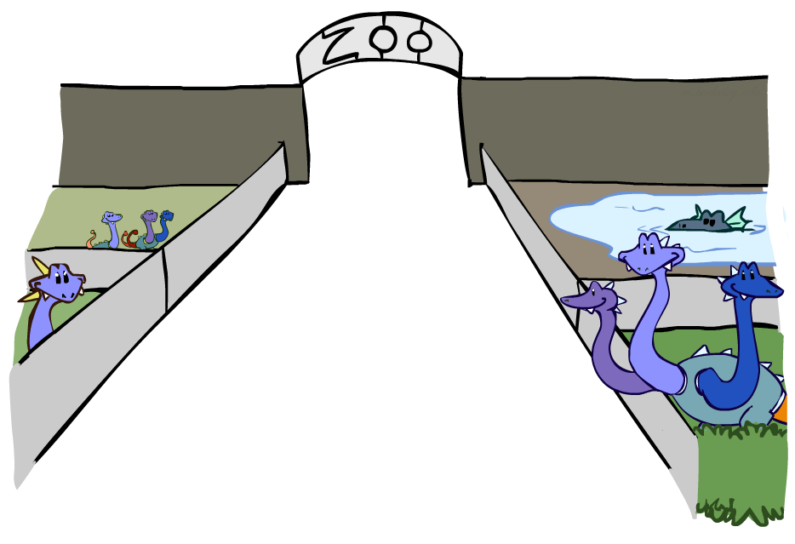
Factor Zoo

Slide 10



Factor Zoo I
Joint distribution: P(X,Y)
Entries P(x,y) for all x, y
Sums to 1
Selected joint: P(x,Y)
A slice of the joint distribution
Entries P(x,y) for fixed x, all y
Sums to P(x)
Number of capitals = dimensionality of the table
T | W | P
hot | sun | 0.4
hot | rain | 0.1
cold | sun | 0.2
cold | rain | 0.3
T | W | P
cold | sun | 0.2
cold | rain | 0.3

Slide 11
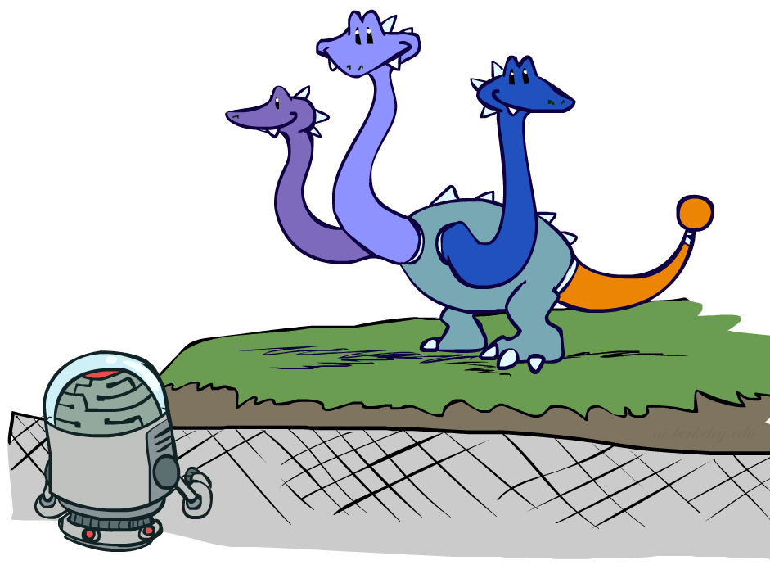

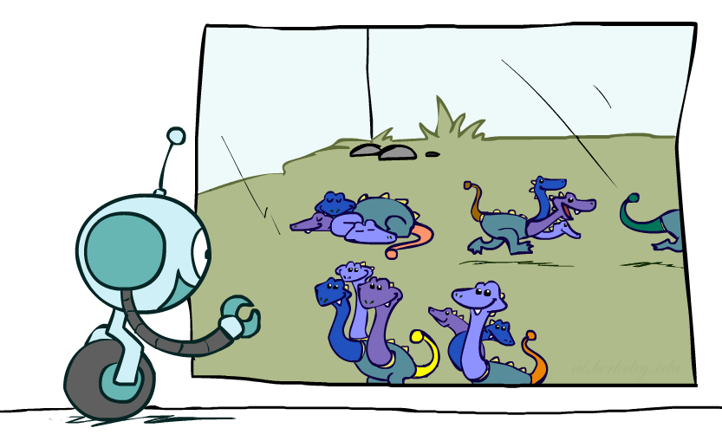



Factor Zoo II
Single conditional: P(Y | x)
Entries P(y | x) for fixed x, all y
Sums to 1
Family of conditionals:
P(X |Y)
Multiple conditionals
Entries P(x | y) for all x, y
Sums to |Y|
T | W | P
cold | sun | 0.4
cold | rain | 0.6
T | W | P
hot | sun | 0.8
hot | rain | 0.2
cold | sun | 0.4
cold | rain | 0.6

Slide 12
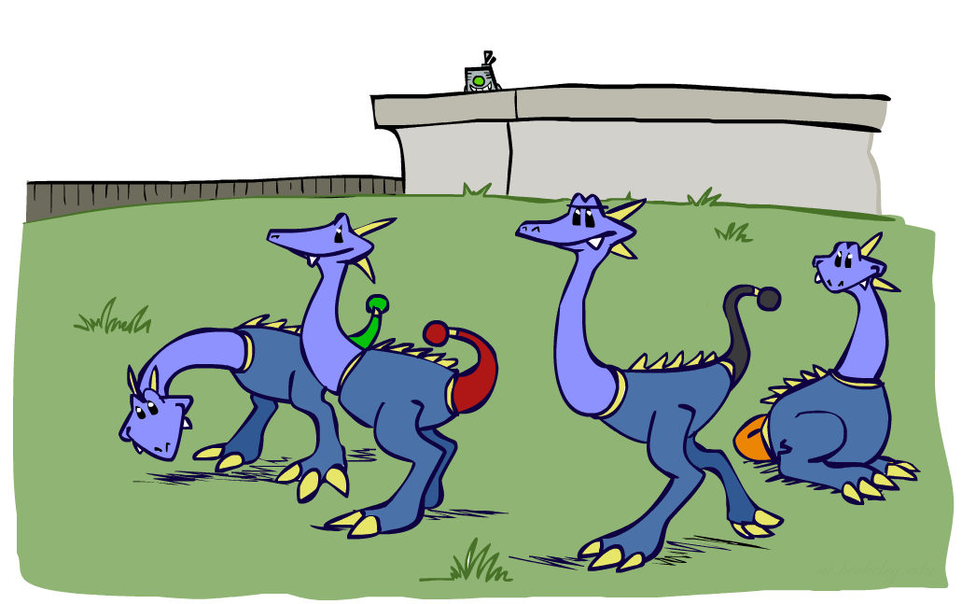



Factor Zoo III
Specified family: P( y | X )
Entries P(y | x) for fixed y,
but for all x
Sums to … who knows!
T | W | P
hot | rain | 0.2
cold | rain | 0.6

Slide 13




Factor Zoo Summary
In general, when we write P(Y₁ … Y_{N} | X₁ … X_{M})
It is a “factor,” a multi-dimensional array
Its values are P(y₁ … y_{N} | x₁ … x_{M})
Any assigned (=lower-case) X or Y is a dimension missing (selected) from the array

Slide 14
Inference by Enumeration
* Works fine with multiple query variables, too
General case:
Evidence variables:
Query* variable:
Hidden variables:
We want:
All variables
Step 1: Select the entries consistent with the evidence
Step 2: Sum out H to get joint of Query and evidence
Step 3: Normalize
Compute joint
Sum out hidden variables

Slide 15


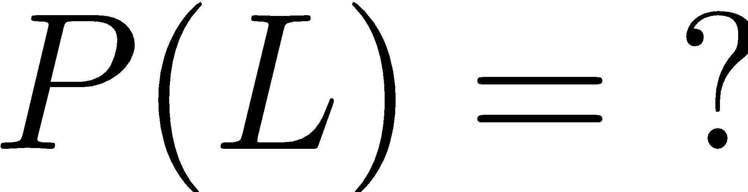
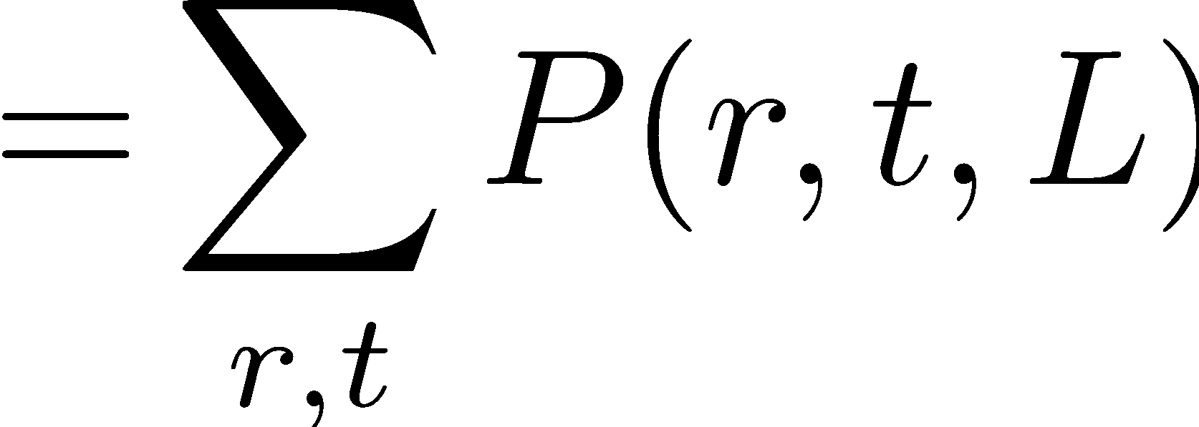

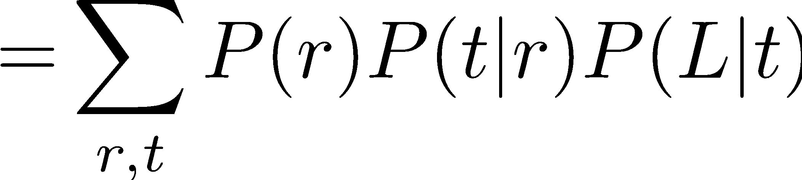
Example: Traffic Domain
Random Variables
R: Raining
T: Traffic
L: Late for class!
+r | 0.1
-r | 0.9
R
T
+r | +t | 0.8
+r | -t | 0.2
-r | +t | 0.1
-r | -t | 0.9
L
+t | +l | 0.3
+t | -l | 0.7
-t | +l | 0.1
-t | -l | 0.9

Slide 16







Inference by Enumeration: Procedural Outline
Track objects called factors
Initial factors are local CPTs (one per node)
Any known values are selected
E.g. if we know , the initial factors are
Procedure: Join all factors, then sum out all hidden variables
+r | 0.1
-r | 0.9
+r | +t | 0.8
+r | -t | 0.2
-r | +t | 0.1
-r | -t | 0.9
+t | +l | 0.3
+t | -l | 0.7
-t | +l | 0.1
-t | -l | 0.9
+r | 0.1
-r | 0.9
+r | +t | 0.8
+r | -t | 0.2
-r | +t | 0.1
-r | -t | 0.9
+t | +l | 0.3
-t | +l | 0.1

Slide 17





Operation 1: Join Factors
First basic operation: joining factors
Combining factors:
Just like a database join
Get all factors over the joining variable
Build a new factor over the union of the variables involved
Example: Join on R
Computation for each entry: pointwise products
R
+r | 0.1
-r | 0.9
+r | +t | 0.8
+r | -t | 0.2
-r | +t | 0.1
-r | -t | 0.9
+r | +t | 0.08
+r | -t | 0.02
-r | +t | 0.09
-r | -t | 0.81
R,T
T

Slide 18
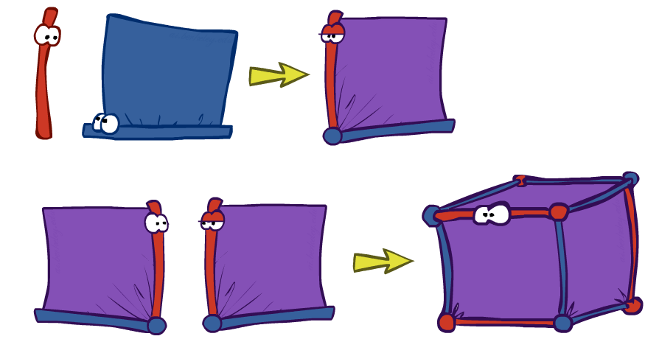
Example: Multiple Joins

Slide 19



Example: Multiple Joins
+r | 0.1
-r | 0.9
R
Join R
Join T
+r | +t | 0.08
+r | -t | 0.02
-r | +t | 0.09
-r | -t | 0.81
R, T, L
T
+r | +t | 0.8
+r | -t | 0.2
-r | +t | 0.1
-r | -t | 0.9
R, T
+r | +t | +l | 0.024
+r | +t | -l | 0.056
+r | -t | +l | 0.002
+r | -t | -l | 0.018
-r | +t | +l | 0.027
-r | +t | -l | 0.063
-r | -t | +l | 0.081
-r | -t | -l | 0.729
L
L
+t | +l | 0.3
+t | -l | 0.7
-t | +l | 0.1
-t | -l | 0.9
+t | +l | 0.3
+t | -l | 0.7
-t | +l | 0.1
-t | -l | 0.9

Slide 20
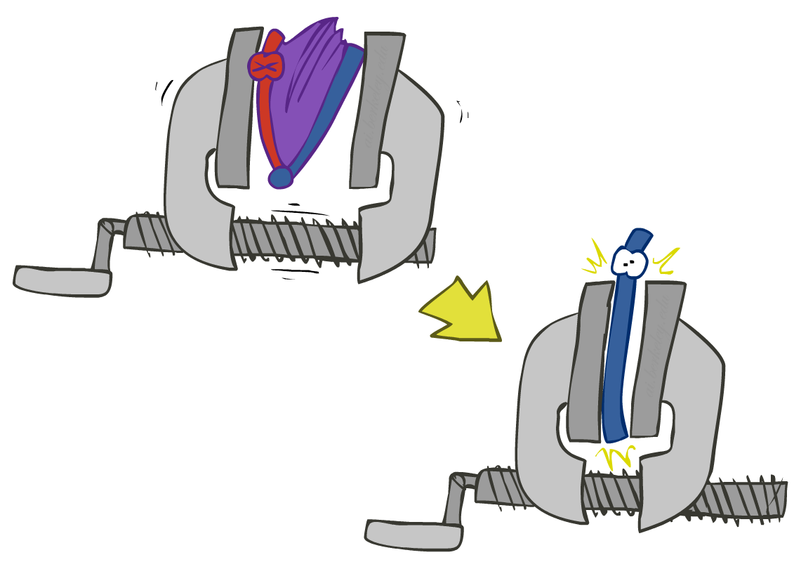


Operation 2: Eliminate
Second basic operation: marginalization
Take a factor and sum out a variable
Shrinks a factor to a smaller one
A projection operation
Example:
+r | +t | 0.08
+r | -t | 0.02
-r | +t | 0.09
-r | -t | 0.81
+t | 0.17
-t | 0.83

Slide 21



Multiple Elimination
R, T, L
T, L
L
+r | +t | +l | 0.024
+r | +t | -l | 0.056
+r | -t | +l | 0.002
+r | -t | -l | 0.018
-r | +t | +l | 0.027
-r | +t | -l | 0.063
-r | -t | +l | 0.081
-r | -t | -l | 0.729
Sum
out R
Sum
out T
+t | +l | 0.051
+t | -l | 0.119
-t | +l | 0.083
-t | -l | 0.747
+l | 0.134
-l | 0.866

Slide 22
Thus Far: Multiple Join, Multiple Eliminate (= Inference by Enumeration)

Slide 23
Inference by Enumeration
* Works fine with multiple query variables, too
General case:
Evidence variables:
Query* variable:
Hidden variables:
We want:
All variables
Step 1: Select the entries consistent with the evidence
Step 2: Sum out H to get joint of Query and evidence
Step 3: Normalize
Compute joint
Sum out hidden variables

Slide 24
Thus Far: Multiple Join, Multiple Eliminate (= Inference by Enumeration)
Compute joint
Sum out hidden variables
[Step 3: Normalize]

Slide 25
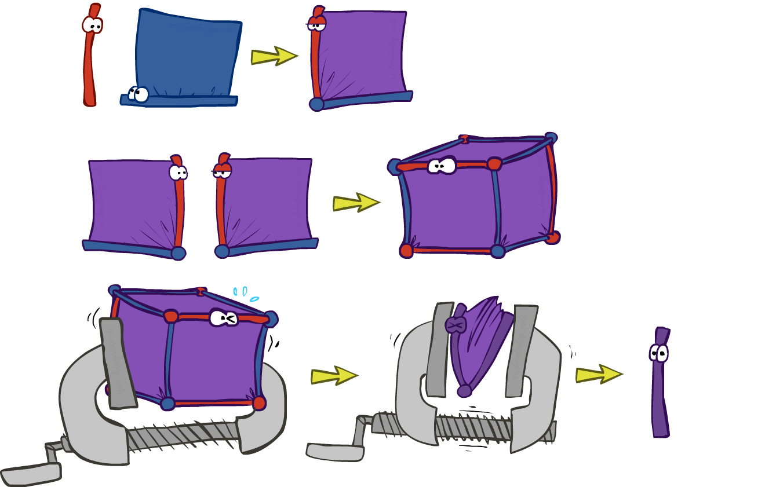
Thus Far: Multiple Join, Multiple Eliminate (= Inference by Enumeration)

Slide 26
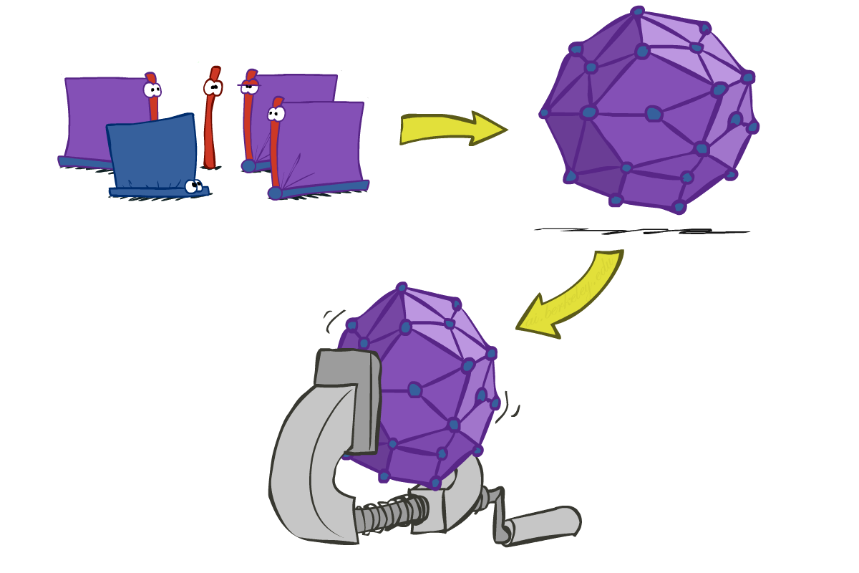
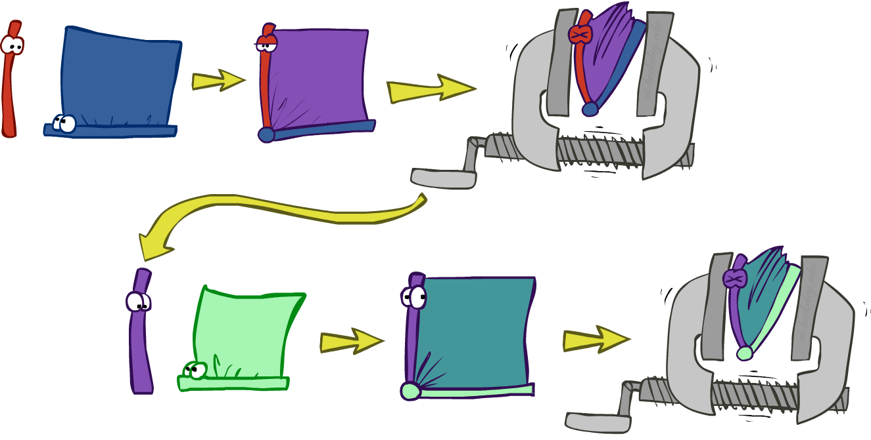
Inference by Enumeration vs. Variable Elimination
Why is inference by enumeration so slow?
You join up the whole joint distribution before you sum out the hidden variables
Idea: interleave joining and marginalizing!
Called “Variable Elimination”
Still NP-hard, but usually much faster than inference by enumeration

Slide 27
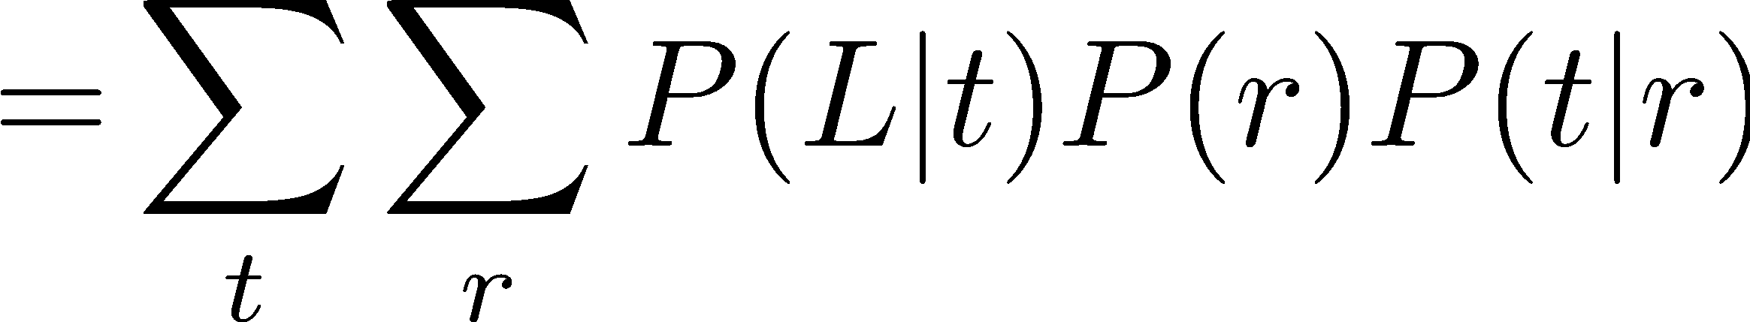
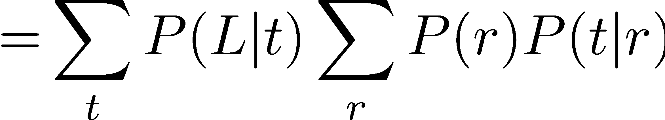
Traffic Domain
R
Inference by Enumeration
Variable Elimination
T
L
Join on r
Join on r
Join on t
Eliminate r
Eliminate r
Join on t
Eliminate t
Eliminate t

Slide 28

Marginalizing Early (= Variable Elimination)

Slide 29


Marginalizing Early! (aka VE)
Join R
Sum out R
Join T
Sum out T
+r | +t | 0.08
+r | -t | 0.02
-r | +t | 0.09
-r | -t | 0.81
+r | 0.1
-r | 0.9
+t | 0.17
-t | 0.83
R
T
T, L
R, T
L
+r | +t | 0.8
+r | -t | 0.2
-r | +t | 0.1
-r | -t | 0.9
T
L
L
+t | +l | 0.051
+t | -l | 0.119
-t | +l | 0.083
-t | -l | 0.747
+l | 0.134
-l | 0.866
L
+t | +l | 0.3
+t | -l | 0.7
-t | +l | 0.1
-t | -l | 0.9
+t | +l | 0.3
+t | -l | 0.7
-t | +l | 0.1
-t | -l | 0.9
+t | +l | 0.3
+t | -l | 0.7
-t | +l | 0.1
-t | -l | 0.9

Slide 30
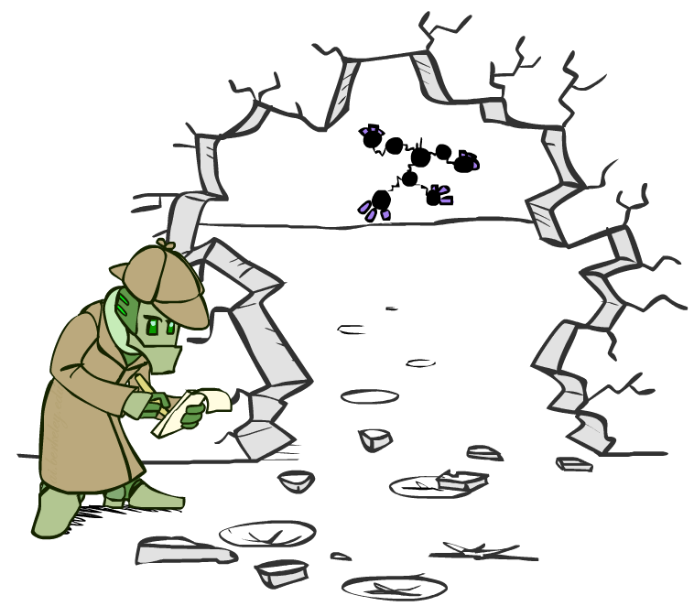



Evidence
If evidence, start with factors that select that evidence
No evidence uses these initial factors:
Computing , the initial factors become:
We eliminate all vars other than query + evidence
+r | 0.1
-r | 0.9
+r | +t | 0.8
+r | -t | 0.2
-r | +t | 0.1
-r | -t | 0.9
+t | +l | 0.3
+t | -l | 0.7
-t | +l | 0.1
-t | -l | 0.9
+r | 0.1
+r | +t | 0.8
+r | -t | 0.2
+t | +l | 0.3
+t | -l | 0.7
-t | +l | 0.1
-t | -l | 0.9

Slide 31

Evidence II
Result will be a selected joint of query and evidence
E.g. for P(L | +r), we would end up with:
To get our answer, just normalize this!
That ’s it!
Normalize
+r | +l | 0.026
+r | -l | 0.074
+l | 0.26
-l | 0.74

Slide 32
Inference by Enumeration
* Works fine with multiple query variables, too
General case:
Evidence variables:
Query* variable:
Hidden variables:
We want:
All variables
Step 1: Select the entries consistent with the evidence
Step 2: Sum out H to get joint of Query and evidence
Step 3: Normalize
Compute joint
Sum out hidden variables

Slide 33
Variable Elimination
* Works fine with multiple query variables, too
General case:
Evidence variables:
Query* variable:
Hidden variables:
We want:
All variables
Step 1: Select the entries consistent with the evidence
Step 2: Sum out H to get joint of Query and evidence
Step 3: Normalize
Interleave joining and summing out

Slide 34

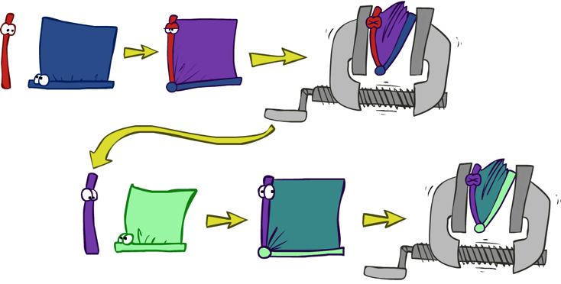


General Variable Elimination
Query:
Start with initial factors:
Local CPTs (but instantiated by evidence)
While there are still hidden variables (not Q or evidence):
Pick a hidden variable H
Join all factors mentioning H
Eliminate (sum out) H
Join all remaining factors and normalize
Notes:
If a variable appears in front of the conditioning bar in any of the factors participating in the join, it’ll be in front of the conditioning bar in the resulting factor. Otherwise it’ll end up behind the conditioning bar.
A variable can never appear in front of the conditioning bar in more than one factor.

Slide 35
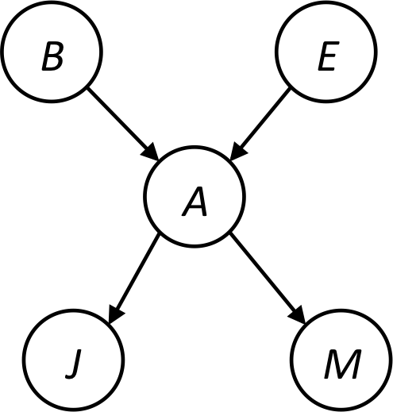






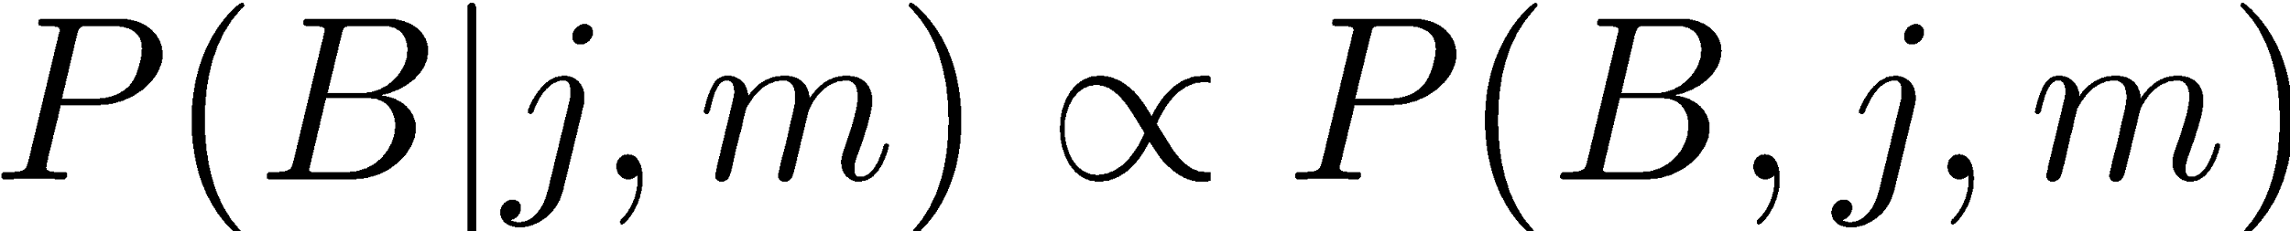
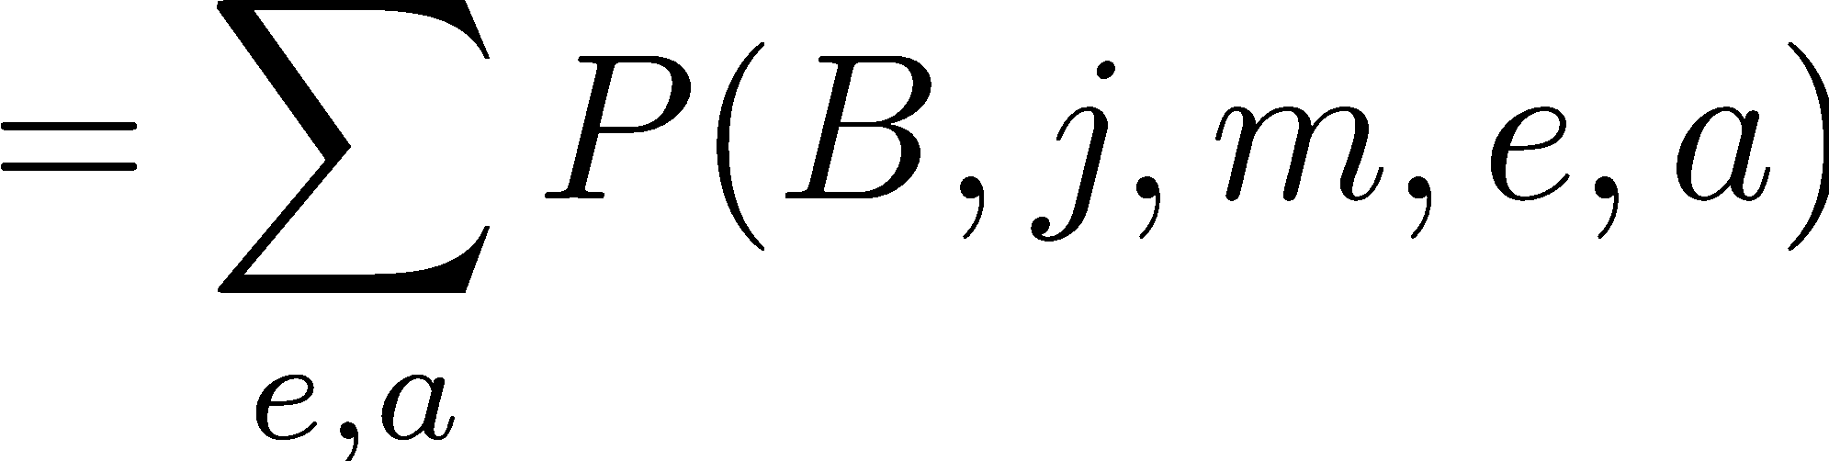
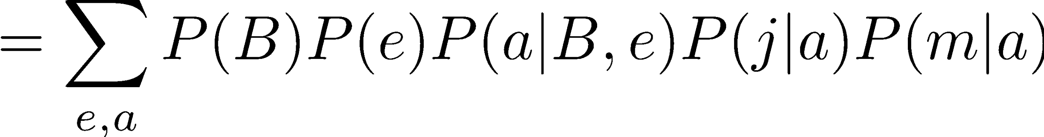
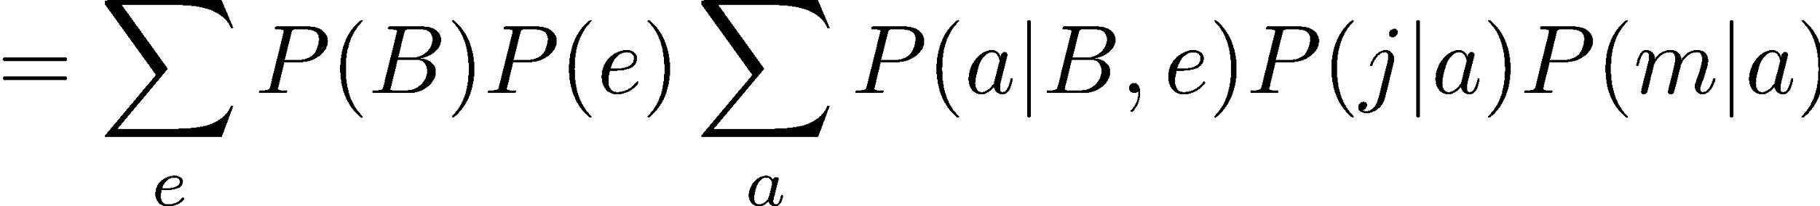
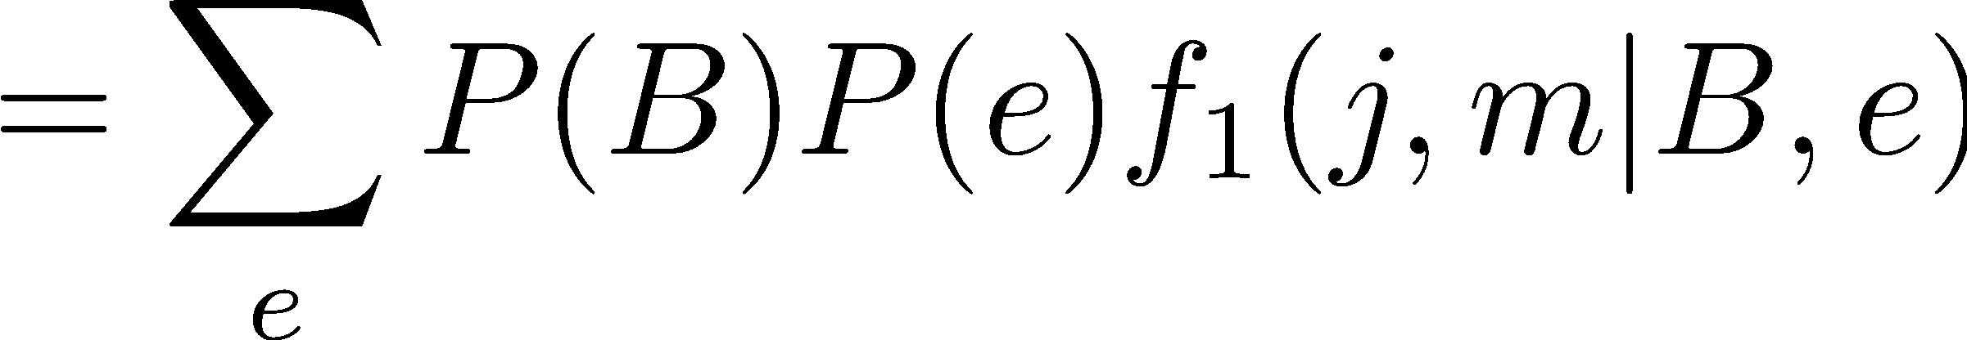
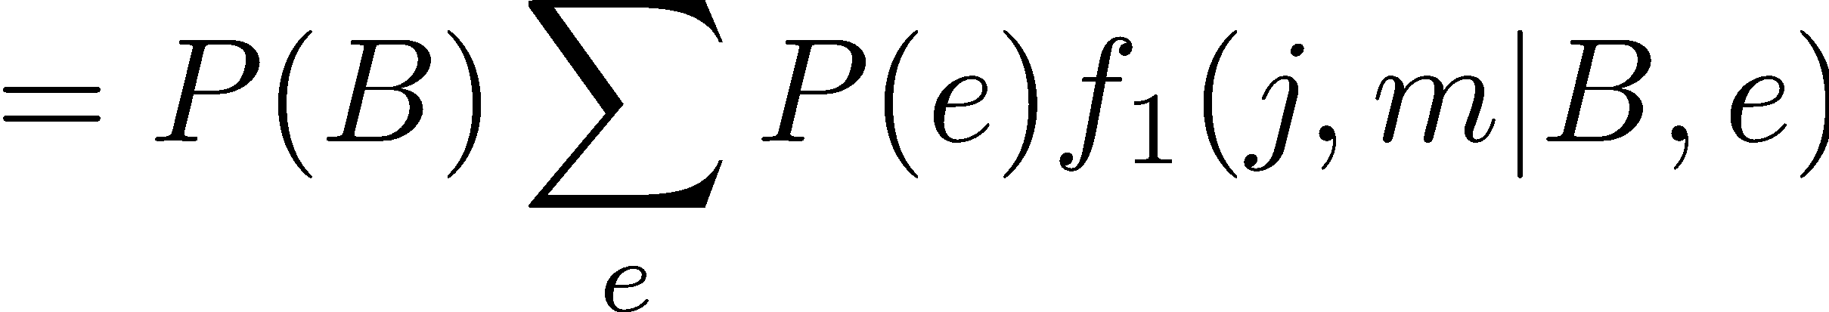
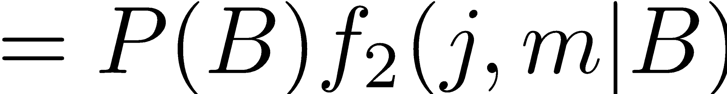
Example
marginal can be obtained from joint by summing out
use Bayes’ net joint distribution expression
use x*(y+z) = xy + xz
joining on a, and then summing out gives f₁
use x*(y+z) = xy + xz
joining on e, and then summing out gives f₂
All we are doing is exploiting uwy + uwz + uxy + uxz + vwy + vwz + vxy +vxz = (u+v)(w+x)(y+z) to improve computational efficiency!

Slide 36



Example
Choose A

Slide 37




Example
Choose E
Finish with B
Normalize

Slide 38





Example 2: P(B|a)
Start / Select
Join on B
Normalize
B
a, B
B | P
+b | 0.1
¬b | 0.9
a
A | B | P
+a | +b | 0.08
+a | ¬b | 0.09
A | B | P
+a | +b | 8/17
+a | ¬b | 9/17
B | A | P
+b | +a | 0.8
b | ¬a | 0.2
¬b | +a | 0.1
¬b | ¬a | 0.9

Slide 39
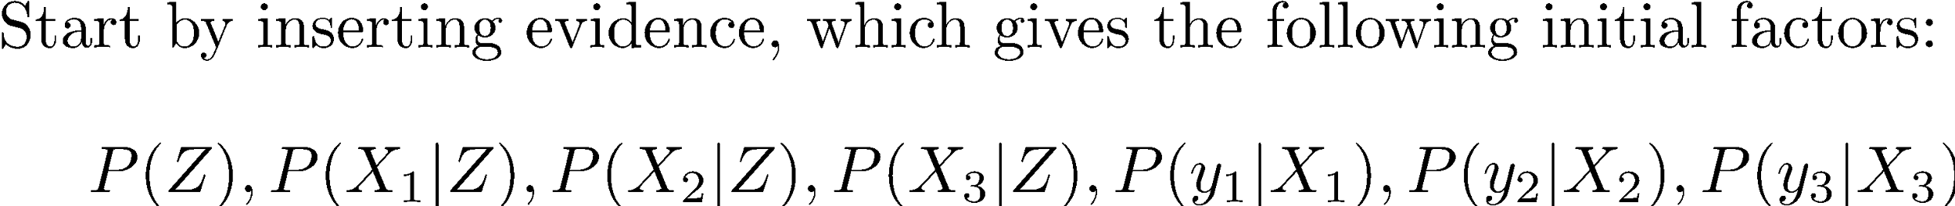

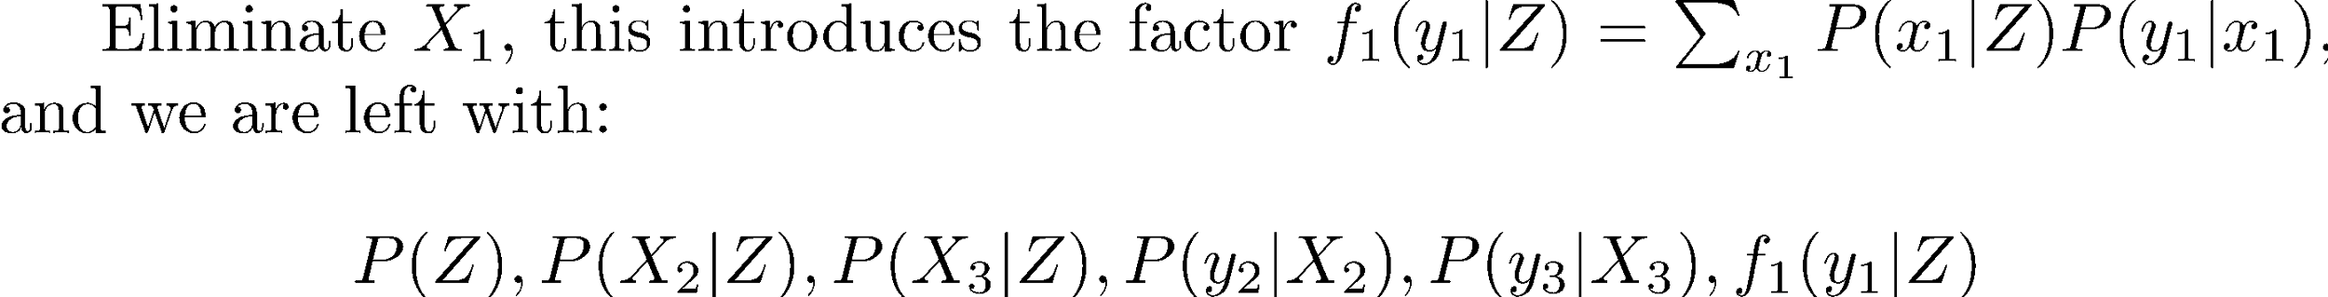






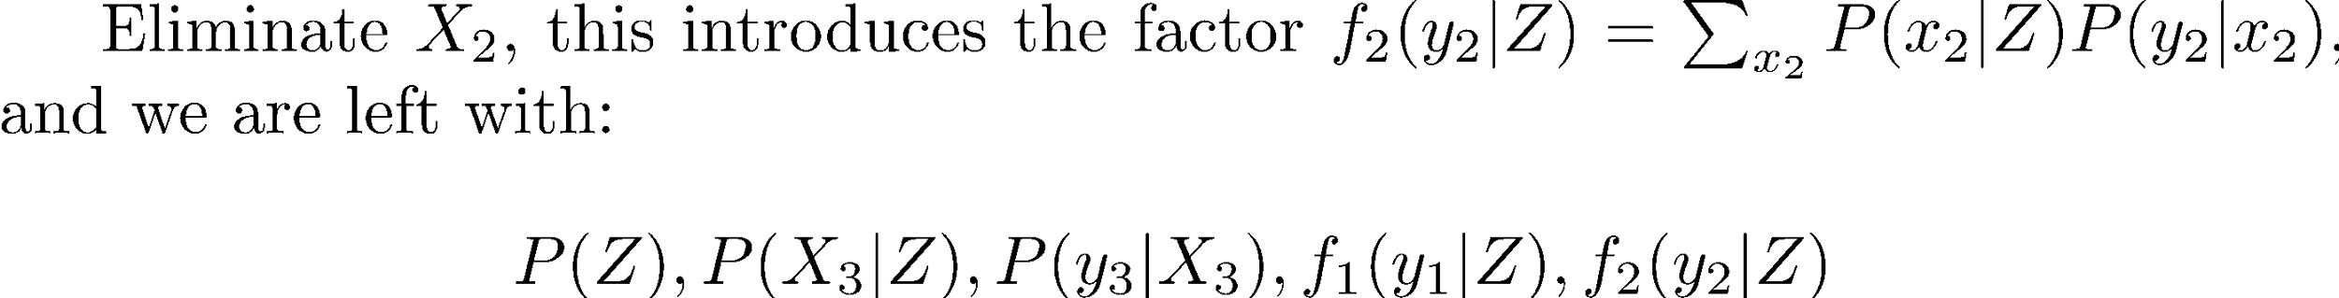
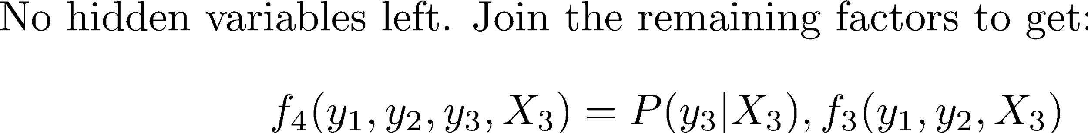
Another Variable Elimination Example
Computational complexity critically depends on the largest factor being generated in this process. Size of factor = number of entries in table. In example above (assuming binary) all factors generated are of size 2 --- as they all only have one variable (Z, Z, and X₃ respectively).

Slide 40




Variable Elimination Ordering
For the query P(X_{n}|y₁,…,y_{n}) work through the following two different orderings as done in previous slide: Z, X₁, …, X_{n-1} and X₁, …, X_{n-1}, Z. What is the size of the maximum factor generated for each of the orderings?
Answer: 2^{n} versus 2 (assuming binary)
In general: the ordering can greatly affect efficiency.
…
…

Slide 41
VE: Computational and Space Complexity
The computational and space complexity of variable elimination is determined by the largest factor
The elimination ordering can greatly affect the size of the largest factor.
E.g., previous slide’s example 2^{n} vs. 2
Does there always exist an ordering that only results in small factors?
No!

Slide 42















Worst Case Complexity?
CSP:
If we can answer P(z) equal to zero or not, we answered whether the 3-SAT problem has a solution.
Hence inference in Bayes’ nets is NP-hard. No known efficient probabilistic inference in general.
…
…

Slide 43
“Easy” Structures: Polytrees
A polytree is a directed graph with no undirected cycles
For poly-trees you can always find an ordering that is efficient
Try it!!

Slide 44

Bayes Nets
Representation
Probabilistic Inference
Enumeration (exact, exponential complexity)
Variable elimination (exact, worst-case
exponential complexity, often better)
Probabilistic inference is NP-complete
Conditional Independences
Sampling
Learning from data

