Slide 1
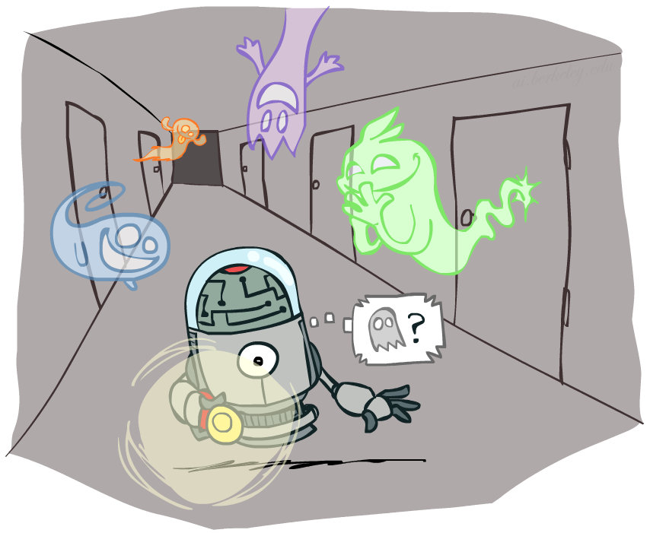
Artificial Intelligence
Hidden Markov Models
[These slides were created by Dan Klein, Pieter Abbeel, and Anca. http://ai.berkeley.edu with minor modifications]
Notes:
Please retain proper attribution, including the reference to ai.berkeley.edu. Thanks!

Slide 2

Reasoning over Time or Space
Often, we want to reason about a sequence of observations
Speech recognition
Robot localization
User attention
Medical monitoring
Need to introduce time (or space) into our models

Slide 3



Markov Models
Value of X at a given time is called the state
Parameters: called transition probabilities or dynamics, specify how the state evolves over time (also, initial state probabilities)
Stationarity assumption: transition probabilities the same at all times
Same as MDP transition model, but no choice of action
A (growable) BN: We can always use generic BN reasoning on it if we truncate the chain at a fixed length
X₁
X₂
X₃
X₄

Slide 4

Markov Assumption: Conditional Independence
Basic conditional independence:
Past and future independent given the present
Each time step only depends on the previous
This is called the (first order) Markov property

Slide 5
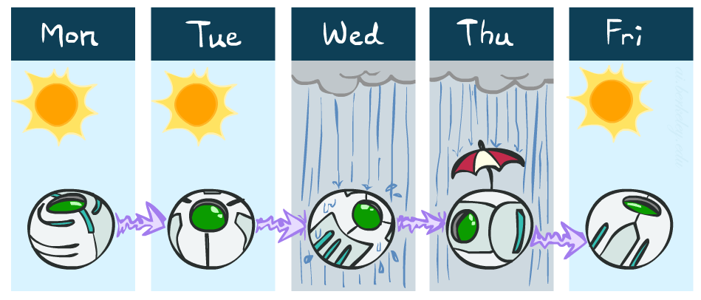
Example Markov Chain: Weather
States: X = {rain, sun}
Initial distribution: 1.0 sun
CPT P(X_{t} | X_{t-1}):
Two new ways of representing the same CPT
X_{t-1} | X_{t} | P(X_{t}|X_{t-1})
sun | sun | 0.9
sun | rain | 0.1
rain | sun | 0.3
rain | rain | 0.7
0.9
0.3
0.9
rain
sun
sun
sun
0.1
0.3
rain
rain
0.7
0.7
0.1

Slide 6

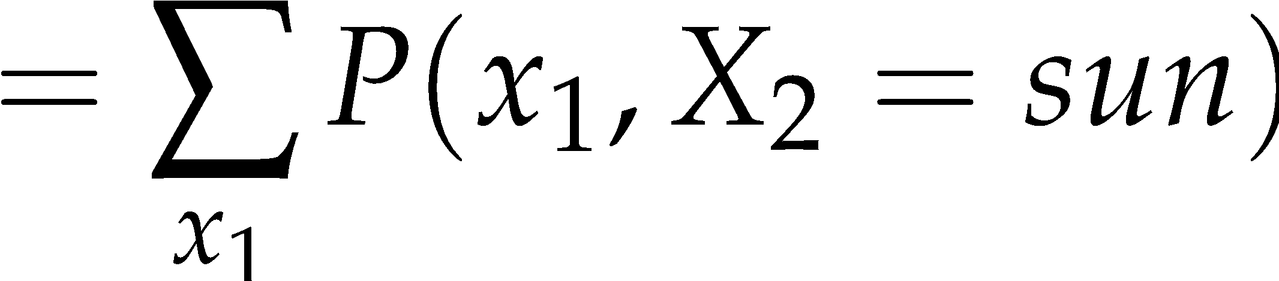
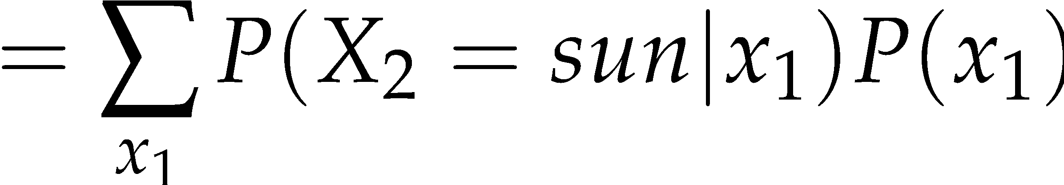
Example Markov Chain: Weather
0.9
0.3
Initial distribution: 1.0 sun
What is the probability distribution after one step?
rain
sun
0.7
0.1

Slide 7
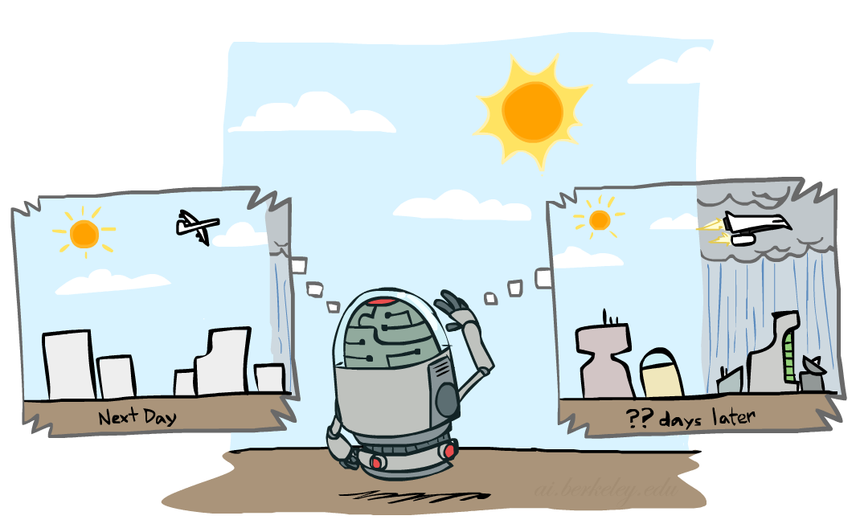


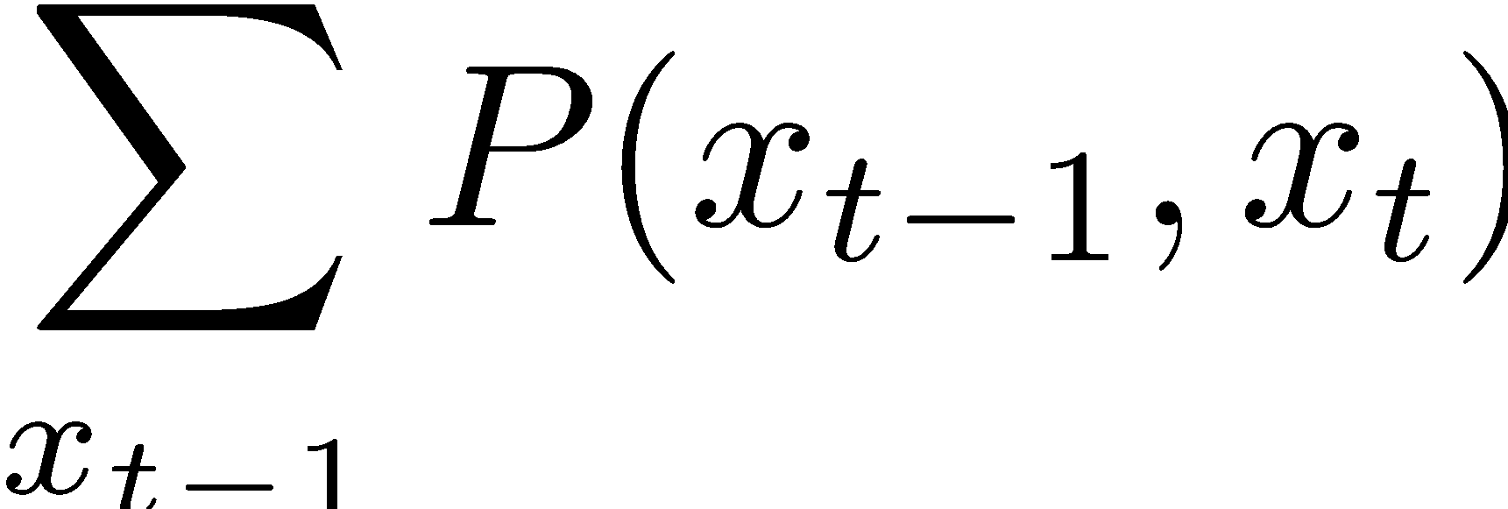
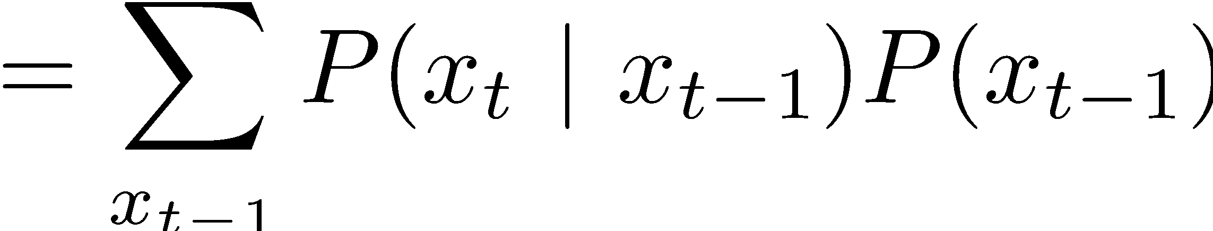
Mini-Forward Algorithm
Question: What’s P(X) on some day t?
X₁
X₂
X₃
X₄
Forward simulation

Slide 8
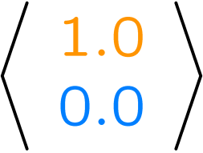
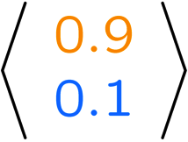
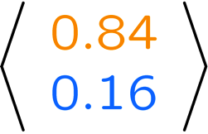
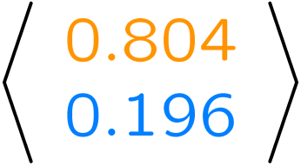
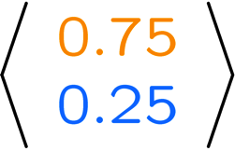
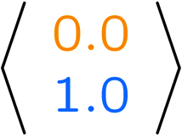
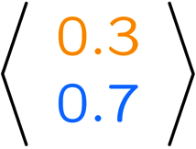
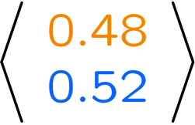
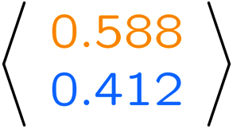
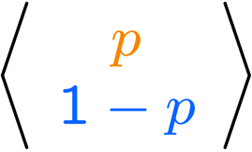
Example Run of Mini-Forward Algorithm
From initial observation of sun
From initial observation of rain
From yet another initial distribution P(X₁):
P(X₁)
P(X₂)
P(X₃)
P(X₄)
P(X∞)
P(X₁)
P(X₂)
P(X₃)
P(X₄)
P(X∞)
…
P(X₁)
P(X∞)
[Demo: L13D1,2,3]

Slide 9

Video of Demo Ghostbusters Basic Dynamics

Slide 10
Video of Demo Ghostbusters Circular Dynamics

Slide 11
Video of Demo Ghostbusters Whirlpool Dynamics

Slide 12

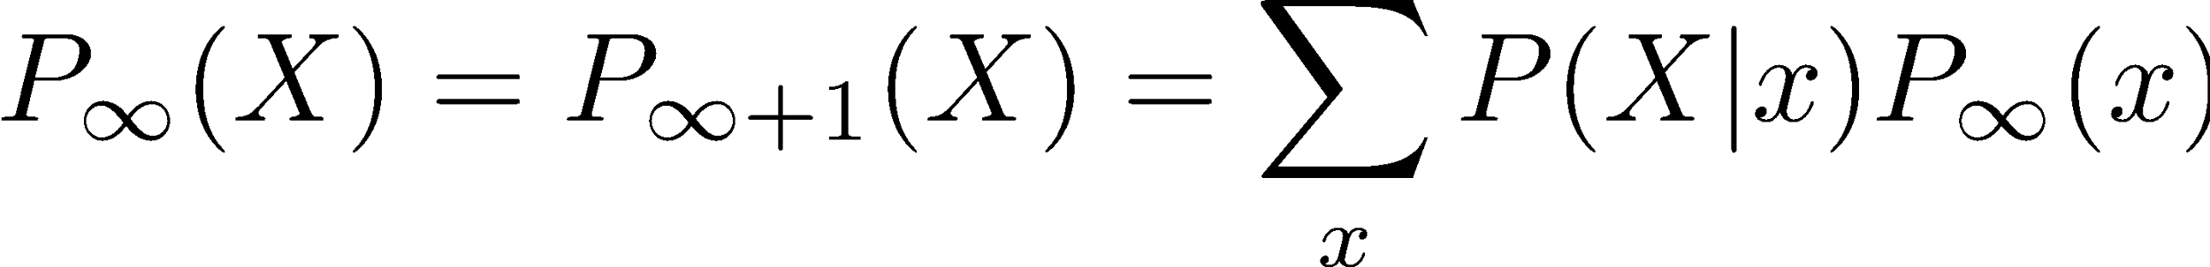

Stationary Distributions
For most chains:
Influence of the initial distribution gets less and less over time.
The distribution we end up in is independent of the initial distribution
Stationary distribution:
The distribution we end up with is called the stationary distribution of the chain
It satisfies

Slide 13
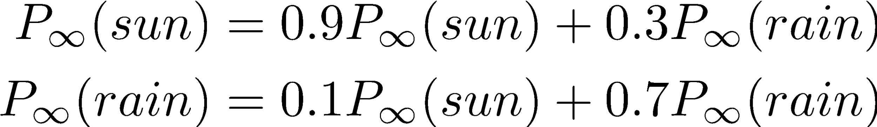
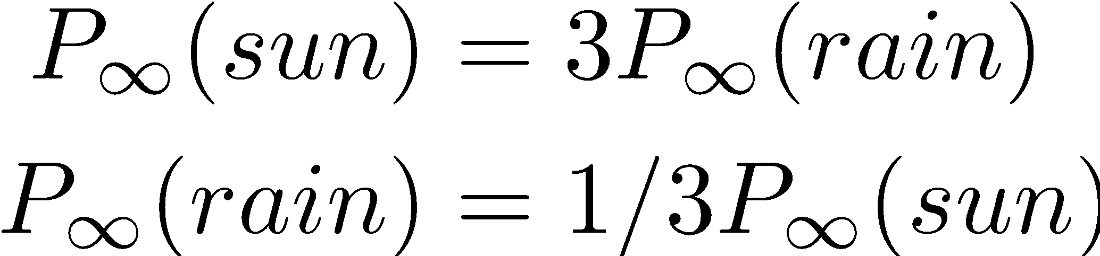
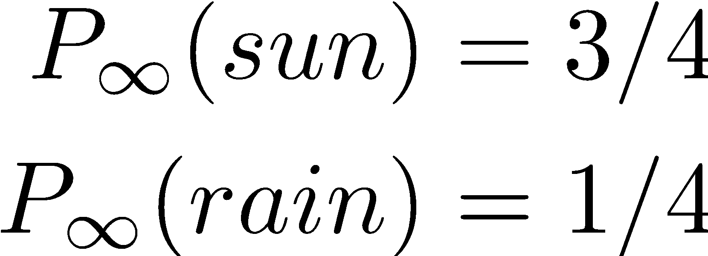
Example: Stationary Distributions
Question: What’s P(X) at time t = infinity?
X₁
X₂
X₃
X₄
X_{t-1} | X_{t} | P(X_{t}|X_{t-1})
sun | sun | 0.9
sun | rain | 0.1
rain | sun | 0.3
rain | rain | 0.7
Also:

Slide 14

Application of Stationary Distribution: Web Link Analysis
PageRank over a web graph
Each web page is a possible value of a state
Initial distribution: uniform over pages
Transitions:
With prob. c, uniform jump to a
random page (dotted lines, not all shown)
With prob. 1-c, follow a random
outlink (solid lines)
Stationary distribution
Will spend more time on highly reachable pages
E.g. many ways to get to the Acrobat Reader download page
Somewhat robust to link spam.
Google 1.0 returned the set of pages containing all your keywords in decreasing rank, now all search engines use link analysis along with many other factors (rank actually getting less important over time)
Notes:
Before: most search engines were merely based on how well a page matches your search words.
Note: currently dominated by clickstreams

Slide 15

Hidden Markov Models

Slide 16
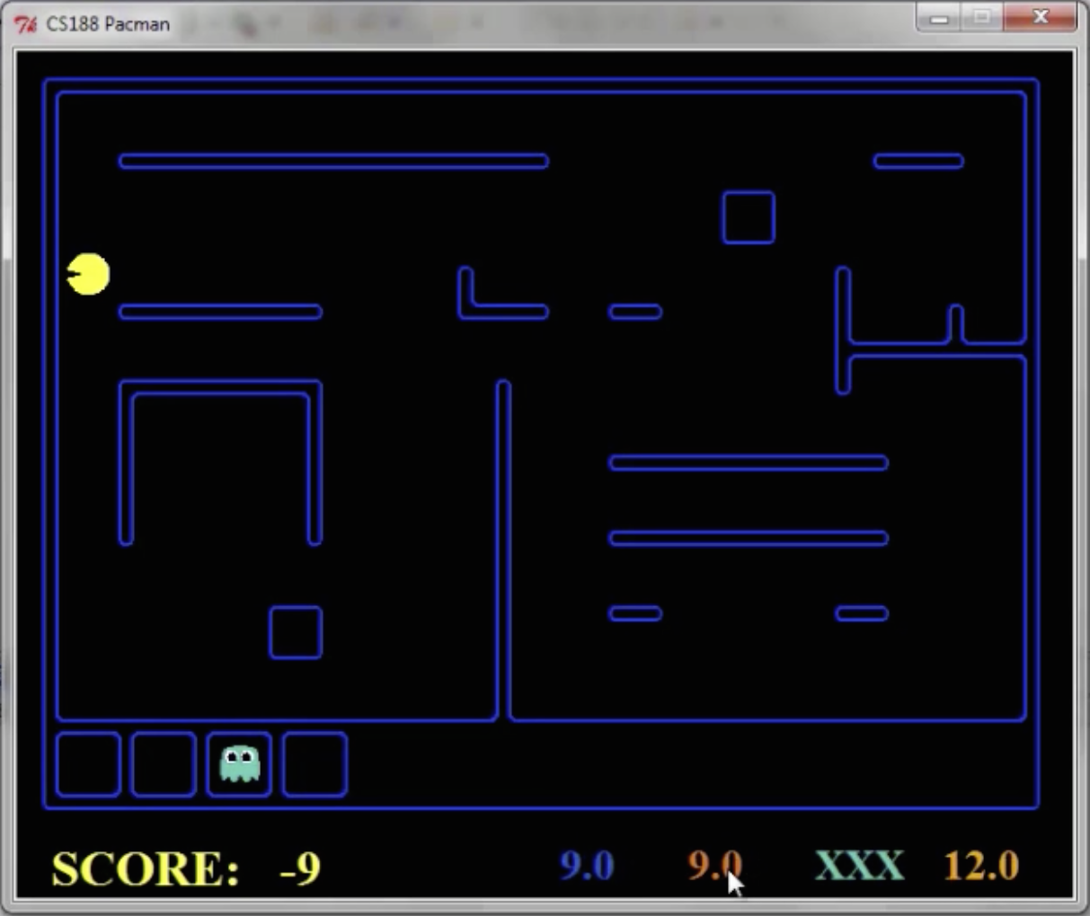
Pacman – Sonar
[Demo: Pacman – Sonar – No Beliefs(L14D1)]

Slide 17
Video of Demo Pacman – Sonar (no beliefs)

Slide 18
Hidden Markov Models
Markov chains not so useful for most agents
Need observations to update your beliefs
Hidden Markov models (HMMs)
Underlying Markov chain over states X
You observe outputs (effects) at each time step
X₁
X₂
X₃
X₄
X₅
E₁
E₂
E₃
E₄
E₅

Slide 19
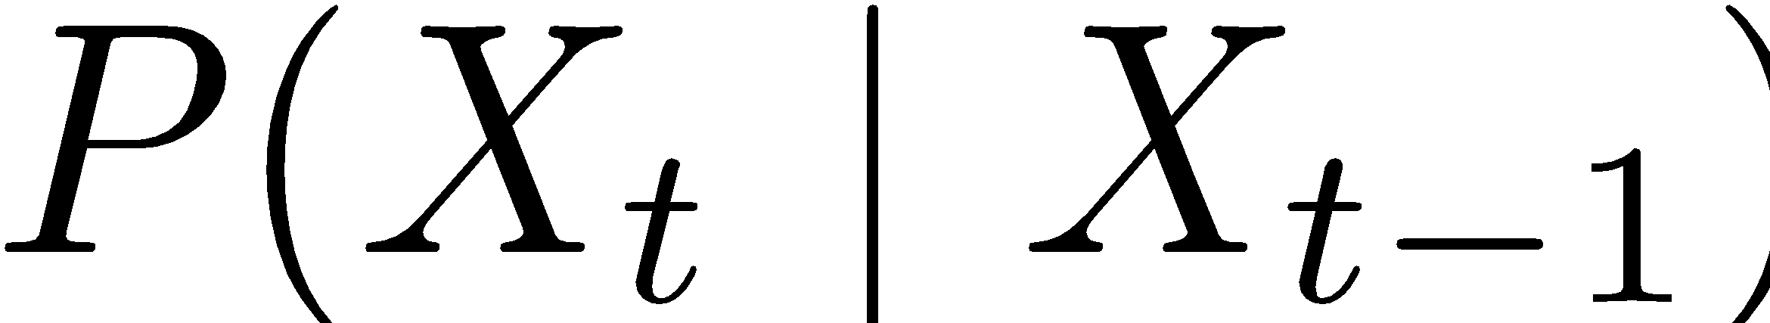



Example: Weather HMM
Rain_{t-1}
Rain_{t}
Rain_{t+1}
Umbrella_{t-1}
Umbrella_{t}
Umbrella_{t+1}
An HMM is defined by:
Initial distribution:
Transitions:
Emissions:
R_{t-1} | R_{t} | P(R_{t}|R_{t-1})
+r | +r | 0.7
+r | -r | 0.3
-r | +r | 0.3
-r | -r | 0.7
R_{t} | U_{t} | P(U_{t}|R_{t})
+r | +u | 0.9
+r | -u | 0.1
-r | +u | 0.2
-r | -u | 0.8
Notes:
demo

Slide 20
Video of Demo Ghostbusters – Circular Dynamics -- HMM

Slide 21


Example: Ghostbusters HMM
P(X₁) = uniform
P(X|X’) = usually move clockwise, but sometimes move in a random direction or stay in place
P(R_{ij}|X) = same sensor model as before: red means close, green means far away.
1/9
1/9
1/9
1/9
1/9
1/9
1/9
1/9
1/9
P(X₁)
1/6
1/6
1/2
0
1/6
0
X₁
X₂
X₃
X₄
0
0
0
X₅
P(X|X’=<1,2>)
R_{i,j}
R_{i,j}
R_{i,j}
R_{i,j}
[Demo: Ghostbusters – Circular Dynamics – HMM (L14D2)]
Notes:
Dan has some demo for this.

Slide 22
Conditional Independence
HMMs have two important independence properties:
Markov hidden process: future depends on past via the present
Current observation independent of all else given current state
Does this mean that evidence variables are guaranteed to be independent?
[No, they tend to correlated by the hidden state]
X₁
X₂
X₃
X₄
X₅
E₁
E₂
E₃
E₄
E₅

Slide 23
Real HMM Examples
Speech recognition HMMs:
Observations are acoustic signals (continuous valued)
States are specific positions in specific words (so, tens of thousands)
Machine translation HMMs:
Observations are words (tens of thousands)
States are translation options
Robot tracking:
Observations are range readings (continuous)
States are positions on a map (continuous)

Slide 24
Filtering / Monitoring
Filtering, or monitoring, is the task of tracking the distribution B_{t}(X) = P_{t}(X_{t} | e₁, …, e_{t}) (the belief state) over time
We start with B₁(X) in an initial setting, usually uniform
As time passes, or we get observations, we update B(X)
The Kalman filter was invented in the 60’s and first implemented as a method of trajectory estimation for the Apollo program
Notes:
Dan has some demo for this

Slide 25
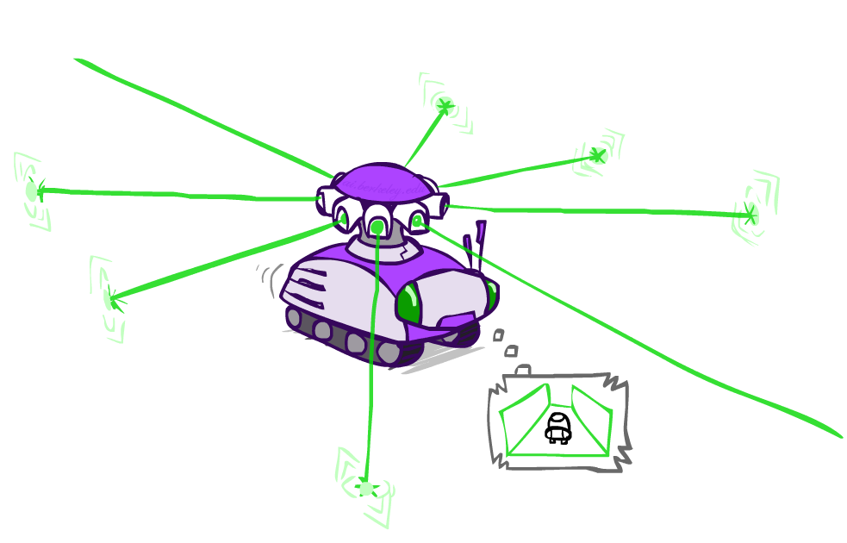
Example: Robot Localization
Example from Michael Pfeiffer
Prob
0
1
t=0
Sensor model: can read in which directions there is a wall, never more than 1 mistake
Motion model: may not execute action with small prob.

Slide 26
Example: Robot Localization
Prob
0
1
t=1
Lighter grey: was possible to get the reading, but less likely b/c required 1 mistake

Slide 27
Example: Robot Localization
Prob
0
1
t=2

Slide 28
Example: Robot Localization
Prob
0
1
t=3

Slide 29
Example: Robot Localization
Prob
0
1
t=4

Slide 30
Example: Robot Localization
Prob
0
1
t=5

Slide 31




Inference
Filtering
Prediction
Smoothing
Most likely explanation

Slide 32

Filtering: Find State Given Evidence
We are given evidence at each time and want to know
Idea: start with P(X₁) and derive B_{t} in terms of B_{t-1}
equivalently, derive B_{t+1} in terms of B_{t}

Slide 33

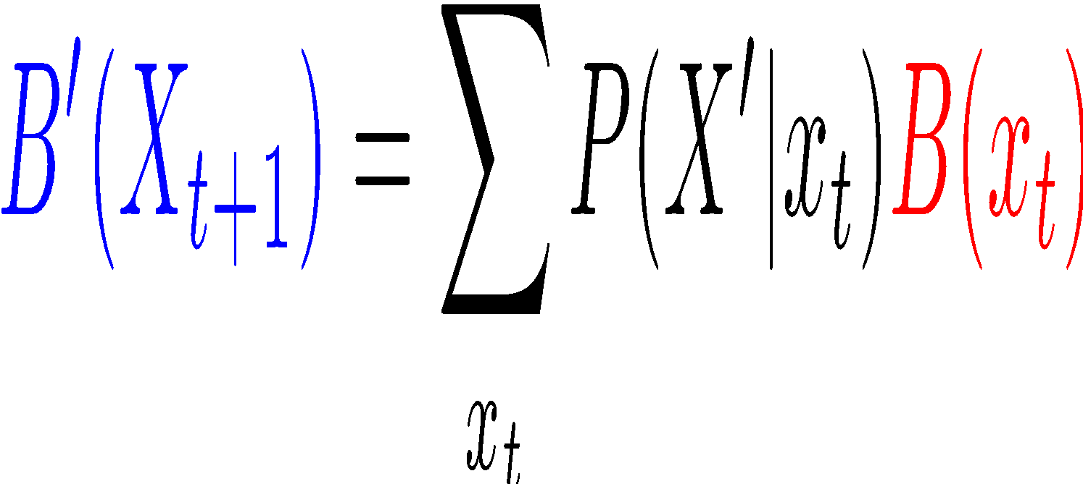
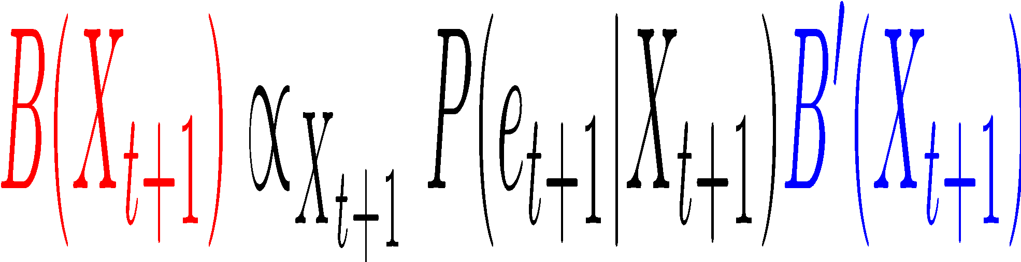
Two Steps: Passage of Time + Observation
X₁
X₂
X₃
X₄
X₅
E₁
E₂
E₃
E₄
E₅

Slide 34


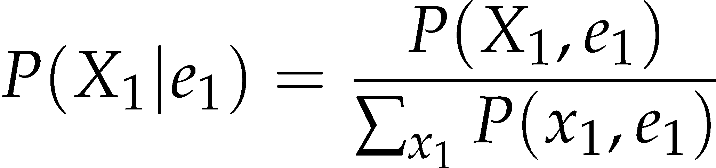
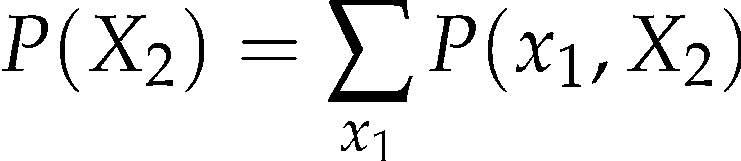
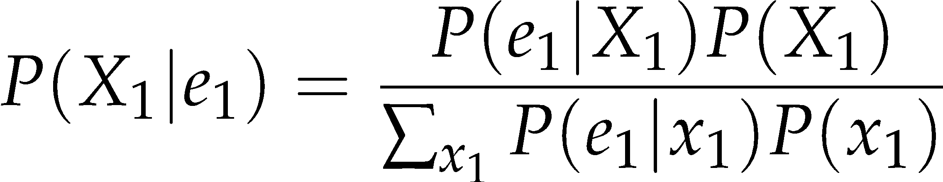
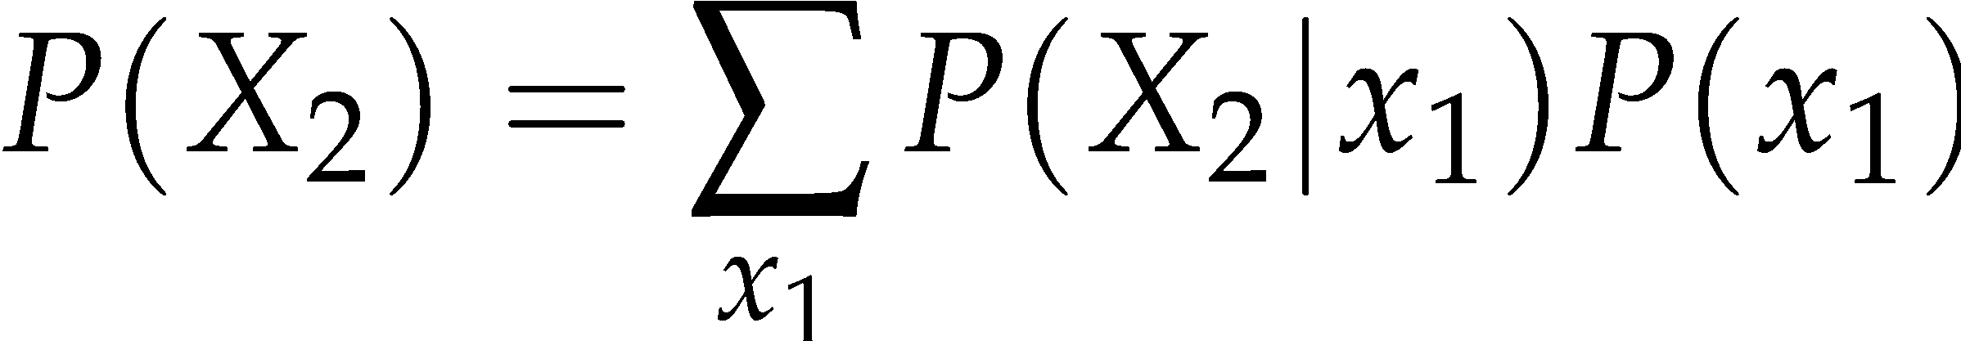
Inference: Base Cases
X₁
X₁
X₂
E₁

Slide 35

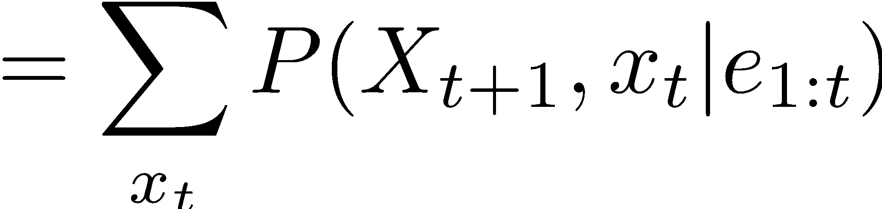
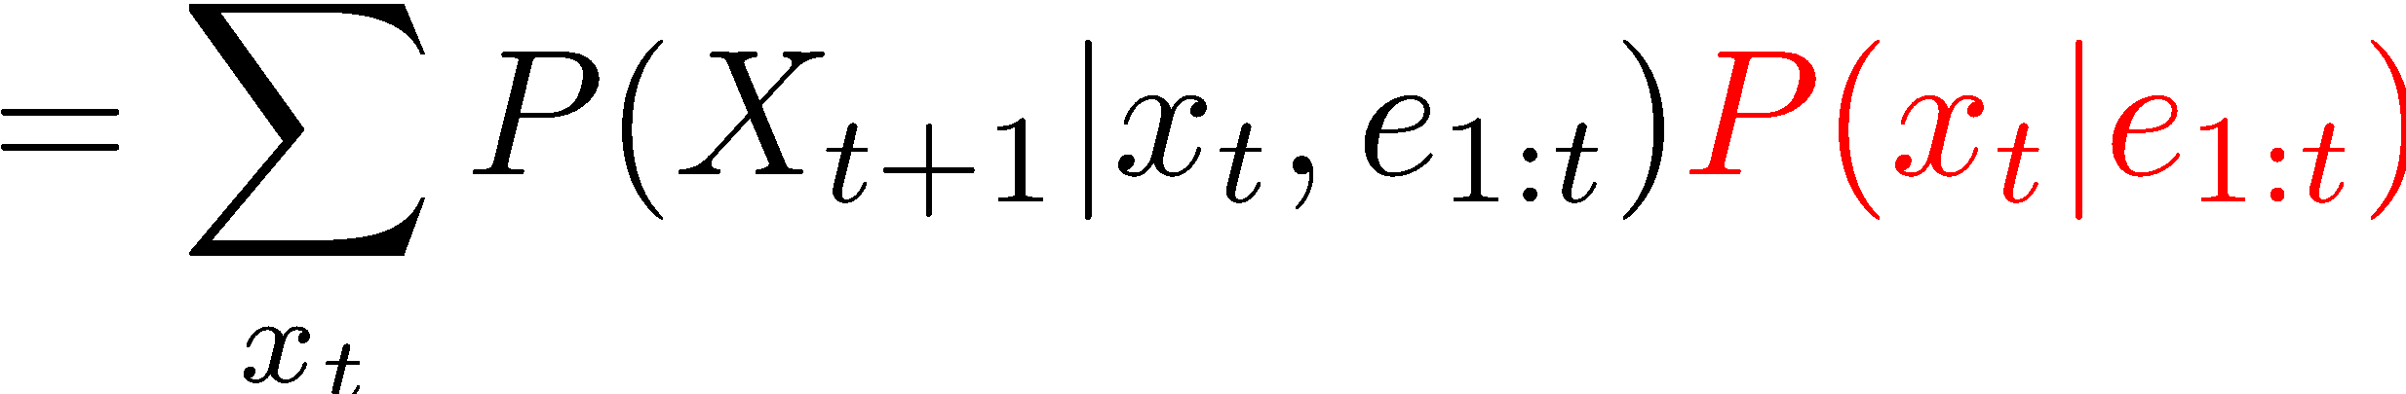
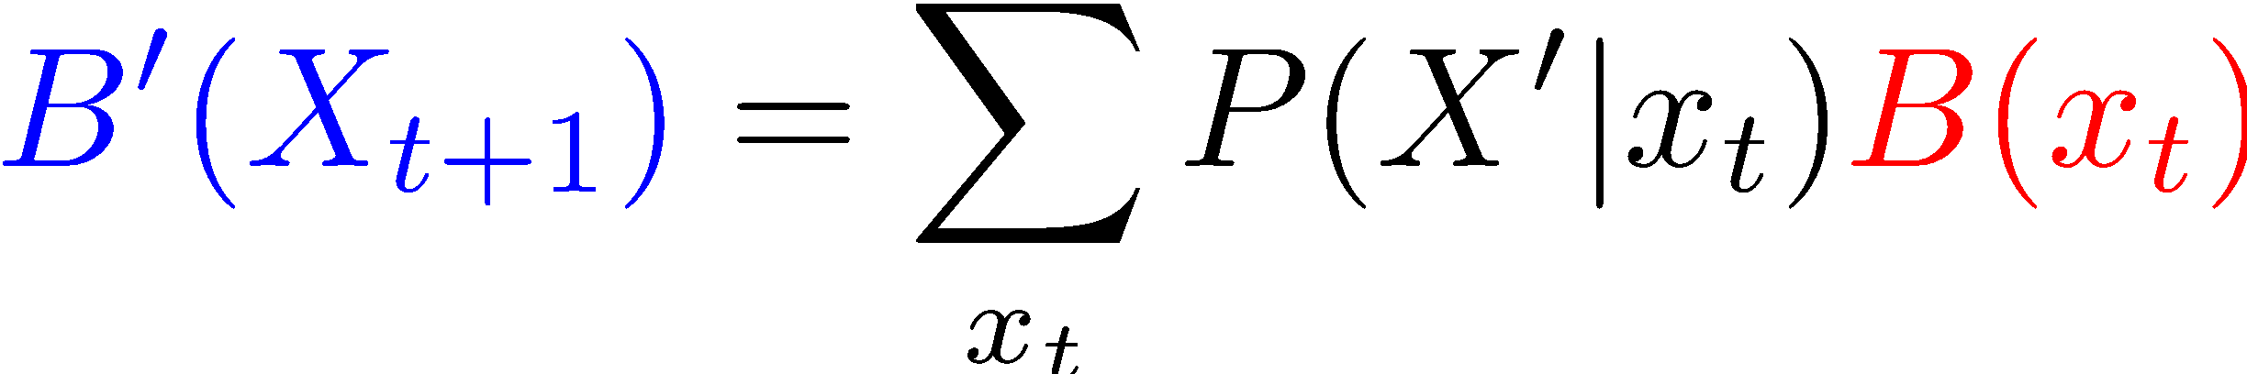
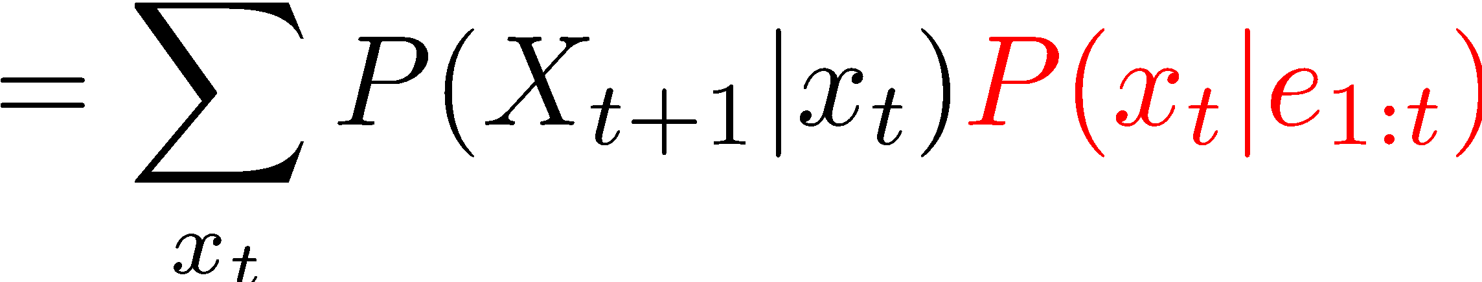
Passage of Time
Assume we have current belief P(X | evidence to date)
Then, after one time step passes:
Basic idea: beliefs get “pushed” through the transitions
With the “B” notation, we have to be careful about what time step t the belief is about, and what evidence it includes
X₁
X₂
Or compactly:
Notes:
TODO: intermediate step in derivation!

Slide 36
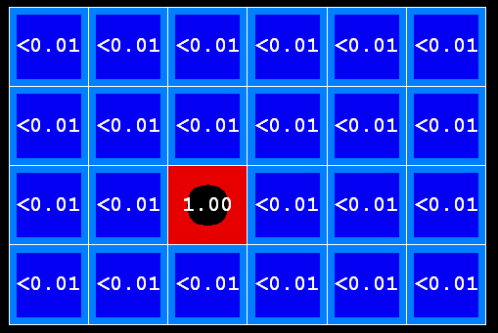
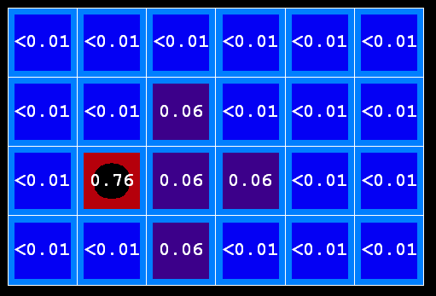
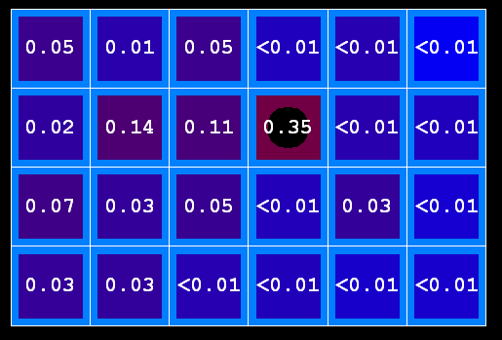

Example: Passage of Time
As time passes, uncertainty “accumulates”
(Transition model: ghosts usually go clockwise)
T = 1
T = 2
T = 5

Slide 37
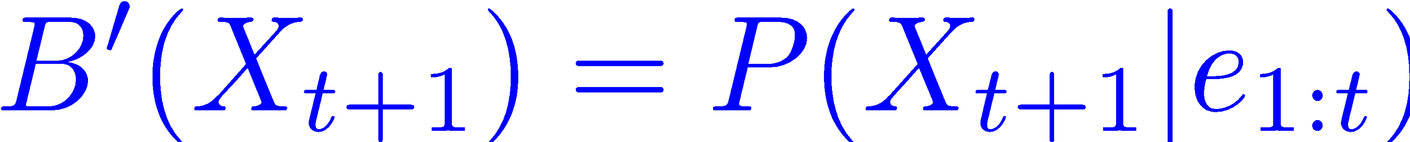

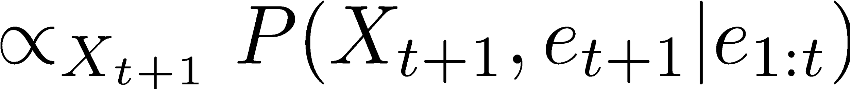
Observation
X₁
Assume we have current belief P(X | previous evidence):
Then, after evidence comes in:
Or, compactly:
E₁
Basic idea: beliefs “reweighted” by likelihood of evidence
Unlike passage of time, we have to renormalize
Notes:
Basic idea: beliefs “reweighted” by likelihood of evidence
Unlike passage of time, we have to renormalize

Slide 38

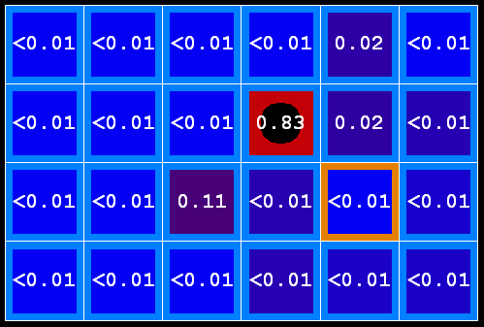



Example: Observation
As we get observations, beliefs get reweighted, uncertainty “decreases”
Before observation
After observation

Slide 39
Example: Weather HMM
B’(+r) = 0.5
B’(-r) = 0.5
B’(+r) = 0.627
B’(-r) = 0.373
B(+r) = 0.5
B(-r) = 0.5
B(+r) = 0.818
B(-r) = 0.182
B(+r) = 0.883
B(-r) = 0.117
Rain₀
Rain₁
Rain₂
R_{t} | R_{t+1} | P(R_{t+1}|R_{t})
+r | +r | 0.7
+r | -r | 0.3
-r | +r | 0.3
-r | -r | 0.7
R_{t} | U_{t} | P(U_{t}|R_{t})
+r | +u | 0.9
+r | -u | 0.1
-r | +u | 0.2
-r | -u | 0.8
Umbrella₁
Umbrella₂
Notes:
demo

Slide 40
Online Belief Updates
Every time step, we start with current P(X | evidence)
We update for time:
We update for evidence:
The forward algorithm does both at once (and doesn’t normalize)
X₁
X₂
X₂
E₂

Slide 41
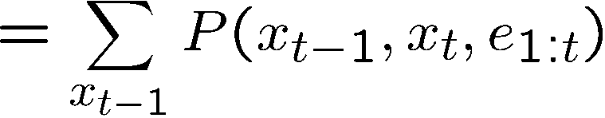
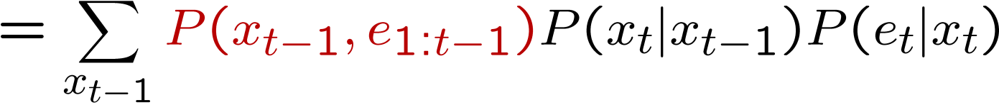
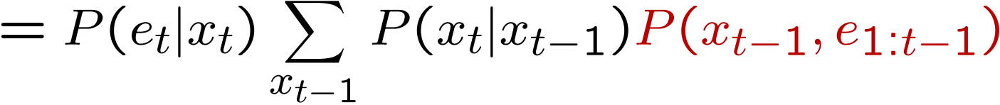
The Forward Algorithm
We are given evidence at each time and want to know
We can derive the following updates
We can normalize as we go if we want to have P(x|e) at each time step, or just once at the end…
t
[Demo: Ghostbusters Exact Filtering (L15D2)]
Notes:
TODO: explain propto and it’s X_t, not X

Slide 42
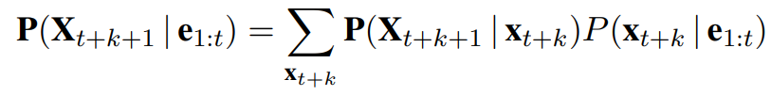
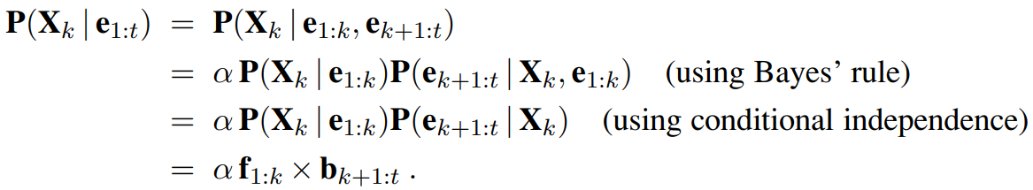
Inference: Prediction
Prediction
Smoothing

Slide 43
Inference: Smoothing
Smoothing

Slide 44
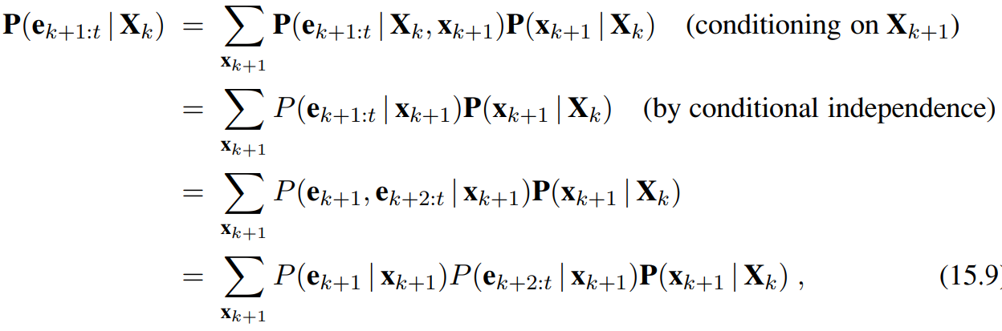
Inference: Smoothing

Slide 45
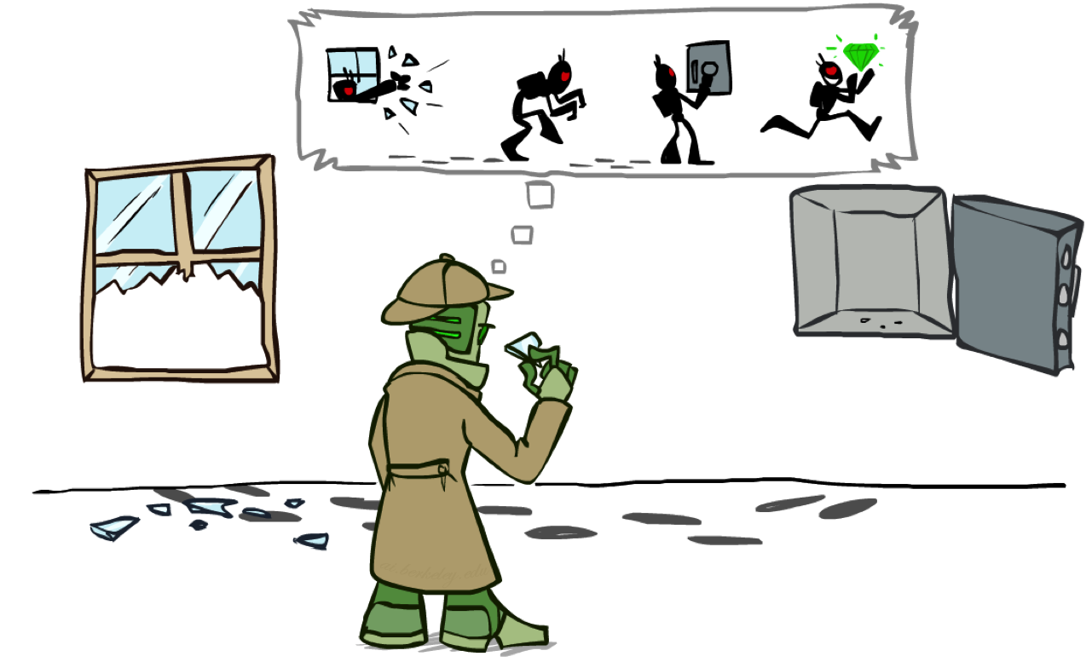
Most Likely Explanation

Slide 46

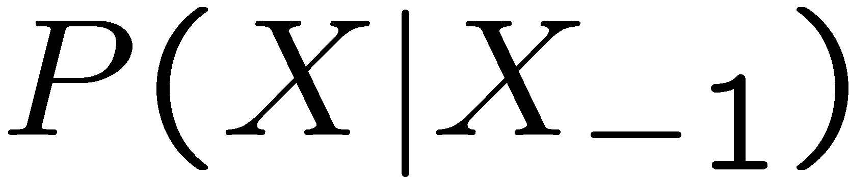

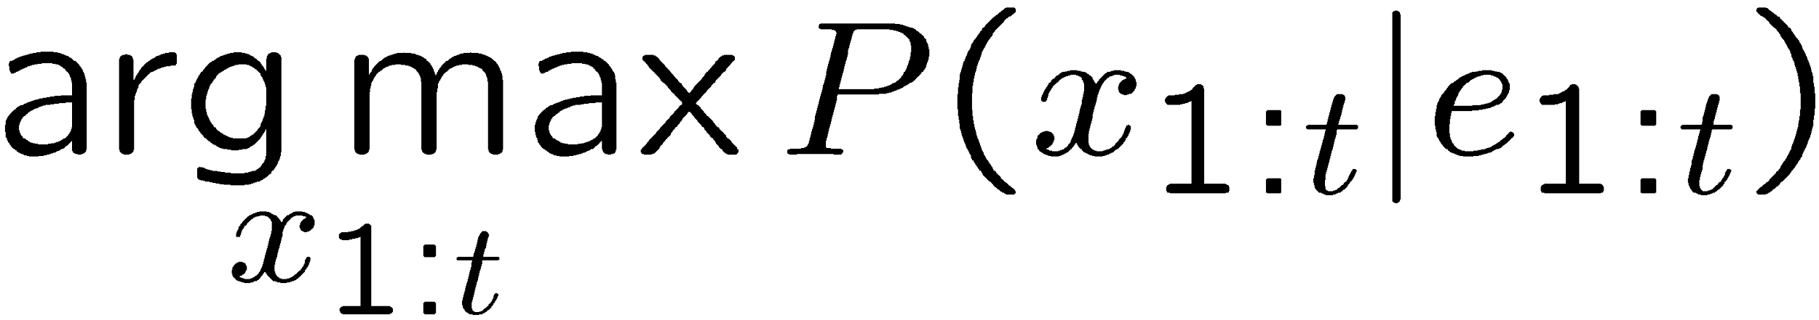
HMMs: MLE Queries
HMMs defined by
States X
Observations E
Initial distribution:
Transitions:
Emissions:
New query: most likely explanation:
New method: the Viterbi algorithm
X₁
X₂
X₃
X₄
X₅
E₁
E₂
E₃
E₄
E₅

Slide 47



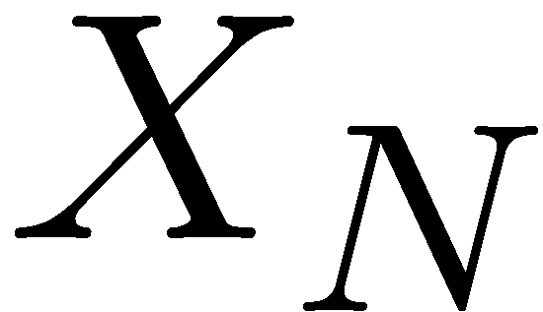


State Trellis
State trellis: graph of states and transitions over time
Each arc represents some transition
Each arc has weight
Each path is a sequence of states
The product of weights on a path is that sequence’s probability along with the evidence
Forward algorithm computes sums of paths, Viterbi computes best paths
sun
sun
sun
sun
rain
rain
rain
rain

Slide 48


Forward / Viterbi Algorithms
sun
sun
sun
sun
rain
rain
rain
rain
Forward Algorithm (Sum)
Viterbi Algorithm (Max)

