Slide 1

Machine learning
Image source

Slide 2
Machine learning
Definition
Getting a computer to do well on a task without explicitly programming it
Improving performance on a task based on experience

Slide 3
Learning for episodic tasks
First, we consider the “easier” problem of learning in episodic environments
The agent gets a series of unrelated problem instances and has to make some decision or inference about each of them
In this case, “experience” comes in the form of training data
At the end of the course, we will look at learning in sequential environments (reinforcement learning)

Slide 4

Example: Image classification
input
desired output
apple
pear
tomato
cow
dog
horse

Slide 5
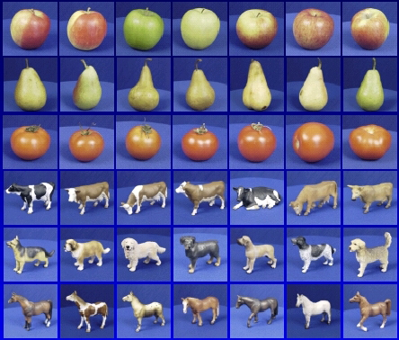
Training data
apple
pear
tomato
cow
dog
horse

Slide 6
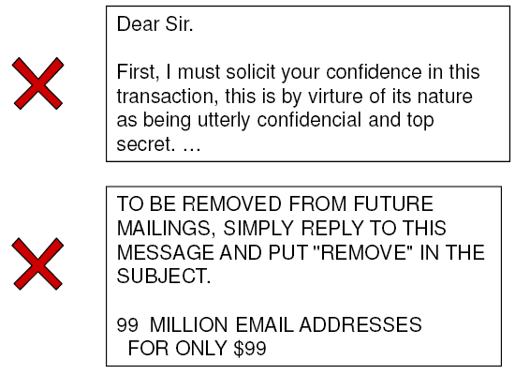
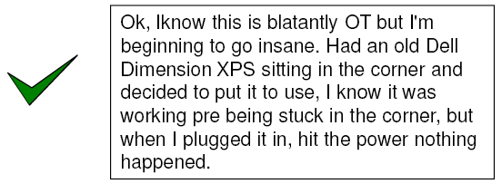
Example 2: Spam filter

Slide 7
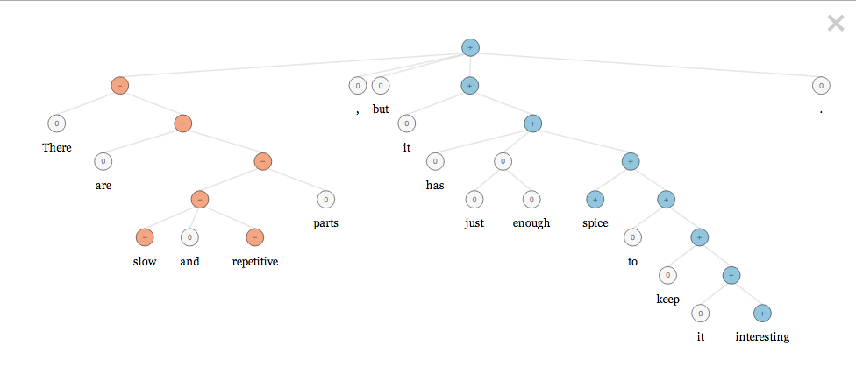
Example 3: Sentiment analysis
http://gigaom.com/2013/10/03/stanford-researchers-to-open-source-model-they-say-has-nailed-sentiment-analysis/
http://nlp.stanford.edu:8080/sentiment/rntnDemo.html

Slide 8
The basic supervised learning framework
y = f(x)
Learning: given a training set of labeled examples {(x₁,y₁), …, (x_{N},y_{N})}, estimate the parameters of the prediction function f
Inference: apply f to a never before seen test example x and output the predicted value y = f(x)
output
classification function
input

Slide 9
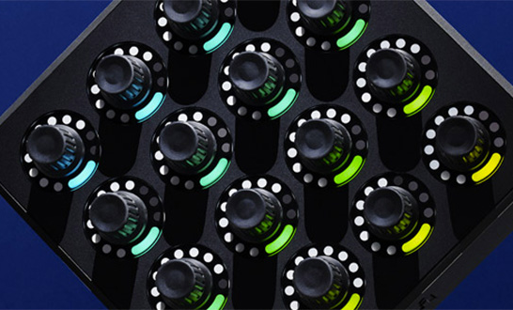

Learning and inference pipeline
Learning
Training Labels
Training Samples
Features
Training
Learned model
Learned model
Inference
Features
Prediction
Test Sample

Slide 10
Naïve Bayes classifier
A single dimension or attribute of x

Slide 11
Decision tree classifier
Example problem: decide whether to wait for a table at a restaurant, based on the following attributes:
Alternate: is there an alternative restaurant nearby?
Bar: is there a comfortable bar area to wait in?
Fri/Sat: is today Friday or Saturday?
Hungry: are we hungry?
Patrons: number of people in the restaurant (None, Some, Full)
Price: price range ($, $$, $$$)
Raining: is it raining outside?
Reservation: have we made a reservation?
Type: kind of restaurant (French, Italian, Thai, Burger)
WaitEstimate: estimated waiting time (0-10, 10-30, 30-60, >60)

Slide 12
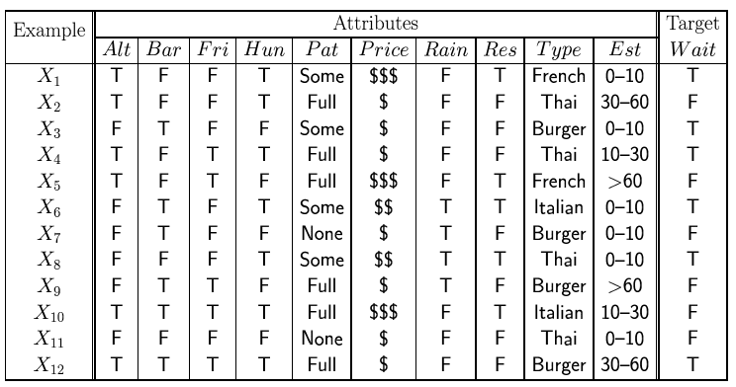
Decision tree classifier

Slide 13
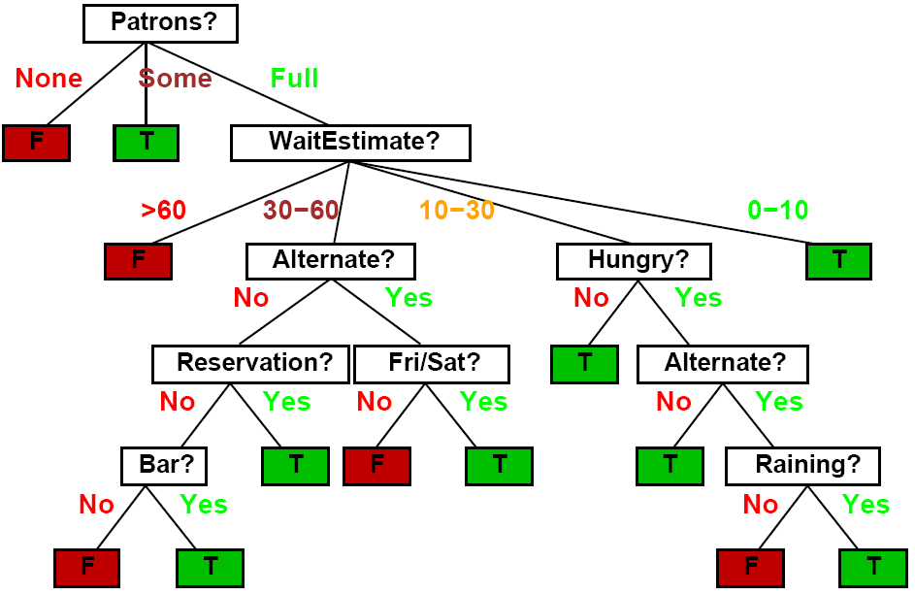
Decision tree classifier

Slide 14
Nearest neighbor classifier
Test example
Training examples from class 2
Training examples from class 1
f(x) = label of the training example nearest to x
All we need is a distance function for our inputs
No training required!

Slide 15
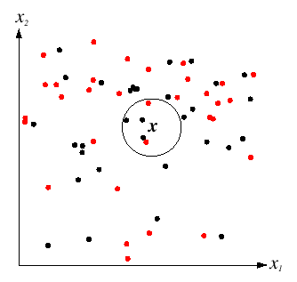
K-nearest neighbor classifier
For a new point, find the k closest points from training data
Vote for class label with labels of the k points
k = 5

Slide 16
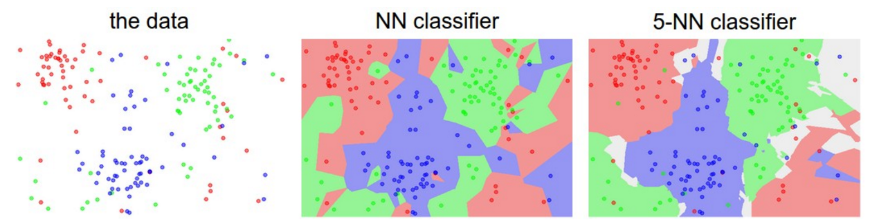
K-nearest neighbor classifier
Which classifier is more robust to outliers?
Credit: Andrej Karpathy, http://cs231n.github.io/classification/

Slide 17
Linear classifier
Find a linear function to separate the classes
f(x) = sgn(w₁x₁ + w₂x₂ + … + w_{D}x_{D} + b) = sgn(w ⋅ x + b)

Slide 18
NN vs. linear classifiers
NN pros:
Simple to implement
Decision boundaries not necessarily linear
Works for any number of classes
NN cons:
Need good distance function
Slow at test time
Linear pros:
Low-dimensional parametric representation
Very fast at test time
Linear cons:
Works for two classes
How to train the linear function?
What if data is not linearly separable?

Slide 19
Learning and inference pipeline
Learning
Training Labels
Training Samples
Features
Training
Learned model
Learned model
Inference
Features
Prediction
Test Sample

Slide 20
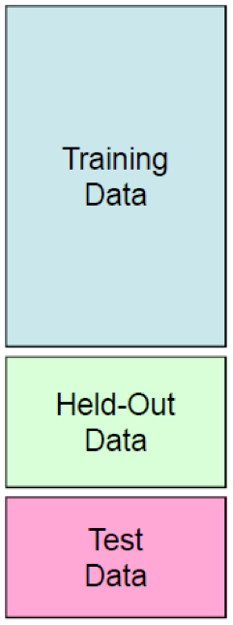
Experimentation cycle
Learn parameters on the training set
Tune hyperparameters (implementation choices) on the held out validation set
Evaluate performance on the test set
Very important: do not peek at the test set!
Generalization and overfitting
Want classifier that does well on never before seen data
Overfitting: good performance on the training/validation set, poor performance on test set

Slide 21
Beyond supervised classification
Other prediction scenarios
Regression
Structured prediction
Other supervision scenarios
Unsupervised learning
Self-supervised or predictive learning
Active learning
Lifelong learning

Slide 22
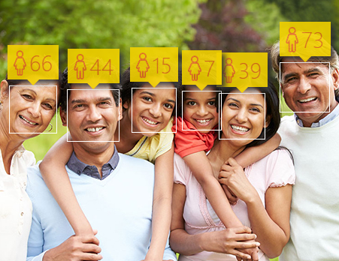
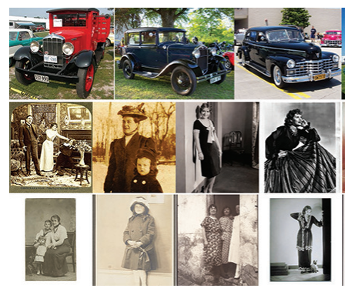
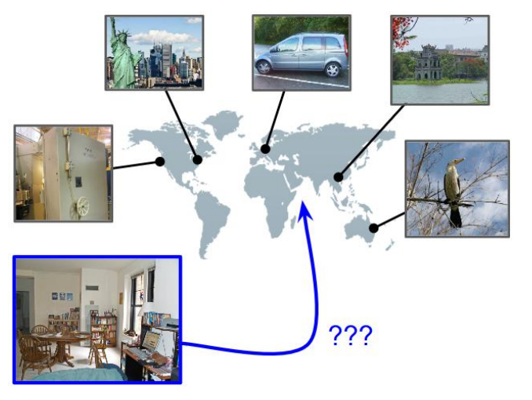
Beyond classification: Regression
Age estimation
When was that made?
IM2GPS

Slide 23
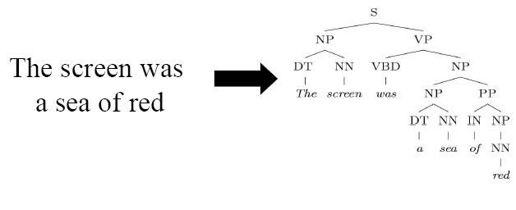
Beyond classification: Structured prediction
Parse tree
Sentence
Source: B. Taskar

Slide 24
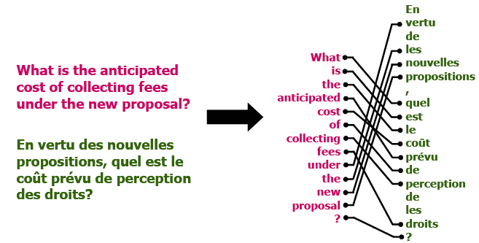
Structured Prediction
Sentence in two languages
Word alignment
Source: B. Taskar

Slide 25
Unsupervised Learning
Idea: Given only unlabeled data as input, learn some sort of structure
The objective is often more vague or subjective than in supervised learning
This is more of an exploratory/descriptive data analysis

Slide 26
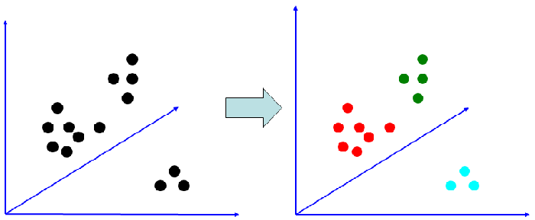
Unsupervised Learning
Clustering
Discover groups of “similar” data points
Dimensionality reduction
Density estimation
Quantization

Slide 27
Continuum of supervision
Semi-supervised (labels for a small portion of training data)
Weakly supervised (noisy labels, labels not exactly for the task of interest)
Unsupervised (no labels)
Supervised (clean, complete training labels for the task of interest)

