Slide 1
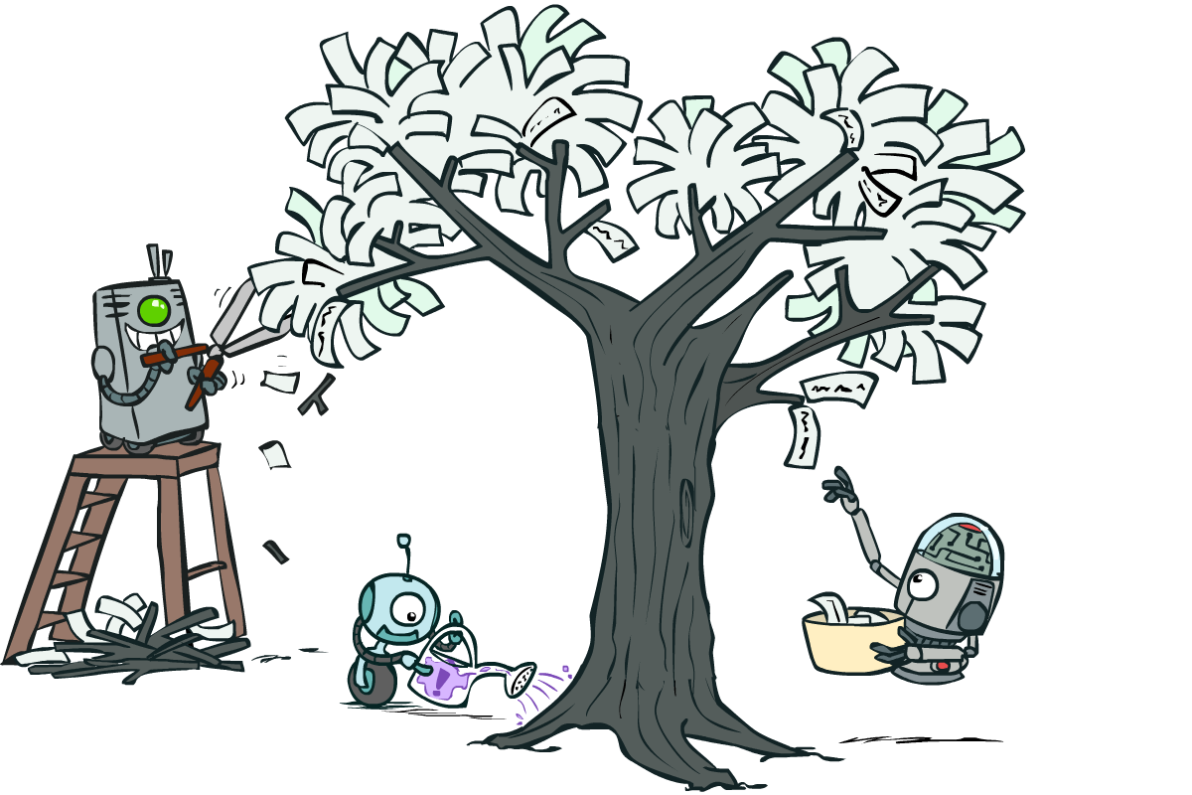
Artificial Intelligence
Decision Trees
[These slides were created by Dan Klein and Pieter Abbeel for CS188 Intro to AI at UC Berkeley. All CS188 materials are available at http://ai.berkeley.edu.]
Notes:
Please retain proper attribution, including the reference to ai.berkeley.edu. Thanks!
‹#›

Slide 2
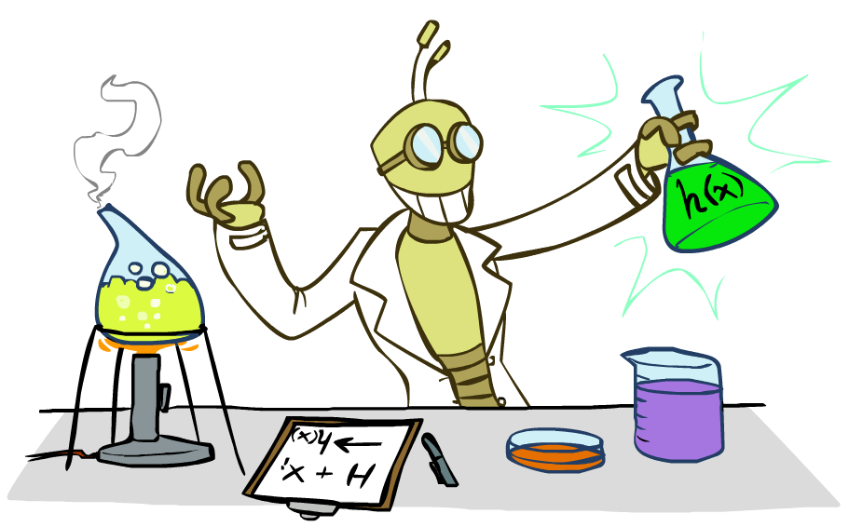
Inductive Learning

Slide 3



Inductive Learning (Science)
Simplest form: learn a function from examples
A target function: g
Examples: input-output pairs (x, g(x))
E.g. x is an email and g(x) is spam / ham
E.g. x is a house and g(x) is its selling price
Problem:
Given a hypothesis space H
Given a training set of examples x_{i}
Find a hypothesis h(x) such that h ~ g
Includes:
Classification (outputs = class labels)
Regression (outputs = real numbers)

Slide 4
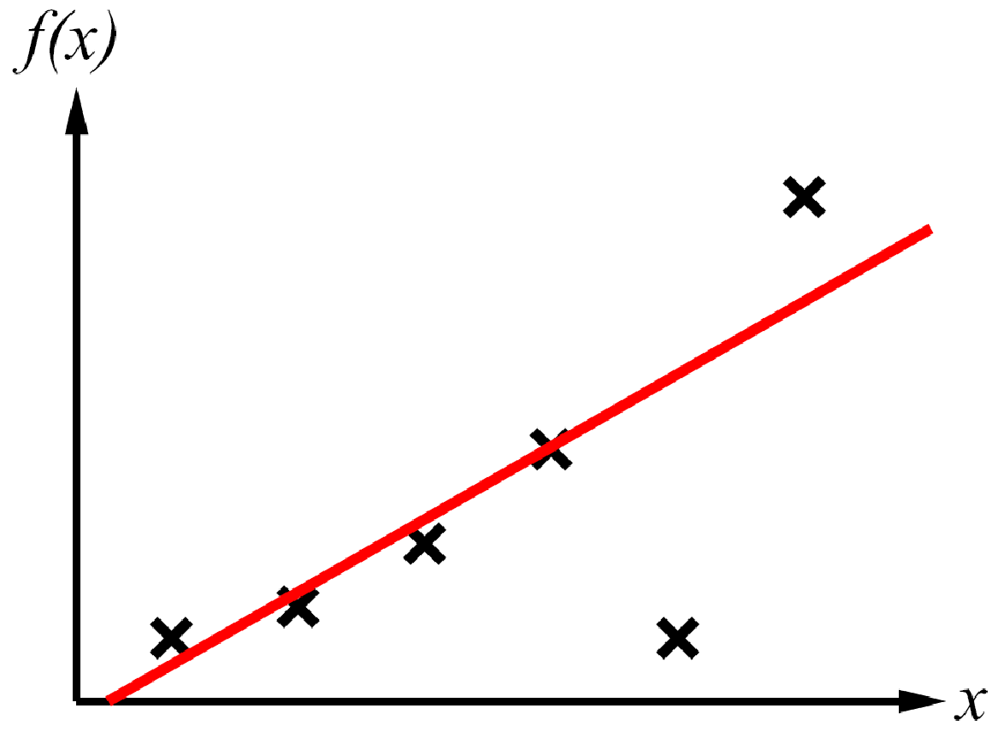
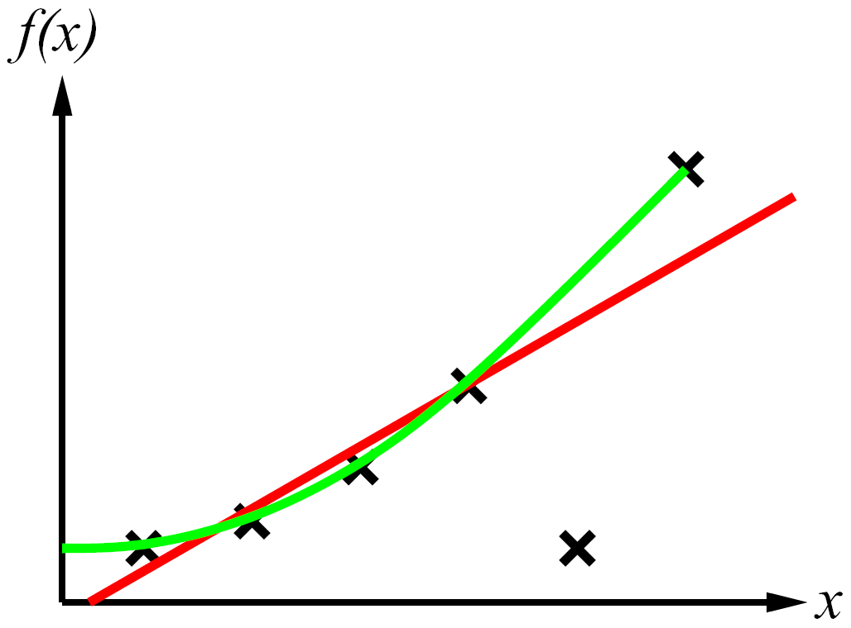
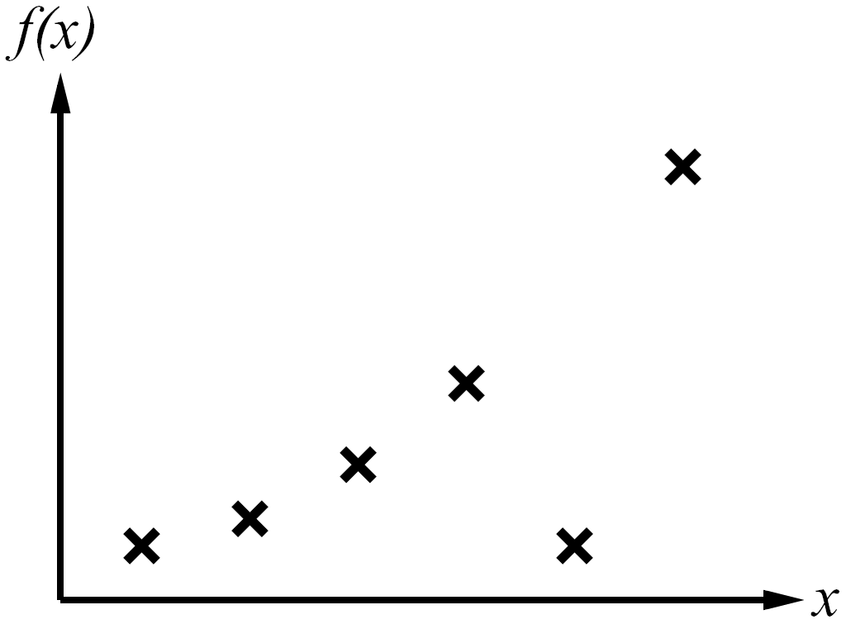
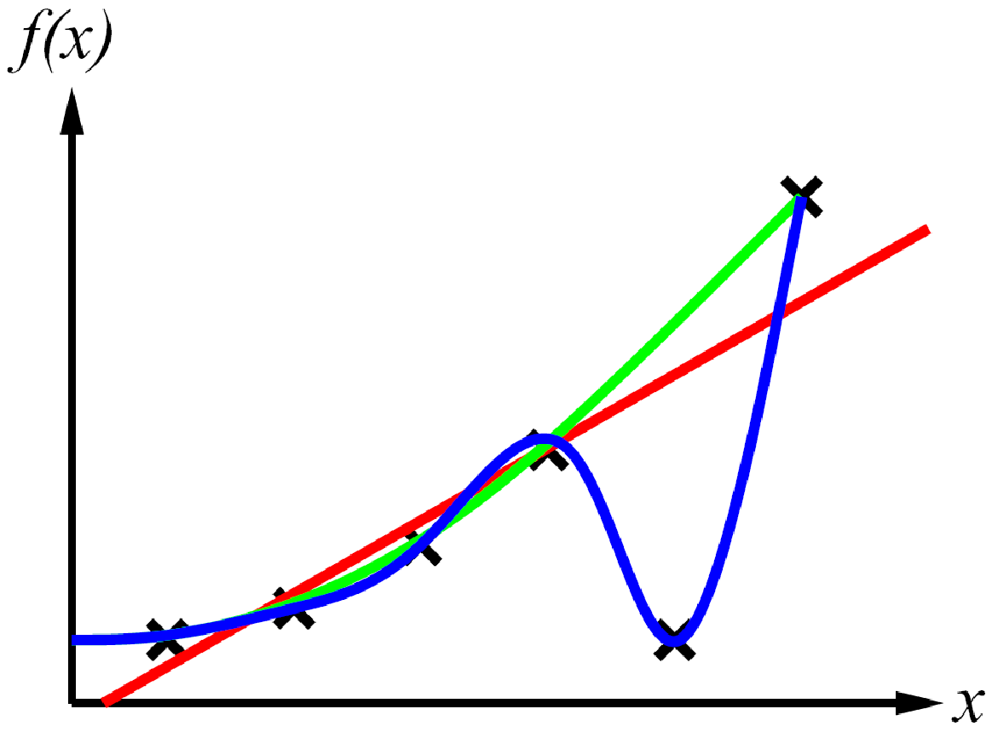
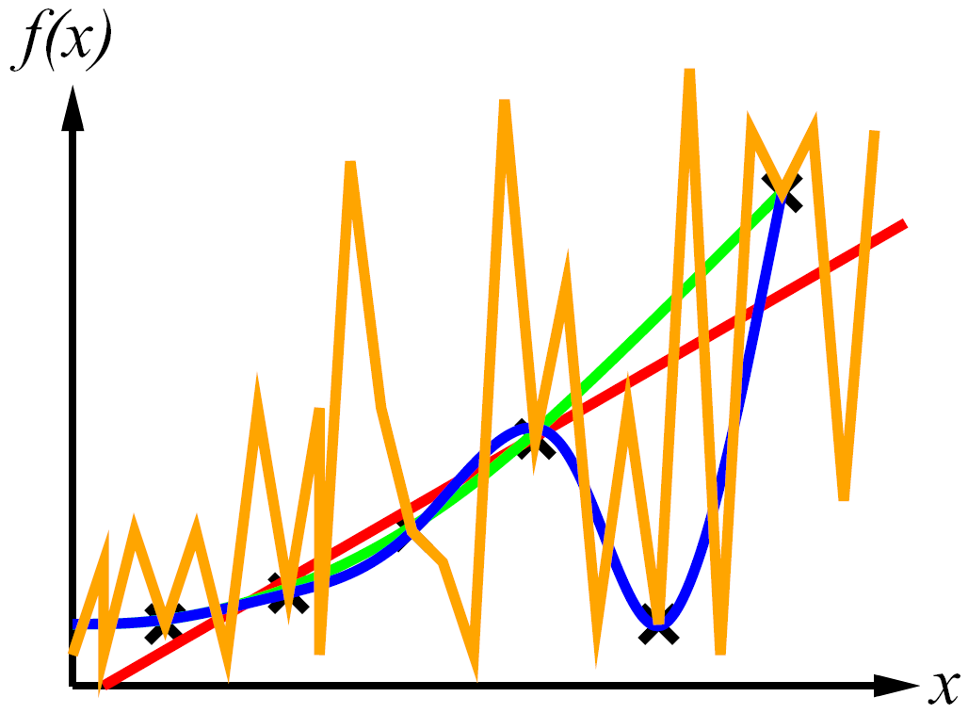
Inductive Learning
Curve fitting (regression, function approximation):
Consistency vs. simplicity
Ockham’s razor

Slide 5
Consistency vs. Simplicity
Fundamental tradeoff: bias vs. variance
Usually algorithms prefer consistency by default (why?)
Several ways to operationalize “simplicity”
Reduce the hypothesis space
Assume more: e.g. independence assumptions, as in naïve Bayes
Have fewer, better features / attributes: feature selection
Other structural limitations (decision lists vs trees)
Regularization
Smoothing: cautious use of small counts
Many other generalization parameters (pruning cutoffs today)
Hypothesis space stays big, but harder to get to the outskirts

Slide 6
Decision Trees

Slide 7
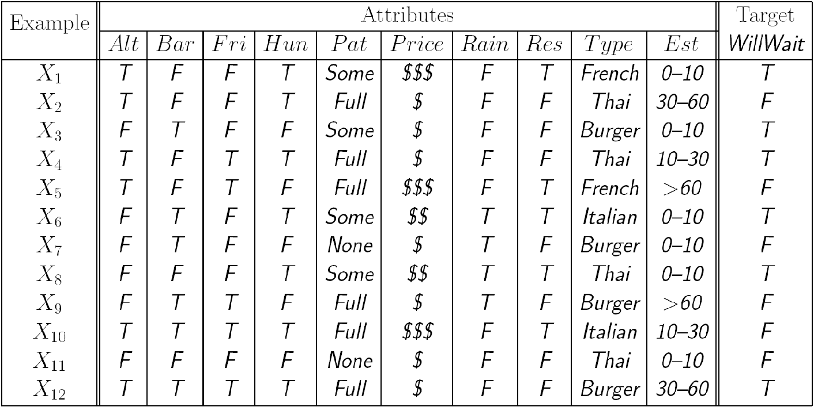
Reminder: Features
Features, aka attributes
Sometimes: TYPE=French
Sometimes: f_{TYPE=French}(x) = 1

Slide 8
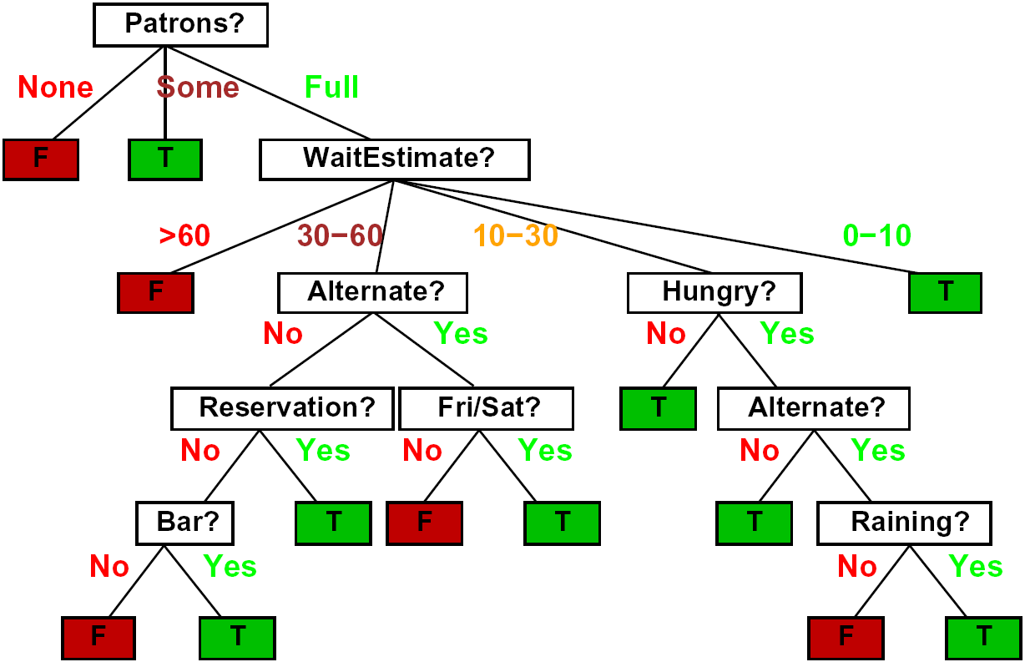
Decision Trees
Compact representation of a function:
Truth table
Conditional probability table
Regression values

Slide 9
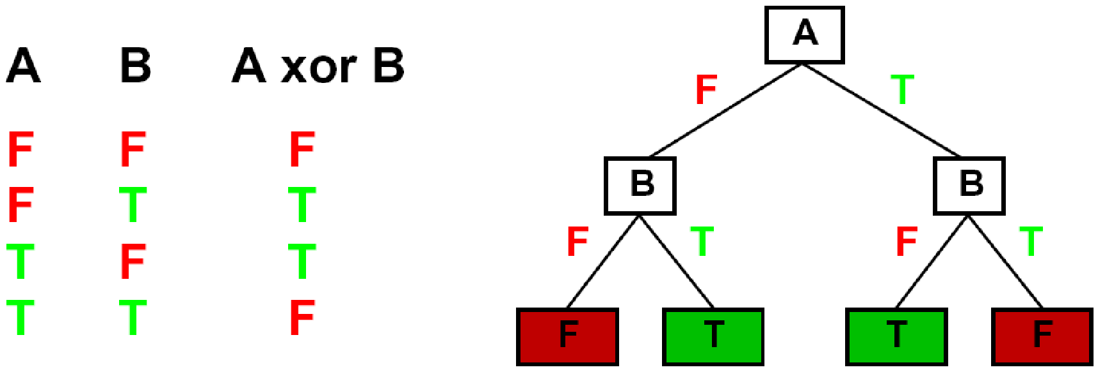

Expressiveness of DTs
Can express any function of the features
However, we hope for compact trees

Slide 10
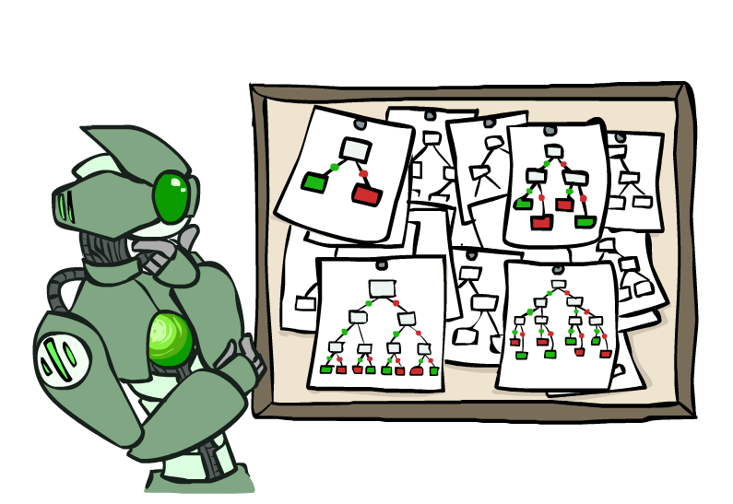
Hypothesis Spaces
How many distinct decision trees with n Boolean attributes?
= number of Boolean functions over n attributes
= number of distinct truth tables with 2^{n} rows
= 2^(2^{n})
E.g., with 6 Boolean attributes, there are
18,446,744,073,709,551,616 trees
How many trees of depth 1 (decision stumps)?
= number of Boolean functions over 1 attribute
= number of truth tables with 2 rows, times n
= 4n
E.g. with 6 Boolean attributes, there are 24 decision stumps
More expressive hypothesis space:
Increases chance that target function can be expressed (good)
Increases number of hypotheses consistent with training set (bad, why?)
Means we can get better predictions (lower bias)
But we may get worse predictions (higher variance)

Slide 11
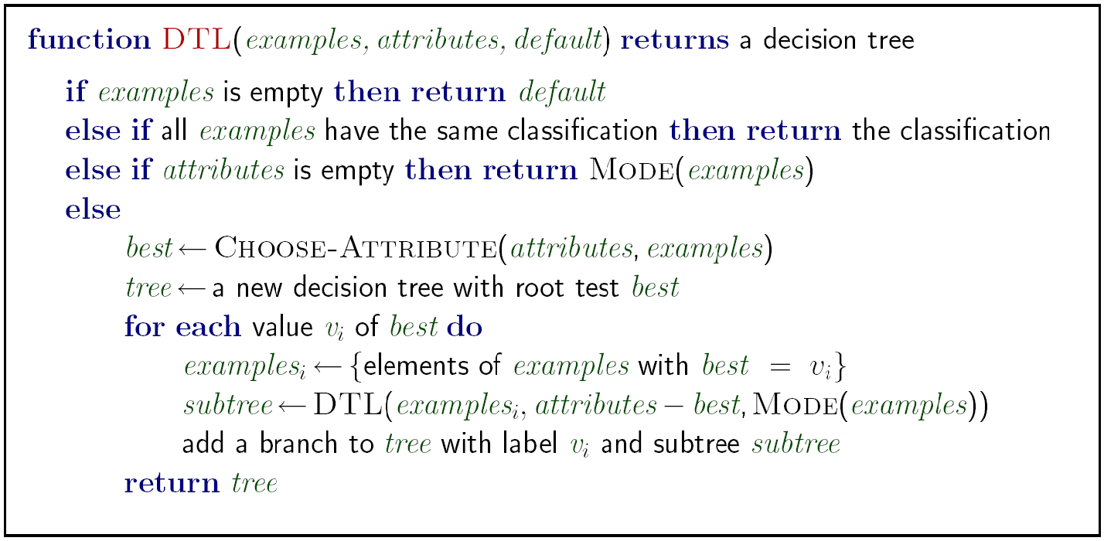
Decision Tree Learning
Aim: find a small tree consistent with the training examples
Idea: (recursively) choose “most significant” attribute as root of (sub)tree

Slide 12
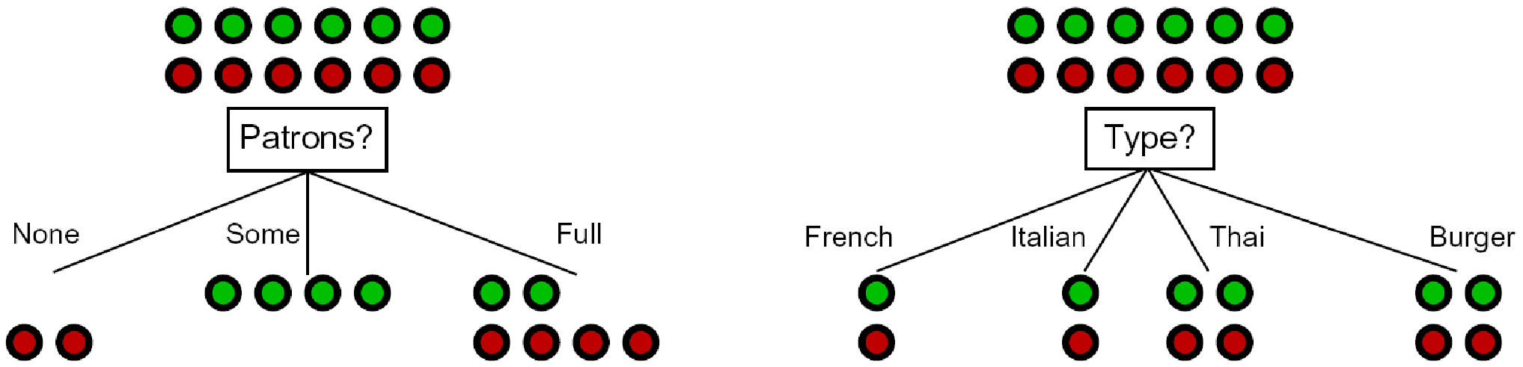
Choosing an Attribute
Idea: a good attribute splits the examples into subsets that are (ideally) “all positive” or “all negative”
So: we need a measure of how “good” a split is, even if the results aren’t perfectly separated out

Slide 13
Entropy and Information
Information answers questions
The more uncertain about the answer initially, the more information in the answer
Scale: bits
Answer to Boolean question with prior <1/2, 1/2>?
Answer to 4-way question with prior <1/4, 1/4, 1/4, 1/4>?
Answer to 4-way question with prior <0, 0, 0, 1>?
Answer to 3-way question with prior <1/2, 1/4, 1/4>?

Slide 14
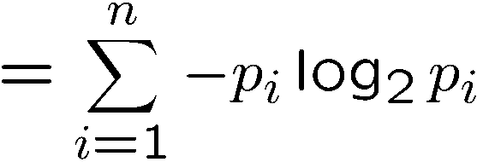
Entropy
General answer: if prior is <p₁,…,p_{n}>:
Information is the expected code length
Also called the entropy of the distribution
More uniform = higher entropy
More values = higher entropy
More peaked = lower entropy
Rare values almost “don’t count”
1 bit
0 bits

Slide 15
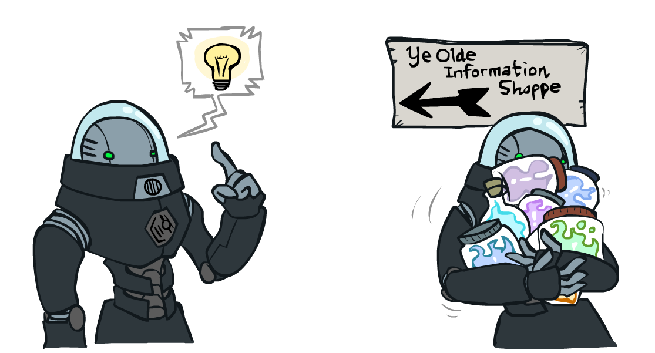
Information Gain
Back to decision trees!
For each split, compare entropy before and after
Difference is the information gain
Problem: there’s more than one distribution after split!
Solution: use expected entropy, weighted by the number of examples

Slide 16

Next Step: Recurse
Now we need to keep growing the tree!
Two branches are done (why?)
What to do under “full”?
See what examples are there…

Slide 17
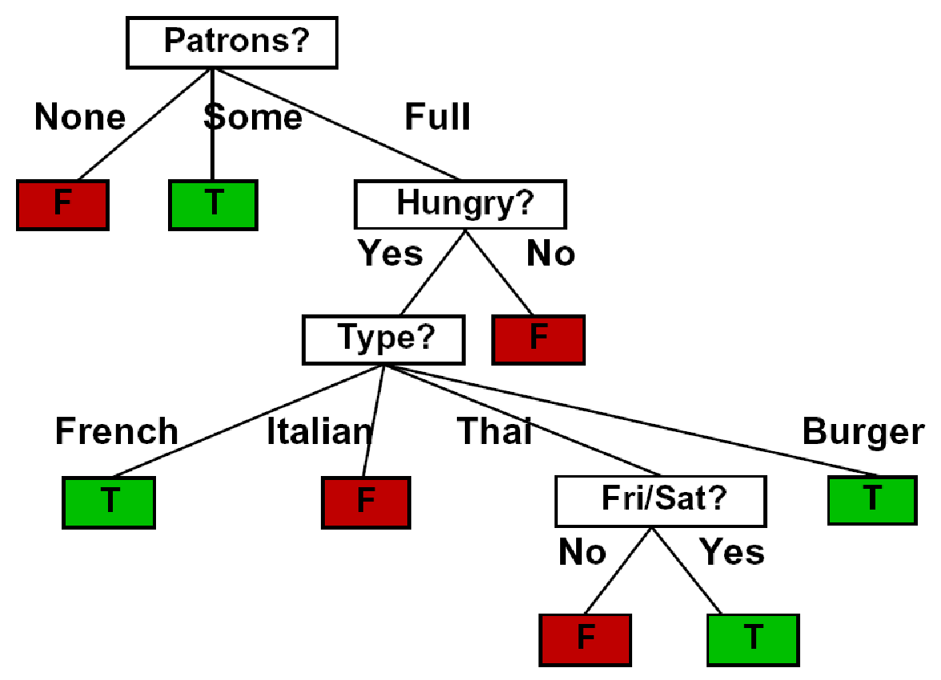
Example: Learned Tree
Decision tree learned from these 12 examples:
Substantially simpler than “true” tree
A more complex hypothesis isn't justified by data
Also: it’s reasonable, but wrong

Slide 18
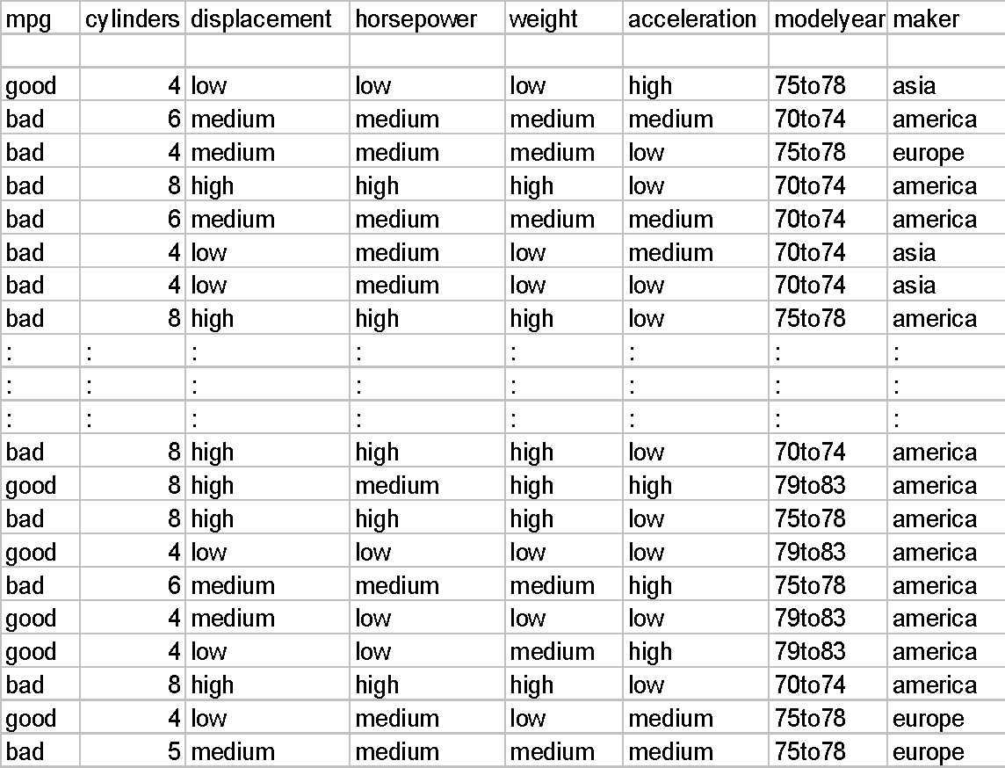
Example: Miles Per Gallon
40 Examples

Slide 19
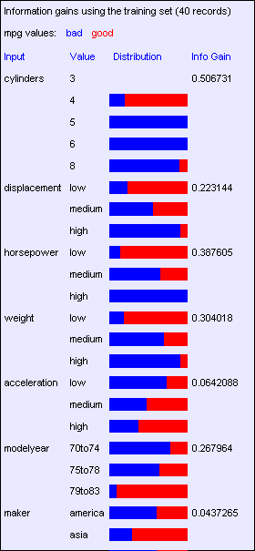
Find the First Split
Look at information gain for each attribute
Note that each attribute is correlated with the target!
What do we split on?

Slide 20
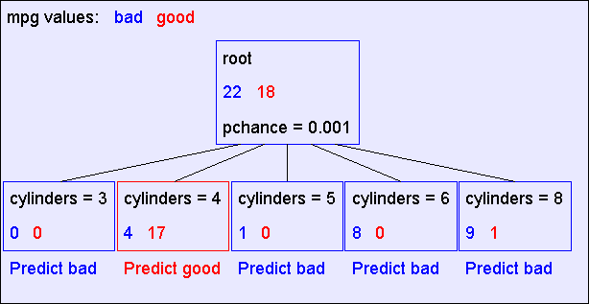
Result: Decision Stump

Slide 21
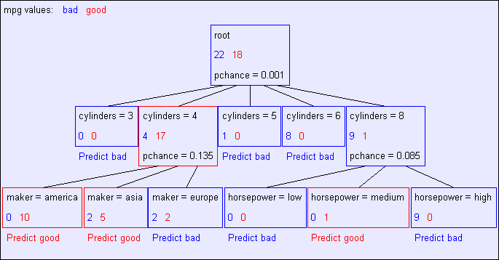
Second Level

Slide 22
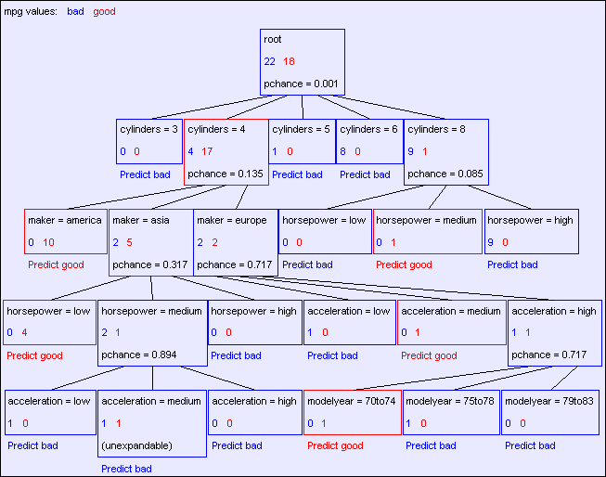
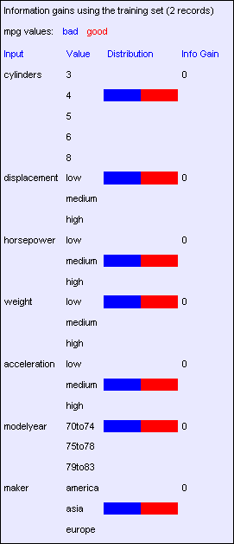
Final Tree

Slide 23
Reminder: Overfitting
Overfitting:
When you stop modeling the patterns in the training data (which generalize)
And start modeling the noise (which doesn’t)

Slide 24

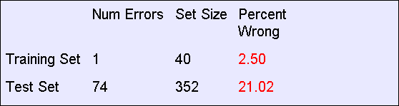
MPG Training Error
The test set error is much worse than the training set error…
…why?

Slide 25
Consider this split

Slide 26
Significance of a Split
Starting with:
Three cars with 4 cylinders, from Asia, with medium HP
2 bad MPG
1 good MPG
What do we expect from a three-way split?
Maybe each example in its own subset?
Maybe just what we saw in the last slide?
Probably shouldn’t split if the counts are so small they could be due to chance
A chi-squared test can tell us how likely it is that deviations from a perfect split are due to chance*
Each split will have a significance value, p_{CHANCE}

Slide 27
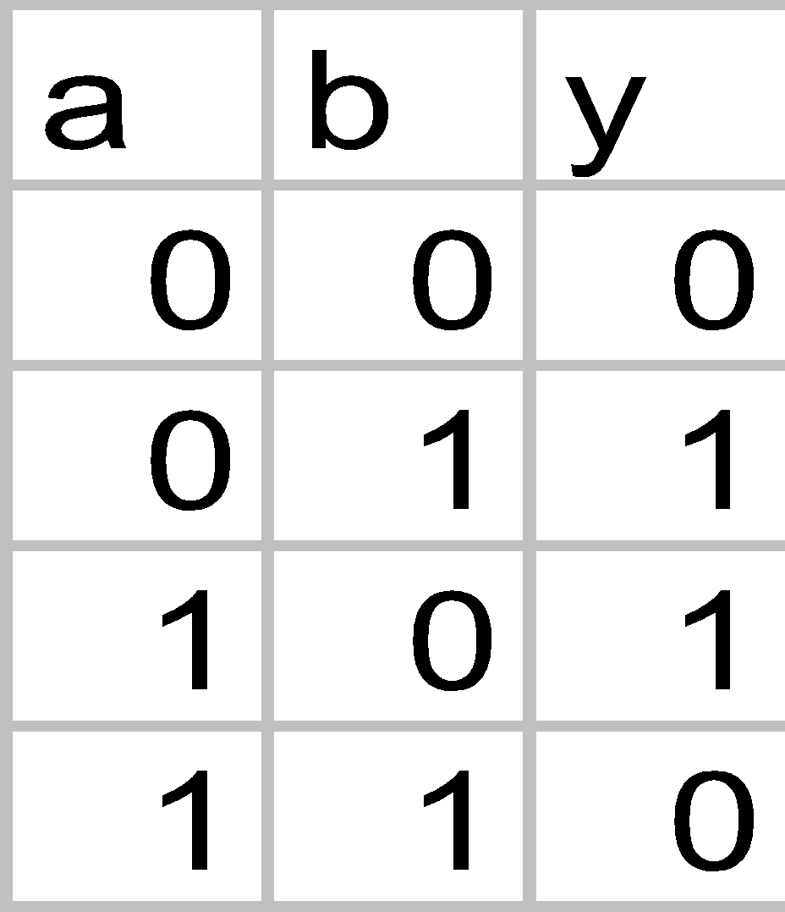

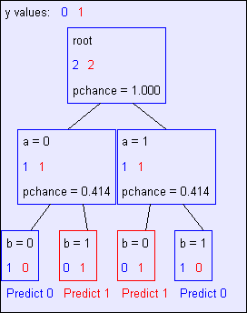
Keeping it General
Pruning:
Build the full decision tree
Begin at the bottom of the tree
Delete splits in which
p_{CHANCE} > MaxP_{CHANCE}
Continue working upward until there are no more prunable nodes
Note: some chance nodes may not get pruned because they were “redeemed” later
y = a XOR b

Slide 28
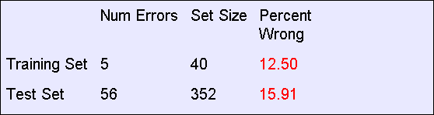
Pruning example
With MaxP_{CHANCE} = 0.1:
Note the improved test set accuracy compared with the unpruned tree

Slide 29
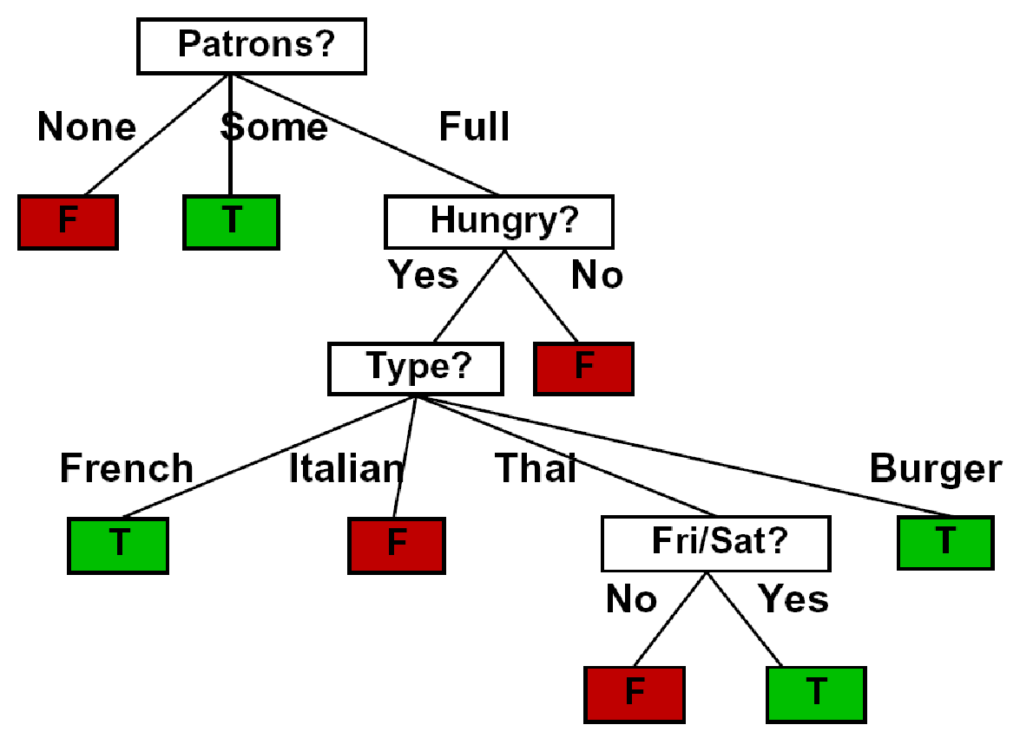
Regularization
MaxP_{CHANCE} is a regularization parameter
Generally, set it using held-out data (as usual)
Training
Held-out / Test
Accuracy
Decreasing
Increasing
MaxP_{CHANCE}
Small Trees
Large Trees
High Bias
High Variance

Slide 30
Two Ways of Controlling Overfitting
Limit the hypothesis space
E.g. limit the max depth of trees
Easier to analyze
Regularize the hypothesis selection
E.g. chance cutoff
Disprefer most of the hypotheses unless data is clear
Usually done in practice

Slide 31
Ensemble Methods
Bagging (Breiman 1994,…)
Random forests (Breiman 2001,…)
Predict class label for unseen data by aggregating a set of predictions (classifiers learned from the training data).
Notes:
‹#›

Slide 32
General Idea
S
Training Data
Multiple Data Sets
S1
S2
Sn
Multiple Classifiers
C1
C2
Cn
Combined Classifier
H
Notes:
‹#›

Slide 33
Bagging & Boosting
Bagging
Training
Given a dataset S, at each iteration i, a training set Si is sampled with replacement from S (i.e. bootstraping)
A classifier Ci is learned for each Si
Classification: given an unseen sample X,
Each classifier Ci returns its class prediction
The bagged classifier H counts the votes and assigns the class with the most votes to X
Regression: can be applied to the prediction of continuous values by taking the average value of each prediction.
Boosting
Sequential training of weak learners
Each base classifier is trained on data that is weighted based on the performance of the previous classifier
Notes:
‹#›

Slide 34
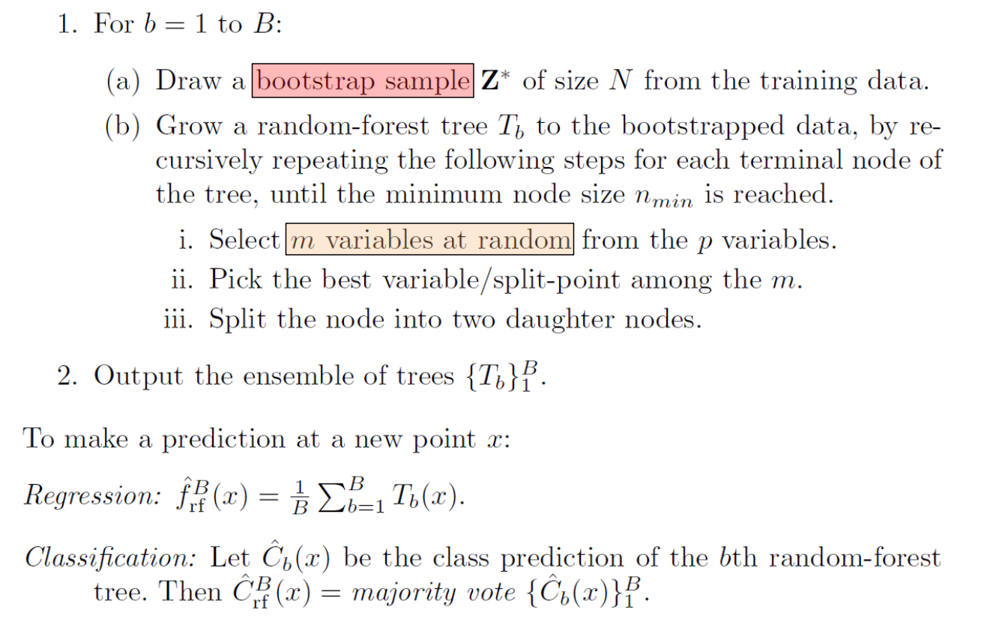
Random Forest

