Slide 1
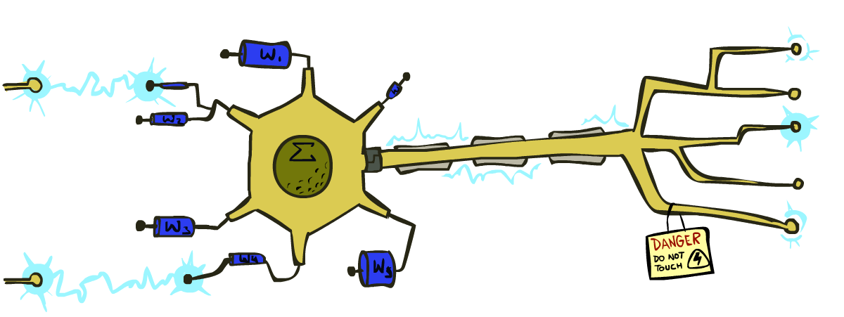
Artificial Intelligence
Perceptrons and Logistic Regression
[These slides were created by Dan Klein, Pieter Abbeel, Anca Dragan, Sergey Levine. All CS188 materials are at http://ai.berkeley.edu.]

Slide 2
Practical Tip: Baselines
First step: get a baseline
Baselines are very simple “straw man” procedures
Help determine how hard the task is
Help know what a “good” accuracy is
Weak baseline: most frequent label classifier
Gives all test instances whatever label was most common in the training set
E.g. for spam filtering, might label everything as ham
Accuracy might be very high if the problem is skewed
E.g. calling everything “ham” gets 66%, so a classifier that gets 70% isn’t very good…
For real research, usually use previous work as a (strong) baseline

Slide 3
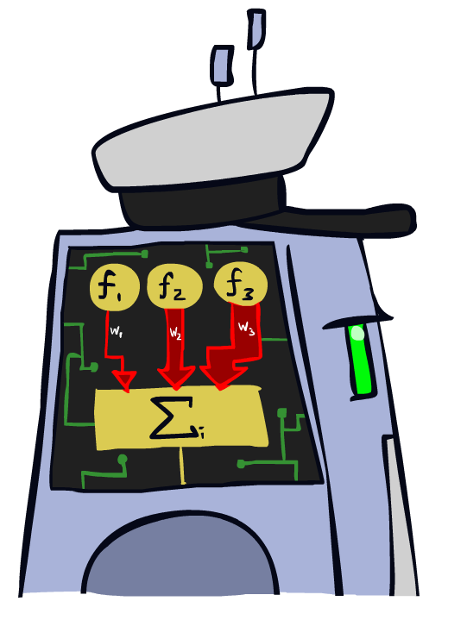
Linear Classifiers

Slide 4
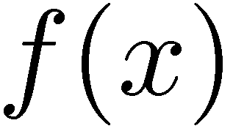

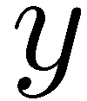

Feature Vectors
Hello,
Do you want free printr cartriges? Why pay more when you can get them ABSOLUTELY FREE! Just
# free : 2
YOUR_NAME : 0
MISSPELLED : 2
FROM_FRIEND : 0
...
SPAM
or
+
PIXEL-7,12 : 1
PIXEL-7,13 : 0
...
NUM_LOOPS : 1
...
“2”
Notes:
‹#›

Slide 5
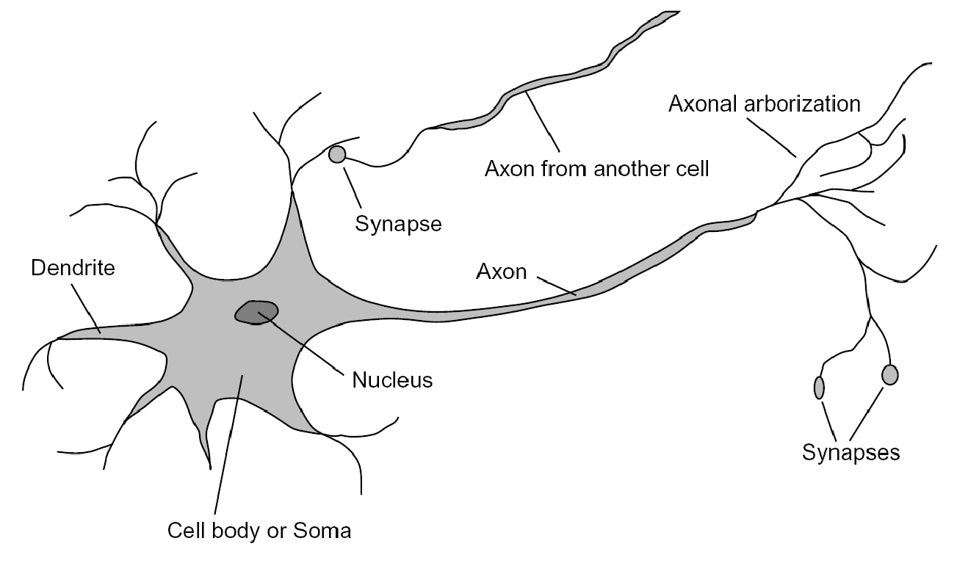
Some (Simplified) Biology
Very loose inspiration: human neurons

Slide 6
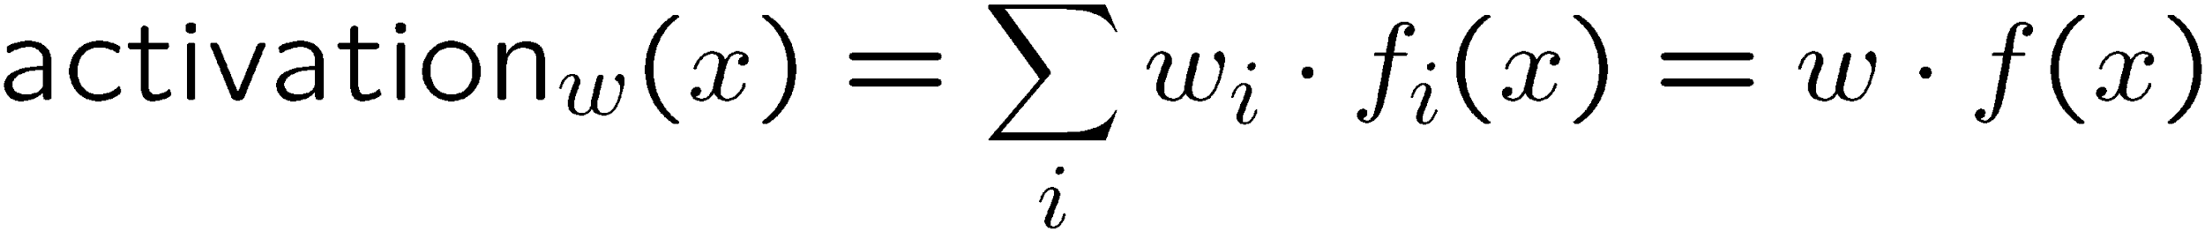
Linear Classifiers
Inputs are feature values
Each feature has a weight
Sum is the activation
If the activation is:
Positive, output +1
w₁
f₁
Σ
w₂
>0?
f₂
w₃
f₃

Slide 7

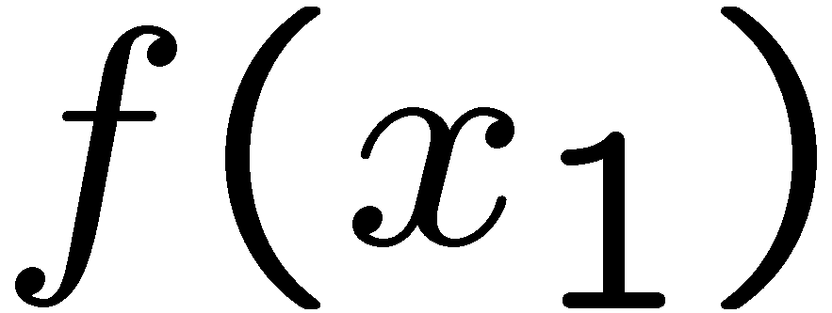
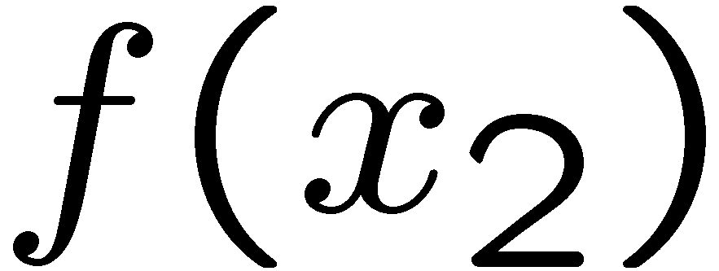
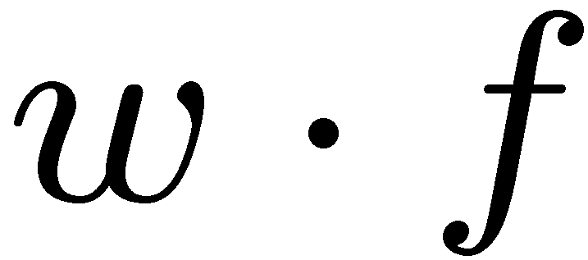
Weights
Binary case: compare features to a weight vector
Learning: figure out the weight vector from examples
# free : 4
YOUR_NAME :-1
MISSPELLED : 1
FROM_FRIEND :-3
...
# free : 2
YOUR_NAME : 0
MISSPELLED : 2
FROM_FRIEND : 0
...
# free : 0
YOUR_NAME : 1
MISSPELLED : 1
FROM_FRIEND : 1
...
Dot product positive means the positive class

Slide 8
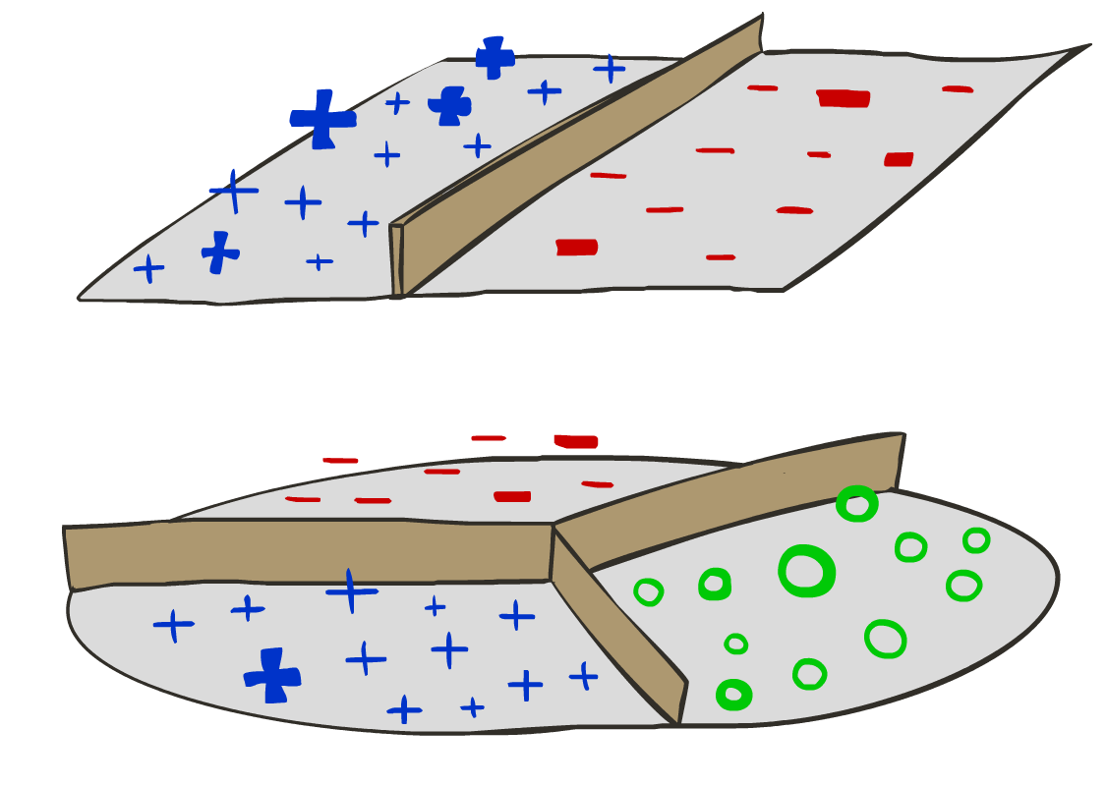
Decision Rules

Slide 9

Binary Decision Rule
In the space of feature vectors
Examples are points
Any weight vector is a hyperplane
One side corresponds to Y=+1
Other corresponds to Y=-1
money
2
1
BIAS : -3
free : 4
money : 2
...
0
0
1
free

Slide 10
Binary Decision Rule
In the space of feature vectors
Examples are points
Any weight vector is a hyperplane
One side corresponds to Y=+1
Other corresponds to Y=-1
money
2
1
free : 4
money : 2
0
0
1
free

Slide 11
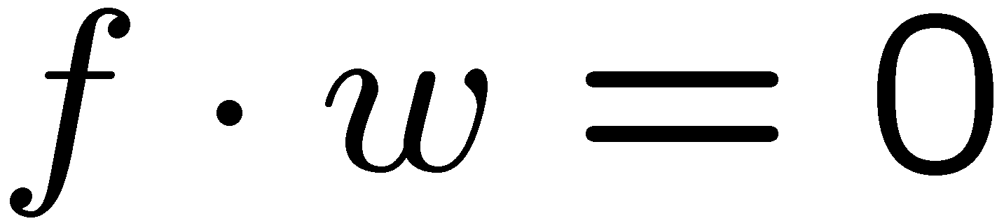
Binary Decision Rule
In the space of feature vectors
Examples are points
Any weight vector is a hyperplane
One side corresponds to Y=+1
Other corresponds to Y=-1
money
2
+1 = SPAM
1
BIAS : -3
free : 4
money : 2
...
0
-1 = HAM
0
1
free

Slide 12
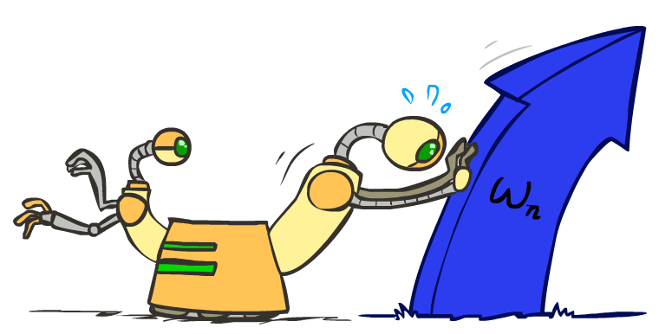
Weight Updates

Slide 13
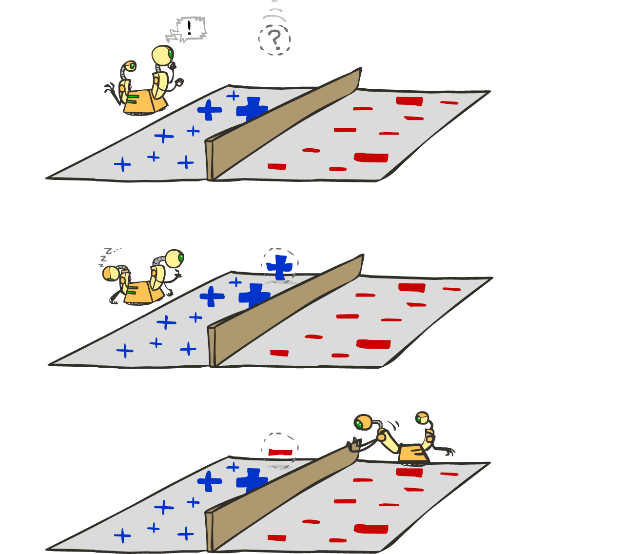
Learning: Binary Perceptron
Start with weights = 0
For each training instance:
Classify with current weights
If correct (i.e., y=y*), no change!
Notes:
http://isl.ira.uka.de/neuralNetCourse/2004/VL_11_5/Perceptron.html
‹#›

Slide 14
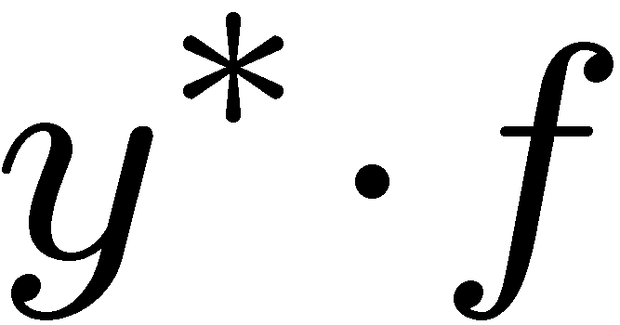

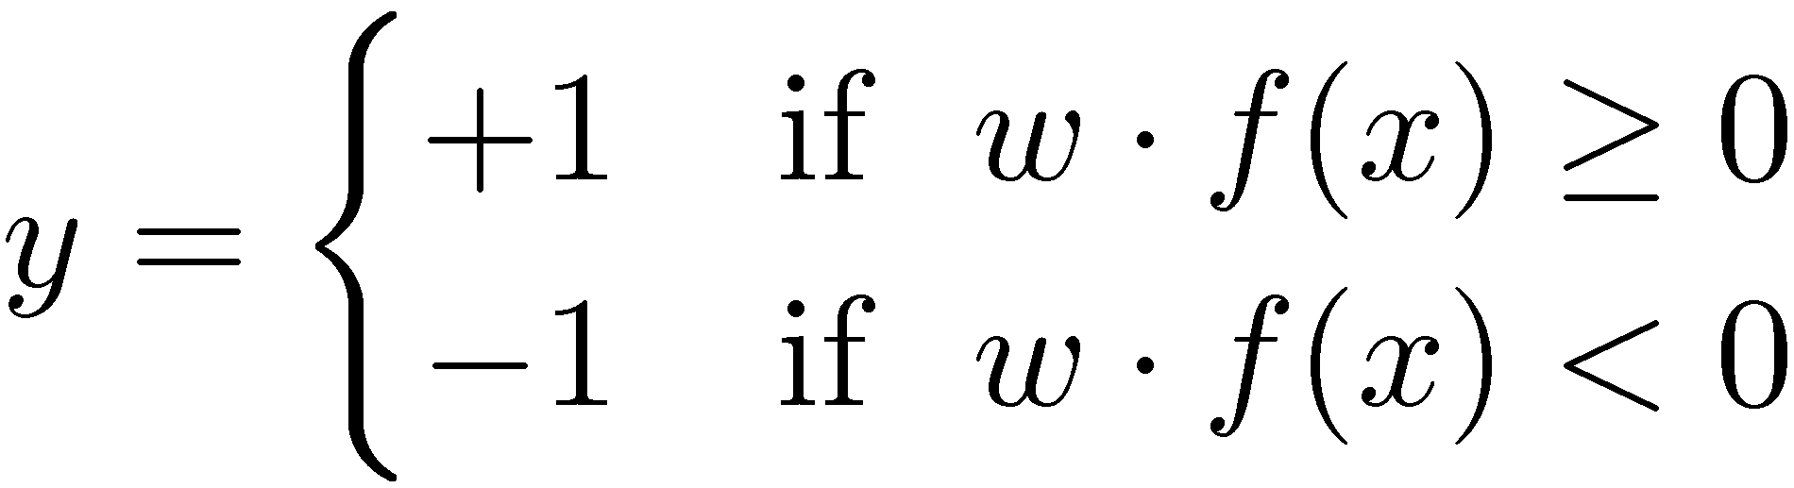
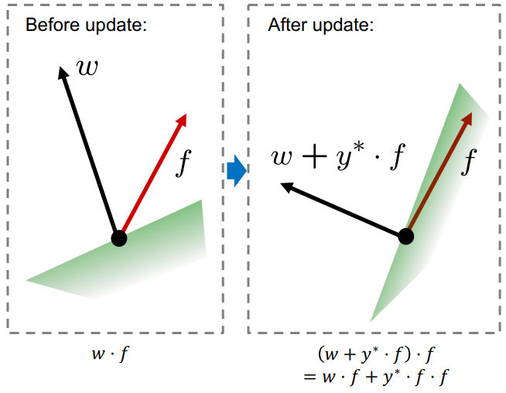
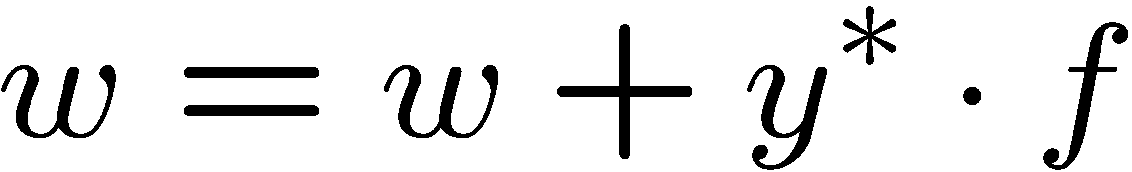
Learning: Binary Perceptron
Start with weights = 0
For each training instance:
Classify with current weights
If correct (i.e., y=y*), no change!
If wrong: adjust the weight vector by adding or subtracting the feature vector. Subtract if y* is -1.
Notes:
http://isl.ira.uka.de/neuralNetCourse/2004/VL_11_5/Perceptron.html
‹#›

Slide 15
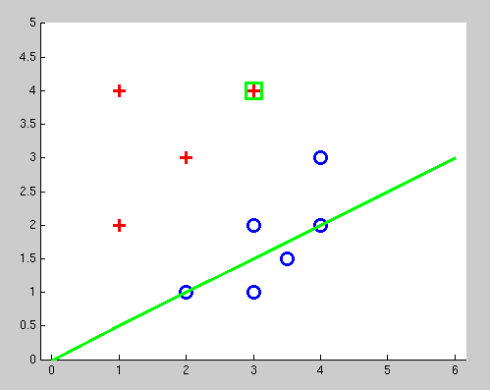
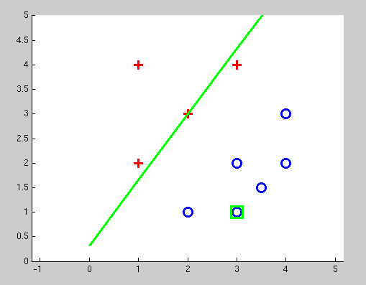
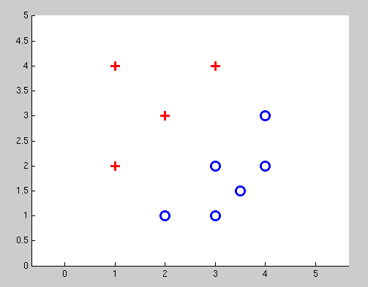
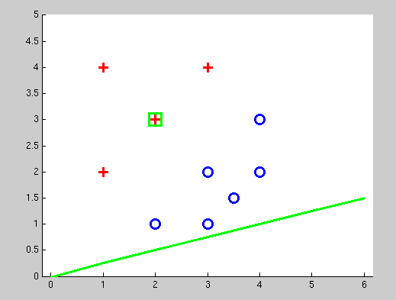
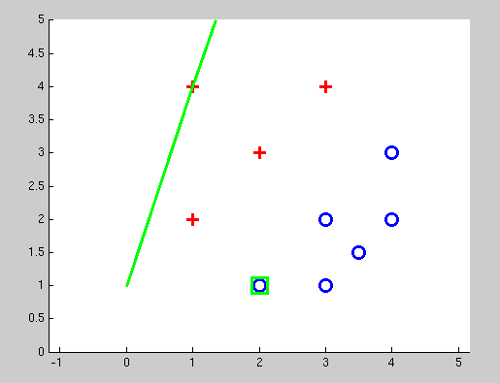
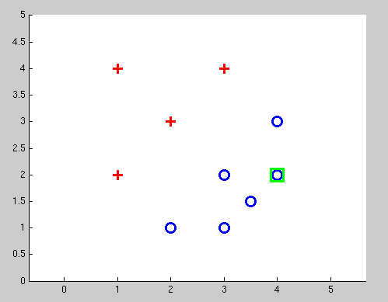
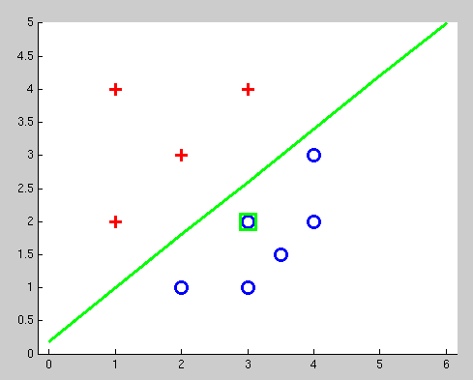
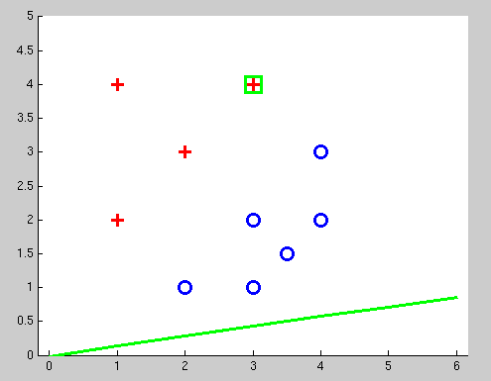
Examples: Perceptron
Separable Case

Slide 16


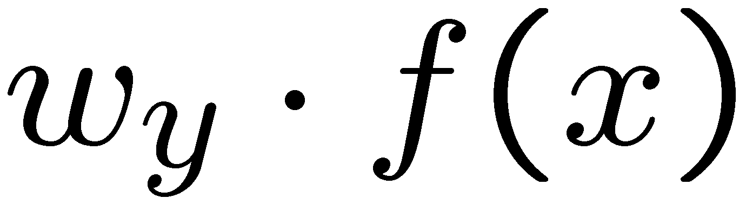


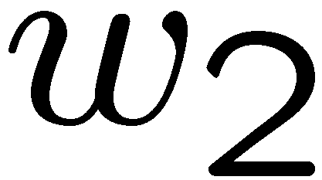
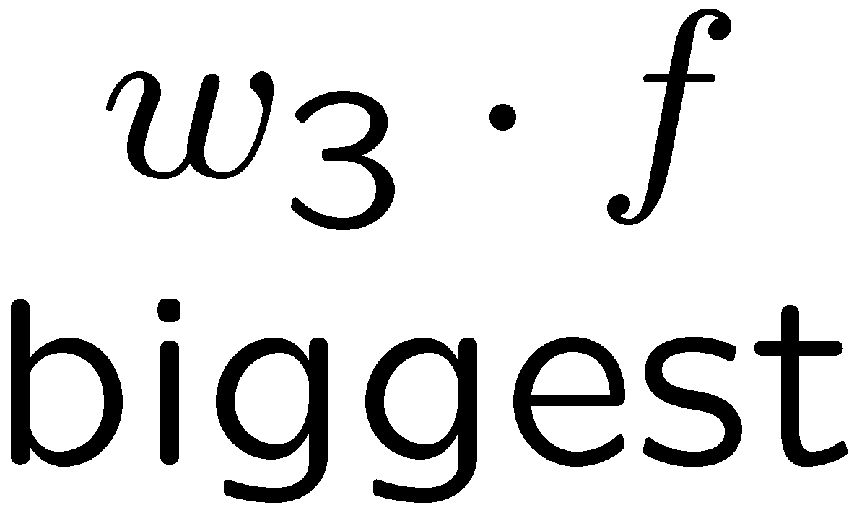
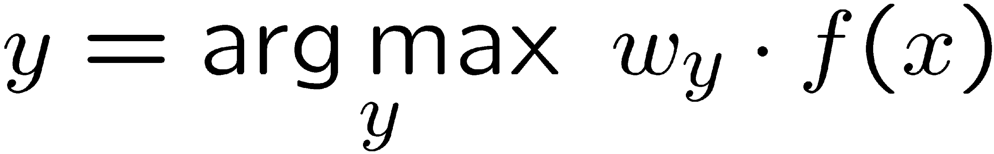
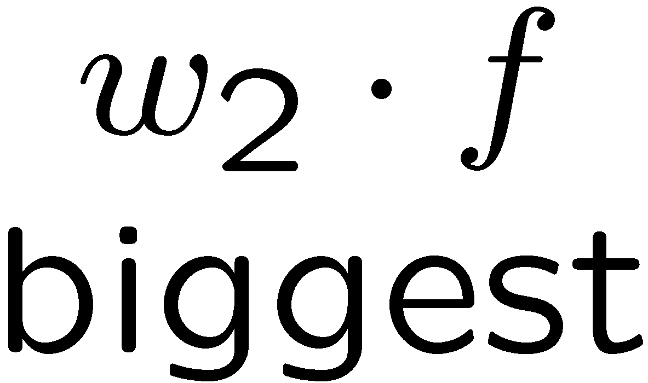
Multiclass Decision Rule
If we have multiple classes:
A weight vector for each class:
Score (activation) of a class y:
Binary = multiclass where the negative class has weight zero
Notes:
Picture only true for equal size ws; if we had a really big or really small w1 yellow are would change
‹#›

Slide 17

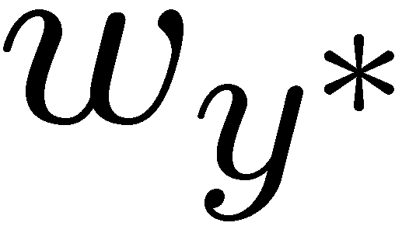

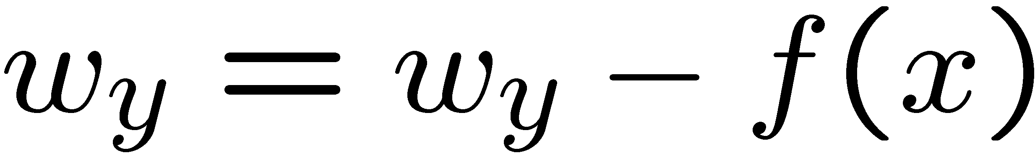
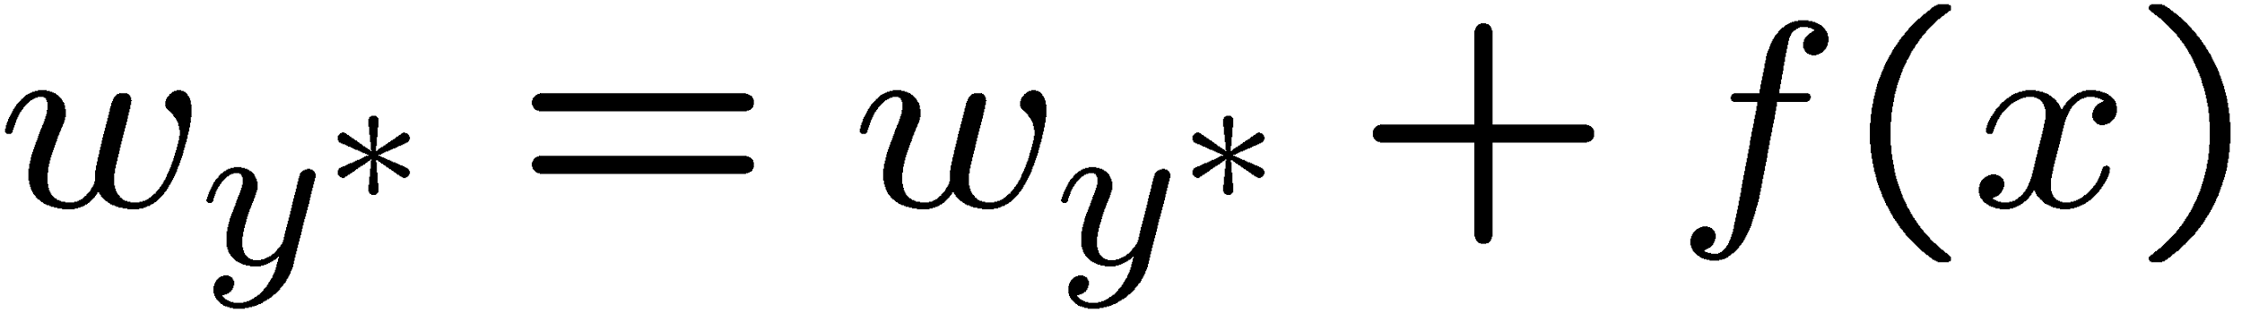
Learning: Multiclass Perceptron
Start with all weights = 0
Pick up training examples one by one
Predict with current weights
If correct, no change!
If wrong: lower score of wrong answer, raise score of right answer

Slide 18



Example: Multiclass Perceptron
“win the vote”
[1 1 0 1 1]
“win the election”
[1 1 0 0 1]
“win the game”
[1 1 1 0 1]
3
0
1
-2
0
3
0
-2
BIAS : 1
win : 0
game : 0
vote : 0
the : 0
...
0
-1
0
-1
-1
1
0
1
-1
0
BIAS : 0
win : 0
game : 0
vote : 0
the : 0
...
1
1
0
1
1
0
0
-1
1
0
BIAS : 0
win : 0
game : 0
vote : 0
the : 0
...

Slide 19
Properties of Perceptrons
Separable
Separability: true if some parameters get the training set perfectly correct
Convergence: if the training is separable, perceptron will eventually converge (binary case)
Mistake Bound: the maximum number of mistakes (binary case) related to the margin or degree of separability
Non-Separable

Slide 20
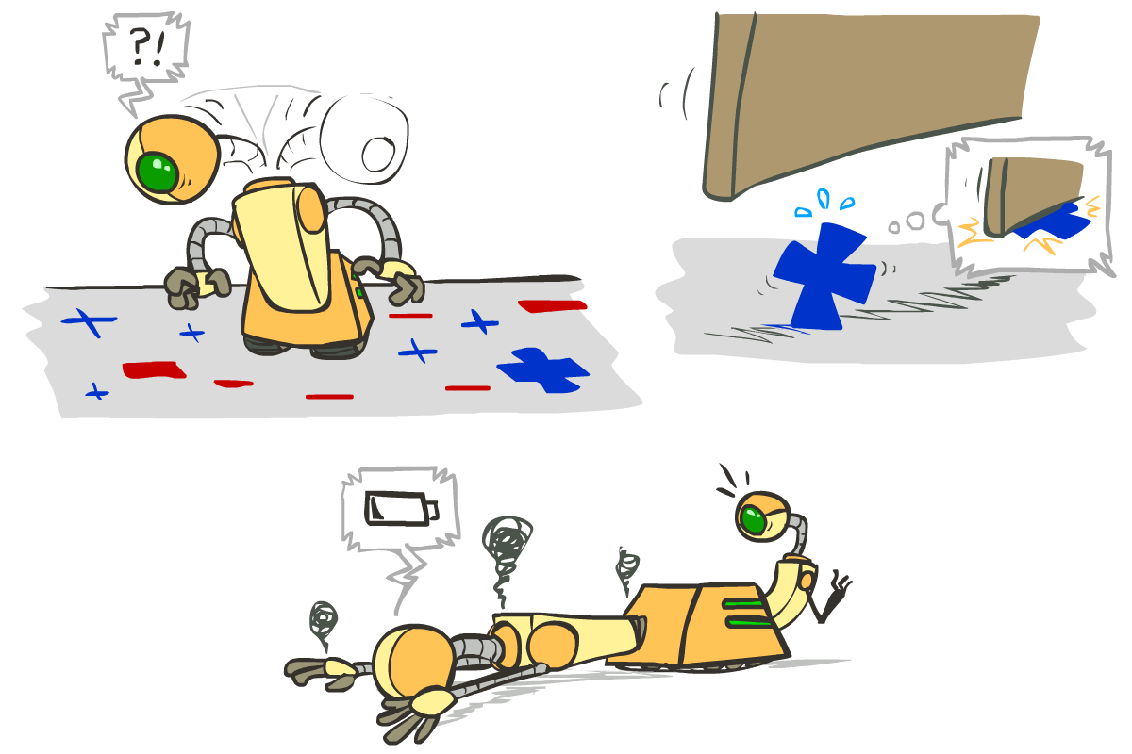





Problems with the Perceptron
Noise: if the data isn’t separable, weights might thrash
Averaging weight vectors over time can help (averaged perceptron)
Mediocre generalization: finds a “barely” separating solution
Overtraining: test / held-out accuracy usually rises, then falls
Overtraining is a kind of overfitting

Slide 21
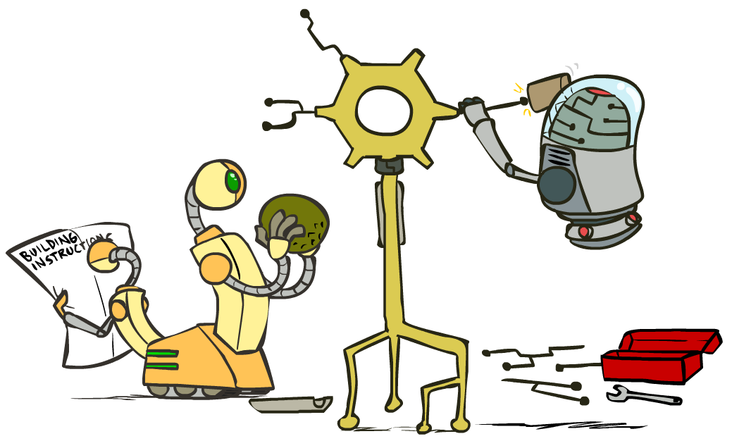
Improving the Perceptron

Slide 22
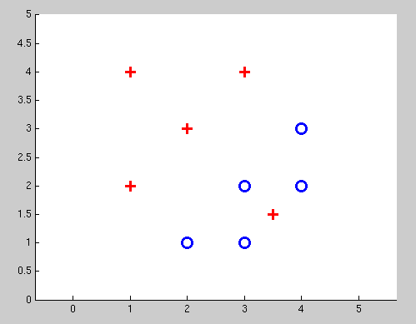
Non-Separable Case: Deterministic Decision
Even the best linear boundary makes at least one mistake

Slide 23
Non-Separable Case: Probabilistic Decision
0.9 | 0.1
0.7 | 0.3
0.5 | 0.5
0.3 | 0.7
0.1 | 0.9

Slide 24
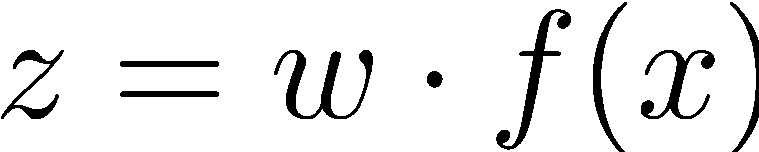
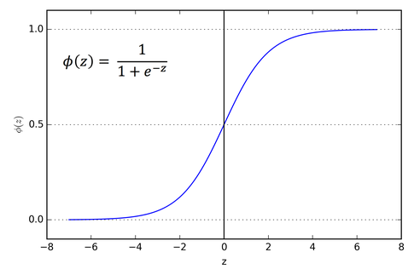
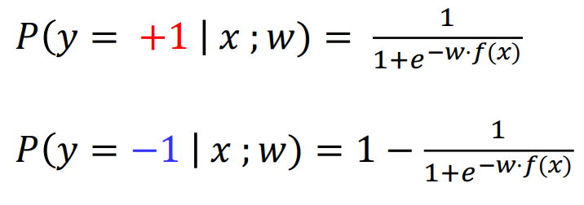
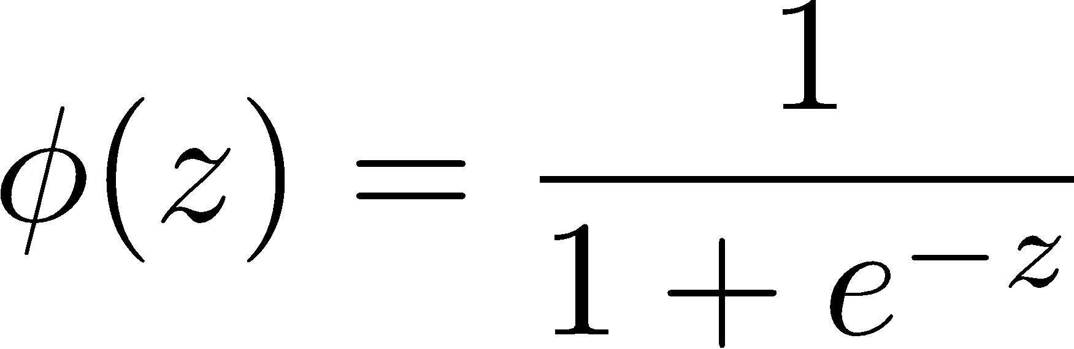
How to get probabilistic decisions?
Perceptron scoring:
If very positive 🡪 want probability going to 1
If very negative 🡪 want probability going to 0

Slide 25



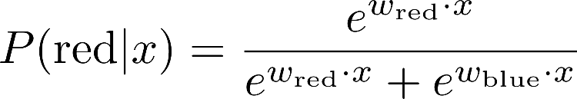
A 1D Example
definitely blue
not sure
definitely red
probability increases exponentially as we move away from boundary
normalizer
Notes:
‹#›

Slide 26
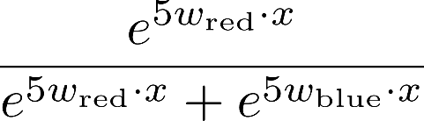
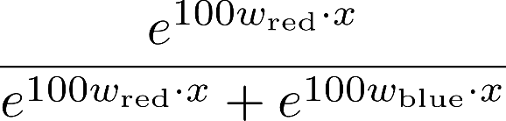

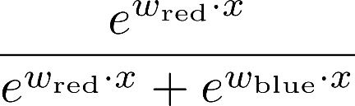
The Soft Max
Notes:
‹#›

Slide 27
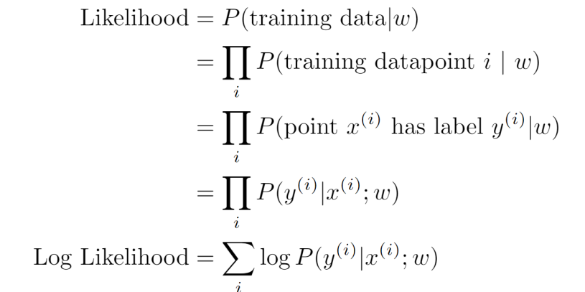
Best w?
Maximum likelihood estimation:
= Logistic Regression

Slide 28
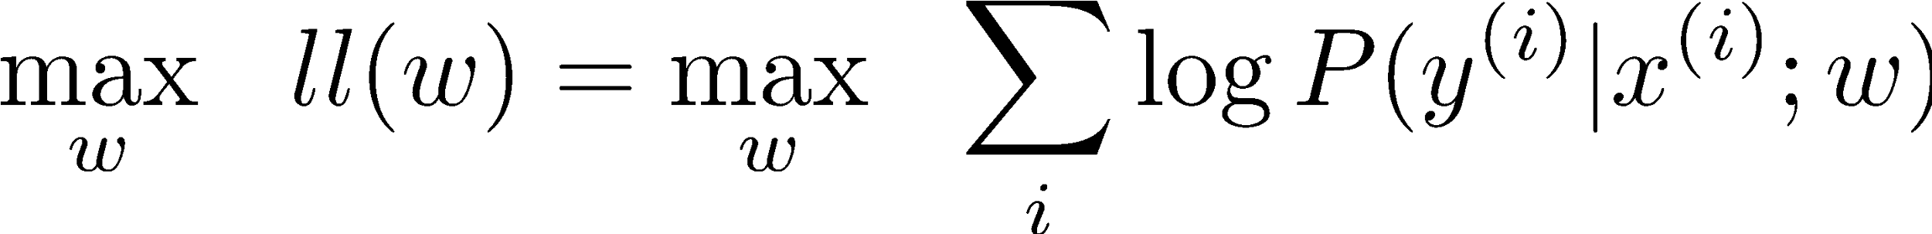
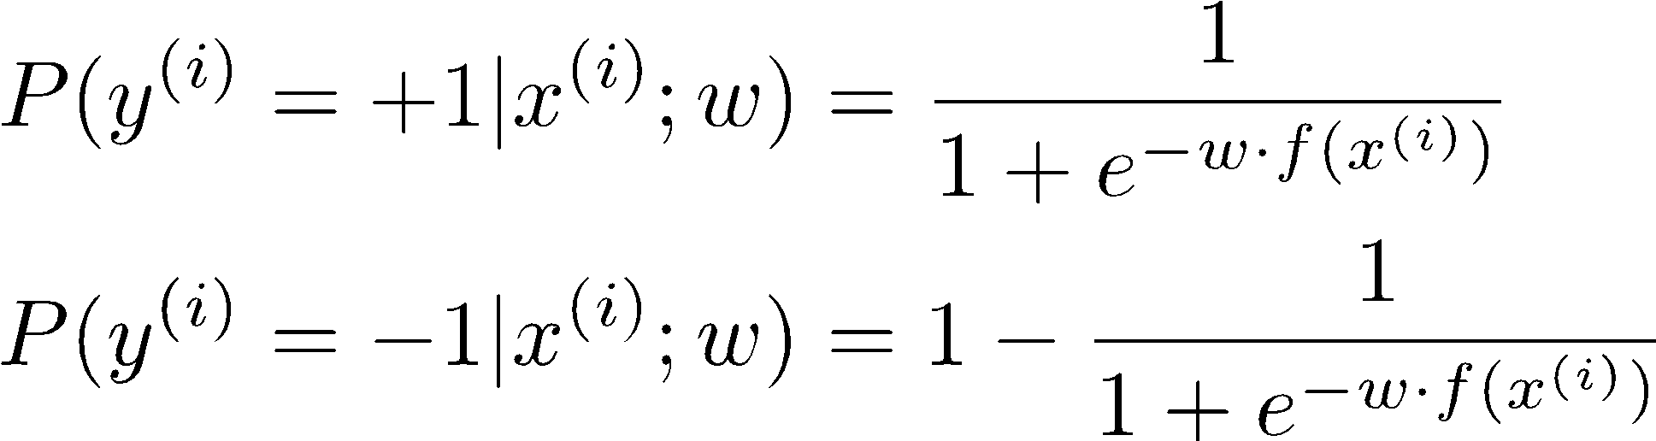
Best w?
Maximum likelihood estimation:
with:
= Logistic Regression

Slide 29
Separable Case: Deterministic Decision – Many Options

Slide 30
Separable Case: Probabilistic Decision – Clear Preference
0.7 | 0.3
0.5 | 0.5
0.7 | 0.3
0.3 | 0.7
0.5 | 0.5
0.3 | 0.7

Slide 31
Multiclass Logistic Regression
Recall Perceptron:
A weight vector for each class:
Score (activation) of a class y:
Prediction highest score wins
How to make the scores into probabilities?
original activations
softmax activations

Slide 32
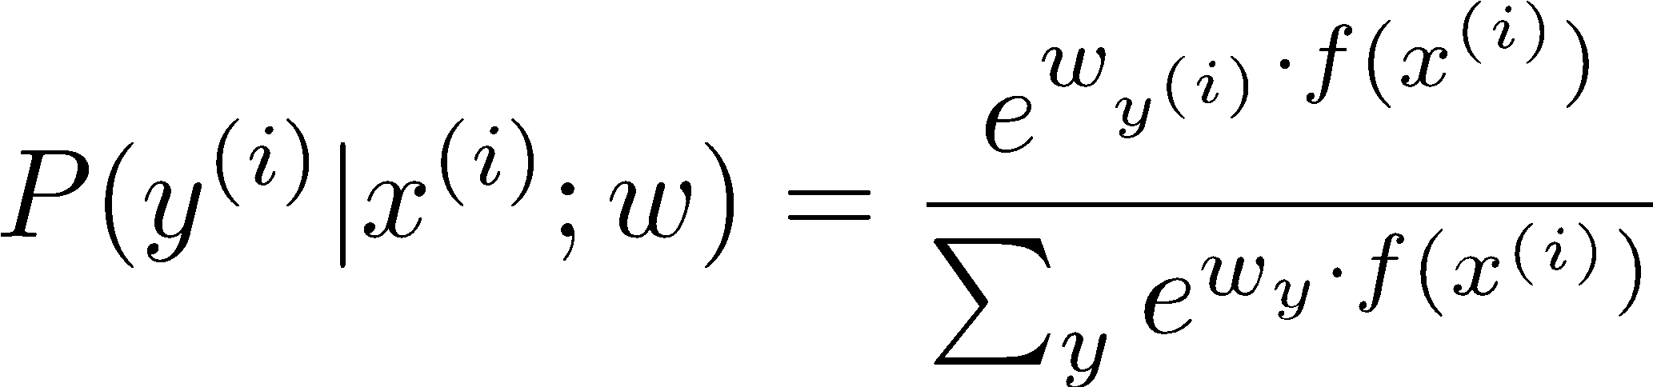
Best w?
Maximum likelihood estimation:
with:
= Multi-Class Logistic Regression

Slide 33
Next Lecture
Optimization
i.e., how do we solve:

