Slide 1
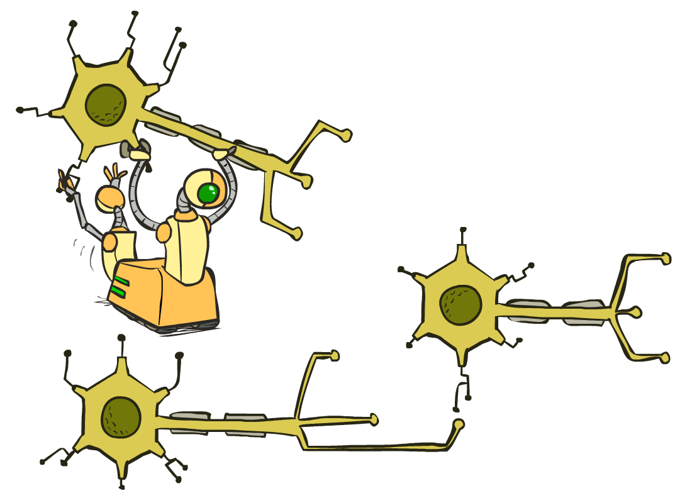
Optimization and Neural Nets
[These slides were created by Dan Klein and Pieter Abbeel for CS188 Intro to AI at UC Berkeley.
Notes:
Please retain proper attribution, including the reference to ai.berkeley.edu. Thanks!
‹#›

Slide 2
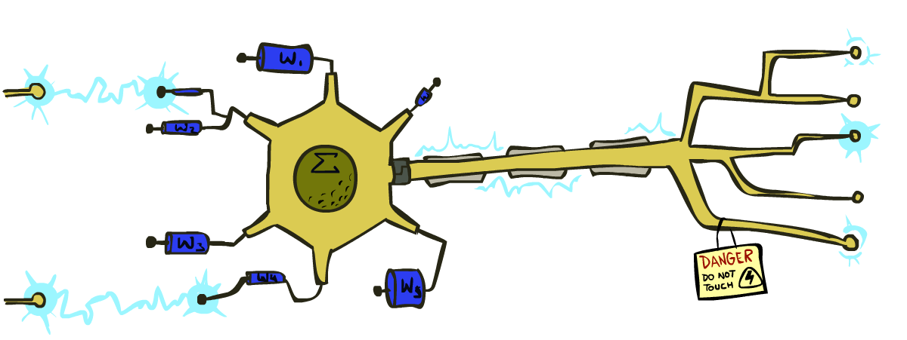
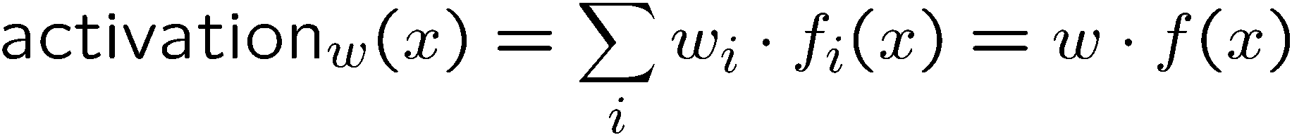
Reminder: Linear Classifiers
Inputs are feature values
Each feature has a weight
Sum is the activation
If the activation is:
Positive, output +1
Negative, output -1
w₁
f₁
Σ
w₂
>0?
f₂
w₃
f₃

Slide 3
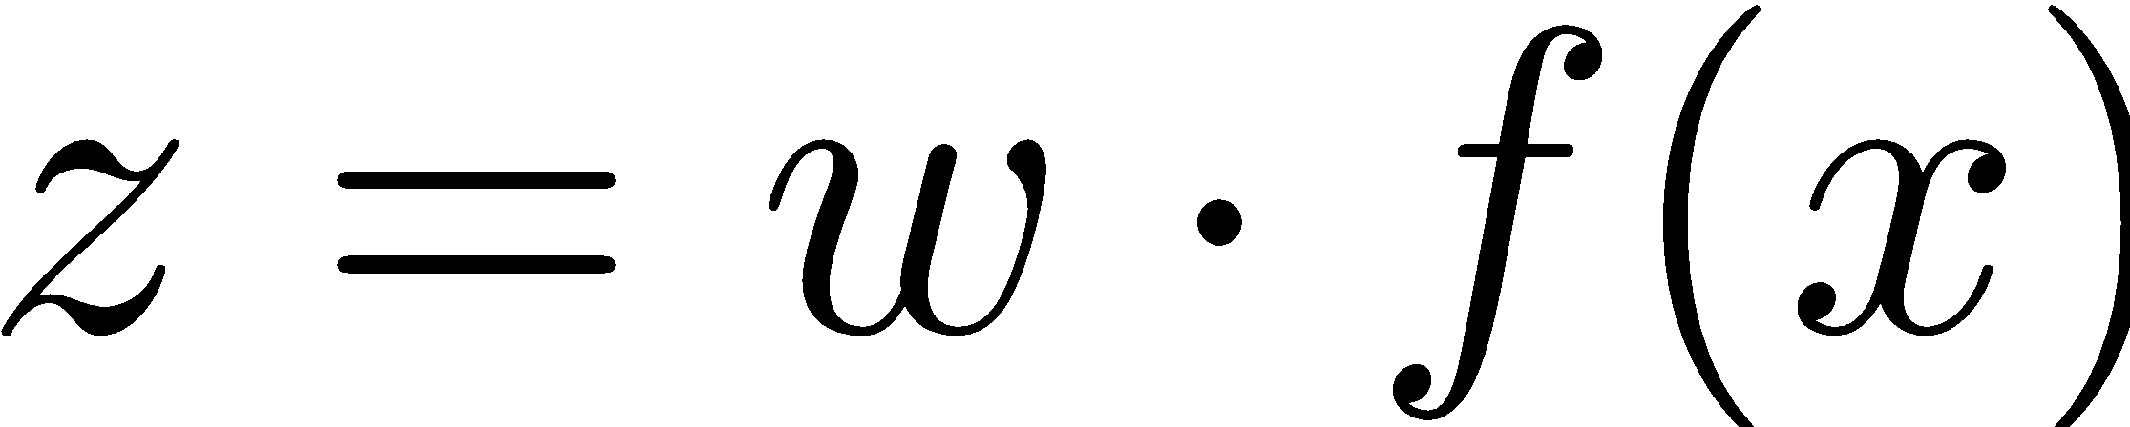
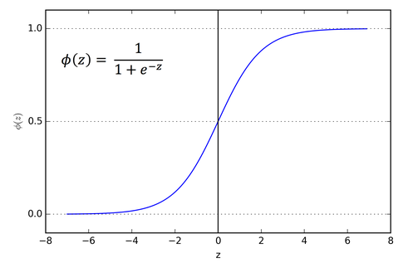
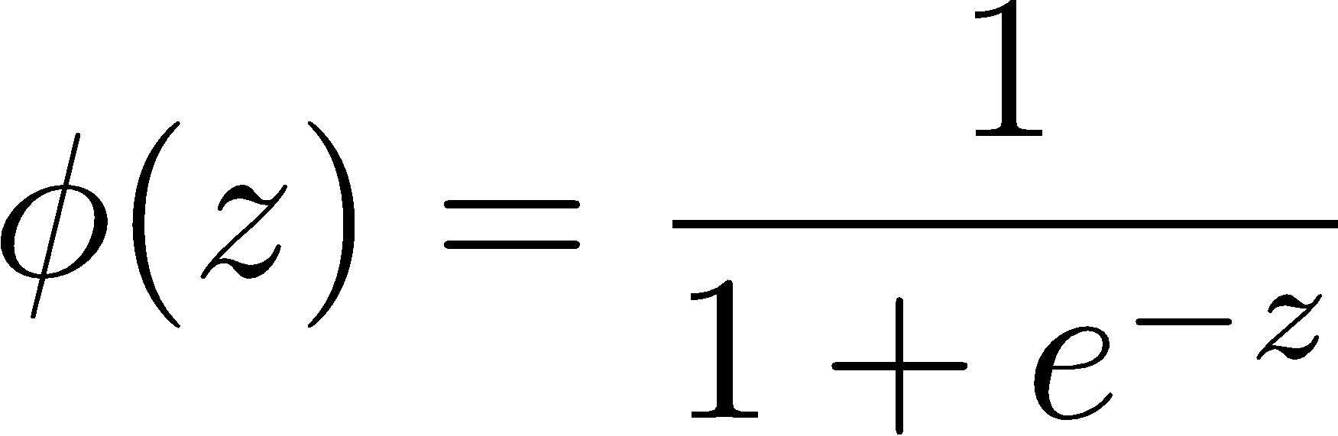
How to get probabilistic decisions?
Activation:
If very positive 🡪 want probability going to 1
If very negative 🡪 want probability going to 0
Sigmoid function

Slide 4



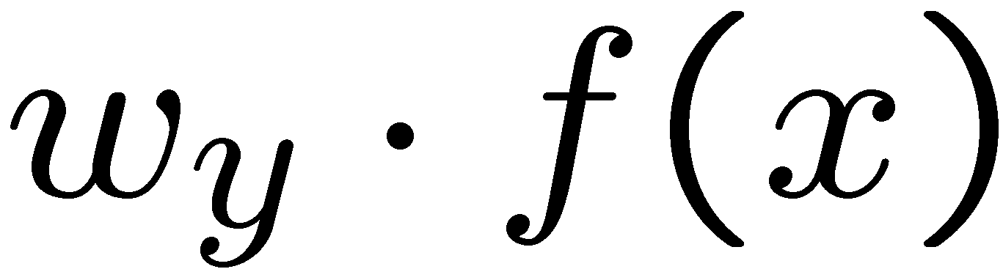

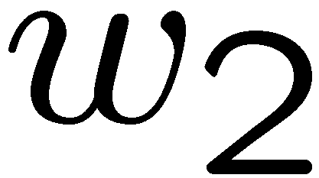
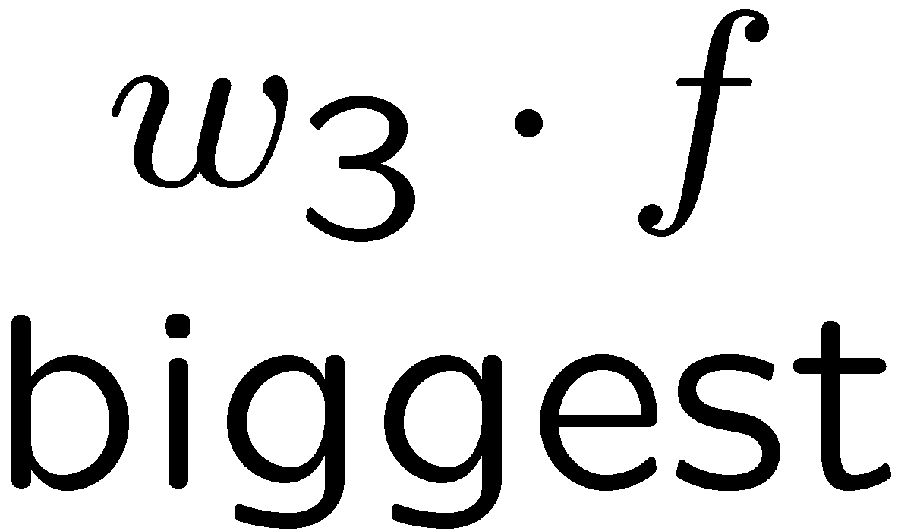
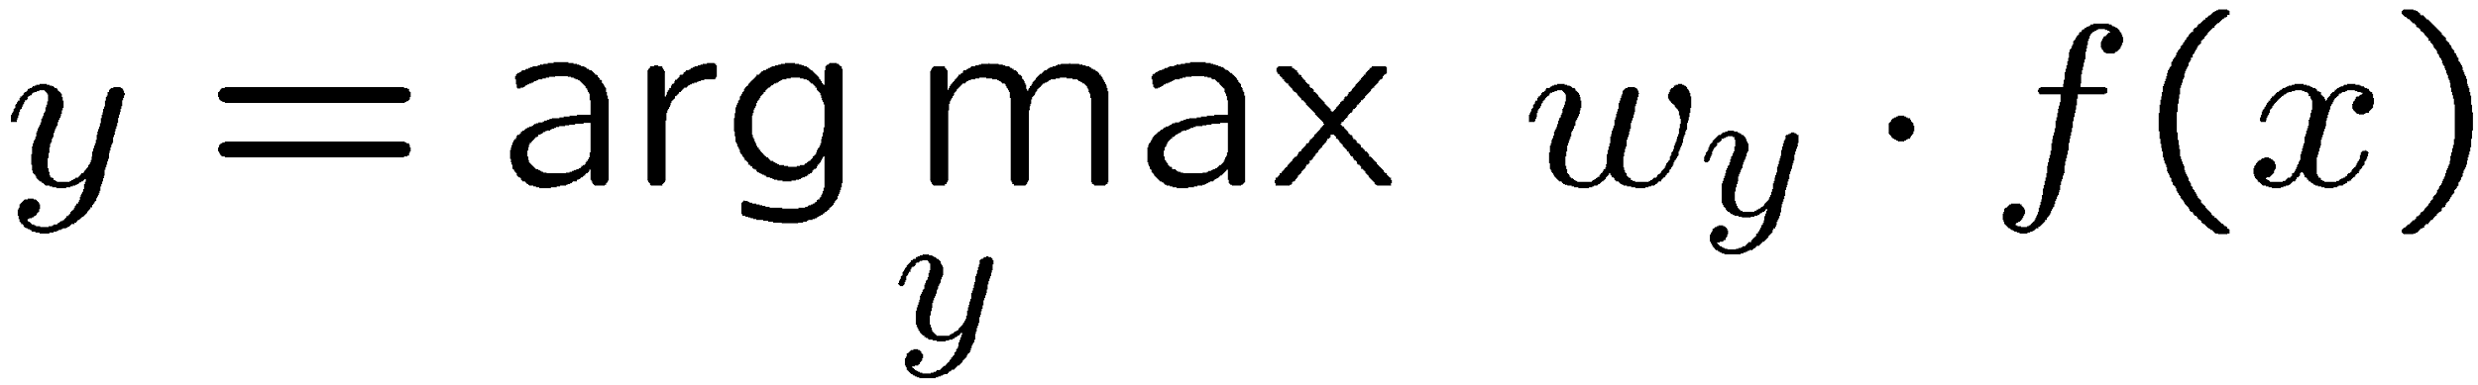
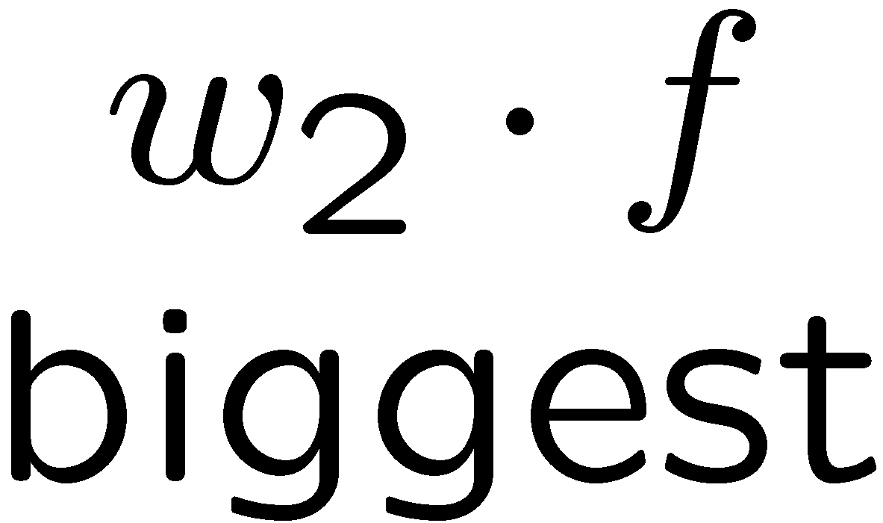
Multiclass Logistic Regression
Multi-class linear classification
A weight vector for each class:
Score (activation) of a class y:
Prediction w/highest score wins:
How to make the scores into probabilities?
original activations
softmax activations

Slide 5
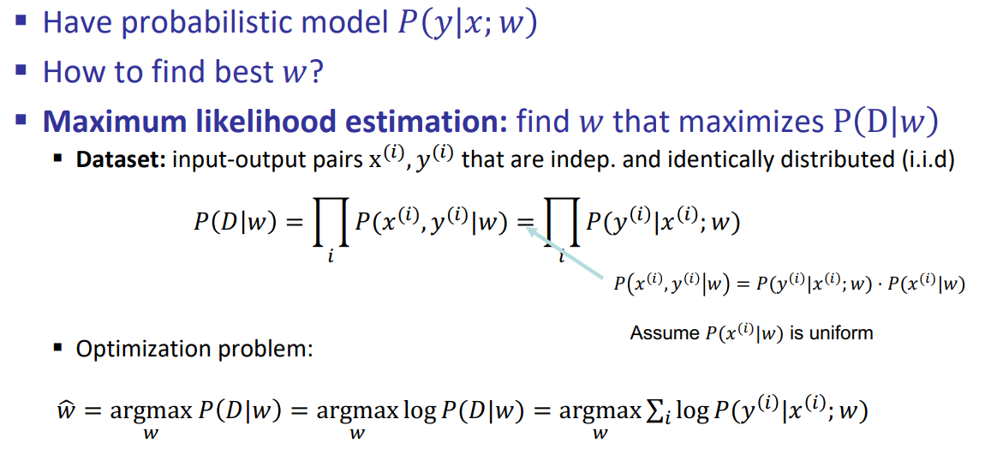
Logistic Regression: Learning

Slide 6
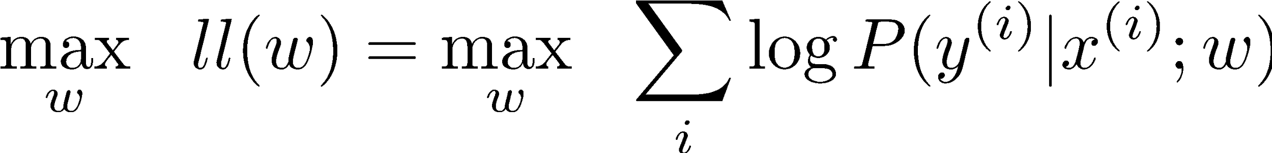
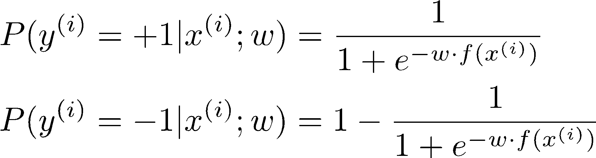
Best w for Logistic Regression
Maximum likelihood estimation:
with:
= Logistic Regression

Slide 7
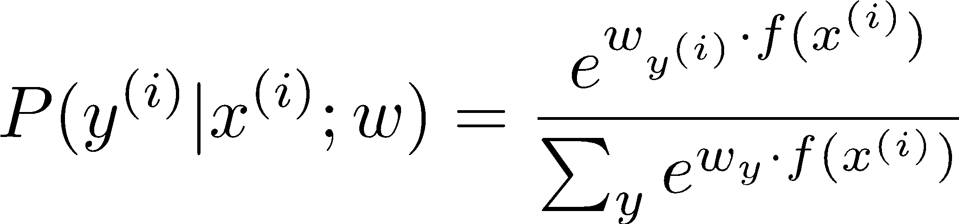
Best w for Multi-Class Logistic Regression
Maximum likelihood estimation:
with:
= Multi-Class Logistic Regression

Slide 8
This Lecture
Optimization
i.e., how do we solve:

Slide 9
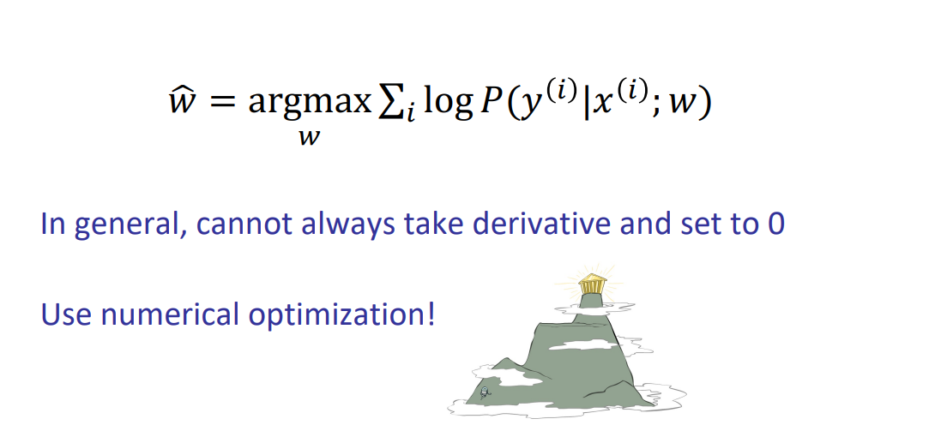
How do we maximize functions?

Slide 10
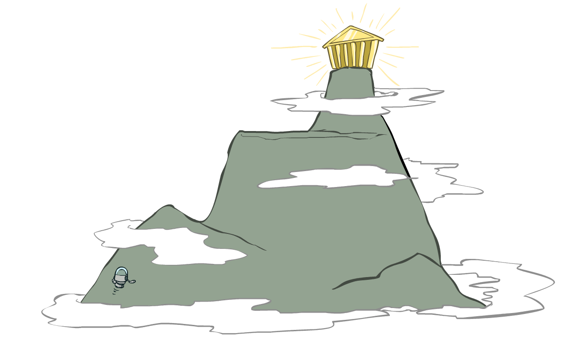
Hill Climbing
Recall from CSPs lecture: simple, general idea
Start wherever
Repeat: move to the best neighboring state
If no neighbors better than current, quit
What’s particularly tricky when hill-climbing for multiclass logistic regression?
Optimization over a continuous space
Infinitely many neighbors!
How to do this efficiently?

Slide 11
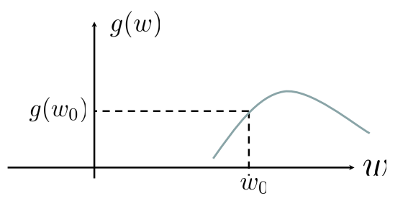
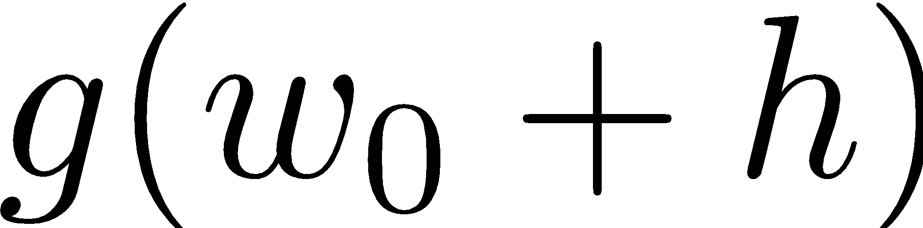
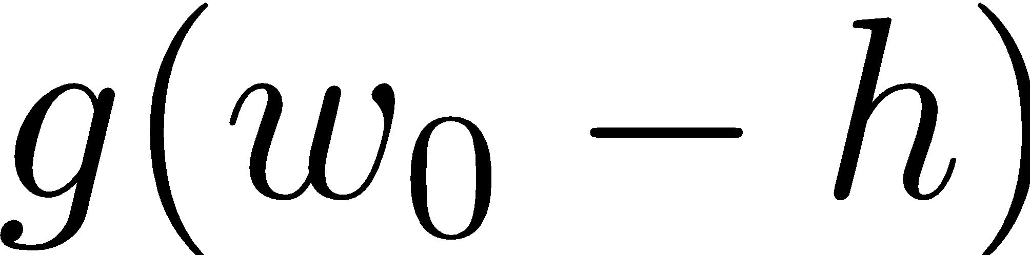
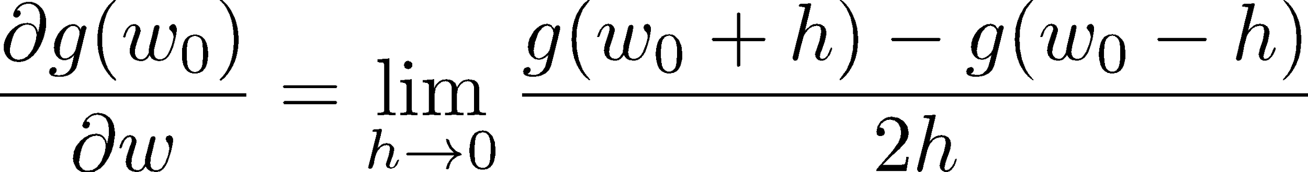
1-D Optimization
Could evaluate and
Then step in best direction
Or, evaluate derivative:
Tells which direction to step into

Slide 12
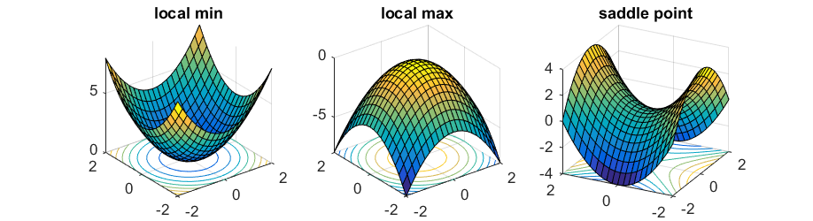
2-D Optimization
Source: offconvex.org

Slide 13
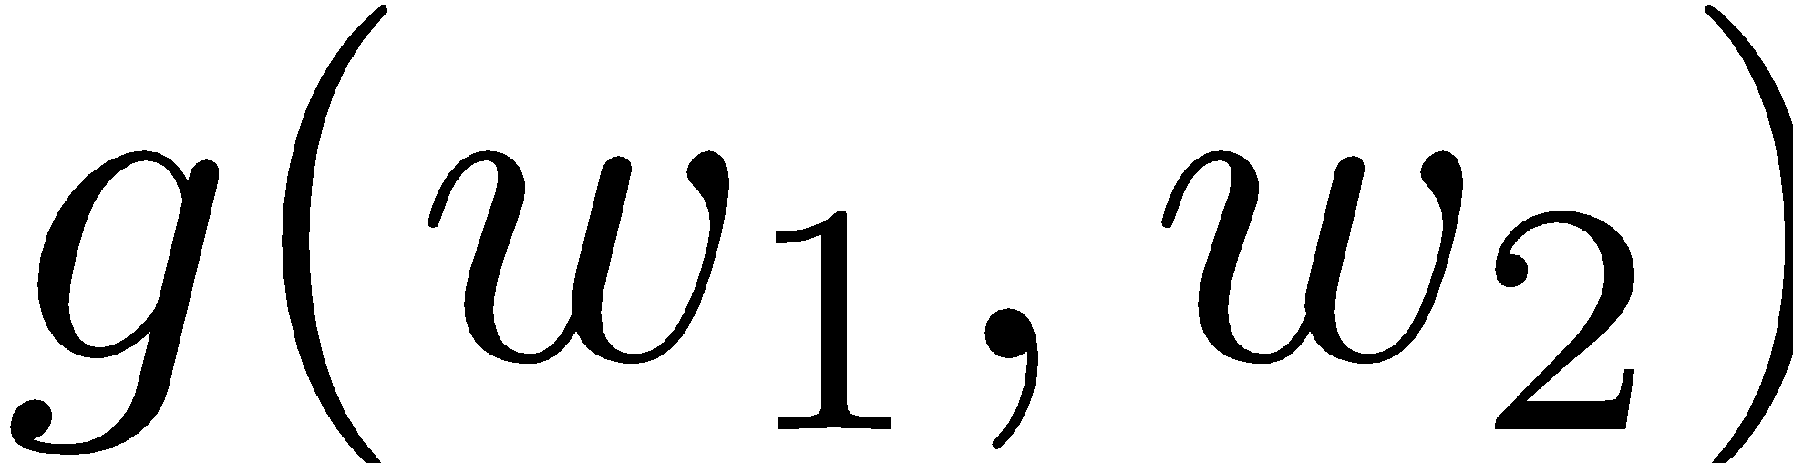
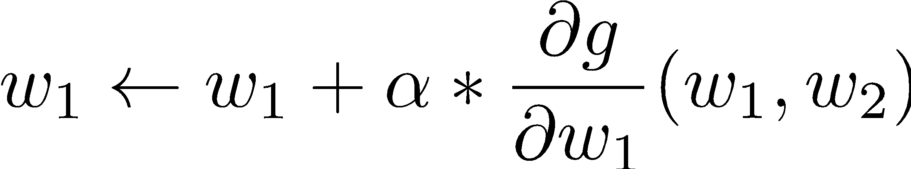
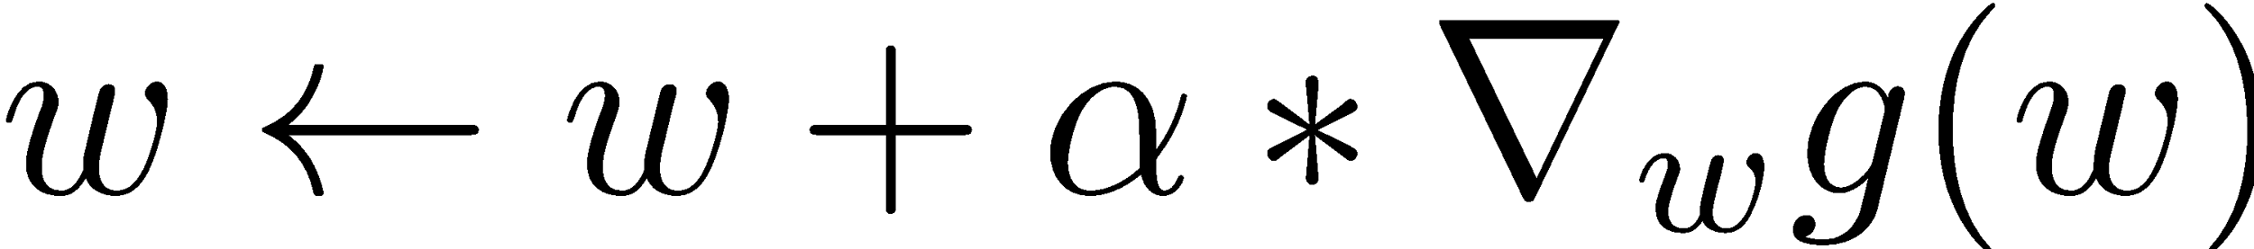
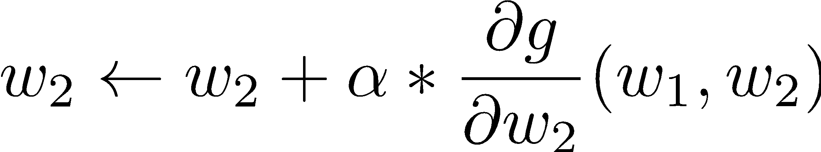
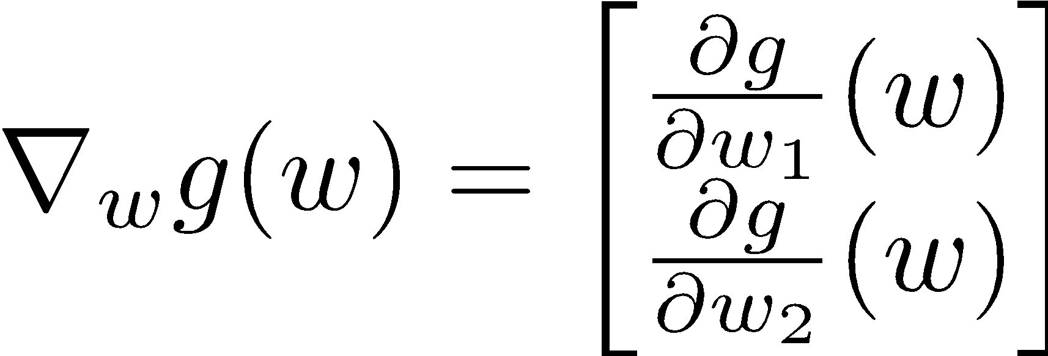
Gradient Ascent
Perform update in uphill direction for each coordinate
The steeper the slope (i.e. the higher the derivative) the bigger the step for that coordinate
E.g., consider:
Updates:
Updates in vector notation:
with:
= gradient

Slide 14
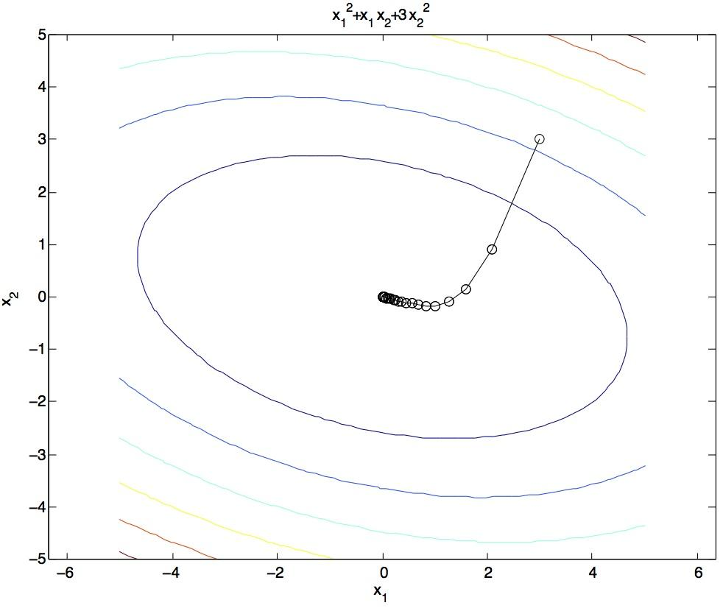
Gradient Ascent
Idea:
Start somewhere
Repeat: Take a step in the gradient direction
Figure source: Mathworks

Slide 15
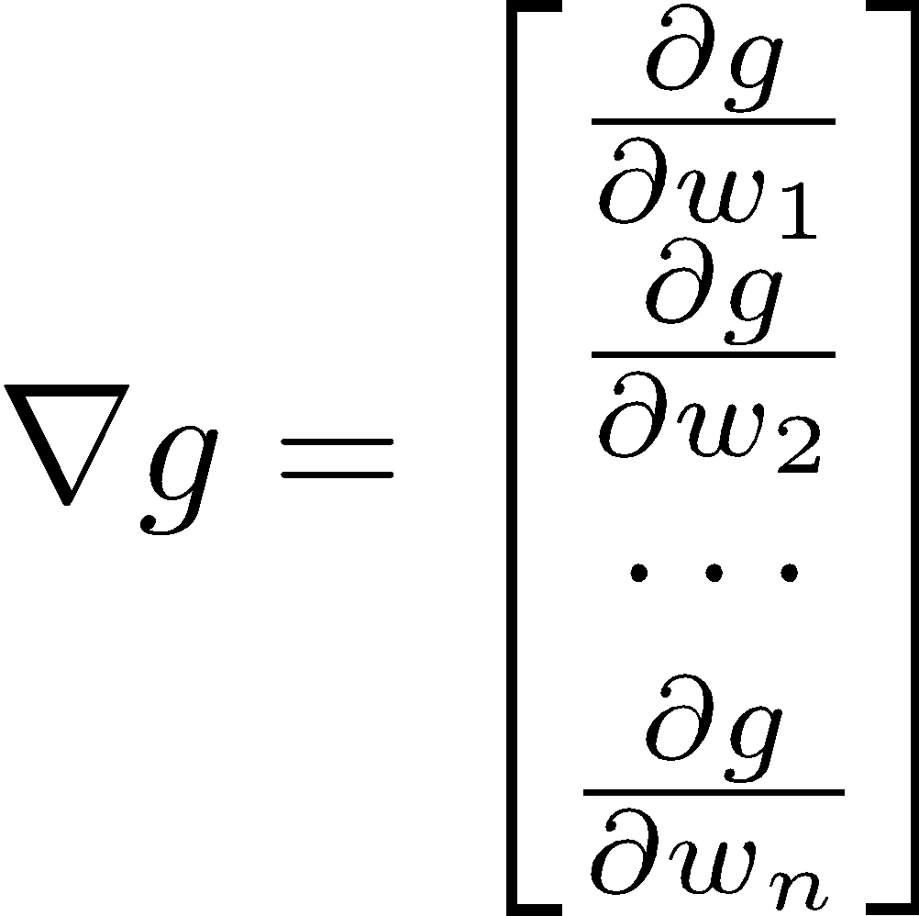
Gradient in n dimensions

Slide 16

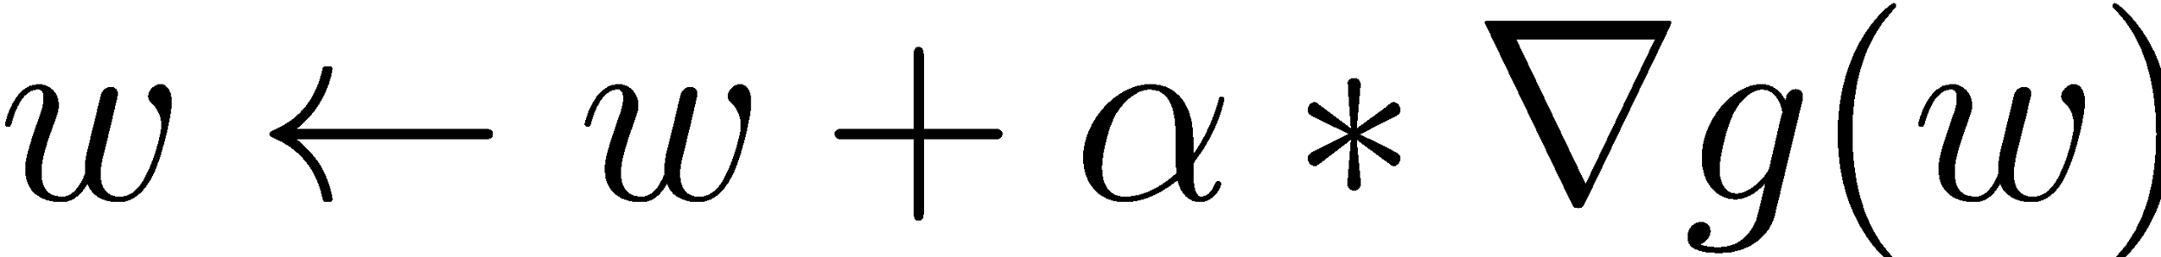

Optimization Procedure: Gradient Ascent
init
for iter = 1, 2, …
: learning rate --- tweaking parameter that needs to be chosen carefully
How? Try multiple choices
Crude rule of thumb: update changes about 0.1 – 1 %

Slide 17
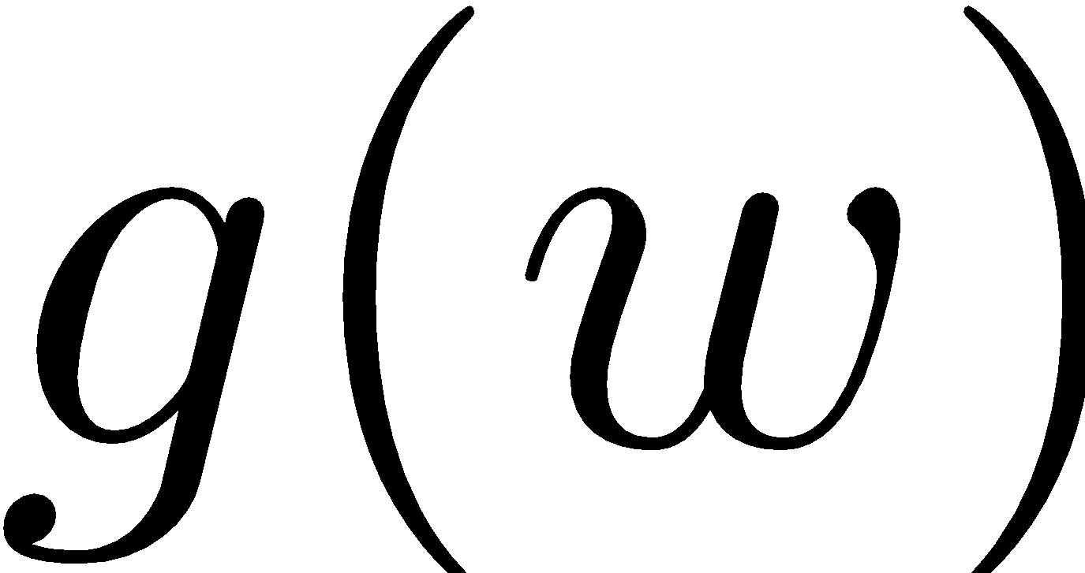
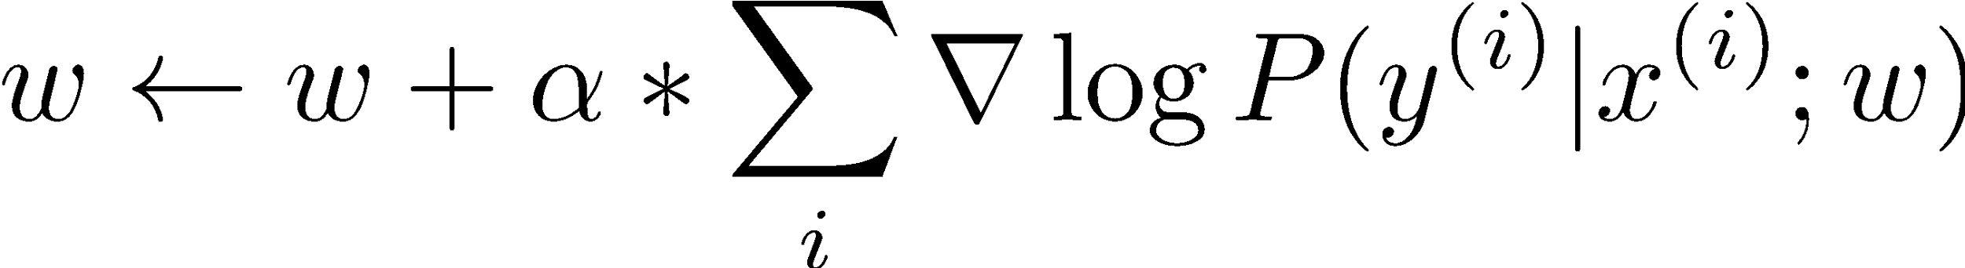
Batch Gradient Ascent on the Log Likelihood Objective
init
for iter = 1, 2, …

Slide 18
Stochastic Gradient Ascent on the Log Likelihood Objective
Observation: once gradient on one training example has been computed, might as well incorporate before computing next one
init
for iter = 1, 2, …
pick random j

Slide 19
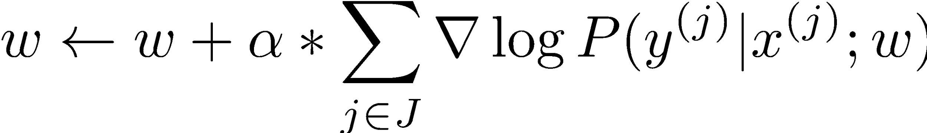
Mini-Batch Gradient Ascent on the Log Likelihood Objective
Observation: gradient over small set of training examples (=mini-batch) can be computed in parallel, might as well do that instead of a single one
init
for iter = 1, 2, …
pick random subset of training examples J

Slide 20
Neural Networks
Notes:
‹#›

Slide 21
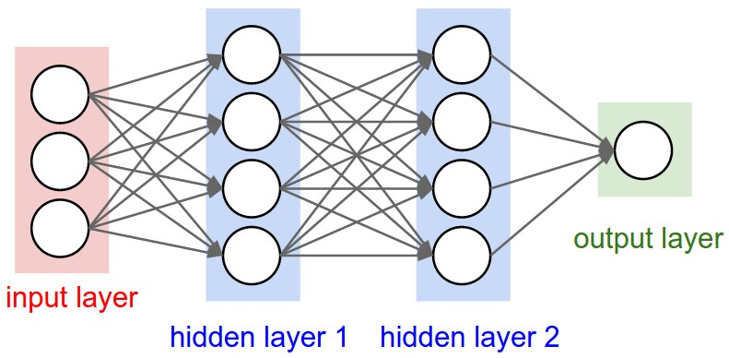
How do we make nonlinear classifiers out of perceptrons?
Build a multi-layer neural network!
Notes:
‹#›

Slide 22
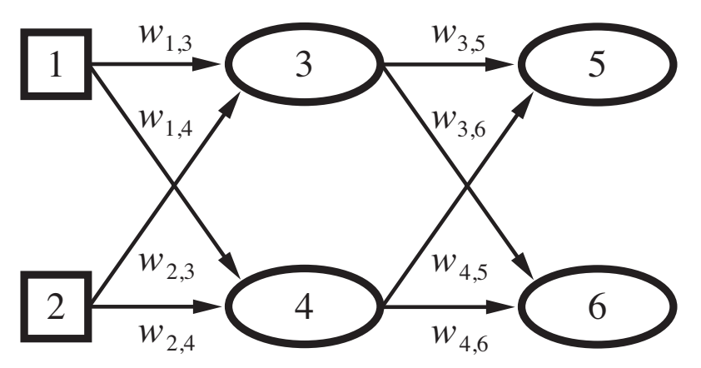

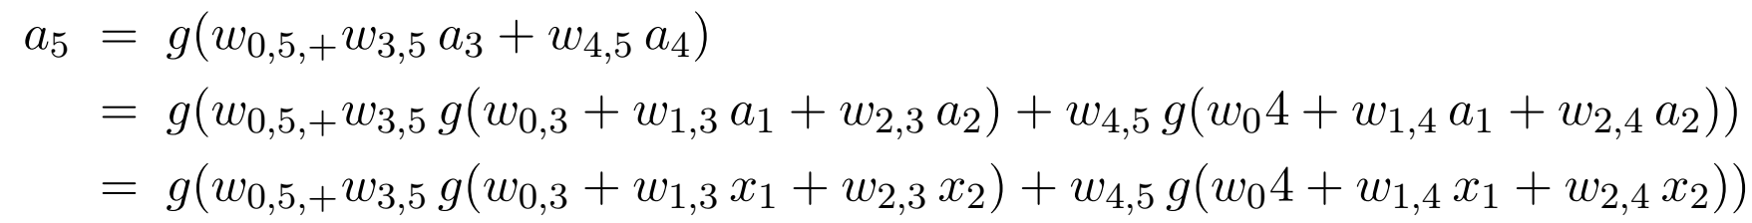

Slide 23
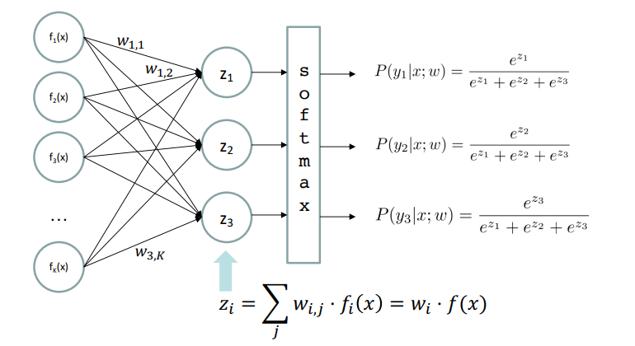
Multi-class Logistic Regression
= special case of neural network

Slide 24
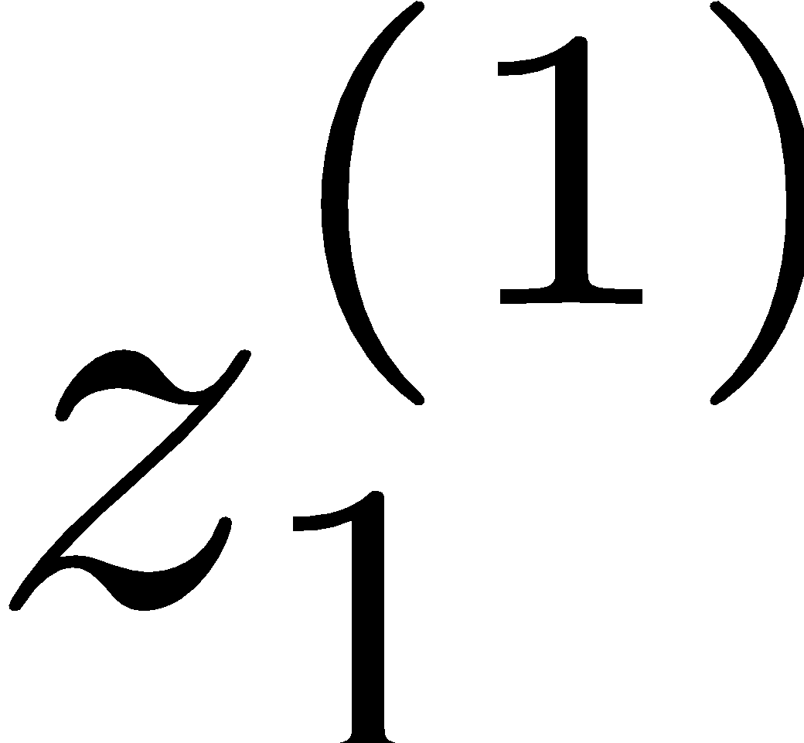
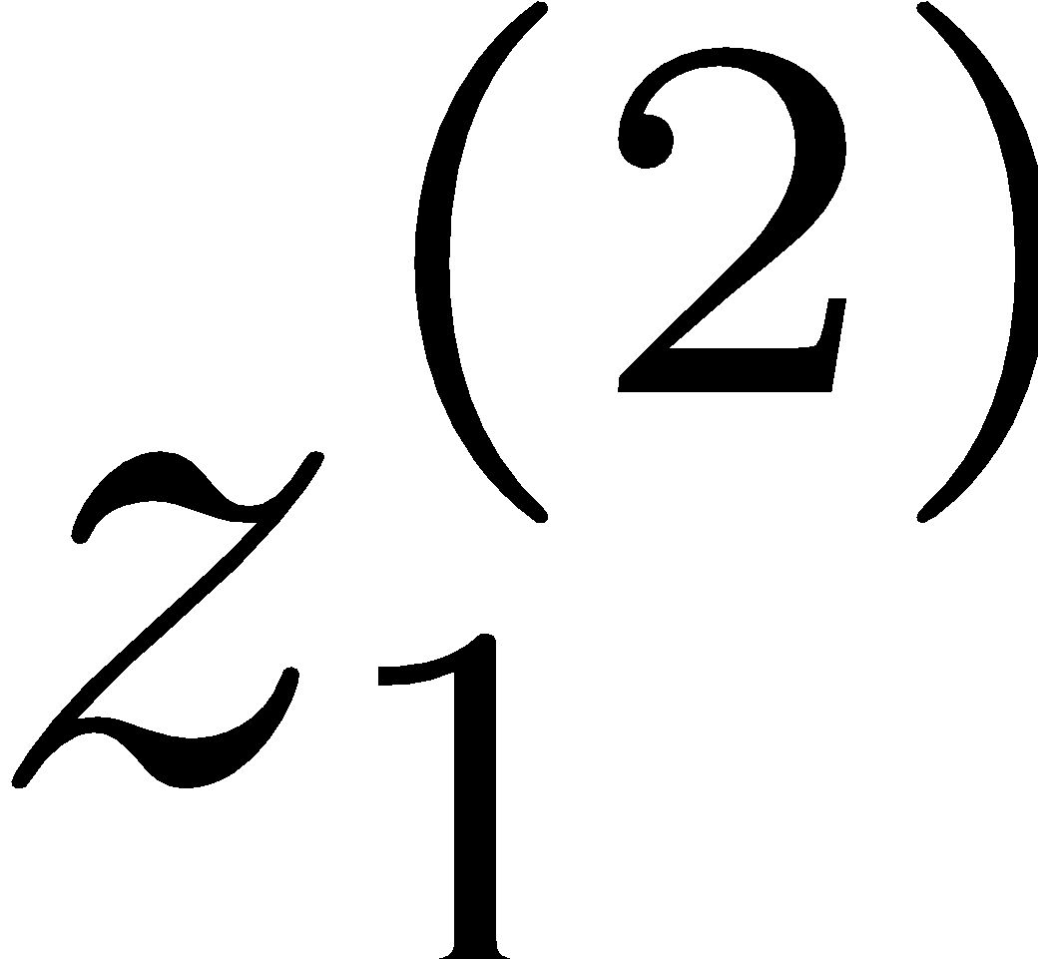
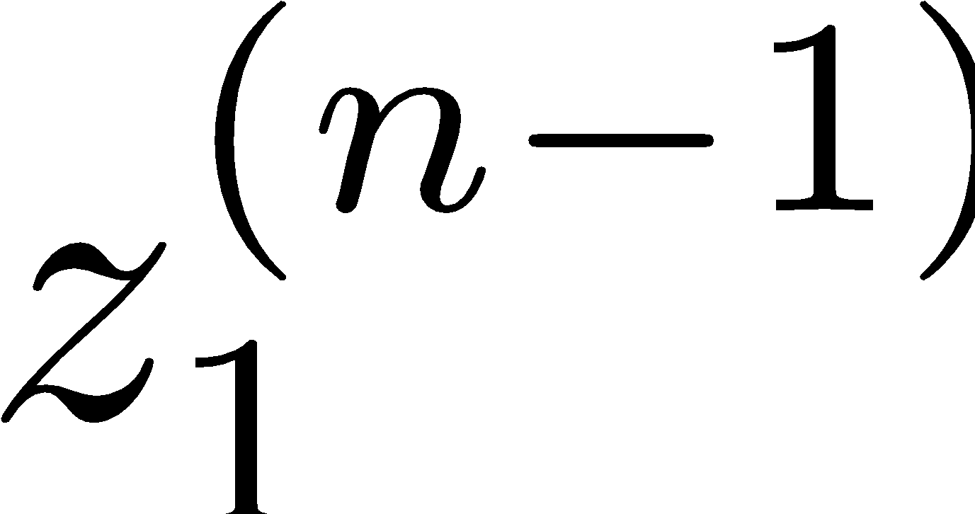
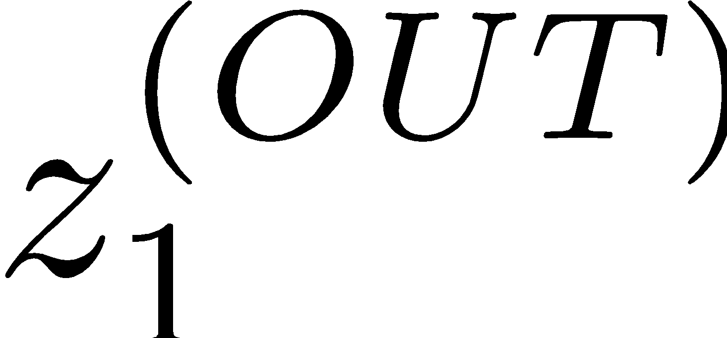
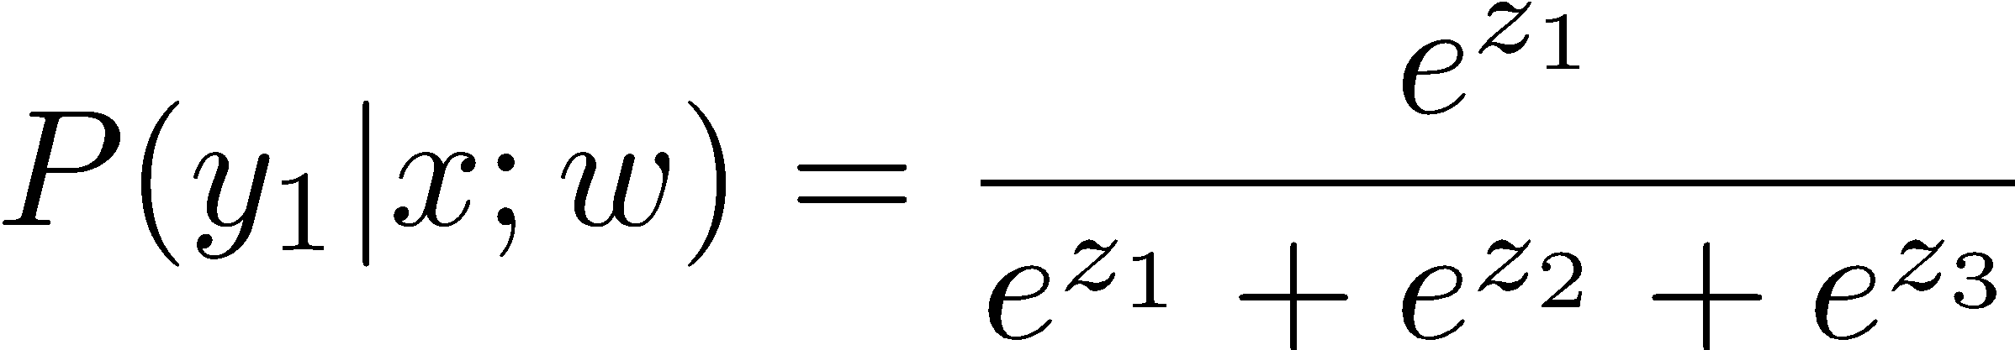
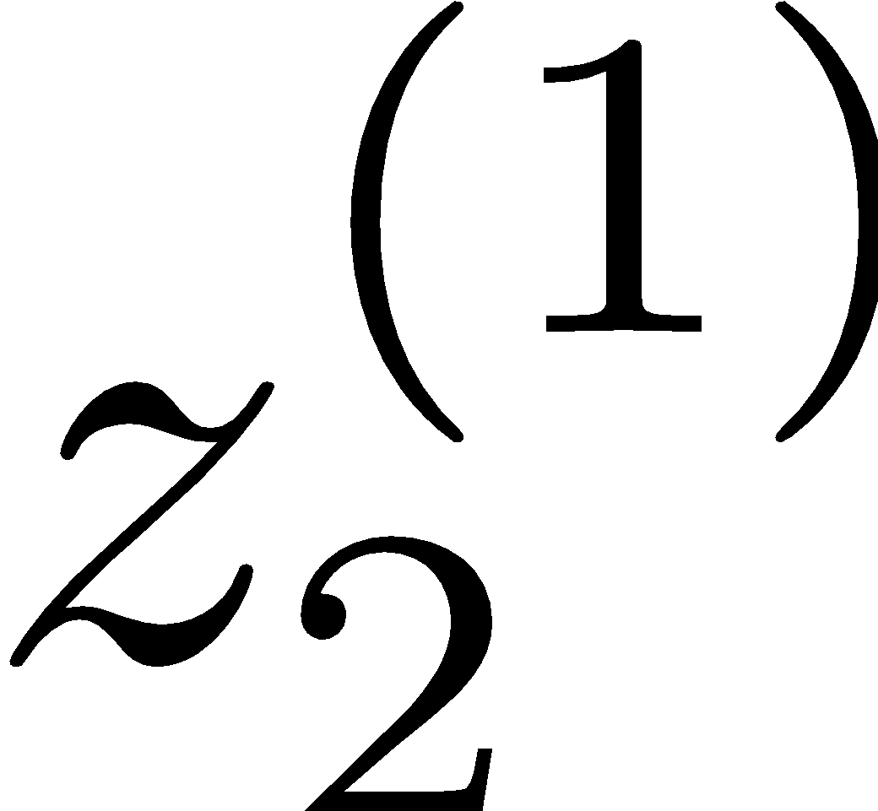
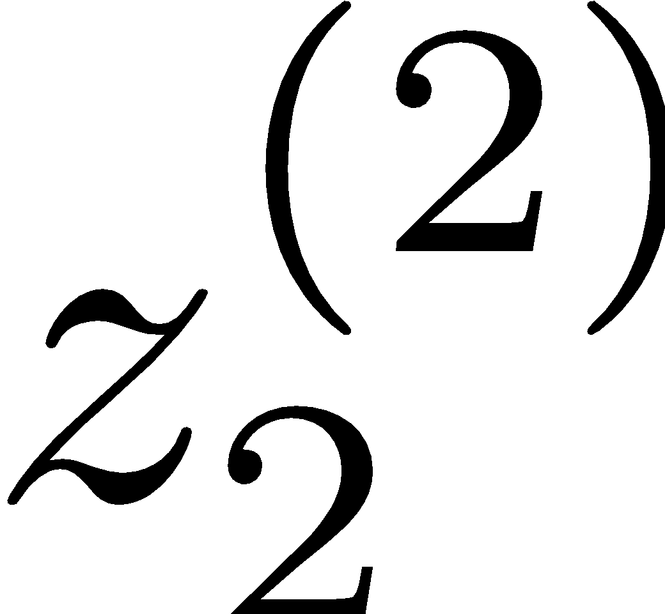
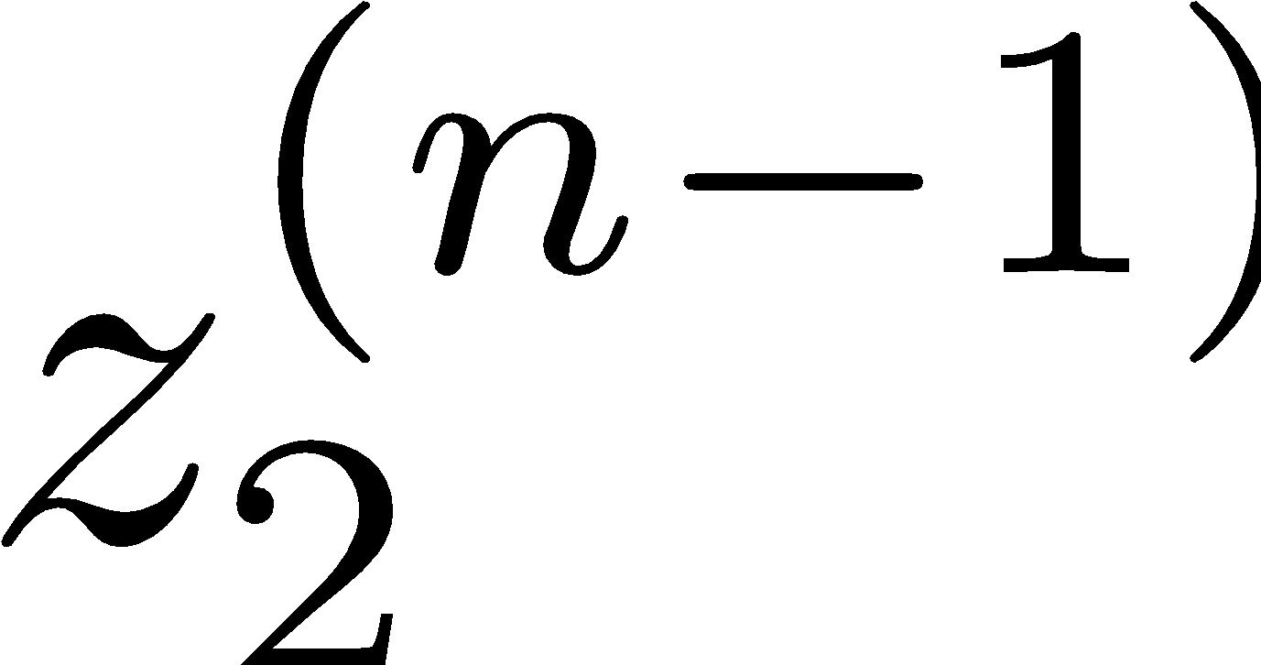
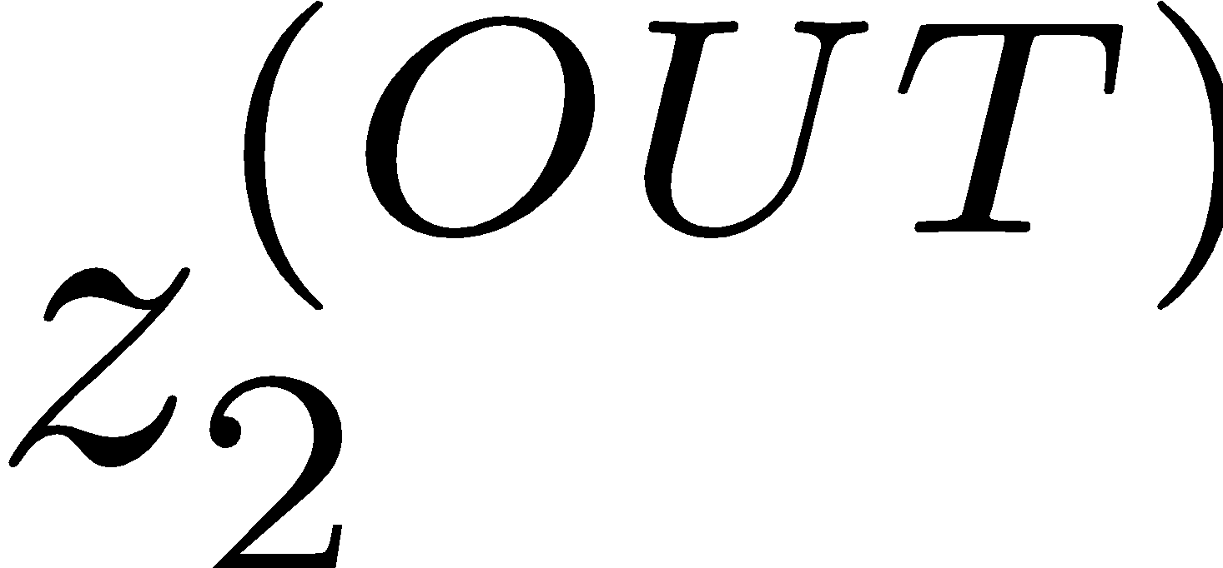
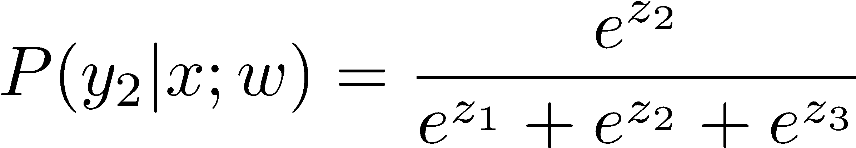
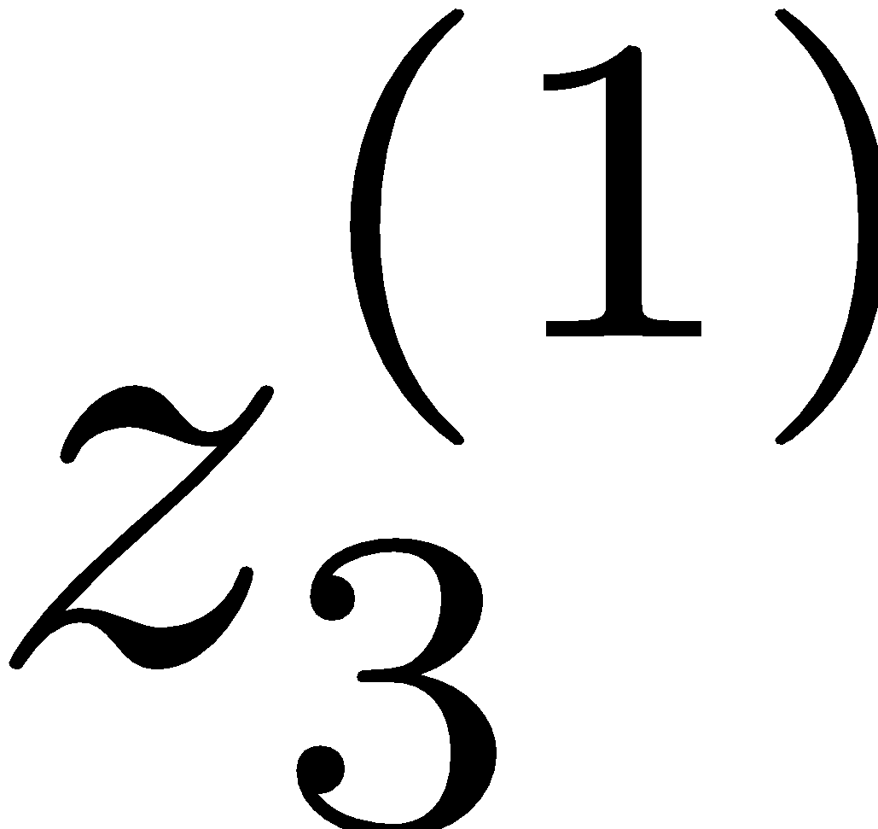
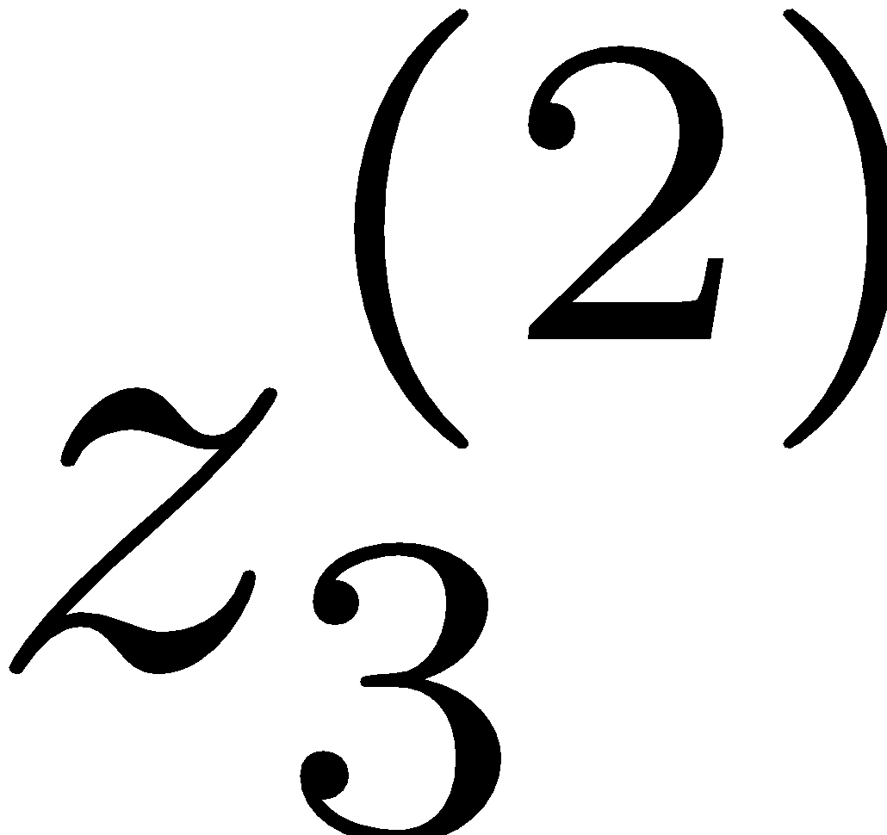
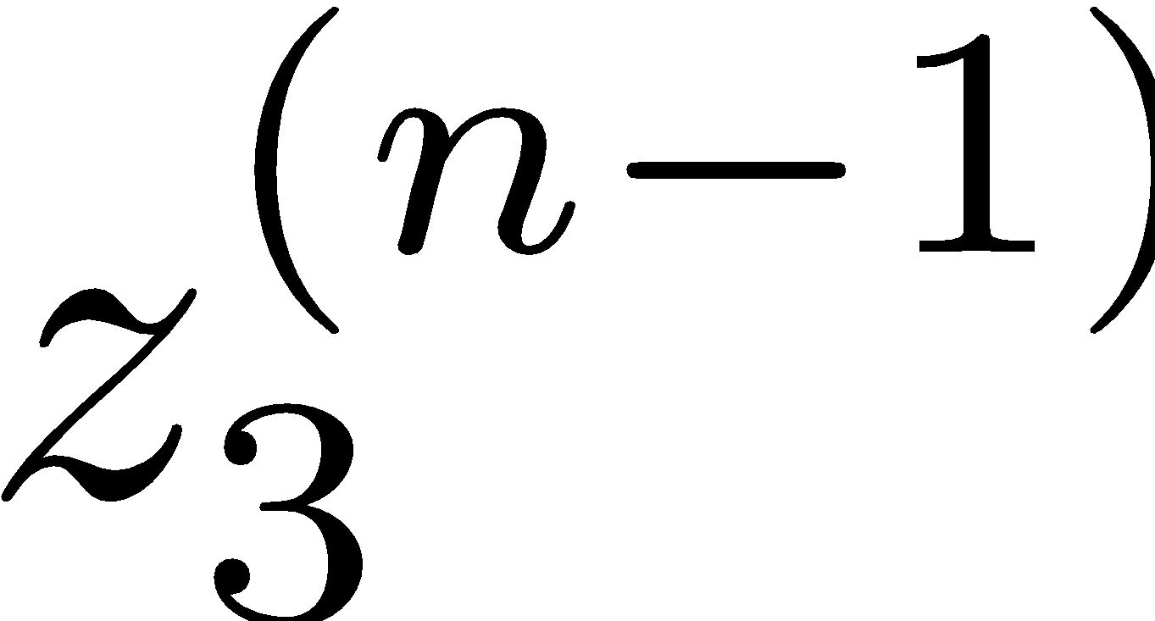










Deep Neural Network = Also learn the features!
x₁
f₁(x)
softmax
x₂
f₂(x)
…
x₃
f₃(x)
…
…
…
…
…
x_{L}
f_{K}(x)
g = nonlinear activation function

Slide 25
Deep Neural Network = Also learn the features!
x₁
softmax
x₂
…
x₃
…
…
…
…
…
x_{L}
g = nonlinear activation function

Slide 26

Deep Neural Network

Slide 27

Common Activation Functions
[source: MIT 6.S191 introtodeeplearning.com]

Slide 28
Deep Neural Network: Training
Training the deep neural network:
just w tends to be a much, much larger vector ☺
just run gradient ascent
+ stop when log likelihood of hold-out data starts to decrease

Slide 29


Deep Neural Network: Training
Training the deep neural network:
Find network weights to minimize the error between true and estimated labels of training examples:
Update weights by gradient descent:
Back-propagation: gradients are computed in the direction from output to input layers and combined using chain rule
Notes:
‹#›

Slide 30

Deep Neural Network: Training
Update weights by gradient descent:
w₂
w₁

Slide 31

Batch vs Stocastic

Slide 32
Neural Networks Properties
Theorem (Universal Function Approximators). A two-layer neural network with a sufficient number of neurons can approximate any continuous function to any desired accuracy.
Practical considerations
Can be seen as learning the features
Large number of neurons
Danger for overfitting
(hence early stopping!)

Slide 33

How about computing all the derivatives?
Derivatives tables:
[source: http://hyperphysics.phy-astr.gsu.edu/hbase/Math/derfunc.html

Slide 34


How about computing all the derivatives?
But neural net f is never one of those?
No problem: CHAIN RULE:
If
Then
🡪 Derivatives can be computed by following well-defined procedures
🡪 Automatic differentiation software
e.g. Theano, TensorFlow, PyTorch

Slide 35

Weight Regularization

Slide 36

Weight Regularization

Slide 37

Preventing Overfitting in Neural Networks

Slide 38

Dropout

Slide 39

Consistency vs. Simplicity

Slide 40

Consistency vs. Simplicity

Slide 41
Fun Neural Net Demo Site
Demo-site:
http://playground.tensorflow.org/

