Slide 1
ADT-Array

Slide 2
ADT(Abstract Data Type)
نوع داده Data Type:
يك نوع داده مجموعه اي از داده ها و عملياتي(operations) كه روي آنها عمل مي كنند، است.
نوع داده مجرد Abstract Data Type
يك نوع داده مجرد، نوع داده اي است كه مشخصات داده ها و عمليات روي آنها از نمايش داده ها (representation of data) و پياده سازي عمليات روي آنها جدا شده است.
يك نوع داده اي پايه اي (primitive data type)، يك قطعه داده واحد را دربر مي گيرد.
(مثلاً int, long, char, boolean ،عمليات مجاز رويinteger : + - * / %)
يك ساختمان داده (data structure)
  معمولا بيش از يك قطعه داده است
  بايد عمليات مجاز روي داده ها را ارائه كند
در نوع داده اي مجرد، مشخصات عمليات مستقل از هر پياده سازي خاصي بيان مي شود.

Slide 3
مثال
Abstract data type Natural_Number
structure Natural_Number is
objects: an ordered subrange of the integers starting at zero and ending
at the maximum integer (INT_MAX) on the computer
functions:
for all x, y ∈ Nat_Number; TRUE, FALSE ∈ Boolean
and where +, -, <, and = = are the usual integer operations.
Nat_No Zero ( ) ::= 0
Boolean Is_Zero(x) ::= if (x) return FALSE
else return TRUE
Nat_No Add(x, y) ::= if ((x+y) <= INT_MAX) return x+y
else return INT_MAX
Boolean Equal(x,y) ::= if (x = = y) return TRUE
else return FALSE
Nat_No Successor(x) ::= if (x = = INT_MAX) return x
else return x+1
Nat_No Subtract(x,y) ::= if (x<y) return 0
else return x-y
end Natural_Number
::= is defined as

Slide 4
آرايه (Array)
تعريف 1:مجموعه اي از داده ها كه در آدرسهاي پشت سرهم حافظه قرار مي گيرند
تعريف 2:مجموعه اي از زوجهاي انديس و مقدار
<index,value>
نوع داده مجرد آرايه:

Slide 5
Structure Array is
objects: A set of pairs <index, value> where for each value of index
there is a value from the set item. Index is a finite ordered set of one or
more dimensions, for example, {0, … , n-1} for one dimension,
{(0,0),(0,1),(0,2),(1,0),(1,1),(1,2),(2,0),(2,1),(2,2)} for two dimensions, etc.
Functions:
for all A ∈ Array, i ∈ index, x ∈ item, j, size ∈ integer
Array Create(j, list) ::= return an array of j dimensions where list is a
j-tuple whose ith element is the size of the
ith dimension. Items are undefined.
Item Retrieve(A, i) ::= if (i ∈ index) return the item associated with
index value i in array A
else return error
Array Store(A, i, x) ::= if (i in index)
return an array that is identical to array
A except the new pair <i, x> has been
inserted else return error
end array

Slide 6
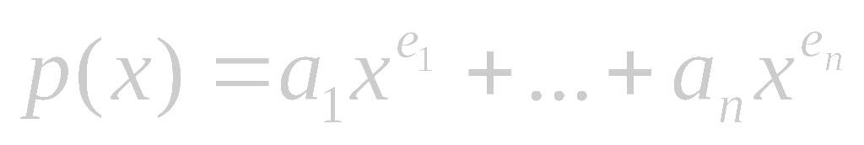
Polynomials A(X)=3X²⁰+2X⁵+4, B(X)=X⁴+10X³+3X²+1
Structure Polynomial is
objects: ; a set of ordered pairs of <e_{i},a_{i}> where a_{i} in Coefficients and e_{i} in Exponents, e_{i} are integers >= 0
functions:
for all poly, poly1, poly2  Polynomial, coef Coefficients, expon  Exponents
Polynomial Zero( ) ::= return the polynomial,
p(x) = 0
Boolean IsZero(poly) ::= if (poly) return FALSE
else return TRUE
Coefficient Coef(poly, expon) ::= if (expon  poly) return its
coefficient else return Zero
Exponent Lead_Exp(poly) ::= return the largest exponent in poly
Polynomial Attach(poly,coef, expon) ::= if (expon  poly) return error
else return the polynomial poly
with the term <coef, expon>
inserted

Slide 7
Polynomial Remove(poly, expon) ::= if (expon  poly) return the polynomial poly with the term whose exponent is expon deleted
else return error
Polynomial SingleMult(poly, coef, expon) ::= return the polynomial
poly • coef • x^{expon}
Polynomial Add(poly1, poly2) ::= return the polynomial
poly1 +poly2
Polynomial Mult(poly1, poly2) ::= return the polynomial
poly1 • poly2
End Polynomial

Slide 8
#define MAX_DEGREE 101
typedef struct {
int degree;
float coef[MAX_DEGREE];
} polynomial;
data structure 1:
polynomial a; ➔ a.degree=n
a.coef[a_{n-i}] 0≤i≤n
P(x)=10x⁵+4x³+6x+2
degree
coef
5
0 | 1 | 2 | 3 | 4 | 5 | 6 | 7 | 8 |  | 100
10 | 0 | 4 | 0 | 6 | 2 |  |  |  | . . . . | 0

Slide 9
جمع دو چندجمله اي
/* d =a + b, where a, b, and d are polynomials */
d = Zero( )
while (! IsZero(a) && ! IsZero(b)) do {
switch COMPARE (Lead_Exp(a), Lead_Exp(b)) {
case -1: // Lead_Exp(a)<Lead_Exp(b)
d =Attach(d, Coef (b, Lead_Exp(b)), Lead_Exp(b));
b = Remove(b, Lead_Exp(b));
break;
case 0:
sum = Coef (a, Lead_Exp (a)) + Coef ( b, Lead_Exp(b));
if (sum) {
Attach (d, sum, Lead_Exp(a));
a = Remove(a , Lead_Exp(a));
b = Remove(b , Lead_Exp(b));
}
break;
case 1:
d =Attach(d, Coef (a, Lead_Exp(a)), Lead_Exp(a));
a = Remove(a, Lead_Exp(a));
}
}
insert any remaining terms of a or b into d

Slide 10
Data structure 2: use one global array to store all polynomials
A(X)=2X¹⁰⁰⁰+1
B(X)=X⁴+10X³+3X²+1
starta finisha startb finishb avail
coef
2 | 1 | 1 | 10 | 3 | 1 |  | . . .
1000 | 0 | 4 | 3 | 2 | 0 |  | . . .
exp
0 1 2 3 4 5 6
MAX_TERMS 100 /* size of terms array */
typedef struct {
float coef;
int expon;
} polynomial;
polynomial terms[MAX_TERMS];
int avail = 0;
poly <start, finish>
A <0,1>
B <2,5>

Slide 11
جمع دو چند جمله اي
void padd (int starta, int finisha, int startb, int finishb, int * startd, int *finishd)
{ /* add A(x) and B(x) to obtain D(x) */
float coefficient;
*startd = avail;
while (starta <= finisha && startb <= finishb)
switch (COMPARE(terms[starta].expon, terms[startb].expon)) {
case -1: /* a expon < b expon */
attach(terms[startb].coef, terms[startb].expon);
startb++; break;
case 0: /* equal exponents */
coefficient = terms[starta].coef + terms[startb].coef;
if (coefficient) attach(coefficient, terms[starta].expon);
starta++; startb++; break;
case 1: /* a expon > b expon */
attach(terms[starta].coef, terms[starta].expon);
starta++;
}
for( ; starta <= finisha; starta++) /* add in remaining terms of A(x) */
attach(terms[starta].coef, terms[starta].expon);
for( ; startb <= finishb; startb++) /* add in remaining terms of B(x) */
attach(terms[startb].coef, terms[startb].expon);
*finishd =avail -1;
}
تحليل: O(n+m) كه nوm تعداد ضرايب غيرصفر در AوB هستند

Slide 12
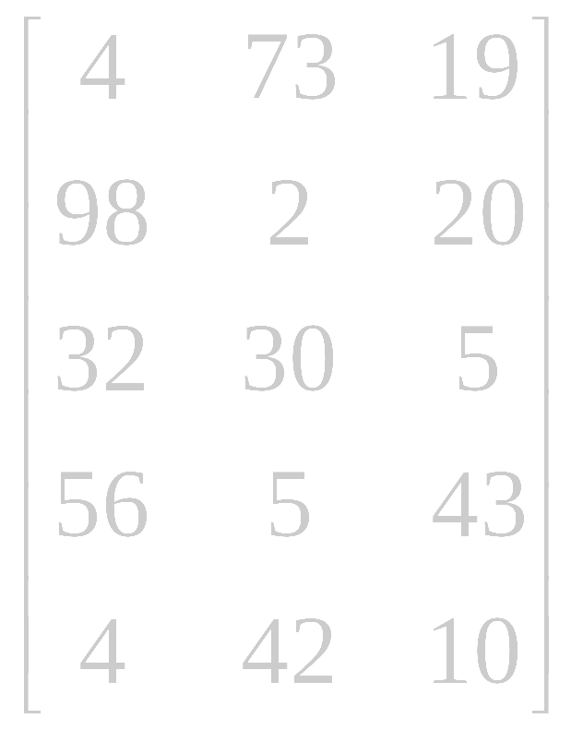
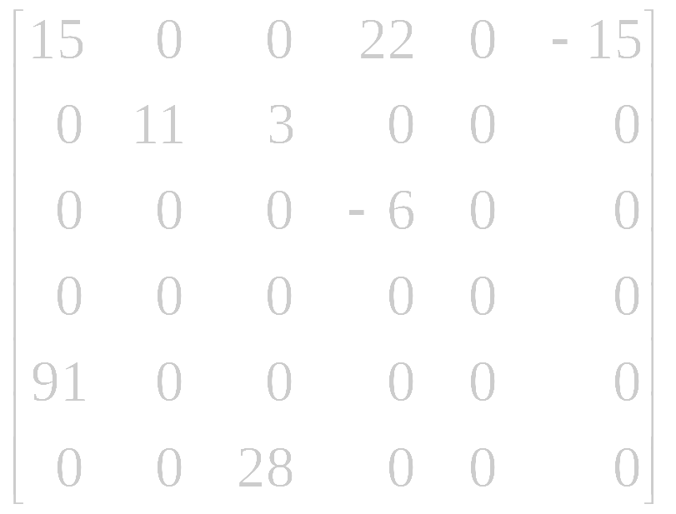
ماتريس اسپارس (Sparse Matrix)
colo col1 col2 col3 col4 col5
col0 col1 col2
row0
row1
row2
row3
row4
row0
row1
row2
row3
row4
row5
5*3
6*6
sparse matrix

Slide 13
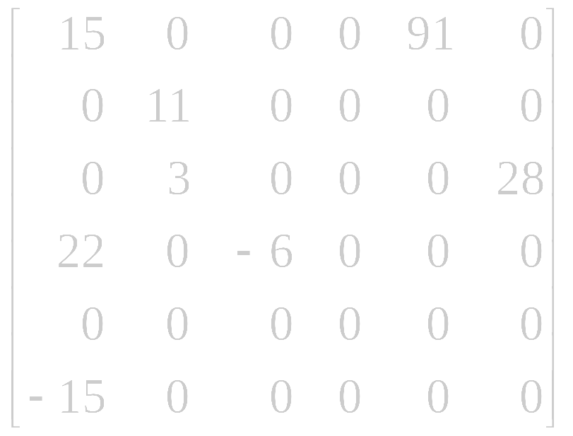
col0 col1 col2 col3 col4 col5
col0 col1 col2 col3 col4 col5
row0
row1
row2
row3
row4
row5
row0
row1
row2
row3
row4
row5
transpose
# of columns
# of nonzero terms
row col value
b[0] 6 6 8
[1] 0 0 15
[2] 0 4 91
[3] 1 1 11
[4] 2 1 3
[5] 2 5 28
[6] 3 0 22
[7] 3 2 -6
[8] 5 0 -15
# of rows
row col value
a[0] 6 6 8
[1] 0 0 15
[2] 0 3 22
[3] 0 5 -15
[4] 1 1 11
[5] 1 2 3
[6] 2 3 -6
[7] 4 0 91
[8] 5 2 28
transpose

Slide 14
Sparse_matrix Create(max_row, max_col) ::=
#define MAX_TERMS 101 /* maximum number of terms +1*/
typedef struct {
int col;
int row;
int value;
} term;
term a[MAX_TERMS]
# of rows (columns)
# of nonzero terms

Slide 15
Transpose a Matrix
(1) for each row i
take element <i, j, value> and store it
in element <j, i, value> of the transpose.
difficulty: where to put <j, i, value>
(0, 0, 15) ====> (0, 0, 15)
(0, 3, 22) ====> (3, 0, 22)
(0, 5, -15) ====> (5, 0, -15)
(1, 1, 11) ====> (1, 1, 11)
Move elements down very often.
(2) For all elements in column j,
place element <i, j, value> in element <j, i, value>

Slide 16
void transpose (term a[], term b[]) /* b is set to the transpose of a */
{
int n, i, j, currentb;
n = a[0].value; /* total number of elements */
b[0].row = a[0].col; /* rows in b = columns in a */
b[0].col = a[0].row; /*columns in b = rows in a */
b[0].value = n;
if (n > 0) { /*non zero matrix */
currentb = 1;
for (i = 0; i < a[0].col; i++) /* transpose by columns in a */
for( j = 1; j <= n; j++) /* find elements from the current column */
if (a[j].col == i) { /* element is in current column, add it to b */
b[currentb].row = a[j].col;
b[currentb].col = a[j].row;
b[currentb].value = a[j].value;
currentb++
}
}
}
columns
elements
O(columns*elements)

Slide 17
a[0] 6 6 8
a[1] 0 0 15
a[2] 0 3 22
a[3] 0 5 -15
a[4] 1 1 11
a[5] 1 2 3
a[6] 2 3 -6
a[7] 4 0 91
a[8] 5 2 28
الگوريتم 2:
1- پيدا كردن آدرس شروع عناصر هر ستون ماتريس (هر سطر ماتريس ترانهاده)
2- طي كردن عناصر ماتريس به ترتيب و قرار دادن آنها در سطر مربوطه در ماتريس ترانهاده
[0] [1] [2] [3] [4] [5]
row_terms = 2 1 2 2 0 1
starting_pos = 1 3 4 6 8 8

Slide 18
void fast_transpose(term a[ ], term b[ ])
{ /* the transpose of a is placed in b */
int row_terms[MAX_COL], starting_pos[MAX_COL];
int i, j, num_cols = a[0].col, num_terms = a[0].value;
b[0].row = num_cols; b[0].col = a[0].row;
b[0].value = num_terms;
if (num_terms > 0){ /*nonzero matrix*/
for (i = 0; i < num_cols; i++)
row_terms[i] = 0;
for (i = 1; i <= num_terms; i++)
row_term [a[i].col]++
starting_pos[0] = 1;
for (i =1; i < num_cols; i++)
starting_pos[i]=starting_pos[i-1] +row_terms [i-1];
for (i=1; i <= num_terms, i++) {
j = starting_pos[a[i].col]++;
b[j].row = a[i].col;
b[j].col = a[i].row;
b[j].value = a[i].value;
}
}
}
columns
elements
columns
elements
O(columns+elements)=O(rows*columns)

Slide 19
آرايه ها
دسته بندي ساختمانهاي داده اي:
  ساختمانهاي داده اي خطي:
    آرايه ها (يك بعدي، دوبعدي، چند بعدي)
    صف
    صف با اولويت
    پشته
    ليستهاي پيوندي
  ساختمانهاي داده اي غيرخطي
    سلسله مراتبي (درختها)
    Hash Table
    گرافها
    مجموعه ها

Slide 20
آرايه ها
آرايه : مجموعه اي از زوج مرتبهاي انديس (index) و مقدار (Value)
مثلاً <1,’x’>, <2,’y’>,<3,’z’>
پياده سازي با استفاده از خانه هاي پشت سرهم حافظه است.
int list[5]; // example in C
عنصر آدرس
list[0] base address = α
list[1] α + sizeof(int)
list[2] α + 2*sizeof(int)
list[3] α + 3*sizeof(int)
list[4] α + 4*size(int)
0 | 1 | 2 | 3 | 4
α

Slide 21
A[0..u₁][0..u₂]
عنصر آدرس
A[i,0] α+i*u₂
A[i,j] α+i*u₂+j
A[0]
A[1]
A[u₁-1]
…
A[0][0]
A[0][1]
A[0][2]
A[1][0]
A[1][1]
A[0][u₂-1]
A[0][2]
A[0][u₂-1]
A[u₁ -1][0]
A[u₁ -1][1]
A[u₁ -1][2]
A[u₁ -1][u₂-1]
A[p₁..q₁][p₂..q₂]…[p_{n}..q_{n}]
U1 U2 Un
U₁=q₁-p₁+1
U₂=q₂-p₂+1
Un=q_{n}-p_{n}+1
A[i₁,i₂,…,i_{n}]=
α + (i₁-p₁)U₂*…*U_{n}
+ (i₂-p₂)U₃…U_{n}
+ (i₃-p₃)U₄…U_{n}
+….
+ (i_{n-1}-p_{n-1})U_{n}
+ i_{n}-p_{n}
A[0]
A[1]
A[u₃-1]
A[1][0]
A[1][0][2]

Slide 22
هرينه عمليات مختلف در آرايه مرتب
هزينه اضافه نمودن عنصر: O(n)
هزينه حذف نمودن عنصر: O(n)
هزينه دستيابي به عنصر i ام: O(1)
Sam
Julie
Julie
Bill
Sam
Sam
Julie
Sue
Sam
Sue

