Slide 1
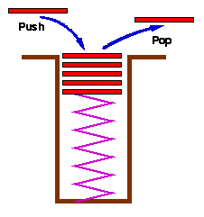
پشته (Stack)
Stack:Last-In-First-Out (LIFO)

Slide 2
A
B
A
C
B
A
D
C
B
A
E
D
C
B
A
top
D
C
B
A
top
top
top
top
top

Slide 3
مثال استفاده از پشته: فراخواني توابع و ذخيره activation record روي پشته
old frame pointer
fp
al
return address
local variables
old frame pointer
fp
main
old frame pointer
stack frame of invoking function
return address
return address
پشته سيستم قبل از فراخواني a1
پشته سيستم بعد از فراخواني a1
fp : اشاره گر به فريم جاري

Slide 4
abstract data type for stack
structure Stack is
objects: a finite ordered list with zero or more elements.
functions:
for all stack ∈ Stack, item ∈ element, max_stack_size ∈ positive integer
Stack CreateS(max_stack_size) ::=
create an empty stack whose maximum size is max_stack_size
Boolean IsFull(stack, max_stack_size) ::=
if (number of elements in stack == max_stack_size) return TRUE
else return FALSE
Stack Add(stack, item) ::=
if (IsFull(stack)) stack_full
else insert item into top of stack and return
Boolean IsEmpty(stack) ::=
if(stack == CreateS(max_stack_size)) return TRUE
else return FALSE
Element Delete(stack) ::=
if(IsEmpty(stack)) return
else remove and return the item on the top of the stack.

Slide 5
Stack CreateS(max_stack_size) ::=
#define MAX_STACK_SIZE 100 /* maximum stack size */ typedef struct { int key;
/* other fields */
} element; element stack[MAX_STACK_SIZE]; int top = -1;
Boolean IsEmpty(Stack) ::= top< 0;
Boolean IsFull(Stack) ::= top >= MAX_STACK_SIZE-1;
پياده سازي: با استفاده از آرايه
MAX_STACK_SIZE-1
5
4
3
2
1
0
top= -1

Slide 6
void add(int *top, element item)
{
/* add an item to the global stack */ if (*top >= MAX_STACK_SIZE-1) { stack_full( ); return;
} stack[++*top] = item;
}
اضافه كردن به پشته
MAX_STACK_SIZE-1
5
4
3
2
1
0
top
element delete(int *top)
{
/* return the top element from the stack */
if (*top == -1)
return stack_empty( ); /* returns an error key */
return stack[(*top)--];
}
حذف از پشته

Slide 7
مثال كاربرد پشته
توازن علامتها ({..},(..),[..],.. )
  An Example: {a,(b+f[4])*3,d+f[5]}
  Bad Examples:
(..)..) // too many closing brackets
(..(..) // too many open brackets
[..(..]..) // mismatched brackets

Slide 8
مثال كاربرد پشته
الگوريتم توازن علامتها
  Make an empty stack.
  Read characters until end of file.
    If the character is an opening symbol, push it onto stack.
    If it is a closing symbol, then if the stack is empty, report an error. Otherwise, pop the stack.
    If the symbol popped is not the corresponding opening symbol, then report an error.
  At the end of file, if the stack is not empty, report an error.

Slide 9
مثال كاربرد پشته: عبارت پسوندي
عبارات پيشوندي(prefix)،پسوندي(postfix)،ميانوندي(infix):
infix postfix prefix
2+3*4 2 3 4 * + +2*3 4
a*b+5 a b * 5 + +*a b 5
(1+2)*7 1 2 + 7 * *+1 2 7
a*b/c a b * c / /*a b c
(a/(b-c+d))*(e-a)*c a b c-d+/e a-*c* **/a+-bcd-eac
a/b-c+d*e-a*c a b/c-d e*+a c*- -+-/abc*de*ac
Postfix(and prefix): no parentheses, no precedence

Slide 10
محاسبه مقدار عبارت Postfix
How does postfix work?
e.g. 6 5 2 3 + 8 * + 3 + *
3
2
5
6
5
5
6
8
5
5
6
40
5
6
45
6
3
45
6
48
6
288
top
top
top
top
top
top
top
top

Slide 11
int eval(void) /* evaluate a postfix expression */
{
precedence token;
char symbol;
int op1, op2, n=0; /* counter for the expression string */
int top = -1;
token = get_token(&symbol, &n);
while (token != eos) {
if (token == operand) add(&top, symbol-’0’); /* stack insert */
else { /* remove two operands, perform operation, and return result to the stack */
op2 = delete(&top); op1 = delete(&top); /* stack delete */
switch(token) { case plus: add(&top, op1+op2); break;
case minus: add(&top, op1-op2); break;
case times: add(&top, op1*op2); break;
case divide: add(&top, op1/op2); break;
case mod: add(&top, op1%op2);
}
}
token = get_token (&symbol, &n);
}
return delete(&top); /* return result */
}
// expr, stack, top of the stack : global variable //get_token returns the token type and character symbol. //Operands:single character digits

Slide 12
precedence get_token(char *symbol, int *n)
{ /* get the next token, symbol is the character representation, which is returned, the token is represented by its enumerated value, which
is returned in the function name */
*symbol =expr[(*n)++];
switch (*symbol) {
case ‘(‘ : return lparen;
case ’)’ : return rparen;
case ‘+’: return plus;
case ‘-’ : return minus;
case ‘/’ : return divide;
case ‘*’ : return times;
case ‘%’ : return mod;
case ‘\0‘ : return eos;
default : return operand; /* no error checking, default is operand*/
}
}

Slide 13

Example Input: 6 2 / 3 - 4 2 * +

Slide 14
تبديل infix به postfix
Assumptions:
operators: +, -, *, /, %
operands: single digit integer
#define MAX_STACK_SIZE 100 /* maximum stack size */
#define MAX_EXPR_SIZE 100 /* max size of expression */
typedef enum{1paran, rparen, plus, minus, times, divide,
mod, eos, operand} precedence;
int stack[MAX_STACK_SIZE]; /* global stack */
char expr[MAX_EXPR_SIZE]; /* input string */

Slide 15
تبديل infix به postfix
Infix (input): A * B + C * D
Postfix (output): A B * C D * +
Stack -> Input Postfix String
A A
* * A
* B A B
+ + A B *
+ C A B * C
+ * * A B * C
+ * D A B * C D
pop stack $ A B * C D * +

Slide 16
تبديل infix به postfix
    (1) Initialize a stack to empty.
    (2) Read a symbol
    (3) If read the end of input, pop the stack until it is empty, write symbols onto the output.
    (4) If it is an operand, place onto the output.
    (5) If it is an operator, push onto the stack.
      (5.1) If it is a right parenthesis, then pop the stack, write symbols, until a left parenthesis is encountered.
      (5.2) If it is any other symbol ('+', '*', '(' ), pop entries from the stack until an entry of lower priority is found. When the popping is done, push the operator onto the stack.
    (6) Goto step (2).

Slide 17
تبديل infix به postfix
  With parentheses, Example: (A+B)*C
Stack -> Input Postfix String
( (
( A A
( + + A
( + B A B
) A B +
* * A B +
* C A B + C
pop stack A B + C *

Slide 18
Multiple stacks
Two stacks
m[0], m[1], …, m[n-2], m[n-1]
bottommost bottommost
stack 1 stack 2
More than two stacks (n)
memory is divided into n equal segments
boundary[stack_no]
0 ≤ stack_no < MAX_STACKS
top[stack_no]
0 ≤ stack_no < MAX_STACKS

Slide 19


Queue
First In First Out (FIFO)

Slide 20
Abstract data type of queue
structure Queue is
objects: a finite ordered list with zero or more elements.
functions:
for all queue ∈ Queue, item ∈ element, max_ queue_ size ∈ positive integer
Queue CreateQ(max_queue_size) ::=
create an empty queue whose maximum size is max_queue_size
Boolean IsFullQ(queue, max_queue_size) ::=
if(number of elements in queue == max_queue_size) return TRUE
else return FALSE
Queue AddQ(queue, item) ::=
if (IsFullQ(queue)) queue_full
else insert item at rear of queue and return queue
Boolean IsEmptyQ(queue) ::=
if (queue ==CreateQ(max_queue_size)) return TRUE
else return FALSE
Element DeleteQ(queue) ::=
if (IsEmptyQ(queue)) return
else remove and return the item at front of queue.

Slide 21
پياده سازي صف با آرايه
صف خالي
AddQ A
AddQ B
AddQ C,D,E,F
n-1
5
4
3
2
1
0
n-1
5
4
3
2
1
0
n-1
5
4
3
2
1
0
n-1
5
4
3
2
1
0
F
E
D
C
B
A
r= 5
r= 1
B
A
A
r= 0
r= -1
f= -1
f= -1
f= -1
f= -1
DeleteQ
DeleteQ
صف خالي
n-1
5
4
3
2
1
0
n-1
5
4
3
2
1
0
n-1
5
4
3
2
1
0
F
E
D
C
B
r= 5
F
E
D
C
r= 5
r= 5
f= 5
f=2
f= 0

Slide 22
پياده سازي: با استفاده از آرايه
Queue CreateQ(max_queue_size) ::=
# define MAX_QUEUE_SIZE 100/* Maximum queue size */
typedef struct {
int key;
/* other fields */
} element;
element queue[MAX_QUEUE_SIZE];
int rear = -1;
int front = -1;
Boolean IsEmpty(queue) ::= front = = rear
Boolean IsFullQ(queue) ::= rear = = MAX_QUEUE_SIZE-1

Slide 23
Add to a queue
void addq(int *rear, element item)
{
/* add an item to the queue */
if (*rear = = MAX_QUEUE_SIZE-1) {
queue_full( );
return;
}
queue [++*rear] = item;
}
element deleteq(int *front, int rear)
{
/* remove element at the front of the queue */
if ( *front = = rear)
return queue_empty( ); /* return an error key */
return queue [++ *front];
}
Delete from a queue

Slide 24
پياده سازي با آرايه دوار (Circular Array)
n-1
5
4
3
2
1
0
X
W
r =n-1
n-1
5
4
3
2
1
0
X
W
Y
f
f
r =n-1
AddQ

Slide 25
rear=3
صف خالي
اضافه شدن اولين عنصر
صف با سه عنصر
[4]
[4]
[4]
[3]
[5]
[3]
[5]
[3]
[5]
[6]
[6]
[6]
[2]
[2]
[2]
[7]
[7]
[7]
[1]
[1]
[1]
[0]
[8]
[0]
[8]
[0]
[8]
[9]
rear=1
[9]
[9]
rear=0
front=0
front=0
front=0
[4]
[4]
[4]
[3]
[5]
[3]
[5]
[3]
[5]
[6]
[6]
[6]
[2]
[2]
[2]
[7]
[7]
[7]
[1]
[1]
[1]
[0]
[8]
[0]
[8]
[0]
[8]
[9]
front=1
[9]
front=1
[9]
front=0
rear=9
rear=9
rear=0
صف پر
صف پر

Slide 26
void addq(int front, int *rear, element item)
{ /* add an item to the queue */
*rear = (*rear +1) % MAX_QUEUE_SIZE;
if (front == *rear) /* reset rear and print error */
return;
}
queue[*rear] = item;
}
element deleteq(int* front, int rear)
{ element item;
/* remove front element from the queue and put it in item */
if (*front == rear)
return queue_empty( );
/* queue_empty returns an error key */
*front = (*front+1) % MAX_QUEUE_SIZE;
return queue[*front];
}
Add to a circular queue
Delete from a circular queue

Slide 27
ليست پيوندي(Linked List)
Singly Linked List
bat •
cat •
sat •
vat NULL
Insertion
bat •
cat •
sat •
vat NULL
mat •
Delete
bat •
cat •
mat •
sat •
vat NULL

Slide 28
ليست پيوندي دوار
اشاره گر به
ابتداي ليست
اشاره گر به
انتهاي ليست
استفاده از Dummy head براي اينكه ليست خالي به عنوان حالت خاص بررسي نشود
ليست دوار با دو عنصر و Dummy Head ليست دوار خالي با Dummy Head

Slide 29
ليست پيوندي دوطرفه (Doubly)
ليست پيوندي دوطرفه دوار(Doubly Circular)

Slide 30
ليست پيوندي دوطرفه دوار با head node
Left Data Right
ليست خالي
node
node
اضافه كردن
اولين عنصر
• •
newnode

Slide 31
عمليات رايج روي ليستها
  Creation
  Insert / remove an element
  Test for emptiness
  Find an element
  Current element / next / previous
  Find k-th element
  Print the entire list
  . . .

Slide 32
Some problems
Print the elements of a linked list
Print the elements of a linked list in reverse order
Print the Middle of a given linked list
Delete middle of linked list
Remove duplicate elements from sorted linked list
Add 1 to a number represented as a linked list
Reverse a linked list
Write a function to reverse the nodes of a linked list.
Find nth node from the end of linked list
Write a function to delete a linked list.

Slide 33
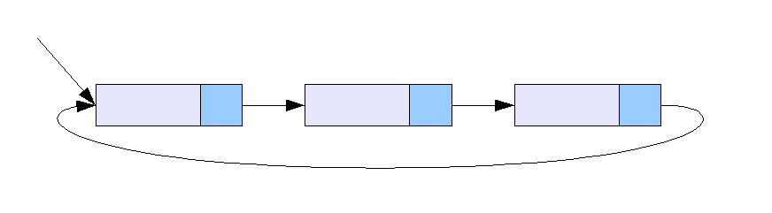

int Func(List * l){
if(l==NIL)
return 0;
if(l → next == l)
return l → data;
l → next = l → next → next ;
return Func(L → next);
}

Slide 34
پياده سازي پشته و صف با ليست پيوندي
top
front
rear
صف
پشته

Slide 35
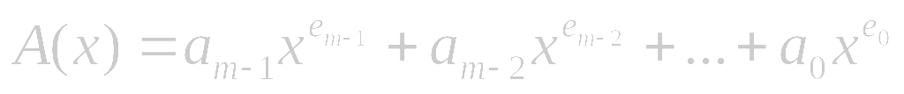
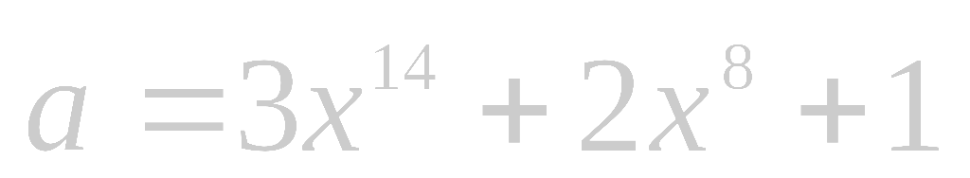
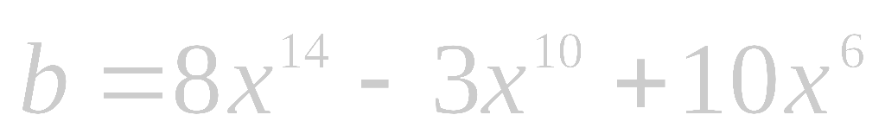
چند جمله اي
Representation
typedef struct poly_node *poly_pointer;
typedef struct poly_node {
int coef;
int expon;
poly_pointer link;
};
poly_pointer a, b, c;
coef expon link
a
3 14
2 8
1 0
null
b
8 14
-3 10
10 6
null

Slide 36
جمع دو چند جمله اي
3 14
2 8
1 0
a
8 14
-3 10
10 6
b
11 14
a->expon == b->expon
d
3 14
2 8
1 0
a
8 14
-3 10
10 6
b
11 14
-3 10
a->expon < b->expon
d

Slide 37
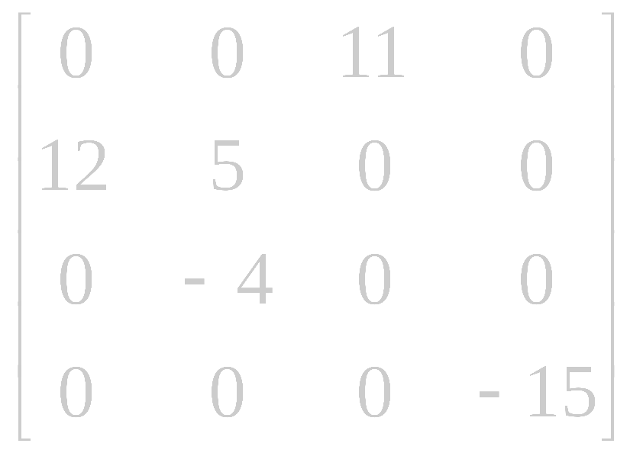
ماتريس اسپارس
# of head nodes = max{# of rows, # of columns}
head node
down
head
right
next
entry node
down
entry
row
col
right
value
aij
entry
i
j
aij

Slide 38
ماتريس اسپارس
H1
H2
H3
H4
4
4
4
0
2
H1
11
H2
1
0
1
1
12
5
2
1
H3
-4
H4
3
3
-15

