Slide 1
Path Matters: Learning Optimal Inference-Time Trajectories for Robotic 2D→3D AI Reconstruction
BUFFER-X
Zero-Shot Point Cloud Registration
New addition to our reconstruction pipeline
Group 03 · Automation Project · WiSe 25/26 · Supervisor: Adam Altenbuchner · Weekly Meeting — March 2026
VGGT ✓
SAM 3D ✓
Fast3R ✓
ICP ✓
BUFFER-X ← NOW

Slide 2
What is BUFFER-X?
Align two point clouds into the same coordinate frame —
no retraining, no fine-tuning, across any scene or sensor.
INPUT
PROCESSING
OUTPUT
Source .ply + Target .ply
Any sensor: RGB-D · LiDAR · Isaac Sim Basler Camera
Multi-scale PointNet++ descriptors
+ RANSAC / KISS-Matcher pose solver
6-DoF rigid transform T ∈ SE(3)
Rotation R + Translation t → feeds ICP
▶
▶
ICCV 2025
MIT SPARK
0.91M
~1 sec
Zero-shot
Highlight Paper
Lab
Parameters
Per pair
No retraining

Slide 3
Where BUFFER-X Fits in Our Pipeline
VGGT
Init
Robot
Home
Image
Recognition
Trajectory
Plan
Traj.
Execution
.PLY
Export
↓ then
2D→3D
Reconstruction
Preprocess
(remove BG)
BUFFER-X
Initial Alignment
ICP
Refinement
Fitness
RMSE
Problem without BUFFER-X
With BUFFER-X
ICP fails without good initial pose → diverges
VGGT/Fast3R clouds come in different coordinate frames
Manual alignment per scan is not scalable
RL agent gets wrong registration signal
Gives ICP a reliable starting pose → converges fast
Works on Isaac Sim .ply files without retraining
Handles UR5e scan density differences automatically
Fitness + RMSE directly usable as RL reward signal

Slide 4
Benchmark Results — Does It Actually Generalize?
97.9%
99.7%
0
~1 s
3DMatch Recall
Indoor RGB-D
ETH Recall
Outdoor LiDAR
Extra training
runs needed
Per pair
inference time
Dataset | Recall | RTE (cm) | RRE (°) | Failed / Total
3DMatch (indoor RGB-D) | ~97.9% | ~5.11 | ~1.72 | ~33 / 1623
ETH (outdoor LiDAR) | 99.7% | 5.88 | 0.65 | 2 / 713
Your 3DMatch run | 97.1% | 5.79 | 1.8 | 47/1623
Why this matters for Path Matters:
Trained only on indoor RGB-D → still achieves 99.7% on outdoor LiDAR. Our Isaac Sim Basler camera data is a completely new domain — BUFFER-X handles it without any retraining. This is exactly the zero-shot transfer our pipeline needs.

Slide 5
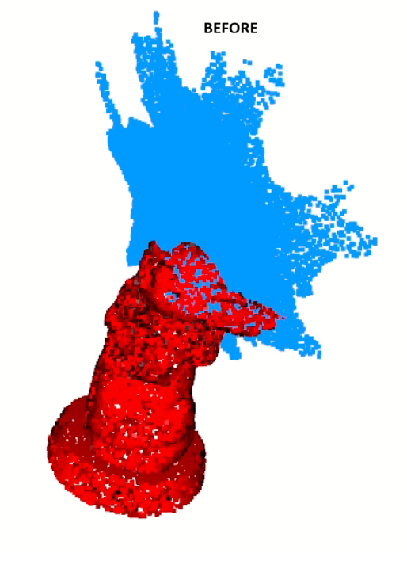
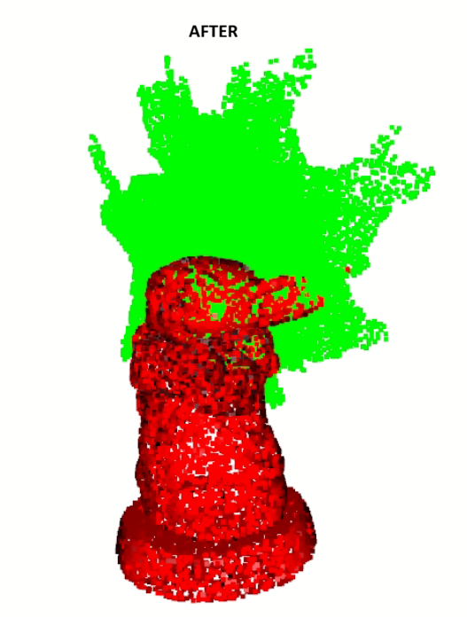
Custom Evaluation — Isaac Sim (Basler Camera)
Isaac Sim Scene
Basler Capture
.PLY Export + GT
BUFFER-X Align
ICP Refine
Fitness / RMSE
Test Case: Baby Yoda (Isaac Sim)
Your Results — run & fill in
Ground truth: Baby_Yoda.ply — 10,000 pts, no color Reconstruction: points.ply — 100,000 pts + RGB Alignment: BUFFER-X → Point-to-Plane ICP Compare command: python compare.py Test/Baby_Yoda.ply Test/points.ply
Metric | Value | Target
Fitness | 0.3342 | → 1.0
RMSE (m) | 0.0287 | → 0.0
RTE (m) |  | → 0.0
RRE (°) | [ insert ] | → 0.0
Visualize before / after alignment:
python results.py Test/Baby_Yoda.ply Test/points.ply
→ Take a screenshot and insert it here (Insert → Picture)

Slide 6
4 Use Cases to Run → Where to Add Results
1
3DMatch Indoor Benchmark
python test.py --dataset 3DMatch --experiment_id threedmatch --verbose 2>&1 | tee test_log.txt
→ Results in test_log.txt → Add Recall, RTE, RRE to Slide 4 table (row 3)
2
ETH Outdoor — Zero-Shot Transfer
python test.py --dataset ETH --experiment_id threedmatch --verbose 2>&1 | tee eth_log.txt
→ Confirms cross-domain generalization → Update numbers on Slide 4
3
Compare Isaac Sim Scan (Baby Yoda)
python compare.py Test/Baby_Yoda.ply Test/points.ply
→ Fitness + RMSE printed to terminal → Fill results table on Slide 5
4
Before / After Alignment Visualization
python results.py Test/Baby_Yoda.ply Test/points.ply
→ Two Open3D windows appear — press Q to toggle → Screenshot → Slide 5 placeholder
Tip: All results are saved automatically to per_sample_results/ and full_results/ directories after each test run.

Slide 7
Next Steps
1
Run all 4 use cases this week
2
Test on your actual industrial parts
Collect Fitness, RMSE, Recall numbers. Fill slides 4 & 5 before next meeting.
Export UR5e scan .ply files from Isaac Sim and run compare.py on real object data, not just Baby Yoda.
3
BUFFER-X → ICP baseline comparison
4
Use Fitness/RMSE as RL reward signal
Measure ICP Fitness/RMSE with BUFFER-X init vs. without. Quantify the improvement for the report.
Replace current reward heuristics with BUFFER-X alignment quality — directly improves the PPO training signal.

