Slide 1
Preemptive Spatial Prediction of Crime using Machine
Learning Methods
Fatima Ahmad 20030011
Awais Bashir 20030014
Taha Muzammil 20030024
Muhammad Badar Shaban 20030033

Slide 2
Introduction

Slide 3
Problem Statement
Crime rate is increasing day by day making society an unsafe place to live. To deal with the issue of increasing crime, predicting the type of crime at a specific time and knowing the major criminal hotspots can help reduce the crime rate.

Slide 4
Goals
Finding High Density Criminal Hotspots
Predicting Crime Type committed at a Specific Time

Slide 5

Motivation
To raise awareness among people about the dangerous locations
Useful for security agencies to control increasing crime rates

Slide 6
Techniques and Input/Output
Techniques
Multinomial Naive Bayes
Gaussian Naive Bayes
Decision Trees
Multinomial Logistic Regression
Neural Network
Apriori Algorithm
FP-Growth Algorithm
Input
Location (Neighbpurhood_ID)
Day
Month
Time
Output
Crime Type
Frequent Patterns

Slide 7
Related Work

Slide 8
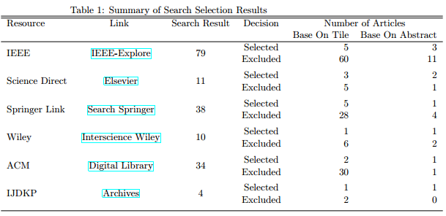
Screening and Search Strategy
Keywords: Crime & Prediction & Machine & Learning & Police & Data & Mining || Process & Crime Hot Spots || Spatial

Slide 9
Selected Papers
[1] Sarvanaguru RA Alkesh Bharati. Crime Prediction And Analysis Using Machine Learning. IRJET, 2018.
[2] Ella Haig Ginger Saltos. An Exploration of Crime Prediction Using Data Mining On Open Data. IJITDM, 2017.
[3] Jasleen kaur Jude Hemanth Mamta Mittal, Lalit Mohan. Monitoring the Impact of Economic Crisis on Crime in India Using Machine Learning,Springer Link, 2018.
[4] Razana Alwee Nurul Hazwani, Nor Azizah. An Overview of Crime Prediction Methods. ICT-ISPC, 2017.
[5] Elizabeth Lor Tahani Almanie, Rsha Mirza. Crime Prediction Based On Crime Types And Using Spatial And Temporal Criminal Hotspots. IJDKP,2018.

Slide 10
Elizabeth Lor Tahani Almanie, Rsha Mirza. Crime Prediction Based On Crime Types And Using Spatial And Temporal Criminal Hotspots.
Real World Dataset and is publicly available
Denver Dataset has 19 attributes
Los Angeles Dataset has 14 attributes
Apriori Algorithm
Naive Bayes
Decision Tree

Slide 11
Dataset

Slide 12
Dataset
Dataset used for our project is “Denver Crime Data”
Dataset contains 467,150 instances and 19 attributes (‘reported_date’, ‘last_occurance_date’, ‘incident_address’, “offence_type_id”, “offence_category_id”, “first_occurance_date”, “neighborhood_id”, “is_crime” etc)
Key attributes:
Attributes | Data Type | Description
Offense Category ID | String | Name of offence category
First Occurrence Date | Date | Date of the event
Neighbourhood ID | String | Name of neighborhood
Is Crime | Boolean | Incident is crime or not

Slide 13
Data Cleaning
Remove those instances in which value of “IS_CRIME” is 0
Missing values in ‘reported_date’, ‘last_occurance_date’, and ‘incident_address’
Do not require these attributes
After data cleaning dataset size reduced to 353,717

Slide 14
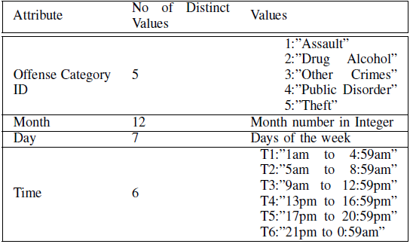
Data Integration and Transformation
”FIRST OCCURRENCE DATE” is divided into three different attributes named as: ”Month”, ”Day” and ”Time”
Time is divided into 6 groups, each group contains interval of 4 hours.
13 crime categories are divided into 5 major groups

Slide 15
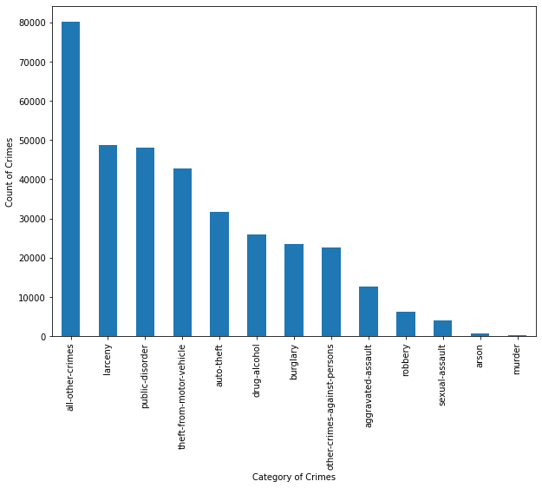
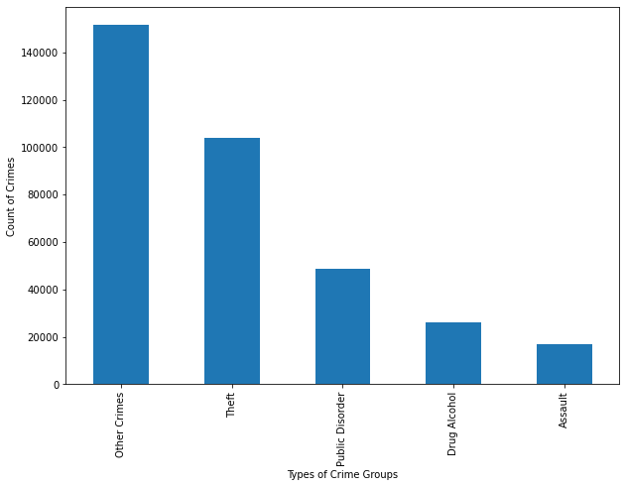
Exploratory Data Analysis
Total number of crimes in each crime category
Total number of crimes in each crime group

Slide 16
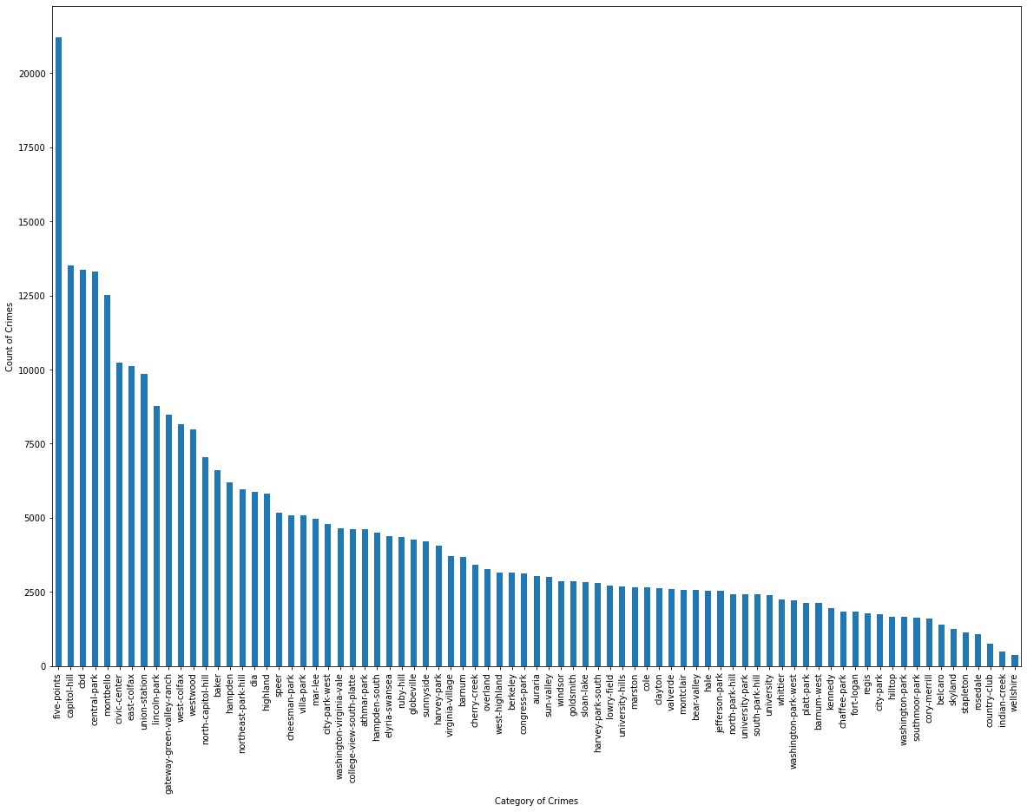
Exploratory Data Analysis
Total number of crimes in each neighborhood:
Wellshire
Five-points

Slide 17
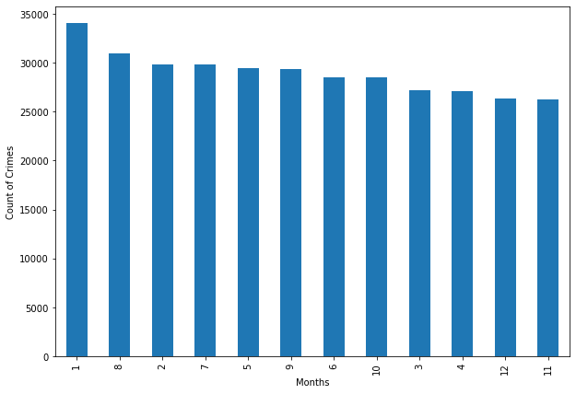
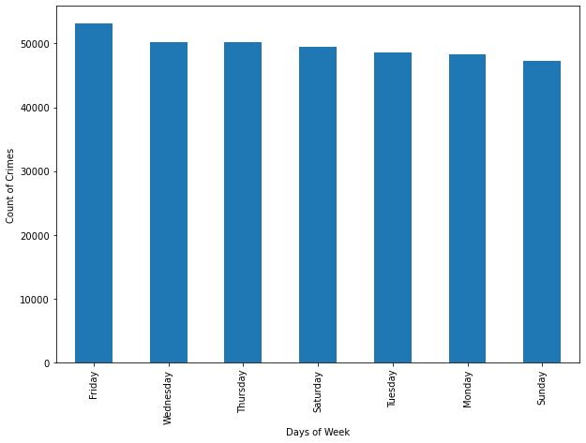
Exploratory Data Analysis
Total number of crimes in each crime Month
Total number of crimes on each day of Week

Slide 18
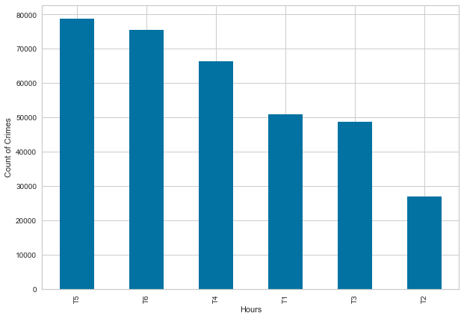
Exploratory Data Analysis
Total number of crimes in Hour groups:
Groups | Time Interval
T1 | 1:00 am to 4:59 am
T2 | 5:00 am to 8:59 am
T3 | 9:00 am to 12:59 pm
T4 | 1:00 pm to 16:59 am
T5 | 17:00 pm to 20:59 pm
T6 | 21:00 pm to 0:59 pm
T5

Slide 19
Methodology

Slide 20
Techniques Used
Split dataset into six groups on the basis of time.
For classification, passed the features and labels to following algorithms:
Decision Trees
Multinomial and Gaussian Naive Bayes
Multinomial Logistic Regression
Neural Networks with hidden layers
For extraction of frequent patterns:
Apriori
FP-Growth

Slide 21
Decision Tree
Tree-like model of decisions along with their possible consequences
Conditional control statements on basis of features
Tree generation is computationally expensive task
Inappropriate for many classes & less training data
Scikit-learn Decision tree (k-folds approach i.e. k=5)
Average accuracy is 38%

Slide 22
Naive Bayes
Scikit-learn Multinomial Naive Bayes and Gaussian Naive Bayes
Independent feature values
k-folds approach(k=5)
Average accuracy for Gaussian NB is 43%
Average accuracy for Multinomial NB is 38%
Keep changing the value of k & took 2 to 3 minutes per iteration.
Gaussian NB more suitable for generic classification tasks

Slide 23
Multinomial Logistic Regression
Used L2 regularization with softmax
Keep a minimum predefined threshold (predefined by scikit-learn library in our case) to determine the classification of each train set.
K-folds approach(k=5)
The average accuracy is 43.42%.
Repeat experiment by changing the value of k
Took 2 to 3 minutes per iteration.

Slide 24
Neural Networks
Scikit-learn MLP library
Two hidden layers with RELU and one input and output layer with softmax
Adaptive learning rate(initially 0.0001)
SGD (stochastic gradient descent) to update weights
The average accuracy is 44.96%.
Kept changing the value of k, learning rates & number of hidden layers
Accuracy achieved between 42-44%

Slide 25
Apriori and FP-Growth
Used for calculating frequent item-sets in the dataset
Return the association rules and frequent items in the dataset on the basis of given threshold
Used mlxtend.frequent_patterns library for this task
Minimum thresholds for 0.001, 0.01 & 0.005 for Apriori
Minimum thresholds for 0.001, 0.01, 0.005 & 0.00012 for FP-Growth
Need to transform the data using the ‘Transaction Encoder’ function for the pre-processing
Changing threshold gave different frequent itemsets

Slide 26
Evaluation and Comparison

Slide 27
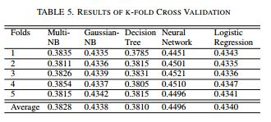
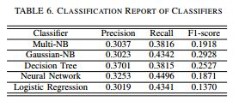
Evaluation and Comparisons
Train Test Split
5 Fold Cross Validation
Accuracy
Precision
Recall
F1-Score

Slide 28
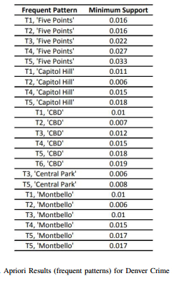
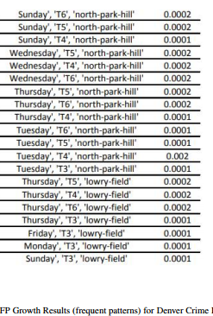
Evaluation and Comparisons
Frequent Patterns | Minimum Support
FP Growth Algorithm can extract 3-pairs frequent patterns with very low minimum support value and its execution time is better than Apriori.

Slide 29
Conclusion and Future Work

Slide 30
Prediction of criminal hotspots and type of crime at specific time
Neural Network- a better approach
FP-growth - a better approach
Concluding Remarks
Future Work
Can be applied to datasets of different areas
Different Algorithms can be tested for much better accuracy

Slide 31
Thankyou.

