Slide 1
OPERATOR GUIDE / WINDOWS
DDRCV
From first install
to tournament operation
Setup walkthrough + event-day reference
01
SET UP
02
REHEARSE
03
OPERATE
Install and select your source
Verify scores and integrations
Save, recover, and hand over
Desktop workflow • 18 September 2026 • Speaker notes included
DDRCV / Operator guide / Windows
01 / 21
Notes:
Audience: the person setting up or running the tournament station.
Walk through slides 1–16 before the event; use slides 17–21 at the desk.
The screenshots are current desktop forms in an isolated stopped session,
with example local paths and no credentials. They are not a live rehearsal.
Source: doc/operator_walkthrough.md and doc/operator_reference.md.
Source/UI snapshot: 18 September 2026. Recheck labels after application updates.

Slide 2
01 / SETUP
What connects to what
Start with recognition. Add the integrations your event uses.
Score display
Game feed
DDRCV
ddr_score_render → OBS
Capture device or RTSP
Full 1280 × 720 frame
→
Recognize state
Read and publish scores
→
Results evidence
Local screenshots
Optional Discord delivery
FIRST MILESTONE
A clean picture and accepted scores that match the machine.
DDRCV / 01 / Setup
02 / 21
Notes:
DDRCV reads the full DDR World game feed and publishes live scores.
ddr_score_render is a separate repository that displays those scores in a
window. OBS can capture that window and optionally automate scene selection.
Results capture saves evidence locally and can send it through a Discord webhook.
Neither OBS nor the renderer is required to verify recognition itself.
Source: doc/operator_walkthrough.md, introduction and sections 5–7.

Slide 3
01 / SETUP
Before you start
Prepare the station and the event’s files.
Required
If your event uses them
64-bit Windows + first-install internet
DDRCV ZIP / checkout
Full game feed at 1280 × 720
Or a full-frame rehearsal recording
Saved event JSON profile
OBS scene collection
ddr_score_render folder + assets
Discord channel webhook
FOLDER EXAMPLE
C:\Games\ddrcv — extract the ZIP completely before running setup.
DDRCV / 01 / Setup
03 / 21
Notes:
Use the version or ZIP supplied by the event organizer. Extract it into a
writable folder, not Program Files and not inside the ZIP. First setup needs
internet. No existing Python install is necessary. Live capture is fixed at
1280 × 720; a full-frame 16:9 recording can be resized explicitly.
OBS, renderer assets, and a webhook are optional. Get the renderer repository
and its assets from the organizer; DDRCV setup does not download them.
Source: doc/operator_walkthrough.md sections 1–2; doc/installation.md.

Slide 4
01 / SETUP
Install once, then use the launcher
No preinstalled Python is required.
1 Extract
Open the folder containing setup_desktop.bat.
2 Run setup
Double-click setup_desktop.bat; choose option 1.
3 Wait
Leave the console open until “Setup complete”.
4 Launch
Double-click launch_desktop.vbs.
CHECK
The desktop panel opens. Capture stays stopped until you click Start.
DDRCV / 01 / Setup
04 / 21
Notes:
Double-click setup_desktop.bat. On a fresh install, Enter selects option 1:
Install/use local Python in this checkout. Option 2 finds compatible installed
Python versions; option 3 accepts a manual path. The supported interpreter is
x64 CPython 3.12. On later runs, option 4 reuses the existing environment.
Setup installs locked dependencies, provisions and tests actual OCR, and checks
WebView2. Wait for Setup complete. If it fails, retain the exact error text.
Do not move or delete .venv or .tools/python. Set up a fresh environment when
moving to another computer. See doc/installation.md for troubleshooting.

Slide 5
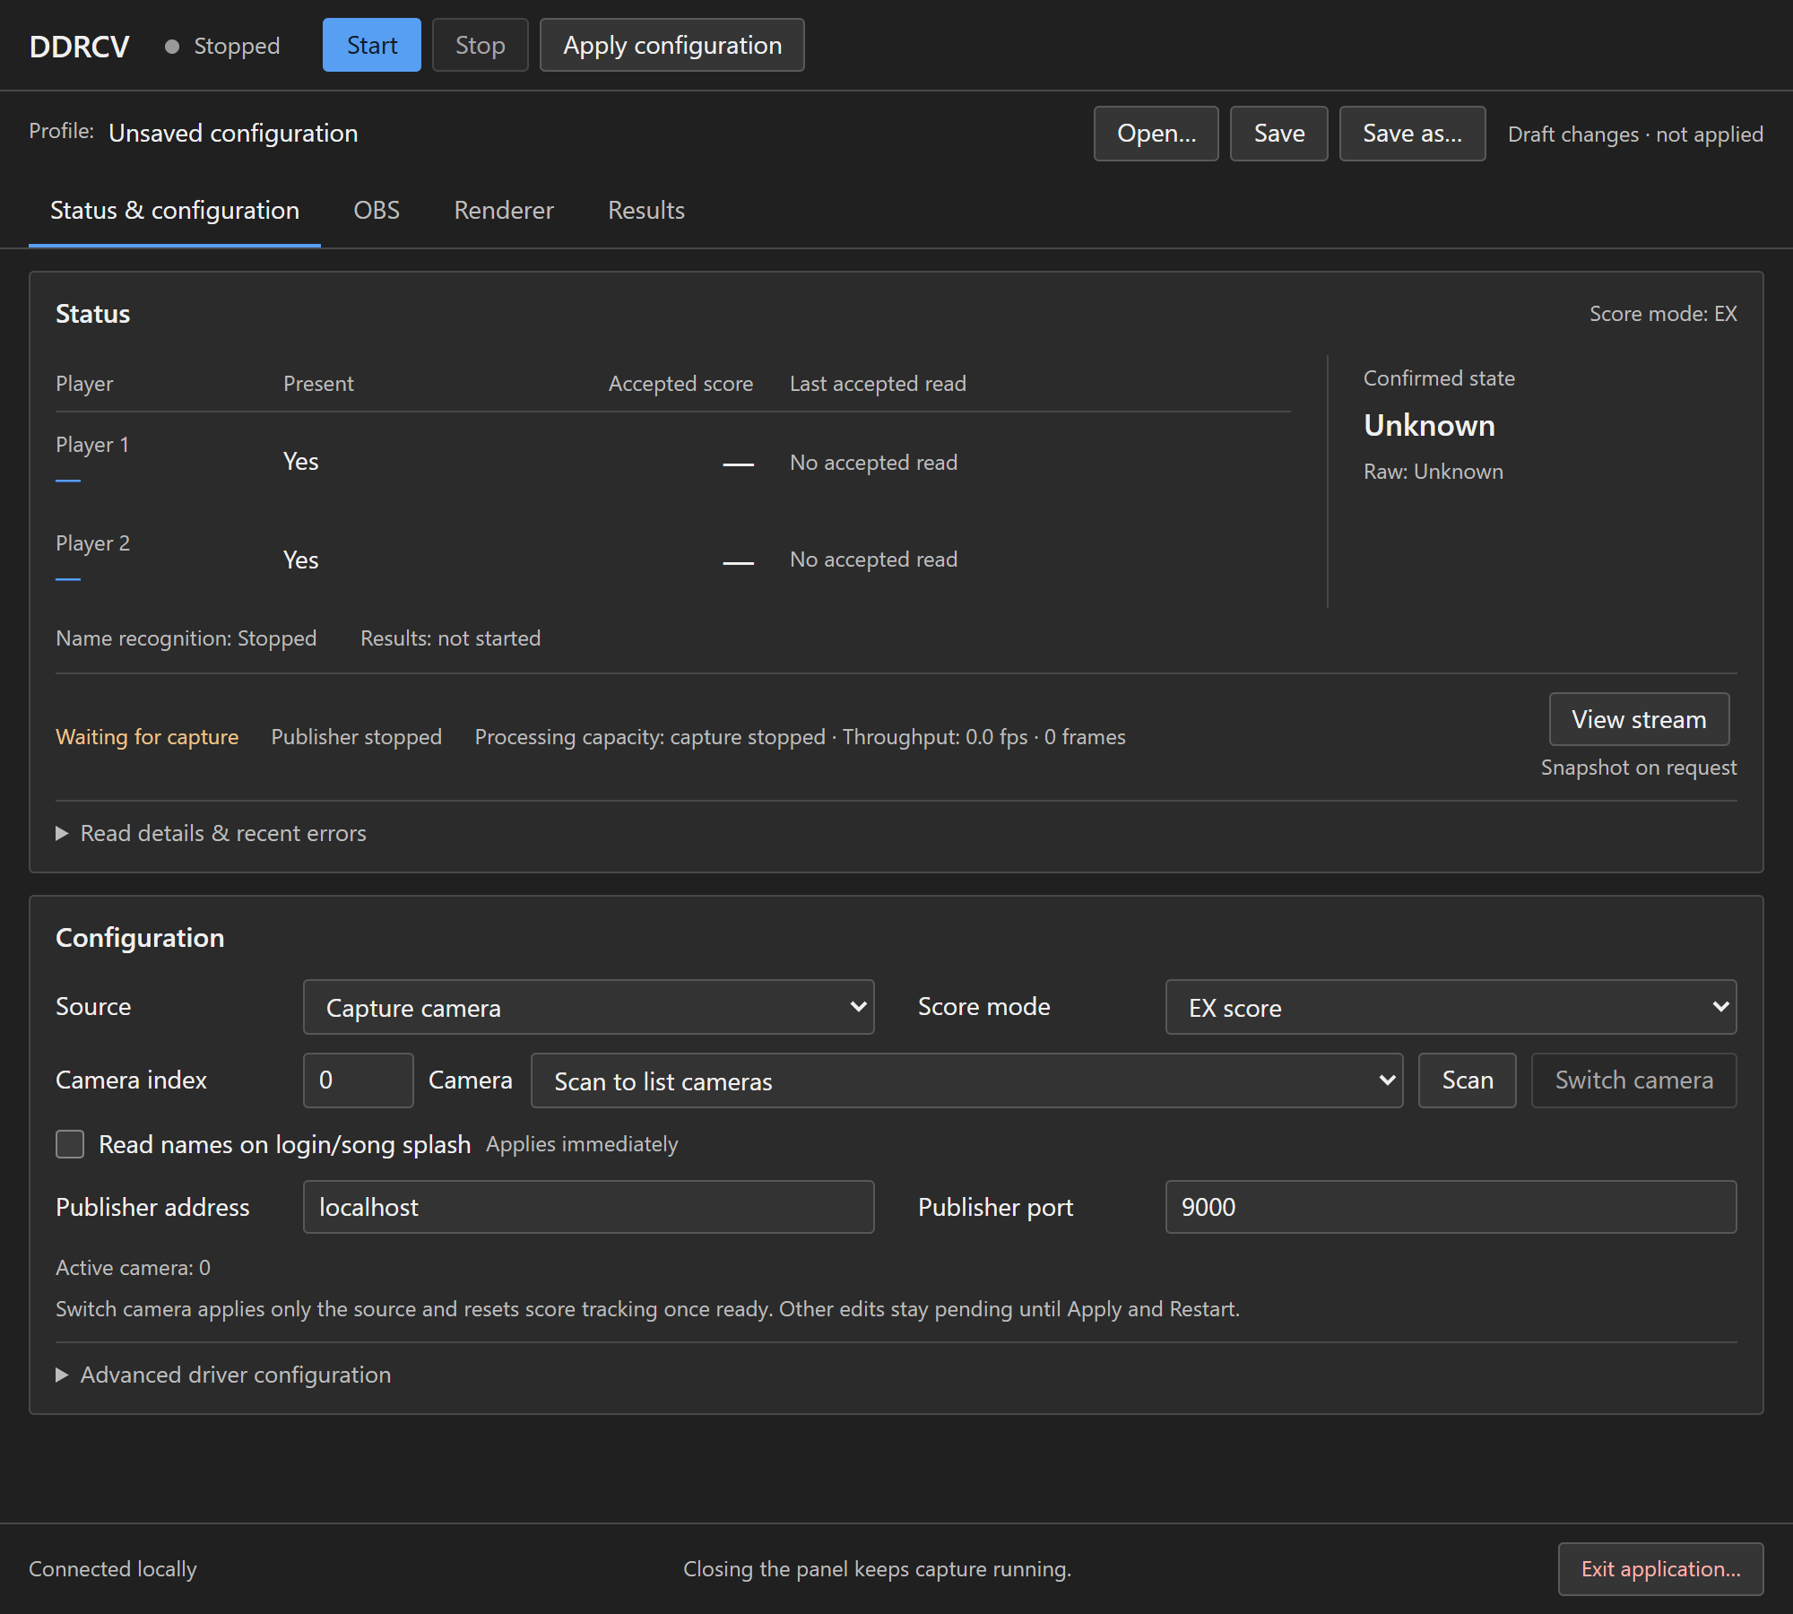
01 / SETUP
Find the four areas of the panel
Start, Stop, Apply, and profile controls remain available across tabs.
Status & configuration
Choose the feed and inspect live reads.
OBS
Connect scenes and control automation.
Renderer
Launch the separate score display.
Results
Save screenshots, post, and recover.
Current app • isolated, stopped session • example paths
DDRCV / 01 / Setup
05 / 21
Notes:
This screenshot shows the real app with capture stopped. The UI may display
unknown or absent players until a live session observes them.
Status & configuration: source, score mode, health, names, accepted scores.
OBS: connection, mapping, automation and manual scene switching.
Renderer: repository path and launch controls.
Results: screenshots, Discord, and recent results/recovery.
Source: ddrcv/desktop/templates/index.html and static/desk.js.

Slide 6
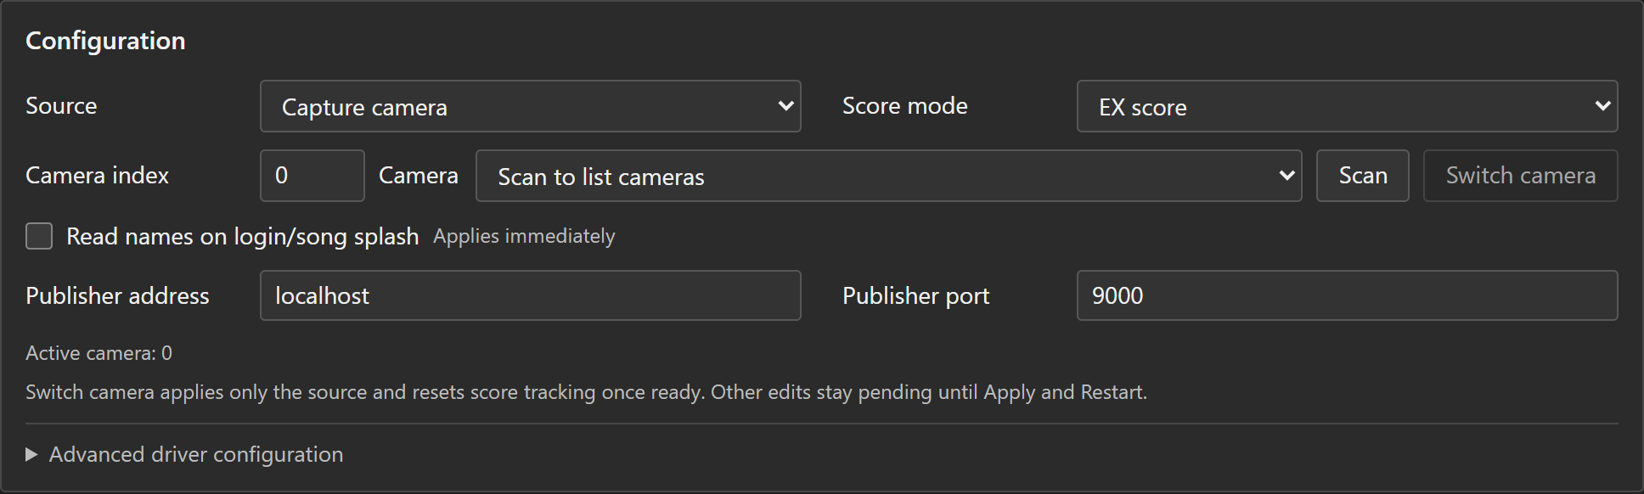
01 / SETUP
Choose a clean source
Status & configuration → Source
Current app • isolated, stopped session • example paths
LIVE CAMERA
RTSP
RECORDING
Scan → select device
Check Camera index
Enter Stream URL
Require 1280 × 720
Browse to Local video
Resize only full 16:9 files
DDRCV / 01 / Setup
06 / 21
Notes:
Capture camera: Scan, choose the device, then check Camera index. Device indices
can differ between computers. RTSP stream: enter the URL; frames must be 720p.
Local video: Browse to the file, enabling Resize full 16:9 file to 720p if needed.
Borders, cropped broadcasts, overlays, or stretching move the recognition regions.
Still image diagnostics cannot establish temporal score or state confirmation.
Leave publisher localhost:9000 for a single-computer setup. Run only one app,
workbench, or CLI against that publisher port and Results outbox.
Source: doc/operator_walkthrough.md section 3.

Slide 7
01 / SETUP
Match the score mode to the game
This setting affects gameplay filtering and results interpretation.
EX score
Money score
For the event’s EX scoring.
Desktop default.
Verify with an actual song.
For the score toward 1,000,000.
Browser workbench default.
Verify after switching apps.
REMEMBER
An old profile may select a different mode. Check before pressing Start.
DDRCV / 01 / Setup
07 / 21
Notes:
Select EX when the game shows the event EX score. Select Money for the ordinary
score toward 1,000,000. Desktop defaults to EX; the browser workbench defaults
to Money. A profile can override either, so always verify the selected mode.
A wrong score mode may reject otherwise valid score reads and uses the wrong
results crop. Leave Custom filter to the profile maintainer.
Money results do not declare an EX winner.
Source: driver_config.py; doc/results_publishing.md, confirmation/mode rules.

Slide 8
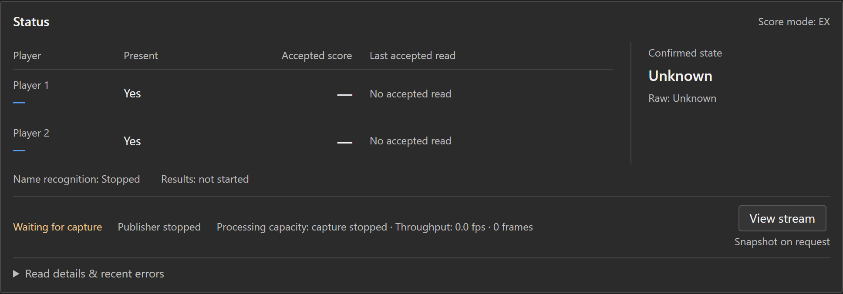
02 / REHEARSAL
Prove recognition before adding integrations
Click Start, then observe a complete song from its splash.
Current app • isolated, stopped session • example paths
1 Picture
2 State
3 Scores
View stream → Refresh frame.
Check full, clean framing.
Song splash → gameplay →
results.
Confirmed state follows the game.
Compare accepted reads and
ages.
Verify the final score too.
DDRCV / 02 / Rehearsal
08 / 21
Notes:
The screenshot is a stopped UI for orientation, not proof of a running capture.
During your test, look for Running, healthy capture, a confirmed state following
the game, and recent accepted reads that agree with the machine.
View stream fetches one snapshot. Refresh frame fetches the next; it is not a
continuous preview. Starting mid-song can lack player-presence evidence.
The final score, including a full-combo ending, must be compared with the machine.
A briefly delayed confirmed state is expected because recognition needs multiple
observations. Source: operator_walkthrough.md section 4; tournament_desktop.md.

Slide 9
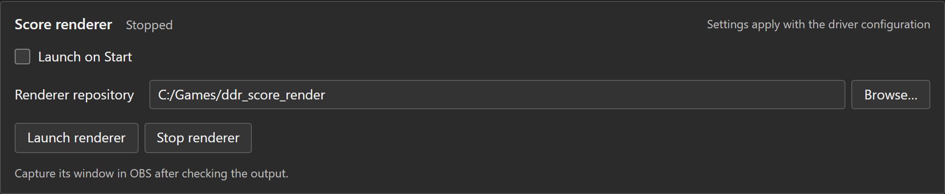
02 / REHEARSAL · OPTIONAL
Add the score renderer
Renderer → select repository → apply → start or launch
Current app • isolated, stopped session • example paths
Choose the folder
Apply the path
Inspect the window
Separate ddr_score_render repo.
Then Start / Launch renderer.
Compare scores; capture in OBS.
CHECK
Visible scores agree with DDRCV’s accepted scores.
DDRCV / 02 / Rehearsal · optional
09 / 21
Notes:
Obtain the separate ddr_score_render repository and assets from the organizer.
Select its folder with Browse; the folder must contain apps/tbd5.py.
Set Launch on Start if desired. Apply configuration while stopped, then Start.
If already running, Apply and Restart resets tracking, so use it between songs.
With automatic launch off, use Launch renderer after starting capture.
Check the actual window, then capture it in OBS. Publisher clients or a running
process alone do not establish visible output. Buttons use the applied path/port.
Source: doc/operator_walkthrough.md section 5; tournament_integrations.py.

Slide 10
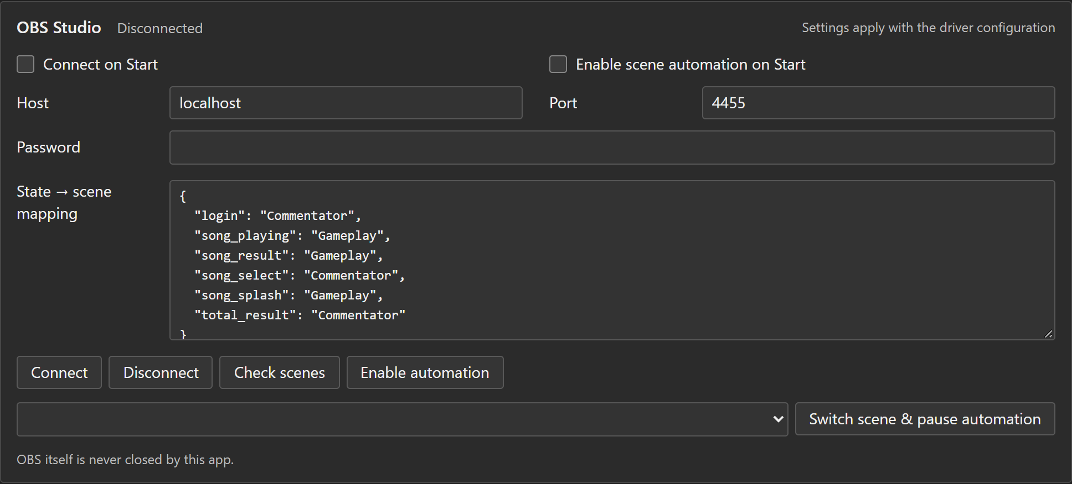
02 / REHEARSAL · OPTIONAL
Connect OBS before enabling automation
Use exact scene names that already exist in the event’s OBS collection.
1 Enter connection details
Host, port, password.
Apply settings before Connect.
2 Check the mapping
Use exact scene names.
Click Check scenes.
Current app • isolated, stopped session • example paths
3 Enable automation
Watch the actual OBS scene
through a complete song.
DDRCV / 02 / Rehearsal · optional
10 / 21
Notes:
Enable OBS's WebSocket server. Enter the host, port and password into DDRCV;
usual same-computer settings are localhost and 4455. Check Connect on Start.
Keep Enable scene automation on Start off for the initial rehearsal.
Edit the JSON map, retaining quotes and commas. Apply configuration and Start;
Connect if necessary, then Check scenes. Enable automation after validation.
song_select, login and total_result default to Commentator; song_splash,
song_playing and song_result default to Gameplay. Null/omitted mappings hold;
unknown always holds. No scenes are created by DDRCV.
Source: doc/operator_walkthrough.md section 6; publish/obs_policy.py.

Slide 11
02 / REHEARSAL · OPTIONAL
Practice manual OBS control
Know how to pause automation before the event needs it.
Take manual control
Resume automatic control
Choose a scene.
Click “Switch scene & pause
automation”.
Verify the scene in OBS.
Click “Enable automation”.
Verify the scene matches the
confirmed game state.
DIRECT OBS EDIT
Pause DDRCV automation before changing a scene inside OBS.
DDRCV / 02 / Rehearsal · optional
11 / 21
Notes:
In DDRCV's OBS tab, select an existing scene and use Switch scene & pause
automation. Resume with Enable automation; it reconciles to the latest
confirmed state. If changing a scene directly in OBS, pause DDRCV automation
first so it does not change the scene back. This does not stop recognition.
After a successful rehearsal, choose whether automation should enable on Start,
then apply and save the profile. Source: tournament_desktop.md and obs_policy.py.

Slide 12
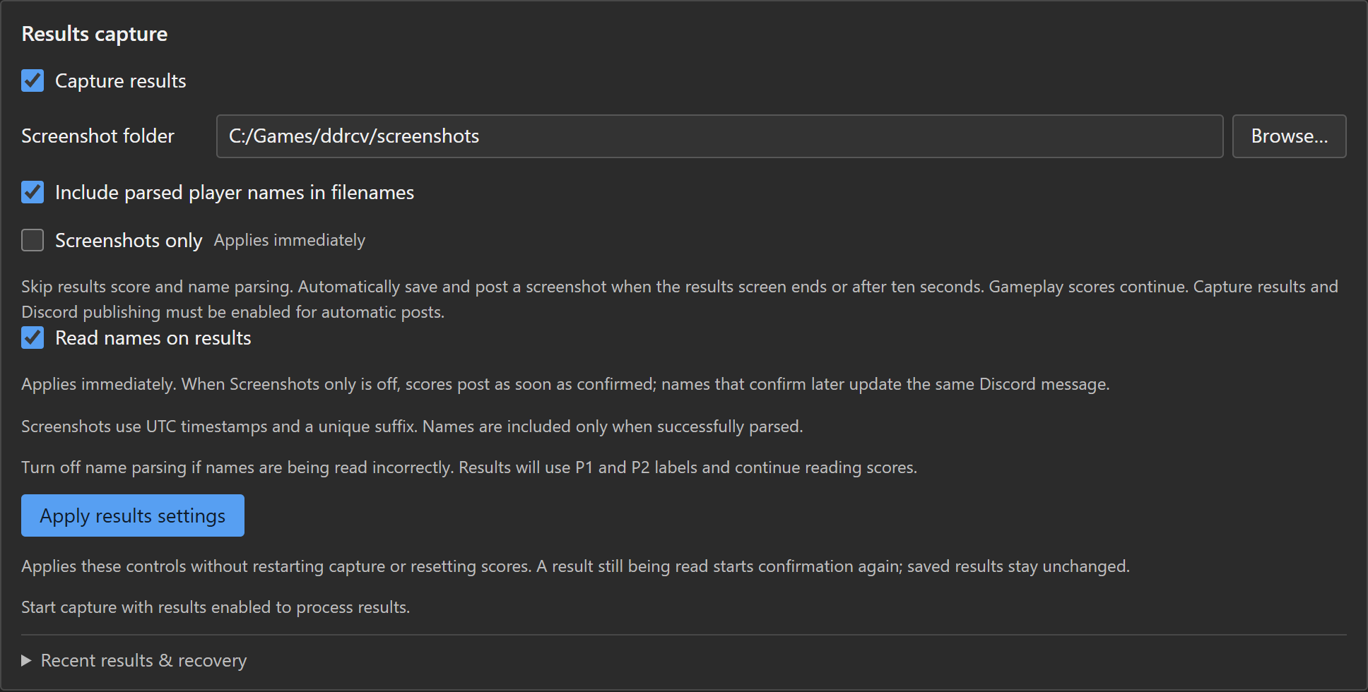
02 / REHEARSAL
Save results screenshots
Results → Capture results → Screenshot folder → Apply results settings
Capture results
Check it even when using
an existing profile.
Screenshot folder
Choose a writable place
you can find later.
Apply results settings
Current app • isolated, stopped session • example paths
Keeps gameplay scores.
DDRCV / 02 / Rehearsal
12 / 21
Notes:
New profiles enable Capture results, but an existing saved off value is honored.
Choose a writable screenshot folder. Default copies are under screenshots in
the checkout. Durable originals and delivery records live in .workbench/results
unless configured otherwise. Changing the screenshot folder does not move old files.
Filenames use UTC time and a unique event suffix. Parsed names can be included
only when recognized. Apply results settings does not restart capture, clear
gameplay scores, or reconnect OBS/renderer. Save the JSON profile separately.
Source: operator_walkthrough.md section 7; results_publishing.md.

Slide 13
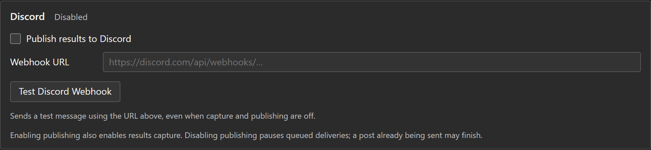
02 / REHEARSAL · OPTIONAL
Test Discord, then enable automatic posts
A webhook test sends a real message to the selected channel.
Current app • isolated, stopped session • example paths
1 Enter + test
2 Verify channel
3 Enable + apply
Webhook URL → Test Discord
Webhook.
Find the actual test message.
Publish results to Discord →
Apply results settings.
DDRCV / 02 / Rehearsal · optional
13 / 21
Notes:
Ask the organizer/channel administrator for the intended results webhook. Enter
it in Results. Test Discord Webhook uses the URL currently entered even when
capture and automatic publishing are off. It does not apply pending settings
or enable publishing. Verify the channel before enabling Publish results to Discord.
Enabling publishing also checks Capture results. Click Apply results settings.
Complete a test song, inspect Recent results & recovery, then inspect Discord.
During a local rehearsal leave publishing off, or use the organizer's test channel.
Source: desktop/templates/index.html; operator_walkthrough.md section 7.

Slide 14
02 / REHEARSAL
Choose how much results text to read
These choices preserve live gameplay scoring.
Scores + names
Screenshots only OFF; Read names on results ON.
Scores + P1/P2
Screenshots only OFF; Read names on results OFF.
Screenshot evidence
Screenshots only ON. Save on departure or after 10 seconds.
SEPARATE
CONTROL
Live-session names use “Read names on login/song splash”.
DDRCV / 02 / Rehearsal
14 / 21
Notes:
Screenshots only and Read names on results apply immediately, without a general
restart. Screenshots only skips both results score and name OCR. The detected
results episode saves on departure or after its original ten-second deadline.
Capture results must stay enabled; Discord must also be enabled for posts.
With parsing enabled, confirmed scores can post before names; later confirmed
names update the same message. With name parsing disabled, scores use P1/P2.
The login/song splash name switch is separate and applies immediately.
These switches do not correct saved results or recover an entirely missed screen.
Source: results_publishing.md and tournament_desktop.md.

Slide 15
02 / REHEARSAL
Save a profile and understand Apply
The form, running session, and saved file can contain different settings.
Save / Save as…
Start
Apply and Restart
Write the current form to
a named JSON profile.
Running settings stay as
they were.
Start recognition using
the current form settings.
Use after opening the
event profile.
Apply pending changes
during a run.
Resets live score
tracking.
BETWEEN SONGS
Use the full Apply and Restart for source/mode/integration changes.
DDRCV / 02 / Rehearsal
15 / 21
Notes:
Open loads a profile into the form without starting capture. Save/Save as writes
the form into a JSON profile without applying pending changes to the current run.
Start uses the current form. Apply configuration works while stopped; Start runs it.
Apply and Restart during a run confirms a reset of live score/state tracking.
Use Results-only Apply for those controls; name and screenshot-only switches are
immediate. Save a named profile after changing settings, even when the local draft
is automatically retained. Profiles contain real secrets and absolute paths.
Source: desktop/controller.py, static/desk.js; operator_walkthrough.md section 8.

Slide 16
02 / REHEARSAL
Finish with a real event rehearsal
Installation checks do not establish tournament readiness.
Game flow
Selection → splash → gameplay → results.
Score accuracy
Two players, one player, and a full-combo ending.
Connections
Capture reconnect; manual OBS scene and resume.
Evidence
Screenshot files, Discord post, and recovery actions.
READY WHEN
Another operator can repeat startup and recovery using the saved profile.
DDRCV / 02 / Rehearsal
16 / 21
Notes:
Use the actual tournament computer, capture device, renderer and OBS scene
collection. Observe select → splash → gameplay → song results → total results.
Validate full-combo final scores, single-player presence and starting mid-song.
Exercise capture reconnect, manual scene selection/resume, and window close/reopen.
Check actual Results files and Discord messages, including recovery from delivery
failure. If a results screen is never detected, automatic recovery has no episode.
Preserve the event's recording or manual evidence procedure.
Source: operator_walkthrough.md section 8; tournament_handoff.md section 5.

Slide 17
03 / EVENT-DAY REFERENCE
Start the station in five steps
Keep this slide available beside the event profile.
1 Connect
Capture device ready; OBS open if used.
2 Launch
launch_desktop.vbs → Open… event profile if needed.
3 Verify
Source, EX/Money, Results, and integration settings.
4 Start
Running + healthy capture; inspect View stream.
5 Confirm
Accepted scores, actual score display, scenes, results post.
DDRCV / 03 / Event-day reference
17 / 21
Notes:
If the panel was closed but the backend remains active, reopening it does not
create another recognition session. Fully exiting or a backend crash requires
relaunch and an explicit Start. Profile restoration never starts capture itself.
Verify mode and capture index every time hardware or computers change. A saved
profile can restore automatic OBS/Discord actions; inspect it before Start.
For problems, check fresh capture and accepted-read ages independently.
Source: operator_reference.md, Start an event session.

Slide 18
03 / EVENT-DAY REFERENCE
Recover a saved result
Results → Recent results & recovery
Saved
Send saved result
Queued / Sending / Retrying
Watch the status and connection.
Failed
Fix the cause → Retry delivery.
Sent
Open Discord message; Retry name update if offered.
Need another post?
More recovery options → Republish creates a duplicate.
REQUIRED
Capture running + Capture results + Discord enabled + webhook.
DDRCV / 03 / Event-day reference
18 / 21
Notes:
Inspect the saved screenshot before sending. Send/retry requires capture Running,
Capture results enabled, Discord publishing enabled, and a configured webhook.
Saved: use Send saved result. Failed: fix the issue and Retry delivery.
Queued/Sending/Retrying: wait and watch connectivity. Sent: Open Discord message.
Retry name update edits the existing message after a failed name update.
Republish under More recovery options confirms creation of another Discord post.
Disabling publishing and applying pauses queued deliveries; in-flight sends may
finish. Re-enabling resumes queued work. A completely missed screen cannot recover.
Source: operator_reference.md, Results recovery; static/desk.js.

Slide 19
03 / EVENT-DAY REFERENCE
When something looks wrong
Check the failing part before restarting the whole session.
Frozen preview
Refresh frame; check capture age and recent errors.
Wrong or stuck score
Check framing + mode; inspect rejection details.
One bad accepted score
Read details & recent errors → Reset P1/P2 tracking.
Blank renderer
Check publisher clients, path, status, and actual window.
Wrong OBS scene
Check connection, scene names, and automation state.
Results text unreliable? Enable Screenshots only; gameplay scoring continues.
DDRCV / 03 / Event-day reference
19 / 21
Notes:
Preview is a requested still; Refresh frame updates it. Capture freshness and
accepted-read age differ: frames can be fresh while score reads are rejected.
Check complete 1280x720 framing, source, score mode, and read rejection reasons.
If a wrongly high accepted score is stuck, use Reset P1/P2 tracking after checking
the input. It clears only that live score and does not edit saved results.
A camera switch tests the new source before replacing the old; success resets
tracking. If a driver cannot open both, Stop/Start the new source between songs.
Port/outbox conflicts: stop the other desktop/workbench/CLI; a closed panel can
still own the session. See operator_reference.md for the full troubleshooting table.

Slide 20
03 / EVENT-DAY REFERENCE
Closing the panel keeps capture running
Use Exit application… when the station should actually stop.
Close window / Alt+F4
Exit application…
Capture keeps running.
Reopen from the tray or
launch_desktop.vbs.
Live scores remain intact.
Stops the application after
confirmation.
OBS itself stays open.
Next launch needs Start.
BEFORE EXITING
Check unresolved deliveries → save the profile → retain event evidence.
DDRCV / 03 / Event-day reference
20 / 21
Notes:
Window close/Alt+F4 closes the disposable UI, while the backend keeps capture,
publishing, automation and owned renderer active. Open panel from the tray or
relaunch the VBS to reopen without resetting scores. Exit application confirms
stopping the backend and its owned renderer; OBS itself remains open.
At session end inspect unresolved deliveries, save intended profile changes,
then exit. Keep the screenshot copies and .workbench/results outbox for evidence.
Desktop settings/logs: %LOCALAPPDATA%/DDRCV/tournament. For updates fully exit,
update source, rerun setup using option 4 for a compatible environment, and rehearse.
Source: operator_reference.md, Files and shutdown; tournament_desktop.md.

Slide 21
03 / HANDOFF
Leave the next operator a complete handoff
Fill these in for the actual tournament computer.
Station details
Evidence and support
Profile path + DDRCV folder/version
Capture device / index + score mode
Renderer folder + OBS scenes
Screenshot folder + Discord channel
Technical contact
Recording / manual-results procedure
Full walkthrough
doc/operator_walkthrough.md
Quick reference
doc/operator_reference.md
Keep credential-bearing profiles private; verify paths on each computer.
DDRCV / 03 / Handoff
21 / 21
Notes:
Fill the event setup table in doc/operator_walkthrough.md before handover.
Include DDRCV folder/version, saved JSON path, source device/index/resolution,
EX/Money, renderer folder, OBS scene collection/mapping, screenshot folder,
Discord channel/contact and manual evidence procedure.
Do not write webhook tokens or passwords into this presentation; saved JSON
profiles contain actual credentials despite masked UI fields. Share them only
with authorized operators. Verify absolute paths and camera index on each computer.
Further reading: doc/operator_walkthrough.md, doc/operator_reference.md,
doc/installation.md, doc/tournament_handoff.md, doc/results_publishing.md.

