Slide 1
Predicting customer buying behaviour
Name: Taha Iqbal Khan

Slide 2
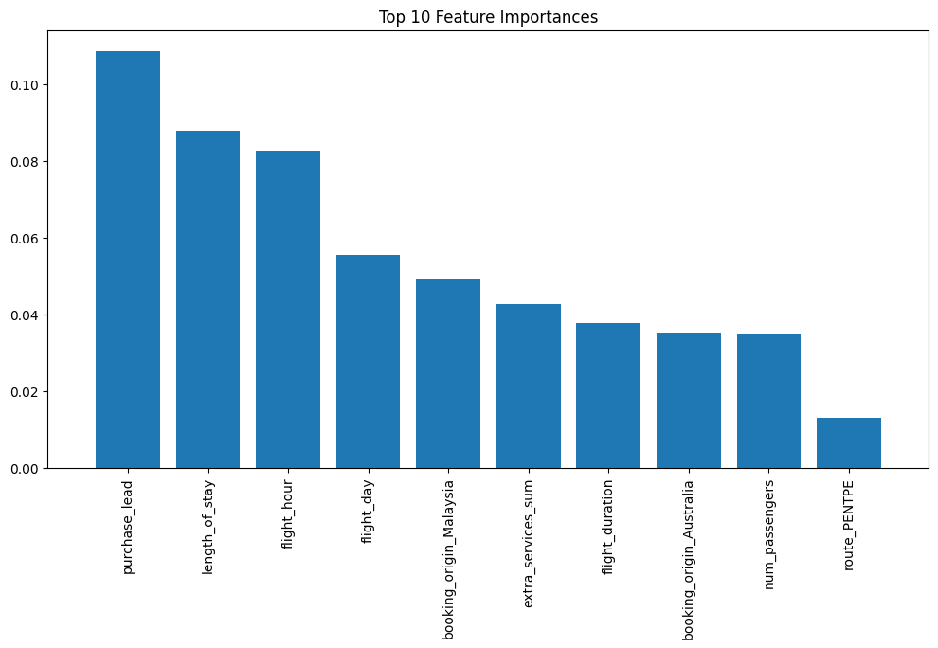
Data Insights
Cross-validated accuracy: 0.85125
Cross-validated precision: 0.527645626280737
Cross-validated recall: 0.08269377258826802
Cross-validated F1 score: 0.14289816558034601
Test set accuracy: 0.8558
Test set precision: 0.5863636363636363
Test set recall: 0.08716216216216216
Test set F1 score: 0.1517647058823529

