Slide 1
Web scraping to gain company insights
Name: Taha Iqbal Khan

Slide 2

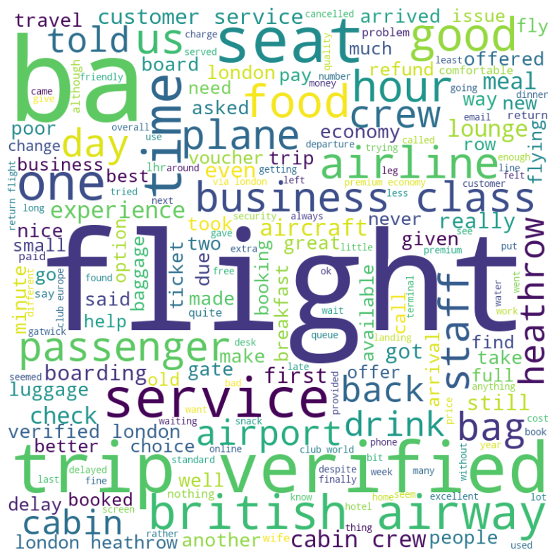
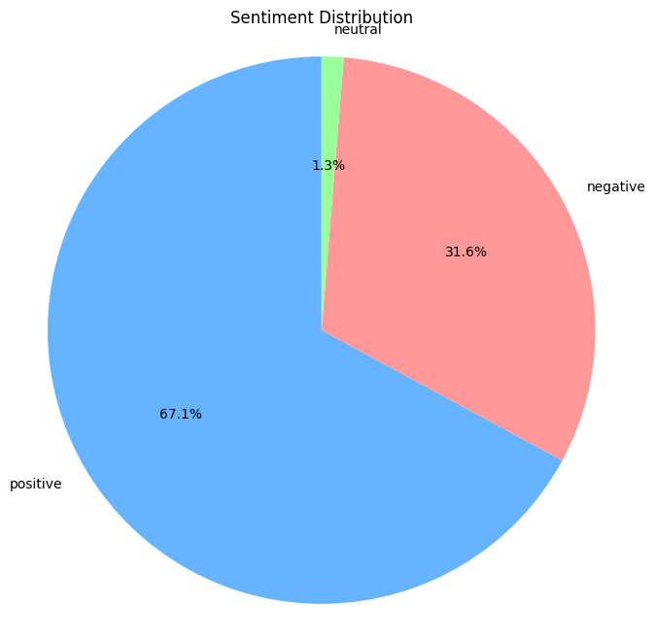
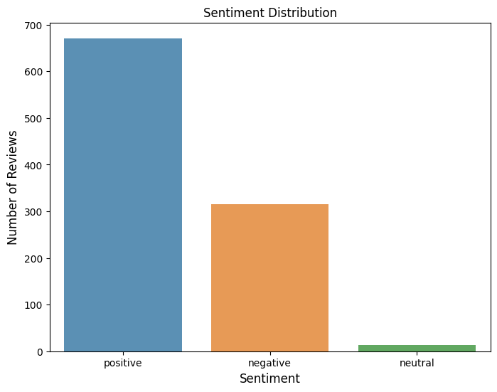
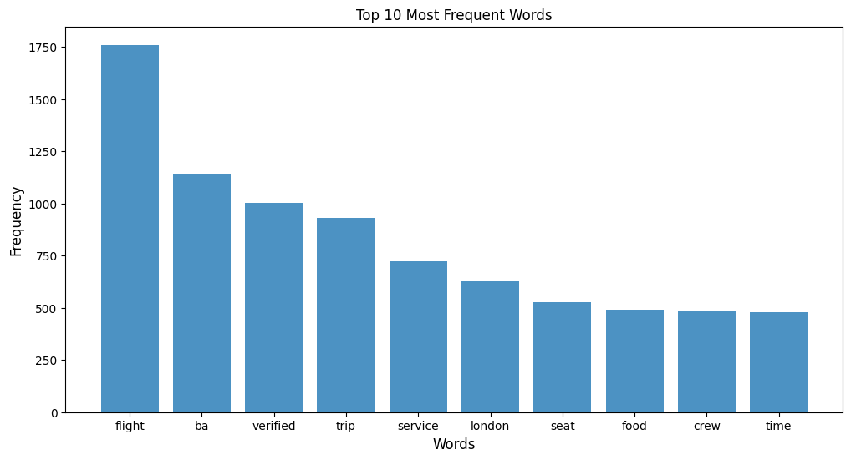
Web Scrap Data Insights
Positive reviews: 67.10%
Negative reviews: 31.60%
Neutral reviews: 1.30%

