Slide 1
WHEN DOES ADAPTIVE RETRAINING HELP?
A Drift-Aware MLOps Study on Multi-Year ACS Income Data
STATIC
0.710
End-to-end ML pipeline with experiment tracking, CI/CD, containerized serving, monitoring, and adaptive retraining under dataset shift.
POLICY
0.734
DRIFT
12 batches
The core result: retraining helps when the new regime is learnable, not when drift is synthetic label noise.
Taha Rasheed | Hamza Zahid | Hasnat Noor
National University of Computers and Emerging Sciences, ISB

Slide 2
RESEARCH PROBLEM
Static models decay quietly when the data-generating world moves
We studied whether monitored, policy-gated retraining can recover performance without retraining on every alert.
A. Dataset shift
The input distribution changes across ACS years and simulated batch regimes.
B. Concept signal
Labels and performance are monitored to distinguish harmless drift from harmful degradation.
0.710
C. Retraining decision
STATIC BATCH-12 F1
Policy decides whether new labeled batches justify replacing the deployed model.
Final batch performance after sustained drift.
0.734
POLICY BATCH-12 F1
Recovered by adapting to recent batches.
Problem framing and final ACS batch signal
Drift-Aware MLOps Pipeline | ACS Income Data

Slide 3
END-TO-END IMPLEMENTATION
Full MLOps loop
Not only a model: data processing, XGBoost training, drift detection, policy retraining, serving, tracking, monitoring, and CI/CD are integrated.
Data + Features
Training
Drift + Policy
Adult + multi-year ACS/Folktables; temporal split; 4.8M processed ACS rows.
XGBoost with CPU/GPU support; encoders and model artifacts saved for serving.
KS / chi-square tests, severity scoring, concept-drift gates, rolling retraining windows.
FastAPI
MLflow
Docker + CI/CD + Grafana
Prediction API, health endpoint, model reload, and Prometheus `/metrics`.
Experiment parameters, metrics, model versions, and training artifacts.
Compose stack, Prometheus scrape, Grafana dashboard, GitHub Actions validation.
Implementation stack mapped to mandatory MLOps requirements
Drift-Aware MLOps Pipeline | ACS Income Data

Slide 4
METHODOLOGY UPGRADE
The important change: stop asking the model to learn noise
Initial label-flip drift created contradictions; final ACS experiments focus on learnable temporal, covariate, and feature-regime shifts.
Before
After
1. Subgroup label flips
1. Learnable drift regimes
Some income labels were artificially reversed for selected groups.
Age, hours, occupation, birthplace, and feature-noise shifts across 12 batches.
2. Short drift spikes
Retraining often adapted to a batch that the next batch did not resemble.
2. Rolling retraining
Train on recent batches plus a small historical anchor, instead of unbounded expansion.
3. Low recovery signal
Static and retrained models stayed close because both faced noisy or unstable targets.
3. Persistence gating
Policy waits for repeated drift/concept signals before replacing the model.
Core methodological correction after noise-drift diagnosis
Drift-Aware MLOps Pipeline | ACS Income Data

Slide 5
MAIN ACS RESULT
Policy retraining recovered late-regime performance with fewer retrains
The adaptive policy closed much of the late-batch degradation while using almost half the retraining events of immediate retraining.
0.730
STATIC FINAL ACCURACY
Baseline remains locked to the original regime.
0.783
POLICY FINAL ACCURACY
Adaptive model recovers under sustained drift.
5 fewer
RETRAINS AVOIDED
Policy retrained 6 times vs 11 immediate retrains.
Source: reports/results_acs.md
Drift-Aware MLOps Pipeline | ACS Income Data

Slide 6
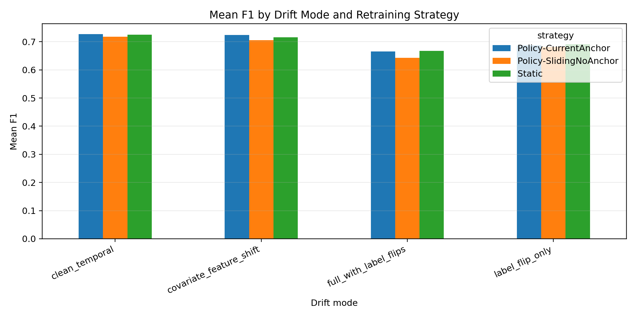
WHY RETRAINING SOMETIMES FAILED
Retraining helps only when the new batch contains a learnable regime
Noise ablation separated real shift from subgroup label-flip stress, explaining why the earliest experiment looked flat.
Interpretation
1. Label flips are not a stable concept
They inject contradictions into the target, so a model cannot generalize the new rule.
2. Sliding windows matter
Recent data dominates adaptation; old data should not drown out the current regime.
3. The final result is conditional
Adaptive retraining is valuable when drift is persistent and learnable.
Noise ablation and regime diagnostics
Drift-Aware MLOps Pipeline | ACS Income Data

Slide 7
PRODUCTION READINESS
The pipeline is demonstrable as a running MLOps system
This is the part to show live: FastAPI, MLflow, Prometheus, Grafana, Docker Compose, and GitHub Actions.
FastAPI
MLflow
Docker
/predict, /health, /metrics, reload-model.
Params, metrics, model artifacts, run history.
API, MLflow, Prometheus, Grafana stack.
Prometheus
Grafana
GitHub Actions
Latency, request count, model version, drift metrics.
Dashboard for operational model monitoring.
Lint, tests, compile checks, Docker validation/build.
Live demo URLs: :8080/docs | :5000 MLflow | :9090 Prometheus | :3000 Grafana
MLOps stack verification

