Slide 1

React Native

Slide 2
React Native
React Native is an open-source UI software framework created by Meta Platforms, Inc. It is used to develop applications for Android, Android TV, iOS, macOS, tvOS, Web, Windows and UWP by enabling developers to use the React framework along with native platform capabilities.

Slide 3
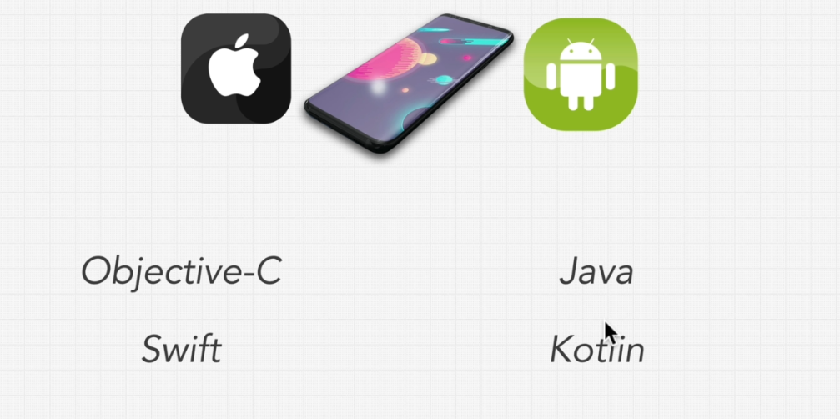
How We Got Here - React Native History

Slide 4
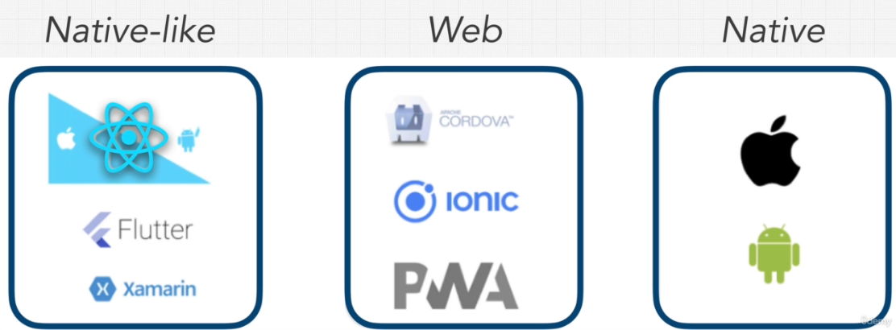

Slide 5
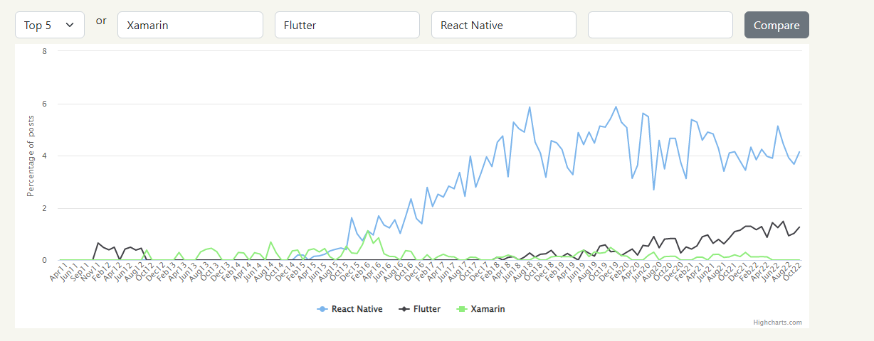
Why React Native?
Big Community
Big Company
Cross Platform

Slide 6
If you are new to mobile development
the easiest way to get started is with Expo Go. Expo is a set of tools and services built around React Native and, while it has many features, the most relevant feature for us right now is that it can get you writing a React Native app within minutes. You will only need a recent version of Node.js and a phone or emulator. If you'd like to try out React Native directly in your web browser before installing any tools, you can try out Snack
If you are already familiar with mobile development
you may want to use React Native CLI. It requires Xcode or Android Studio to get started. If you already have one of these tools installed, you should be able to get up and running within a few minutes. If they are not installed, you should expect to spend about an hour installing and configuring them.

Slide 7
Installing dependencies
You will need Node,
the React Native command line interface
JDK
Android Studio.

Slide 8
Mobile Development Professional Local Setup
MAC Installing GIT
- Git Simplified https//thenewstack.io/tutorial-git-for-absolutely-everyone/
MAC Installing Node And Yarn
- NodeJS https//nodejs.org/en/
- Yarn https//yarnpkg.com/
MAC Installing Android Studio
- Android Studio https//developer.android.com/studio
MAC Installing VSCode
- VSCode https//code.visualstudio.com/download

Slide 9
Mobile Development Professional Local Setup
WINDOWS Installing GIT And VSCode
- VSCode https//code.visualstudio.com/download
- GIT https//git-scm.com/
WINDOWS Installing Android Studio
- Android Studio https//developer.android.com/studio
WINDOWS Installing Node and Yarn
- NodeJS https//nodejs.org/en/
- Yarn https//yarnpkg.com/

Slide 10

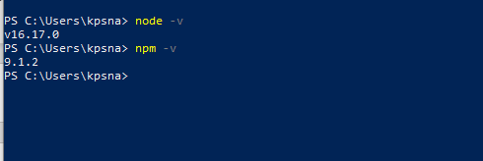
Installing Chocolatey
Get-ExecutionPolicy
Run Get-ExecutionPolicy. If it returns Restricted, then run Set-ExecutionPolicy AllSigned or Set-ExecutionPolicy Bypass -Scope Process.
Now run the following command:
Set-ExecutionPolicy Bypass -Scope Process -Force; [System.Net.ServicePointManager]::SecurityProtocol = [System.Net.ServicePointManager]::SecurityProtocol -bor 3072; iex ((New-Object System.Net.WebClient).DownloadString('https://community.chocolatey.org/install.ps1'))

Slide 11
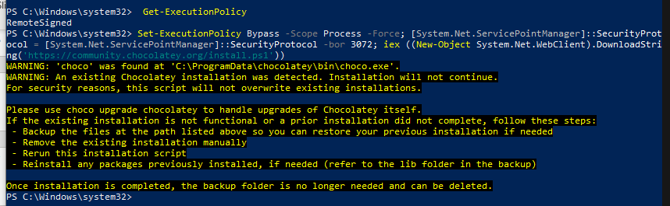
choco -?
Chocolatey v1.1.0

Slide 12
JDK
choco install -y nodejs-lts microsoft-openjdk11
OR
choco install -y microsoft-openjdk11

Slide 13
Android development environment
1. Install Android Studio
Android SDK
Android SDK platform
Android Virtual Device (AVD)
2. Android SDK platform
Android SDK platform 31
Intel x86 Atom_64 System Image or Google APIs Intel x86 Atom System Image

Slide 14
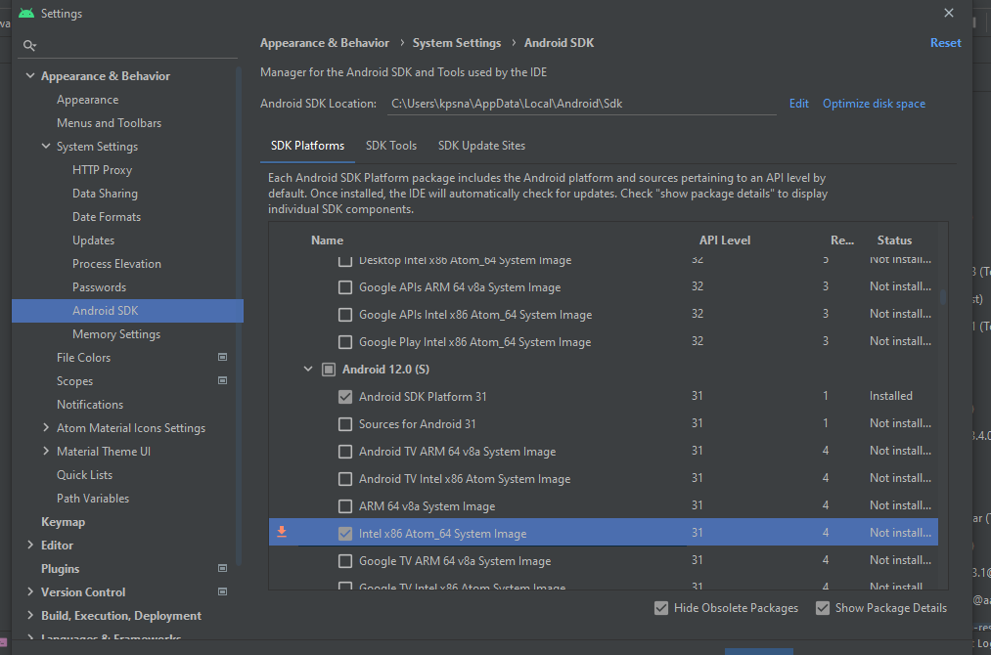

Slide 15
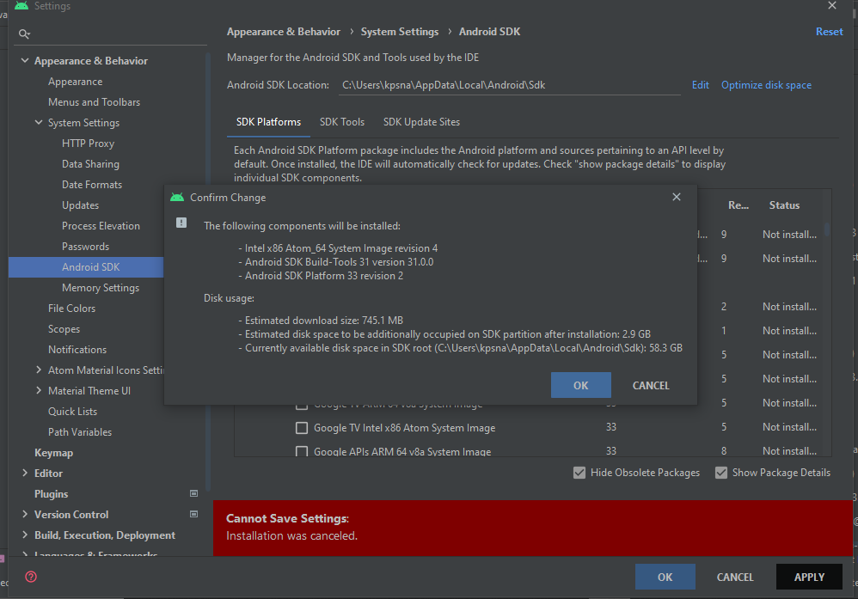

Slide 16
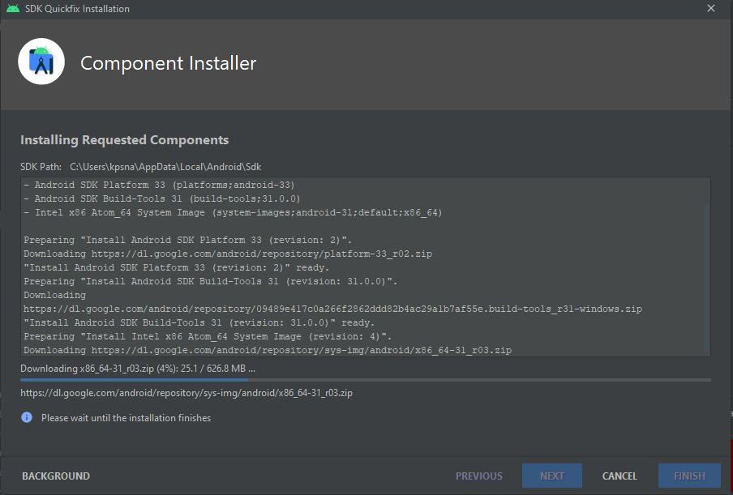

Slide 17
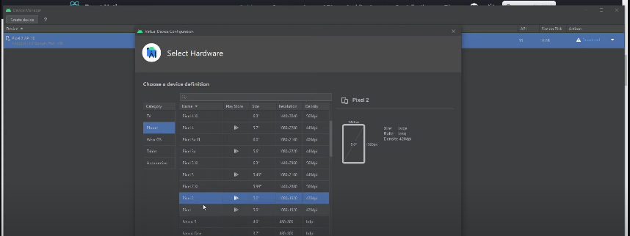

Slide 18
Configure the ANDROID_HOME environment variable
The React Native tools require some environment variables to be set up in order to build apps with native code.
Open the Windows Control Panel.
Click on User Accounts, then click User Accounts again
Click on Change my environment variables
Click on New... to create a new ANDROID_HOME user variable that points to the path to your Android SDK:

Slide 19
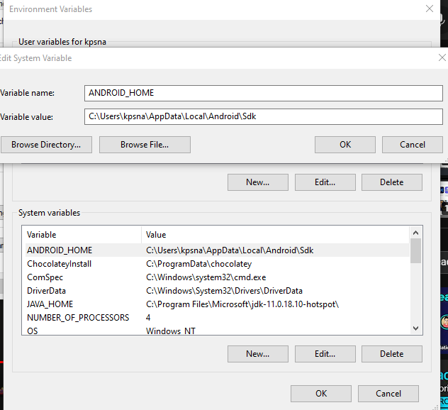
C:\Users\kpsna\AppData\Local\Android\Sdk

Slide 20
Add platform-tools to Path
Open the Windows Control Panel.
Click on User Accounts, then click User Accounts again
Click on Change my environment variables
Select the Path variable.
Click Edit.
Click New and add the path to platform-tools to the list.

Slide 21
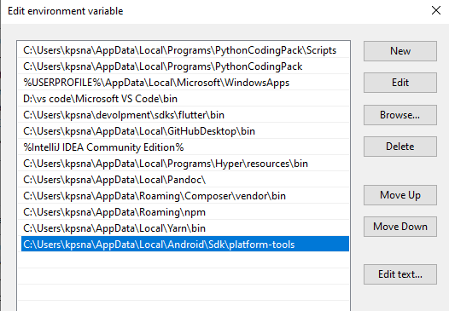
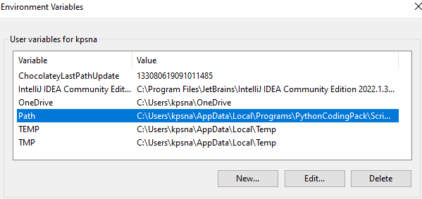
C:\Users\kpsna\AppData\Local\Android\Sdk\platform-tools

Slide 22
Creating a new application
1 npx react-native init AwesomeProject
Running your React Native application
Step 1: Start Metro
npx react-native start
Step 2: Start your application
npx react-native run-android

Slide 23
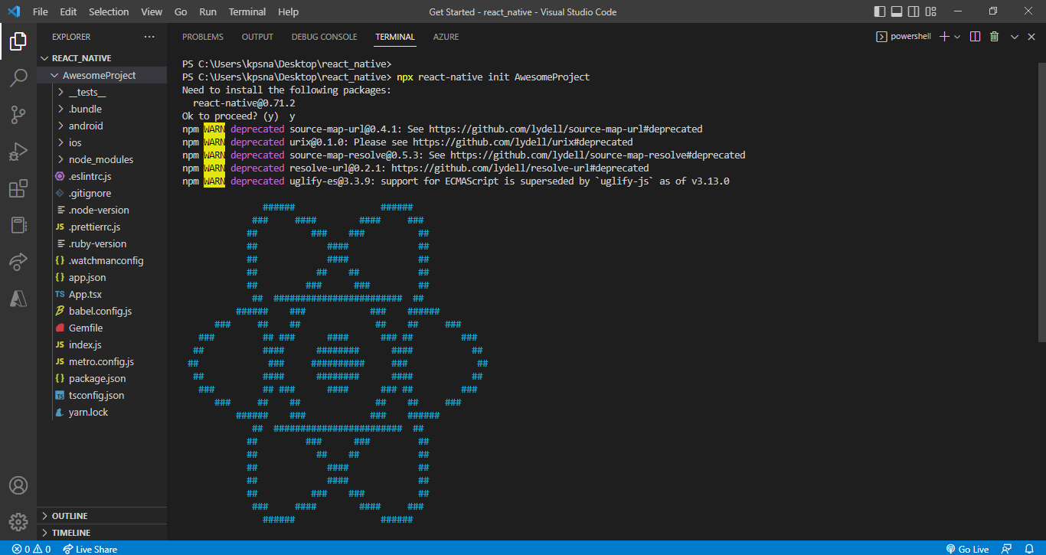
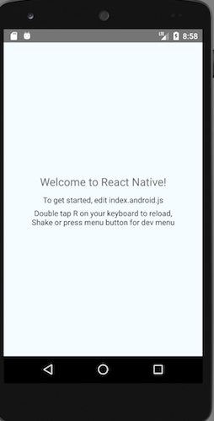

Slide 24
If you are new to mobile development
NPM
npx create-expo-app AwesomeProject
cd AwesomeProject
npx expo start
Yarn
yarn create expo-app AwesomeProject
cd AwesomeProject
yarn expo start

Slide 25
Running your React Native application
Install the Expo Go app on your iOS or Android phone and connect to the same wireless network as your computer. On Android, use the Expo Go app to scan the QR code from your terminal to open your project. On iOS, use the built-in QR code scanner of the default iOS Camera app.

Slide 26


Slide 27

Thank you

