Slide 1
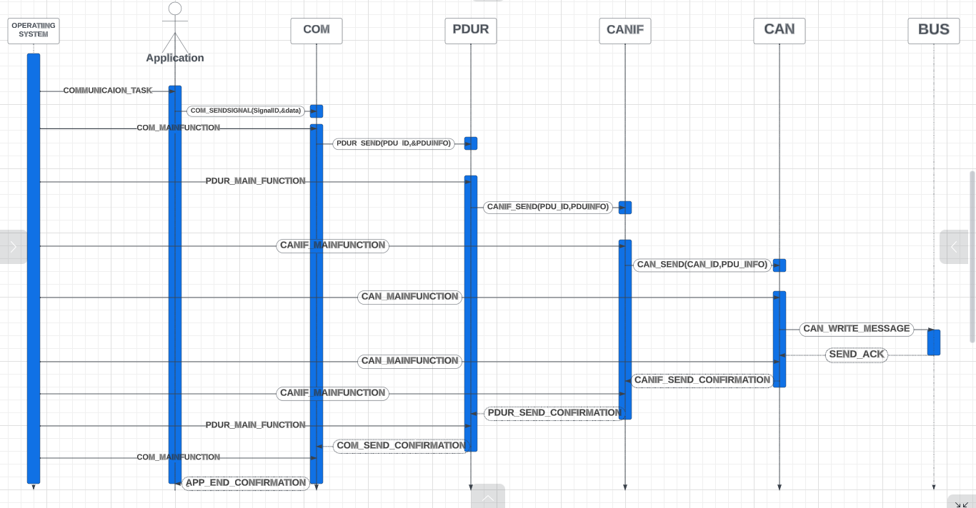

Slide 2
Operating System Triggers
App Communication Task
1

Slide 3
2
When Signal Reach To COM, It Will Check Transceiver Mode if Triggered Will be Sent Synchronous But the filter will be
checked as well.
else if Triggered On Change Will be Sent Synchronous But,
the filter and Update Bit will be checked as well.
else if Pending Will wait Until COM_MAIN_FUNCTION.
BUT, That Depending On Transmission Mode For PDU

Slide 4
In PDUR, It Routing
PDU To the correct
Direction That Doing in
PDUR_MAIN_FUNCTION
3

Slide 5
4
In CANIF, It Will Add Some
Information To PDU
1-CAN_ID
2-BUFFER_ID
And, It Will Send PDU To
CAN In CANIF_MAIN_FUN.

Slide 6
5
In CAN, It Will Send All Information To Hard Ware Buffer And, It Will Trigger To Send In CAN_MAIN_FUN

Slide 7
6

Slide 8
COM_SEND_
CONFIRMATION
PDUR_SEND_
CONFIRMAION
CANIF_
SEND_CONFIRMATION
CAN_SEND_ACK
If Message Send To BUS Correctly
APP_SEND_
CONFIRMATION
7
8
9
11
10

Slide 9
1
2
3
4
5
6
7
8
9
11
10

