Slide 1
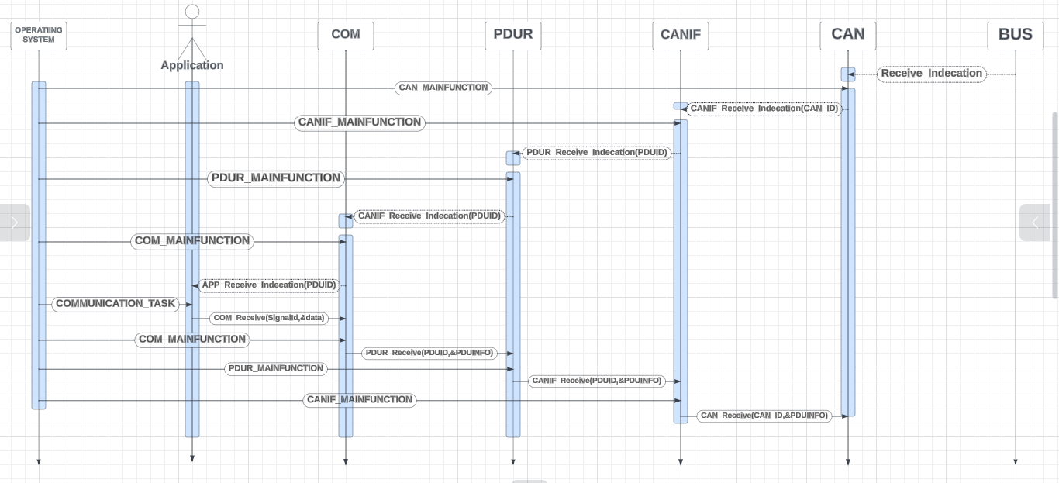

Slide 2
An Message Reach To BUS,
So It Will Request CAN To
Receive This Message.
And When CAN Main Function
Comes Will Raise The
Request To CANIF
1

Slide 3
CANIF_MAIN_FUNCTION Will Raise The Request To
PDUR.
2

Slide 4
3
PDUR_MAIN_FUNCTION Will Raise The Request To
COM.

Slide 5
4
COM_MAIN_FUNCTION Will Raise The Request To
APP.

Slide 6
5
When The Request Reach To
App,
It Will Wait To Communication Task
Come To Receive This Message
Ap

Slide 7
6
App Sends To Com Receive Function.
When Com Main Function Comes Will Send Request To PDUR.

Slide 8
7
In PDUR Main Function Will Route
This Request To CANIF.

Slide 9
8
In CANIF Main Function Will
Send Receive Function To Can.

Slide 10
In CAN Main Function Will Take
Data From The Hardware Buffer.
9

