Slide 1

COURIER MANAGEMENT SYSTEM
PROJECT MEMBERS:-
PROJECT GUIDE:-
*TAHER ALI
*SWAPNEEL SHUBHAM
*RITU VERMA
*CHANDRA SHEKHAR
* MRS. SHWETA JOGLEKAR

Slide 2
INTRODUCTION
The project is a demonstration of a data connectivity web application.
In data connectivity, user interface and the data storage are separated and handled by different languages.
The front-end of the project is “HTML” and “Css” is a very simple platform that offers interactive features to design a powerful GUI (Graphical user interface).
Backend application employed for the project is “PHP,JavaScript and MySQL”. It is widely used in the modern industries and very flexible compared to other databases.
“Courier Management System” is a comprehensive system which
Handles records of operations, Posts, Calculate Post amount, and many more. Consignments and posts details for Sending and tracking, Postage calculation and insurance for consignments .Consignment and posts details are made simply to access via creation of reports.

Slide 3
EXISTING SYSTEM
In earlier system, all the activities of the typical Courier Management systems were carried out manually.
Record Of transactions, complaints, consignment and posts details, Customer details, Employee details, Insurance details and other details and payroll were done on hard paper.
As a result, the system proved to be very much time consuming And costlier and also it lacked efficient report generation.
The overall existing system is incapable of competing in the modern world markets.
In previous there was no insurance facility available for consignments, no postage calculator available for calculating amount for consignments and posts according to its weight, height and length and according to its destination.
The overall efficiency of this system is more reliable than the previous system in terms of database coordination with the front-end application.

Slide 4
SCOPE
Goal: The aim of this project is to create a comprehensive Courier management system using data connectivity tools to efficiently handle the business and generating analysis reports.
Functions:
Maintaining Consignment and posts details, such as adding new consignments and posts for sending to its destination.
Keeping a track of consignments and posts, Delivery details and also which delivery executive is handling those consignments and posts.
Consignments Insurance for customer satisfaction and for consignments safety.
Authentication for office admin login and provides access to system rights for create, update and modify system databases.
The system will be a “Standalone Application” and not an online.(For Now)
Tables Required To be employed in the MySQL for the system.

Slide 5
PROPOSED SYSTEM
Description:-
The Proposed of system is a computer web application for the “Courier Management system” where informational data is stored and manipulated. It deals with the entities like employees, customer sender, customer receiver and so on.
Registers:-
There is no need to maintain huge visitors. As the system carries all it’s operational in a computer, the need physical registers is eliminated.
Speed and accuracy:-
The transactions speed is enhanced by the use of simple and powerful GUI (graphical user interface) and avoiding chances of human failure in typing.
Manpower:-
The New proposed system needs less manpower work and less people can do the large stuff of work in efficient manner.
Efficiency:-
Saves the data entry time and cost of manpower and work tremendous calculation in just a second.

Slide 6
Past Details:-
The Proposed system which contain the details of every record involved
In the system in the beginning. It is a type of system in which you can extract the record of the past to the beginning and also to make the updating easily and in an efficient manner.
Reduce Redundancy:-
One of the most Important feature of this system is that its reduce the redundancy of this system is that it reduce the redundancy of the data and some recording were made in the earlier in this book and thereby the books become looked mercy.

Slide 7
FEASIBILITY STUDY
Technical Feasibility:
Technical study is the analysis and diagnosis of technical component requirement, the availability and the equivalent regarding it.
1. Queries:
1. What are my hardware and these software requirements?
2. Is my current hardware is compatible with the latest or advanced system web application.
3. Is the current technical workforce is capable to handle and operate the system web application in an efficient manner.
4. Is the technical components or resources are available?
5. Does the system have efficient security?
2. Operational feasibility:
1. Is this system is compatible for and GUI (Graphical user interface) system or console based web application.
2. Is this system supporting multiple languages
3. Is it user-friendly?
4. “Does it support multi- user or is it a standalone application”.

Slide 8
Hardware Requirements
1) Processor: 32-bit, Intel-Pentium, 2.5 GHz minimum per core (If your dataset size is significantly larger than the medium dataset, we recommend 8 cores).
2) Processor Speed: 1.25 hitter or above.
3) RAM: 2 GB minimum.
4) HDD capacity: 1024 Mb minimum.
5) Monitor
6) Keyboard
7) Mouse

Slide 9
Software Requirements
1)Operating System: Windows XP and above.
2)Front-End application: HTML and Css.
3)Back-End application: PHP and Java Script and MySQL.
4) Xampp,Wamp Server
5)Notepad++, ATOM

Slide 10
ADVANTAGES
You can find all the Courier office related information without Standing in queue in the Courier office.
Manage the user details.
Admin user can have facility to reduce the chances of the duplication of the data.
Assured and speedy delivery of goods is possible.
Addressee receives the parcel at the doorstep. He does not have to travel too far in search of his parcel.
View various transactions.
Parcel can be easily dispatched because the post offices are mostly near market places.

Slide 11
DISADVANTAGES
The main disadvantages of Courier management system is a admin support.
Admin cannot book more then two Shipment simultaneously at a time for customer
Maintenance cost of the system, wear tier of the system is very expensive
It is not an online system, it is a standalone system.
Due to standalone system admin have to collect the feedback from Customer manually.
Report can be generated at the end of the day.

Slide 12
FUTURE-ENHANCEMENTS
Customer can book or use our services direct in our online portal in the next upcoming days.
Customer can have the online particular id through which a customer can book or ship more than two parcel at a time
And the delivery boy can pick the parcel from the doorstep.
Feedback can be provided by customer on our online portal directly.

Slide 13
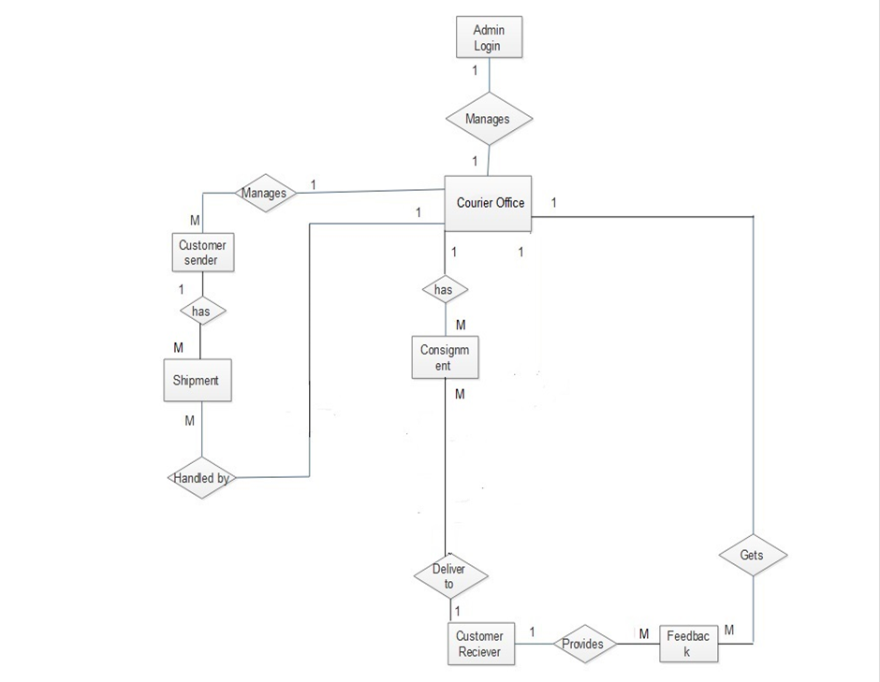
ER-DIAGRAM

Slide 14
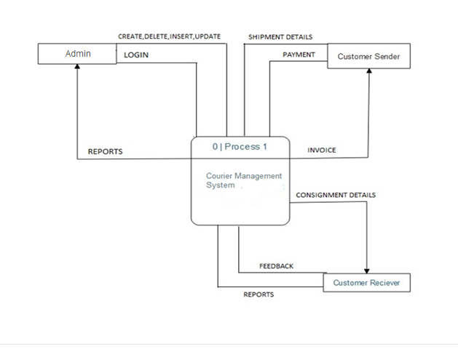
Context Level Diagram

Slide 15
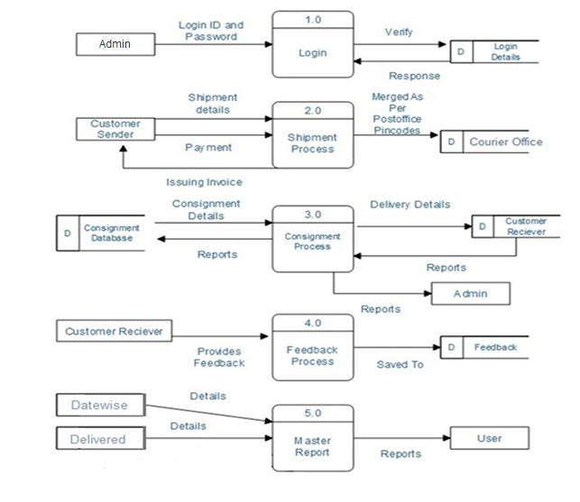
Data Flow Diagram(DFD)

Slide 16
“Thank You”

