Slide 1
Chekpoint number 1
How does the web work?
What do you need to be a web developer?
Why did you choose to learn web development?

Slide 2
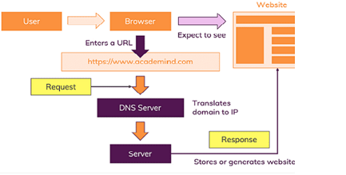
How does the web work?
when the user enter the domain name, the domain name server translate it to an IP address and this request is sent to the server of the site web next the response of the server is parsed and The page is rendered and displayed

Slide 3
What do you need to be a web developer?
To become a Web Developer, you should have an understanding of HTML, CSS, and JavaScript. It’s also recommended to learn about CSS and CSS frameworks. Developing these fundamental web development skills will give you the foundation and logic for communicating with programming languages.

Slide 4
Why did you choose to learn web development?
Nowadays web development is very necessary. Because there are lot of business running through websites which needs web developers and designers. Websites runs in every Application so it Increase the need of web development.

