Slide 1
An analysis of applications on Google Play Store
By the frontbenchers;
Pranav Bhatt, Sourav T Raveendran, Taher Taiyab Lokhandwala

Slide 2
Intro to the dataset
The dataset consists of 10000+ android apps with columns specifying app name, rating, number of installs, number of reviews, size of app, price, etc
Quite a few columns have inconsistent use of units, missing values and so on; quite a few which we have cleaned depending on cleaning.

Slide 3
Objectives
Find out the most popular categories and what categories don’t have much competition
Graph the frequencies of the ratings to show general trends
Number of installs vs number of reviews to show how the ratio changes as the installs increase
Pie chart of paid vs free apps
Our take on apps with reviews that you can trust

Slide 4
Data Cleaning
Size column: We converted KB to MB and replaced “varies with device” with NaN
Installs column: Removed ‘+’ and commas that occurred in the columns
Price column: Removed dollar symbol
Sorted the dataframe based on ‘Category’ column

Slide 5
Data Cleaning
We then also replaced the NaN values with respective mean in the Size and Rating columns, rounding to 1 decimal place.
Converted number of reviews, installs, price to numeric
Converted the version of the apps to only represent major version iterations, and ignored minor version changes

Slide 6
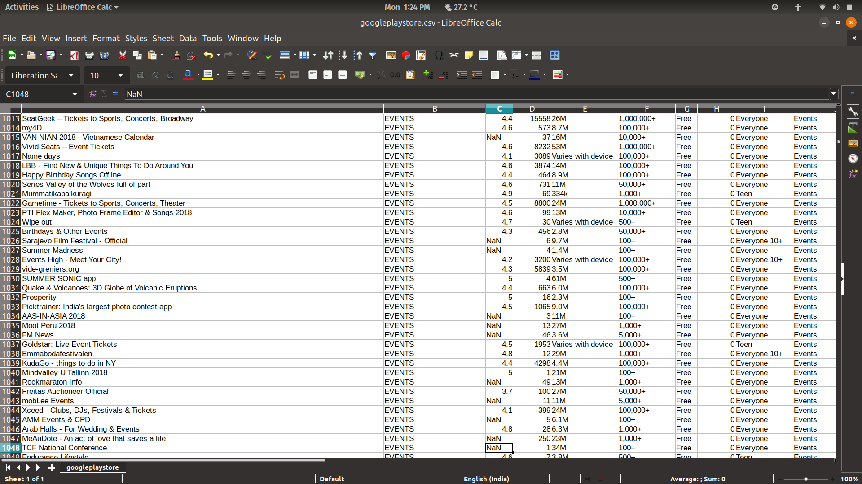
Before cleaning

Slide 7
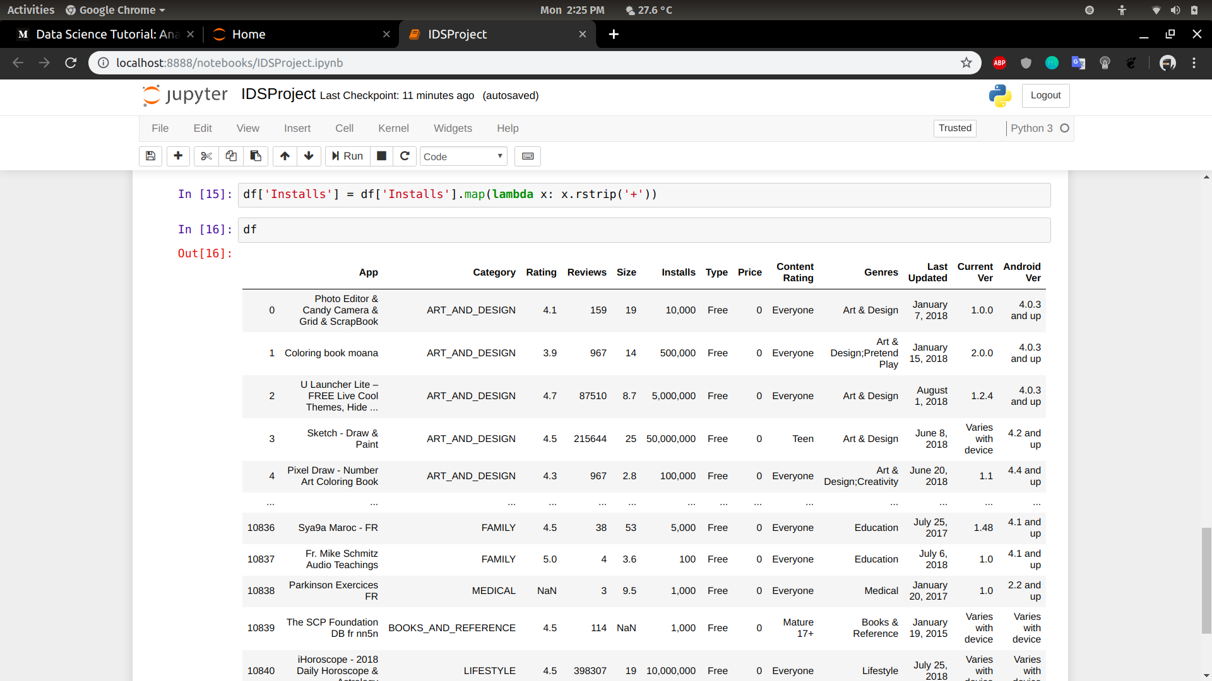
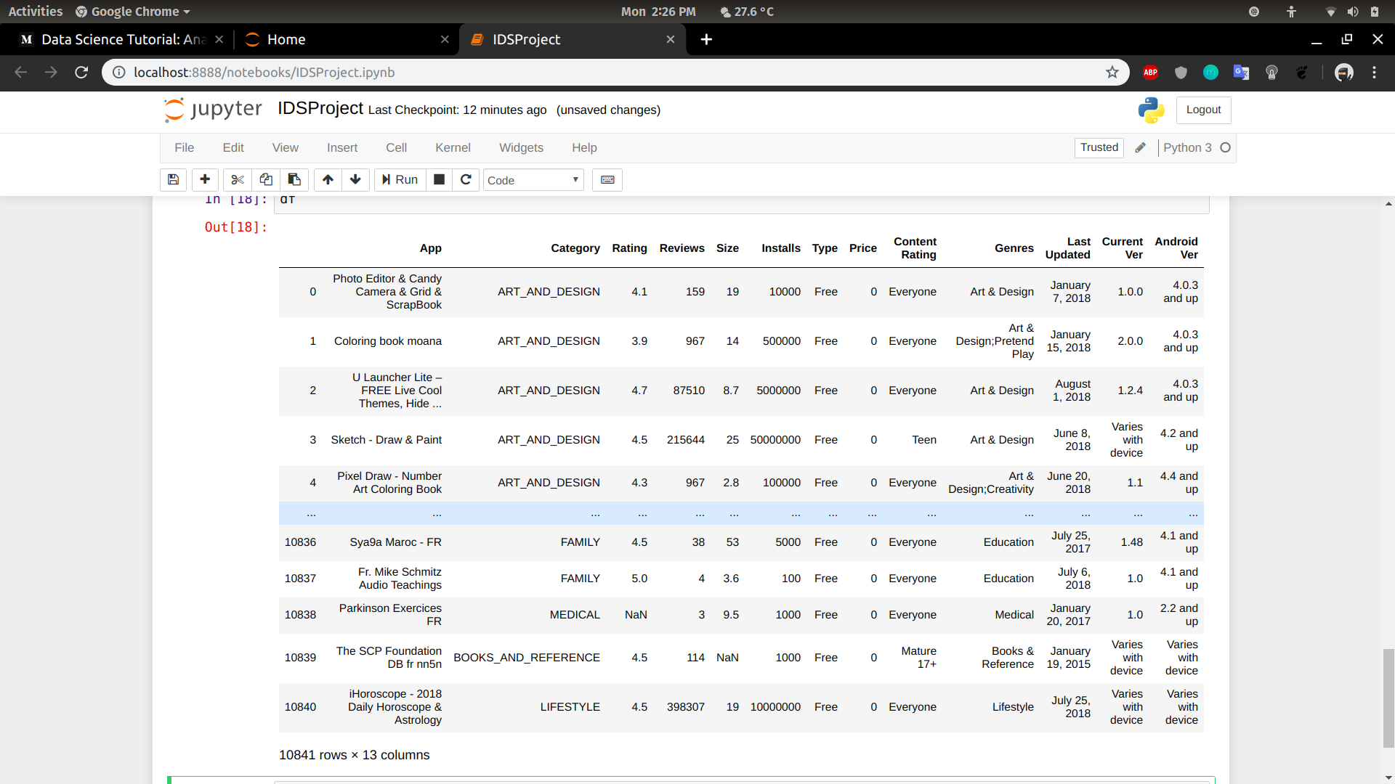
After cleaning (installs)
Removed ‘+’
Removed commas

Slide 8
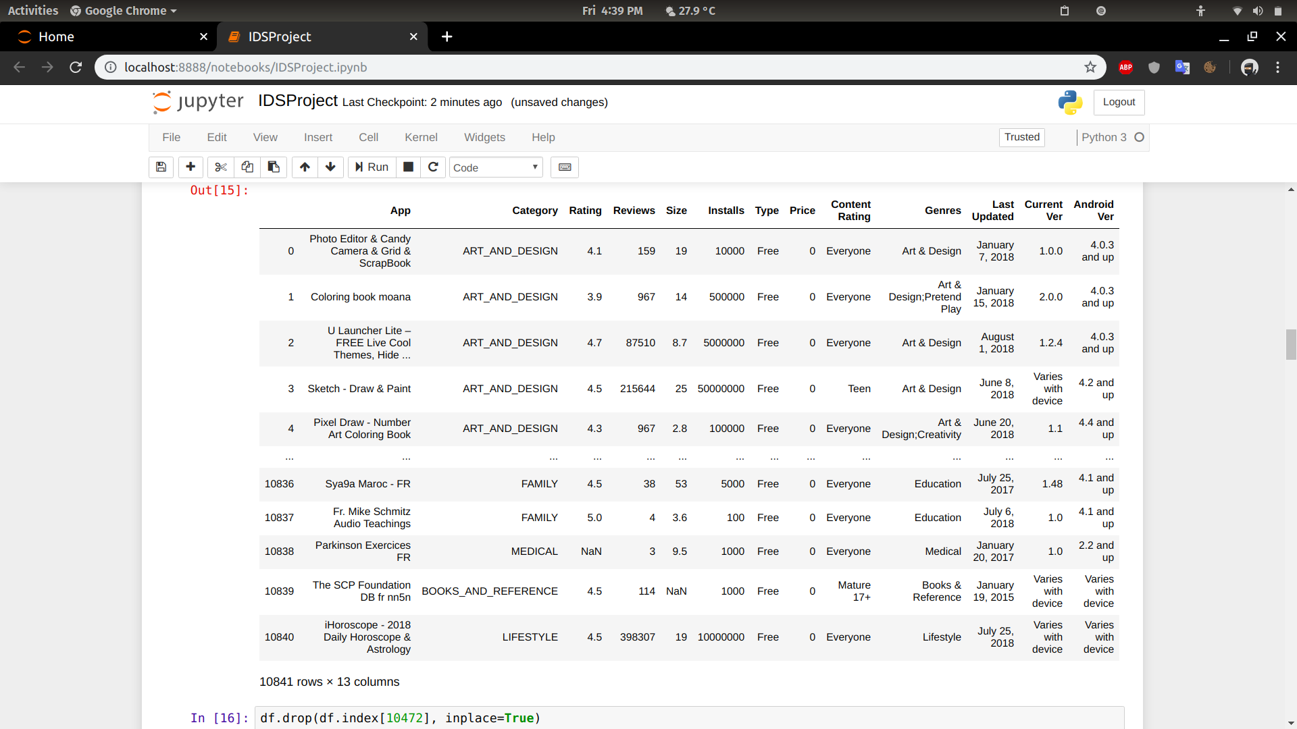
After cleaning (price)
Removed dollar symbol
Removed commas

Slide 9
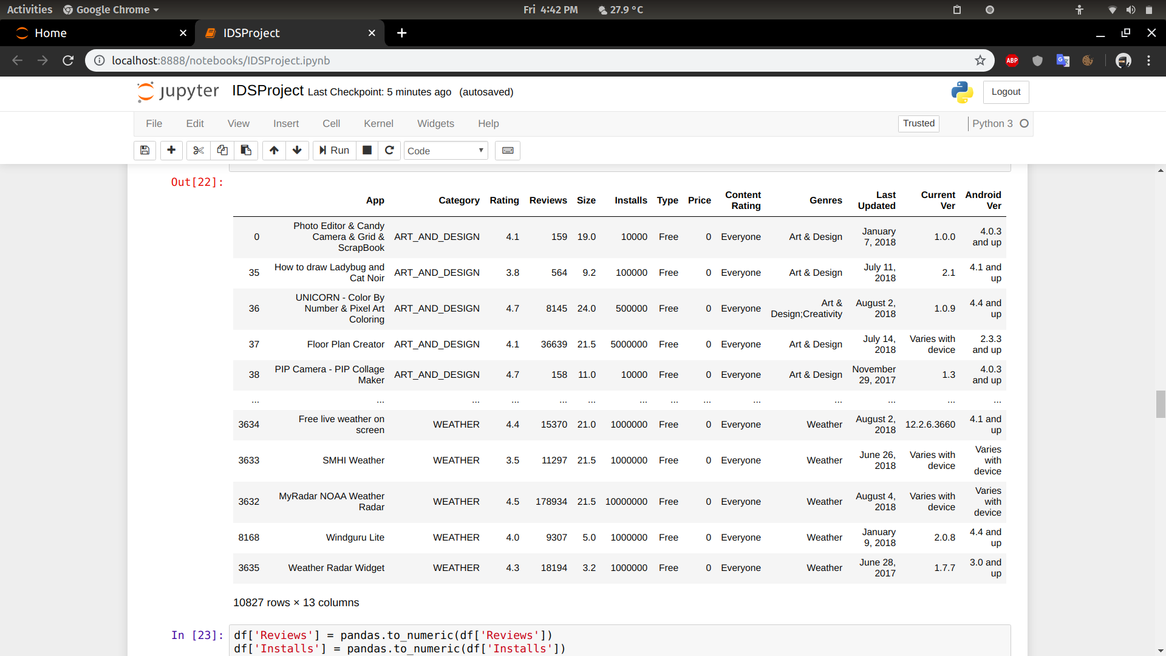
After cleaning (ratings)
Replaced NaN with mean and
rounded the ratings
Removed commas

Slide 10
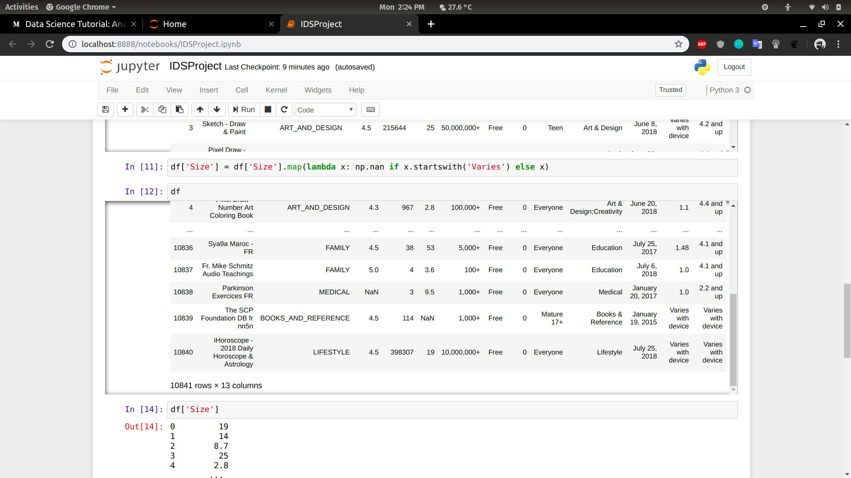
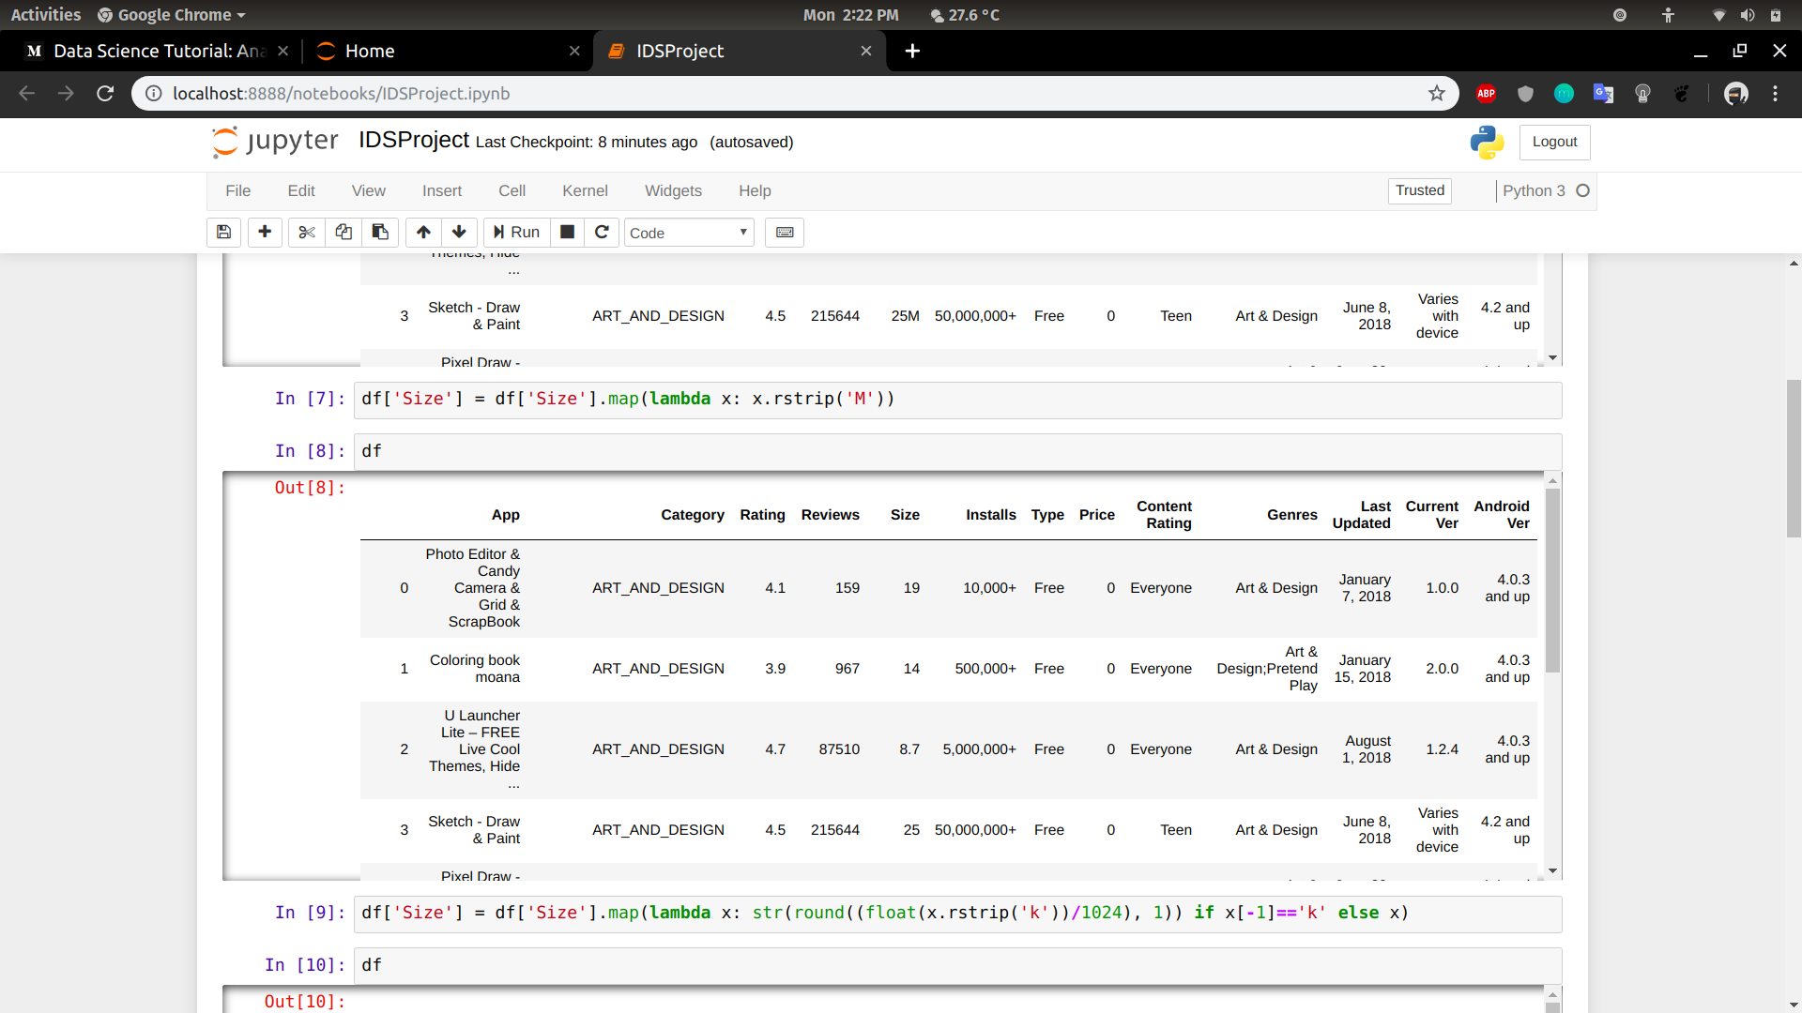
After cleaning (size)
Replaced ‘Varies’ with NaN
Removed ‘M’ and ‘k’

Slide 11
Data Visualisation
1. Find out the most popular categories and what categories don’t have much competition:
We create a bar graph consisting of the category on the y axis, and the number of installs on the x axis
From this we see that Family, Games, and Tools are the most popular categories, in that order.

Slide 12
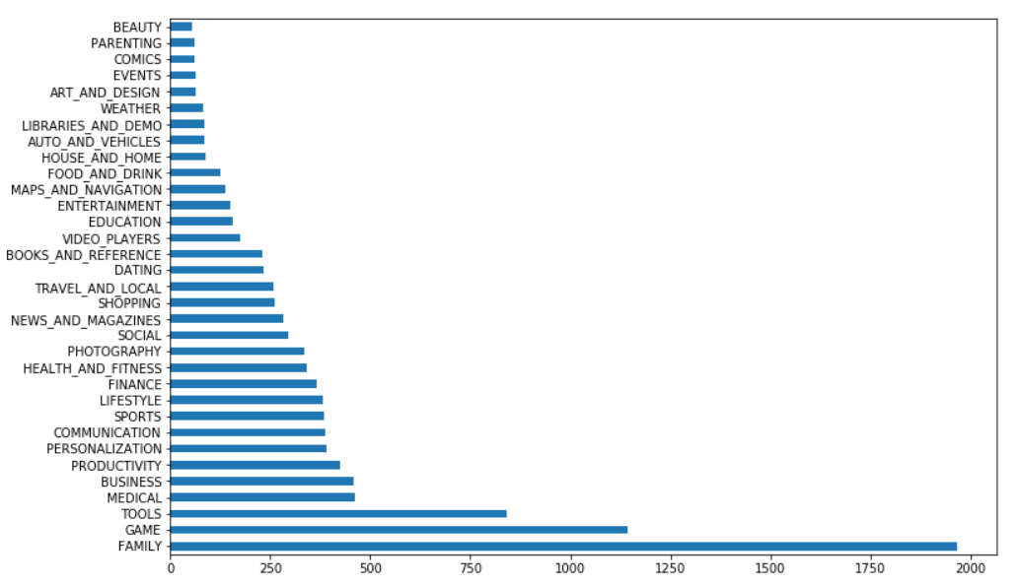
Data Visualisation
Removed commas

Slide 13
Data Visualisation
2. The distribution of apps and their ratings:
Similar to last time, we plot the number of apps on the y axis and the rating on the x axis.
We can see that most apps lie between 4 to 5 points.

Slide 14
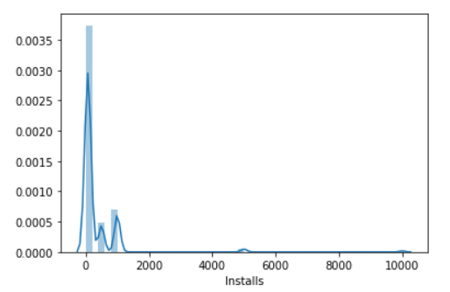
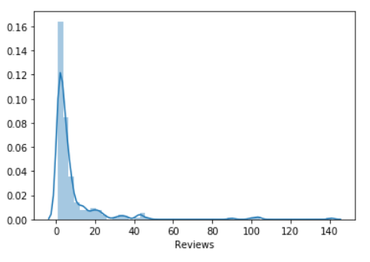
Data Visualisation
Removed commas

Slide 15
Data Visualisation
3. Paid vs Free apps:
A simple pie chart that represents the proportion of paid vs free apps
We can see that only 7.4% are paid, and 92.6% are free!

Slide 16
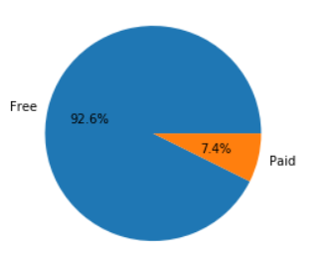
Data Visualisation
Removed commas

Slide 17
Data Visualisation
4.Trusted App:
Aims to assign a score of ‘trust’ to apps to see how much you can trust the reviews, based solely on the number of reviews.

Slide 18
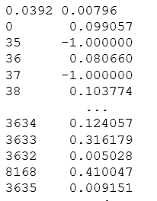
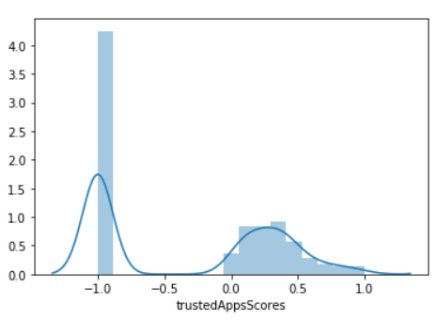
Data Visualisation

Slide 19
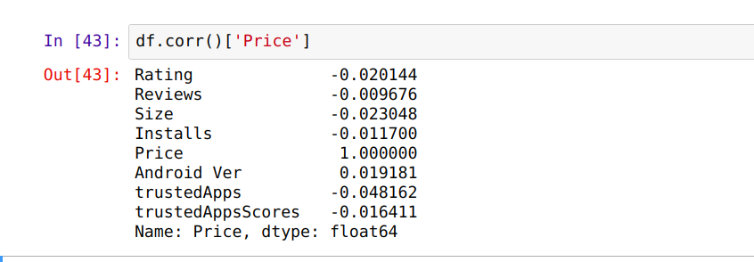
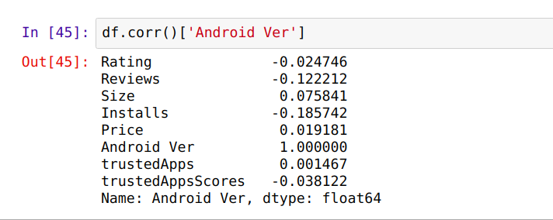
Column Co-Relations:

Slide 20
Hypothesis Testing:
Is the average rating for all apps greater than 4 stars ?
Null Hypothesis : x̄ = 4
Alternate Hypothesis : x̄ > 4
Population Mean = 4.192953
Standard Deviation = 0.479089
Z-Score = (4 - 4.192953) / 0.47908
= -0.40276
P-Value = 0.0344578
We can reject the Null hypothesis that the mean rating is equal to 4 stars. There is strong evidence in support for the alternatine hypothesis that the mean rating is, in fact, higher than 4 stars.

