Slide 1

New Product development Lifecycle

Slide 2
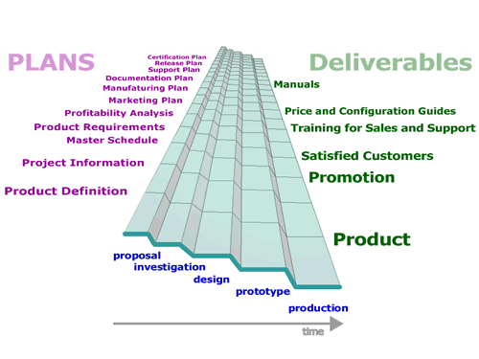
Product development methodology : generic
Proposal-Investigation-Design- ______________________ - Production

Slide 3
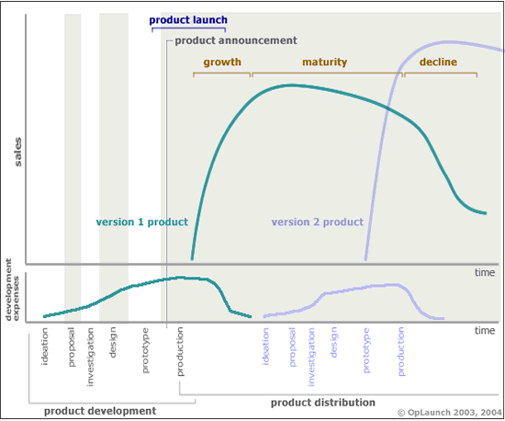
A portion of a product life cycle for a given product can be shown in a sales-versus-time graph.

Slide 4
Ensuring Development of the Next Version of Your Product ..some points
Consistently best decisions (idea creation, development & launch phases
Correct Staff
planning and development of deliverables
orchestrated launch - of the product into the target market.
  Having adequate product availability, quality, and the support criteria dictated by the market maximizes the probability of a smooth launch.
attain early product sales and growth
Maintaining high sales rates at maturity
Rapid adjustments to market and competitive factors
for obsolescence version 1 product while transitioning to the version 2 product
Maximizing harmony with vendors and partners during the transitions
Earning the customer's approval- for potential future products

Slide 5


Product Development Management decisions impact customers probability to buy

Slide 6
Product Life Cycle Management's (PLM’s) Impact on the Customer's Viewpoint
Before investing in a product, a customer may ask questions such as:
How long will it be before this product is completed?
Will it be easy to keep this product operating? For example, "Will I be able to get a replacement battery when I need it?"
Will this company be in business in a few years?
Should I wait to buy the next version of the product with more features and a lower price?
After buying and using the product, will the customer be inclined to recommend your product to a friend?
To maximize launch success, consider translating your PLM decisions into a form that will improve the chances a customer will purchase your current product.

Slide 7

There are specific checklists and deliverables that are reviewed at milestones such as the transitions between two phases of a project.

Slide 8

We can use ‘Stages and Gates’
Formal processes are used to direct the development process from ideas to launch.
Dr. Robert G. Cooper has spent more than 30 years studying the practices and pitfalls of 3,000+ new product projects in thousands of companies
(According to a Product Development & Management Association (PDMA) best-practices study, almost 70% of leading U.S. product developers now use some type of Stage-Gate process. )

Slide 9
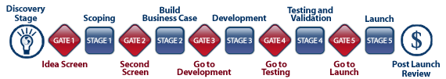
A Stage-Gate System is a conceptual and operational road map for moving a new-product project from idea to launch. Stage-Gate divides the effort into distinct stages separated by management decision gates. Cross-functional teams must successfully complete a prescribed set of related cross-functional tasks in each stage prior to obtaining management approval to proceed to the next stage of product development
http://www.prod-dev.com/stage-gate.shtml
http://www.prod-dev.com/downloads/working_papers/wp_25.pdf :gates for technology

Slide 10

What are we trying to do whilst progressing
a product development lifecycle ?

Slide 11

What are we trying to do whilst progressing a product development lifecycle ?
IDENTIFY/DESCRIBE/(ENSURE)
the customer problem solved by this product
the product from the customer's viewpoint
the financial return on investment
all the activities required to manufacture and ship the product
the internal design (such as the software language, algorithms, technology, and materials) of the product
the tests required to verify the functional requirements for software products

Slide 12
What are we trying to do whilst progressing a product development lifecycle ?
IDENTIFY/DESCRIBE/(ENSURE)
the required customer documentation (such as manuals, labels, and online help)
the after sales support requirements (such as training programs, replacement parts, and warranty plans)
the responsibilities and major activities of individuals and departments
the resources and time required to develop the product
and identify the compatibility issues between all the components of a system
and verify the quality, and regulatory requirements (such as EMC and safety testing) for hardware products
and summarize the market, sales, and support strategies
Ensure that the developer is legally compliant with patents, trademarks, and copyrights

Slide 13
Generic Product development Methodology
Opportunity
Proposal
Investigation
_____
Prototype
production
high level definition of the product
Continual Refinement of Proposal
-manufacturing process
-post-sales support strategy
-product release criteria in terms of functionality, reliability and performance
the system architecture and internal design chosen
technical feasibility of the design is proven.
Build a fully functional product
Evaluate the product in terms of usability, manufacturing and cost specifications
product is built in quantity
meets quality standards
product packaging
Execute introduction activities
http://www.oplaunch.com/formal_development_processes.htm

Slide 14

Proposal- a high level definition of the product is developed
We try to
  Describe the target users and market
  List the requirements for the product
  State the proposition
  List the critical success factors and dependencies for the project
  List the key project team members and resources
  Present a financial analysis
  Verify that all intellectual property issues can be resolved
  In the proposal phase, preliminary documents are written. In subsequent phases, these documents are refined.

Slide 15

Investigation (analysis)
We try to
  identify the intended distribution channels
  identify the characteristics of the product. This may include the industrial design (hardware) or the user interface design (software)
  Describe the documentation available to the customer (such as printed manuals, electronic manuals (in PDF format), online help, videos, CD-ROMs, web content, and certification examinations)
  Describe the manufacturing process
  Specify the post-sales support strategy for the product. This may include a list of replacement parts, an overview of training programs, and required regional modifications (such as multiple language options).
  Define the product release criteria in terms of functionality, reliability and performance

Slide 16
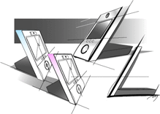
Design
Refine previous docs/deliverables.
The system architecture and internal design are chosen so that all the requirements can be met. The technical feasibility of the design is proven. The product definition is validated with customers.
New documents should:
  Describe how the components will be tested
  Describe the required regulatory criteria (for hardware products this may includes environmental, EMC, and safety testing)
  Specify the acceptable system performance criteria >
Cell phone giant Nokia collaborated with industrial design students from Central Saint Martins College of Art and Design in London to come up with a cell phone of the future- Daniel Meyer was proclaimed the winner, with-
a phone that would double as a stand-up picture frame. -Her design uses sight, smell and touch. This phone is intended to detect and emit odor, as well as radiate colors, light and temperature from the caller’s environment. .. http://www.techshout.com/category/mobile-phones/

Slide 17

Prototype
Further refinement of previous docs/deliverables.
includes the following new activities:
  Build a fully functional product (remember invention)
  Test the product's capabilities and features
  Evaluate the product in terms of usability, manufacturing and cost specifications
  Conduct regulatory tests

Slide 18

Production
During this phase, the product is built in quantity.
Before the product is shipped to customers one must:
  Verify that the product meets all quality standards
  Confirm that the documentation is complete and ready for duplication
  Confirm that all sales and support programs are ready
  Finalize product packaging
  Execute introduction activities (this can include advertising, press releases, and other promotions) >

Slide 19
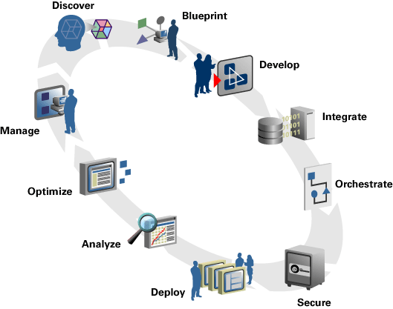
Software
Web development is a process that ends with an application also known as software
Software is therefore a Product
There are many specific Software development methodologies
Eg. Prototyping, waterfall, v-model, spiral, agile programming, phased and iterative etc

Slide 20
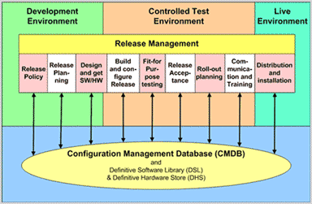
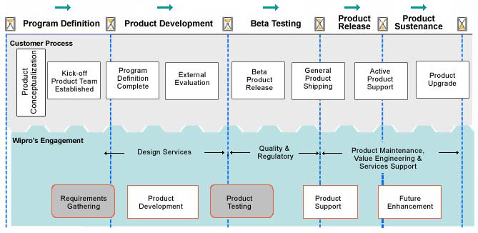
Software release management

Slide 21
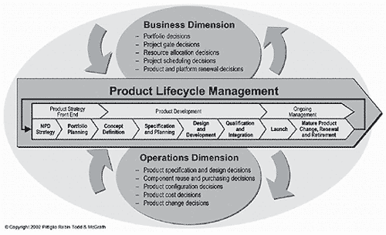
Product Lifecycle Management by PDMA
www.pdma.org

