Slide 1
Investigation into network security countermeasures
Purpose: To demonstrate the setup and configuration of a secure network environment, which includes the OpenSSH server, the Cowrie honeypot, and the iptables firewall.

Slide 2

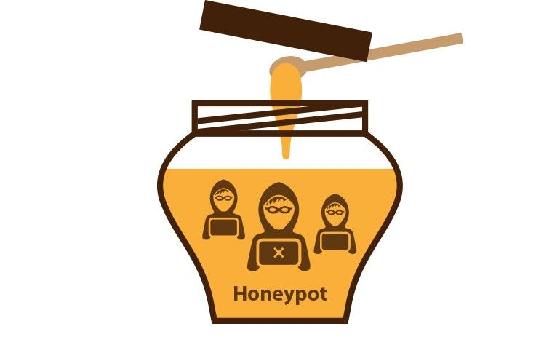

logical/conceptual diagram of the Implemented System
IP address: 192.168.0.102
Client Machine
e.g. Kali
Firewall
Allow the incoming traffic of OpenSSH(port:2220 and Cowrie(2222).
Block the other traffic
IP address: 192.168.0.100
Cowrie Honeypot Port : 2222
Open SSH Server Port : 2220
Implement two users root and staff
Cowrie honeypot will simulates SSH activity and records all actions.
Implement key base authentication
Disable the password login
MFA authentication
Target Host e.g. Ubuntu

