Slide 1
Networking Technologies - Assignment 2
Name: Tahiatul Jannath Bhuiyan
ID: 10637997

Slide 2
The link I’m using
http://watin.sourceforge.net/

Slide 3
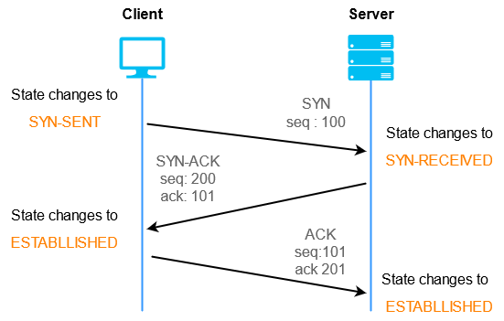
TCP handshake process

Slide 4
Header Length and Payload Calcultion
IP header length+ TCP header length+ payload = total length

Slide 5
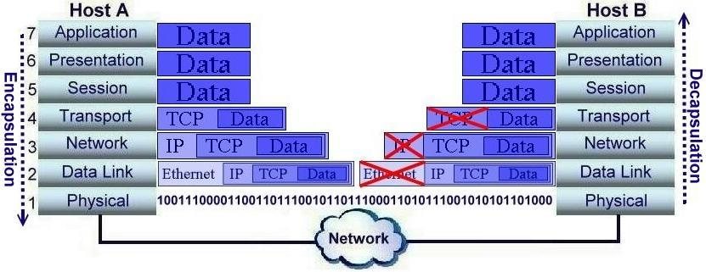

Slide 6
variations in sequence numbers, acknowledge numbers and window size
Sequence Numbers are used to maintain the order of transmitted data segments
Sequence numbers are attached to the segments by the sender and help the receiver to reassemble the data in the correct order.
Acknowledgment Numbers indicate the sequence number of the next expected data byte. They are included in the TCP header of the acknowledgment segment sent by the receiver. Acknowledgment numbers inform the sender about the successful receipt of the data up to the acknowledged sequence number.
Window Size specifies the amount of data that can be sent before requiring an acknowledgment from the receiver. It plays a crucial role in flow control, allowing the sender to adjust the rate of data transmission based on the receiver's capacity to process data.

Slide 7
When Congestion happen
When the number of packet send by the sender is greater than the capacity of the network, and it create network traffic or blockage.

Slide 8
3. Could we determine the expected acknowledge number for a packet with known sequence number and total length? How?
Yes, it is possible to determine the expected acknowledgment number for a packet with a known sequence number and total length in the context of TCP (Transmission Control Protocol) communication. The acknowledgment number in TCP is always the next sequence number that the receiver is expecting to receive. To determine the expected acknowledgment number:
Known Sequence Number: Start with the known sequence number of the packet you are interested in.
Total Length of the Packet: Determine the total length of the packet, including both the header and the data payload. This can be obtained from the TCP header's length field.
Compute the Acknowledgment Number: Add the total length of the packet to the known sequence number. The result would be the acknowledgment number that the receiver is expecting after receiving the packet.

Slide 9
If congestion happen
Sequence Number: During network congestion, sequence numbers may still increase, but the rate of increment might become irregular or delayed. This behaviour can occur due to packet retransmissions, segment losses, or network delays caused by congestion. As a result, the sequence numbers might not be in consistent progression.
Window Size: During congestion, the window size is expected to decrease. This reduction in the window size serves as a congestion control mechanism to prevent the sender from overwhelming the network or the receiver with an excessive amount of data.

