Slide 1
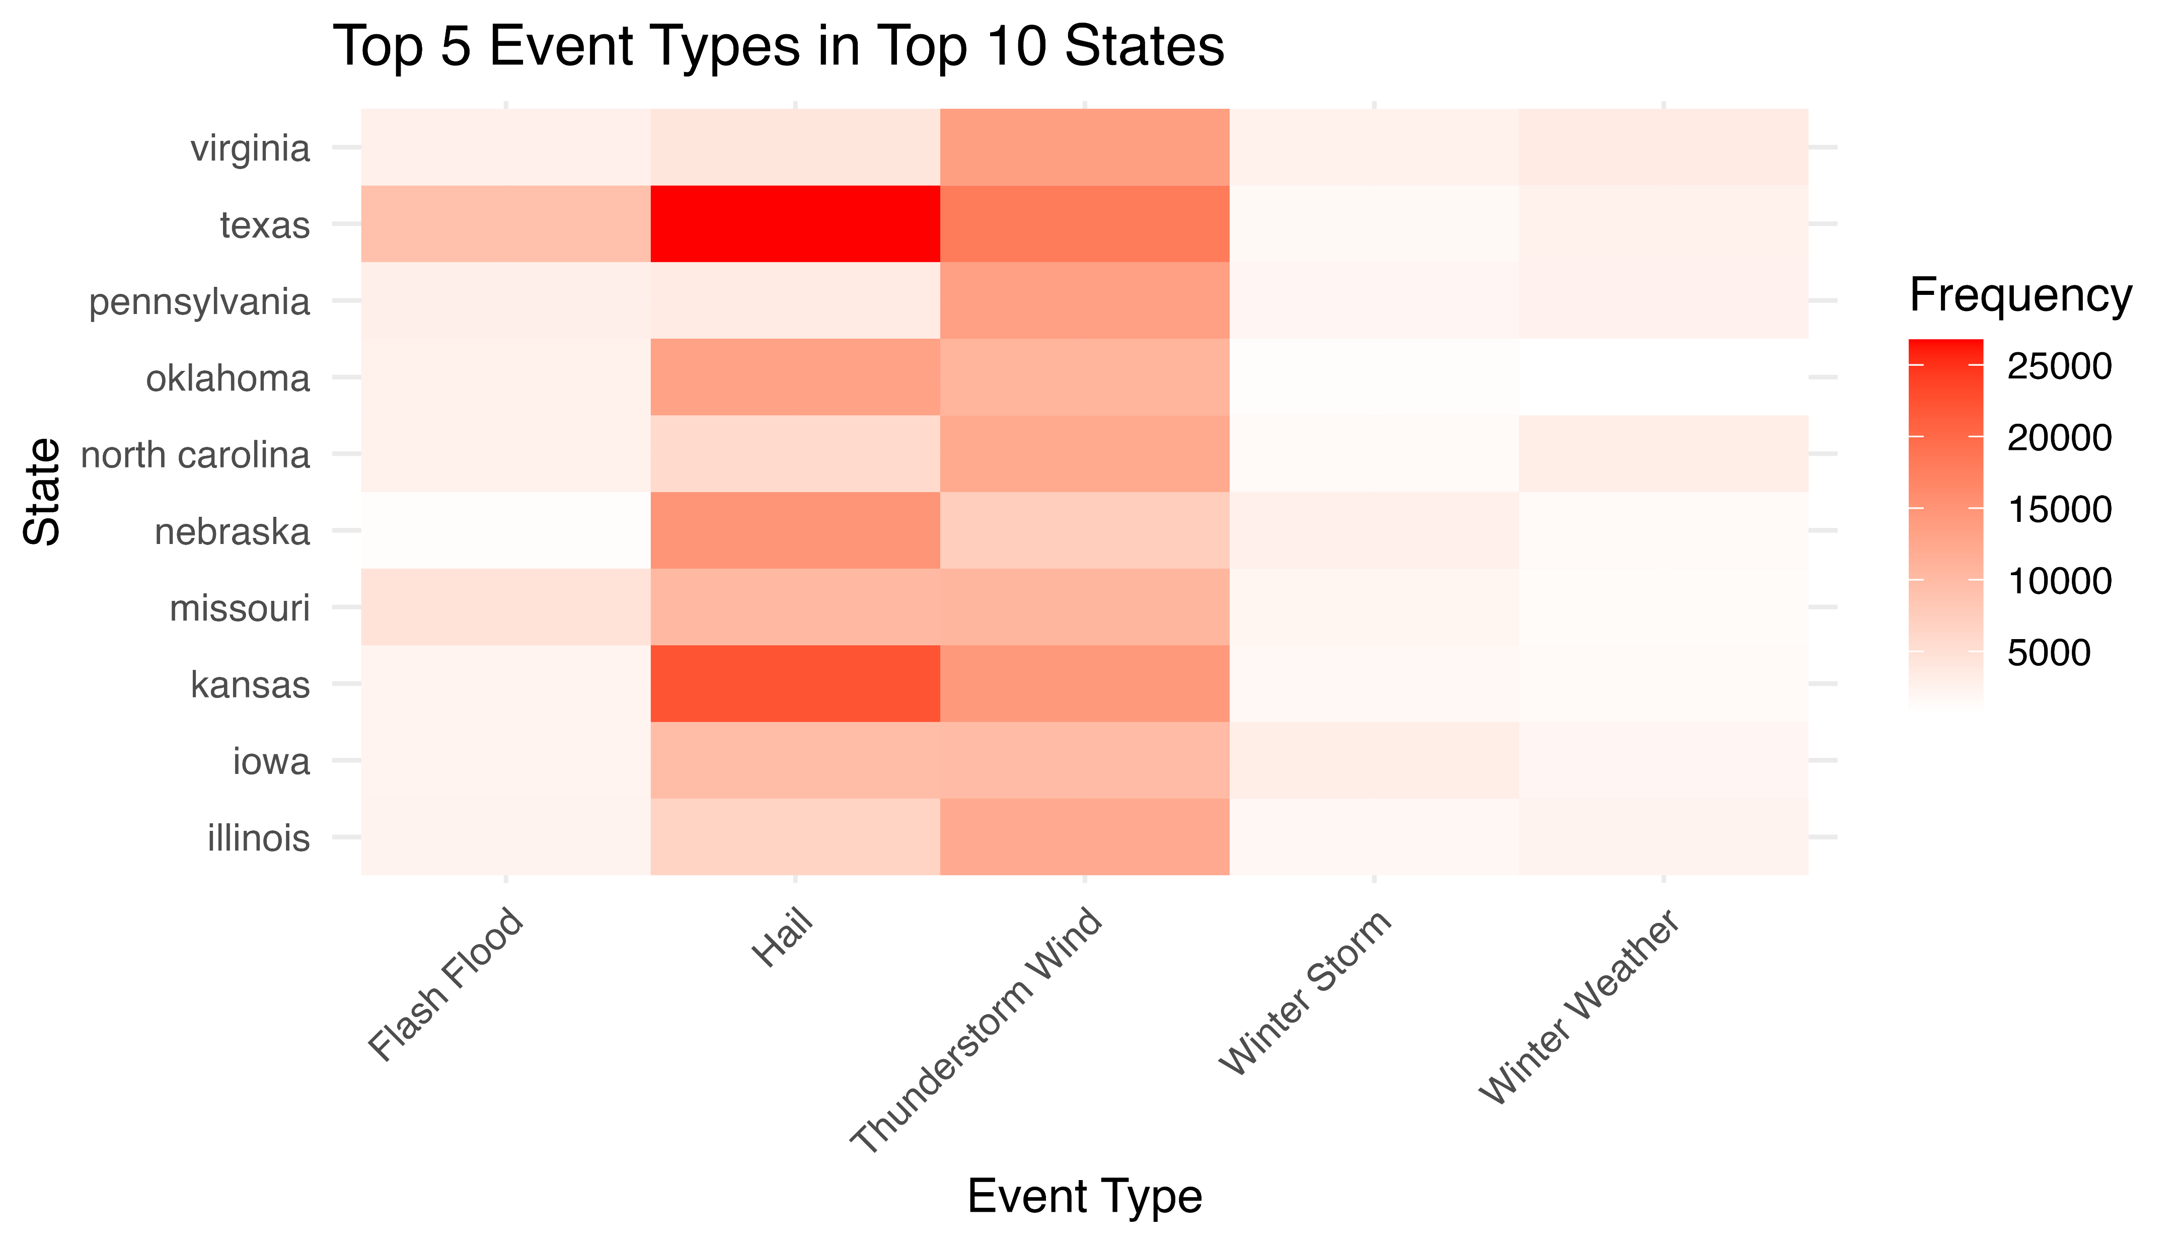
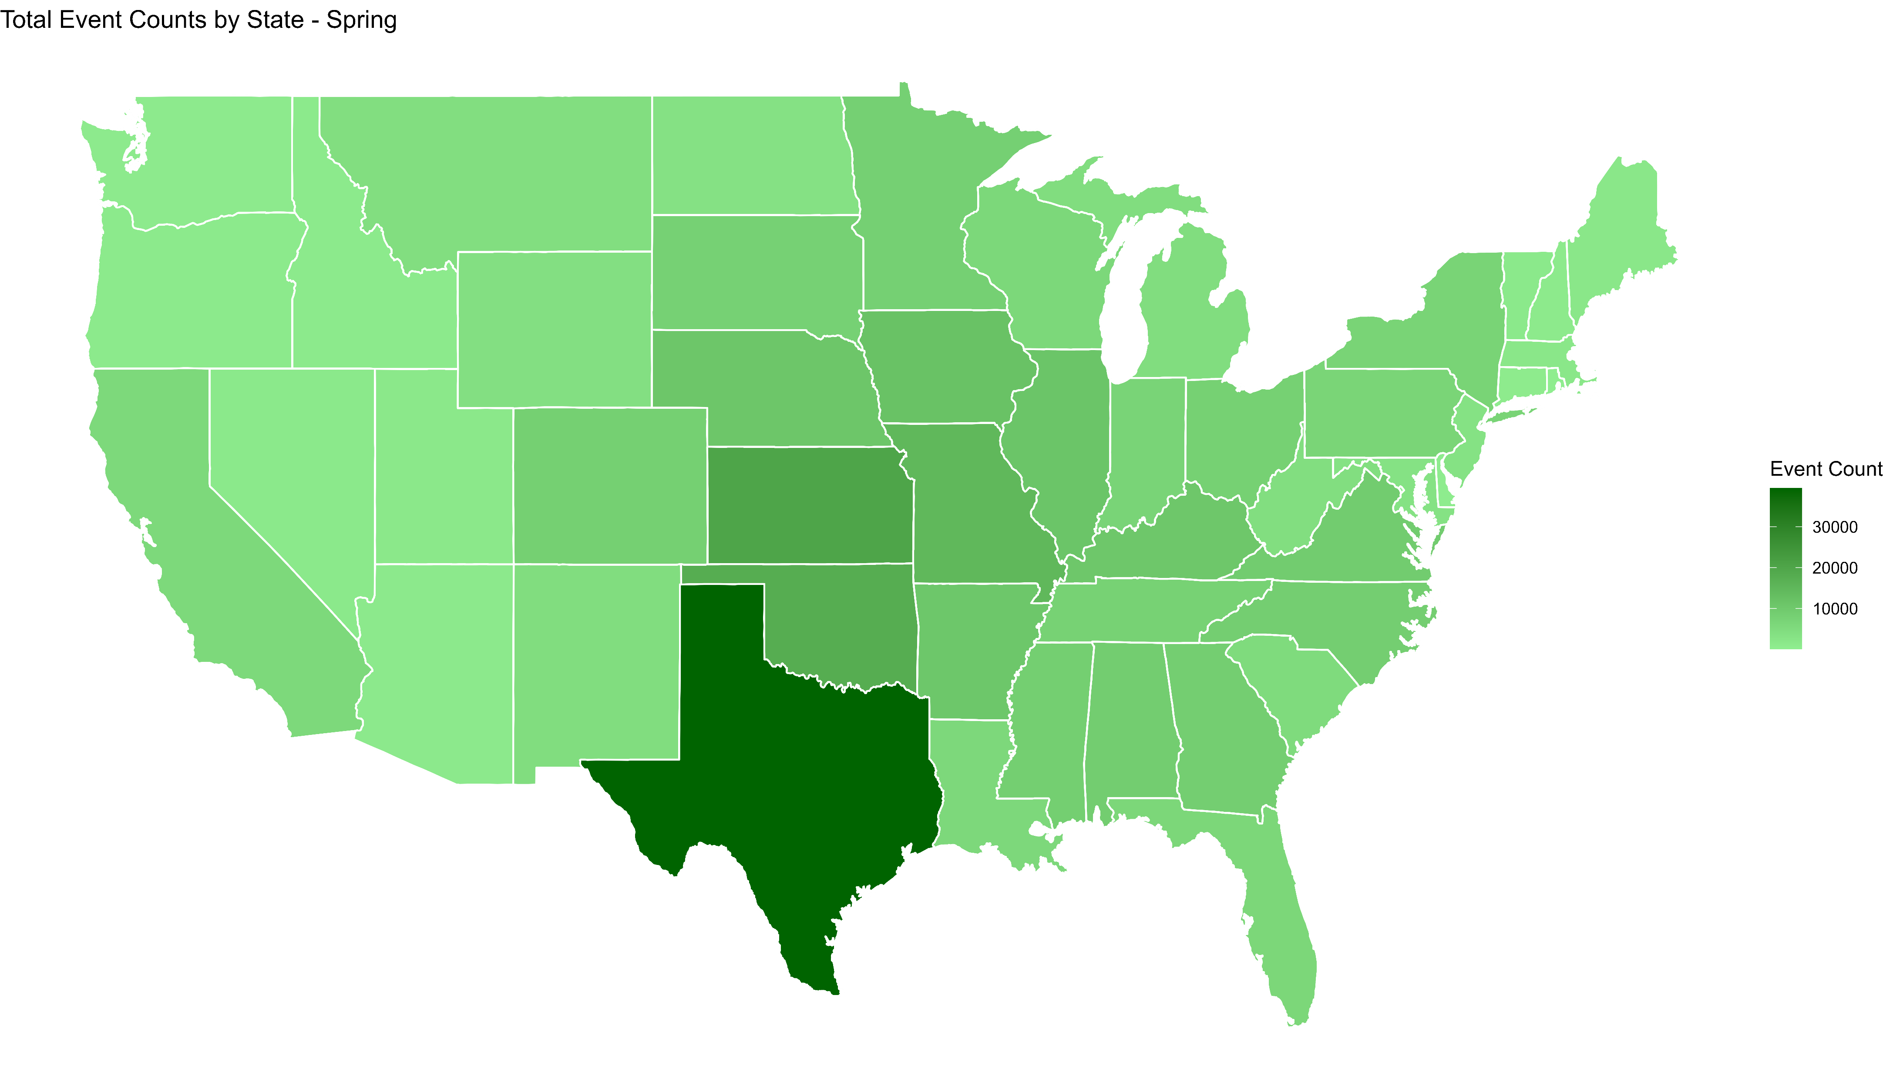
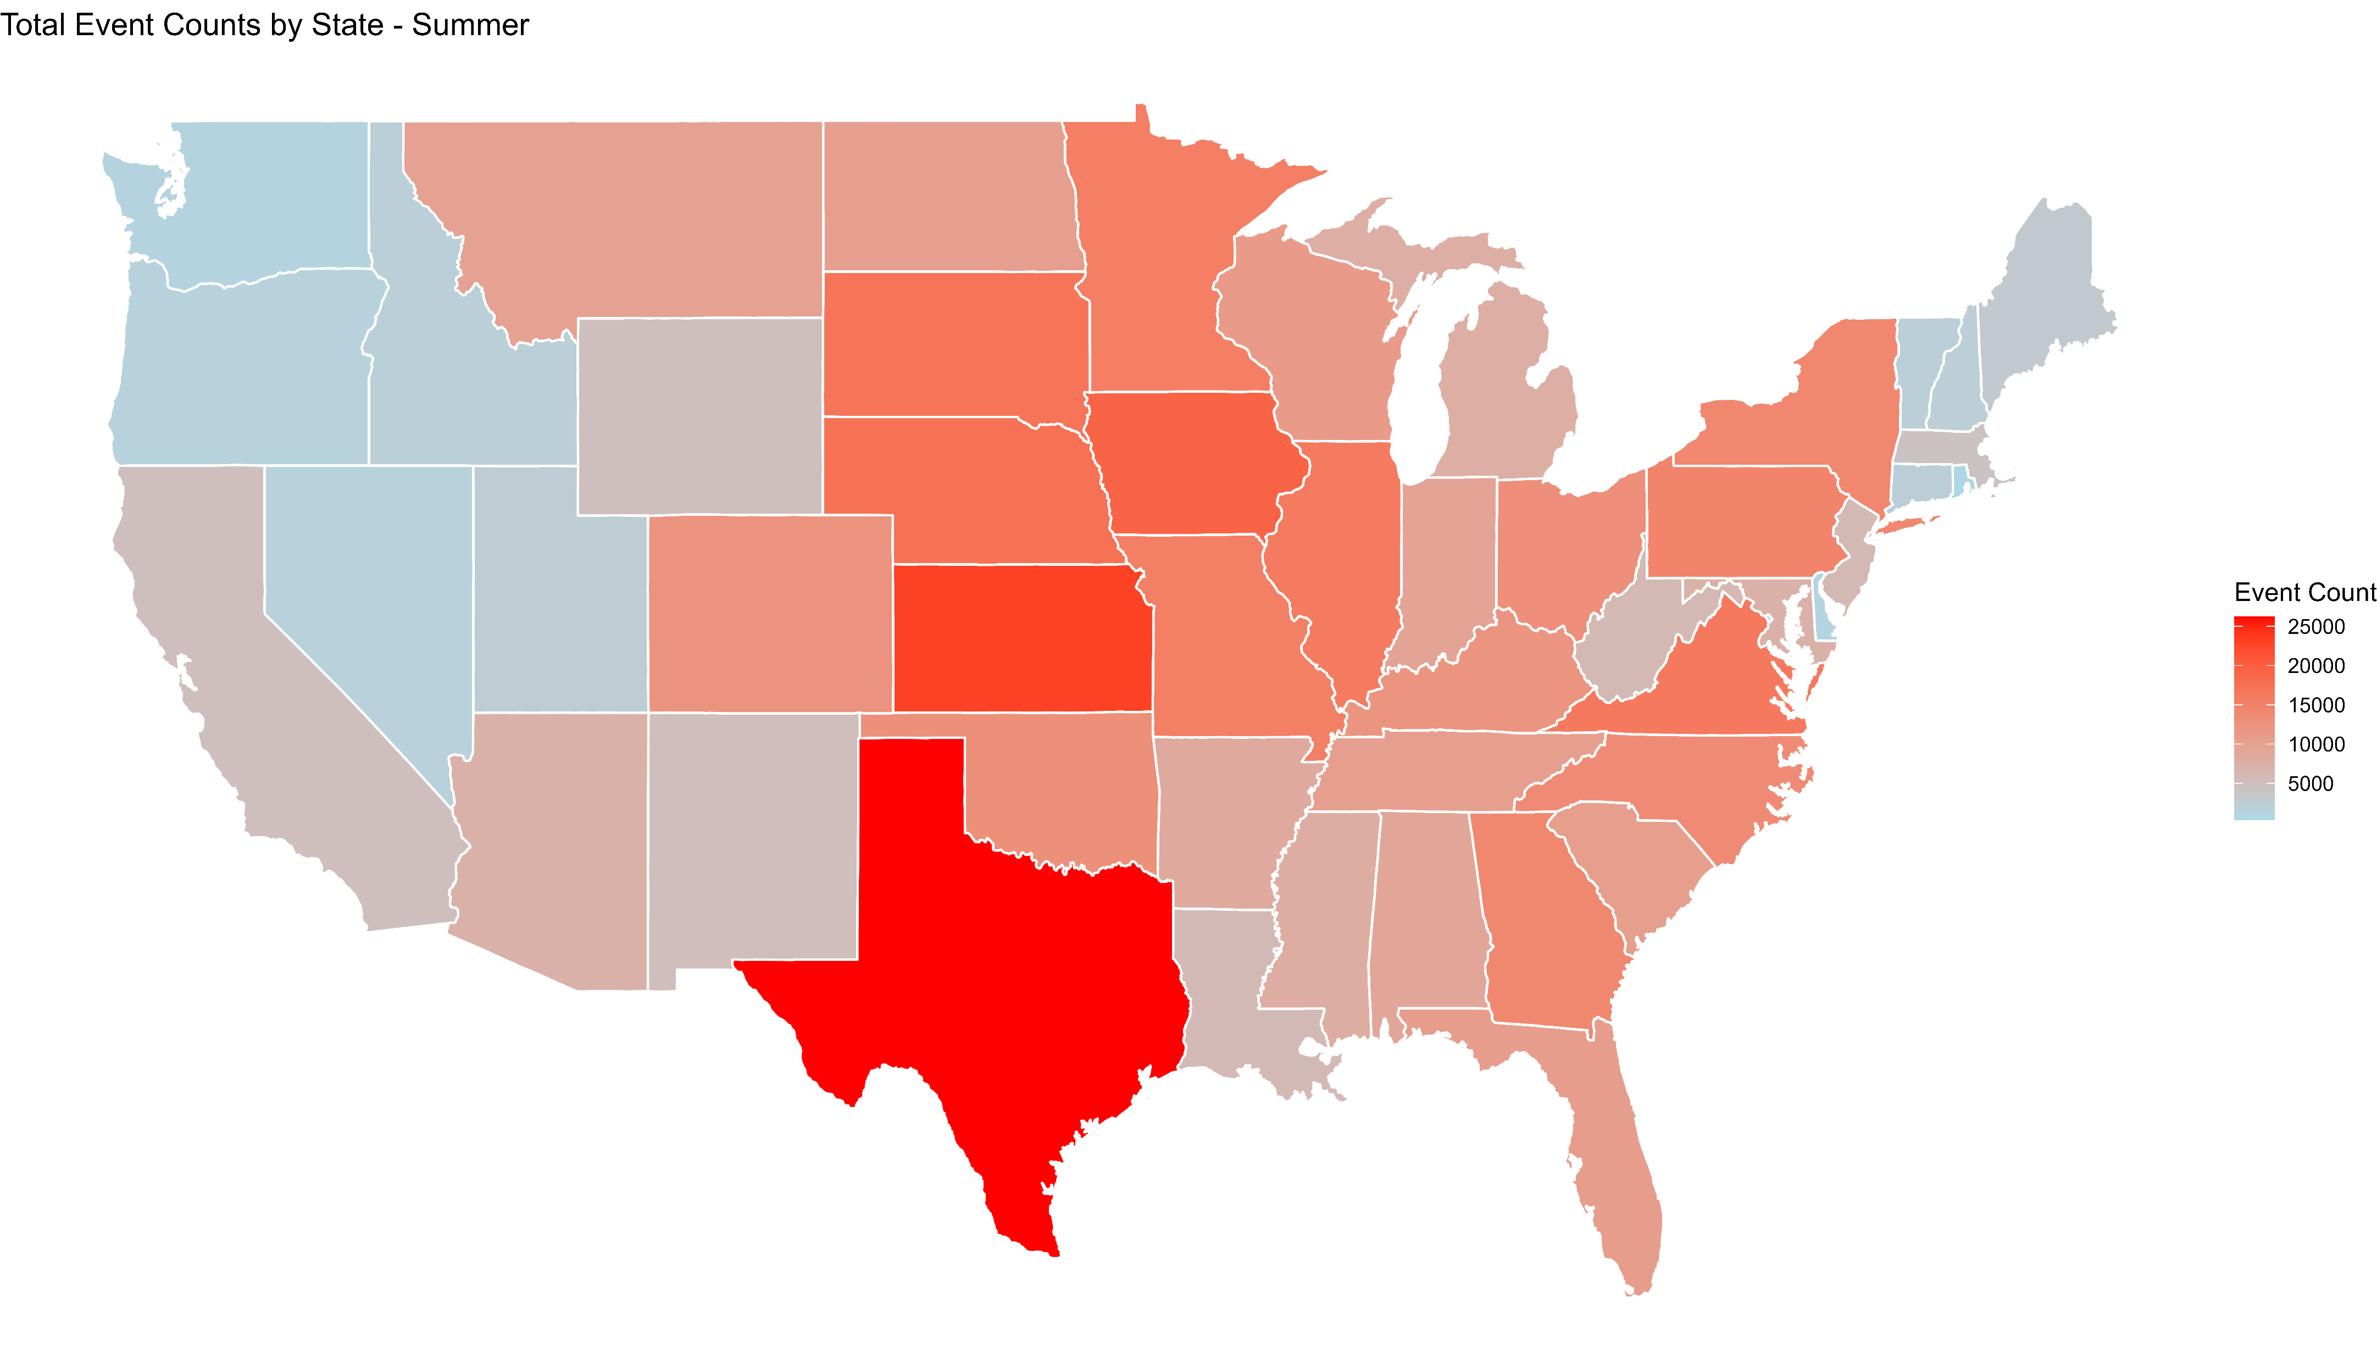
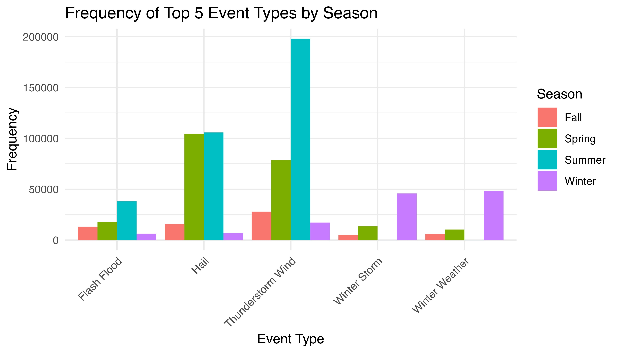
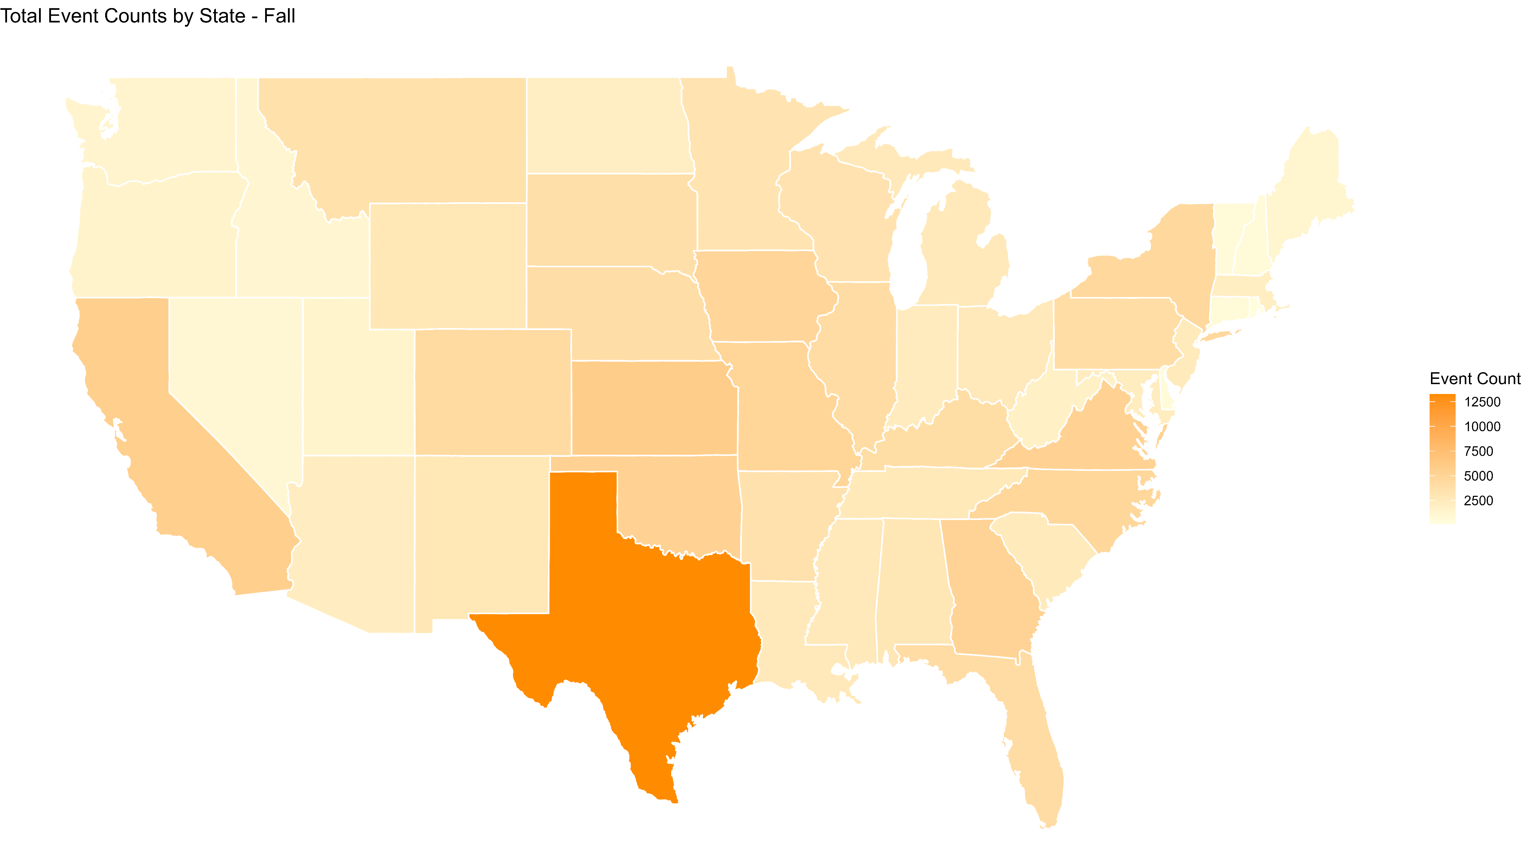
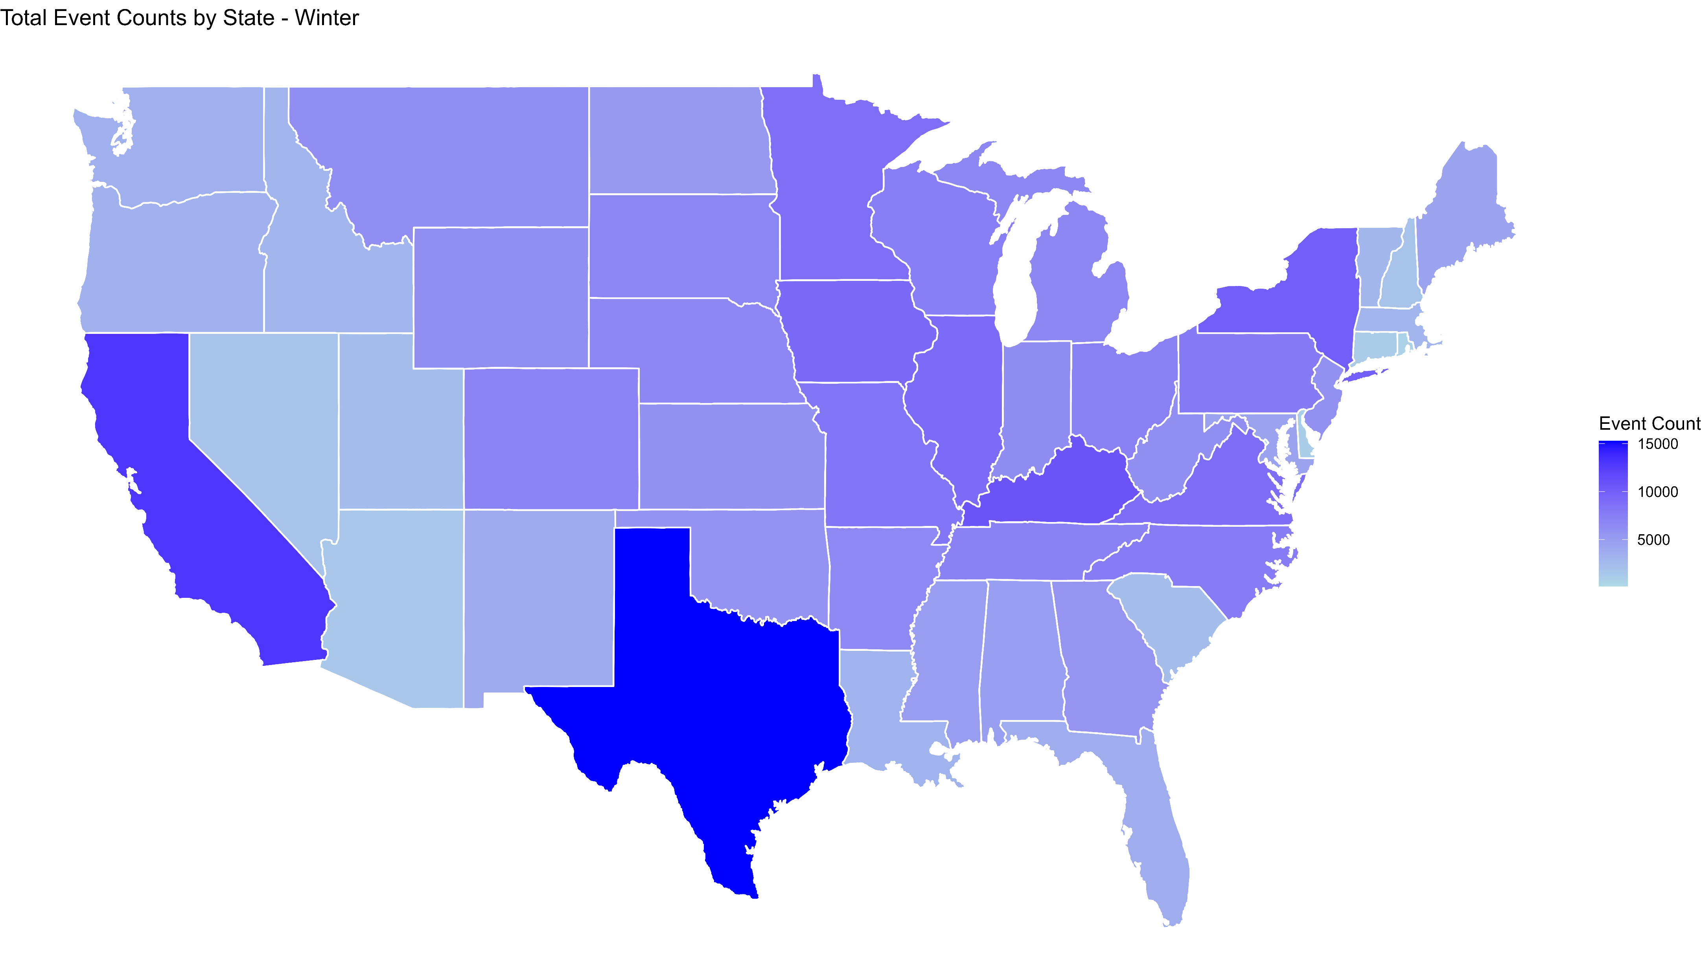
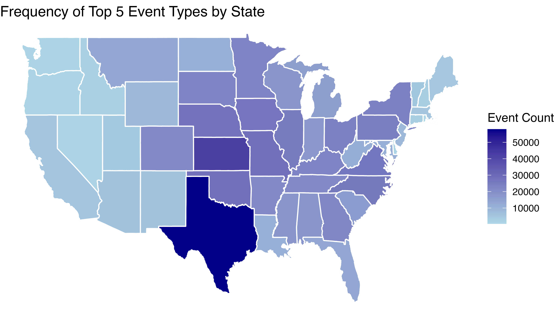
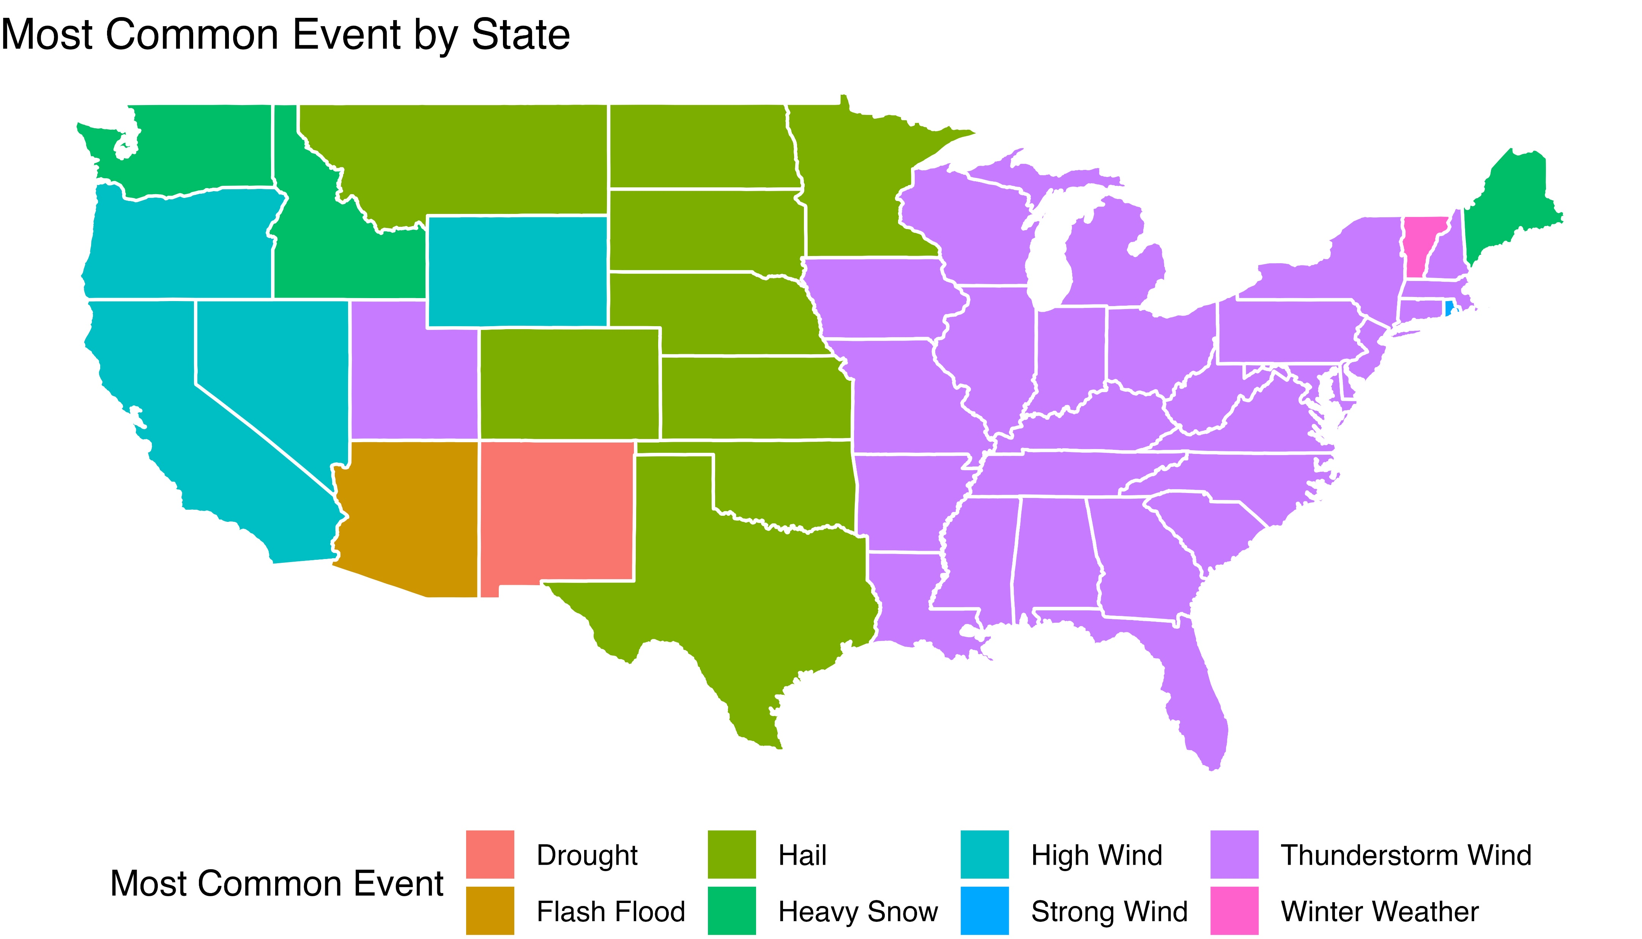
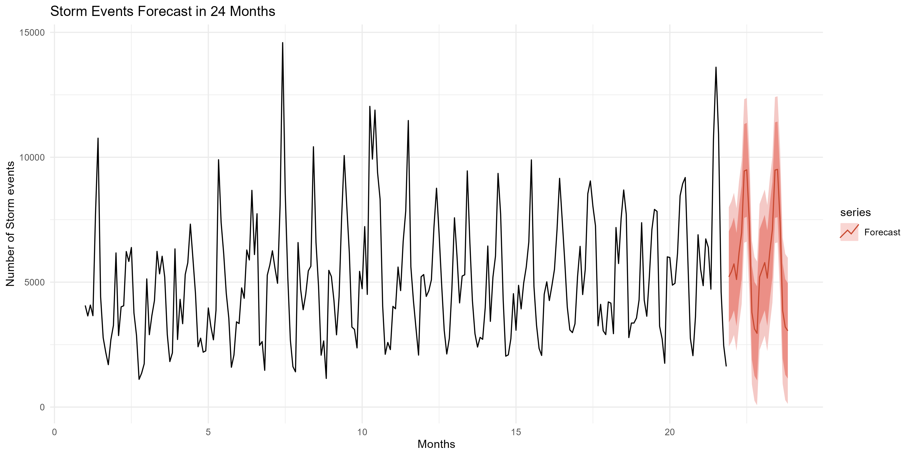
Storm Dynamics:​ An Analysis of Impact, Trends, and Predictive Patterns of storm events Across the USA​ Drafted By: Reyhaneh Bolouri, Md Tahidul Islam, Sai Varsha Sreeperumbudur​
Overview
Storm events have always had a significant impact on human lives, property, and agriculture across the USA. This study analyzes the temporal and spatial patterns of these events using data from The National Oceanic and Atmospheric Administration (NOAA) Storm Events Database, which logs significant weather events from January 1950 to present, capturing impacts on life, property, and commerce. Employing data preparation, time series analysis, and dynamic mapping methods, we looked for geospatial maps and tried to identify trends to enhance our understanding of storm dynamics and provide insights for future forecasting.
Future Directions
In our project, we utilize ARIMA modeling to forecast storm patterns for the next three years, exploring the relationship between global temperature shifts (data to be sourced) and storm dynamics in the U.S. We aim to identify correlations and insights into future weather patterns

