Slide 1
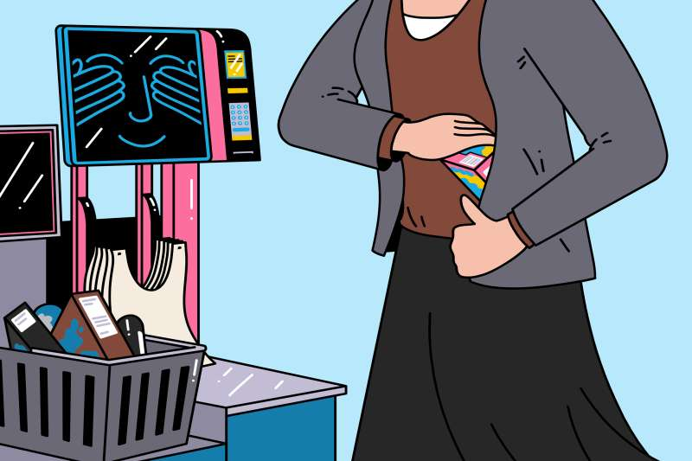
Developing ML Models for Fraud Prediction in Self-Checkout Transactions​

Slide 2








Who Are the Victims?

Slide 3
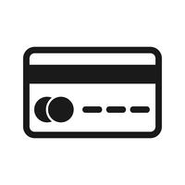




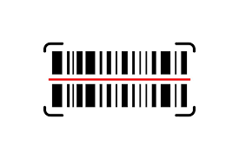

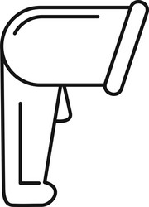
Description of Dataset Variables
Understanding Key Attributes
Modified Quantities: The number of modified quantities for the scanned products.
Credit: High or Low
Duration: the time in seconds between the first and last scans.
Fraud: Whether the purchase is fraudulent or not.
Total: the total amount of all scanned and not cancelled products
Scan: The number of all scanned and not cancelled products.
Voided Scan: The number of voided scans.
Attempts to Scan:The number of attempts to activate the scanner without scanning any products.

Slide 4
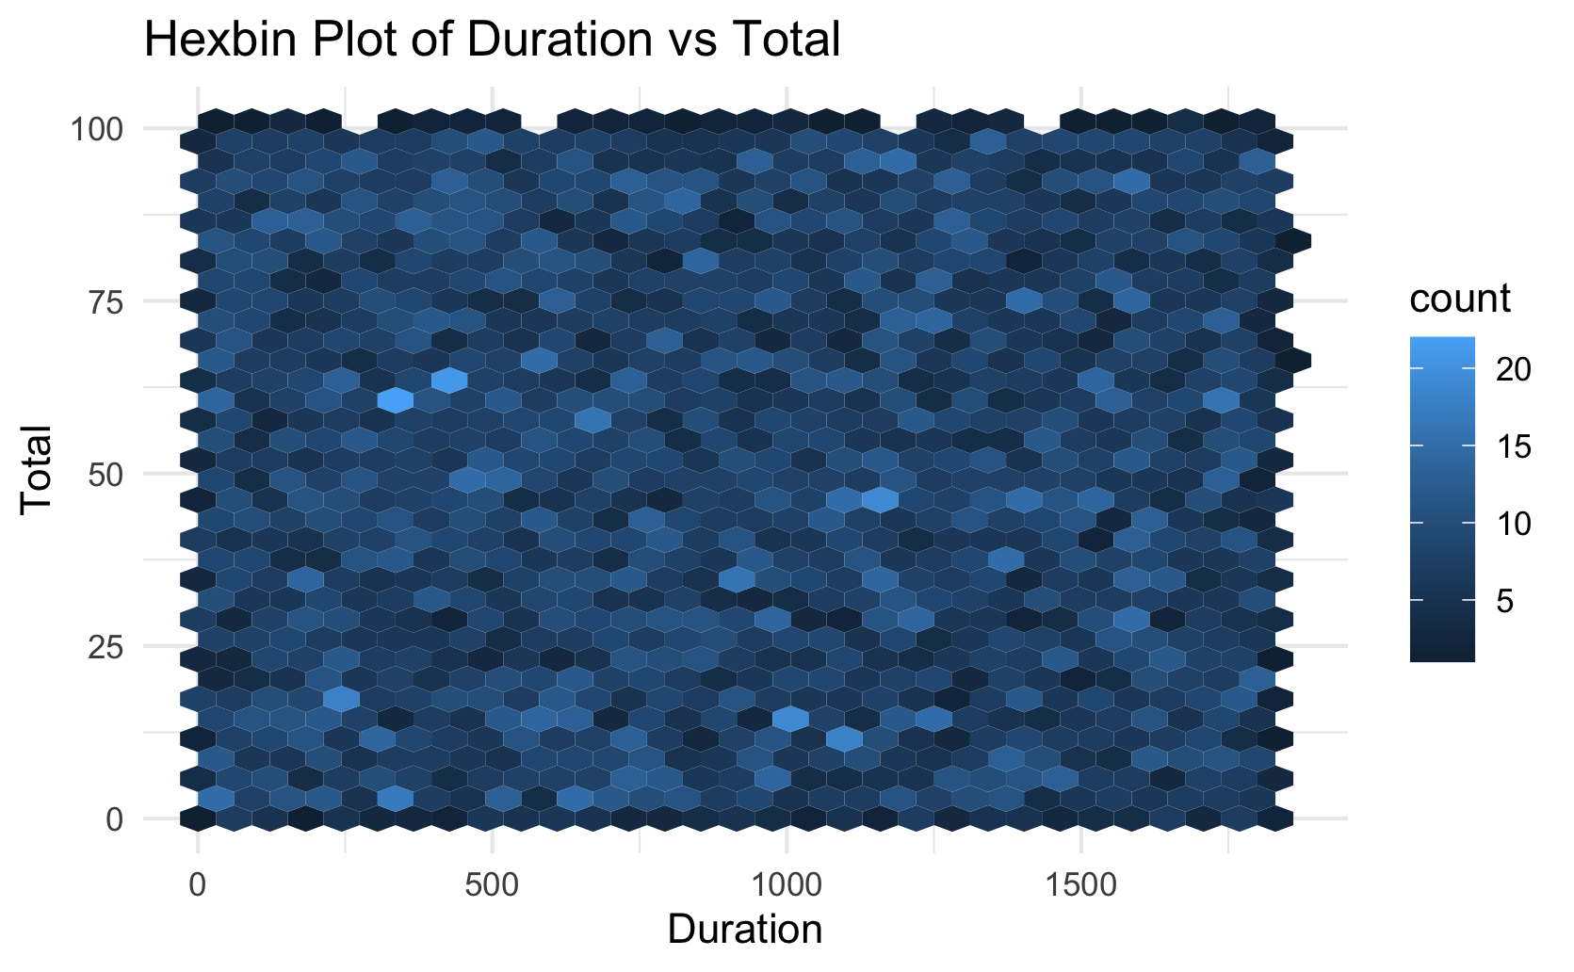
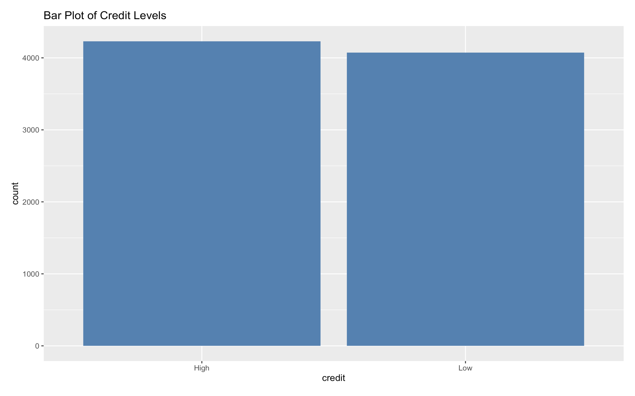
Data Exploration and Visualization

Slide 5
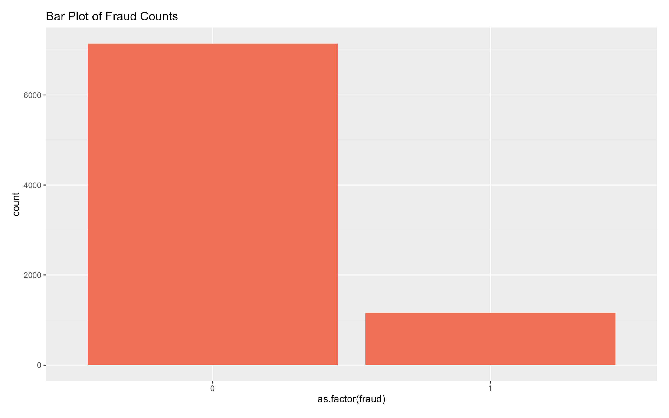
Data Exploration and Visualization

Slide 6
Handling the Unbalanced data
Fraud and non-fraud ratio is 6:1
Upsampling and Class Weights

Slide 7
Feature Engineering
Interaction between duration and total
2. Ratio features between scans and total
3. Ratio features between voided scan and scans
4. Adding a composite risk score on voided scans and attempt without scan.

Slide 8
Design Matrix

Slide 9
Validation Approach for Machine Learning Models
Why validation approach:
i. Ensures model performs well on unseen data
Ii. Prevents overfitting
Iii. Helps in tuning model parameters
Validation Techniques Overview:
i. Holdout Method
Ii. K-Fold Cross-Validation
Chosen Validation Method: K-Fold Cross-Validation
i. Number of folds is 5
Ii. AUC-ROC curve by pROC package

Slide 10
Model Selection and Parameter Tuning
Score | algorithm | Tress | Parameter tunning (Best tunning ) | Validation
0.964317 | SVM | it use hyperlane | k=5 | cross-validation
0.983468 | LightGBM | 500/1000 | k = 5,10 tuneGrid = gbmGrid Shrinkage=0.1,0.01 No. Of iteration= 1000 | cross-validation
0.984169 | Xgboost | 500/1000 | eta = 0.2 max_depth = 6 min_child_weight = 1 | Holdout Method & cross-validation

Slide 11
Summary and Interesting Findings
Accuracy: 1
Kaggle Score: 0.984169
Threshold = 0.1
Accuracy: 0.8703
Kaggle Score: 0.983357
Threshold = 0.3

Slide 12

I,Md Tahidul Islam would like to thank Dr. Zoe for the opportunity to learn and develop my ML skills!

