Slide 1
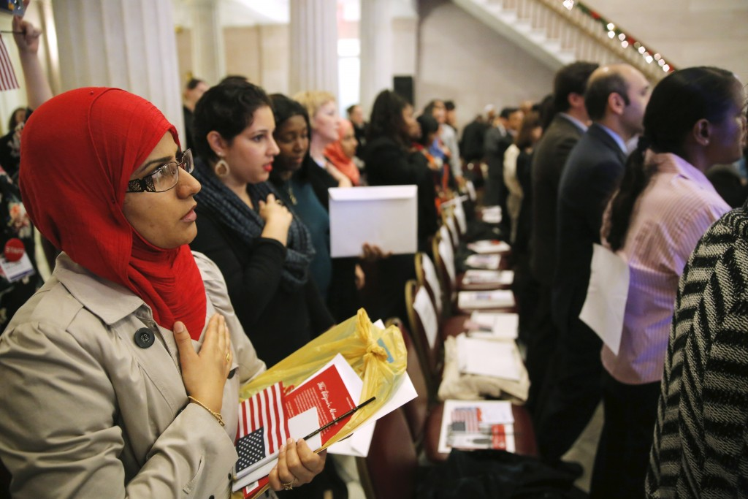

Promoting Syrian Refugee Resettlement in New Jersey

Slide 2
Mission Statement
To provide a trusted, scalable online solution that connects volunteers with established relief agencies serving Syrian refugee families in New Jersey.

Slide 3
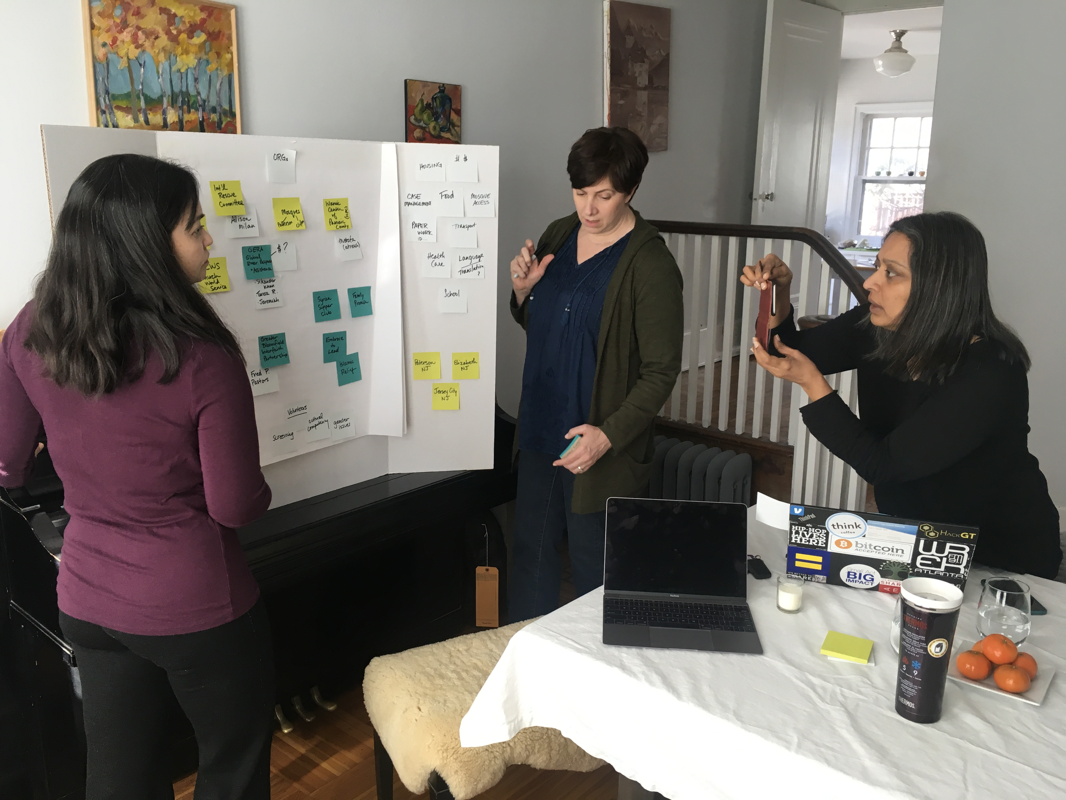
Team
Yalla!, meaning “Let’s go!” in Arabic implies a sense of urgency, of movement, of getting to a destination. It also resonates with the energetic volunteer base it seeks to seamlessly connect with action-oriented relief agencies.
L: Tahi Hunter, business owner, volunteer in refugee resettlement organization.
Middle: Jodi Paroff, evaluator, public policy and services.
R: Pritha Gopalan, applied anthropologist, international development

Slide 4
Background
The Syrian conflict has waged on for over 6 years displacing 6 million citizens and forcing over 3 million Syrians to migrate overseas.
More than 18,000 Syrian refugees arrived in the US between 2011 and 2016
Quota increased to 110,000 in 2017 but the new national administration halted new arrivals of Syrian refugees on grounds that they are a threat.
New Jersey is home to almost 300 Syrian refugees.
NJ governor prohibited state agencies from distributing federal relief assistance to families,
Relief agencies, large and small, have risen to fill the void and are stretched to capacity in meeting the considerable health, educational, and financial needs of displaced families.
National and state-level discourse against refugees has generated
Pro-refugee protests.
A groundswell of volunteerism for their cause. Volunteers range from individuals who “adopt” a Syrian family and help them navigate the difficult transition.

Slide 5
Introduction
Our fieldwork was conducted among Syrian families and relief agencies working in the Paterson and Elizabeth NJ area. Paterson is home to the second largest Arab-American population in the United States and is a desired relocation destination for Syrians seeking a like-minded community.
State agencies are now restricted from distributing federal relief assistance to families, echoing mainstream nationalist sentiments. Relief agencies, large and small, have risen to fill the vacuum, and are stretched to capacity in meeting the considerable health, educational, and financial needs of displaced families.
Representatives of NJ relief agencies, namely Greater Bloomfield Interfaith Partnership (GBIP), Global Emergency Response and Action (GERA), Church World Services (CWS), and Syrian American Medical Society (SAMS) have enthusiastically supported its premise, and engaged with us to inform its design (and even its name). Yalla! beckons neighbors and citizens to uphold the human values of inclusion, tolerance, and activism.
Notes:
Restate gap solution here

Slide 6
Quotes
“Shock of displacement is acute for Syrian refugees compared to other groups as they have been moved here within a very short period of losing their home. They need more time just to breathe.” Megan Johnson, Christian World Services
‘We founded GERA because we wanted to help refugees assimilate successfully,” Sikandar Khan, founder, GERA.
“ I don’t want charity. I need a job!” Nour Ajouz, head of household of a refugee family in Paterson.
“This level of civic engagement is new to us. We are in triage mode,” Salaheddin Mustafa, Outreach coordinator, Paterson mosque.

Slide 7
Target Audience
Community Outreach Organizations
American citizens of various backgrounds, religious affiliations, racial makeup.
Includes volunteers, service providers, relief agencies.
Intermediary Outreach Coordinators
Muslim American citizens who may be first or second generation immigrants.
Informed on logistical and cultural challenges of resettlement and assimilation.
Includes interpreters, business owners, students.
Resettled Syrian Refugee Families
Settled by International Rescue Committee or World Church Services in the past 2 years.
Notes:
What is the title to this slide

Slide 8
Resettlement Map
Timeline and Services Provided by Organized Relief Agencies
Arrival
Housing
Household Goods
Clothing
Healthcare
School Enrollment
Library card
Mosque connection
Three Months
Caseworker
Medicare Health care cards
ID paperwork
Medicare
Food Stamps
English tutoring
Community connections
Six Months
Check in
One time cash donation
Volunteer referrals
Employment support
Notes:
What does the average resettlement program look like?
What things go by the wayside? Transportation, sustainable employment, mental health, children’s matriculation into schools
Unclear goals – do another slide

Slide 9
Resettlement Gaps (needs work)
GOALS
Happy Family
Stable Employment
Continued enrollment in formal schooling
CURRENT STATE
GAPS
English Tutoring
Language Translation Support
Mental Health and Health Care
Health Care Support
Job Training
Transportation
Notes:
Gap analysis (for agencies and families)
Gaps handled by intermediary coordinators and volunteers within the organized relief agencies.
Goals: Stable employment and continued enrollment in school
Unclear goals – do another slide

Slide 10
Yalla! Initiative
How might we clarify the steps a family takes to “resettle”, and find other resources to meet their short term needs?
The sum total of all essential services does not meet families’ needs.
How might we connect volunteer resources to fill the gaps and meet a family’s longer term needs?
How might we organize volunteer efforts by creating a centralized infrastructure to access available volunteer services?
The range of relief agencies services are relatively comprehensive. However, volunteer efforts are often managed using disparate methods such as Excel, text messaging, What’s App, Facebook, Signup Genius.
How might we set up mentorship for male heads of households to navigate the American employment system?
Men are often overqualified for the jobs that are locally available.
Notes:
Bridging the gap between relief agency contract gap and longer term matriculation issues.

Slide 11
Resources
American socio-economic systems want to donate goods, time or money to provide short term services such as tutoring, moving, or driving.
Volunteers’ skills and energy are a valuable resource
Utilizes existing vetting processes such as background checks
Ease of access to online tools and resources
With proper coordination can be very beneficial to non-profits and relief agencies.
Universal access to smart phones, web-based apps and websites.

Slide 12
How Groups Connect
Community Outreach Agencies and Intermediary Outreach Coordinators
Churches, temples
One-on-one in cafes, restaurants
Email/Phone contact
Resettled Syrian Refugee Families
Mosque: Imam and community
Gender-based communication (radio) : male head of household disseminates information
Uber, Whats App (trusted, encrypted tools)
Voice phone calls
One-on-one in the home; gender-based

Slide 13
Motivations
Community Outreach Agencies
To assist immediate needs of resettlement such as driving, shopping, school enrollment, healthcare needs.
Intermediary Outreach Coordinators
To facilitate communication to reduce language and culture barriers.
To implement longer term solutions for resettlement such as networking, employment, language tutoring.
Resettled Syrian Refugee Families
Immediate goals: safety, shelter, connection to mosque
Secondary goals: school enrollment, employment, transportation, health care
Longer term goals: happy home life with stable employment and continued enrollment in schools.

Slide 14
Challenges and Frustrations
Community and Intermediary Outreach
Organizing volunteers.
Navigating protocol of federal, county, resettlement organizations, insurance.
Finance; planning, fundraising, bookkeeping.
Intermediary Outreach Respondents
Bridging cultural gap (gender, generational).
Longer term strategies not addressed by various groups.
Resettled Syrian Refugee Respondents
Trust.
Societal construct of religion not represented in America.
Notes:
Let’s ask the IORs about gender issues.

Slide 15


Initial Approach
Based on the research that most families had a smartphone, the original design was a peer-to-peer application
Uber or Task Rabbit
Connected families directly to volunteers.
Pros:
Ease and independence for families
Cons:
Language, safety, and cultural barriers
Strong resistance from relief agencies on these grounds
Newly-arrived refugee family
Service provider responds to their call

Slide 16




Broader Approach
Relief agencies are contacted for a specific service
Ensures an efficient one time delivery of a service to families through a skilled volunteer, for example a tutor for tutoring, someone who wants to drive for a trip to the mosque.
Opportunity to form “relationships” rather than delivery of a service, e.g., ongoing ESL lessons.
Relief agencies vet and match volunteers to families

Slide 17
Solution
Yalla! is a web-based management system that allows relief agencies to seamlessly match volunteers with Syrian refugee families in NJ.
Matching criteria:
Volunteer
Level of background check / Availability and Schedule / Pre-defined skills
Attributes that identify cultural and other sensitivities such as gender, privacy.
Activity (pre-defined)
Driving, shopping, financial statement review, job coaching, health care visits
Family Request
Pre-defined, categorized request such as tutoring, driving, health care visits
.

Slide 18
Yalla! Product Roadmap
TARGET MARKET
Syrian Families
Relief Agencies
GOALS
Connect local resources
Organize volunteers
RELEVANCE
Community Access
Number of families
STRATEGY
Match local resources with families
EXECUTE & MEASURE
Gather
Data Insights
Strategize
& Plan
Deliver. Market
& Sell
Data Collection
Field Work
Interviews
Design Initiation
Feasibility Research Assessing Opportunities
Competitive Analysis
Product Research
Project Scope
Prototype
Design and Development
Pilot Program
User Acceptance Testing
Marketing Plan
Partner Engagement
User Training
Data Analysis

Slide 19





Volunteers
Volunteer profile
Name, Category of volunteering; Schedule
Volunteer Category:
Goods donor or administrative coordinator
Volunteer Category:
Services donor
Interacts with family
Certification, Background Check
MATCHING FAMILIES WITH VOLUNTEER SERVICE DONORS
Resettled Family Profiles; Needs and Requests
SAMS
GERA
GREATER BLOOMFIELD INTERFAITH
TEAM YALLA!
CHURCH WORLD SERVICE

Slide 20

Family 1
Tea Time
Family 2
Tutoring
Driving
Family 3
Job Coaching
Tea Time
ACTIVITIES
Driving
Tutoring
Find Housing
Bank Statement Review
Job/Resume Coaching
Tea Time
Assignment 1
Driving
Assignment 2
ACTIVITY
Donate Funds
Volunteer 1
Tea Time
Volunteer 2
Tutoring
Voulnteer 3
Job Coach
Driving
Find Housing
Driving

