Slide 1
Adventure Works Data Analytics
A Data Engineering Project

Slide 2

Table of Contents
1.
Introduction
2.
Data Engineering Pipeline
3.
Tools & Technologies
4.
Challenges & Solutions
5.
Conclusions

Slide 3
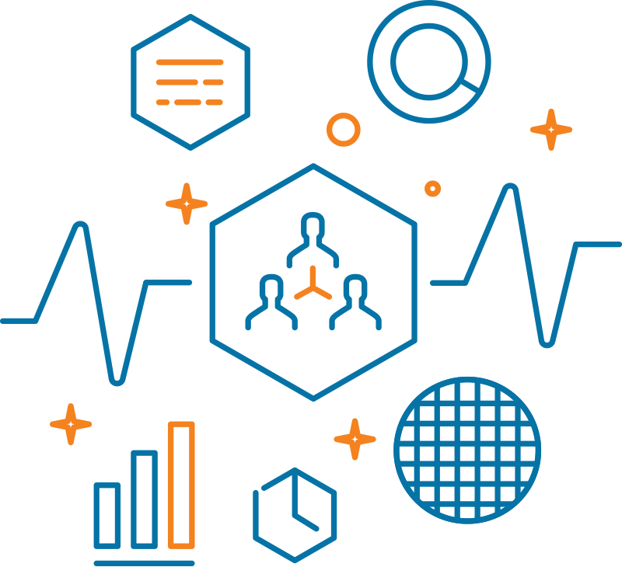
What this project is all about?
Introduction
This project demonstrates data engineering concepts using the `AdventureWorks` dataset.
It involves data ingestion, transformation, and storage using modern data engineering tools and workflows.

Slide 4

Dataset Wiki
Introduction
The "Adventure Works" dataset is a sample database provided by Microsoft, designed to showcase how to structure a SQL Server database, particularly for Online Transaction Processing (OLTP) operations.
Dataset contains information about: customers, calendar, product_categories and product_subcategories, territories, products, returns, sales from 2015-2017
You can checkout the original dataset link uploaded on kaggle: https://www.kaggle.com/datasets/ukveteran/adventure-works/data

Slide 5
What is a data engineering pipeline?
Data Engineering Pipeline
A data engineering pipeline is a system that collects, processes, and delivers data from various sources to its destination, often in a clean, structured format, ready for analysis or use in applications.

Slide 6
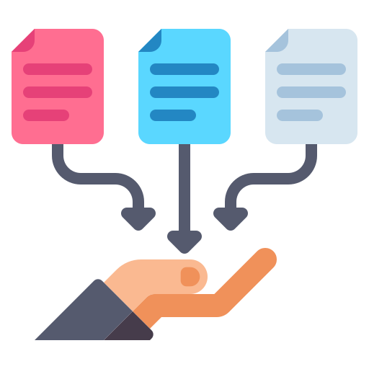
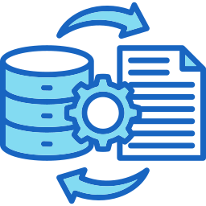

Data Engineering Pipeline
Data Engineering Pipeline
Data Collection (E)
Data Transformation (T)
Data Storage (L)
Extracting data from various sources within the AdventureWorks database.
Performs cleaning, normalization, and transformation processes applied to prepare the data for analysis.
Loading transformed data into the storage solution, such as databases or data warehouses.

Slide 7
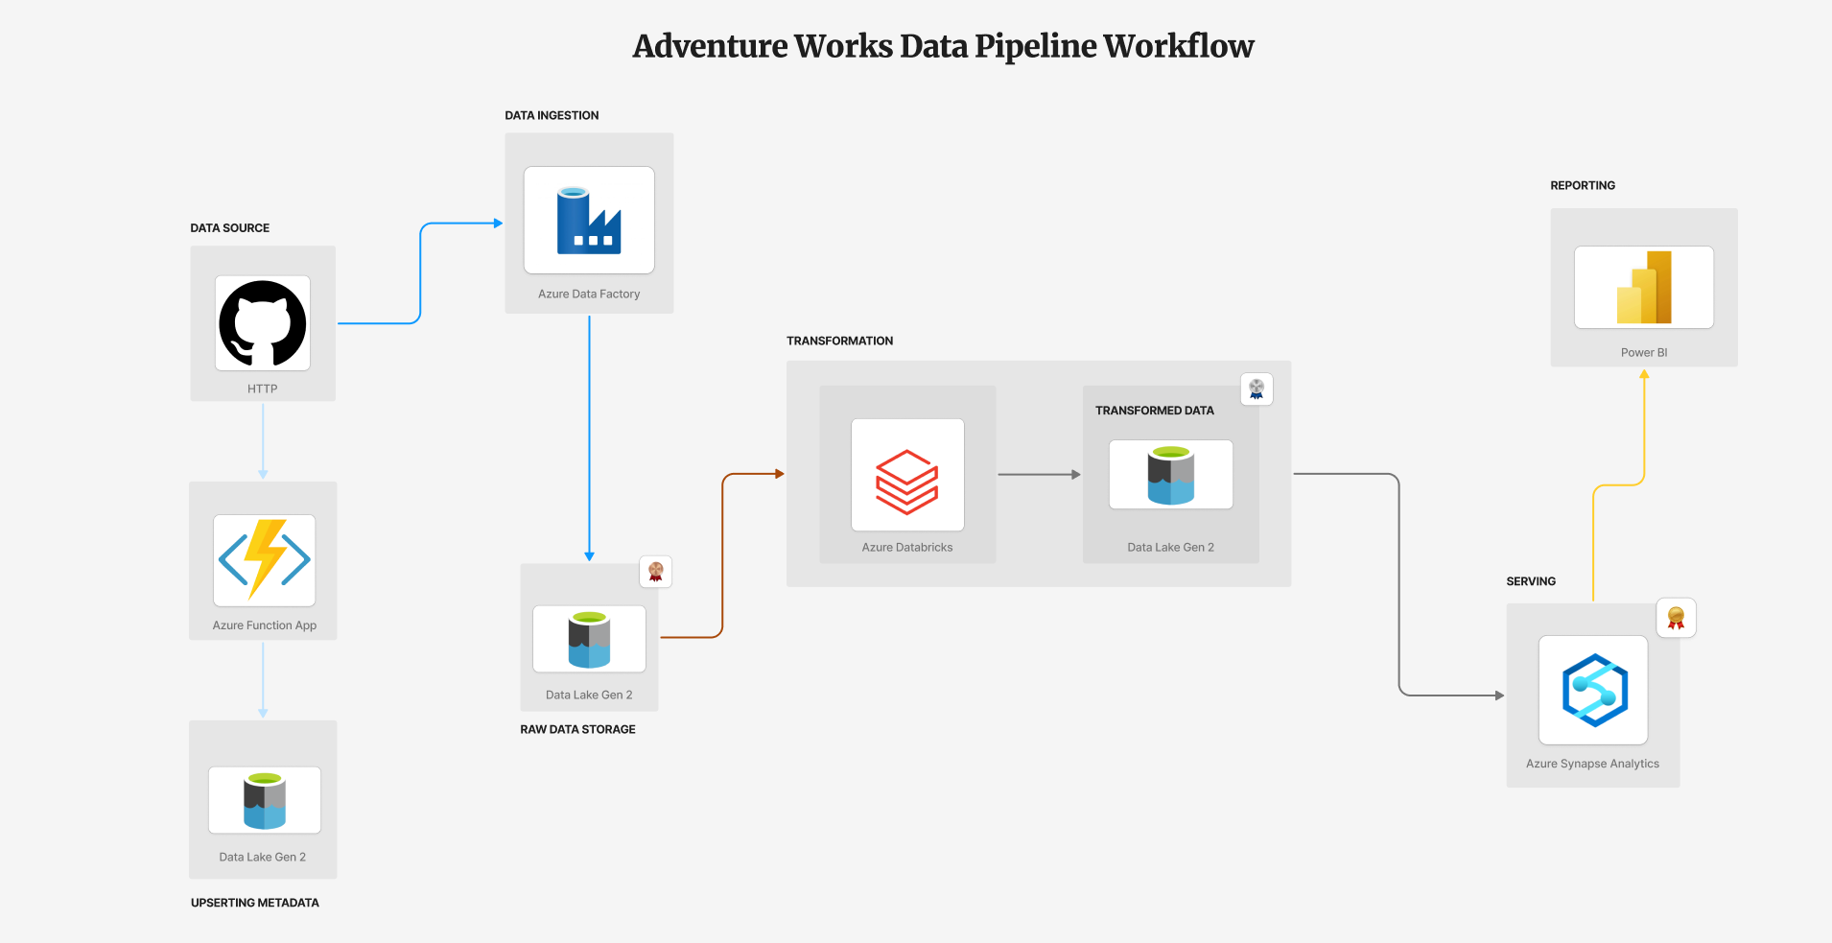
Our Project Pipeline
Data Engineering Pipeline

Slide 8
Must Have To Get-Started
Tools & Technologies
Microsoft Azure Subscription
Github Account
Power BI
Tools:
Azure Data Factory
Azure Databricks
Azure Synapse Analytics
Azure Function App

Slide 9
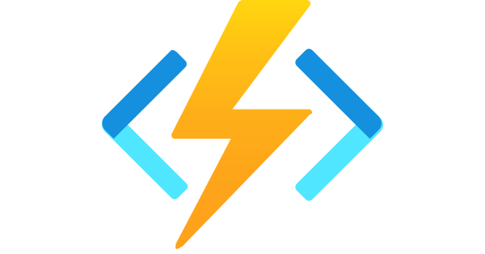

Opportunities Disguised In The Form of Obstacles
Challenges & Solutions
My biggest obstacle while completing this project was integrating Azure Function App with our pipeline
Package dependencies
Connection of Azure Function with Azure Data Lake Gen 2

Slide 10
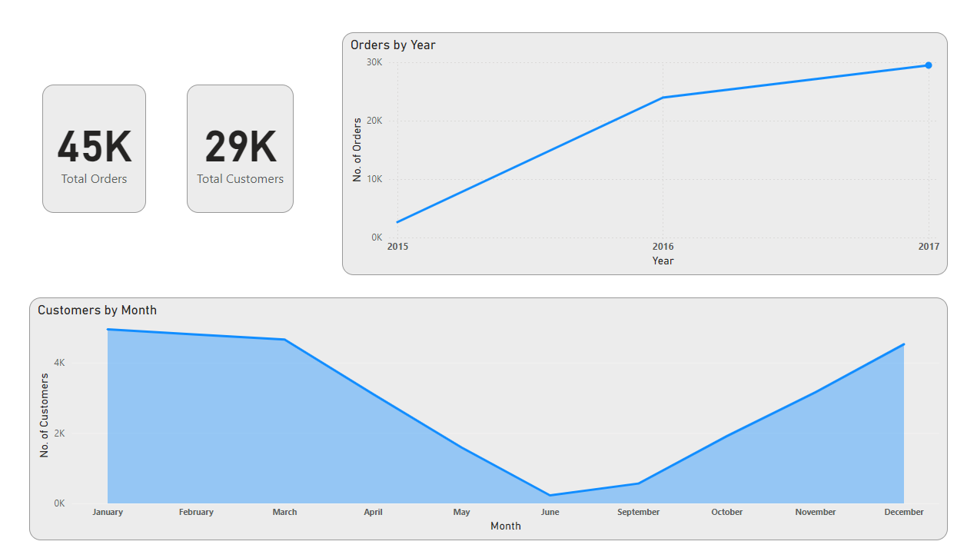



Dashboard & Socials
Conclusions

