Slide 1

Incremental Data
Analytics
A data engineering project

Slide 2
What is this project all about?
This project demonstrates incremental analysis of car sales data.
It leverages a medallion architecture to efficiently process and analyze sales data over time.
This enables stakeholders to gain insights into sales trends, customer preferences, and inventory management.

Slide 3
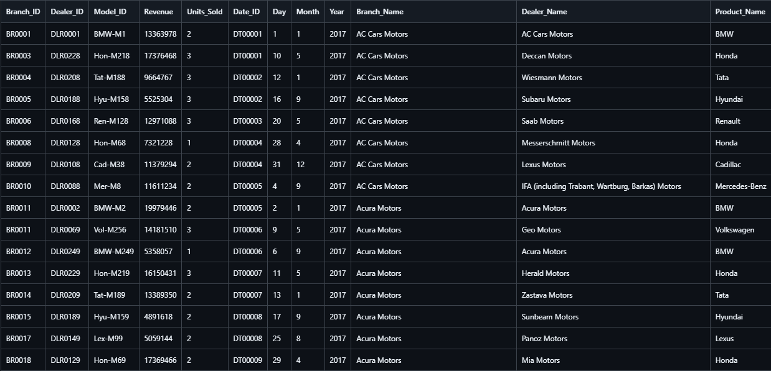
Dataset

Slide 4
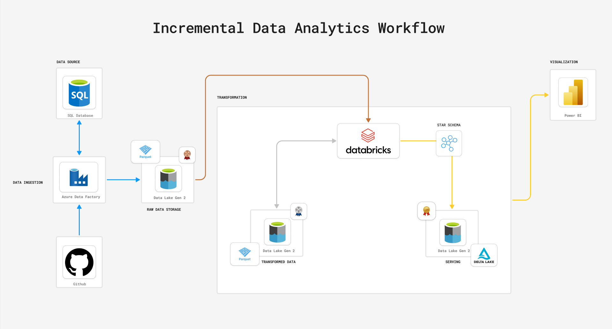
Workflow

Slide 5
Star Schema
dim_model
dim_dealer
The star schema is a widely used data modeling design in data warehousing that organizes data for analytical purposes.
It consists of a fact table (which contains foreign keys and quantitative data) surrounded by dimension tables (which contain descriptive attributes).
This design is simple, intuitive, and optimized for querying large datasets, especially for reporting and analytics.
Fact Sales
dim_branch
dim_date

Slide 6
dim_model
dim_dealer
PK
dim_model_key
PK
dim_dealer_key
Fact Sales
model_id
dealer_id
dim_model_key, dim_branch_key,
dim_dealer_key,
dim_date_key
model_category
dealer_name
PK
revenue
dim_branch
units_sold
dim_date
rev_per_unit
PK
dim_branch_key
PK
dim_date_key
branch_id
date_id
branch_name

Slide 7
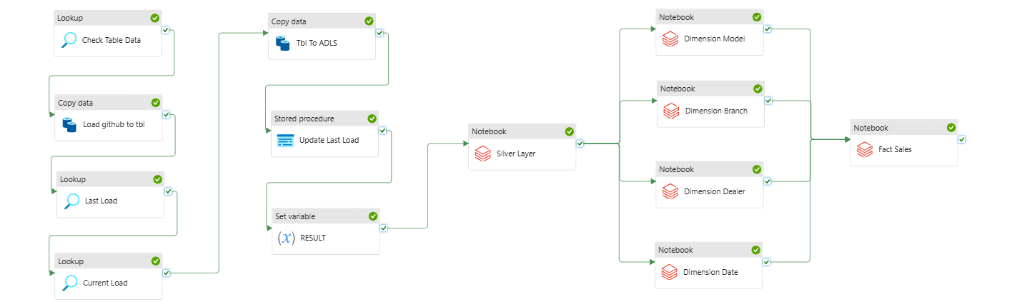
Pipeline

