Slide 1
Financial Data Analysis

Slide 2
Introduction
In the ever-evolving landscape of business, the ability to navigate and thrive in a competitive environment is paramount for sustained success. Without a profound understanding of the competition, businesses face the risk of stagnation or even failure.
I was tasked to analyse the competition for the management to provide better results.
The dataset has information on the market capitalization & quarterly sales of the top 500 companies in India.

Slide 3
Approach
I have followed 6 step data analysis approach for this financial data analytics project
(ASK – PREPARE – PROCESS – ANALYSE – SHARE – ACT )
Ask - prepared questions which I can answer during my analysis
Prepare - I received the dataset from unified mentor management team
Process - renaming columns, checked null values, updated missing records with mean values

Slide 4
Approach
Analyse -
Sorting & filtering data
Created histogram charts for market cap & quarterly sales distribution
Added sales efficiency ratio column
Visualized largest & smallest companies based on market cap & quarterly sales

Slide 5
Approach
Share -
Reliance Industries (5,83,436 Cr) has the biggest market cap share
Natl. Fertilizers (3,017 Cr) has the smallest market share
IOCL (1,10,666 Cr) has most quarterly sales
Ujjivan Financial Services (0 Cr) has least quarterly sales
SPARC (553.82) has the highest Sales Efficiency Ratio
Ujjivan Financial Services (0.0) has the lowest Sales Efficiency Ratio
Majority companies' market cap lies between 0 - 1,50,000 Cr
Majority companies' quarterly sales lies between 0 - 27,500 Cr

Slide 6
Approach
Conclusion (Act) -
Reliance Industries stands out with the largest market capitalization, while Ujjivan Financial Services appears to be struggling with both low quarterly sales and low sales efficiency
Most companies fall within certain ranges of market capitalization and quarterly sales, indicating the typical distribution in the market
Overall, these insights provide a snapshot of the market dynamics and the performance of different companies within it.

Slide 7
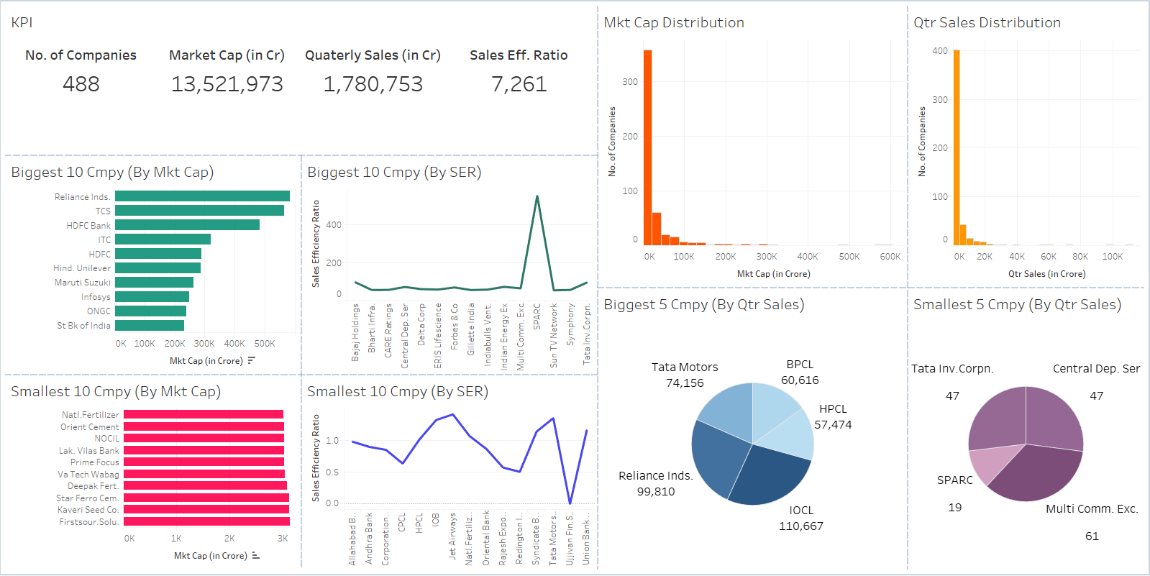
Dashboard

Slide 8




Thank You

