Slide 1
Heart Rate Diagnose Data Analysis

Slide 2
Introduction
Health is real wealth in the pandemic time we all realized the brute effects of covid-19 on all irrespective of any status.
As being a Data Analyst, I was asked to analyze the health and medical data & produce meaningful insights.

Slide 3
Approach
I have followed 6 step data analysis approach for this financial data analytics project
(ASK – PREPARE – PROCESS – ANALYSE – SHARE – ACT )
Ask - prepared questions which I can answer during my analysis
Prepare - I received the dataset from unified mentor management team
Process - renaming columns, checked null values, we found out rest of the dataset was well organized

Slide 4
Approach
Analyse -
Sorting & filtering data
Calculated heart disease prevalence rate throughout the dataset
Calculated avg. age
Calculated avg. resting blood pressure
Calculated avg. serum cholesterol
Calculated % individual of high fasting blood sugar level
Calculated peak heart rate in both genders
Calculated avg. ST depression etc ..

Slide 5
Approach
Share -
Heart Patient: 526, Non-Heart Patient: 499, Total Patients: 1025
Heart Disease Prevalence Rate: 51.3 %
Average age in dataset: 54 years
Average resting blood pressure: 131 BPM
Average serum cholesterol: 246 mg/dl
High fasting blood sugar rate: 14.9 %
Females in dataset: 312, Males in dataset: 713
Max Heart Rate (female): 192 BPM, Max Heart Rate (male): 202 BPM
Exercise Induced Angina Rate: 33.7 %
Abnormal Resting Electrocardiographic Rate: 51.5 %

Slide 6
Approach
Conclusion (Act) -
Heart Disease Prevalence: The prevalence of heart disease in the dataset is relatively high at 51.3%, indicating that heart disease is a significant health concern among the patients included in the study.
Demographic Distribution: The dataset consists of 312 females and 713 males, suggesting a higher representation of males. This may indicate either a higher prevalence of heart disease among males or a higher proportion of males seeking medical attention for heart-related issues.
Resting Blood Pressure and Serum Cholesterol: The average resting blood pressure and serum cholesterol levels are 131 BPM and 246 mg/dl, respectively. Elevated levels of both indicators are associated with an increased risk of heart disease, highlighting the importance of monitoring these parameters for early detection and prevention.
Exercise Induced Angina and Abnormal Resting Electrocardiographic Rate: The rates of exercise-induced angina (33.7%) and abnormal resting electrocardiographic findings (51.5%) are both relatively high. These findings indicate that a significant portion of the patient population experiences symptoms during physical activity and may have abnormal heart rhythms at rest, further emphasizing the prevalence and severity of heart disease in the dataset.

Slide 7
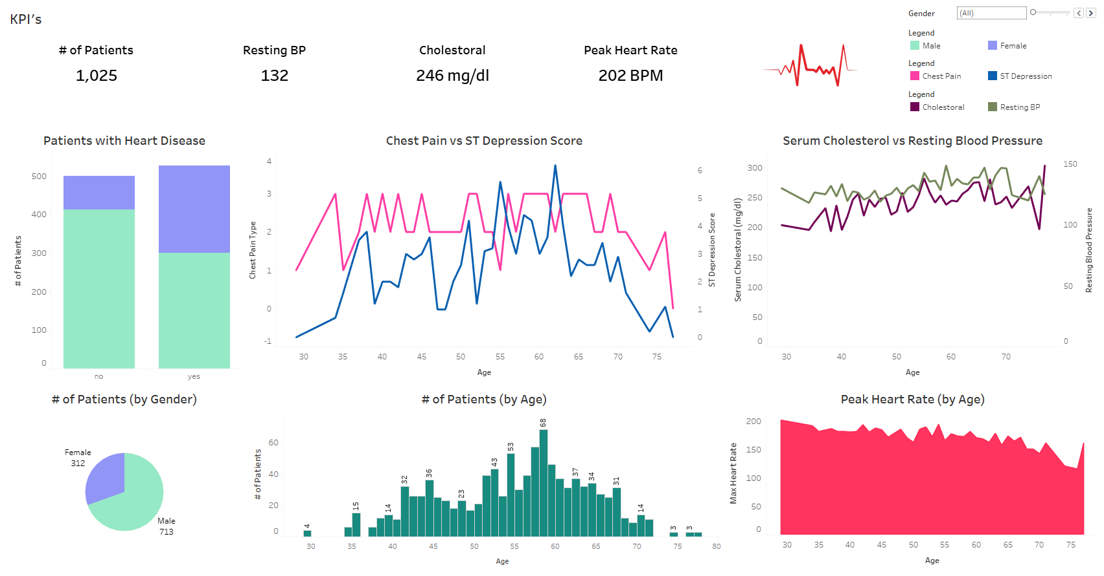
Dashboard

Slide 8




Thank You

