Slide 1
Unified Academic Support Platform
Student: Malik, Tahira
Penn State University
Professor: Nalabandhu, Santosh
May 02, 2025

Slide 2
Problem Statement & Requirements
• Problem: Fragmented student experience in online academic support systems
• Functionalities: Session booking, scheduling, feedback, notifications
• Target Users: Students, tutors, advisors needing a unified interaction platform
• Business Goal: Improve service accessibility and session success rates
• Performance: Scalable, low-latency response, high throughput
• Security: User authentication, role-based access, encrypted communication
• Maintainability: Modular design, reusable code, documentation, testable modules
• Others: High availability, cloud-ready, API-first architecture

Slide 3
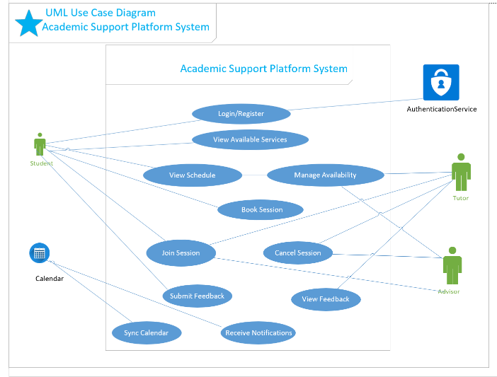
UML Use Case Diagram

Slide 4
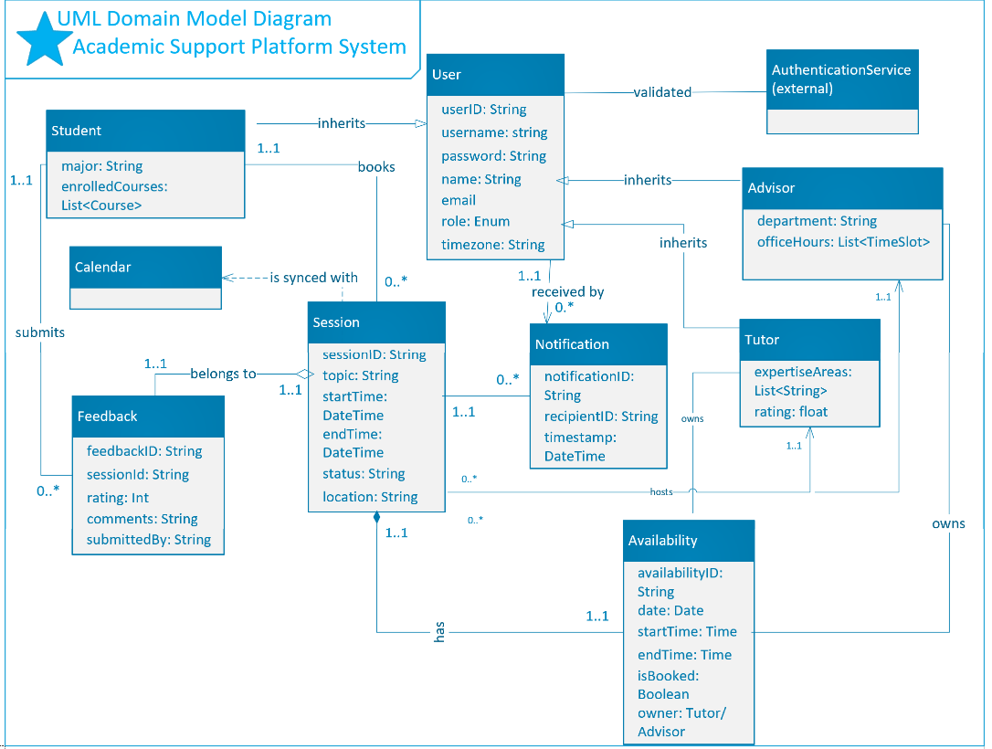
UML Domain Model

Slide 5
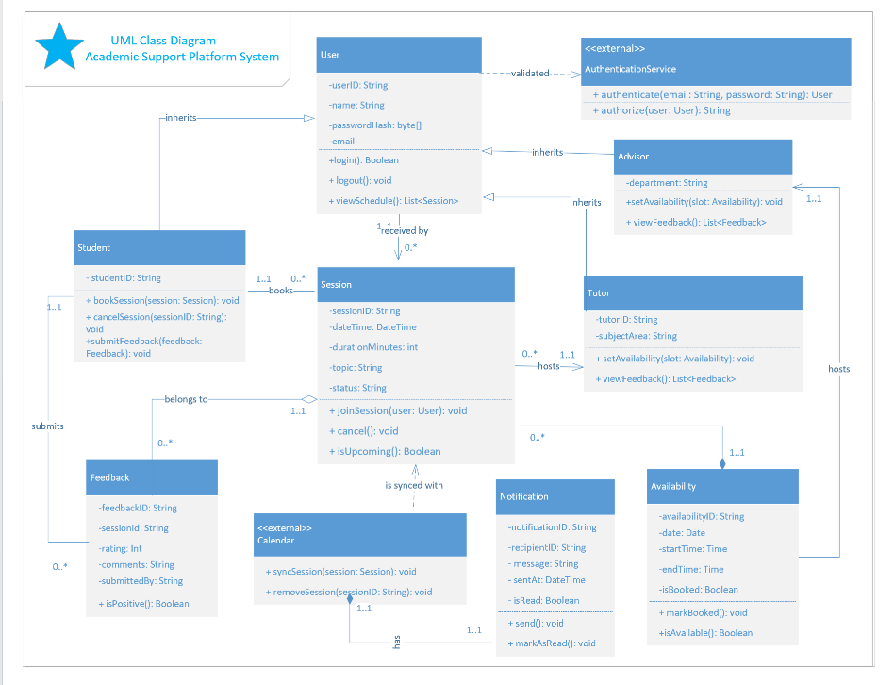
UML Class Diagram

Slide 6
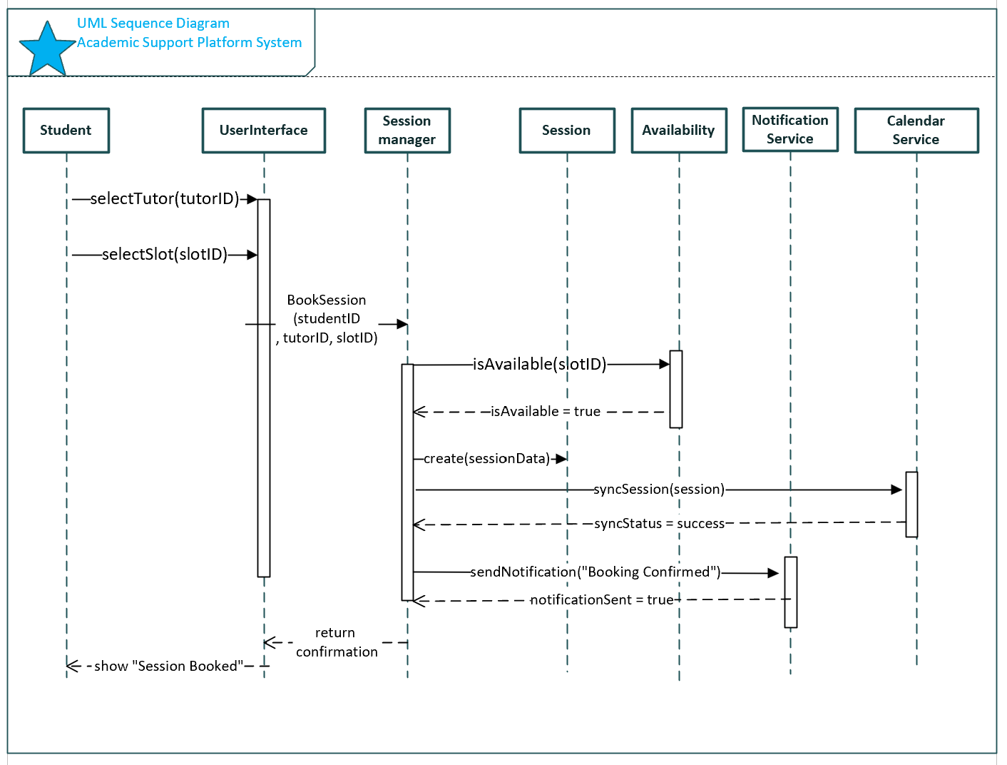
UML Sequence Diagram

Slide 7
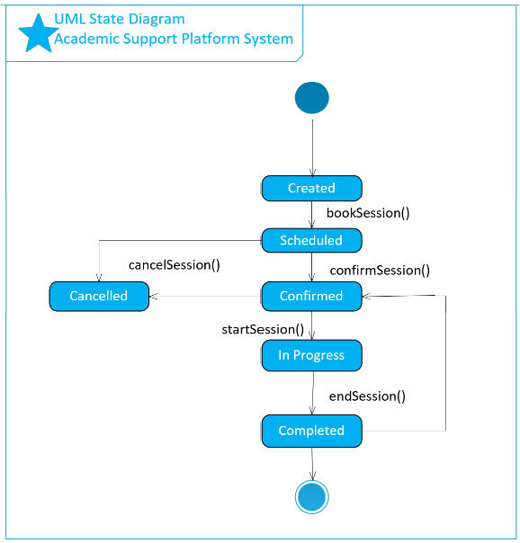
UML State Diagram
Lifecycle of a Session object

Slide 8
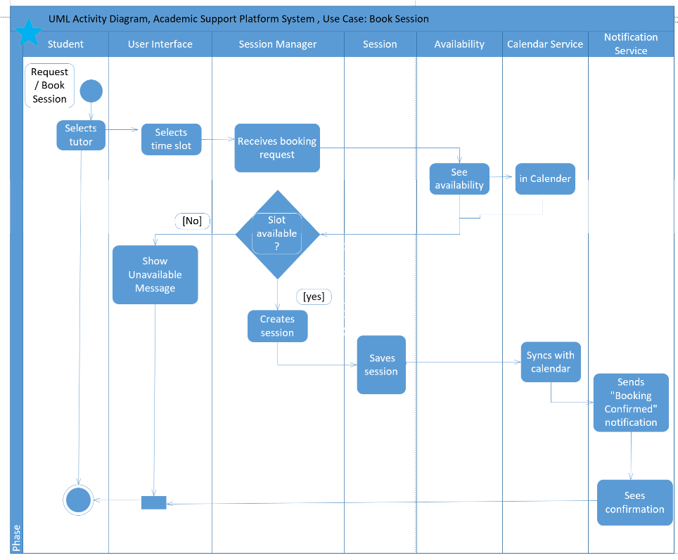
UML Activity Diagram

Slide 9
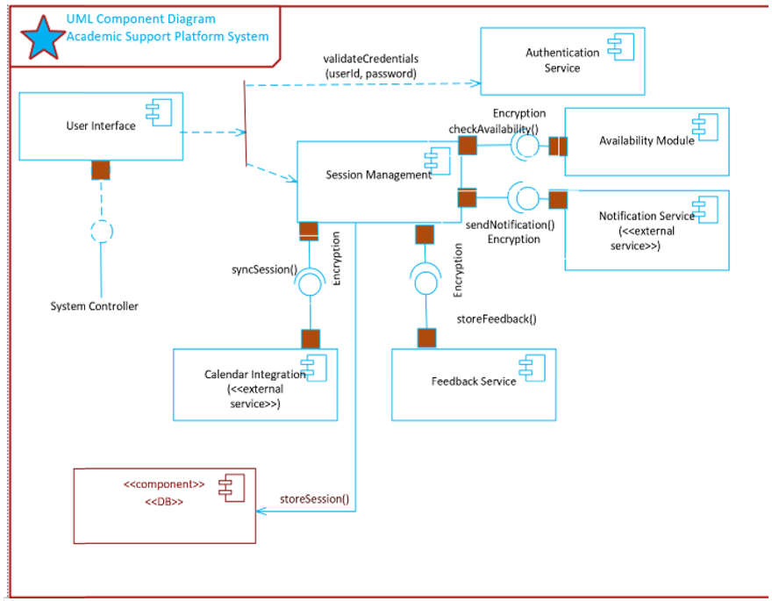

Slide 10
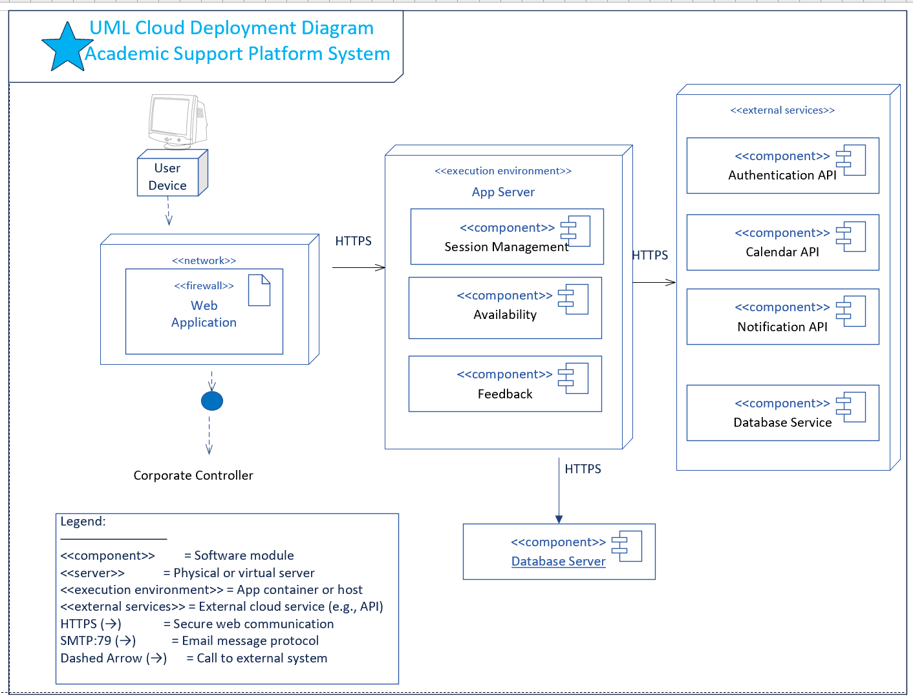

Slide 11
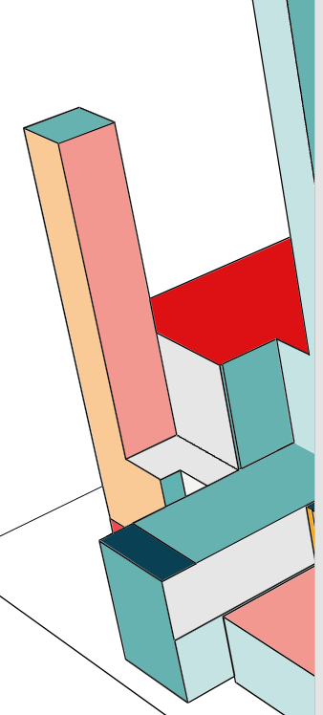
Skeleton Classes and Tables Definition
a. Skeleton Class Definitions:
• User: user_id, name, email, role Methods: login(), logout()
• Student: Inherits from User | Methods: book_session(), cancel_session(), submit_feedback()
• Tutor: Inherits from User
Methods: set_availability(), view_feedback()
• Session: session_id, student, tutor, datetime, status | Methods: join(), cancel()
• Feedback: feedback_id, session_id, rating, comments
b. Database Tables:
• Users(user_id PK, name, email, role)
• Sessions(session_id PK, student_id FK, tutor_id FK, datetime, status)
• Feedback(feedback_id PK, session_id FK, rating, comments)
• Availability(slot_id PK, tutor_id FK, date, start_time, end_time, is_booked)

Slide 12
Design Patterns and Best Practices
• GRASP:
- Controller: SessionManager coordinates operations
- Information Expert: Classes handle their own data
• SOLID:
- SRP: Each class has a single responsibility
- OCP, LSP, ISP, DIP used to promote modularity
• GoF Patterns:
- Observer: Notification system
- Factory: Session creation
- Strategy (optional): For notification types
• Microservices:
- Service decomposition: Session, Feedback, etc.
- Loose coupling, independent scaling

Slide 13
Thank you
Tahira Malik

