Slide 1
Final Project Unified Academic Support Platform Software Engineering System and Design 837:
Malik, Tahira
Penn State University
Professor Nalabandhu, Santosh
May 02, 2025
By Malik, Tahira

Slide 2
Selecting visual aids
Enhancing your presentation

Slide 3
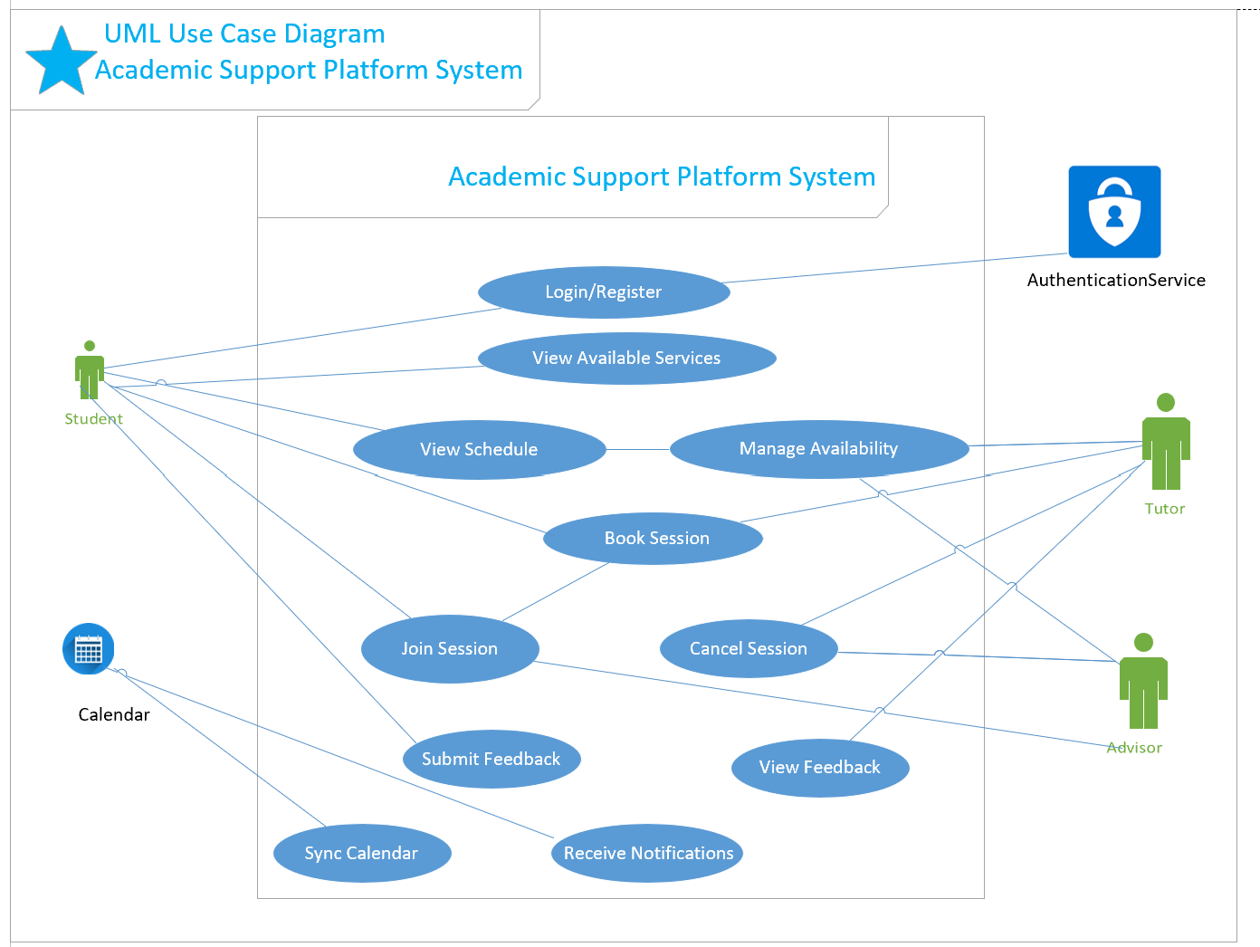
UML Use Case Diagram

Slide 4
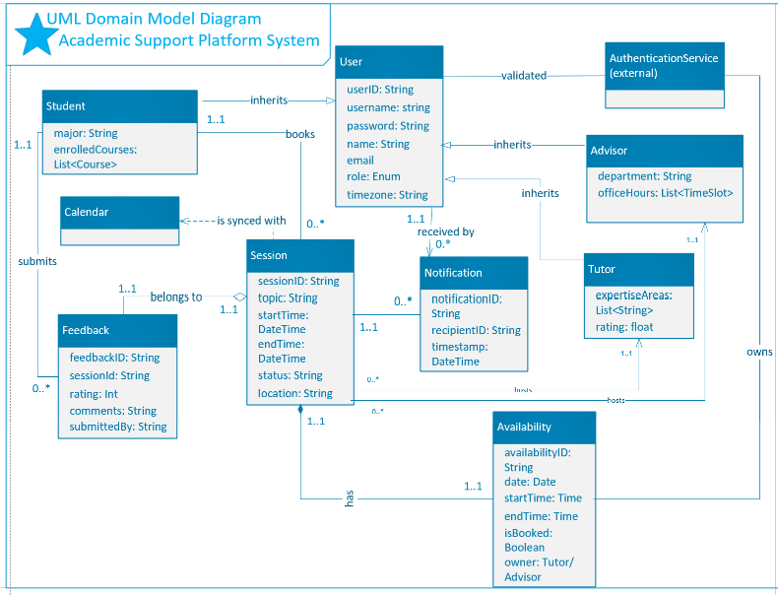

Slide 5
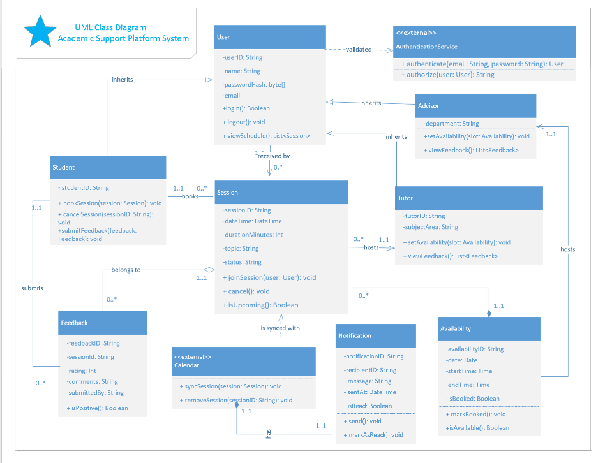

Slide 6
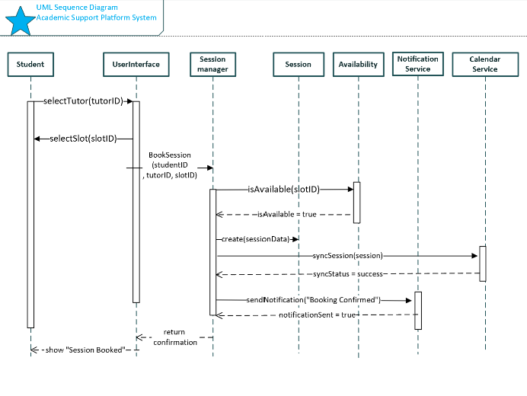

Slide 7
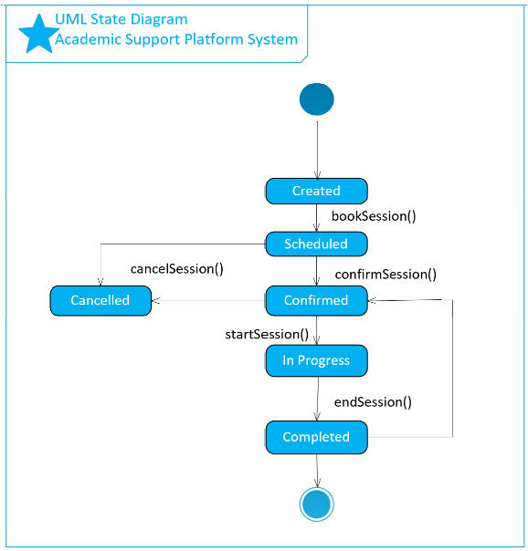

Slide 8
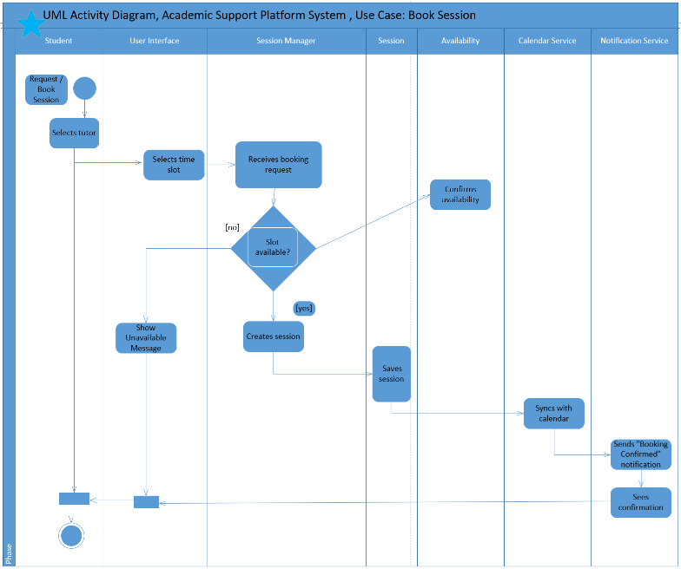

Slide 9
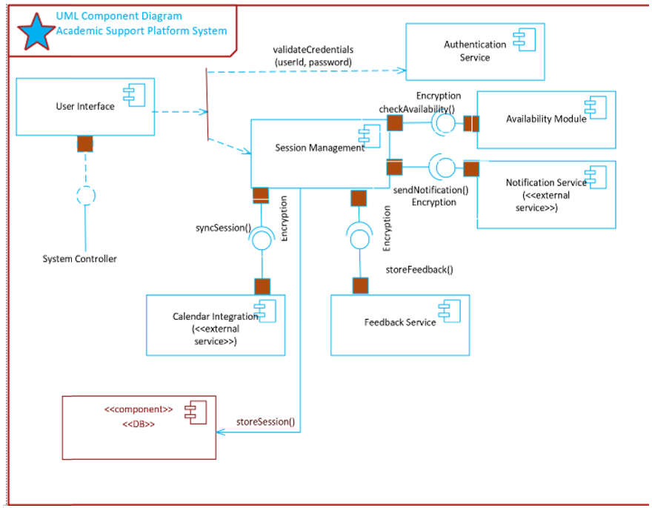

Slide 10
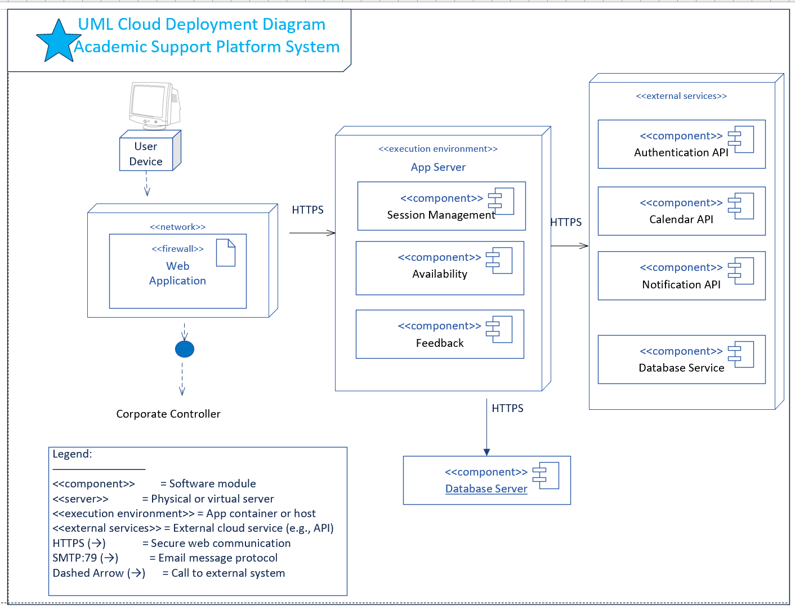

Slide 11
Skeleton Classes and Tables Definition
a. Skeleton Class Definitions:
• User: user_id, name, email, role | Methods: login(), logout()
• Student: Inherits from User | Methods: book_session(), cancel_session(), submit_feedback()
• Tutor: Inherits from User | Methods: set_availability(), view_feedback()
• Session: session_id, student, tutor, datetime, status | Methods: join(), cancel()
• Feedback: feedback_id, session_id, rating, comments
b. Database Tables:
• Users(user_id PK, name, email, role)
• Sessions(session_id PK, student_id FK, tutor_id FK, datetime, status)
• Feedback(feedback_id PK, session_id FK, rating, comments)
• Availability(slot_id PK, tutor_id FK, date, start_time, end_time, is_booked)

Slide 12
Design Patterns and Best Practices
• GRASP:
- Controller: SessionManager coordinates operations
- Information Expert: Classes handle their own data
• SOLID:
- SRP: Each class has a single responsibility
- OCP, LSP, ISP, DIP used to promote modularity
• GoF Patterns:
- Observer: Notification system
- Factory: Session creation
- Strategy (optional): For notification types
• Microservices:
- Service decomposition: Session, Feedback, etc.
- Loose coupling, independent scaling

Slide 13
Thank you
Tahira Malik

