Slide 1





Slide 2



AI-based and controlled smart agricultural field
Supervised by Dr. Muhammad Zulqarnain Siddiqui

Slide 3
Group Members
Hussain Saleem (13079)
Hamza Siddiqui (12626)
Muhammad Osama (13088) Syed Tahir Abbas (12868)

Slide 4
Contents
Introduction
Features
Hardware Requirements
Software Requirements
Libraries
Workflow Diagram
Circuit Diagram
Circuit Image
Algorithms
Issues
B2B of Project

Slide 5
INTRODUCTION

Slide 6
Welcome to the future of farming - an era where artificial intelligence (AI) takes the reins of agriculture, ushering in a new era of efficiency, sustainability, and productivity. In this A.I.-based and controlled Smart Agricultural field, traditional farming practices meld seamlessly with cutting-edge technology. By harnessing the power of advanced algorithms, real-time data analysis, and automation, we are transforming how we cultivate the land and nurture our crops. From precision planting and irrigation management to pest detection and crop health monitoring, our Smart Agricultural field represents a harmonious blend of nature and innovation.
Step into the forefront of modern agriculture, where the fusion of artificial intelligence and farming expertise has birthed the remarkable A.I.-based and controlled Smart Agricultural field.
This groundbreaking innovation redefines the agricultural landscape, imbuing it with unparalleled precision, sustainability, and optimization. Guided by the intricate dance of data-driven insights and autonomous decision-making, this field epitomizes the synergy between technology and nature. From intelligent planting and vigilant pest management to resource-efficient irrigation and real-time crop monitoring, our Smart Agricultural domain exemplifies a harmonious coexistence of human ingenuity and advanced algorithms.

Slide 7
Features
It performs Automatic operation of Farming With the help of image recognition it can detect Diseases in farming products like plants, vegetables and fruits.We can get a complete Information of Bugs and Diseases in our online servers.It display all information on web pages related to the Field
Smart agriculture is an emerging concept, because IOT sensors are capable of providing information about agriculture fields and so touch supported the user input. Smart farming refers to the use of technology and data analysis to optimize and improve agricultural practices. Some examples of smart farming technologies include precision agriculture, which uses sensors and GPS to collect data on soil conditions, crop health, and weather patterns, and then uses that data to optimize irrigation,fertilization, and pest control; and precision livestock farming, which uses sensors and other technologies to monitor the health and welfare of livestock and optimize their feeding, housing, and care.
One way that image processing could be used in a smart farming project is for disease detection in crops or livestock. By analyzing images of crops or animals, it may be possible to identify signs of disease or stress, such as changes in color, texture, or shape. This information could be used to take early action to prevent the spread of Disease or to treat affected plants or animals. There are many other ways that image processing could be used in a smart farming project. For example, it could be used to monitor the growth and development of crops, to identify weeds or pests, or to assess the quality of produce.

Slide 8
Hardware Requirement
Raspberry pi
Soil moisture sensor
Soil pH sensor
Temperature & Moisture sensor (DHT11)
LDR sensor
Submersible-mini Water pump
Pi camera
Four-channel Relay module
12 Fan
LCD 16*2
Barometric pressure sensor
Analog to digital converter (mcp3008)
Gas sensor

Slide 9
Software Requirement
VS Code
Laravel
Xampp
Arduino IDE
Arduino Create Agent
Baki osama se puch ke laga lena

Slide 10









Libraries Used in the Project

Slide 11
SOME IMPORTANT LIBRARIES USED IN OUR PROJECT
LiquidCrystall2C.h
Dht.h
Tkinter
Serial
Mysql.connector

Slide 12
WORKFLOW DIAGRAM

Slide 13
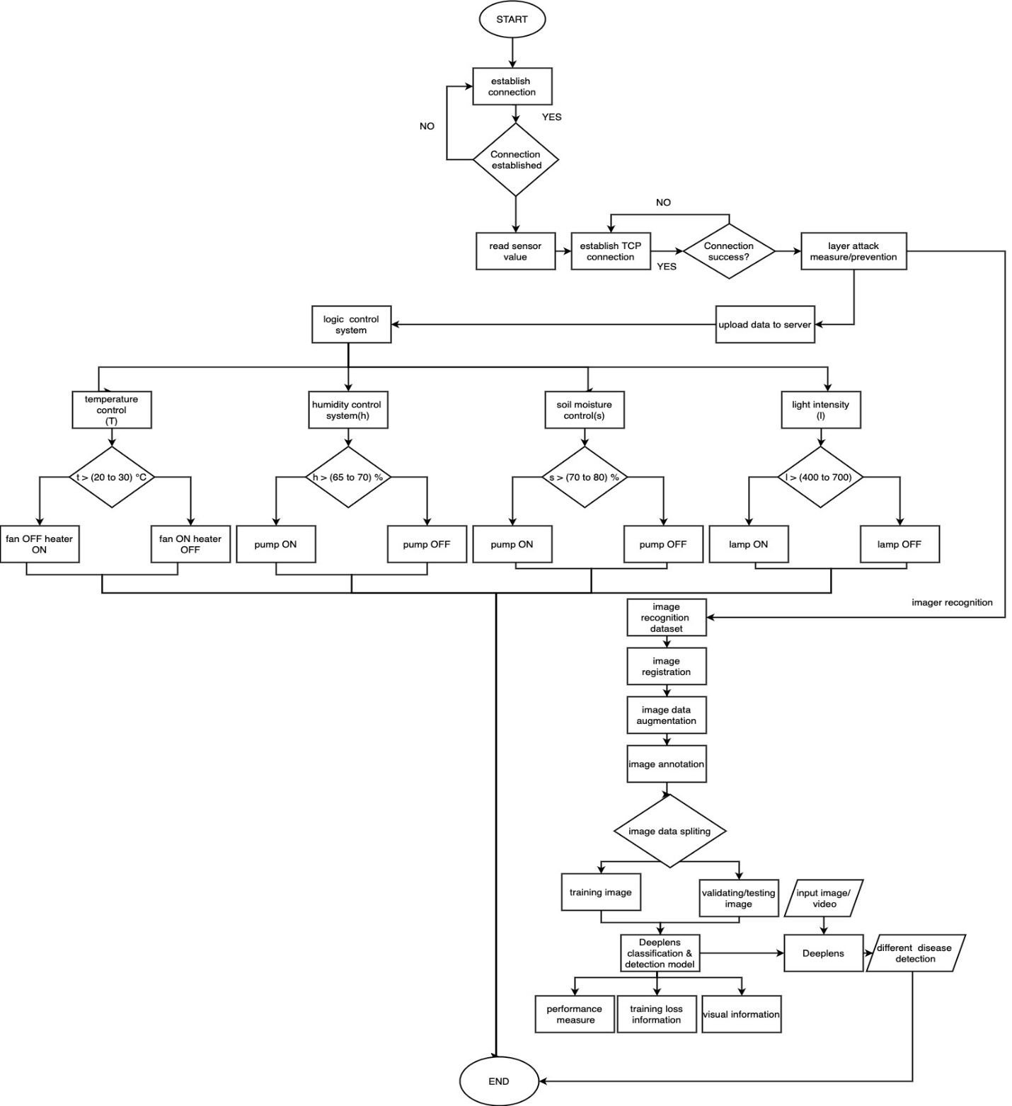

Slide 14
CIRCUIT DIAGRAM

Slide 15
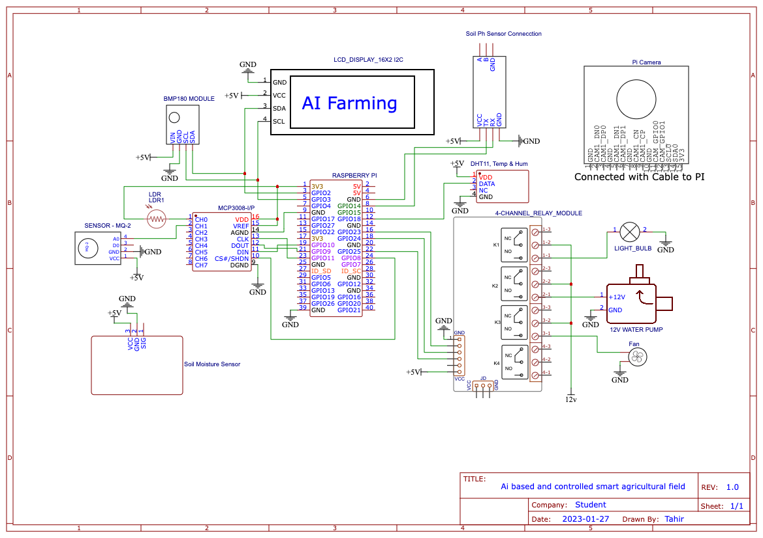

Slide 16
Circuit
Image

Slide 17
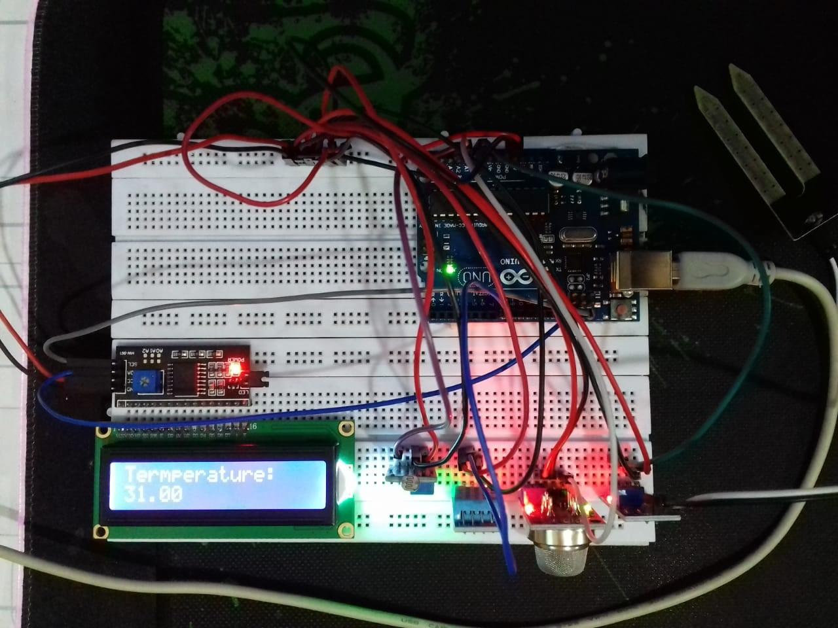

Slide 18
Image Processing Algorithms

Slide 19
Algorithms
Some of the image processing algorithms that are commonly used in an AI-based and controlled smart agricultural field project to detect plant diseases include:
Convolutional Neural Networks (CNNs): These are deep learning algorithms that are particularly well-suited for image classification tasks. They can be trained on large datasets of images to identify the presence of diseases based on the visual symptoms.The machine learning approaches such as SVM, K-NN and CNN are used to distinguish diseased or non-diseased leaf.
Transfer Learning: This involves using pre-trained CNNs that have already been trained on large image datasets and fine-tuning them to the specific task of plant disease detection.
Image Segmentation: This technique involves separating the plants from the background in the images and isolating the relevant features, such as leaves and stems, for further analysis.
Object Detection: This technique involves detecting and locating the plants in the images and then classifying them based on the presence of disease symptoms.
Feature Extraction: This technique involves identifying and extracting relevant features from the images, such as color, texture, and shape, that can be used to distinguish between healthy and diseased plants.
These algorithms can be combined and fine-tuned to achieve high accuracy in detecting plant diseases in an AI-based and controlled smart agricultural field project.

Slide 20
Issues in
Project

Slide 21
Server issue Due To many API’s running At the Same Time
Obtaining high-quality and reliable data from various sensors and devices was challenging. Some sensors experienced calibration drift, and data inconsistency posed difficulties in accurately training the A.I. models.
As the project involved sensitive agricultural data, ensuring data privacy and protection against unauthorized access or cyber threats was a paramount concern.
The reliance on power sources for A.I. computation and sensor operation raised concerns about energy efficiency and the field's sustainability, especially in remote or off-grid locations.
Implementing the A.I. system on a larger scale or integrating it with existing agricultural infrastructures posed scalability challenges. Considerations of cost, compatibility, and adaptability were necessary.
Evaluating the cost-effectiveness of implementing the A.I. system compared to traditional agricultural practices was crucial for decision-making and widespread adoption.
The complex nature of the A.I. system required skilled technical support for troubleshooting, regular maintenance, and timely updates to ensure smooth operations.

Slide 22
B2B of this Project

Slide 23
The project's business-to-business (B2B) component entails making the AI-based smart agriculture system available to other players in the agricultural sector. Partnerships with agricultural technology firms, farming cooperatives, agricultural research facilities, and agribusinesses may fall under this category. Real-time field monitoring, automated decision-making, and user-controlled interventions are just a few of the system's features that might be packaged into a comprehensive solution suited to the particular requirements of these B2B clients. To improve agricultural productivity, sustainability, and profitability on a broader scale, the system might be integrated into their current operations, offering them advanced insights, resource optimization, and data-driven decision assistance.

Slide 24

Questions and Answers

Slide 25
Thank You

