Slide 2
Scala Beyond the Basics
Daniel Hinojosa
4/28/14 •

Slide 3

About Me...
Daniel Hinojosa
Programmer, Developer, Consultant, Instructor, and Speaker
Notable Content:
Testing in Scala (Book)
Beginning Scala Programming (Video)
Java & TDD (Video Training)
Speaker:
A Few OSCONs
No Fluff Just Stuff Tour
DevNexus
dhinojosa@evolutionnext.com
@dhinojosa
4/28/14 •

Slide 4
Structure of the Class
All LiveCoding
Performed in IntelliJ and Eclipse
Commits and Pushing performed throughout the class
Your Choice :
Watch
Code with Me
Definitely Ask Questions
4/28/14 •

Slide 5
Project Setup
4/28/14 •

Slide 6
Checklist before setup...
We provided pre-setup configuration already.
Be sure JAVA_HOME is set and that the following works:
javac -version
java -version
Be sure SBT is setup and ensure that the following works
sbt sbtVersion
4/28/14 •

Slide 7
Repository Location, Clone it!
https://github.com/dhinojosa/scala_beyond_basics
4/28/14 •

Slide 8
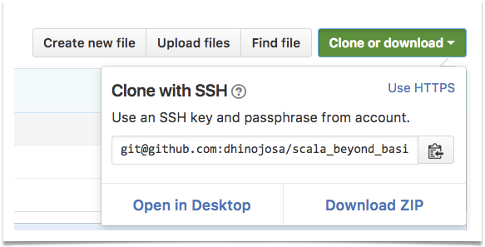

But, if don’t know Git too well...
4/28/14 •

Slide 9
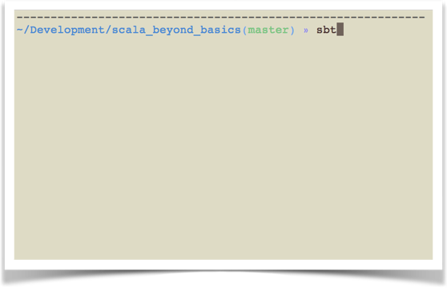
Once downloaded...Run SBT
4/28/14 •

Slide 10
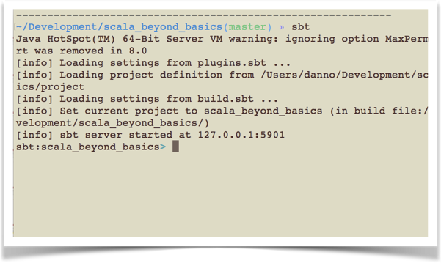
You should see something like this...
4/28/14 •

Slide 11
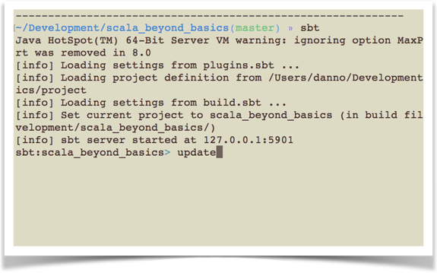
You’ll need to update your project...
4/28/14 •

Slide 12
Updating Your Project
This will download Scala and all your dependencies into your ~/.ivy2
This may take a while depending on your connection speed.
If you have any problems, there might be issues with network connection, or proxy based issues
4/28/14 •

Slide 13
Proxy Issues
If you have problems because of any proxy server, add the following to your environment variables and change username and password accordingly
export JAVA_OPTS="$JAVA_OPTS \
-Dhttp.proxyHost=yourserver \
-Dhttp.proxyPort=8080 \
-Dhttp.proxyUser=username \
-Dhttp.proxyPassword=password"
4/28/14 •

Slide 14
Lab: Let’s get setup!
Clone or download scala_beyond_basics from https://github.com/dhinojosa/scala_beyond_basics
Run sbt at the command line
Once in the sbt console, run update
Wait for the download to complete
4/28/14 •

Slide 15
Setup for Eclipse
4/28/14 •

Slide 16
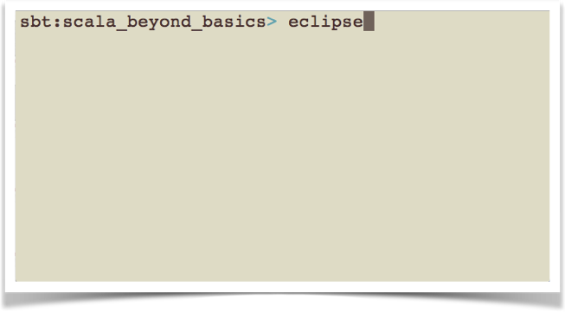
Run the Eclipse Plugin in SBT
4/28/14 •

Slide 17
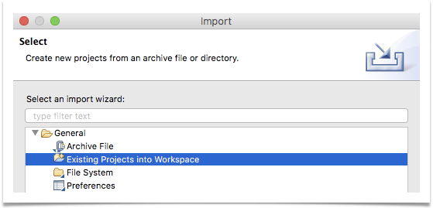
Import Existing Project
File > Import Project >
Select Existing Projects Into Workspace > Next
4/28/14 •

Slide 18
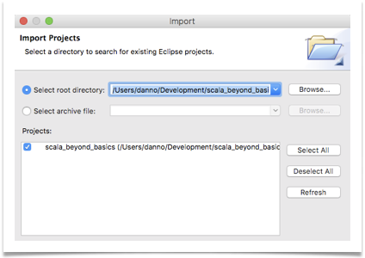
Select Root Directory
Select the Root Directory of the Project using Browse,
Ensure that the Project is Found, hit Finish
4/28/14 •

Slide 19
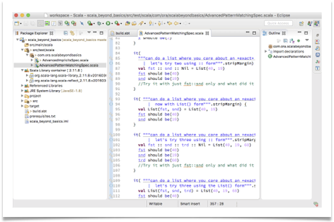
Project is now ready
Select the Root Directory of the Project using Browse,
Ensure that the Project is Found, hit Finish
4/28/14 •

Slide 20
Setup for IntelliJ
4/28/14 •

Slide 21
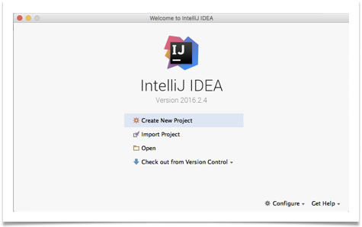

From IntelliJ Intro Screen, or from the splash screen, select Open
4/28/14 •

Slide 22
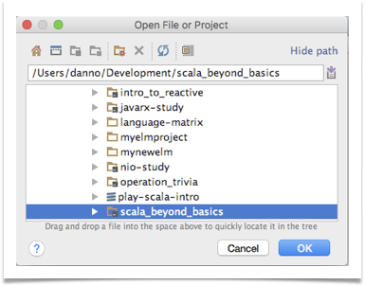
Locate the scala_beyond_basics project and click OK
4/28/14 •

Slide 23

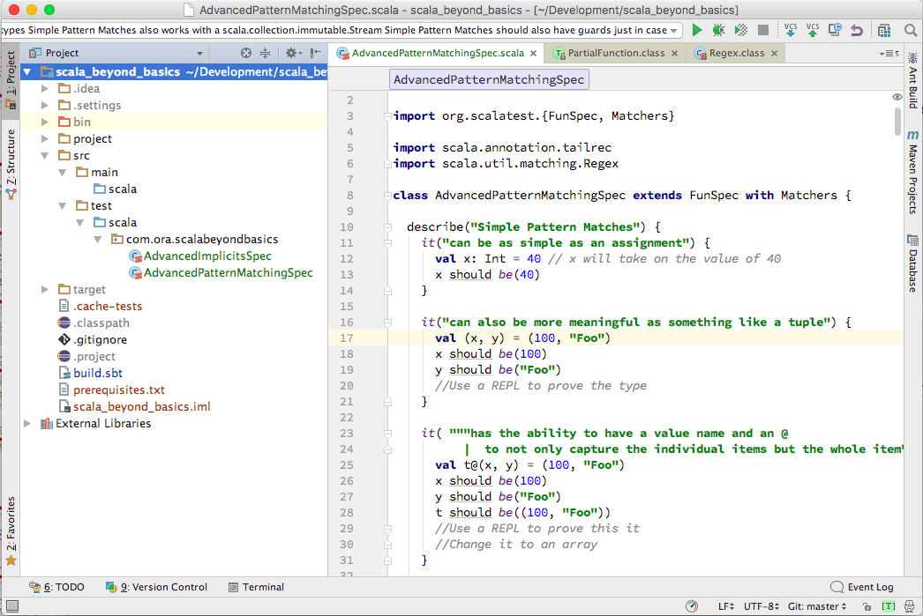
Project is now ready...
4/28/14 •

Slide 24
Day 1: Pattern Matching
(Live Coding)
4/28/14 •

Slide 25
Day 2: Implicits and Typeclasses
(Live Coding)
4/28/14 •

Slide 26
Thank You
4/28/14 •

