Slide 1



Department Of Computer Science And Engineering
Presentation Day-2
Guided By- Presented By-
Mrs. K.Deepa Prabhakar Jha(15BCS2073)
(A.P./CSE) Sheikh Abutahir(15BCS2305)

Slide 2
Do You Know The Following?
5
Docker Example
1
What is docker?
?
4
2
Who uses docker?
Why we need docker?
3
Docker Components
2/25/2018
Docker
2

Slide 3
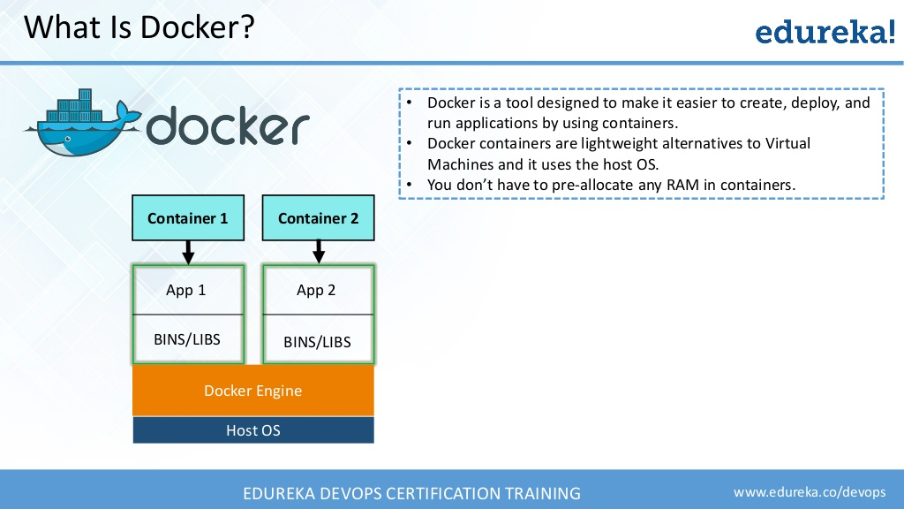
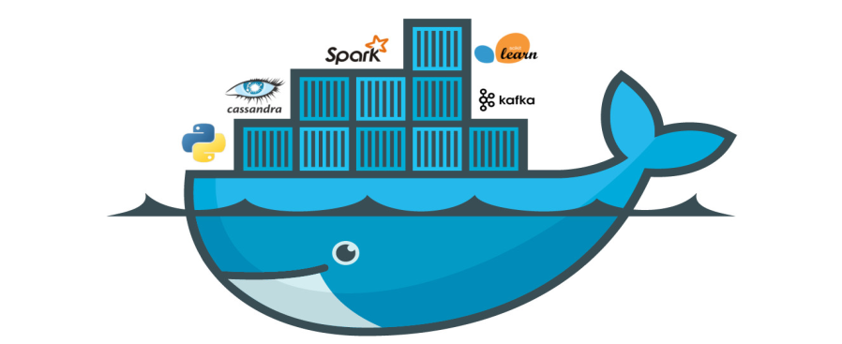
What Is Docker?
Docker is a tool designed to make it easier to create, deploy, and run applications by using containers.
Docker containers are light weight alternatives to Virtual Machines.
No need to pre-allocate RAM in containers.
2/25/2018
Docker
3

Slide 4
Why We Need Docker?
2/25/2018
Docker
4

Slide 5
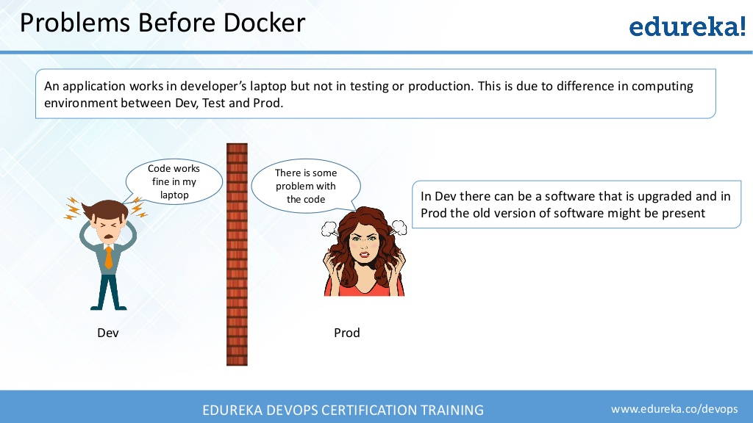
Problems Before Docker
2/25/2018
Docker
5

Slide 6
Contd..,
Microservices
Account
Service
Account DB
Online Shopping Services
Product Catlog
Product DB
Cart
Server
Cart DB
Order
Server
Order DB
2/25/2018
Docker
6

Slide 7
Contd..,
Virtual Machines for different micro services
Developer’s
Laptop
2/25/2018
Docker
7

Slide 8
How Docker Solves These Problems?
You can run several microservices in the same VM by running various Docker containers for each microservice.
Docker Containers
Docker
Engine
Developer’s
Laptop
2/25/2018
Docker
8

Slide 9
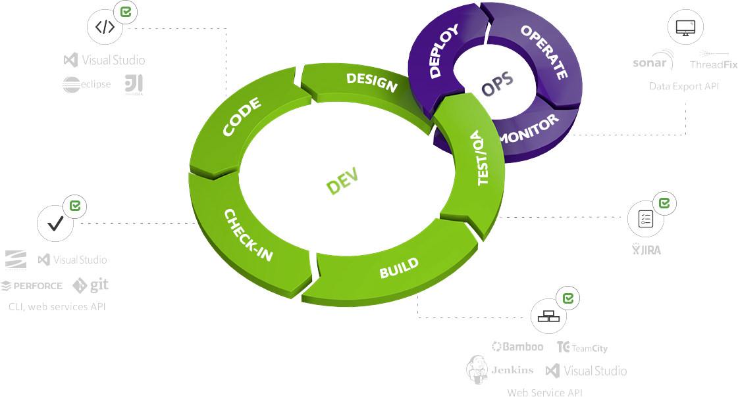
Contd..,
Provides a consistent computing environment throughout the whole SDLC.
2/25/2018
Docker
9

Slide 10
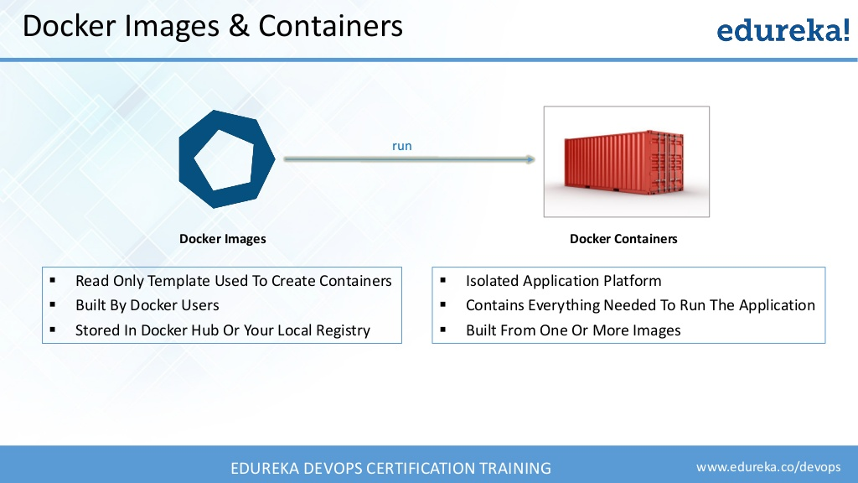
Docker Components
Docker has two components:
Image
Containers
2/25/2018
Docker
10

Slide 11
Docker Images
Read only template to create Containers.
Used to create Docker containers.
2/25/2018
Docker
11

Slide 12
Docker Containers
Isolated application platform.
Contains everything needed to run the application.
2/25/2018
Docker
12

Slide 13






Who Uses Docker?
2/25/2018
Docker
13

Slide 14
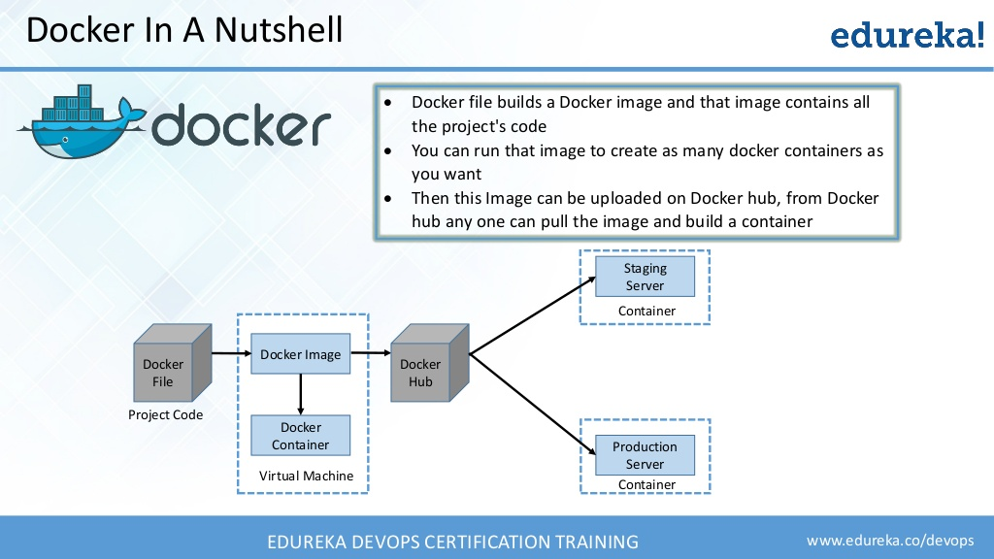
Docker Example
Docker file builds a Docker Image and it contains all the projects code.
One image can be used to create any number of servers as needed
2/25/2018
Docker
14

Slide 15

Conclusion
2/25/2018
Docker
15

Slide 16
THANK YOU
2/26/2018
Docker
16

