Slide 1
M.KUMARASAMY COLLEGE OF ENGINEERING(AUTONOMOUS).
JAVA FOR ANDROID
PRESENTED BY:
SHEIKH ABUTAHIR
R.PAARTHIBAN
GUIDED BY:
Mr.M.VINOTH
AP/CSE.

Slide 2
OVERVIEWS:
Android
Open handset alliance
Android architecture
Features
Applications
Conclusion

Slide 3
What is ANDROID?
Android is an open-source platform.
Includes an operating system, middleware and key applications.
Android platform using the Java programming language.
Based on the Linux kernel

Slide 4
Open Handset Alliance
Est. 5th Nov 2007, led by Google, open Source
Main Product Android Platform
Enthusiastic Support from Industry
Equipment makers
Network Operators
HTC was First to deliver ANDROID

Slide 5
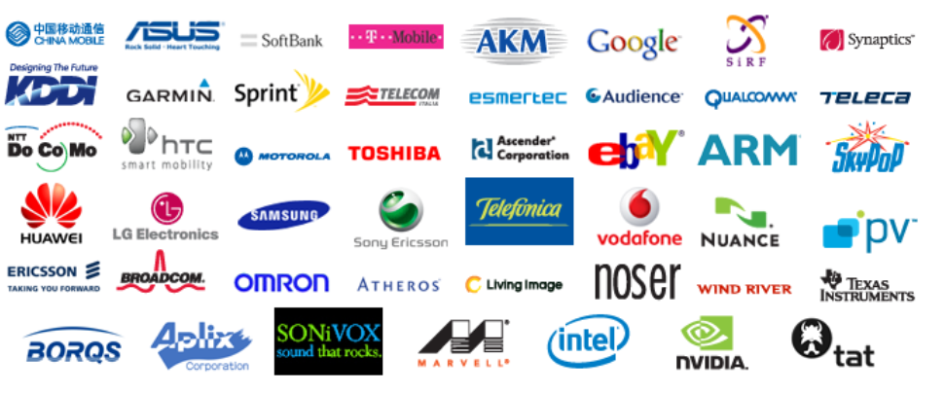
OPEN HANDSET ALLIACES(OHA): It includes of many companies

Slide 6
Android Architecture :
The software stack is split into Four Layers::
The application layer
The application framework
The libraries and runtime
The kernel

Slide 7
APPLICATIONS:
Includes an email client, SMS program, calendar, maps, browser, contacts.
Application Framework:
Access location information, run background services, set alarms, add notifications to the status bar, and much, much more.

Slide 8
Features:
Dalvik virtual machine
Integrated browser
Media support
Bluetooth, EDGE, 3G, and Wi-Fi
Rich development environment

Slide 9
Anatomy of android applications:
Activity
a single screen
Intent Receiver
to execute in reaction to an external event(Phone Ring)
Service
code that is long-lived and runs without a UI(Media Player)
Content Provider
an application's data to be shared with other applications

Slide 10
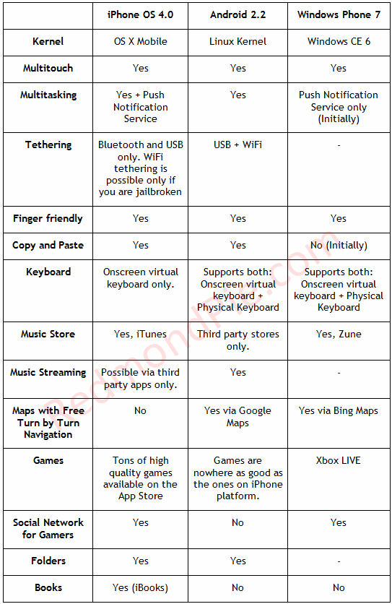
iPhone OS 4 vs Android 2.2 vs Windows Phone 7 – The Inevitable Comparison

Slide 11
Conclusion:
Android is open to all: industry, developers and users
Participating in many of the successful open
source projects
Aims to be as easy to build for as the web.
Google Android is stepping into the next level
of Mobile Internet

Slide 12
THANK YOU

