Slide 1

Glance 2.0
ICG | Rates
Summer Analyst Presentation | 7/22/18
Summer Analyst – Rates
Mandy Hsu, Vincent Taylor, Tahiya Chowdhury
July 23rd, 2018
Strictly Private and Confidential

Slide 2
Agenda
About Us
Our Assignment
Snapshots
Our Technology
Challenges/Solutions
Impact
Shortcomings, Accomplishments, & Improvements
Q/A
Collaborate

Slide 3
Rates – ICG Technology
Our Team
Mentors/Buddies
Sam Eberspacher
Vincent Taylor
Moshe Teitz
Mandy Hsu
Tenzing Passang
Tahiya Chowdhury
Rates Technology
Managers
Phillip Jung
Jonathan Elphick

Slide 4
Rates Technology
ICG
Banking
Markets &
Securities Services
Fixed Income
Markets
Equity Markets
Securities
Services
Emerging
Markets
Equities
Prime
Finance
Commodities
Credit
Municipals
G10
Rates
FX
Securitized
Markets
Futures
G10
Rates Tech
e-Trading
TPS
MTFD
Risk

Slide 5
G10 Rates
E-trading – trading securities electronically
Trader Desktop
IMM (Internal Market Making)
Distribution
Pricing
Notes:
G10 rates include G10 trading, G10 sales, Quants, MRM (market risk management) , PCG, Audit and other legal support team, and production support.
G10 rates tech itself has several departments: e-Trading, TPS (official trade capture service), MTFD (markets treasury finance desk), risk

Slide 6
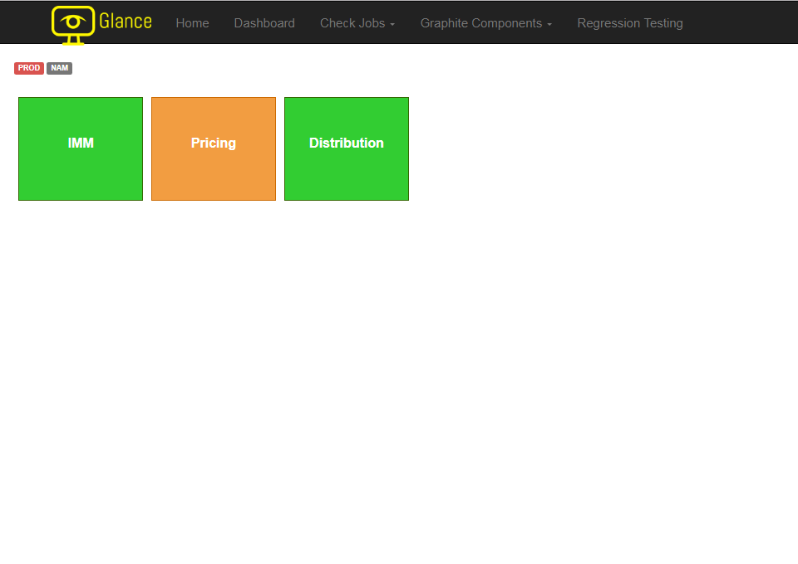
What is Glance?
Notes:
Suggestive script: The competitive advantage that supports the bulk of the team’s fundamentals is stability, agility and experience. These three goals inspired our summer project, which is to take an existing functioning program, Glance, and upgrade it with a new backend for scalability and a new frontend for a better user experience.
So what is Glance? Glance is a user-facing web-based dashboard based on Grails, Groovy, and Javascript designed for monitoring the health of the Rates platform. Glance was originally intended to be used with MkvPythonMonitor and/or MkvFetch to provide a user-friendly view of python checks for UAT and production surveying. Now we are trying to scale the number of checks that Glance can perform by switching our backend to Apache Ignite, which increases the performance through distributive memory.

Slide 7
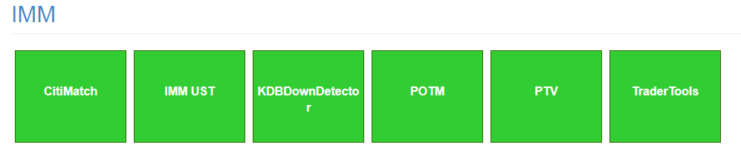
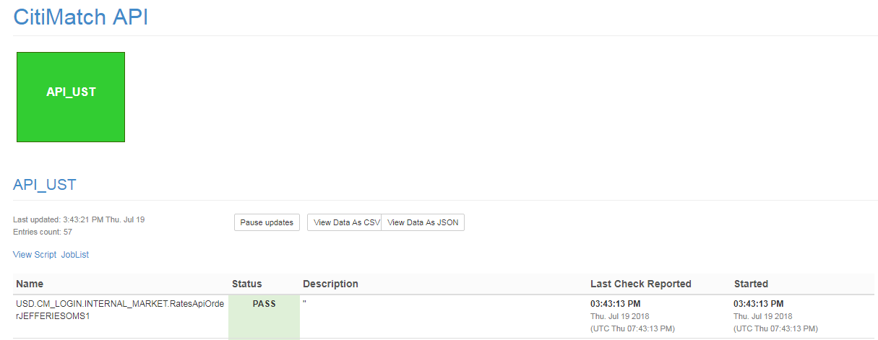
What is Glance?
Notes:
Suggestive script: The competitive advantage that supports the bulk of the team’s fundamentals is stability, agility and experience. These three goals inspired our summer project, which is to take an existing functioning program, Glance, and upgrade it with a new backend for scalability and a new frontend for a better user experience.
So what is Glance? Glance is a user-facing web-based dashboard based on Grails, Groovy, and Javascript designed for monitoring the health of the Rates platform. Glance was originally intended to be used with MkvPythonMonitor and/or MkvFetch to provide a user-friendly view of python checks for UAT and production surveying. Now we are trying to scale the number of checks that Glance can perform by switching our backend to Apache Ignite, which increases the performance through distributive memory.

Slide 8
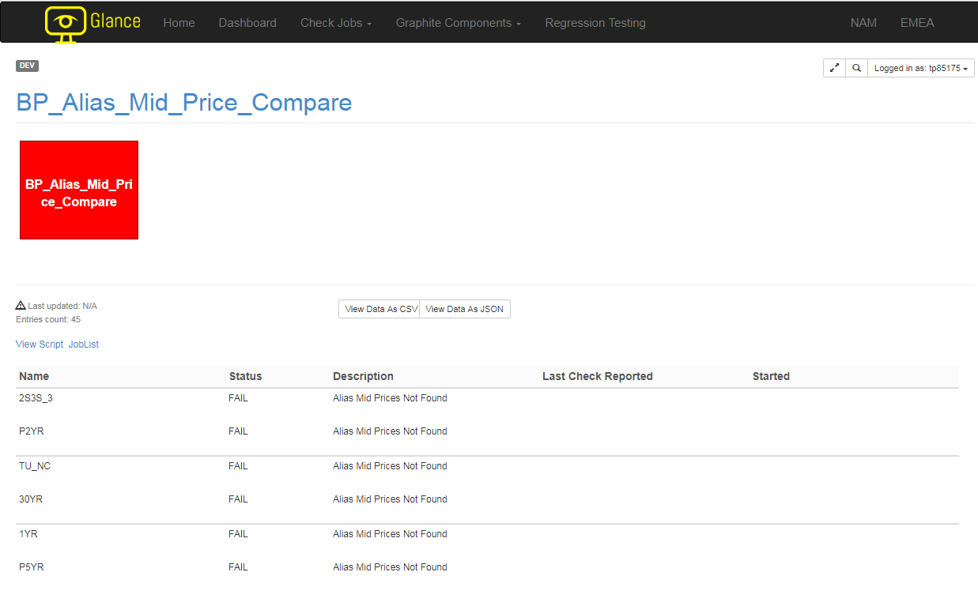
What is Glance?
Creating a check job from start to finish:
3
Text and Layouts
Notes:
To show a simple demonstration of how the UI works, allow me to walk you through the makings of a check. From left to right, up to down you would see the general flow of creating one check. At this point, the target user, which are usually a software developer within Pricing, IMM, or distribution, would write down a check in groovy within Glance. All the data would be retrieved through our backend service, supported via Apache Ignite, and the computation of the logic itself is done within Glance. The user would proceed to create nodes to display the information computed with the data received. There are two types of nodes, the suite node itself contains all of the information returned during the computation, which you can see in the bottom left. The internal node provides the structure of all suite nodes based on what groups they are part of.

Slide 9
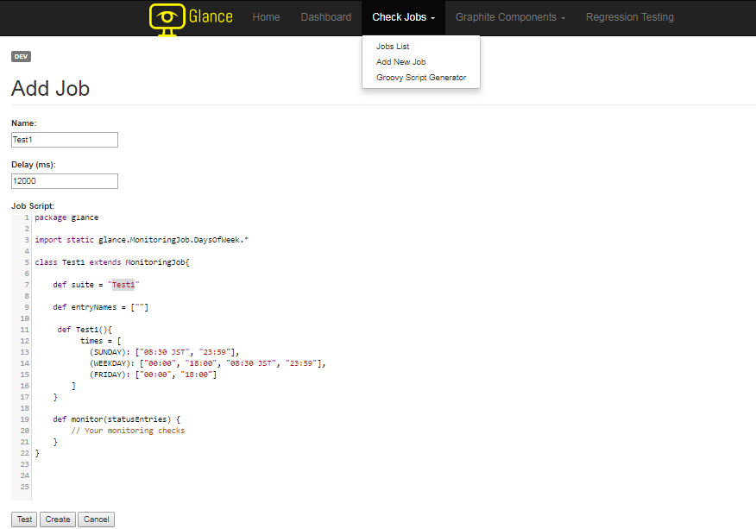
What is Glance?
3
Text and Layouts
Notes:
To show a simple demonstration of how the UI works, allow me to walk you through the makings of a check. From left to right, up to down you would see the general flow of creating one check. At this point, the target user, which are usually a software developer within Pricing, IMM, or distribution, would write down a check in groovy within Glance. All the data would be retrieved through our backend service, supported via Apache Ignite, and the computation of the logic itself is done within Glance. The user would proceed to create nodes to display the information computed with the data received. There are two types of nodes, the suite node itself contains all of the information returned during the computation, which you can see in the bottom left. The internal node provides the structure of all suite nodes based on what groups they are part of.

Slide 10
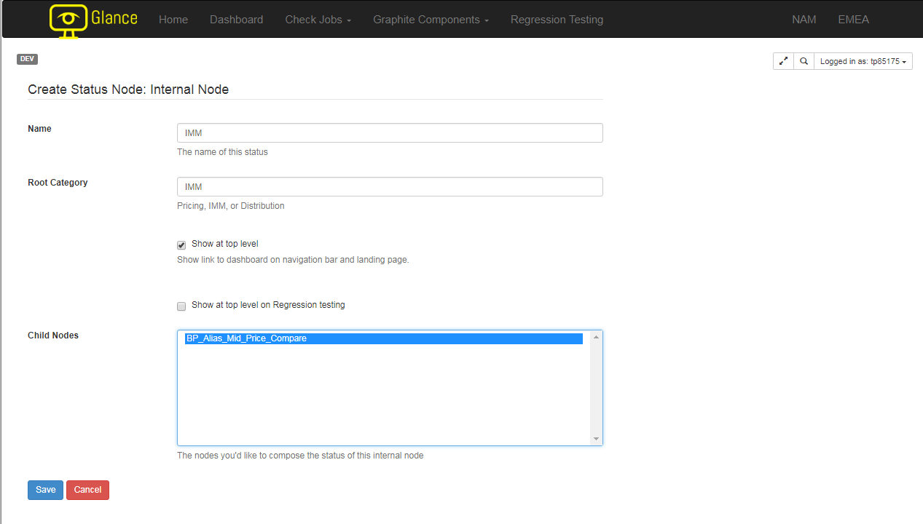
What is Glance?
Creating a check job from start to finish:
3
Text and Layouts
Notes:
To show a simple demonstration of how the UI works, allow me to walk you through the makings of a check. From left to right, up to down you would see the general flow of creating one check. At this point, the target user, which are usually a software developer within Pricing, IMM, or distribution, would write down a check in groovy within Glance. All the data would be retrieved through our backend service, supported via Apache Ignite, and the computation of the logic itself is done within Glance. The user would proceed to create nodes to display the information computed with the data received. There are two types of nodes, the suite node itself contains all of the information returned during the computation, which you can see in the bottom left. The internal node provides the structure of all suite nodes based on what groups they are part of.

Slide 11
What is Glance?
Market
View
Requests Information
Mkv Fetch
Calls
Returns
Specific Data
Glance
Jobs

Slide 12
Problems
User Interface
No direct access
Long and complex scripts
No differentiation between checks
Backend
Increase in data
Increase in checks
Call driven

Slide 13
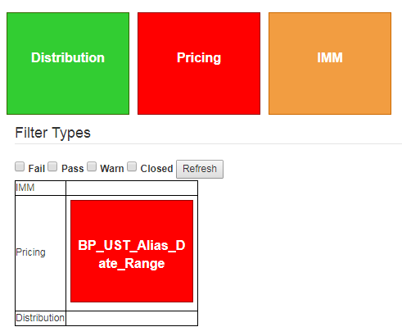
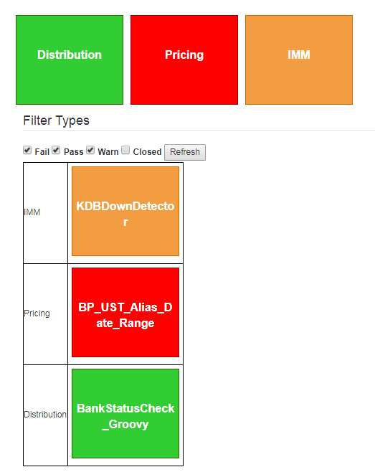
Solutions: User Interface
3
Text and Layouts
Notes:
One of the problems that the production support team raised with the previous version of Glance was that it was very difficult to browse through the entire On the home page, the default display shows all root nodes, which are the high level categories that each check belongs to, and a table showing all errors failing in the respective category. Currently there are four different statuses that a node can possibly render: red means that the check didn’t pass and requires the production support to look further into the issues, orange means a warning that something is not necessarily in place, green means the logic passed, white means the check job is not suppose to preform in this current time period therefore would show as closed. One of the reach goals that we have yet to implement is the critical status. Certain

Slide 14

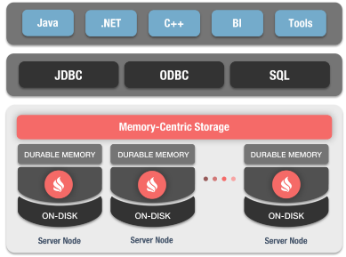
Solutions: Backend

Slide 15
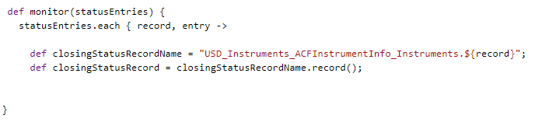
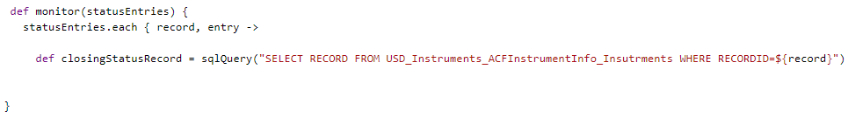
Solutions: User Interface

Slide 16
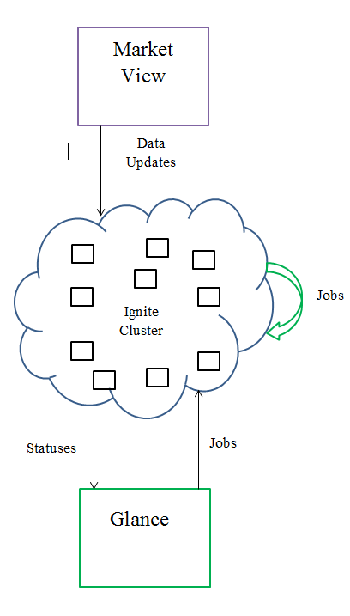
Solutions: Backend
Market
View
Requests Information
Mkv Fetch
Calls
Returns
Specific Data
Glance
Jobs

Slide 17








Technology Stack
4

Slide 18
Challenges
New software, tools, programming languages
Mentorship
External Documentations
Translating clients’ need into feasible products
Mentorship
Scrums
Limited hardware
Filter

Slide 19
Next Steps: User Interface
Eviction Policies
Manage the cache
Get rid of unused chains
Scalability and Persistence
Can create a more robust cluster to handle faults
Distribute Backups both offline and online
Ignite Services
Run jobs remotely
Schedule jobs within the cluster

Slide 20
Next Steps: Backend
Eviction Policies
Manage the cache
Get rid of unused chains
Scalability and Persistence
Can create a more robust cluster to handle faults
Distribute Backups both offline and online
Ignite Services
Run jobs remotely
Schedule jobs within the cluster

Slide 21
Key Take Away
In depth understanding of Glance
Software Engineering Application
Team work distribution

Slide 22
Accomplishments
Create Cluster Caches
Simplified Checks
SQL queries
Improved User Interface

Slide 23
Questions?

Slide 24
Collaborate
https://cedt-confluence.nam.nsroot.net/confluence/display/1571041/Glance+2.0

