Slide 1
Band Matrix Offline
Nafis Tahmid

Slide 2


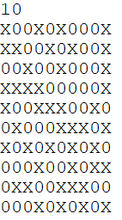
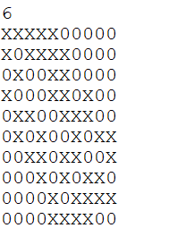
What are doing actually?
Bandwidth 2

Slide 3

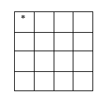
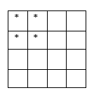
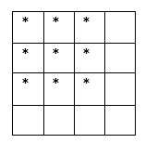
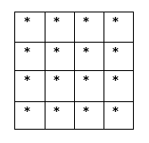
We don’t do this “actually”

Slide 4
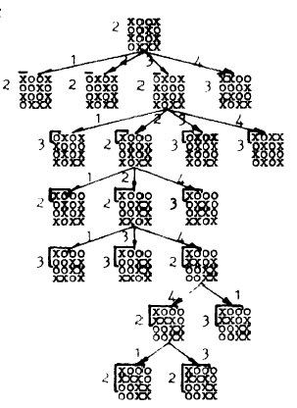

Slide 5
Bounding
Fixed Region
1. Fixed Row
2. Fixed Column
Unfixed Region (Easy)

Slide 6


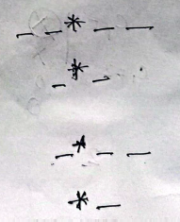


Unfixed - floor((count +1)/2)

Slide 8
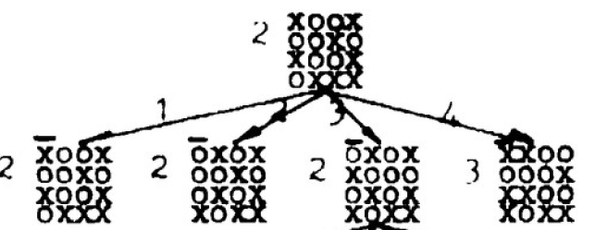

Just Fixed a Column

Slide 9
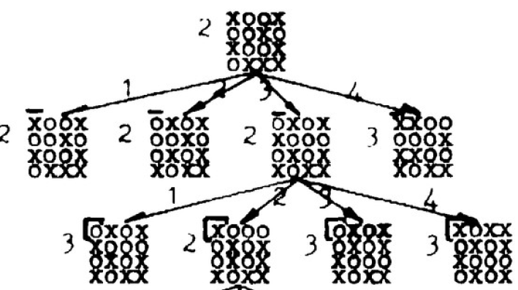

Fixed a row

Slide 10



After some fixing along the tree

Slide 11
Bounding (Revisited)
Fixed Region
1. Fixed Row
2. Fixed Column
fixed = max(row,col)
Unfixed Region (Easy)
Take bound = max(fixed, unfixed)

Slide 12
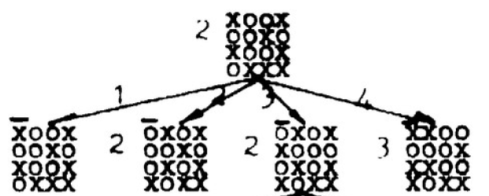
Branching

Slide 13
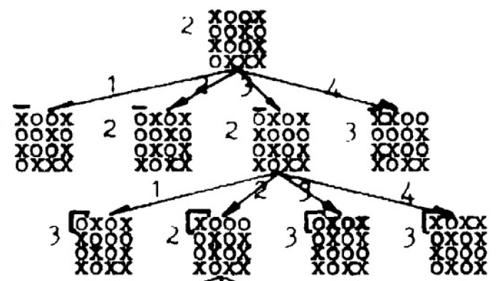

Slide 14
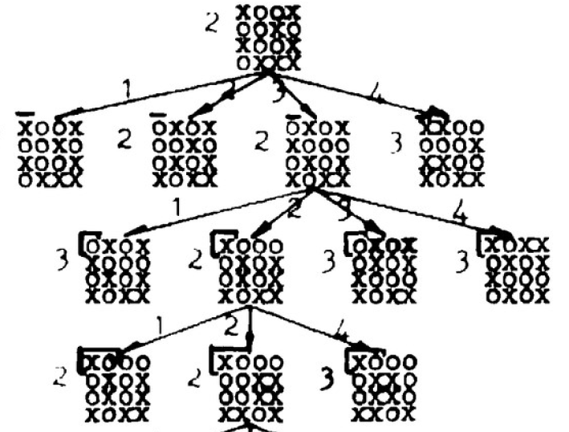

Slide 16
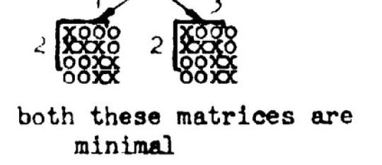



Slide 17
Implementation
Use priority Queue
3 metric comparison (In the order of precedence)
Bound
Level
Order
Keep the record of #fixedRow and #fixedColumn
If (#fixedRow == #fixedColumn)
// fix next column
Else
// fix next row
Terminate when m.#fixedCol = m.#fixedRow = n-1
[m = pq.pop() ]

Slide 18
Thank You !!

