Slide 1
Band Matrix Offline
Nafis Tahmid

Slide 2


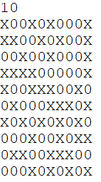
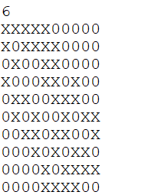
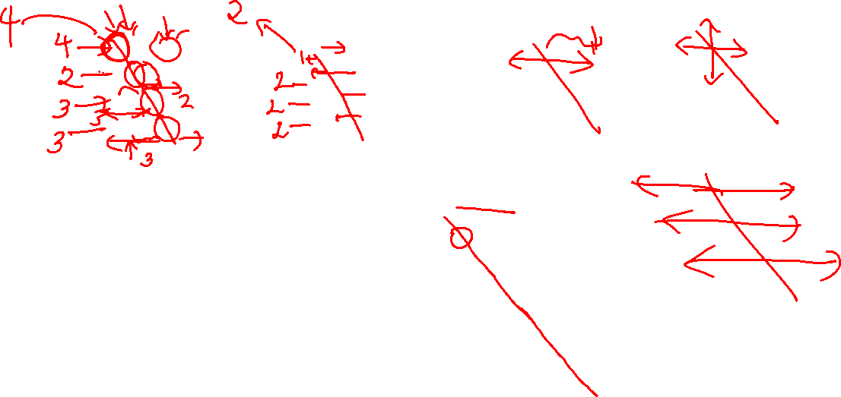
What are doing actually?
Bandwidth 2

Slide 3

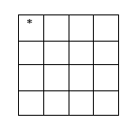
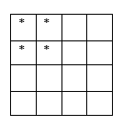
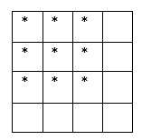
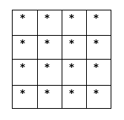

We don’t do this “actually”

Slide 4
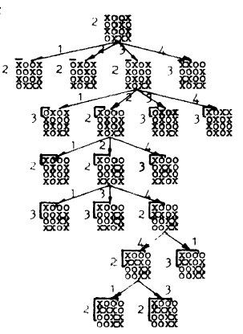
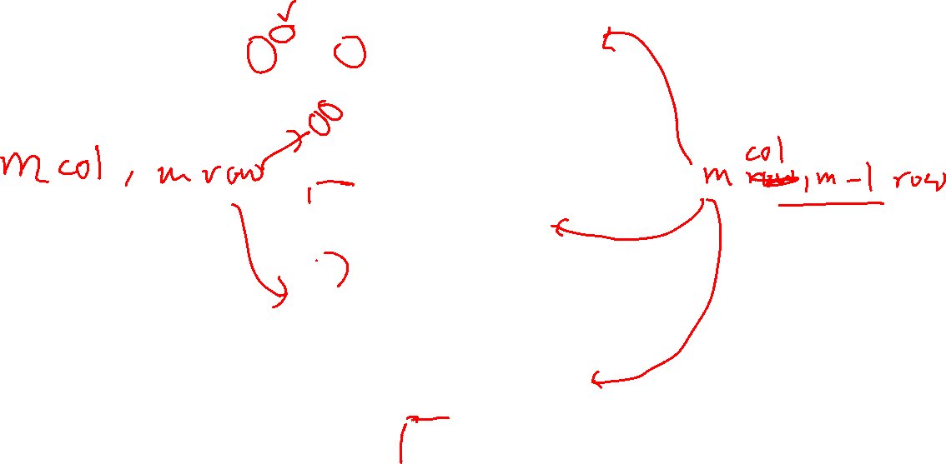

Slide 5
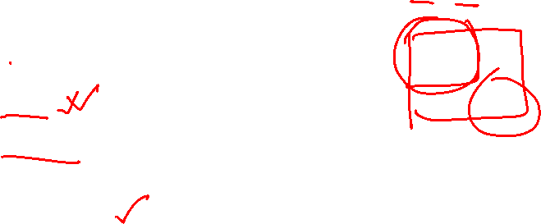
Bounding
Fixed Region
1. Fixed Row
2. Fixed Column
Unfixed Region (Easy)

Slide 6


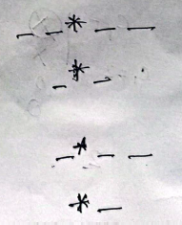


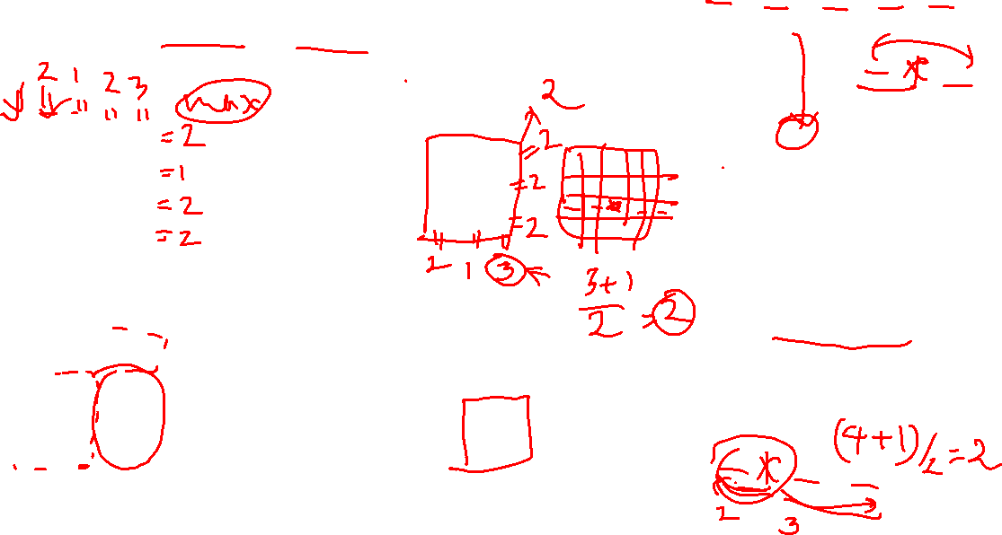
Unfixed - floor((count +1)/2)

Slide 7


Slide 8
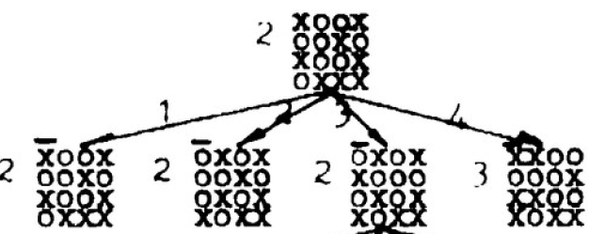

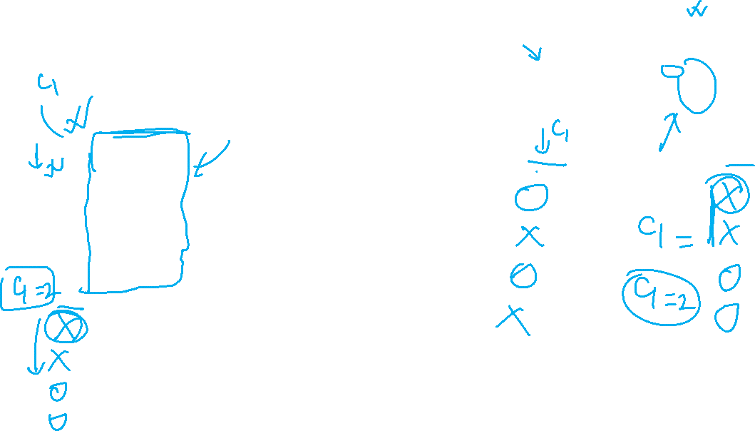
Just Fixed a Column

Slide 9
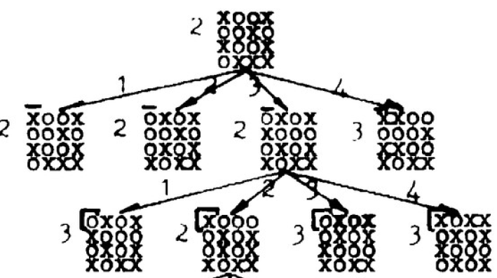

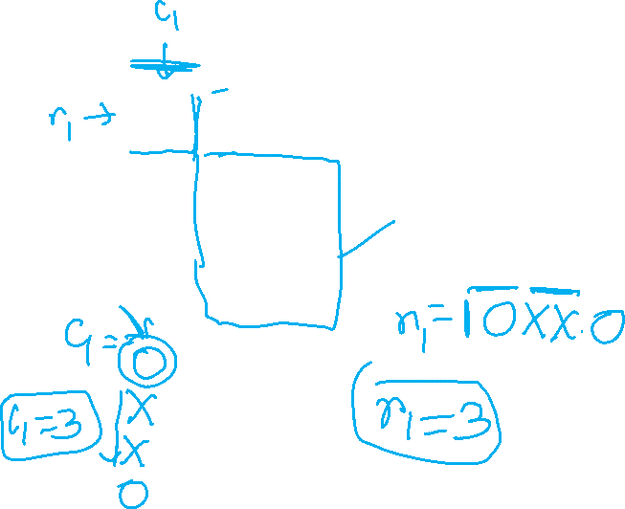
Fixed a row

Slide 10



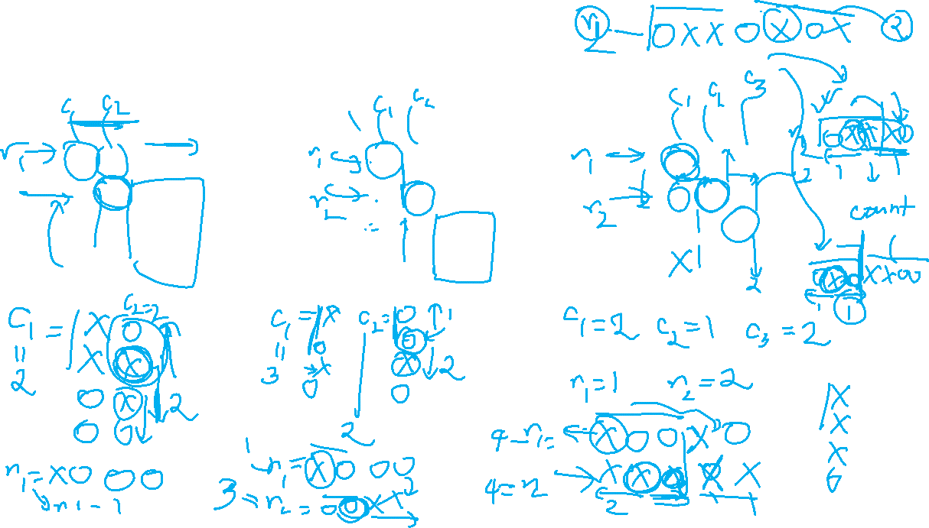
After some fixing along the tree

Slide 11

Bounding (Revisited)
Fixed Region
1. Fixed Row
2. Fixed Column
fixed = max(row,col)
Unfixed Region (Easy)
Take bound = max(fixed, unfixed)

Slide 12
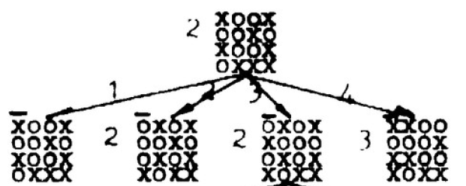
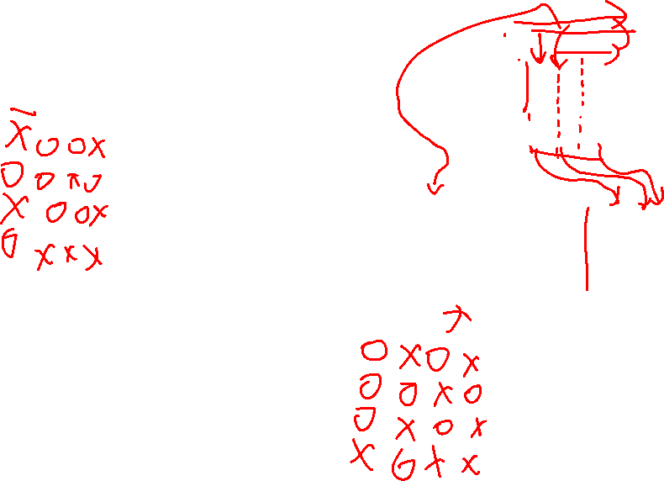
Branching

Slide 13
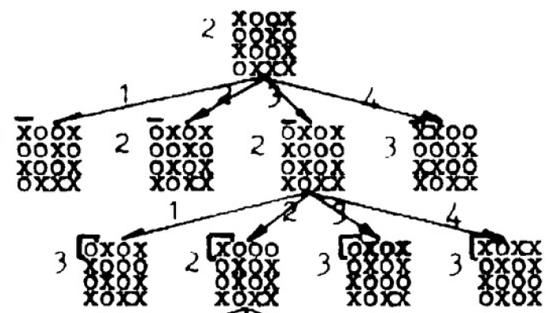


Slide 14
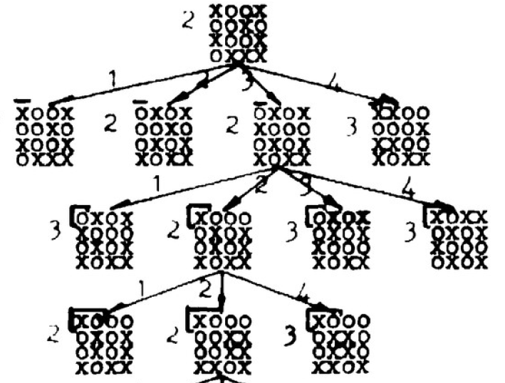
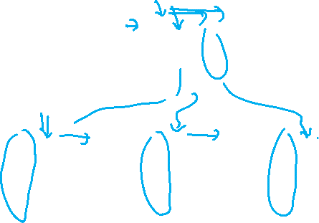

Slide 15
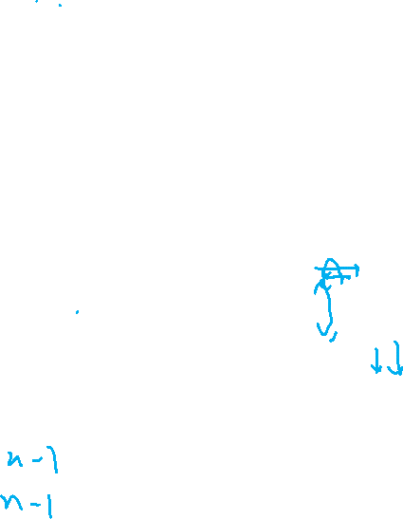

Slide 16
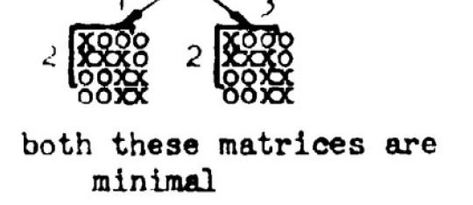




Slide 17
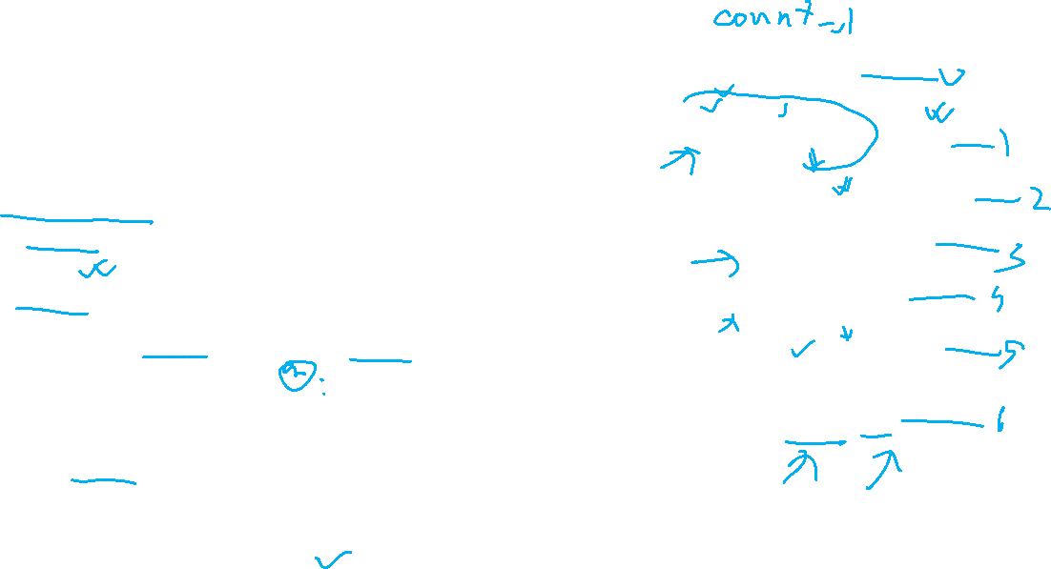
Implementation
Use priority Queue
3 metric comparison (In the order of precedence)
Bound
Level
Order
Keep the record of #fixedRow and #fixedColumn
If (#fixedRow == #fixedColumn)
// fix next column
Else
// fix next row
Terminate when m.#fixedCol = m.#fixedRow = n-1
[m = pq.pop() ]

Slide 18
Thank You !!

