Slide 1
Bison Offline
Nafis Tahmid

Slide 2
What to do?
Modify Lex File
Modify and Add SymbolInfo, SymbolTable(maybe)
Write parser.y file

Slide 3

Common to lexical analysis
Lex file log output
All the regex
Modification “pattern” { // print to log file yylval.symbol = new SymbolInfo(yytext, PATTERN); // startline, endline, isLeaf = true (parse tree) return PATTERN;
}

Slide 4
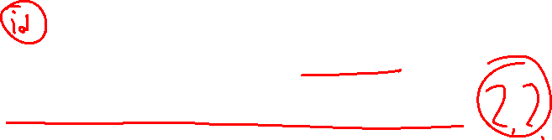
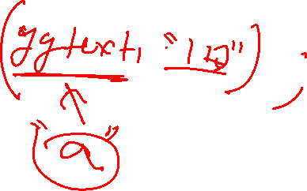
Beware!!!!
Do not insert in SymbolTable in Lex File.
It is inserted(?) during variable declaration!!

Slide 5
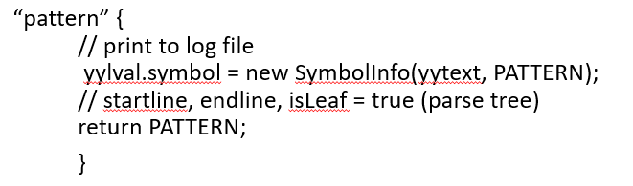
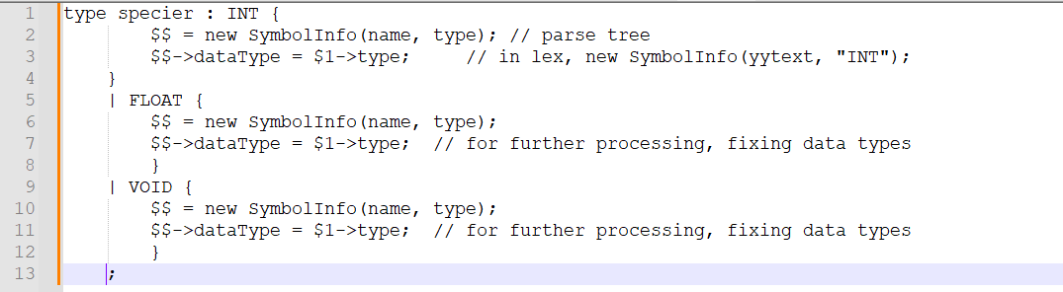
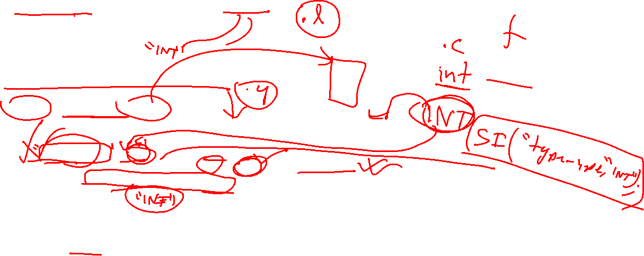

%union { SymbolInfo* symbol; }
%token <SymbolInfo> PATTERN PATTERN2 …… (example FOR IF ELSE INT ID)

Slide 6

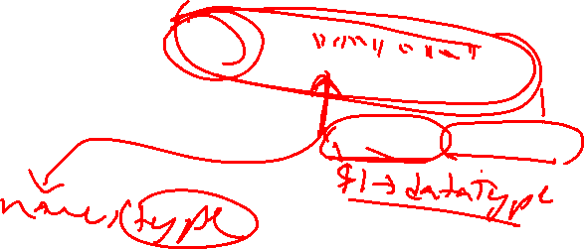
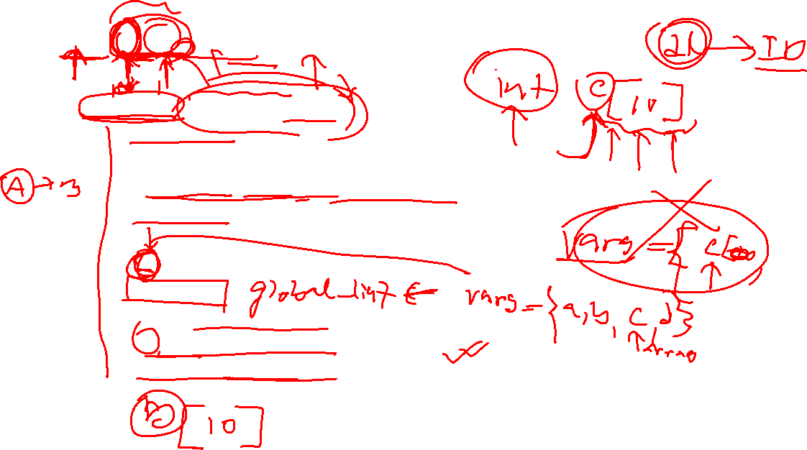
int a, b, c[10], d;
declaration_list : declaration_list COMMA ID {
// push in the list
}
| declaration_list COMMA ID LTHIRD CONST_INT RTHIRD {
// push in the list
}
| ID {
// create a list
}
| ID LTHIRD CONST_INT RTHIRD {
// create a list, var is an array
} ;

Slide 7
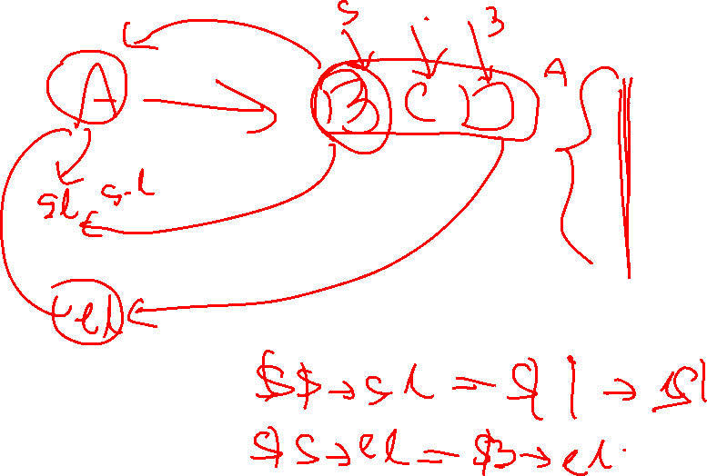
Parse Tree

Slide 8
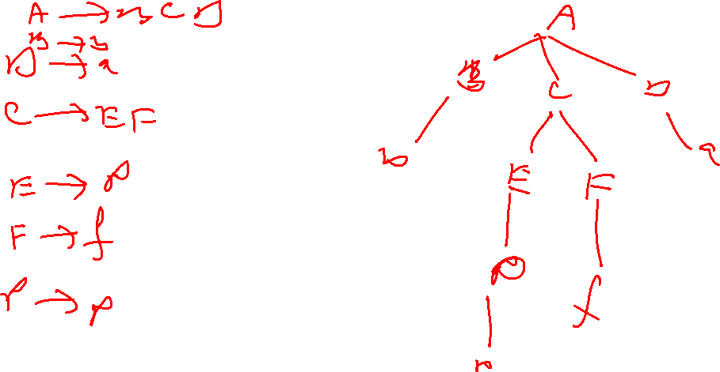
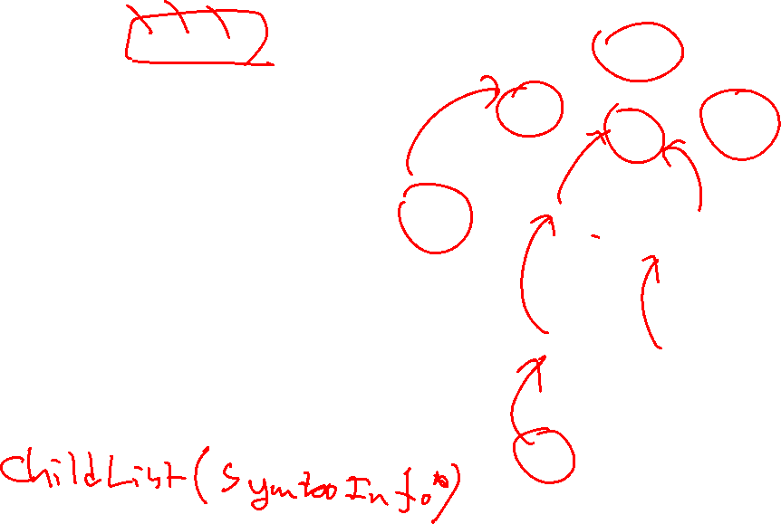

Slide 9
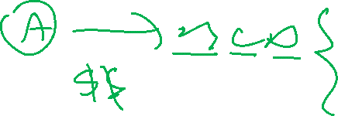

Slide 10
